Slide 1
DLA Transaction Services Overview
June 11, 2015
Notes:
Good Morning
My name is Eric Flanagan
Today I’ll be giving you a short overview of DLA Transaction Services
We will walk through a requisition scenario that will generate a bill
I will primarily talk about two applications, MILSINQ and eDAASINQ
We’ll talk about what types of information can be queried in both systems and how it might help when researching bills

Slide 2
DLA Transaction Services
DLA Transaction Services Overview
Requisition to Billing Scenario
MILSINQ
eDAASINQ
Logistics Data Gateway (LDG)
Wrap Up

Slide 3
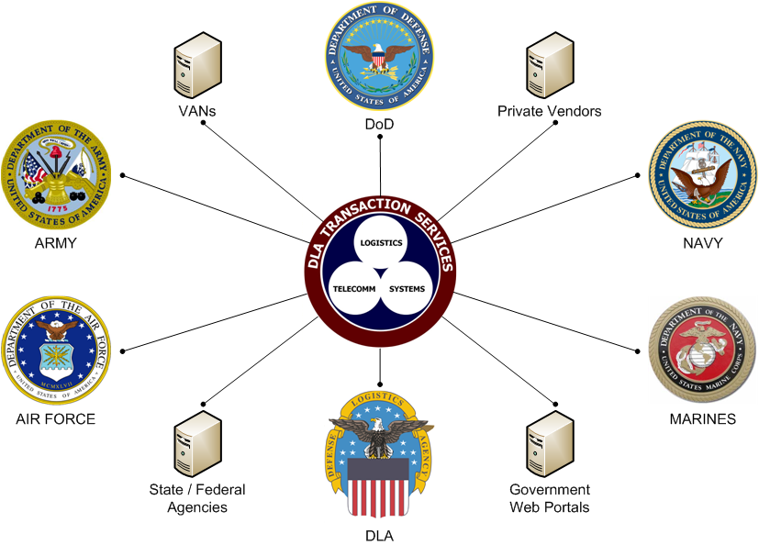
DLA Transaction Services Overview
Who They Are:
DLA Transaction Services
(Formerly DAASC)
An End-to-End System Design Center Operating 24x7, 365 Days.
Host to Mission Assurance Category (MAC) I Systems
DoD’s Workhorse for Transaction Processing & Logistics Support
What They Do:
  Provide a full range of Transaction Processing capabilities (Receipt, Edit, Route, Translate, Convert, Deliver)
  Support Acquisition, Financial, Logistics, Transportation, Healthcare and Travel Business Areas.
  Enables interoperability between disparate DOD networks/systems
  Process 21 Million Transactions (Daily) in support of 225,002 DoDAACs (MILS) and 32,239 Trading Partners (EDI)
Notes:
DLA Transaction Services is an organization within DLA J6 Information Operations
They formerly called the Defense Automated Addressing System Center until when the name was changed to DLA Transaction Services
DLA Transaction Services hosts MAC I systems, which is a measure of MISSION CRITICALITY AND AVAILABILITY
They provide a full range of transaction processing capabilities, including receipt, editing, routing, translation, conversion and deliver.
DLA Transaction Services processes approximately 21 million transaction a day in support of over 266K DODAACs and 32K EDI trading partners

Slide 4
Core Business
Most transactions that we process fall in to two broad categories:
  Military Standard (MILS) transactions – 59% of all transactions
  Electronic Data Interchange (EDI) transactions – 41% of all transactions
MILS transactions are legacy transaction sets used for over 45 years based on the IBM 80-column punched card
MILS transactions are used in various forms including:
MILSTRIP, MILSTRAP, & Extended MILS
Supports over 266K DoDAAC activities & locations
1,174 Document Identifiers (DICs) in use
EDI transactions are modern, variable length transaction sets which can consist of:
X12, XML, iDoc and UDF transaction file types
  Supports 50 different transaction sets and over 32K trading partners
  A subset of X12 EDI transactions exists which are called Defense Logistics Management System (DLMS) transactions
  Most EDI transactions are processed through the Global Exchange System, or GEX
Notes:
The core business is processing transactions
Transactions generally fall into two broad categories, MILS and EDI.

Slide 5
DLA Transaction Services Processing Locations
Hot COOP
Zero Downtime
Dayton, OH
WPAFB
Tracy, CA
DDJC
San Joaquin
Dual Sites Provide Concurrent Transaction Processing Capability.
DLA Transaction Services Dayton & Tracy are
DLA’s two Operational Data Centers.
Notes:
The main site is at Wright-Patterson AFB in Dayton, Ohio
A COOP site is located at DLA Distribution, San Joaquin in Tracy, California
This is a “hot” site which means that it can continue the DLA Transaction Services mission with near-zero downtime.

Slide 6
DLA Transaction Services and DAAS
DLA Transaction Services is the organization, part of DLA J-6.
DAAS, Defense Automated Addressing System, is the system used to process logistics transactions.
DAASC, Defense Automated Addressing System Center, is previous name of DLA Transaction Services. Same thing, just renamed.
Notes:
You may hear the term DAAS and DLA Transaction Services used interchangeably.
Remember, DLA Transaction Services is the organization and DAAS is the system

Slide 7
DLA Transaction Services
DLA Transaction Services Overview
Requisition to Billing Scenario
MILSINQ
eDAASINQ
Logistics Data Gateway (LDG)
Wrap Up

Slide 8
Requisition to Billing Scenario
  Example flow of a requisition for 12 lamps ordered by MacDill AFB, Document Number FB490032490003
DSS Depot
Delivery of Items
Ship Status 856S
MRO Confirm 945A
MRO 940R
NIIN 014704272
MacDill
AFB
Requisition, A0A
Requisition 511R
DLA Transaction
Services
Processing
MRO Confirm 945A,
Confirmation of Delivery, DRA
EBS
Confirmation of Delivery 527R
Req Status AE1, Ship Status AS1
Status 870S, MRO 940R , BILL 810L
Web Apps (MILSINQ, DAASINQ, WebVLIPS, LDG)
Historical Archive
DFAS
Bill FS1, FA1
Notes:
This slide depicts a typical requisition transaction flow:
For our example, we are going to follow a requisition for 12 lamps ordered by MacDill AFB
This was an actual requisition, submitted on day 249, 6 September, 2013
MacDill sent this transaction to us in as a MILS A0A 80-character requisition

Slide 9
Requisition to Billing Scenario
Certain information from the Requisition carries over to the Billing Transaction
Requisition 11 March 2015
A0AB14S1240015766134 EA00026W9100050700023NW34XC5J51 12072
Bill 28 May 2015
FS1 00197X4930AC9DB14 W91000505 1Y7ZWW52H09 512152020 000990600
FA1B14 1240015766134 EA00026W9100050700023LW34XC5J511Y7ZW 1470009906000038100
Signal Code “J” in rp 51 means Ship-to is rp 45-50 (W34XC5) and the Bill-to is rp 30-35 (W91000), same as rp 30-35 Summary Billing Record (SBR)
Fund Code “51” in rp 52-53, same as rp 52-53 in SBR
Fund Code “51” corresponds to 2152020 in Fund Code Table, same as rp 54-64 Appropriation/Fund Account (charge) in the SBR
Cost of Item is multiplied by quantity and rolled up into FS1
Notes:
I used a different document number, W9100050700023 due to my familiarity with Army supply systems
Notice that some of the information from the original requisition carries forward to the Bill

Slide 10
DAAS Edits
Minimal edits on Billing Transactions, most occur on original Requisition
Batch integrity – Summary plus Detail must not be more than 496 lines, will generate a single reject and reference the Summary bill only
DODAAC in rp 30-35 must be valid and authorized for billing, (Authority Code 01, 06, 07 rejected)
Detail Count in rp 5-7 of Summary must match number of Detail transactions
Dollar Value in FS1/2 must equal sum of Dollar Value of all Detail transactions
Standard Line of Accounting (SLOA) data elements in the 810L must match the SFIS Fund Code table or else reject.
Other edits include images (copies) as requested by the components.
Notes:
Besides converting and translating from one format to another, DAAS also performs several validations and edits on transactions.
Validations ensure that the data in the transactions are valid and formed correctly.
Edits have to do with special routing rules that we enforce due to MILSTRIP rules or service specific rules.

Slide 11
DLA Transaction Services
DLA Transaction Services maintains several Web Applications for users to look up transactional and messaging information.
MILSINQ, or MILSBILLS Inquiry allows users to query Interfund Bills
eDAASINQ and DAASINQ contain information for DOD Activity Address Codes (DODAAC), National Item Identification Number (NIIN), Routing Identifier Codes (RIC), Military Assistance Program Address Codes (MAPAC), Communication Routing Identifiers (COMMRI), and Distribution Codes
WebVLIPS and Logistics Data Gateway (LDG ) allow users to look up transaction history by Document Number
Notes:
Web Applications for our users to look up transactional and messaging information
Transactional Information is the data itself, messaging data is about when it was received, from what system, and to what system it was sent
MILSINQ, or MILSBILLS Inquiry, allows users to query Interfund Bills
eDAAS INQ contains information for DODAACs, NIINs, RICs, MAPACs (for FMS), COMMRI and Distribution Codes
WebVLIPS, which Paul will cover later, and Logistics Data Gateway allow users to look up transaction history by Document Number
Today we are going to take a closer look at MILSINQ and DAASINQ

Slide 12
DLA Transaction Services
DLA Transaction Services Overview
Requisition to Billing Scenario
MILSINQ
DAASINQ
Logistics Data Gateway (LDG)
Wrap Up

Slide 13
MILSINQ
MILSBILLS Inquiry (MILSINQ) provides users the capability to query and display Interfund Bills.
MILSBILLS data is stored for 1 year, FMS bills are stored for 2 years
Allows users to retransmit bills
Allows users to view Materiel Obligation Validation (MOV) on requisitions
CAC and System Access Request (SAR) required
Notes:
MILSINQ allows user to look up bills
Bill data is stored for one year (2 years for FMS)
Within MILSINQ, There is an option that allows users to retransmit bills
We will not be covering MOV’s here since our focus is on billing transactions
You need a CAC and a System Access Request to use MILSINQ

Slide 14
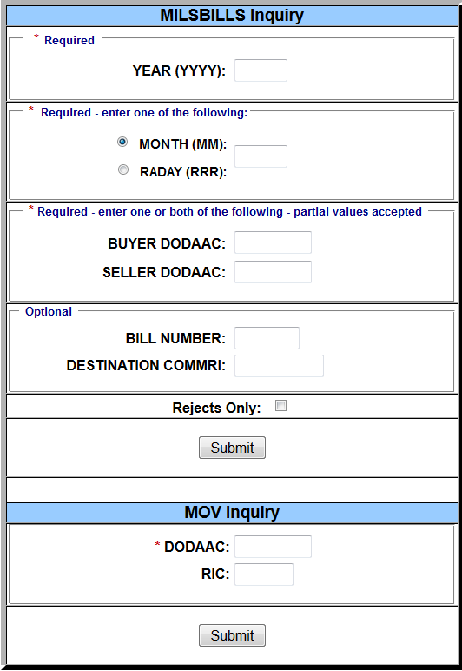
MILSINQ MENU
Displays in MILS-only format
No current user Help Manual
Re-engineered approximately 2005 (new layout in 2015)
Notes:
This slide shows the MILSINQ home screen and the available query options.
The layout changed this year.
Notice the MOV inquiry at the bottom.
You can also filter to search for rejects only.
MILSINQ, like the other DLA Transaction Services applications is still MILS-based at this time.

Slide 15
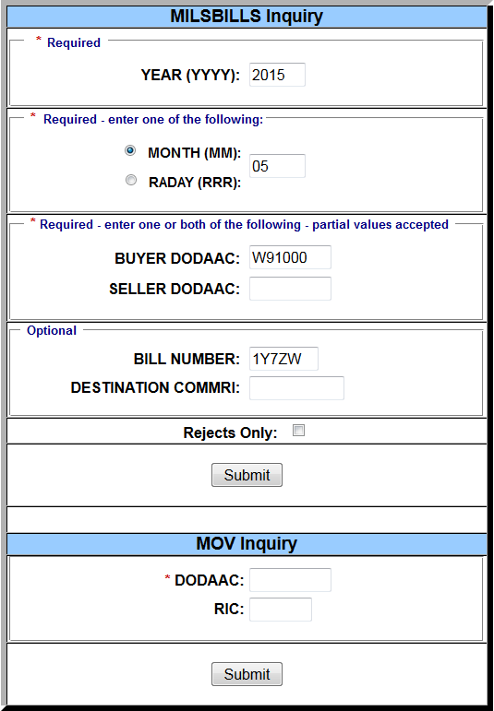
MILSINQ MENU
Year from rp 36
Month from rp 37-38
Buyer (Billed) DODAAC from rp 30-35
Bill Number from rp 40-44
Notes:
In this example we will use DoDAAC W91000 and bill number 1Y7ZW and the month of May, 2015

Slide 16
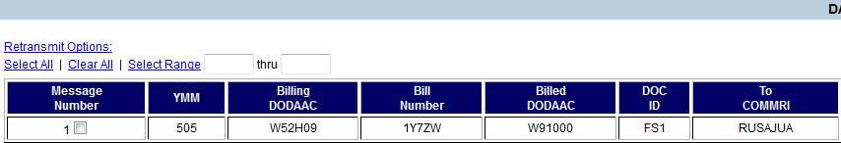
DAAS MILSBILLS Header Inquiry
rp 36-38
rp 45-50
rp 40-44
rp 30-35
rp 1-3
Information on the left is parsed from FS_ transaction
Information on the right comes from the message header
Information to the right is information about DAAS receipt, processing and delivery (messaging information)
Notes:
The information to the left of the squiggly line is derived from the summary billing record transaction.
The information on the right comes from the message header.
The lower screenshot shows how the information on this screen is correlated to the data elements in the summary billing record.

Slide 17

DAAS MILSBILLS Header Inquiry
R, Routine processing, (Insignificant outside DAAS)
0212, Time Processed, UTC
RUSAJUA, COMMRI-to
This is where the message was delivered
0810, Station Serial Number (SSN)
148, (28 May) Julian Day processed
Also called RADAY
RUSAHRU, COMMRI-from This is the account from which DAAS received the message
This information comes from the Message Header.
Header is information about the message itself, not the data in it.
Contains communication information for transmission from system to system.
Notes:
This screenshot focuses on the header information.

Slide 18
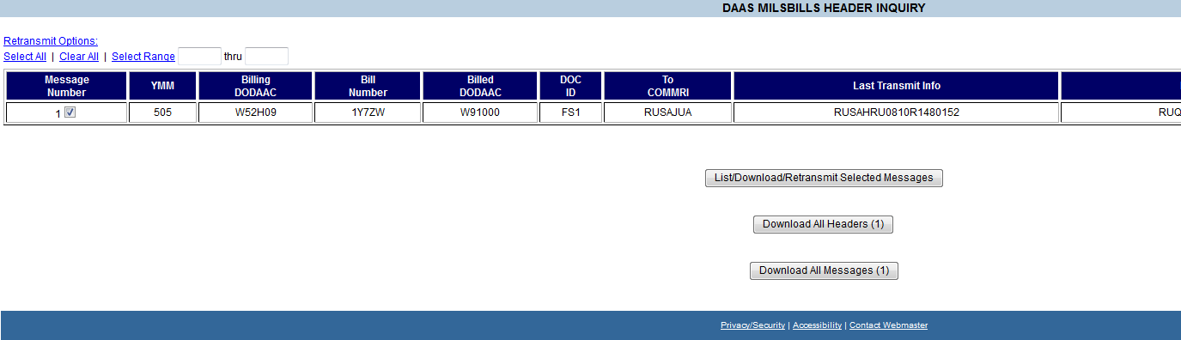
DAAS MILSBILLS Header Inquiry
Check Message Number 1
Choose List/Download/Retransmit Selected Messages
Notes:
On this slide, we have selected the message as indicated by the check in the box.
We’ll click on “List/Download/Retransmit Selected Messages” to show the transactions contained within the message.

Slide 19
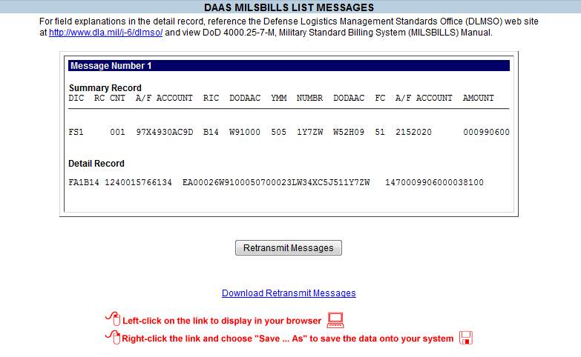
DAAS MILSBILLS List Messages
Displays the Summary Bill information
Detail records in raw 80-character format below
Option to retransmit, sends entire message
Option to download file
Notes:
Here you can see the summary billing record and the detail record information.
From this screen you can retransmit the message(s) if needed
You can also download the message as a text file.

Slide 20
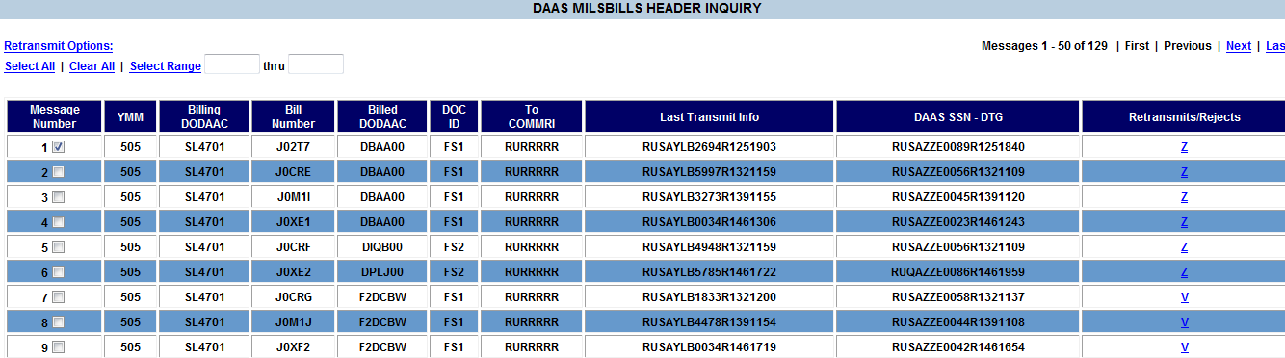


MILSINQ Rejected Messages
Rejected Messages show a Reject Code in last column
Click on Reject Code for explanation
Messages 1-4 have an invalid BILL TO, DBAA00
Messages 7-9 is Unauthorized BILL TO, F2DCBW
Notes:
This slide shows messages that have rejected.
Messages 1-6 have a Z, Invalid Bill To
Messages 7-9 have a V, Unauthorized Bill To
You can go to DAASINQ to research the Bill To DODAACs
Let’s click on Message 1 to see the detailed information.

Slide 21
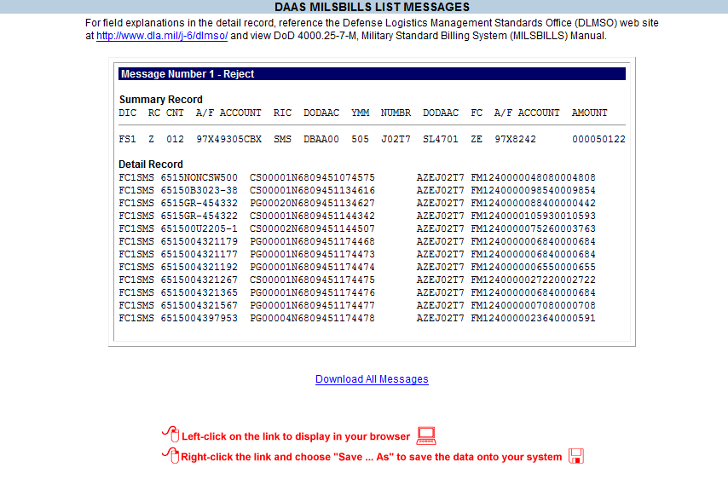
DAAS MILSBILLS LIST MESSAGES
Summary and Detail for rejected message 1
Notes:
Here’s the summary and details for the first message that rejected. We will revisit this transaction later in the presentation.

Slide 22
MILSINQ Review
Use as much data as you have to limit your query results, then expand parameters if needed.
RADAY is a Julian date that indicates when DAAS received or processed messages
When using searches with RADAY: If you don't find a Bill using the RADAY you expected, try the one before or after. It is possible for DAAS to receive a message one day and process the next, especially at end of day.
Notes:
Review

Slide 23
DLA Transaction Services
DLA Transaction Services Overview
Requisition to Billing Scenario
MILSINQ
eDAASINQ
Logistics Data Gateway (LDG)
Wrap Up

Slide 24
eDAASINQ
Two Versions available:
eDAASINQ (enhanced-DAASINQ) is an enhanced version of the basic DAASINQ, includes all of the above, plus
  Communication Routing Identifiers (COMMRI)
  Distribution Codes
  eDAASINQ Provides additional queries and downloads by service or "All" in "TA1" delimited format in addition to all the basic functionality that is available in DAASINQ.
  eDAASINQ is PKI-enabled and access to the application may be requested by submitting a System Access Request (SAR).
DAASINQ provides information on
  DOD Activity Address Codes (DODAAC)
  National Item Identification Number (NIIN)
  Routing Identifier Codes (RIC)
  Military Assistance Program Address Codes (MAPAC)
Notes:
Enhanced DAAS Inquiry (eDAASINQ) is a DLA Transaction Services web application that allows users to query DoDAACs, RICs, MAPACs, Distribution Codes, NIINs, and COMMRIs.
User can also download various reports which include Fund Codes, the DoDAAD file, and the MAPAD file among others.
User can perform wildcard searches or search using a wide range of criteria such as by Major Command, Service/Agency, etc.
A stripped-down version of eDAASINQ, simply called DAASINQ is available for users who have not been granted access to the CAC-enabled site.
Downloads are not available in DAASINQ, and a user can only query one code at a time.

Slide 25
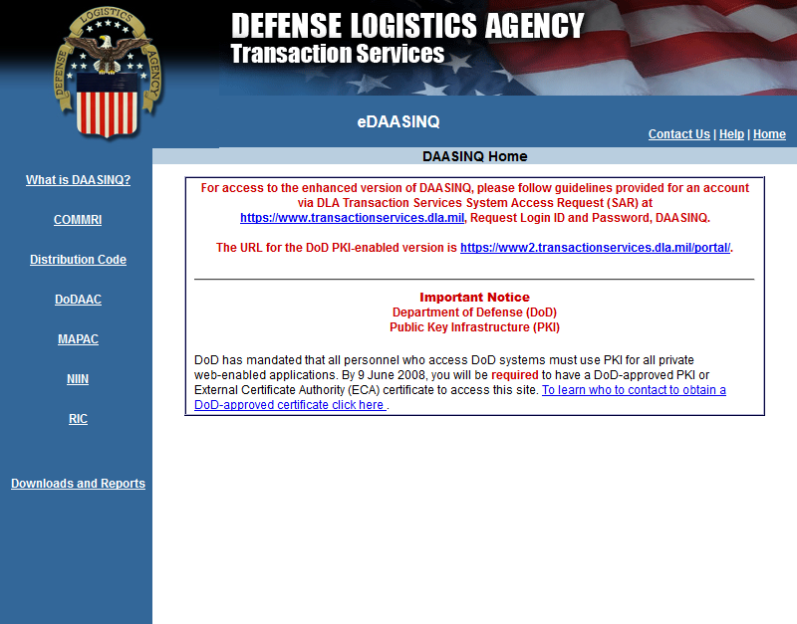
eDAASINQ
EDAASINQ Home Page
Notes:
Displayed is the eDAASINQ home page.

Slide 26
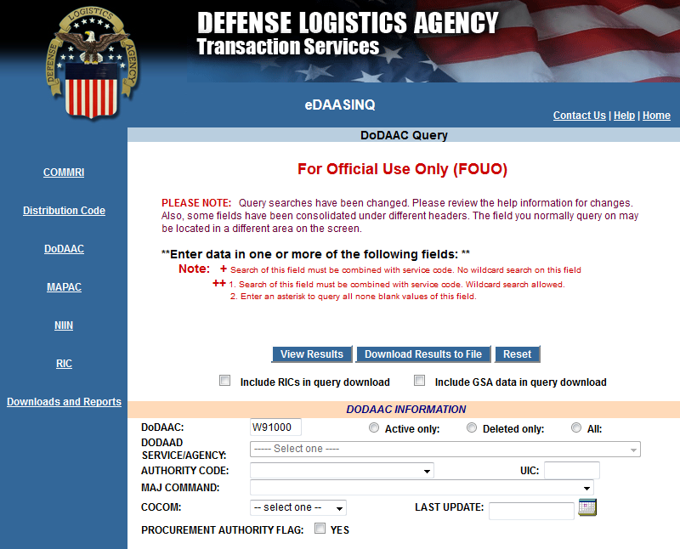
eDAASINQ DODAAC Query
Notes:
This slide displays the MILSBILLS header inquiry for the bill we queried earlier in MILSINQ.
The buyer DoDAAC, W91000 populates DoDAAC field.

Slide 27
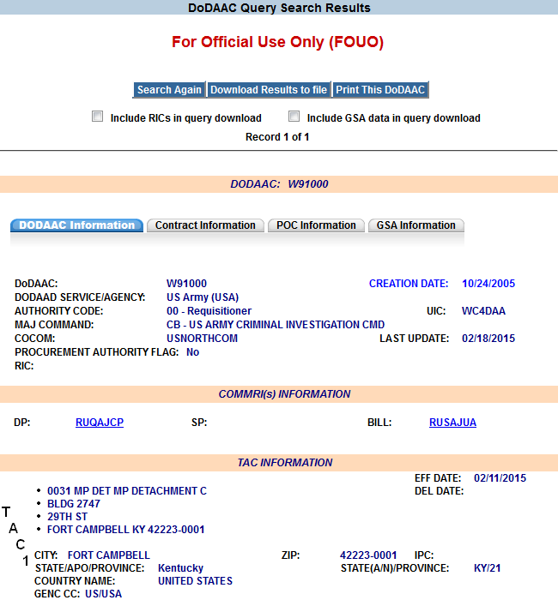
eDAASINQ DODAAC Query
Bills that route TO W91000 will be delivered TO RUSAJUA
All other transactions that route to W91000 will be delivered to RUQAJCP
If no BILL COMMRI exists, the billing transaction will be delivered to the DP COMMRI.
Notes:
Here is the information returned:
We are looking at the DoDAAC Information tab
The top section displays important information such as the Authority Code for example.
DAAS will reject a requisition by a DODAAC with Authority Code 01, 06, 07
The COMMRI Information section is directly below.
The data-pattern (DP) COMMRI is where supply-related transactions are sent to. In this example, RUQACJP represents GCSS-Army.
For example, status and MRA follow-up transactions for DoDAAC W91000 would route to this COMMRI.
The billing (BILL) COMMRI is where billing-related transactions are sent. RUSAJUA is the financial side of GCSS-Army.
Interfund Bills would route to this COMMRI.

Slide 28
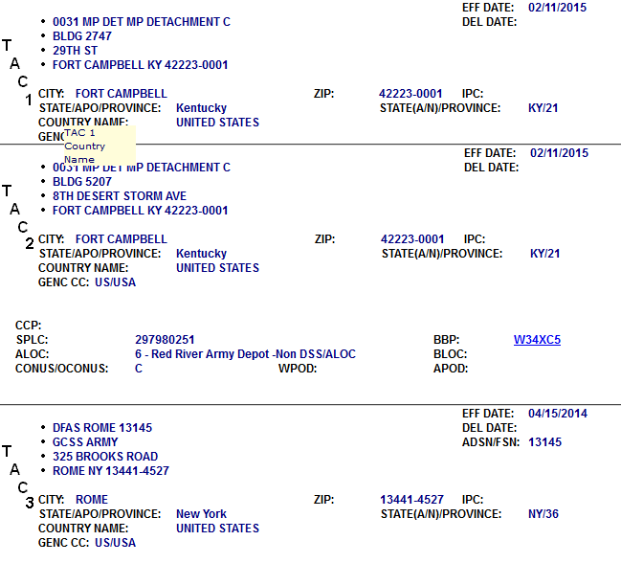
eDAASINQ DODAAC Query (cont)
Depending on the S/A, the Bill COMMRI is associated with an ADSN/FSN in line 1 of TAC 3
Army uses Fiscal Station Number (FSN)
Air Force uses Account Disbursing Station Number (ADSN)
FSN
Notes:
Generally speaking, component DoDAAC Central Service Points (CSPs) can assign COMMRIs for their respective DoDAACs and RICs. DLA Transaction Services logistics support personnel can do this as well.
For some services, DLA Transaction Services associates billing COMMRIs to identifiers based on service-specific rules:
For example, Army billing COMMRIs are linked to a Fiscal Station Number (FSN); Air Force to Account Disbursing Station Number (ADSN)
These identifiers are in a precise record position within the first line of the TAC 3 (billing) address
eDAASINQ has an “ADSN/FSN” field to conveniently display this information

Slide 29
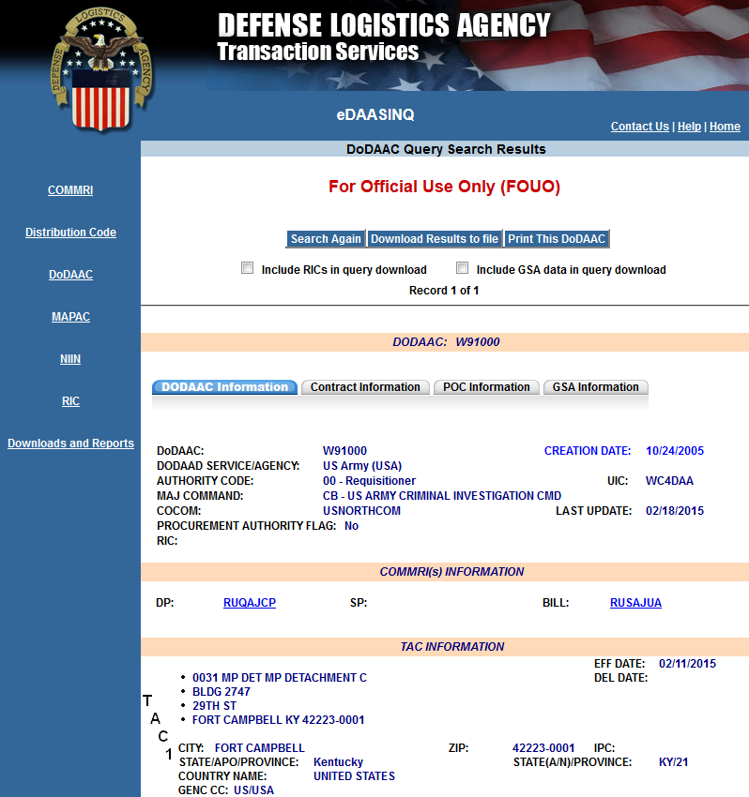
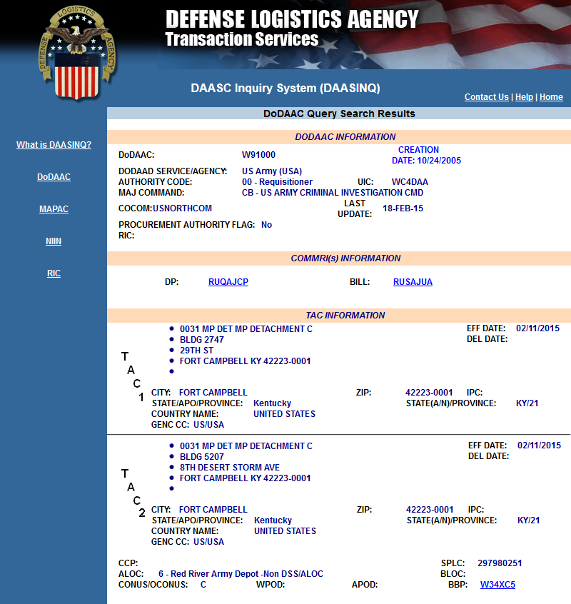
eDAASINQ vs DAASINQ
eDAASINQ
DAASINQ
Notes:
This slide shows eDAASINQ and DAASINQ side-by-side
Notice the additional menu options in eDAASINQ along with the additional tabs on the query display

Slide 30
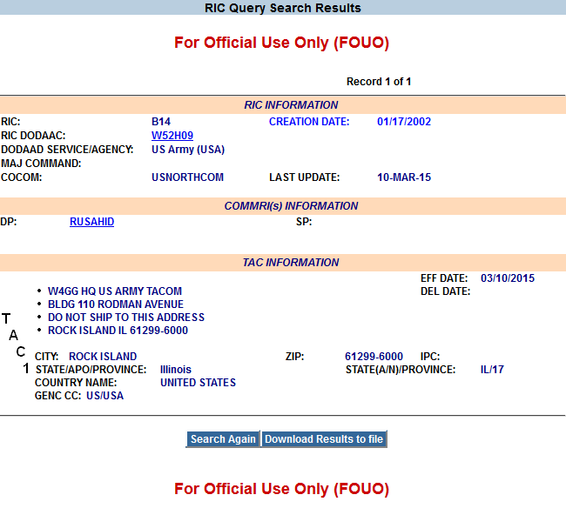
eDAASINQ RIC Query
Notes:
Here is an example of a RIC query
RIC B14, TACOM Rock Island is associated to COMMRI RUSAHID which is the MILS component of Army LMP
Notice however that the “Last Transmit Info” shows RUSAHRU in the header.
This is due to DAAS routing rules which on a DIC basis, cross-reference the LMP MILS COMMRI to the LMP DLMS COMMRI
The item ordered in our example document is managed by B14 and you can see that the DoDAAC for this RIC (W52H09) is the Billing DoDAAC

Slide 31
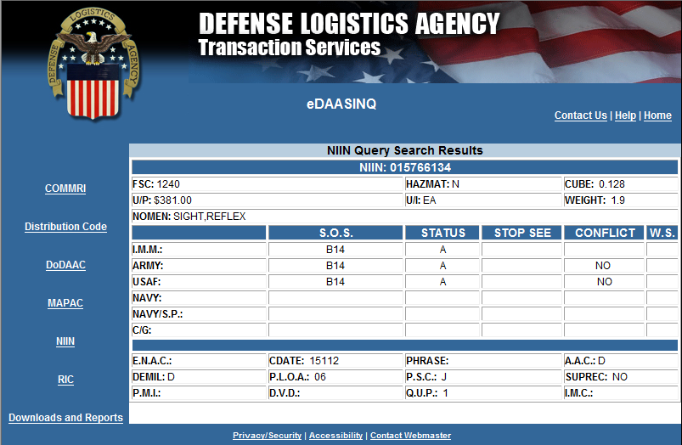
eDAASINQ NIIN Query
FS1 00197X4930AC9DB14 W91000505 1Y7ZWW52H09 512152020 000990600
FA1B14 1240015766134 EA00026W9100050700023LW34XC5J511Y7ZW 1470009906000038100
Notes:
DLA Transaction Services receives NIIN updates from the Federal Logistics Information System (FLIS).
This information is used to maintain the DAAS source of supply (SoS) table which is used when routing transactions.
For example, a transaction addressed to SMS containing this NIIN would be re-addressed to B14 based on the information shown
The DAAS and FLIS tables are occasionally out of sync, but FLIS is the authoritative source of item management information
An out-of-date record can lead to the misrouting of transactions

Slide 32
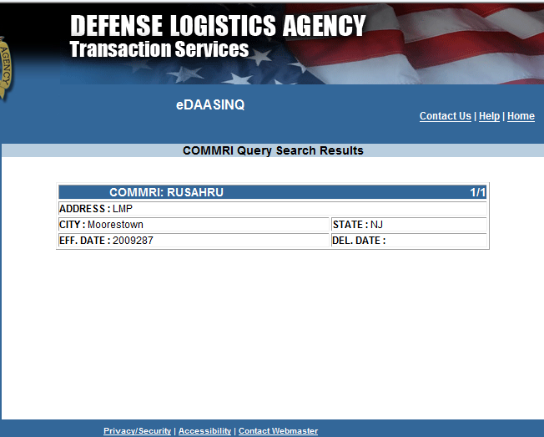
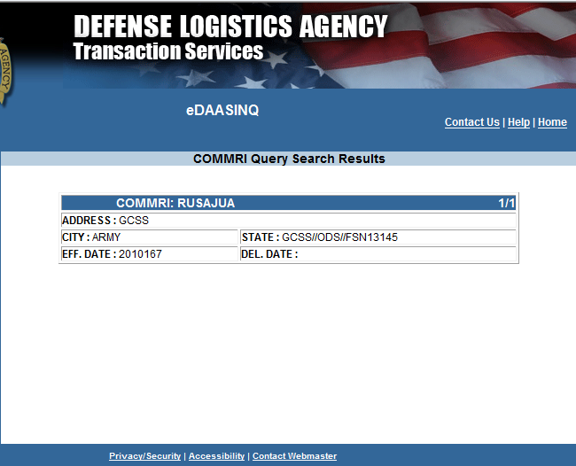
DAASINQ
COMMRI RUSAHRU and RUSAJUA
Notes:
This slide displays COMMRI query results:
The query on the left is Army Logistics Modernization Program (LMP)
This is the system performing the billing in this case
The query on the right is GCSS-Army – Financial
This is the system receiving the bill

Slide 33
Routing vs Delivery
Transactions ROUTE to DODAACs or RICs.
ROUTING is determined by MILSTRIP, MILSBILLS and DLMS manuals, in addition to service-unique business rules.
Transactions are packaged in messages that are DELIVERED to a COMMRI.
DELIVERY is a communications function separate from ROUTING.
In our example, the Interfund Bill was submitted by W52H09 and it came to DAAS using COMMRI RUSAHRU.
It ROUTED to W91000 but was DELIVERED to RUSAJUA.
Notes:
This slide provides some clarifications between routing and delivery:
Individual transactions route to DoDAACs or RICs
Transactions route according to a multitude of business rules that come from the DLMs and service-specific guidance
Transactions are packaged into messages that are delivered to a COMMRI

Slide 34
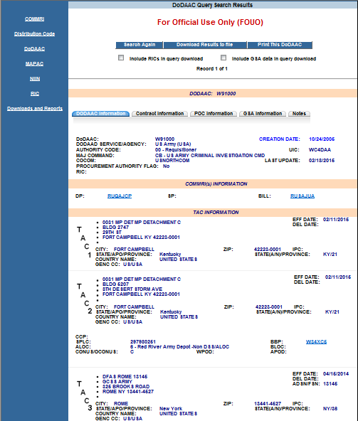
DAAS COMMRIs
RUTTTTT – Terminate. Transactions are written to history (e.g., VLIPS, LDG), but terminate in DAAS.
RURRRRR – Rejected. The transaction has failed a DAAS edit.
RUMMMMM – Mail. An outdated COMMRI that functions the same as RUTTTTT. Transactions process but terminate.
RUSAZZZ – A COMMRI assigned automatically by DAAS when new DoDAACs or RICs are created.
Notes:
The COMMRIs on the right are some used exclusively by DAAS. I included a description of each since you will often see them when using DAAS applications.
RUTTTTT is used to “terminate” transactions in DAAS. Sometimes this is performed when a transaction has rejected with AE9 supply status. Other times, it is used to terminate the A_8 status transaction from the SoS. Additionally, it associated to DODAACs and RICs that have no COMMRI assignment.
RURRRRR denotes that a transaction was rejected and terminated in DAAS.
RUMMMMM was used for the DAAS mailer. That was an decommissioned process where GSA customers could received physical mail in lieu of electronic transaction status. This COMMRI essentially serves the same purpose as RUTTTTT, but will presumably be replaced with RUTTTTT in the future.
RUSAZZZ is assigned automatically by DAAS when new DoDAACs or RICs are created. Transactions that route to this COMMRI build up in an “Intercept” queue, and the system periodically attempts to re-transmit the queued messages to a valid COMMRI.

Slide 35
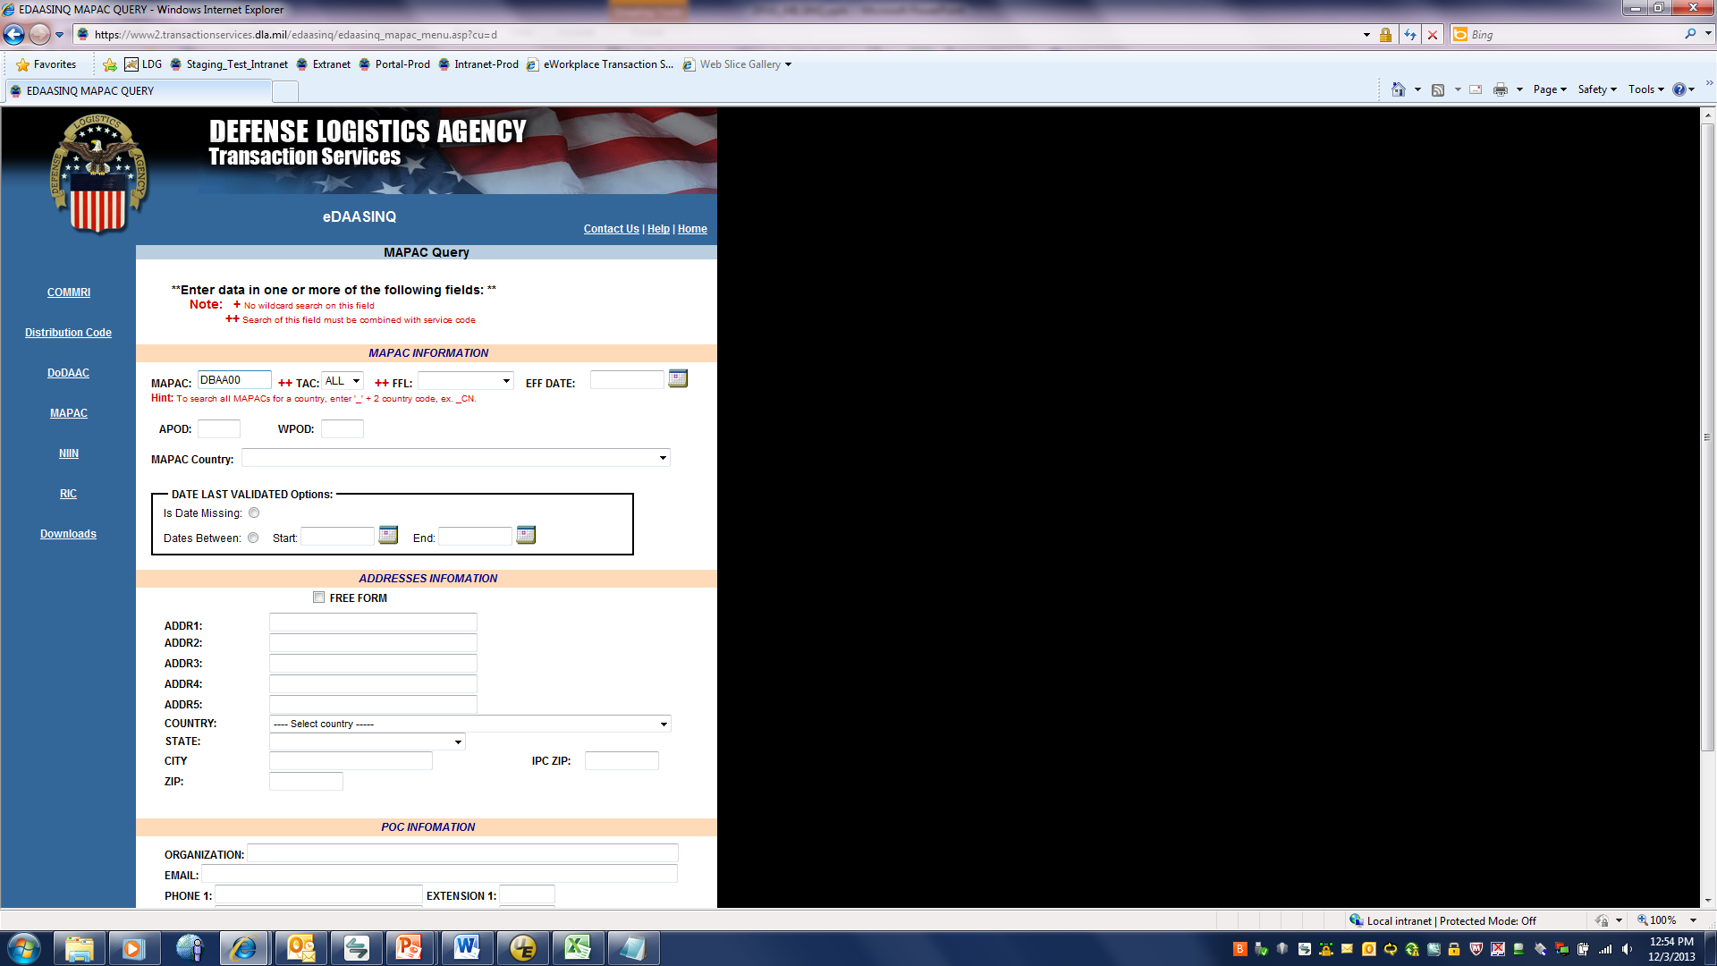
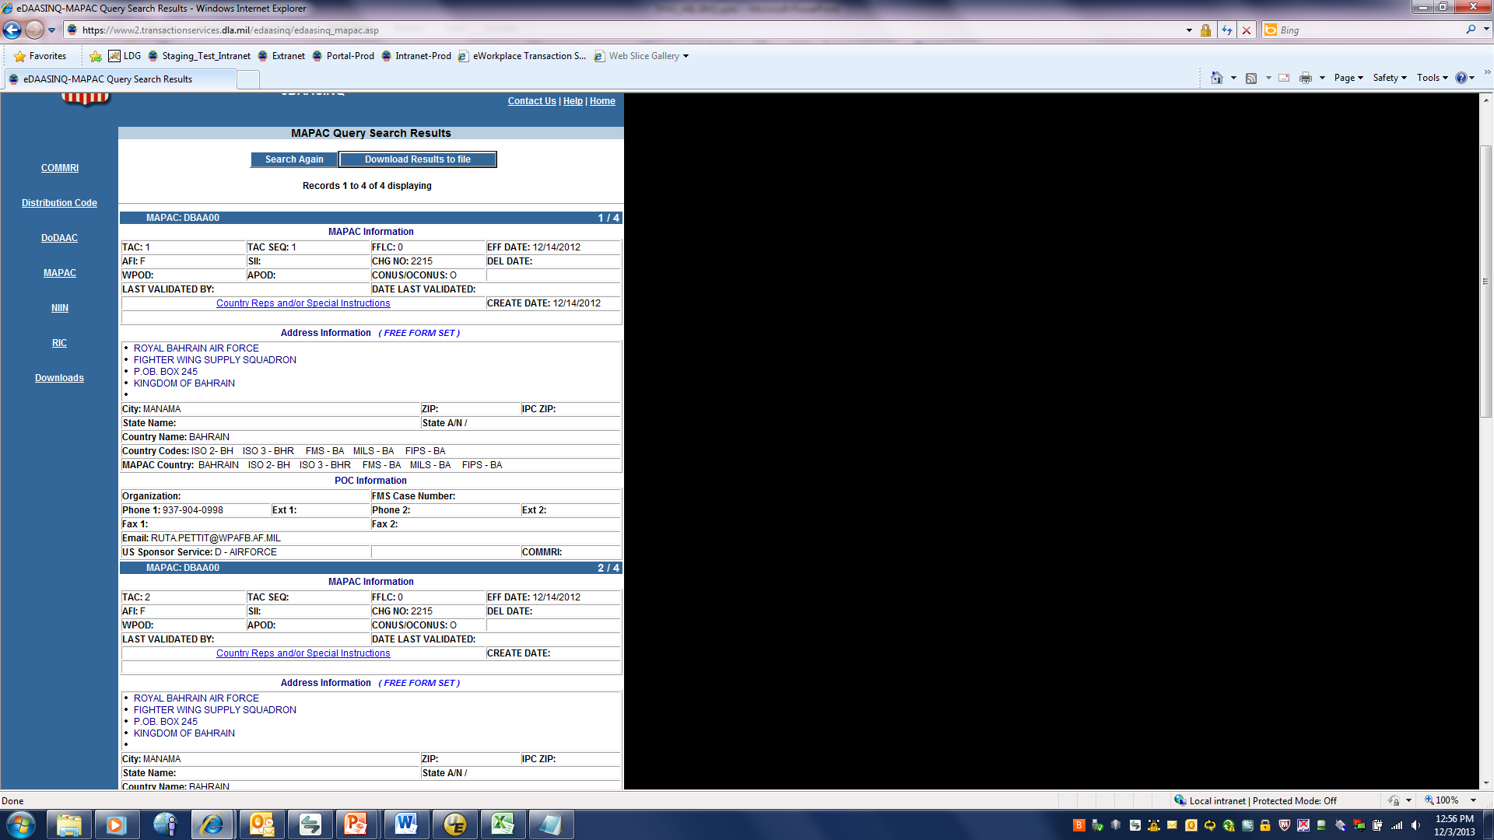
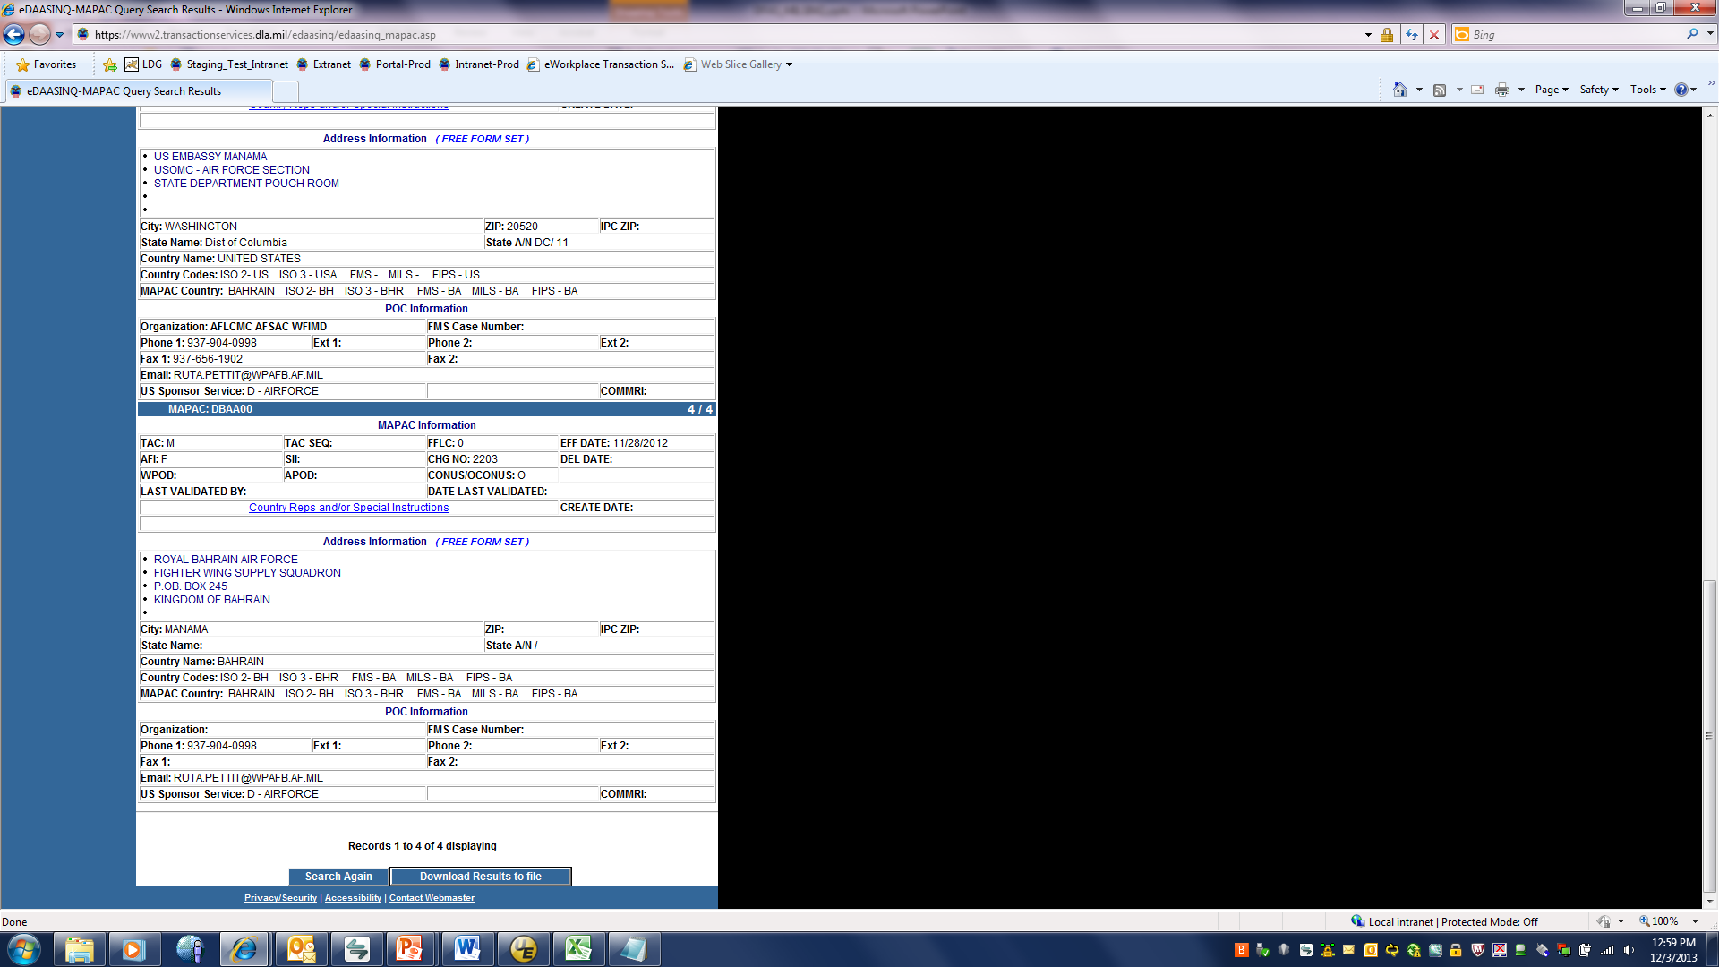
eDAASINQ
Messages 1-4 from MILSINQ example had an invalid BILL TO, DBAA00
DBAA00 is a MAPAC, indicated by ‘D’ in the first position
MAPAC’s do not have Authority Codes, therefore cannot be billed directly
MAPAC Point of Contact Information at bottom of screen
Notes:
Recall our transactions that rejected in MILSINQ:
The first four messages rejected due to an invalid Bill-To address:
DBAA00 is a MAPAC and cannot be used as a bill-to activity
eDAASINQ can be used to query MAPAC information
The screenshot on the right shows the POC information for this MAPAC

Slide 36
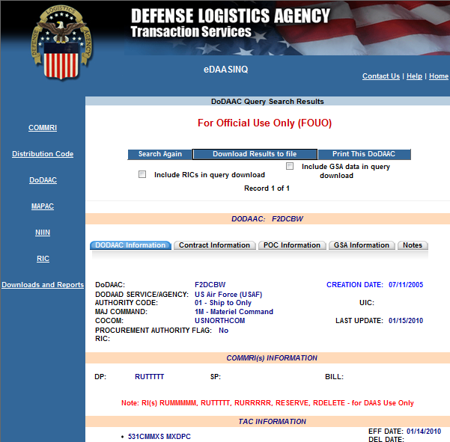
eDAASINQ
Messages 7-9 from MILSINQ example rejected Unauthorized BILL TO, F2DCBW
DAASINQ shows F2DCBW
has Authority Code 01 – Ship-To Only
DODAAC in rp30-35 must be valid and authorized for billing, Authority Code 01, 06, 07 reject
Notes:
Messages seven through nine rejected due to an unauthorized bill-to address, F2DCBW
F2DCBW has an authority code of ‘07’ which is for Administrative use only
Recall that authority codes 01,06, 07 are invalid for billing

Slide 37
eDAASINQ
Authority Code explanations from DLM 4000.25, Defense Logistics Management System (DLMS), Vol 6, Logistics Interoperability Support Services, Chapter 2 DoD Activity Address Directory, http://www2.dla.mil/j-6/dlmso/elibrary/manuals/dlm/dlm_pubs.asp
BILL COMMRIs are assigned by direction from the Service/Agencies. They associate to an ADSN for Air Force, and an FSN for Army.
Bills are delivered to BILL COMMRIs, unless none exists in DAASINQ, then delivered to DP COMMRI
There are many DAAS use-only COMMRIs. RUTTTTT usually means a DoDAAC is not tied to a supply system. The data must be sent somewhere. RUMMMMM was used for the DAAS Mailer Process and will eventually be cleansed. RURRRRR means the transaction rejected.
Notes:
eDAASINQ Review

Slide 38
DLA Transaction Services
DLA Transaction Services Overview
Requisition to Billing Scenario
MILSINQ
eDAASINQ
Logistics Data Gateway (LDG)
Wrap Up

Slide 39
Logistics Data Gateway (LDG)
LDG is another application available to query billing transactions
  Useful if you are doing extensive research on old bills
  At least three years of data
  Can do searches by with many of the same parameters as MILSINQ, but not as constrained by date range.
LDG Queries:
  Interfund Bills by Billed DoDAAC (buyer) and Bill Number
  Interfund Bills by Billing DoDAAC (seller) and DAAS Received
  Interfund Bills by Billing DoDAAC (seller) and Bill Number
  Interfund Bills by Billing DoDAAC (seller) and DAAS Received Date
Notes:
The Logistics Data Gateway (LDG) is another option for researching logistics bills.
LDG retains data longer than MILSINQ which only retains data for 1 year, and 2 years for FMS-related data
LDG generally stores data for at least three years, possibly longer for bills
Here are the bill-related queries available to users

Slide 40
DLA Transaction Services
DLA Transaction Services Overview
Requisition to Billing Scenario
MILSINQ
DAASINQ
Logistics Data Gateway (LDG)
Wrap Up

Slide 41
Access to Applications
Access to DAASINQ
  https://www.transactionservices.dla.mil/daasinq
  Requires a PKI Certificate
Access to MILSINQ, eDAASINQ or LDG (CAC required)
  https://www.transactionservices.dla.mil
  To submit SARs choose Request Login ID and Password, navigate to appropriate SAR page.
  Applications are accessed through the DLA Transaction Services Portal once a System Access Request (SAR) is approved.
You must log-on every 300 days or account will become be revoked, after 60 days it is deleted. For revoked accounts contact the Help Desk.
    https://www.transactionservices.dla.mil
    Link to send an email under "Contact Us"
    or daashelp@dla.mil
    For 24 hour 7 days-a-week Phone Support:
    Telephone: (937) 656-3247
    DSN: 986-3247
Notes:
Here are some helpful links

Slide 42
Points of Contact
Logistics Support Team Leads
Bernace Collier Lead, Air Force Support 937-656-3766, DSN 986 Bernace.collier@dla.mil | Allen Coleman Lead, Army Support 937-656-3766, DSN 986 Allen.Coleman@dla.mil
George Amburgey Lead, DLA Support 937-656-3766, DSN 986 George.Amburgey@dla.mil | Edward Davis Lead, Navy/USMC/USCG Support 937-656-3766, DSN 986 Edward.Davis@dla.mil
24/7 DLA Transaction Services Help Desk: E-mail: daashelp@dla.mil Phone Support: Telephone: (937) 656-3247 DSN: 986-3247
Notes:
DLA Transaction Services logistics support consists of four teams based on branch of service. The POC information for each respective team lead is shown.
DLA Transaction Services maintains a 24/7 help desk. The e-mail and phone number are shown.

Slide 43
DLA Transaction Services
Questions?

