Slide 1
Supply Process Review Committee 22-1
Defense Enterprise Data Standards Office (DEDSO)
March 9, 2022, 0845-1400

Slide 2
Agenda
0845-0915 | Welcome, Admin, & Introductions Dr. Gail Fuller Administrator, DEDSO / Mr. Nelson Alvarez, Acting Director, DEDSO / Dr. Linsey Saul, Chief Data & Analytics Officer / DASD Logistics
0915-0945 | Action Item SPRC 21-1 and 21-2 Dr. Gail Fuller DEDSO
0945-1000 | Purpose Code Recap Mr. Rafael Gonzalez, DEDSO
1000-1030 | DLA Non-Cataloged Stock Numbers Ms. Amy Walker DLA / Mr. Rafael Gonzalez DEDSO, Services/Components
1030-1045 | Break
1045-1100 | ADC 1160 Recommending and Authorizing Credit for Validated SDRs Mr. Troy Brown, DLA / Mr. Rafael Gonzalez DEDSO
1100-1130 | PDC 1408 Requisitions with Priority Designator Code 09-15 and Special Requirement Category 777 Mr. Damian Alvarez, NAVSUP WSS P&D / Mr. Richard Morrow, DEDSO
1130-1200 | Lunch
1200-1230 | Pseudo RIC Ms. Tonja Carter / Mr. Richard Morrow, DEDSO
1230-1300 | Pseudo DoDAAC Ms. Tonja Carter / Mr. Richard Morrow, DEDSO
Supply Team, DEDSO As of March 9, 2022, Office DLA Slide

Slide 3
Agenda cont.
1300-1330 | War Materiel Requirements (WRM) Procedures Ms. Tonja Carter, DEDSO
1330-1400 | Wrap Up/Action Items
Supply Team, DEDSO As of March 9, 2022, Office DLA Slide

Slide 4
Action Items SPRC 21-1 and SRPC 21-2
No | SPRC Ref. | Action Item | Responsibility | Target Due Date | Status | Notes
1 | 21-1 Topic 1 | Army to provide CONOPS for LMP TAV-C to DEDSO | AMC | 10/23/2021 | Open | DEDSO Sent follow up 12/30/21
2 | 21-1 Topic 1 | Navy and USMC to provide information on their contract repair visibility processes or applications | Navy/USMC | 10/23/2021 | Open | DEDSO Sent follow-up 12/30/21
3 | 21-1 Topic 1 | DPC to brief on the PIEE GFP Module capabilities | DPC | 10/23/2021 | Open | DEDSO Sent follow-up 12/30/21
4 | 21-1 Topic 1 | DEDSO and DPC to assist the Services on property transfer gaps that support DFARS requirements and GFP logistical requirements | DPC/DEDSO | 10/23/2021 | Open | DEDSO Sent follow-Up 12/30/21
5 | 21-2 Topic 2 | Provide a comprehensive list of POCs who can discuss the use of pseudo RICs to the DoD Supply PRC member group | DLA HQ | 12/31/2021 | Open | DEDSO Sent follow-up 1/3/22
Supply Team, DEDSO As of March 9, 2022, Office DLA Slide
Notes:
Here is a combined list of action items from two previous Supply PRC ( 25 August 2021) SPRC 27 October 2021

Slide 5
Purpose Code Recap

Slide 6
DLA Non-Cataloged Stock Numbers

Slide 7
Non-Cataloged Stock Numbers
Background
DLA currently receipts all material regardless of whether all operational/audit attributes are provided
Non-cataloged stock numbers traditionally do not have appropriate prepositioned material receipts (PMR) or sufficient evidential matter (document/label) to clearly identify the material or owner
Inability to identify material for receipt is an issue for DLA as well as our customers:
Additional manpower to research and identify – resulting in increased costs and delays in material availability
DLA Distribution does not have the authority to systemically send unidentified items to Disposition Services
In Jun 2020, we had ~63K non-catalogued stock number records in the Distribution Standard System (DSS) with stock on hand… Currently there are ~30K in DSS with stock on hand.
Breakdown by service:
Army | Navy | Air Force | USMC | Other
2,641 | 3,731 | 15,392 | 6,116 | 391
May 7, 2020
Jul 15, 2020
Jul 2020 - Jun 2021
Jul 7, 2021
Supply Process Review Committee (PRC) – DLA briefed non-catalogued stock numbers and the proposed WMS way ahead to include PMR and catalogued records.
DLA sent each Service a data file of all stock number records in DLA custody as of June 30, 2020 and requested disposition instructions on non-catalogued records (i.e., dispose of material, keep for transfer to WMS).
DLA held discussions with Military Services – some had projects underway that would reduce non-catalogued items in DLA custody. Burndown plans and master data requirements delayed to allow focus on those projects.
DLA provided updated data file along with service POC names who receive monthly reports and requested burndown plans for non-catalogued items
Supply Team, DEDSO As of March 9, 2022, Office DLA Slide

Slide 8
Non-Cataloged Stock Numbers
Moving forward with Warehouse Management System (WMS)
WMS requires a product master record to exist and relies on PMR and advance shipment notification to capture operational/audit attributes
Enforces compliance with current cataloging policy to minimize WMS customization; eliminates DLA decision of operational/audit attributes related to Existence and Rights
For existing items, DLA will require the Services and DLA EBS to send 832N transactions to WMS for Product Master creation for Non-Cataloged items to be stored in DLA Distribution.
For future/incoming items, DLA will require 527Ds for Pre-positioned Material Receipts (PMR) for ownership upon receipt.
DLA POCs continue to be available as needed to move existing non-cataloged items to WMS and get the master data required
Supply Team, DEDSO As of March 9, 2022, Office DLA Slide

Slide 9
DLA ADC 1160 Recommending and Authorizing Credit for Validated SDRs

Slide 10
ADC 1160 Issue Reversal Discussion
DLA performs D7_ issue reversals in certain circumstances for the Navy and Air Force IAW ADC 1160
The D7_ reversal process is used to trigger a credit process and changes the on-hand inventory balance(s). Normally we would just post an inventory gain D8A or loss D9A
Performing this D7_ issue reversal can result in having to process additional manual inventory losses with D9A to correct balances
DLA would like to understand if this process is still needed
Supply Team, DEDSO As of March 9, 2022, Office DLA Slide

Slide 11
ADC 1160 Issue Reversal Discussion cont.
Scenario A - Shortage type 7 SDR received:
After the SDR is validated a physical inventory count is conducted
If an overage is found a D7_ reversal (negative) is processed which increases the on-hand quantity in lieu of a D8A gain
Occasionally a manual D9A loss is also required
Scenario B - Wrong item type 7 SDR received:
After the SDR is validated a physical inventory count is conducted
A D9A loss is posted for the wrong item
A D8A gain is posted for the ordered item
Once the wrong item is returned a receipt is posted
A D7_ reversal (negative) is posted for the ordered item which erroneously increases the on-hand quantity
A manual D9A loss is posted for the ordered item to correct the gain from the D7_ reversal
Supply Team, DEDSO As of March 9, 2022, Office DLA Slide

Slide 12
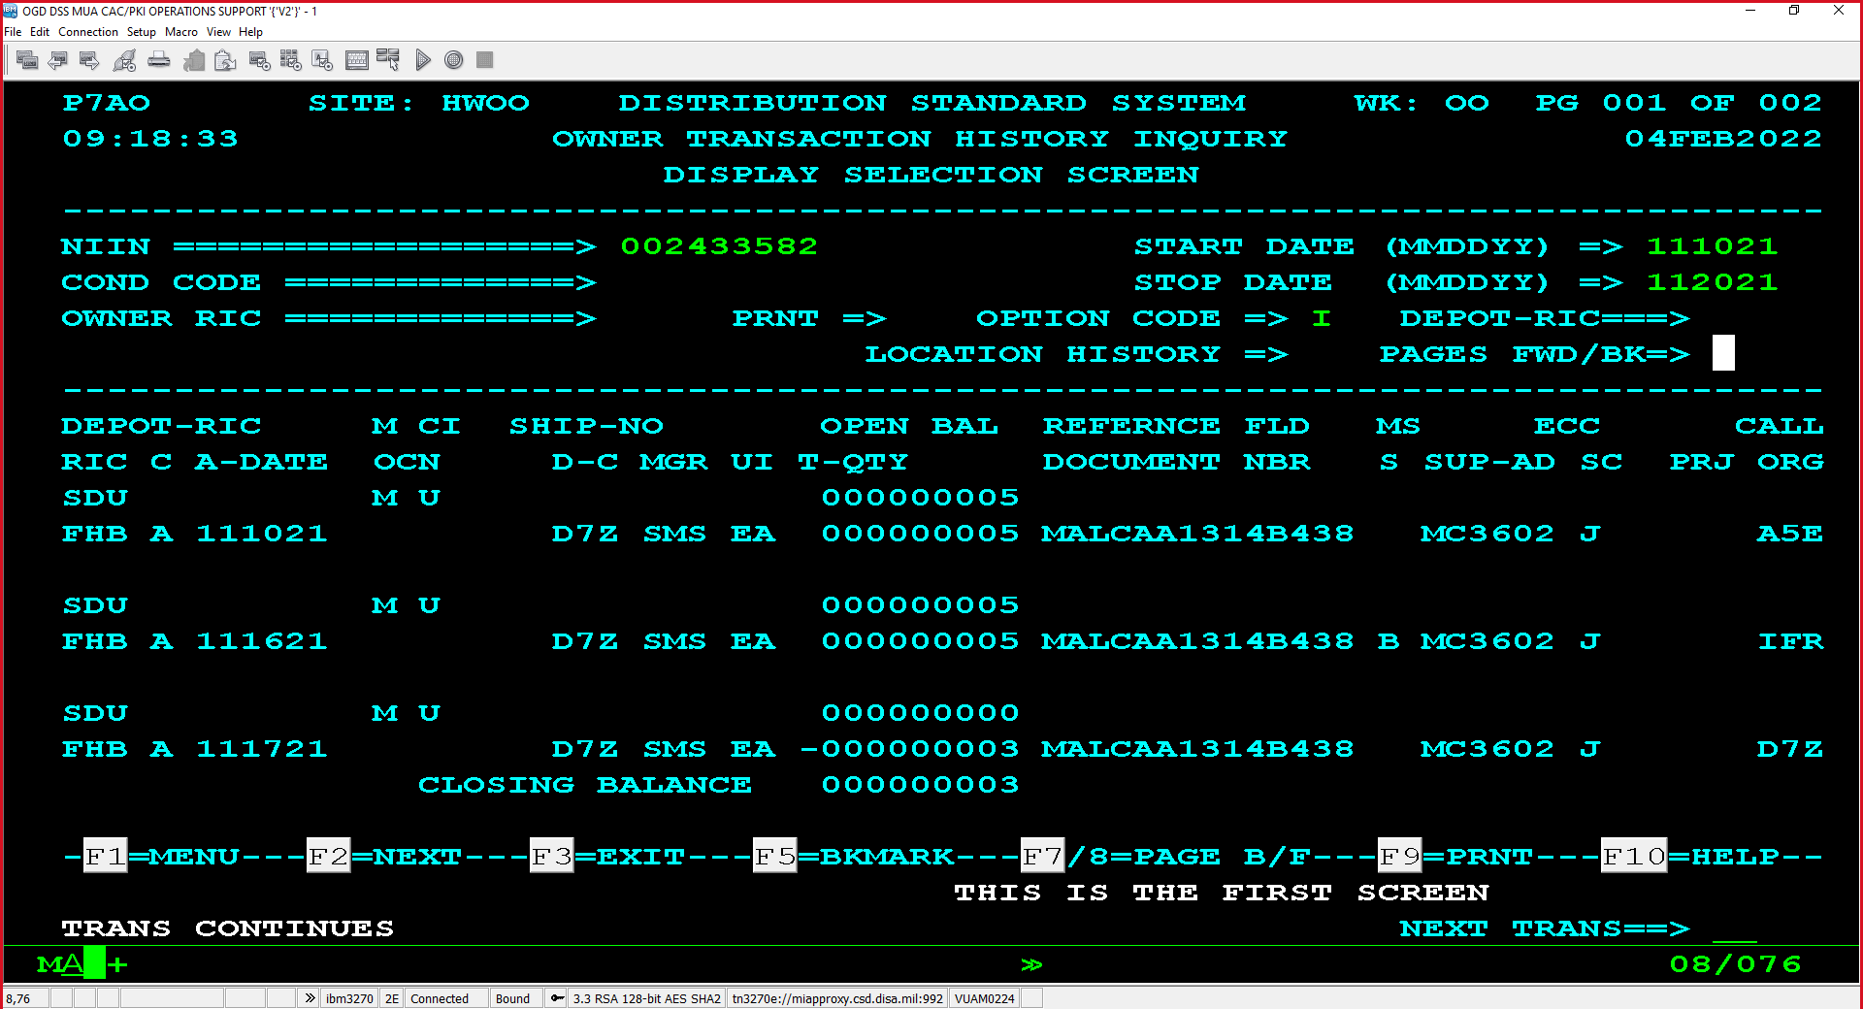
ADC 1160 – Issue Reversal DSS Example
DSS Screen Shot
Supply Team, DEDSO As of March 9, 2022, Office DLA Slide

Slide 13
PDC 1408, Requisitions with Priority Designator 09-15 and Special Requirement Category 777

Slide 14
PDC 1408 Requisitions with Priority Designator (PD) 09-15 and Special Requirement Category (SRC) 777
Background: NAVSUP WSS T&D (N31) conducted an analysis in 2019 and discovered SRC 777 stripped from PD 09-15 U.S. Navy requisitions. With NAVSUP BSC’s assistance, ADC 057 dated May 23, 2002 had been identified to be responsible for the system change.
As-Is: U.S. Navy requisitions PD 09-15 w/stripped SRC 777 are assigned Transportation Priority 3 (Transportation Mode=Surface), and not in accordance with Defense Transportation Regulation (DTR),Table 203-3 (https://www.ustranscom.mil/dtr/part-ii/dtr_part_ii_203.pdf)
To-Be: U.S. Navy requisitions PD 09-15 w/SRC 777 are assigned Transportation Priority 2 (Transportation Mode=Air) in accordance w/Defense Transportation Regulation, Table 203-3
Recommendation: Approval of PDC 1408 to align requisition processing with the DTR
Supply Team, DEDSO As of March 9, 2022, Office DLA Slide

Slide 15
Pseudo RIC

Slide 16
Pseudo RIC Discussion
Components to brief about their current use of pseudo RICs and implementation efforts to discontinue.
Talking Points:
DLMS transactions routed via DAAS with pseudo RICs
Root cause Analysis
Negative effect
Efforts to stop using pseudo RICs
Supply Team, DEDSO As of March 9, 2022, Office DLA Slide
Notes:
Why are services sending transactions routed to DAAS that contain pseudo RICs and why should DAAS continue to process these?

Slide 17
Pseudo DoDAACs

Slide 18
Pseudo DoDAAC Discussion
Components to brief about their current use of pseudo DoDAAC and implementation efforts to discontinue.
Talking Points:
DLMS transactions routed via DAAS with pseudo DoDAAC
Root cause Analysis
Downstream implications (financial, procurement, transportation)
Efforts to stop using pseudo DoDAAC
Supply Team, DEDSO As of March 9, 2022, Office DLA Slide
Notes:
Why are services sending transactions routed to DAAS that contain pseudo RICs and why should DAAS continue to process these?

Slide 19
War Reserve Materiel (WRM) Procedures

Slide 20
War Reserve Materiel (WRM) Procedures
DLM 4000.25, Volume 2, Chapter 3 provides procedures on WRM
This chapter addresses procedures applicable to WRM functions
The WRM function is identified by the DLMS 830W transaction
Paragraph C3.2.4 states “the DoD Components shall send WRM data to reach IMMs by 15 February of each year and shall submit corrections and/or changes as required”
DEDSO would like clarification from the Services on the following:
Are the procedures identified in Volume 2, Chapter 3 still accurate?
Are the Services using the DLMS 830W transaction?
DEDSO reviewed 12 months of transactions routed to DAAS, and not able to find any 830W transactions
Supply Team, DEDSO As of March 9, 2022, Office DLA Slide
Notes:
DoDI 3110.06

Slide 21
Wrap Up/Action Items

Slide 22
Next PRC
Supply PRC
July 2022
December 2022
Supply Discrepancy Reporting (SDR)
March 24, 2022
October 2022
Finance
May 4, 2022
November 2022
Supply Team, DEDSO As of March 9, 2022, Office DLA Slide

Slide 24
BACKUP

Slide 25
Federal Law and Policies
Title 10 U.S. Code § 2451 - Defense Supply Management
(b) In cataloging, the Secretary shall name, describe, classify, and number each item recurrently used, bought, stocked, or distributed by the Department of Defense, so that only one distinctive combination of letters or numerals, or both, identifies the same item throughout the Department of Defense.
(c) In standardizing supplies the Secretary shall, to the highest degree practicable—
(1) standardize items used throughout the Department of Defense by developing and using single specifications, eliminating overlapping and duplicate specifications, and reducing the number of sizes and kinds of items that are generally similar;
10 U.S. Code § 2454 - Supply Catalog: New or Obsolete Items
(a) After any part of the supply catalog described in section 2451 of this title is distributed, and with respect to the kinds of items covered by that part, only the items listed in it may be procured for recurrent use in the Department of Defense. However, a military department may acquire any new item that is necessary to carry out its mission. As soon as such an item is acquired, it shall be submitted to the Secretary for inclusion in the catalog and the standardization program
DoDM 4140.01 Volume 2, DoD Supply Chain Materiel Mgt. Procedures Enclosure 3
Section 2 Provisioning
(c) In accordance with section 2451 of Reference (e), catalog items repeatedly used, bought, stocked, or distributed. Generally, catalog new items before first units are equipped. Emphasize reduction of the variety of parts and associated documentation required by weapon systems or end items through provisioning screening.
Section 6 Material Stockage Computations
f. Non-Stocked Items
(1) No stockage level is authorized
(2) Materiel managers initiate the procurement upon receipt of a valid requisition at the wholesale level or a demand signal. At the retail level, materiel managers initiate the requisition quantity upon receipt of a valid demand and normally limit it to the customer demand quantity. Exceptions are allowed on an individual item basis, but must be held to a minimum.
DoDM 4140.01-V8, February 10, 2014
1. CATALOGING
a. Management of the Federal Catalog
(1) DoD Components will catalog items using the processes instituted by the FCP in accordance with the mandates in Chapter 145 of Title 10, United States Code (Reference (j)) to:
(a) Uniformly identify items to preclude or eliminate different identifications of like items; to reveal interchangeability among items.
(b) Aid in parts standardization; facilitate intra- and inter-departmental logistics support.
(c) Improve materiel management and military effectiveness by promoting efficiency and economy in logistics operations.
b. Catalog Procedures
(1) DoD Components catalog each item recurrently used, bought, stocked, or distributed by the DoD and follow FCS processes to catalog the items in FLIS. Cataloging includes naming and describing the item, classifying it, and assigning it one distinctive combination of numerals for use throughout the DoD.
(2) The acquisition program manager ensures that new items introduced as part of a new system acquisition program are catalogued.

