Slide 1
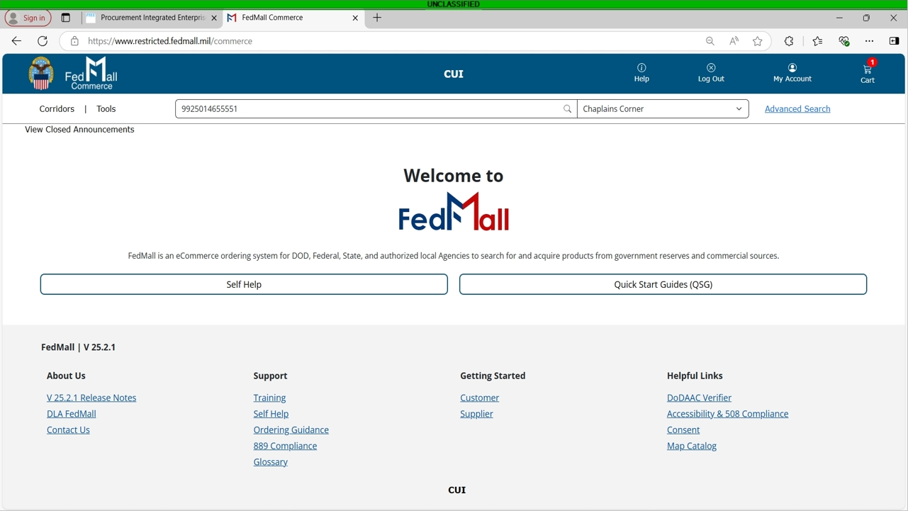

Notes:
Welcome to this instructional video on how to place an order on FEDMALL, presented by the DLA Office of the Chaplain.

Slide 2
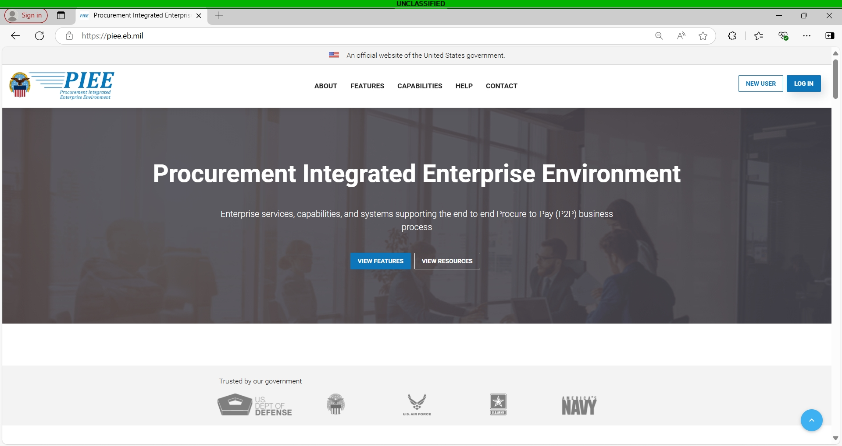
Notes:
First you will need to go to piee.eb.mil and click on Log In. If you do not have a piee account, please see my other video on How to register in PIEE and access FEDMALL

Slide 3
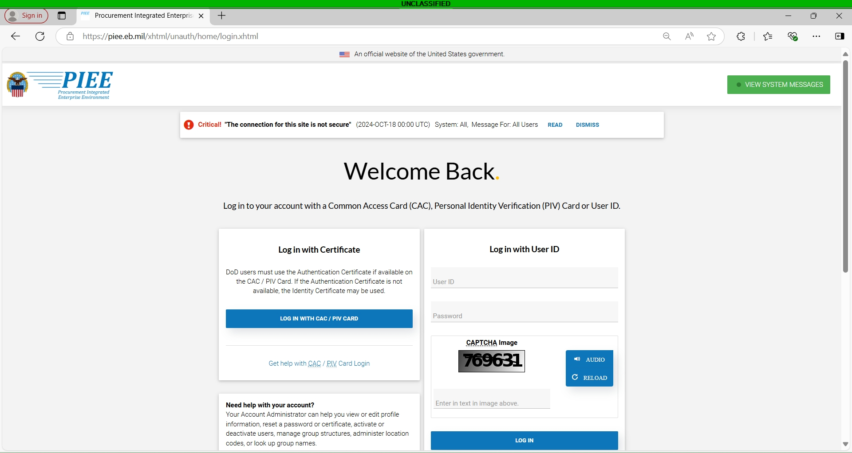
Notes:
Here you will click on “Log in with CAC/PIV Card”

Slide 4
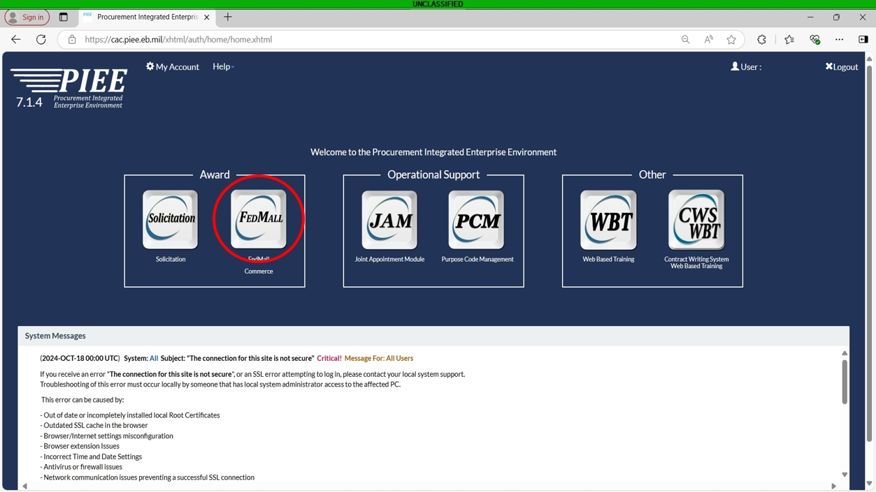
Notes:
On this page, click the FEDMALL buton

Slide 5
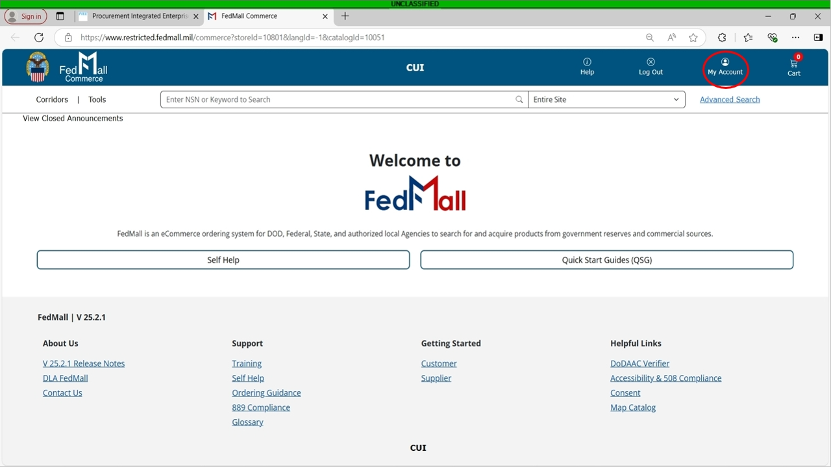
Notes:
If this is your first time on FEDMALL, you will need to set up your credit card information. To do this, click on My Account in the upper righthand corner

Slide 6
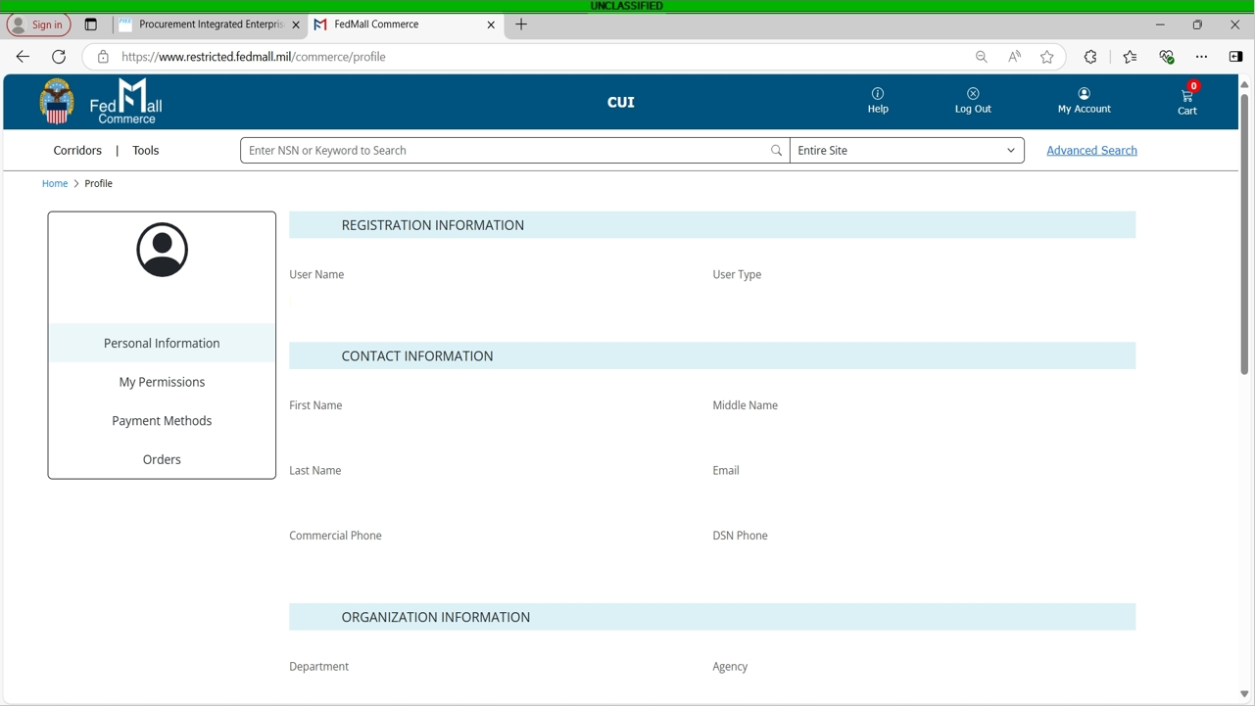
Notes:
On this page, verify that all of your personal information is correct. This information is pulled from you CAC and PIEE. If anything is wrong, at the bottom of the page, there is an Edit Information button.

Slide 7
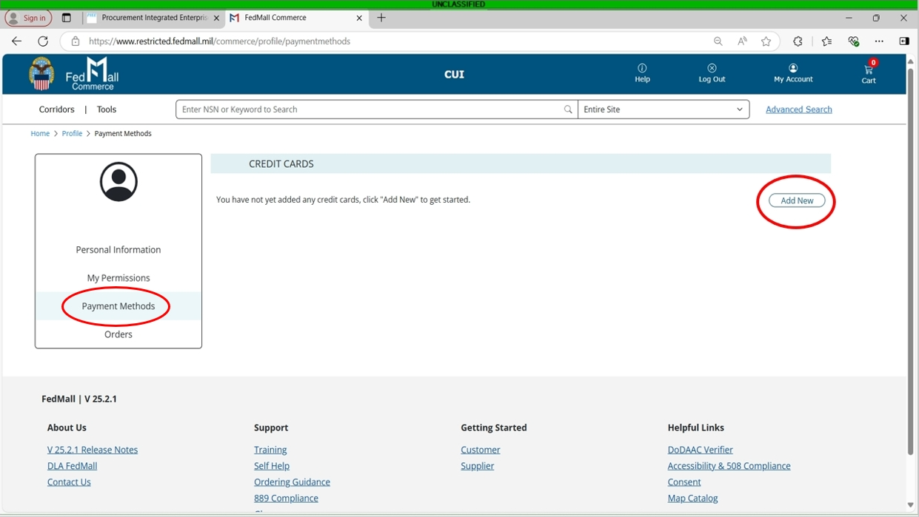
Notes:
Click on Payment Methods on the left, then click Add New on the right.

Slide 8
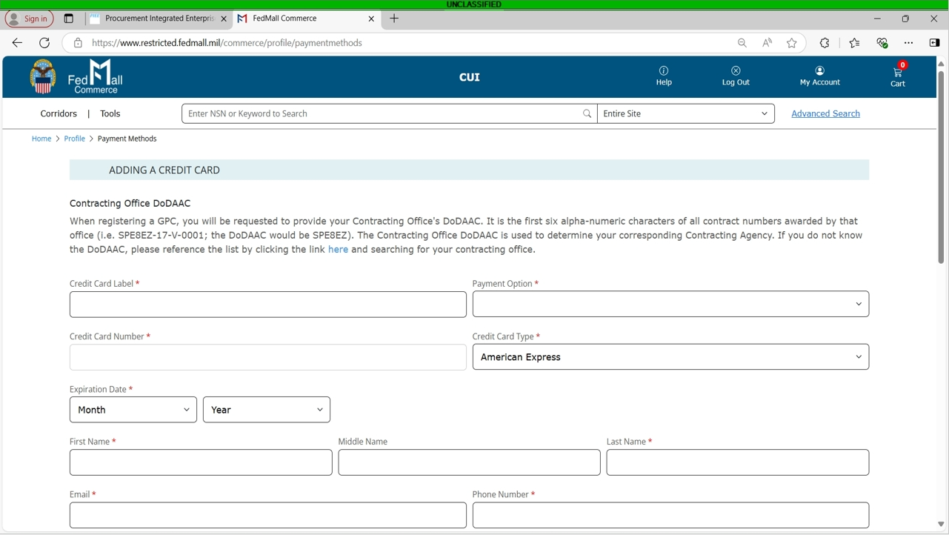
Notes:
Here you will input all of your credit card information. Note, you can not use a personal credit card to purchase items on FEDMALL. It will need to be a Government Purchase Card that is associated and attached to your DODAAC. Once all of the information is correct, click submit at the bottom of the page.

Slide 9
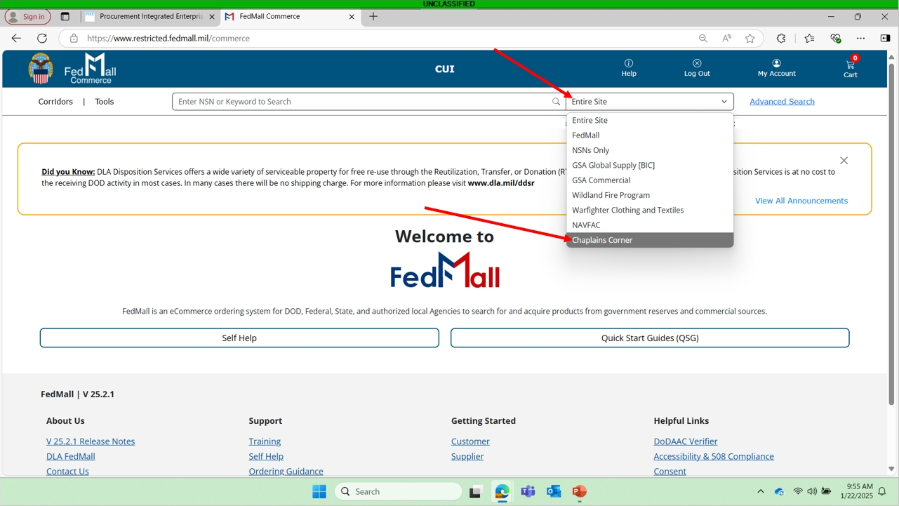
Notes:
At the main page for fedmall, you can either search the entire site, or just the chaplain’s corner. To access the chaplain’s corner, click the dropdown next to the search bar and select chaplain’s corner.

Slide 10
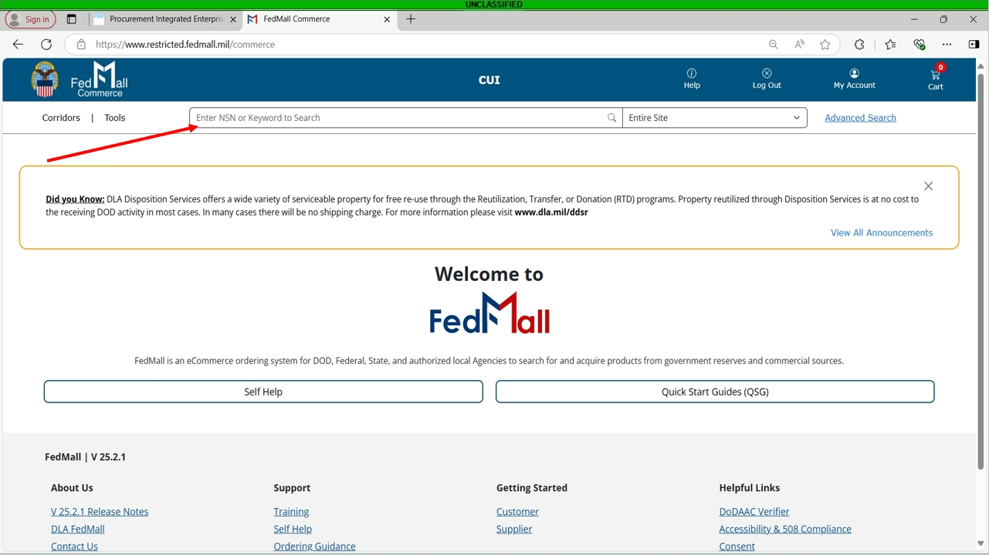
Notes:
Next you can enter either keywords or the NSN of the item you are looking for. Note, when searching by NSN, do not use dashes. Once you have it inputted, hit enter

Slide 11
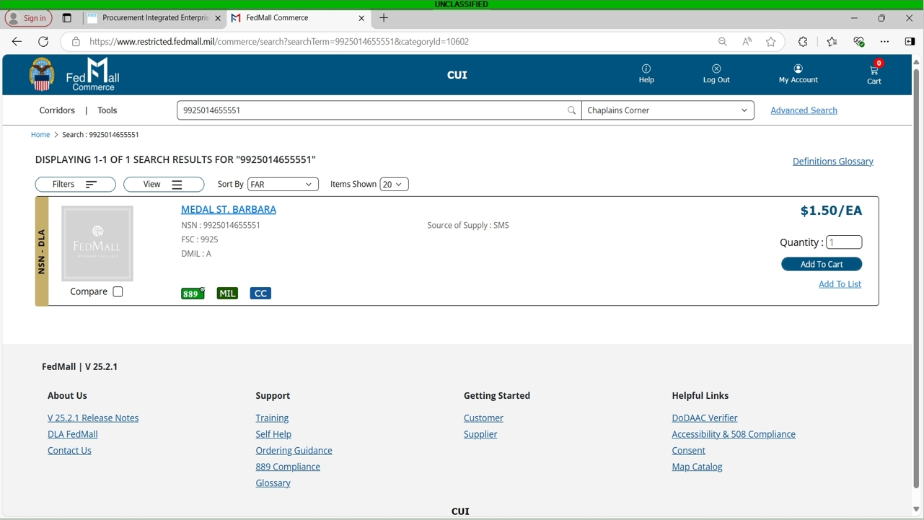
Notes:
The item you searched for will populate. You can click on the name in blue for more information, or you can change the quantity and click add to cart.

Slide 12
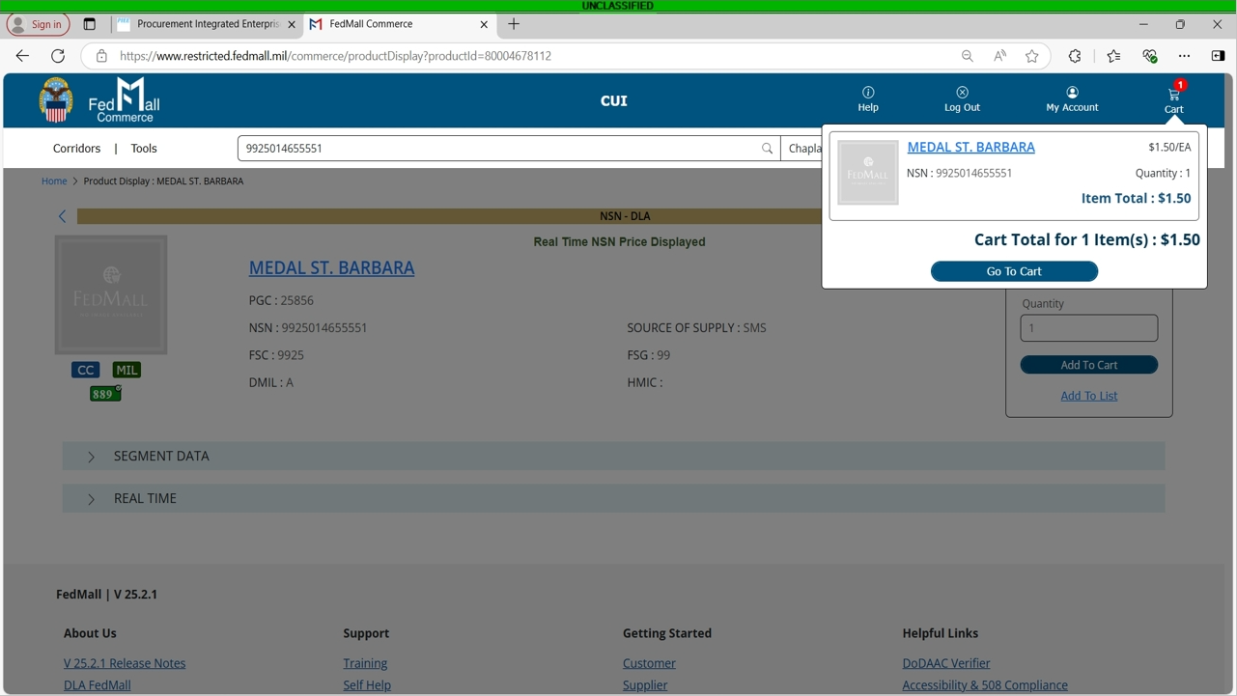
Notes:
If you click on the cart icon on the top right of the screen, it will show all of the items that are currently in your cart as well as the total price.

Slide 13
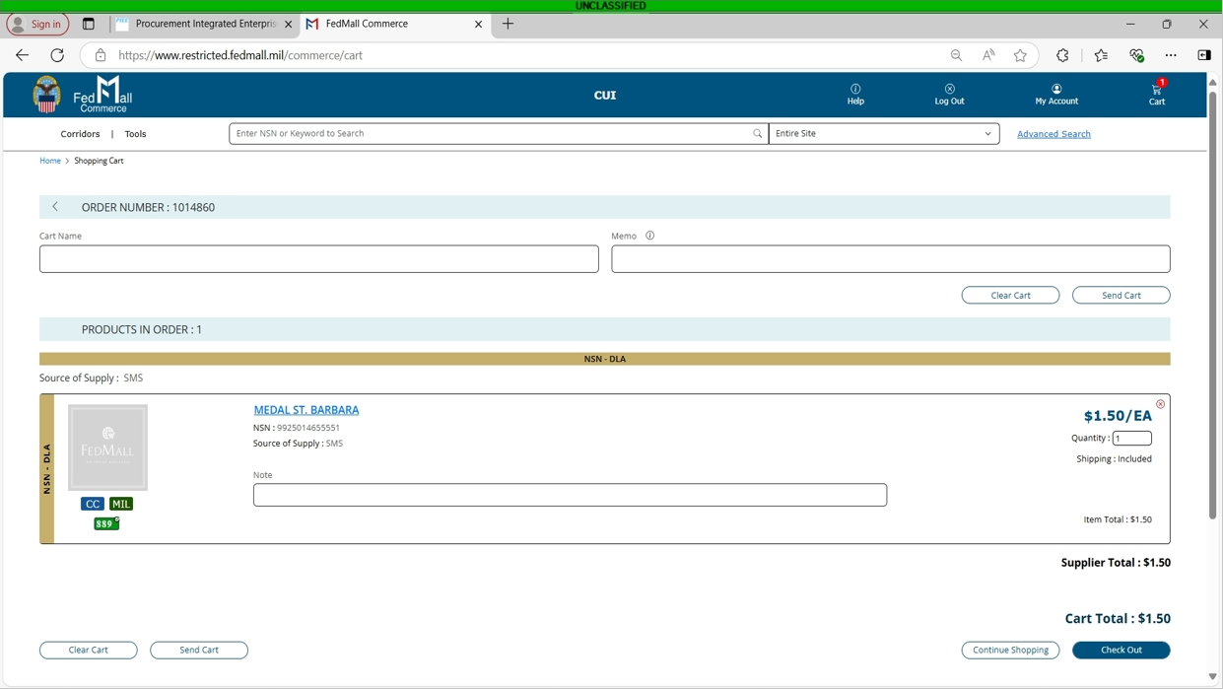
Notes:
Once you are ready, you can click on Go To Cart. This will show your items and totals. Here you can name your cart and give it a memo for internal use. You can also clear the cart or send it to another fedmall user. When you are ready, click check out.

Slide 14
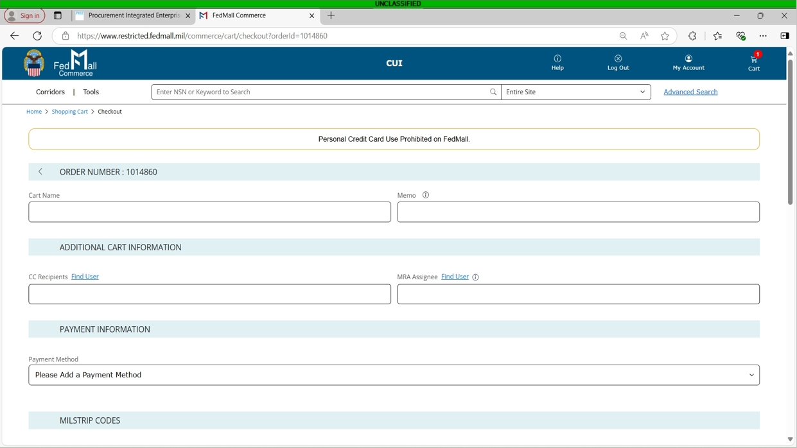
Notes:
Here again, you can put in a cart name or internal memo as well as designate CC recipients. You will also select your payment method that we set up earlier.

Slide 15
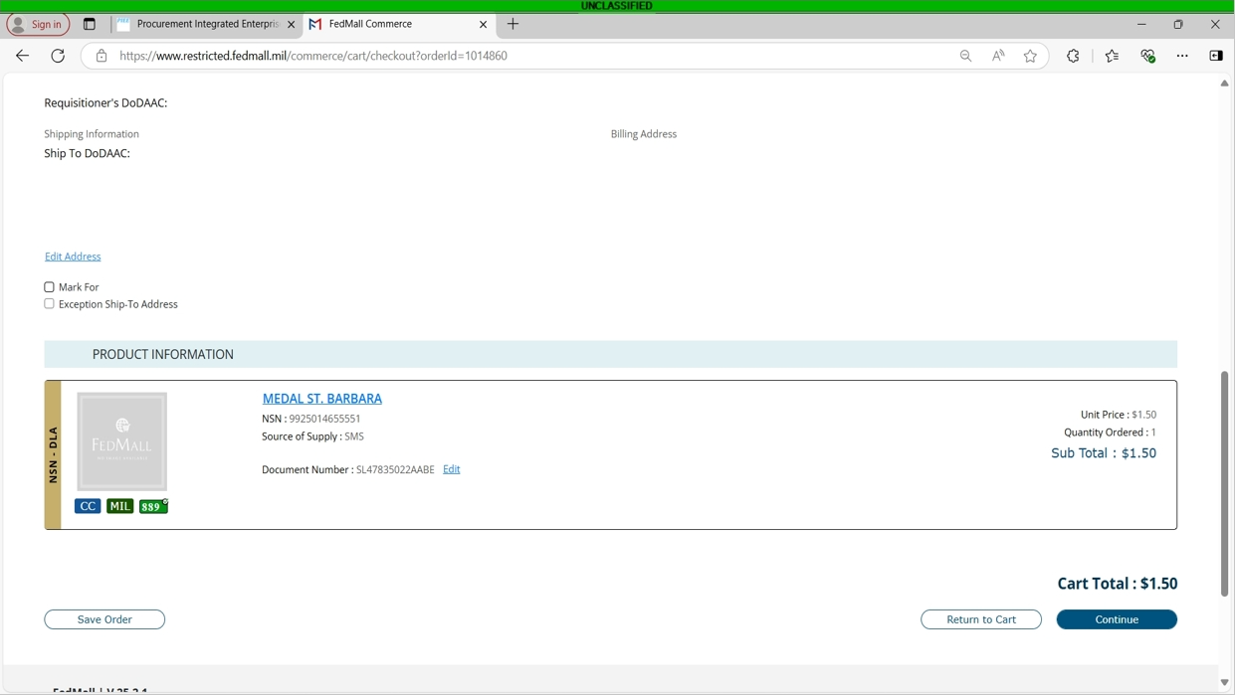
Notes:
If you scroll to the bottom, you will see the DoDAAC, shipping information, billing address, product information and cart total. You can edit the address, mark it for a specific recipient, put an exception ship to address, save the order, return to cart, or continue to complete the purchase.

Slide 16
Notes:
Thank you for your attention. If you have any questions, please contact the DLA Office of the Chaplain by emailing DLACHAPLAIN@DLA.MIL

