Slide 1
DoD Supply Discrepancy Reporting Process Review Committee Meeting
Mr. Ben Breen,
DoD Supply Discrepancy Reporting Administrator, Defense Enterprise Data Standards Office (DEDSO)
March 24, 2022

Slide 2
Agenda
DoD SDR PRC Meeting - March 24, 2022
0900-0915 (15 min) | Welcome, Admin, & Introductions Mr. Nelson Alvarez, Acting Division Chief, DEDSO & Deputy Chief Data & Analytics Officer Mr. Ben Breen, DoD Supply Discrepancy Reporting Administrator, DEDSO
0915-0945 (30 min) | WebSDR Metrics Mr. Ben Breen, DEDSO
0945-1000 (15 min) | WebSDR Document Type 5 Storage Quality Control Report Reply Functionality Mr. Ben Breen, DEDSO
1000-1030 (30 min) | Foreign Military Sales Product Quality Deficiency Reporting Mr. Steve Nace, DLA HQ
1030-1115 (45 min) | WebSDR - ADC Implementation Status Review Mr. Ben Breen, DEDSO
1115-1200 (45 min) | Lunch
1200-1245 (45 min) | Army – SDR ADC Implementation Status Review
1245-1330 (45 min) | Navy / USMC – SDR ADC Implementation Status Review
1330-1415 (45 min) | Air Force – SDR ADC Implementation Status Review
1415-1430 (15 min) | Break
1430-1530 (60 min) | DLA / DLA Distribution – SDR ADC Implementation Status Review
1530-1600 (30 min) | Wrap-up/Action Items Mr. Ben Breen, DEDSO
https://www.dla.mil/Defense-Data-Standards/Committees/SDR/
Mr. Ben Breen, DEDSO
DEDSO.SDR@dla.mil
https://www.dla.mil/Defense-Data-Standards/

Slide 3
WebSDR Metrics
Proposed Status Codes
Welcome | WebSDR Metrics | WebSDR Type 5 SQCR Reply | FMS PQDR | ADC Impl. Status - WebSDR | Lunch | Army | Navy & USMC | Air Force | Break | DLA | Wrap-up
Mr. Ben Breen, DEDSO
DEDSO.SDR@dla.mil
https://www.dla.mil/Defense-Data-Standards/

Slide 4
WebSDR Metrics
Proposed Status Codes to Define Current Status of SDR
Open/Awaiting Disposition | Status Code: | 1
Interpreted to mean that no disposition/status reply codes have posted or a reply was used to indicate forwarding or interim response Valid Submission Type 00 (Original) – initially sets status = 1 upon record creation
Open/Awaiting Reconsideration | Status Code: | 2
Valid Submission Type 15 (Reconsideration)
Open/Awaiting Second Reconsideration | Status Code: | 3
Valid Submission Type 50 (Contested)
Open/Awaiting Disposition after Follow-up | Status Code: | TBD
Valid Submission Type 45 (Follow Up) First, Second, Third Follow up status and calculate days
Validated/Disposition Provided | Status Code: | 4
Interpreted to mean that an SDR reply from shipper or the ICP has been provided Valid 11 reply codes of 100/200 series (except 103,104,107,108) Valid 11 with 600s except 601 Calculate the 00 date, from the validated disposition date and determine if response falls within standard response timeframe 504/Reconsideration will not reset the date of creation of the SDR for response time
Welcome | WebSDR Metrics | WebSDR Type 5 SQCR Reply | FMS PQDR | ADC Impl. Status - WebSDR | Lunch | Army | Navy & USMC | Air Force | Break | DLA | Wrap-up
Mr. Ben Breen, DEDSO
DEDSO.SDR@dla.mil
https://www.dla.mil/Defense-Data-Standards/

Slide 5
WebSDR Metrics
Proposed Status Codes to Define Current Status of SDR
SDR Cancelled by Initiator | Status Code: | 5
Valid Submission Type 01 (Cancellation)
SDR Denied | Status Code: | 6
Interpreted to mean that an SDR reply with one of the following reply codes has been posted Valid Submission Type 11 (Reply) With 200-Series Discrepancy Code(s) With 700-Series Discrepancy Code(s) With 800-Series Discrepancy Code(s) With 900-Series Discrepancy Code(s) exception (936,937)
ILCO Rejection | Status Code: | 7
Valid Submission Type 44 (ILCO Rejection)
SDR Closed – CN Closure | Status Code: | TBD
Valid Submission Type CN (Closure Notification) Calculate the time from the validated 11 response, with when the CN sent If SCC is J/K DSS has 30 days to send CN, and 3 days for SCC L
SDR Closed – Info Only | Status Code: | TBD
Valid Submission Type 00 (Original) With an Action Code “1H” With an Action Code “3B”
Welcome | WebSDR Metrics | WebSDR Type 5 SQCR Reply | FMS PQDR | ADC Impl. Status - WebSDR | Lunch | Army | Navy & USMC | Air Force | Break | DLA | Wrap-up
Mr. Ben Breen, DEDSO
DEDSO.SDR@dla.mil
https://www.dla.mil/Defense-Data-Standards/

Slide 6
WebSDR Metrics
Proposed Status Codes to Define Current Status of SDR
SDR Open – Interim Response Provided | Status Code: | TBD
11 with 103, 520, 519, 521 104 and get a 321- calculate this time, should not exceed 30 days 608 with 320- calculate this time, should not exceed 30 days
SDR Closed - Invalid | Status Code: | TBD
Invalid Submission Type 00 (Original) No valid Submission Type 00 (Original) (should we exclude these from metrics entirely)
?
Questions?
Welcome | WebSDR Metrics | WebSDR Type 5 SQCR Reply | FMS PQDR | ADC Impl. Status - WebSDR | Lunch | Army | Navy & USMC | Air Force | Break | DLA | Wrap-up
Mr. Ben Breen, DEDSO
DEDSO.SDR@dla.mil
https://www.dla.mil/Defense-Data-Standards/

Slide 7
WebSDR Document Type 5
Storage Quality Control Report (SQCR) Reply Functionality
Welcome | WebSDR Metrics | WebSDR Type 5 SQCR Reply | FMS PQDR | ADC Impl. Status - WebSDR | Lunch | Army | Navy & USMC | Air Force | Break | DLA | Wrap-up
Mr. Ben Breen, DEDSO
DEDSO.SDR@dla.mil
https://www.dla.mil/Defense-Data-Standards/

Slide 8
WebSDR Document Type 5
SQCR Reply Functionality
SDR replies are used to pass pertinent information from the SDR action activity to the SDR initiator and other interested parties.
Typical Disposition instructions would provide the following:
  Repackaging disposition instructions
  Interim status requesting more information
  Disposition instructions for discrepant materiel
  Disposition instructions to upgrade material
Welcome | WebSDR Metrics | WebSDR Type 5 SQCR Reply | FMS PQDR | ADC Impl. Status - WebSDR | Lunch | Army | Navy & USMC | Air Force | Break | DLA | Wrap-up
Mr. Ben Breen, DEDSO
DEDSO.SDR@dla.mil
https://www.dla.mil/Defense-Data-Standards/
Notes:
just copy over a few WebSDR TRN slides on how to do a reply and we just need to add Type 5 Screen shots, I can help with this, should only be about 5-8 slides for whole brief since we can copy the existing WebSDR TRN slides but just need to use Type 5 screen shots.

Slide 9
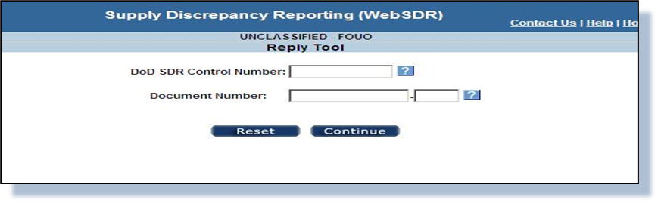
WebSDR Document Type 5
SQCR Reply Functionality (con’t)
Action Activity Response
Log into https://www2.transactionservices.dla.mil , select “WebSDR”
From the side menu, select “Reply to an SDR” to prepare a reply to an SDR you have received for action.
Using the document number or SDR control number, locate the SDR record.
Welcome | WebSDR Metrics | WebSDR Type 5 SQCR Reply | FMS PQDR | ADC Impl. Status - WebSDR | Lunch | Army | Navy & USMC | Air Force | Break | DLA | Wrap-up
Mr. Ben Breen, DEDSO
DEDSO.SDR@dla.mil
https://www.dla.mil/Defense-Data-Standards/

Slide 10
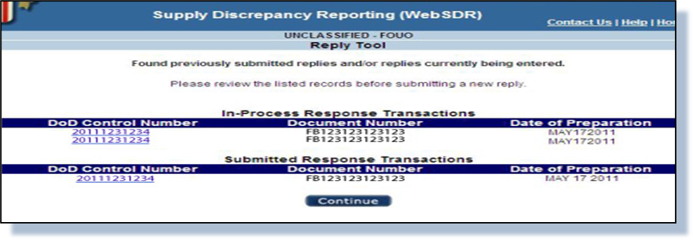
WebSDR Document Type 5
SQCR Reply Functionality (con’t)
Select the appropriate SDR from the list provided and click continue. (If you are not sure which SDR is needed, select the hyperlink to view the entire SDR record).
Welcome | WebSDR Metrics | WebSDR Type 5 SQCR Reply | FMS PQDR | ADC Impl. Status - WebSDR | Lunch | Army | Navy & USMC | Air Force | Break | DLA | Wrap-up
Mr. Ben Breen, DEDSO
DEDSO.SDR@dla.mil
https://www.dla.mil/Defense-Data-Standards/

Slide 11
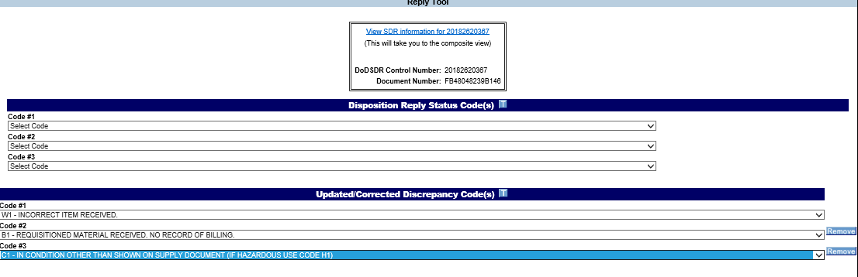
WebSDR Document Type 5
SQCR Reply Functionality (con’t)
Select at least one disposition reply code to assign to the discrepancy report.
Note: Discrepancy code(s) are pre-filled from the original SDR as reported by the submitter.
Welcome | WebSDR Metrics | WebSDR Type 5 SQCR Reply | FMS PQDR | ADC Impl. Status - WebSDR | Lunch | Army | Navy & USMC | Air Force | Break | DLA | Wrap-up
Mr. Ben Breen, DEDSO
DEDSO.SDR@dla.mil
https://www.dla.mil/Defense-Data-Standards/

Slide 12
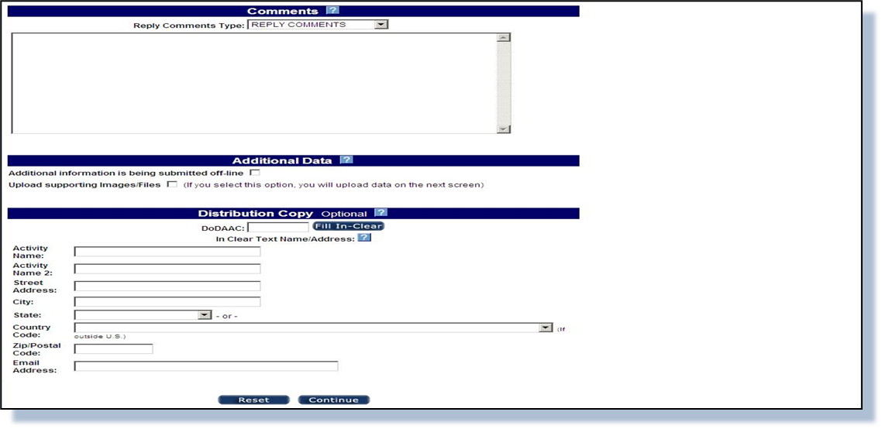
WebSDR Document Type 5
SQCR Reply Functionality (con’t)
Use the “Comments” section to provide clarification for disposition instructions such things as ship-to address or to indicate that images, files or supporting documents are being provided offline.
Welcome | WebSDR Metrics | WebSDR Type 5 SQCR Reply | FMS PQDR | ADC Impl. Status - WebSDR | Lunch | Army | Navy & USMC | Air Force | Break | DLA | Wrap-up
Mr. Ben Breen, DEDSO
DEDSO.SDR@dla.mil
https://www.dla.mil/Defense-Data-Standards/

Slide 13
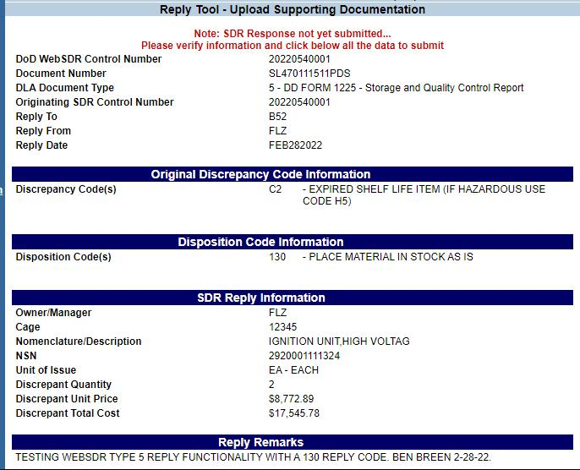
WebSDR Document Type 5
SQCR Reply Functionality (con’t)
The response action is still not completed until you click on “SUBMIT.”
Confirmation is then provided to the responder.
Welcome | WebSDR Metrics | WebSDR Type 5 SQCR Reply | FMS PQDR | ADC Impl. Status - WebSDR | Lunch | Army | Navy & USMC | Air Force | Break | DLA | Wrap-up
Mr. Ben Breen, DEDSO
DEDSO.SDR@dla.mil
https://www.dla.mil/Defense-Data-Standards/

Slide 14
WebSDR Document Type 5
SQCR Reply Functionality (con’t)
?
Questions?
Welcome | WebSDR Metrics | WebSDR Type 5 SQCR Reply | FMS PQDR | ADC Impl. Status - WebSDR | Lunch | Army | Navy & USMC | Air Force | Break | DLA | Wrap-up
Mr. Ben Breen, DEDSO
DEDSO.SDR@dla.mil
https://www.dla.mil/Defense-Data-Standards/

Slide 15
Foreign Military Sales (FMS)
Product Quality Deficiency Reporting (PQDR)
Steve Nace
Sub-process Owner, PQDR
March 24, 2022

Slide 16
Background
2008
WebSDR and PDREP interface for FMS quality reporting
2012
842P IC for PQDR data exchange
(ADC 1007)
2014
DoD supply community meet to discuss FMS quality reporting background/issues
2020
AFSAC Reports quality reporting issue by customer to DLA
/
DLA conducts an internal review of the FMS PQDR reporting process
2021
DoD PQDR/SDR policy representatives meet to discuss FMS
2022
DoD SDR/PQDR policy members agree to standardize SDR/PQDR reporting
FMS PQDR Reporting Timeline
Welcome | WebSDR Metrics | WebSDR Type 5 SQCR Reply | FMS PQDR | ADC Impl. Status - WebSDR | Lunch | Army | Navy & USMC | Air Force | Break | DLA | Wrap-up
Mr. Steve Nace, DLA HQ, Sub-process Owner, PQDR
Steven.Nace@dla.mil

Slide 17
FY2021 FMS PQDR
Assessment
Assessment of FMS Quality Deficiency Reporting
Supply Discrepancy Report (SDR) and PQDR policy are both conflicting and unclear on how FMS quality reporting is to be conducted
There is no standardization with how ILCOs report quality related SDRs (sometimes as SDR sometimes as PQDR)
There is no standardization for how the DoD supply activities are investigating FMS quality related SDRs
SDR systems were not designed to capture the same investigative information as SDRs, causing frustration for FMS customers
SDR reporting has a limit on the amount of days that an SDR must be reported in, while the PQDR process does not
Welcome | WebSDR Metrics | WebSDR Type 5 SQCR Reply | FMS PQDR | ADC Impl. Status - WebSDR | Lunch | Army | Navy & USMC | Air Force | Break | DLA | Wrap-up
Mr. Steve Nace, DLA HQ, Sub-process Owner, PQDR
Steven.Nace@dla.mil

Slide 18
DoD SDR/PQDR Policy Positions
DoD SDR/PQDR Policy Representative Concur to Standardized Reporting with the Following Comments
  FMS quality deficiencies reporting through an established PQDR reporting system pending full implementation of DLMS 842P
    Final 842P Implementation pending PDC 1007E – PDC nearing completion
  This change will not affect the process partner nations use to submit their findings.
  The new language will clearly state that the timeframe for PQDR submission remains 12 months – current allowable timeframe for SDR submissions (Requirement per DSCA General Counsel).
  ILCOs receive formal training prior to go-live reporting through PQDR processing systems
Welcome | WebSDR Metrics | WebSDR Type 5 SQCR Reply | FMS PQDR | ADC Impl. Status - WebSDR | Lunch | Army | Navy & USMC | Air Force | Break | DLA | Wrap-up
Mr. Steve Nace, DLA HQ, Sub-process Owner, PQDR
Steven.Nace@dla.mil

Slide 19
Next Steps Towards Standardization
Publications and Issuance Updates
  DoDM 4140.01-V5
  DLM 4000.25, Volume 2, Chapter 17
  DLM 4000.25, Volume 2, Chapter 24
    DLMS 842P Implementation Convention FMS Requirements
  DSCA Manual 5105.38-M (SAMM)
  DLAR 4155.24/AR 702- 7/SECNAVINST 4855.21/AFI 21-115/DCMA INST 305
DLMS 842P Implementation
  Publish and program PQDR processing systems IAW ADC 1007E
PQDR Training
  Conduct formal training to support ILCOs PQDR processing
DoD PQDR Steering Committee Expansion
  Formally invite ILCOs to participate in recurring PQDR policy meetings
Welcome | WebSDR Metrics | WebSDR Type 5 SQCR Reply | FMS PQDR | ADC Impl. Status - WebSDR | Lunch | Army | Navy & USMC | Air Force | Break | DLA | Wrap-up
Mr. Steve Nace, DLA HQ, Sub-process Owner, PQDR
Steven.Nace@dla.mil

Slide 20
Welcome | WebSDR Metrics | WebSDR Type 5 SQCR Reply | FMS PQDR | ADC Impl. Status - WebSDR | Lunch | Army | Navy & USMC | Air Force | Break | DLA | Wrap-up
Mr. Steve Nace, DLA HQ, Sub-process Owner, PQDR
Steven.Nace@dla.mil

Slide 21
WebSDR
SDR ADC Implementation Status Review
Welcome | WebSDR Metrics | WebSDR Type 5 SQCR Reply | FMS PQDR | ADC Impl. Status - WebSDR | Lunch | Army | Navy & USMC | Air Force | Break | DLA | Wrap-up
Mr. Ben Breen, DEDSO
DEDSO.SDR@dla.mil
https://www.dla.mil/Defense-Data-Standards/

Slide 22
Lunch Break
Welcome | WebSDR Metrics | WebSDR Type 5 SQCR Reply | FMS PQDR | ADC Impl. Status - WebSDR | Lunch | Army | Navy & USMC | Air Force | Break | DLA | Wrap-up
https://www.dla.mil/Defense-Data-Standards/

Slide 23
Army
SDR ADC Implementation Status Review
Welcome | WebSDR Metrics | WebSDR Type 5 SQCR Reply | FMS PQDR | ADC Impl. Status - WebSDR | Lunch | Army | Navy & USMC | Air Force | Break | DLA | Wrap-up
https://www.dla.mil/Defense-Data-Standards/

Slide 24
Navy/USMC
SDR ADC Implementation Status Review
Welcome | WebSDR Metrics | WebSDR Type 5 SQCR Reply | FMS PQDR | ADC Impl. Status - WebSDR | Lunch | Army | Navy & USMC | Air Force | Break | DLA | Wrap-up
https://www.dla.mil/Defense-Data-Standards/

Slide 25
Air Force
SDR ADC Implementation Status Review
Welcome | WebSDR Metrics | WebSDR Type 5 SQCR Reply | FMS PQDR | ADC Impl. Status - WebSDR | Lunch | Army | Navy & USMC | Air Force | Break | DLA | Wrap-up
https://www.dla.mil/Defense-Data-Standards/

Slide 26
Break
Welcome | WebSDR Metrics | WebSDR Type 5 SQCR Reply | FMS PQDR | ADC Impl. Status - WebSDR | Lunch | Army | Navy & USMC | Air Force | Break | DLA | Wrap-up
https://www.dla.mil/Defense-Data-Standards/

Slide 27
DLA / DLA Distribution
SDR ADC Implementation Status Review
Welcome | WebSDR Metrics | WebSDR Type 5 SQCR Reply | FMS PQDR | ADC Impl. Status - WebSDR | Lunch | Army | Navy & USMC | Air Force | Break | DLA | Wrap-up
https://www.dla.mil/Defense-Data-Standards/

Slide 28
Wrap-up
Action Items
Closing remarks
Upcoming PRC Meetings:
  Supply PRC
    July 2022
    December 2022
  Supply Discrepancy Reporting (SDR)
    October 2022
  Finance
    May 4, 2022
    November 2022
Welcome | WebSDR Metrics | WebSDR Type 5 SQCR Reply | FMS PQDR | ADC Impl. Status - WebSDR | Lunch | Army | Navy & USMC | Air Force | Break | DLA | Wrap-up
Mr. Ben Breen, DEDSO
DEDSO.SDR@dla.mil
https://www.dla.mil/Defense-Data-Standards/

Slide 29
Thank You

