Slide 1
DoD Supply Discrepancy Reporting Process Review Committee Meeting
22-2
Mr. Ben Breen,
DoD Supply Discrepancy Reporting Administrator, Defense Enterprise Data Standards Office (DEDSO)
November 15, 2022

Slide 2
Agenda
DoD SDR PRC Meeting - November 15, 2022
0900-0915 (15 min) | Welcome, Admin, & Introductions Mr. Ben Breen, DoD Supply Discrepancy Reporting Administrator, DEDSO Mr. Nelson Alvarez, Acting Division Chief, DEDSO & Deputy Chief Data & Analytics Officer Ms. Jan Mulligan, Director of Supply ODASD (Logistics)
0915-1100 (1hr 45 min) | Custodial Receiving Mr. James Weiner, DLA HQ
1100-1110 (10 min) | Break
1110-1155 (45 min) | Return of Material Related to Constructed Document Numbers DLMS Change (ADC) 1411 Mr. Steve Nace, DLA HQ
1145-1200 (15 min) | Wrap Up
https://www.dla.mil/Defense-Data-Standards/Committees/SDR/
Mr. Ben Breen, DEDSO
DEDSO.SDR@dla.mil
https://www.dla.mil/Defense-Data-Standards/

Slide 3
Custodial Receiving
Jim Weiner
DLA Receiving Program Manager
November 15, 2022

Slide 4
DLA’s Role in DOD Logistics
DLA initially was assigned the role of SS&D for DoD wholesale operations as a result of DRMD-902 in the early 1990’s. Subsequently BRAC 2003 assigned DLA to certain retail functions. All in support of our customers in DoD as well as other Government Agencies.
As a result, DLA receives, stores, and issues many items across a multi-customer base every day.
This presentation is focused on the initial receipt of goods into the DLA system in an auditable environment. Two challenges exist
    Shipment Preparation
    Electronic (Systemic) notification of the inbound delivery (DLMS 527D/856_)
The goal is to improve the receiving program/process for DoD agencies and other Government Agencies, a win-win for all.

Slide 5
Shipment Preparation Processes
DoD Regulation(s)of the shipment preparation process is that the shipment is to be prepared so that the recipient can clearly define
  the intent of the shipment
  The item(s) contained in the shipment
  and the Owner’s account the item is to be posted to
To Achieve this, the following is required
  Use of the DLMS 527D Due-in prior to shipment, and use of the DLMS 856_ at time of shipment
  Proper inclusion of documentation as instructed by MIL-STD 129 (copy of the document on the exterior, as well as inside the package for containers, and for items not in containers, fixed to the item.
  Markings/Item identification labels on the item and packaging as instructed in MIL-STD 129
Lack of any of these actions, results in frustrated shipments, receipt errors, increased cost and financial policy violations.
Receiving STARTS at SHIPMENT Preparation

Slide 6
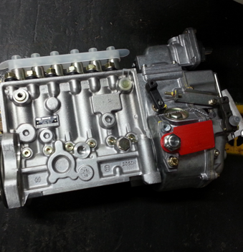
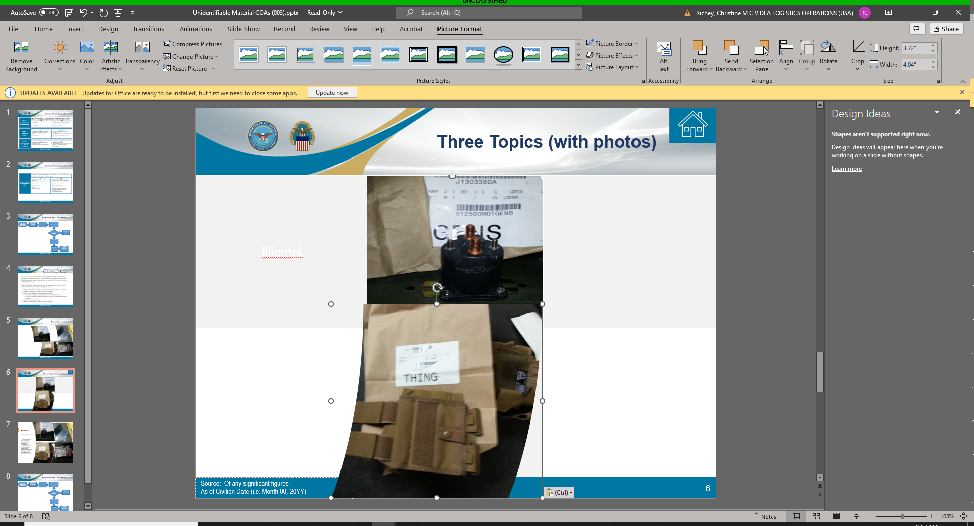
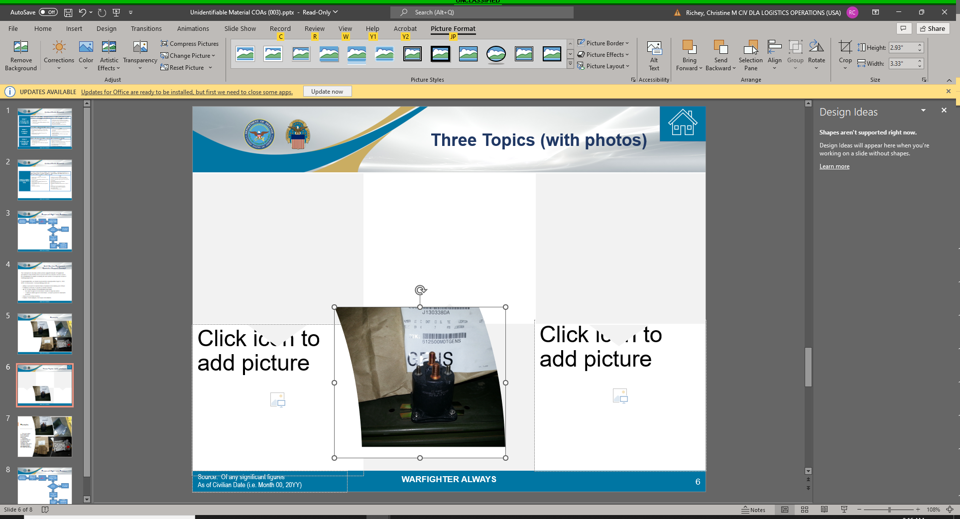
Improper Shipment Preparation Examples- Unidentifiable Items
Actual items received by DLA without paperwork, or item identification Markings
DLA unable to identify items after research (internet queries and standard DoD item data repositories)

Slide 7
Improper Shipment Preparation Examples- Systemic 527D
We evaluated the volume of the systemic 527D – Materiel Due in systemic transactions, which is invaluable to post ownership of an item received. Although we received a 527D overall in excess of 90% of the time, the financial value of items received without a 527D was 16.1 Billion USD (FLIS Value)
This places ALL of DoD at risk for Anti Deficiency Act violations!!!
Customer | PMR Status
 | No PMR | No PMR $ Value | PMR | PMR %
AIR_FORCE | 56,537 | $6.2B | 474,594 | 89.4%
ARMY | 49,062 | $5.8B | 190,989 | 79.6%
COAST_GUARD | 27 | $0.02B |  | 0.0%
DLA | 62,024 | $0.56B | 767,656 | 92.5%
GSA | 376 | $0.003B | 16 | 4.1%
MARINE | 4,294 | $0.2B | 197,688 | 97.9%
NAVY | 33,329 | $3.3B | 264,198 | 88.8%
OTHER | 1,324 | $0.002B |  | 0.0%
Grand Total | 206,973 | $16.1B | 1,895,141 | 90.2%

Slide 8
Improper Shipment Preparation Examples- Systemic 856_
We evaluated the volume of the systemic 856_ – Advanced Shipment Notification (ASN) systemic transactions, which is invaluable to post specific information of an item received. These transactions are invaluable to validate Unique Item Tracking items, Controlled items, as well as tracking information etc…
The 856 ASN is an integral part of the receiving process, without this transaction, we lose a lot of valuable data and for certain items, must expend additional resources to process. This decreases efficiency and accuracy and increases audit risk.
Total Quantity of Receipts
FY22
SERVICE | New Procurement |  |  | Non-Procurement
 | No ASN | ASN | ASN% | No ASN | ASN | ASN%
AIR_FORCE | 8,260 | 3,891 | 32.0% | 115,980 | 492,457 | 80.9%
ARMY | 8,485 | 9,726 | 53.4% | 6,828 | 245,137 | 97.3%
COAST_GUARD | 0 | 1 | 100.0% | 0 | 26 | 100.0%
DLA | 352,142 | 54,311 | 13.4% | 236,878 | 344,410 | 59.2%
GSA | 0 | 0 | - | 44 | 445 | 91.0%
MARINE | 107 | 22 | 17.1% | 684 | 232,279 | 99.7%
NAVY | 19,326 | 2,256 | 10.5% | 55,243 | 263,304 | 82.7%
OTHER | 0 | 952 | 100.0% | 11 | 609 | 98.2%
Grand Total | 388,320 | 71,159 | 15.5% | 415,668 | 1,578,667 | 79.2%

Slide 9
Conceptual Improvements- Proposal
We have determined based on our analysis, that the 2 focus areas of this effort to improve are
  Unidentifiable items,
  and items without a systemic 527D/856_.
For the Unidentifiable items, the concept we feel has the most promise to pursue is a to develop unique Local Stock Numbers based on item type, and post to a holding account.
Develop Distribution Generic LSN(s) and a Holding RIC to identify the workflow (for certain time period). Once identified, items leave the holding RIC and post to the appropriate RIC or sent to Disposal.
Pros
Opportunity to research and properly identify item
Quantity of unidentifiable material on hand can be tracked
Avoids costs for material that can’t be ordered/acted upon
Can leverage current SMS auto disposal process
Improves Auditability
Cons
Additional costs for receipt and storage (unknown unit cost, back-bill proper owner)
Need for dedicated resource(s) with technical knowledge
Requires assistance from Services
Requires Services buy-in
Decision to dispose on Distribution in lieu of ICP
WMS has no auto disposal process
Not fiscally responsible to dispose of serviceable items
DLA absorbs disposal cost

Slide 10
Conceptual Improvements- Proposal(continued)
For the items without a systemic 527D/856, the concept we feel has the most promise to pursue is a to post to a holding RIC.
The holding RIC will allow for our customers to identify their items and claim via a 527D.
We also believe for customers without the capability to transmit 527D transactions, a web-based application can be leveraged to transmit the transaction, effectively providing the accountable transaction we desire to offset financial pitfalls and improve DoD’s audit posture.
We are still working thru how to account for the suspense RIC, which is a temporary place to record assets until their supported financial posting is determined.
If items are not claimed in each rolling time period (proposed 30 days post receipt) the DLA system can develop the capability to dispose of unclaimed items or post to the PICA , and the generator DODAAC will be billed for the processing charges.
The intent here is for generators of shipments destined to an entity responsible for multiple accounts to ensure prior to shipment, a 527D is present to avoid surcharges, improving DoD audit and processing cost reductions for all agencies.

Slide 11





Basic Concept
Inter-service support network of specialists to help identify items
Establish a DoD network of experts to identify materiel
  Potential to account for material that is frustrated immediately
  post offload.
Army
Marines
DLA
  Timeframe for identification and claim (30, 45, 60 day)
Navy
Air Force
  Enables trend analysis and root cause remediation
Coast Guard
Next Step: Present to DoD SDR Committee (Nov 15, 2022)

Slide 12
Next Steps-Way Ahead
Based on what we have discussed, do we have proponent level support to work together to work on solutions to the issues presented?
What we feel we need:
Policy adjustments
  Logistics
  Finance
Operational adjustments
  Shipment Preparation
  Receipt Processing
Systemic Adjustments
  DLMS Compliance
  Web Based App support
Questions?

Slide 13
Wrap up
Thank you all for giving me the opportunity to present this concept for your consideration.
Hopefully, I have at a minimum, gained your agencies interest, as this single process known as Shipment Preparation is essential to our operations moving forward in the DoD Audit world we live in today.
Only together can we reap the benefits of this, we see the benefits by far outweigh the level of effort to incorporate the process into our standard business models.
Without a unified commitment, we are destined to remain as we are, vulnerable to failures, which will eventually result in greater costs to the agencies than acting now.
Warfighter Always
Questions?

Slide 14
Returns of Materials Related to Constructed Document Numbers
Steve Nace, Sub-Process Owner, DLA Product Quality Deficiency Reporting
November 15, 2022

Slide 15



Background
ADC 1411 removed the ability to provide credit/materiel replacement when referencing a constructed document number.
Since ADC 1411 Implementation, there have been increased requests to return materiel upon completion of quality related investigations
Increased requests prompted questions on three focus areas
Materiel Return Request
Transportation Cost Responsibility
Disposal Cost Responsibility
Briefer: Steve Nace
DoD Component: DLA Logistics Operations

Slide 16
Questions #1
Should we include a change that requires the originator of a SDR or PQDR to inform the action activity of whether they want the material returned upon completion of the investigation?
Briefer: Steve Nace
DoD Component: DLA Logistics Operations

Slide 17
Component Responses to Question #1
Army PQDR Community: Final disposition of the material would most likely depend upon PQDR investigation findings. However, YES, the originator should be offered the return of their material.
USASAC (FMS SDRs): Yes, however most of the time when a quality SDR is submitted country requests disposition instructions and credit.
Navy SDR/PQDR: Yes, the Originator shall have the option to request their exhibit returned upon completion of investigation, even if the exhibit cannot be repaired or replaced.
Marine Corps PQDR: Yes they should request to have equipment sent back. Sometimes the service will decide to DRMO the equipment instead of it being sent back to them.
Air Force SDR: Yes.
DLA SDR/PQDR: Yes. The entity that submitted the SDR or PQDR should provide this information up front as part of the initial SDR/PQDR submission
Briefer: Steve Nace
DoD Component: DLA Logistics Operations

Slide 18
Question #2
Who should be responsible to pay for return shipping?
Briefer: Steve Nace
DoD Component: DLA Logistics Operations

Slide 19
Component Responses to Question #2
Army PQDR Community: Given DLA had requested the material for the PQDR investigation, then DLA should pay for its return.
USASAC (FMS SDRs): FMS uses transportation reimbursements (information attached). According to the attachment- Reimbursements to the FMS customer will be paid from the FMS Transportation Account (L009) and PC&H Account (L081).
Navy SDR/PQDR: If the Action Point determines they are not the crediting activity agrees there is a discrepancy and requests the exhibit for repair or replacement, the Action Point will handle the shipping charges to receive the exhibit, to ship exhibit to/from the vendor, and to ship the exhibit back upon Originators request.
Marine Corps PQDR: Source of supply or the person who made error. User fault Vs. Manufacturer
Air Force SDR: After the investigation as mentioned in question 1.A, the responsible and/or at fault party should be responsible to pay for the return shipping..
DLA SDR/PQDR: This should be dependent on who was responsible for the defect.
Briefer: Steve Nace
DoD Component: DLA Logistics Operations

Slide 20
Question #3
Who should be responsible to pay for disposal, and should that responsibility change depending on question number 2?
Briefer: Steve Nace
DoD Component: DLA Logistics Operations

Slide 21
Component Responses to Question #3
Army PQDR Community: Given DLA had requested the material for the PQDR investigation, then DLA should pay for disposal of any material not returned to the originator.
USASAC (FMS SDRs): The customer is responsible for local disposals will receive a 5% of the discrepant value back.
Navy SDR/PQDR: If the Action Point determines they are not the crediting activity, but the Action Point wants the material back in order to return the material to the vendor for repair or replacement, the Action Point will handle the shipping charges and disposal charges.
Marine Corps PQDR: Could change depending on fault. User vs. Manufacturer. Unit providing disposition instructions. Service is if it is end of life.
Air Force SDR: As to the same effect at question 2 above, the responsible and/or at fault party should be responsible for paying for disposal fees.
DLA SDR/PQDR: The same as question two above, where the responsible party for the defect pays for the disposal.
Briefer: Steve Nace
DoD Component: DLA Logistics Operations

Slide 22
Constructed Requisition Number Breakdown (CY2022)
Out of 3,517 PQDRs received by DLA (open and closed reports) this CY, only 174 (~5%) reference a constructed document in reporting.
Out of 1156 PQDRs completed by DLA as vendor non-compliance this CY, only 92 of those referenced a constructed document number.
Out of 225 PQDRs completed by DLA as procurement being the responsible for the defect this CY, 0 referenced a constructed document number.
Out of 51 PQDRs completed by DLA as the using activity being responsible for the defect this CY, only 10 referenced a constructed document number.
Briefer: Steve Nace
DoD Component: DLA Logistics Operations

Slide 24
ADC 1411
Discontinue Credit/Replacement for Constructed Document Numbers
Welcome | WebSDR Metrics | WebSDR Type 5 SQCR Reply | FMS PQDR | ADC Impl. Status - WebSDR | Lunch | Army | Navy & USMC | Air Force | Break | DLA | Wrap-up
Mr. Ben Breen, DEDSO
DEDSO.SDR@dla.mil
https://www.dla.mil/Defense-Data-Standards/

Slide 25
WebSDR Document Type 5
SQCR Reply Functionality (con’t)
?
Questions?
Welcome | WebSDR Metrics | WebSDR Type 5 SQCR Reply | FMS PQDR | ADC Impl. Status - WebSDR | Lunch | Army | Navy & USMC | Air Force | Break | DLA | Wrap-up
Mr. Ben Breen, DEDSO
DEDSO.SDR@dla.mil
https://www.dla.mil/Defense-Data-Standards/

Slide 26
Wrap-up
Action Items
Closing remarks
Upcoming PRC Meetings:
  Supply PRC
    January 2023
    December 2022
  Supply Discrepancy Reporting (SDR)
  Finance
    November 2022
Welcome | WebSDR Metrics | WebSDR Type 5 SQCR Reply | FMS PQDR | ADC Impl. Status - WebSDR | Lunch | Army | Navy & USMC | Air Force | Break | DLA | Wrap-up
Mr. Ben Breen, DEDSO
DEDSO.SDR@dla.mil
https://www.dla.mil/Defense-Data-Standards/

Slide 27
Thank You

