Slide 1
DoD Supply Discrepancy Reporting Process Review Committee Meeting
Mr. Ben Breen,
DoD Supply Discrepancy Report Administrator, Defense Enterprise Data Standards Office (DEDSO)
November 29, 2023

Slide 2
Agenda SDR PRC Meeting – November 29, 2023
0900-0915 (15 min) | Welcome, Admin, & Introductions Mr. Ben Breen, DoD Supply Discrepancy Report Administrator, DEDSO Ms. Sarah Winegardner Director, DEDSO Ms. Jan Mulligan, Director of Supply ODASD (Logistics)
0915-0930 (15 min) | Overview of ADC 1240 Official Appointment letters and Response Matrix Mr. Ben Breen, DEDSO
0930-1015 (45 min) | WebSDR SDR Status Codes Mr. Ben Breen, DEDSO
1015-1045 (30 min) | WebSDR API Future Initiatives Mr. Sean Humenansky, DAAS
1045-1115 (30 min) | DEDSO Overview of DLA Service Portal and DEDSO Request Ms. Amy Zink, DEDSO
1115-1145 (30 min) | DEDSO Overview of DoD Data Dictionary Ms. Amy Zink, DEDSO
1145-1200 (15 min) | Closing comments/Action Items Mr. Ben Breen, DEDSO

Slide 3
Approved DLMS Change 1240A
Mr. Ben Breen,
DoD Supply Discrepancy Reporting Administrator, Defense Enterprise Data Standards Office (DEDSO)
November 29, 2023

Slide 4
ADC 1240A
This change requires DoD Components to appoint designated Process Review Committee (PRC)/Working Group (WG) representatives using official correspondence on Service/Agency letterhead.
DEDSO will retain official Letters of Appointment and review them annually to validate accuracy of primary and alternate appointments. When an appointment assignment changes, the Service/Agency is required to submit a new officially signed letter to the DEDSO designating the new representative(s).
This change also requires DoD Components to respond to requests for formal review of PDCs by using the comment matrix.

Slide 6
WebSDR Metrics and Proposed Status Codes
Mr. Ben Breen,
DoD Supply Discrepancy Report Administrator, Defense Enterprise Data Standards Office (DEDSO)
November 29, 2023

Slide 7
WebSDR Metrics Proposed Status Codes to Define Current Status of SDR

Slide 8
WebSDR Metrics Proposed Status Codes to Define Current Status of SDR

Slide 9
WebSDR Metrics Proposed Status Codes to Define Current Status of SDR

Slide 11
DAAS WebSDR API Modernization
Mr. Sean Humenansky
Defense Automatic Address System November 29, 2023

Slide 12
WebSDR / DAAS API
As part of the overall DLA efforts for modernization, WebSDR is pursuing API options for external customers
Initial API project – Attachment Requests
SDR team has had preliminary discussions with the DAAS API team in October 2023 and is also getting access to the DAAS API environment
Attachment delivery can be affected by various issues upstream. Allow end-systems to request missing attachment files from WebSDR
Rest API POST request initiated to WebSDR. Delivery through existing DAAS GEX Attachment transmission processes
Instead of attempting to cover every scenario, allow end-systems when the attachment is needed or missing, ask for it via an API call

Slide 13
WebSDR / DAAS API
Other potential API options
Transactional Processes
Instead of a complete 842 A/R transaction, only a small set of that info is needed to trigger events
842 A/R – Disposition Code 936 – Request for Original
842 A/R – Disposition Code 504 – Forwarding of SDR
Information Requests/Queries
WebSDR Control Number – send system control number and get back the WebSDR control number
SDR Status – get WebSDR status for an SDR by control number
Reporting Options
Expanding canned reports into real-time on-demand data calls with varying data constraints

Slide 15
DLA Service Portal DEDSO Request
Ms. Amy Zink
Data Standards and Implementation Administrator,
Defense Enterprise Data Standards Office (DEDSO)
November 29, 2023

Slide 16
DEDSO New Support Request Process
New DEDSO Request Process launch early CY24 in DLA Service Portal
Defense Logistics Management Standards Request Tile in the Portal will support:
Requests for Training
Requests for Change (PDC Process)
Requests for Information

Slide 17
DEDSO New Support Request Process
Why a Defense Logistics Management Standards Request Tile?
Improve project tracking
Provide better project coverage
Enable strategic prioritization
Help DEDSO get the resources it needs to provide you with timely, effective support!

Slide 18
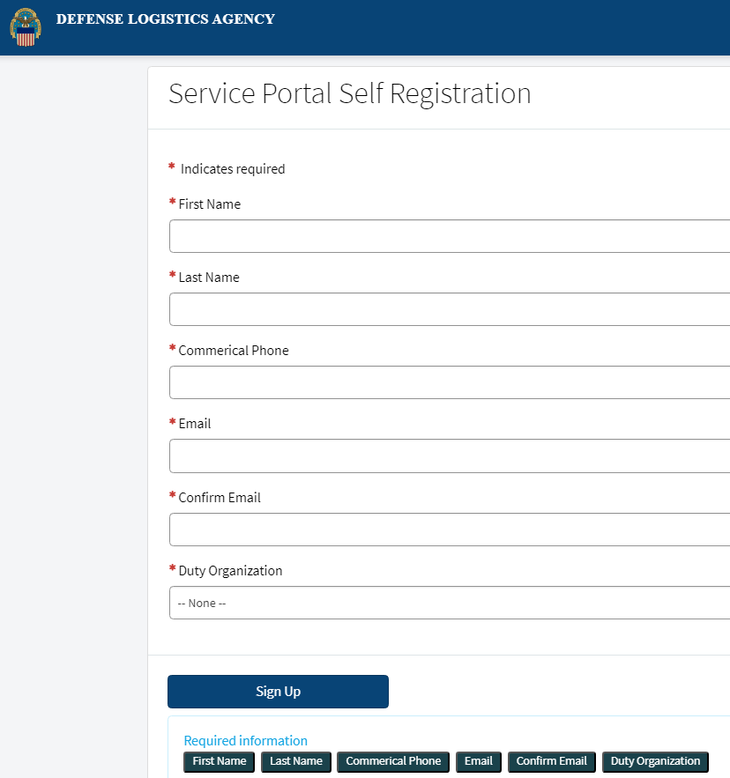
DLA Service Portal Account Access
Register for a DLA Service Portal Account
User Registration - Defense Logistics Agency (servicenowservices.mil)
Contact DEDSO if you have any issues registering (amy.zink@dla.mil)

Slide 19
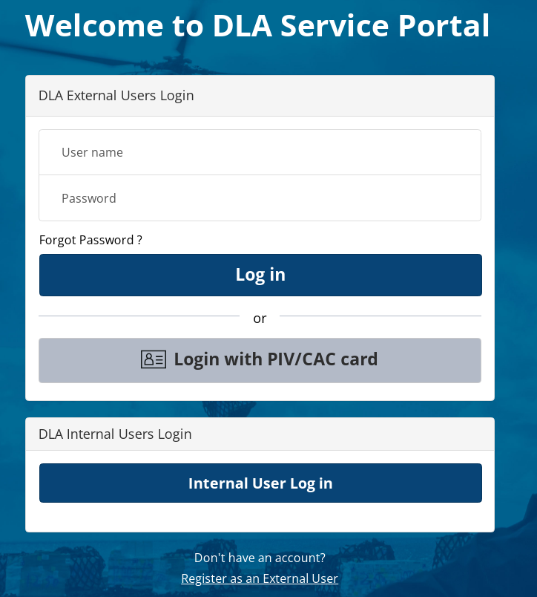
DLA Service Portal Access
Detailed instructions, training, and support for accessing the Defense Logistics Management Standards Tile will be provided to the PRC community prior to and with deployment
ITSM Landing Page - Defense Logistics Agency (servicenowservices.mil)

Slide 21
DoD Supply Data Dictionary
Ms. Amy Zink
Data Standards and Implementation Administrator,
Defense Enterprise Data Standards Office (DEDSO)
November 29, 2023

Slide 22
Data Dictionary
DoD Supply Data Dictionary
DEDSO definition
Scope
Methodology
Way Ahead

Slide 23
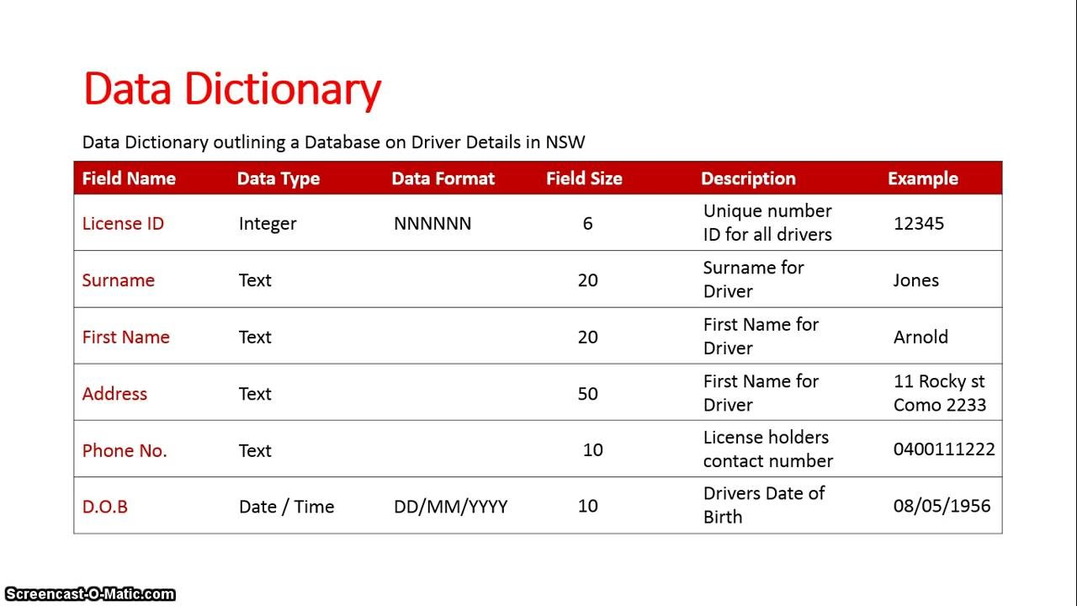
Data Dictionary
DEDSO’s definition:
Uses business terms
Utilizes a standard naming convention for the data elements
Provides information on data elements
Identifies Authoritative Data Sources
Remains system agnostic
Example:
23
Notes:
We don’t need their system information. This is system agnostic

Slide 24
Scope
Primary Areas – basis of data dictionary
Secondary Areas

Slide 25
Methodology
Road to a Data Dictionary
Analyze Data Elements
Inventory Data Elements
Validate Results
FEEDBACK
FEEDBACK
FEEDBACK
Review element
Shared elements
Validate with steward
Next Steps
Code list/ meta data
Element steward
Harmonize across DoD
Peer dictionaries
Validate metadata
Define Core
Authoritative source
Define metadata

Slide 26
Way Ahead
What we need from the SDR/PQDR PRC
Review the DoD Data Dictionary
https://www.dla.mil/Portals/104/Documents/DLMS/Committees/DD/DEDSO_Data_Dictionary.xlsx
Provide input to DEDSO
The Data Dictionary is system agnostic
Suspense Date
January 19, 2024
Contact DEDSO if you would like a walkthrough meeting (DEDSODD@dla.mil)
Notes:
Provide what’s wrong, right, missing, extraneous. This is only version 1.0

Slide 28
Closing Comments/Action Items
Action Items
Closing remarks
Upcoming PRC Meetings:
ADC 1244B January 17th, 2024
Supply PRC- March 20th, 2024

