Slide 1
Joint Supply and
Finance 23-2 Process Review Committee Meeting
Defense Enterprise Data Standards Office (DEDSO)
July 19, 2023, 0900-1230

Slide 2
Agenda
0900-0915 | Welcome, Admin, & Introductions Ms. Sarah Winegardner, Director, DEDSO / Dr. Lindsey Saul, Chief Data & Analytics Officer, DLA J6/ Ms. Jan Mulligan, ODASD Logistics/ DPC/Comptroller DEDSO Administrators / Supply, Dr. Gail Fuller & Mr. Rafael Gonzalez / Finance, Mr. Nolan Davis
0915-0945 | Army ADC 1244B Implementation Status
0945-1000 | DLA ADC 1244B Implementation Status
1000-1015 | USMC ADC 1244B Implementation Status
1015-1045 | Navy ADC 1244B Implementation Status
1045-1100 | USAF ADC 1244B Implementation Status
1100-1115 | Break – 15 Minutes
1115-1130 | Ms. Fatimah Ajadi, OSD Comptroller
1130-1145 | Ms. Gail Bruss, GSA
1145-1215 | Ms. Wendy Villaman, DLA Finance J8G
1215-1245 | Mr. Eric Flanagan, DLA J341
1245-1300 | Wrap-up Dr. Gail Fuller / Mr. Rafael Gonzalez / Mr. Nolan Davis, DEDSO Administrators
Supply/Finance Teams, DEDSO
As of July 19, 2023, Office DLA Slide

Slide 3
DoD Supply (ADC 1244B Implementation)
Process Review Committee Meeting
Dr. Gail Fuller & Mr. Rafael Gonzalez DEDSO Administrators
Supply/Finance Teams, DEDSO
As of July 19, 2023, Office DLA Slide

Slide 4
ADC 1244B Implementation Status- Army
01JUN23
Complete GCSS-A analysis
Complete Army LLASIE testing
Complete Army analysis on generating automated small arms shipment follow-ups
Provide other Services API technical documentation
Validate 30-character serial number impacts on registry
DoD has requested all Army Components provide their latest implementation efforts for Process Review Change (PRC) Approved DLMS Change (ADC) 1244B Establishing Visibility of Unique Item Tracking Program Items for Component-Owned Assets Stored at DoD Storage Activities and Corresponding Revisions to the Small Arms and Light Weapons Program
The Army concurs with the changes in ADC 1244B will help streamline current practices and reduce duplication of efforts within the DoD and continue to make plans to update our logistics sustainment support system
LMP initial analysis has identified no coding effort to implement 1244B and will support any required trader partner testing. Further information on ownership requirements needed pending meeting with DEDSO (Raphael)
GCSS-A analysis in process
AESIP Hub
  LLASIE in testing – APSR API build documentation in process.
  Will implement any DLMS mapping identified by GCSS-A analysis
Updating Army and DoD polices
  Approved Defense Logistics Management Standard Change, ADC 1244B, Signed April 22, 2022
    Retire the DoD Small Arms Registry and require Service API creation based on Army specification.
    Future of Army UIT programs under review
Setting timelines of new operational policies, dates TBD (dependent on bullet above)
EX. 710- 3
While not in 1244B, the system generation of follow-ups on open shipments needs to exist in G-Army and LMP. The Small Arms Registry today manually follows up on open small arms shipments but with registry sunset this assistance will go away. The initial feedback from G-Army and LMP is that the systems do auto-generated follow ups for open requisitions but NOT open shipments. This requirement is not Small Arms specific.
For Material Receipt Acknowledgement, MRA, the receiving activity has 5 days to process the receipt, 12 days for OCONUS. After that, the shipper sends one or more follow-ups until the MRA is received. These requirement need to be implemented in 1244B ASAP.
Supply/Finance Teams, DEDSO
As of July 19, 2023, Office DLA Slide

Slide 5
ADC 1244B Implementation Status- Army
18 July 2023
DoD has requested all Army Components provide their latest implementation efforts for Process Review Change (PRC) Approved DLMS Change (ADC) 1244B Establishing Visibility of Unique Item Tracking Program Items for Component-Owned Assets Stored at DoD Storage Activities and Corresponding Revisions to the Small Arms and Light Weapons Program
The Army concurs with the changes in ADC 1244B will help streamline current practices and reduce duplication of efforts within the DoD and continue to make plans to update our logistics sustainment support system
LMP initial analysis has identified no coding effort to implement 1244B and will support any required trader partner testing. Further information on ownership requirements needed pending meeting with DEDSO (Raphael)
GCSS-A analysis in process
AESIP Hub
  LLASIE in testing – APSR API build documentation in process.
  Will implement any DLMS mapping identified by GCSS-A analysis
Complete GCSS-A analysis
Complete Army LLASIE testing
Complete Army analysis on generating automated small arms shipment follow-ups
Provide other Services API technical documentation
Validate 30-character serial number impacts on registry- Target date to start work is August 2023.
Updating Army and DoD polices
  Approved Defense Logistics Management Standard Change, ADC 1244B, Signed April 22, 2022
    Retire the DoD Small Arms Registry and require Service API creation based on Army specification.
    Future of Army UIT programs under review
Setting timelines of new operational policies, dates TBD (dependent on bullet above)
EX. 710- 3
While not in 1244B, the system generation of follow-ups on open shipments needs to exist in G-Army and LMP. The Small Arms Registry today manually follows up on open small arms shipments but with registry sunset this assistance will go away. The initial feedback from G-Army and LMP is that the systems do auto-generated follow ups for open requisitions but NOT open shipments. This requirement is not Small Arms specific.
For Material Receipt Acknowledgement, MRA, the receiving activity has 5 days to process the receipt, 12 days for OCONUS. After that, the shipper sends one or more follow-ups until the MRA is received. These requirement need to be implemented in 1244B ASAP.

Slide 6
ADC 1244B Status- DLA Small Arms Team
Jun 30, 2023
- Ensure all the SASP requirements and processes (receipt, storage and issues)
are functioning properly
- DLAI 4140.05 pending signature
- RFC DOF-C22-0087 has been developed for SASP for Disposition Services
- Implementation of DSS/WMS is scheduled for Jan 2024 which is part of DSS
modernization
- 527R is currently being used for serialized assets for the UIT program
- DLA does have functionality related to the 856S and 856R for serialized assets
- Finalizing the RFCs for DLA Distribution and DLA Disposition for ADC 1244B
- Once DLAI 4140.05 is signed this will allow Anniston to receipt New Procurement
weapons expeditiously
- Ensuring that the services have the connectivity with DLA and DPAS for DLMS
changes
- DSS/WMS interacts with LLASIE. Waiting for LLASIE requirements from the
Army
- How to ensure material removed from DSS is properly accounted for in WMS
while being compliant with ADC 1244B
Supply/Finance Teams, DEDSO
As of July 19, 2023, Office DLA Slide

Slide 7
ADC 1244B Implementation Status- USMC
July 19, 2023
Per HQMC, GCSS-MC will to be compliant with ADC 1244B by FY26
Per HQMC, USMC will continue to utilize Crane USMC Component Registry after ADC 1244B goes live
  Populate Marine Corps RICs to UICs in MSADA per eDAASINQ and route questions to SAEA/HQMC.
  Crane Marine Corps Registry Team will formulate processes with HQMC/SAEA guidance for GCSS-MC/MSADA interface
  Crane MC Registry Team assist GCSS-MC Resource Sponsor to ensure programming is compliant with ADC 1244B and all SA/LW policy
  Deploy Crane’s expansion of s/n field from 11 to 30 once other services are ready: Army (in process of validating readiness), Air Force(?), SOCOM(?), DOD overlay file (ticket pending)
Crane obtain access to PDREP and learn how to find SDRs. Discuss with HQMC/SAEA closer to the time need access
Cont. to assist HQMC with GCSS-MC s/n problem (see Challenges).
Is funding for GCSS-MC changes available?
Need API requirements stated within an ADC before funding for API can be requested.
  Need new ATO as required for API.
Programming GCSS-MC to send only INTER-Service transactions via DAAS (not INTRA-Service, within the Marine Corps).
  Associated memory requirement and cost if Intra-Service is incl.
Ensuring implementation of all other ADCs (GCSS-MC & MSADA)
  ADC 1111, 1198, 1198A, 1244, 1244A (listed in 1244B)
  ADCs/PDCs in the Pipeline listed on DEDSO Slide: ADC 1441 and PDCs 1415, 1437, 1431, 1414A, 1422.
GCSS-MC programming has removed non-compliant characters from ALL serial numbers, including weapons not requiring a change by ADC 1244B (not leaving the service). However, the weapons have not been physically re-marked. Crane still reflects correct serial number. USMC has implemented a working group to find viable options to bring APSR, Registry and physical markings into compliance with ADC 1244B.
Any request to not comply with the physical re-marking requirements within ADC 1244B must be obtained via waiver from OSD, not JSALWCG Chair. This includes any serial numbers with markings other than the accepted A-Z, 0-9, dash (-), and forward slash (/) when the item is being transferred from one service to another, unless it is going to DRMO in which case it does not need re-marked.
Supply/Finance Teams, DEDSO
As of July 19, 2023, Office DLA Slide

Slide 8
ADC 1244B Implementation Status- Navy
July 19, 2023
MSADA deemed Navy program of record and is the stated work-around for the Navy until ERP can implement all ADC 1244 Requirements
Test sending 856S to DAAS successful after multiple adjustments
Test sending 527R to DAAS - adjustments still being made
Continue to test 527R being sent to DAAS
Obtain DAAS routing rules from DEDSO in order to begin testing the sending and receiving of 856S & 527R transactions externally
  Complete populating Navy RICs to UICs in MSADA per eDAASINQ if previously unavailable RICs become available
  Deploy Crane’s expansion of s/n field from 11 to 30 once other services are ready: Army (in process of validating readiness), Air Force(?), SOCOM(?), DOD overlay file (ticket pending)
Crane obtain access to PDREP (Product Data Reporting and Evaluation Program) and learn how to find Navy SDRs. Discuss with NAVSUP closer to the time access is needed
Is funding available for ERP changes?
Need API requirements stated within an ADC before API funding can be requested.
  Need new ATO as required for API
Cont. to work with ERP Resource Sponsor to ensure programming is compliant with ADC 1244B and all SA/LW policy, including implementation of all other ADCs (ERP & MSADA)
  Updates from NAVSUP: ADC 1111, 1198, 1198A, 1244, 1244A (listed in 1244B). ADCs/PDCs in the Pipeline listed on DEDSO Slide: ADC 1441 and PDCs 1415, 1437, 1431, 1414A, and 1422.
  DLMS compliance efforts for N-ERP and the MILSTRIP project: Full project to start 01 AUG 2023. Backlog of ADCs will be prioritized. Planned to be a 4-5 year effort with a phased release roll-out, TBD
Programming ERP to send only INTER-Service transactions via DAAS (not INTRA-service, within the Navy)
  Associated memory requirement and cost if Intra-Service is incl.
Physically re-marking weapons that contain non-compliant characters in their current serial number then updating the Navy Registry will not be a challenge as previously thought because most of these weapons are at museums and do not fall under the ADC 1244B requirement to have non-compliant serial numbers removed because they are not moving to another service.
Supply/Finance Teams, DEDSO
As of July 19, 2023, Office DLA Slide

Slide 9
ADC 1244B Implementation Status- USAF
6 July 2023
AF Small Arms Accountability & Visibility
DPAS being utilized as APSR and Serial # Registry
  SA/LWs are accounted for by serial number
  Full visibility/tracking of weapons by organization or AF member and movement of weapons to include deployment status
  GO PDW accounted for and managed via DPAS
  Inventory and reconciliation capability
COMRI tested: successfully passing transactions from DSS (Anniston) to DPAS via DAAS
DPAS Mass Load: 254,638 out of 255769 Anniston records loaded into DPAS Serial number registry--1131 records were already loaded.
DPAS PMO develop process to reconcile weapon serial numbers w/ Anniston and DPAS serial number registry to include mitigation steps to correct errors.
AF currently does not have visibility of SA/LWs stored by DLA at Anniston Army Depot
DLA does not provide the AF direct access to the Small Arms Serialization Program (SASP) module within the Distribution Standard System (DSS)
  Currently only able to track AF weapons stored in Anniston by qty, not serial number
  Inventory validation or reconciliation for these weapons is difficult to perform
AF lacked proper accountability of GO PDW and Anniston stored SA/LWs
Created process for GO PDW within DPAS provided missing visibility/accountability
Though DLA maintains accountability of AF stored SA/LWs, AF needs to also have full visibility to validate inventory and perform reconciliation
Supply/Finance Teams, DEDSO
As of July 19, 2023, Office DLA Slide
Notes:
DPAS PMO develop process to reconcile weapon serial numbers w/ Anniston and DPAS serial number registry to include appropriate access and permissions (Currently SA/LW Office only has View capability), and mitigation steps to correct errors.

Slide 10
DoD Finance Process Review Committee Meeting
Mr. Nolan Davis, DEDSO Administrator
Welcome, Admin, & Introductions
Ms. Sarah Winegardner, Director, DEDSO / Dr. Lindsey Saul, Chief Data & Analytics Officer, DASD Logistics / Ms. Jan Mulligan, DASD Logistics/ODASD Comptroller
DEDSO Administrators / Finance, Mr. Nolan Davis
Supply/Finance Teams, DEDSO
As of July 19, 2023, Office DLA Slide

Slide 11

PRC Conference
Fatimoh Ajadi
July 19, 2023

Slide 12
Agenda
OUSDC G-Invoicing Team
  OUSDC G-Invoicing Team Responsibilities
  OUSDC G-Invoicing Team Initiatives
  What is G-Invoicing
  Intragovernmental Activity
  DoD Component G-Invoicing Implementation Timeline
  IGT Process Areas
  IGT Cross Functional Collaboration
  IGT Partnerships
  Policy Guidance
  Open Audit NFRs/CAPs
  Questions and Answers
  Program Contacts

Slide 13
Who are the OUSDC G-Invoicing Team?
Mr. Edson Barbosa, SES
Ms. Deera Morida, CIV
Ms. Fatimoh Ajadi, CIV
Mr. Michael Shannon, CTR (PT)
Ms. Michelle Davis, CTR
Mr. Dwayne Carter, CTR
Mr. Alex Balm, CTR
(PT)

Slide 14
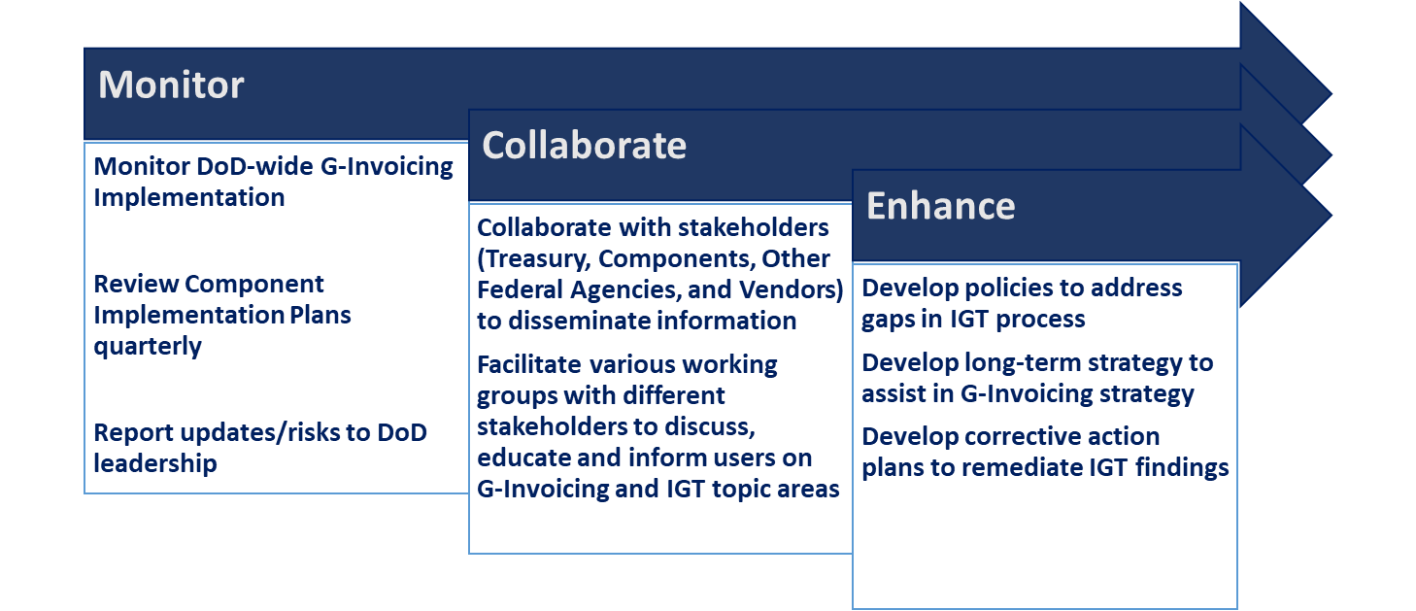
OUSDC G-Invoicing Team Responsibilities

Slide 15
OUSDC G-Invoicing Team Initiatives
Meeting/ Working Group | Purpose
Collaborative Action Working Group (CAWG) | The group is sponsored by OUSD (C) IGT Leads from all organizations and working groups engaged to focus on G-Invoicing development and data standards, timeline and milestones, the status of the implementation, and Treasury and GEX statuses and milestones
Group Systems Implementation Group (GSIG) | The group is sponsored by OUSD (C) Components share information critical to the development and implementation of processes and procedures, highlight key milestones, share and resolve challenges, capture and apply lessons learned, and distribute Treasury data standards and schemas
Trading Partner Working Group (TPWG) | The group is sponsored by OUSD (C) The membership discusses emerging issues and potential solutions to establish policies, processes and procedures to support the implementation of the G-Invoicing tool
Sensitive Activity Working Group (SAWG) | The group is sponsored by OUSD (C) and DFAS. Sensitive Activity leads from all organizations meet to determine a solution for reimbursable buy/sell sensitive activity transactions.
Deferred Payments Accruals Sub Working Group | The group is sponsored by OUSD (C) Members discuss the DoD policy for implementation of G-Invoicing requirements related to Deferred Payment Performance Transactions
G-Invoicing User Forum | The group is sponsored by OUSD (C) Stakeholders of G-Invoicing share implementation experience, lessons learned, and identify additional opportunities for the user community to communicate issues and questions to DoD regarding G-Invoicing.
G-Invoicing Executive Summit | The group is sponsored by OUSD (C) and comprised of Senior leaders within the Military Departments, Defense Agencies, Defense Activities, and Other Defense Organizations implementing IGTs Senior Leaders deliver an executive update on strategy and progress along with a roundtable discussion
CAWG
GSIG
TPWG
G-Invoicing User Forum
G-Invoicing Executive Summit
SAWG

Slide 16
What is G-Invoicing?
G-Invoicing is Treasury owned system to process intragovernmental buy/sell transactions addressing current buy/sell accounting and reporting challenges.
Treasury
G-Invoicing
Common Platform for Brokering all IGT Buy/Sell Activity
Federal IGT Buy/ Sell Data Standard
Common Data Repository of Brokered Transactions

Slide 17
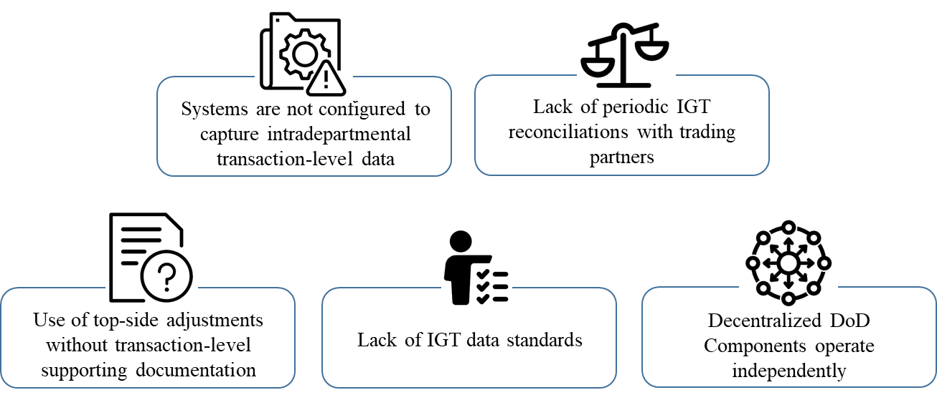
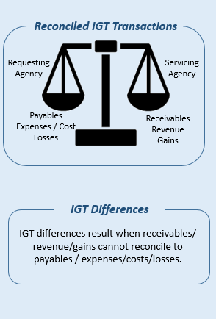
What Problem will it Fix?
Over the past decade, DoD has continued to receive similar IGT findings from the DoD Inspector General and GAO, contributing to the on-going material weakness…

Slide 18
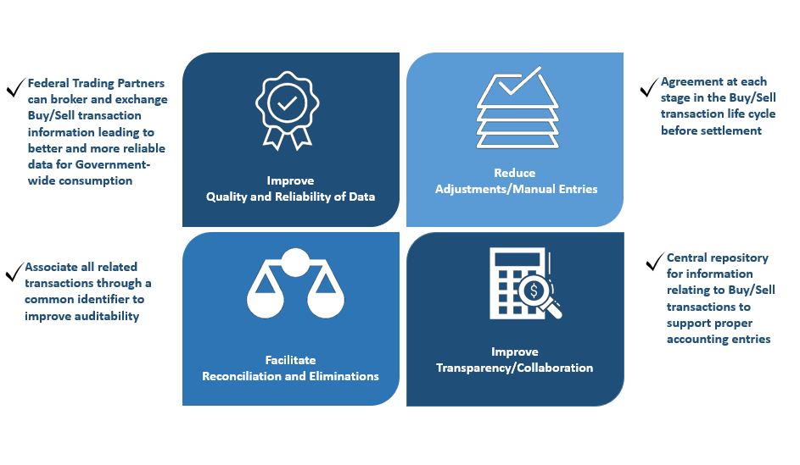
The Benefits of G-Invoicing

Slide 19
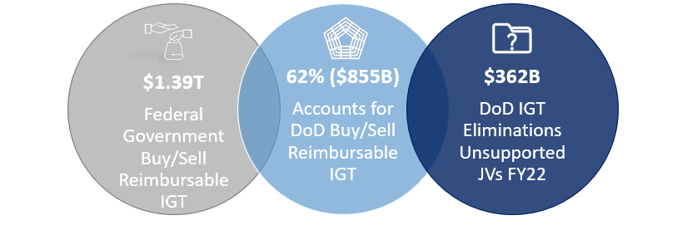
Intragovernmental Activity
There are approximately $1.39 Trillion Buy/Sell reimbursable IGTs throughout the federal government.
62% ($855B) accounts for the DoD's buy/sell reimbursable IGTs activity.
As of FY22 DoD had approximately $362 Billion in unsupported journal vouchers related to IGT eliminations. This has contributed to DoD’s long-standing material weakness related to IGTs.

Slide 20
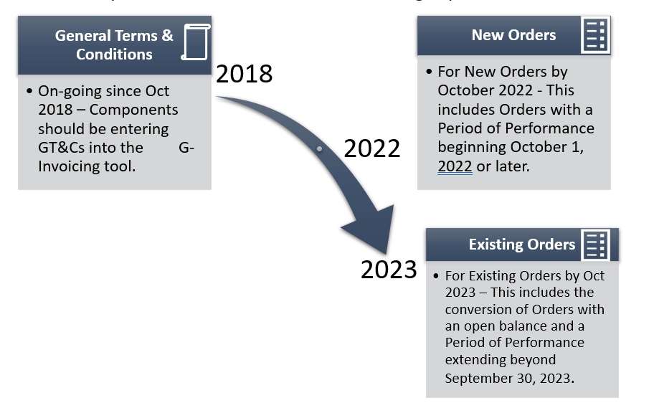



G-Invoicing Treasury Mandate

Slide 21
Component Timeline Snapshot
Key
June 2023
GOTS
SAP
Oracle
System Owner | Processing GT&Cs | Processing Orders | Processing R&A/Invoice | Deployment (New Orders)
Army (GFEBS) | June 2019 | March 2024 | March 2024 | March 2024
Army (LMP) | June 2019 | March 2024 | March 2024 | March 2024
Air Force (DEAMS) | Oct 2019 | April 2024 | April 2024 | March 2024
Air Force (MROi) | Aug 2026 | Aug 2026 | Aug 2026 | Aug 2026
Navy (ERP) | Apr 2019 | Oct 2024 | Oct 2024 | Oct 2024
Navy (CFMS)*** | Apr 2019 | Oct 2024 | Oct 2024 | Oct 2024
DHA-CRM | Oct 2020 | Oct 2023 | Oct 2023 | Oct 2023
DISA-WCF (FAMIS)* | Oct 2020 | Oct 2022 | Oct 2022 | Oct 2022
DLA (EBS) | May 2019 | April 2024 | April 2024 | April 2024
TRANSCOM (TFMS)** | May 2019 | Oct 2022 | Oct 2022 | Oct 2022
USACE (CEFMS) | Dec 2019 | July 2023 | July 2023 | July 2023
DAI System Users (4Th Estate + USMC) | Oct 2019 | Oct 2022 | Oct 2022 | Oct 2022
*Per DISA – These dates are for MIPR-based orders only. Full deployment of Telecom (via DISA sales portal) is Oct 2025.
** Per USTRANSCOM – These dates are for MIPR-based orders only. Other business lines are dependent on MilDeps systems G-Invoicing implementation timeline
***Per Navy schedule - ERP change to go-live to October 1, 2024. However, Navy may not achieve full compliance with G-Invoicing for ALL transactions until Q1 FY25.
CFMS could support intra-departmental IGT Buy/Sell transactions earlier than 10/01/2023. Navy CFMS started its proof-of-concept stage and is expected to proceed through this fiscal year. The reference to Q3 FY2023 in the Attachment A they submitted is that CFMS/SABRS will complete the system enhancements to support more complex RWO Performance transactions (e.g., partial settlement).
*USACE – Not confirmed as of yet.

Slide 22
IGT Buy/Sell Process Areas
IGT Buy/Sell activities are in the Procure to Pay (P2P) business process for Buyer activity and Order to Cash (O2C) business process for Seller activity.
Both P2P and O2C business processes result in accounting events of which must report/post to the Budget to Report (B2R) business process defined by DoD.
IGT Buyer Procure-to-Pay/Order-to-Cash/Budget-to-Report
Procure to Pay
Budget to Report
Buyer
Order to Cash
Budget to Report
Seller

Slide 23
IGT Cross-Functional Collaboration
Contracting & Logistics
Financial Management
G-Invoicing
Acquisition & Sustainment
The G-Invoicing implementation initiative requires cross functional collaboration amongst the members of our contracting and logistics, acquisition and sustainment, and financial management communities to work closely together.

Slide 24
IGT Partnerships
The G-Invoicing implementation and deployment requires partnership OUSD(C) partnership with the Department of the Treasury, DoD Components and ERP Vendors.
DoD OUSDC
DoD Components
Treasury
ERP Vendors

Slide 25
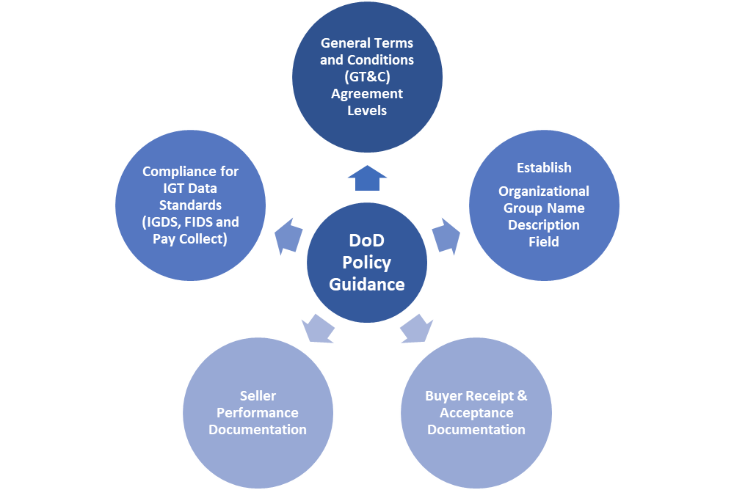
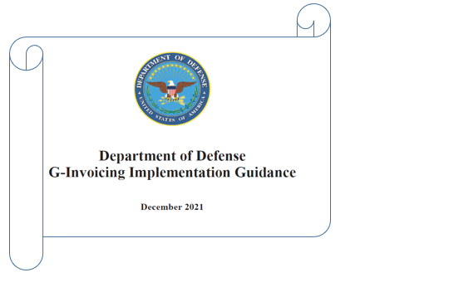
Published Policy Guidance

Slide 26

Policy Guidance In Process
DoD Policy Guidance
Establishment of High-level GT&Cs
Business Rules for FOB Source and Destination in G-Invoicing
Deferred Payments in G-Invoicing
G-Invoicing Constructive Receipt Days

Slide 27
Open Audit NFRs/CAPs
GAO IGT Audit Report 21-84
DoDIG IGT Audit Report 2015-056
DoD-wide NFR IGT NFR AWC-2021-N0036

Slide 28
Questions and Answers

Slide 29
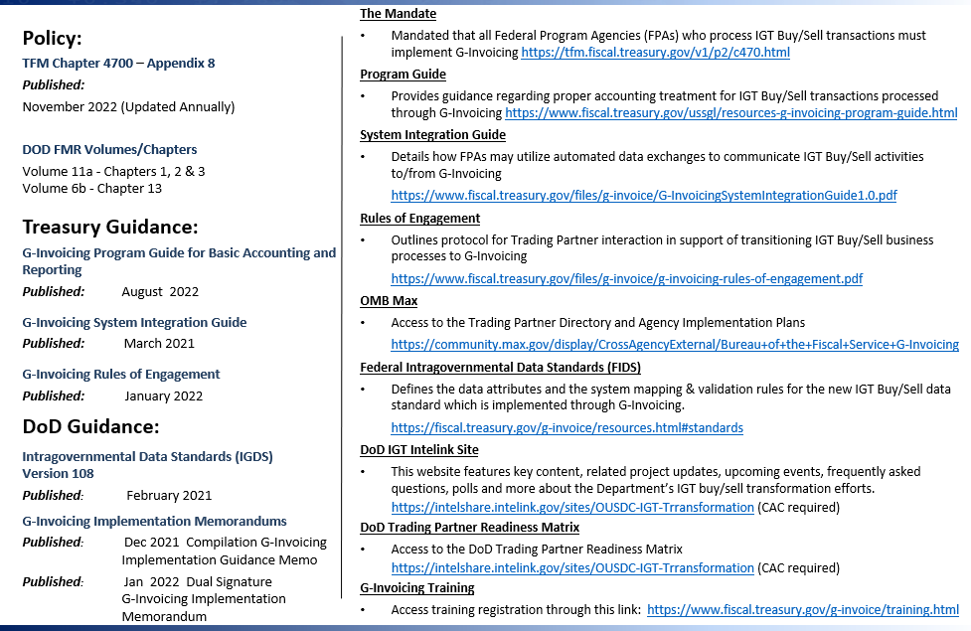
G-Invoicing Reference Material

Slide 30
OUSDC G-Invoicing Program Contacts
Name | Team | E-mail
OUSDC FMPR Team
Ajadi, Fatimoh | OUSDC FMPR G-Invoicing Team | fatimoh.o.ajadi.civ@mail.mil
Davis, Michelle | OUSDC FMPR G-Invoicing Team | michelle.d.davis50.ctr@mail.mil
Carter, Dwayne | OUSDC FMPR G-Invoicing Team | dwayne.d.carter2.ctr@mail.mil
Baum, Alex | OUSDC FMPR G-Invoicing Team | alexander.baum2.ctr@mail.mil
Shannon, Michael | OUSDC FMPR G-Invoicing Team | michael.r.shannon8.ctr@mail.mil

Slide 31
G-Invoicing Implementation at GSA
Presented by:
Gail Bruss
July 19, 2023
Notes:
Comment:
Do we have enough information answering the questions?
What is it?
Who has to use it?
When do they have to use it?
How to get started?
Do we need a “why” slide?

Slide 32
G-Invoicing Timeline
Implementation by business line
AAS
Pilot
Manual Business Lines and GSA as a Buyer
(in progress)
AAS
Pilot
Peg
V8.1
AAS
OPS
Fleet
Rent
PBS
RWA?
Supply: No Date Yet
FY 22
FY 23
FY 24
FY 25
FY 26
Mandate Date
Oct. 1, 2022
Notes:
Acronyms:
AAS - assisted acquisition service,
Peg - GSA’s financial system a momentum product,
AAS OPS - AAS operations - full adoption of G-Invoicing approximate 2,000 orders annually $10B in new work
PBS - GSA’s public Buildings Service,
RWA - reimbursable work authorizations (tenant improvements, utilities, repairs on buildings)
This is a quick, visual depiction of when various GSA programs will be ready for G-Invoicing. Notice in the red vertical line - the mandated date of October 1, 2022. Full implementation of Assisted Acquisition Service (AAS) slipped to FY25. We plan to pilot orders from a few selected customers in the beginning with lots of eyes on the process to ensure interfaces are recording accurately before introducing a large volume introducing a larger volume of orders.
RWA may be delayed pending decision by Treasury on system change request.

Slide 33
GSA - Partially implemented
G-Invoicing works
Approximately 300 GT&Cs.
Over 150 Orders.
Through June G-invoicing transfers:
Collected $49M
Paid $10M

Slide 34
G-Invoicing Workflows
GSA Business Line | Which G-Invoicing workflow | Target Implementation Date
Manual business lines | Mixed: Buyer initiated & Seller facilitated | Live and using G-Invoicing
Assisted Acquisition Service | Buyer Initiated Order | Piloting agreements and orders in FY 24. Fully live in October 2024(FY25)
Fleet Leasing | EZInvoice | April 2025
Fleet Vehicle Purchasing | Seller Facilitated Order | April 2025
Rent | Seller Facilitated w/ COA | April 2025
Reimbursable Work (RWA) | Seller Facilitated Order | Slipping past April 2025
Supply | EZInvoice | TBD
Notes:
Fleet purchasing and supply

Slide 35
Lessons Learned
Know your group name and ASK your trading partner for theirs - don’t guess
Get to know your superuser - who can fix groups
Don't touch the mod button unless you really mean to
  ‘Mod’ takes an order out of open status this causes problems
Fields cannot be edited after performance has been recorded
Be patient, there is a steep learning curve.
  You may need to cooperate with partners to un-do and re-do.
Attend Treasury’s on demand training, then customize training to agency specific requirements.
  Never underestimate a ‘wild’ user’s creative interpretation of the info to enter

Slide 36
G-Invoicing Issues / Challenges
Timing: GSA is dependent on Momentum version 8.1
  Upgrade incorporates three G-Invoicing workflows: Seller facilitated Orders, Constructive Order Acceptance and EZInvoicing
Middleware: All GSA business systems interface into our financial system (Momentum).
  Interfaces and Data exchange files must be updated
  Gap analysis. What data is available from Supply portal?
  Build new reference table to provide G-Invoicing required data

Slide 37
Supply Issues related to G-Invoicing
Treating supply requisitions as interagency agreements would have added additional approvals steps and potential delays - Treasury developed the concept of the 7600EZInvoice
Assumptions for solution
  Customers continue to use same ordering portals
  Average customer has little accounting knowledge
  Data required for 7600EZInvoicing could be derived from a middleware or look up table
GSA is working with DLA and Treasury regarding interfund transactions.

Slide 38
GSA Points of Contact
Name | Email
Gail Bruss | gail.bruss@gsa.gov
General questions | g-invoicing@gsa.gov
Rent | ginvoicing.rent@gsa.gov
Reimbursable work | ginvoicing.rwa@gsa.gov
Fleet questions | gsafleet_g-invoicing@gsa.gov

Slide 39
DLA G-Invoicing Strategic Way Forward
19 July 2023

Slide 40
Agenda
BLUF
Background:
  DLA G-INV Vision
  G-INV System Development Status
Scope 7600B vs. 7600EZ
Sales Order Doc Type Logic
DLA Recommended 7600EZ Way Forward
DLA POC’s
Questions/Feedback
Backup:
  System Requirements Overview

Slide 41
BLUF
US Treasury requires all intragovernmental buy/sell transactions to meet G-Invoicing requirements by October 2022.
  Scope includes:
    MIPR transactions resulting in an IPAC collection/disbursement (typically for services)
    MILSTRIP transactions resulting in an IPAC collection/disbursement (typically for materiel)
    MILSTRIP transactions resulting in an interfund collection/disbursement
    Note: Although DoD has focused only on transactions resulting in an IPAC collection/disbursement, UST has confirmed numerous times the requirement applies to ALL buy/sell transactions (which includes MILSTRIP transactions resulting in an interfund collection/disbursement)
  Bulk IPAC shutdown: October 2025
7600EZ is the optimal way forward for MILSTRIP type transactions
  DoD needs to agree on a high-level implementation strategy
  Partner to design a solution for 7600EZ
  Components needs to implement 7600EZ solution design

Slide 42
DLA G-INV
Vision
  In 5 years*, deliver a reengineered Inbound/Outbound IGT RWO Process, improving improve warfighter support and positioning DLA for audit success
  Key Capabilities:
    Auditability: Improving audit readiness by transitioning existing key controls into more robust systemic controls
    Process Improvement: Allowing DLA to be more efficient and effective through systemic processes
    Innovation: Leading DoD in business transformation to better support the warfighter
  Deliver a cohesive, standard, and consistent system solution from GT&C, through O2C/P2P process, to IPAC settlement
  Serve as the primary voice to internal and external stakeholders of DLA’s RWO Transformation efforts (GT&C, O2C, and P2P)
*IPAC transactions by Oct 2022, Interfund transactions by Oct 2026

Slide 43
G-INV System Development Status
Move to Enterprise Platform – ServiceNow
  Waiting on new J6 Integrator contract (summer 2023 award)
Leverage SAP G-Invoicing Capabilities
  For backend solutions involving EBS
Next Steps
  Post-kickoff, present user stories and process flows with Integrator Agile development team to create WBS with milestone/timelines for multi-wave rollout of a solution
High Level Timeline
  O2C Business Cycle: April 2024
  IPAC settlement of O2C transactions: April 2024
  P2P Business Cycle: September 2024
  O2C 7600 EZ: January 2025
  P2P 7600 EZ: May 2025
  Backlog of ‘Lower Priority’ user experience requirements: October 2025

Slide 44
Scope
7600B vs 7600EZ
7600B Process
(Projected Implementation Date: April 2024)
7600EZ Process
(Projected Implementation Date: May 2025; Subject to ISSWG success)
7600EZ Process
(Interfund is outside of DLA’s current scope. Projected Implementation Date is TBD)
“Service” Transactions (and materiel transactions) typically using a “MIPR” resulting in an IPAC Settlement
“Supply” (materiel) Transactions (typically Milstrip XP Fund Code) resulting in an IPAC Settlement
“Supply” (materiel) Transactions (typically Milstrip transactions) resulting in an Interfund collection/disbursement
>10,000 funding documents annually
>$8B
Establish a pot of money used throughout the year
>Millions of requisitions annually
>$4B
One time requisition
>Millions of requisitions annually
>$28B
One time requisition
Dependent upon ISSWG success
Dependent upon ISSWG success
Notes:
ISSWG: Interfund Supply Strategy Working Group
7600EZ Process:
Challenges:
Treasury post mandate implementation (Dec 2022)
7600EZ process Not included in SAP G-Invoicing solution
Working group (ISSWG) meeting to propose common/standard implementation business rules
DEDSO, GSA, Treasury, FLEX Team, DLA
Removal of the DODAAC as a mandatory data element in G-INV

Slide 45
Sales Order Type Logic
MSC | Sales order Type | Description | Category (Material/Service) | 7600B or 7600EZ?*** | System Name
All | CR | Credit Memo Request | Either | Based on Original SO Referenced | EBS
 | DR | Debit Memo Request | Either | Based on Original SO Referenced | EBS
 | OR | Standard Order | Material | 7600EZ | EBS
 | YCR | Credit Memo Req-RRB | Either | Based on Original SO Referenced | EBS
 | YDR | Debit Memo Req-RRB | Either | Based on Original SO Referenced | EBS
 | ZDC | Debit Memo Request | Either | Based on Original SO Referenced | EBS
 | ZFMS | Foreign Military | Material | 7600EZ | MILSTRIP/DAAS
 | ZPNE | Part # Order - EMALL | Material | 7600EZ | FEDMALL
 | ZPNM | Part # Order - MILSTRIP | Material | 7600EZ | MILSTRIP/DAAS
 | ZPPD | Post Post Depot | Materials | 7600EZ | EBS
 | ZRSO | Reimbursable Sales Order - WCF | Services (Storages and distribution, utilities, rent, etc.) | 7600B | EBS
 | ZRTO | Retail STO | Material | 7600EZ
Disposition | ZHAZ | Hazardous Waste | Hazardous Waste Disposal | 7600EZ | HMMS
Document Services (J67) | ZDAP | Shipboard Sales Order | Equipment Leasing/Printing Services | 7600B | EBS
 | ZDCR | DAPS Credit | Printing Services | 7600B | DSO
 | ZEMC | DAPS EMS Credit | Equipment Leasing | 7600B | EBS
 | ZEMS | EMS Sales Order | Equipment Leasing | 7600B | EBS
 | ZGPO | DAPS GPO Order | Printing Services | 7600B | DSO
HQC | ZRSA | Reimbursable Sales Order - Appropriated | Services (IT services, utilities, rent, etc.) | 7600B | EBS
N/A | ZERR | Excess Return Request | N/A | N/A
 | ZEXR | Excess Return | N/A | N/A

Slide 46
Sales Order Type Logic
MSC | Sales order Type | Description | Category (Material/Service) | 7600B or 7600EZ?*** | System Name
Energy | ZASK | Energy Manual Credit Memo Request | Fuels | 7600EZ | EBS
 | ZASL | Energy Manual Debit Memo Request | Fuels | 7600EZ | EBS
 | ZASO | Energy Manual Sales Order | Fuels | 7600EZ | WAWF
 | ZASR | Energy Manual Return Order | Fuels | 7600EZ | EBS
 | ZEAO | Exch. Agreement Sales Order | Fuels | 7600EZ | EBS
 | ZEAR | Exch. Agreement Returns Order | Fuels | 7600EZ | EBS
 | ZEAX | Exch. Agreement Sales Reversal | Fuels | 7600EZ | EBS
 | ZPAO | Upload Program Sales Order | Fuels | 7600EZ | EBS
 | ZPBK | Automated CD Reversal Credit | Fuels | 7600EZ | EBS
 | ZPCO | Card Program Sales Order | Fuels | 7600EZ | EBS
 | ZPDO | FEA Sales Order | Fuels | 7600EZ | EBS
 | ZPEK | Card Program Credit Memo Request | Fuels | 7600EZ | EBS
 | ZPEO | EEBP Sales Order | Fuels | 7600EZ | EBS -EEBP
 | ZPER | FEA Secondary Return Order | Fuels | 7600EZ | EBS
 | ZPES | FEA Secondary Sale | Fuels | 7600EZ | EBS
 | ZPET | FEA Secondary Sale Reversal | Fuels | 7600EZ | EBS
 | ZPFK | FMD Secondary Sale Credit | Fuels | 7600EZ | FMD
 | ZPFL | FMD Secondary Sale Debit | Fuels | 7600EZ | FMD
 | ZPFO | FMD Sales Order | Fuels | 7600EZ | FMD
 | ZPFR | FMD Returns Order | Fuels | 7600EZ | FMD
 | ZPFX | FMD Sales Reversal | Fuels | 7600EZ | FMD
Troop Support | ZCR | STORES Credit Memo Request | Materials (Subsistence) | 7600EZ | STORES
 | ZFFV | FFAVORS order | Materials (Subsistence) | 7600EZ | FFAVORS
 | ZPPA | AMMA Post Post Issue | Materials (Medical) | 7600EZ | TEWLS
 | ZRTN | Rations order type | Materials (Subsistence) | 7600EZ | STORES
 | ZSTO | STORES Order | Materials (Subsistence) | 7600EZ | STORES
 | ZTVR | TVR Order | Materials (Subsistence, C&E, and Medical) | 7600B or 7600EZ | EBS

Slide 47
DLA Recommended
7600EZ Way Forward
Two step incremental plan for “materiel” transactions:
  Prerequisite - US Treasury actions:
    Remove $10K 7600EZ limitation (Treasury announced approval on July 11, 2023)
    Update TFM to specify 7600EZ limitation removal for “materiel” transactions (Treasury to publish decision in the November TFM bulletin)
  Phase 1 Define 7600EZ Invoice Solution Strategy:
    OUSD Actions:
      Publish 7600EZ mandate requirements and deadline
      Ensure 7600EZ process is part of the ERP Vendor G-Invoicing solution
    Request components:
      Implement DLMS changes (DoDD 8190.01E dated 1/9/2015, revised 12/30/2019)
      Partner to Design & Develop systemic process for 7600EZ for all system interfaces (not just DLMS compliant systems)
        DLMS – FEDMall (MilStrip transactions)
        EDI – Troop Support STORES transactions
        Other System (non-DLMS or EDI) – e.g., Energy Fuel Card Programs
      Implement 7600EZ requirements prior to Oct 2025
  Phase 2 “Front End” remaining solution (worked concurrently with Phase 1):
    OUSD Actions:
      Establish working group with SES Champion and governance process
    Working Group Actions:
      Conduct BPR on the FRONT END of the ordering process to ensure required data elements are exchanged between trading partners to alleviate trading partner audit concerns.
      Achieve solution design consensus for components to implement as close to Oct 2025 as possible
Notes:
Phase 1 Components: (minimum requirements to be able to continue to transact in G-INV)
By implementing DoDD 8190.01E, all automated information systems would be DLMS compliant (and EDI) and would incorporate the DLMS changes to date, moving from the 80 -character data elements to the use of SLOA.
However, the DLMS requirement is a DoD requirement, therefore the components need to partner to design and develop the systemic process for the 7600EZ for not only those DLMS compliant systems, but also for the EDI and other systems to ensure all transactions carry the necessary information to process 7600EZ invoices.
Finally, the requirements need to be implemented before the IPAC shut-off in October 2025 to continue to conduct materiel business transactions
Phase 2:
The proposed working group will identify gaps in the process and/or system solution and develop an approach to resolve those issues that fall outside of the minimum FIDS/IGT data requirements, such as passing back additional fields needed by TP1, interfacing buyer/seller systems for more visibility, status queries, and report generation.

Slide 48
DLA POCs
DLA Business POCs:
  Michael Lane Michael.lane@dla.mil (DLA G-INV PM)
  Wendy Villaman wendy.villaman@dla.mil (DLA G-INV Process Lead)
  Shelly Pond shelly.pond@dla.mil (DLA G-INV Program Lead
DLA Logistics POC:
  Eric Flanagan Eric.Flanagan@dla.mil (DLA Logistics POC (J341))
Defense Enterprise Data Standards Office (DEDSO):
  Edward (Nolan) Davis edward.davis@dla.mil (DEDSO Finance POC)

Slide 49
Questions…?
Feedback…?

Slide 50
Backup Slides

Slide 51
System Requirements Overview
User Stories built from System requirements
NOTE: O2C and P2P User Stories include 7600EZ requirements
Notes:
GT&C=General Terms and Conditions (***Note – process improvements are all DLA Transformation – as the process owner)
O2C=Order to Cash (inbound MIPR)
P2P=Procure to Pay (outbound MIPR)

Slide 52
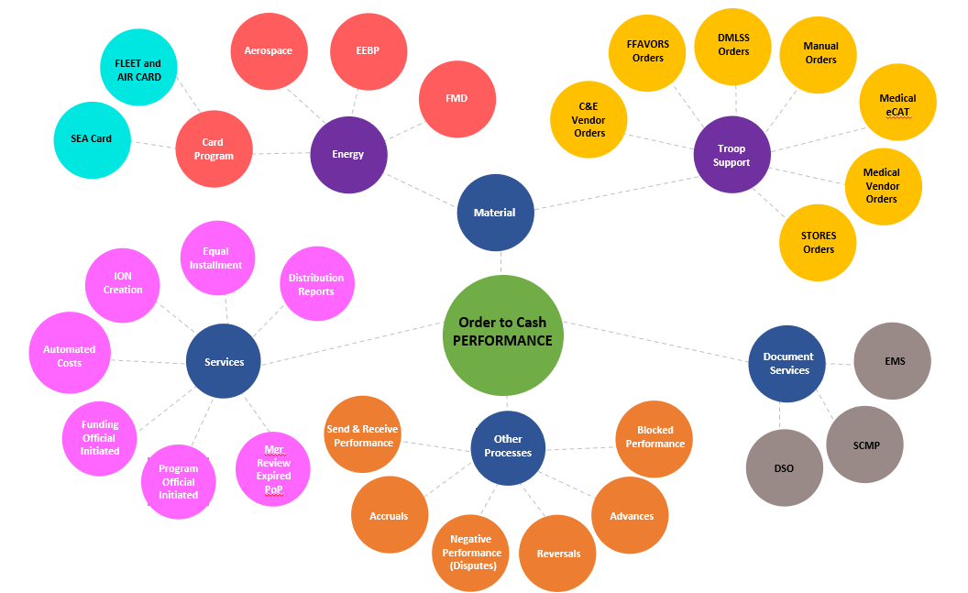
G-Invoicing Scope (for O2C)

Slide 53
G-Invoicing Scope (in total)
Collections
Disbursements
SRM
MIPRs
Outbound
MIPR
Services
FBwT
P2P
Outbound
MIPR
Material
Energy Order Systems
Other
Order Systems
G-Invoicing
Organic Manufacturing
Receipt/ Acceptance
Non-MIPR
IPAC
Orders
O2C
GT&C
Standard
J67
Orders
Inbound
MIPR
Services
Troop Support Order Systems
Overarching
Inbound
MIPR
Material
Standard Orders
HTSA

Slide 55
PDC 1442 Update and 7600EZ Implementation Strategy
Eric Flanagan (DLA)
July 19, 2023

Slide 56
Agenda
SFIS/SLOA Relationship to G-Invoicing
DLMS Support of SFIS/SLOA Compliance
Proposed DLMS Change (PDC) 1442 Update
Application Types and Possible Implementation Strategies

Slide 57
SFIS/SLOA Relationship to G-Invoicing
This section explains the DoD regulations and policy that form the underlying rationale of PDC 1442.

Slide 58
Standard Financial Information Structure (SFIS)
Overview
OUSD(C) released a memorandum titled, “Standard Financial Information Structure (SFIS) Implementation Policy on August 4, 2005.
SFIS is a data structure that supports DoD Financial Statements and requirements for:
  Budgeting
  Financial Accounting
  Cost/Performance
  External Reporting
SFIS requires systems containing financial information to capture and transmit SFIS data or demonstrate a cross-walking capability to the SFIS format.
SFIS Resources:
Homepage: https://comptroller.defense.gov/odcfo/sfis.aspx
SFIS Values Library: https://beis-web.csd.disa.mil/sfis-library/
SFIS Policy Memorandum (2005)
https://comptroller.defense.gov/Portals/45/Documents/ODCFO/SFIS/SFIS_Policy_Memorandum.pdf

Slide 59
DoD Standard Line of Accounting/Classification Memo
Overview: OUSD(C) released a memorandum titled, “Department of Defense Standard Line of Accounting/Classification” on September 14, 2012.
Directed system owners to implement a Standard Line of Accounting (SLOA) to improve financial information, business system interoperability, and provide better end-to-end traceability and linkage between expenditures.
Required DoD Components to submit an initial SLOA implementation plan within 120 days of the memorandum’s date.
Noted that each Component and functional area used different structures to represent the Line of Accounting (LOA), which creates the following problems:
  Errors
  Rejections
  Reconciliation Problems
  Unmatched Disbursements
  Unsupported Eliminations
  Higher costs to develop and maintain interfaces
Department of Defense Standard Line of Accounting/Classification Memorandum (2012)
https://comptroller.defense.gov/Portals/45/Documents/ODCFO/SFIS/SLoA_Accounting_Class_Memo.pdf

Slide 60
SFIS Implementation Approaches
Target Accounting System
Configured to post transactions to an internal USSGL compliant subsidiary or general ledger and does not have a system retirement plan and date.
Legacy Accounting System
Configured to post transactions to an internal subsidiary or general ledger and has a retirement plan and date.
Target Financial Business Feeder System
Does not qualify as a target accounting system and does not have a retirement plan and date.
Creates or processes transactions with financial impacts and exchanges accounting data with another business feeder system(s) and/or accounting system(s).
Legacy Financial Business Feeder System
Does not qualify as an accounting system and has a retirement plan and date.
Creates or processes transactions with financial impacts and exchanges accounting data with another business feeder system(s) and/or accounting system(s).
Includes “emerging” Enterprise Resource Planning (ERP) systems
DoD Financial Management Regulation (FMR),
Volume 1, Chapter 4

Slide 61
Business Systems Financial Interoperability and the Standard Line of Accounting (SLOA)
Overview: OUSD(C) released a memo titled, “Business Systems Financial Interoperability and the Standard Line of Accounting” on August 8, 2020.
Mandated full Department-wide implementation of SLOA by October 1, 2022.
Identifies SLOA implementation as a critical path enabler for several widely accepted enterprise financial management initiatives, including:
  Treasury-Direct Disbursing for daily reporting
  G-Invoicing for intragovernmental transactions
  Procure-to-Pay data exchanges
Required each Component to submit SLOA implementation plans for each financial system in use within 60 days of the memorandum date.
Plans must include all financial and feeder system status, implementation milestones w/dates, and limiting factors.
Stated that constant communication, emphasis, and collaboration to overcome hurdles are needed to achieve SLOA compliance no later than the end of FY 2022.
Business Systems Financial Interoperability and the Standard Line of Accounting” Memorandum (2020)
https://comptroller.defense.gov/Portals/45/Documents/ODCFO/SFIS/Business_System_and_SLOA_Memo-Signed_20200805.pdf

Slide 62
DLMS Support of SFIS/SLOA Compliance
This section explains the approved DLMS changes that support SFIS/SLOA compliance, and how they may enable supply to transition to G-Invoicing.

Slide 63
Approved DLMS Change (ADC) 435
Overview: DEDSO released ADC 435, “DLMS Revisions for Standard Financial Information Structure (SFIS)” on October 3, 2011.
Background: ADC 435 described two concepts for exchanging SFIS data:
Carry all SFIS data in DLMS transactions as discrete data elements
Use referential data exchange as the primary method for acquiring SFIS data elements
The DoD Components and GSA opted for the “referential data” approach
Approved Changes:
Established a “referential data” table called the SFIS Fund Code to Fund Account Conversion Table
Updated applicable DLMS transactions to include the buyer’s Business Partner Number (BPN)
BPN: A unique, 9-character alpha-numeric identifier primarily used to identify buying or selling entities processing intragovernmental transactions.
Federal civilian agencies obtained Data Universal Numbering System (DUNS) numbers from Dun and Bradstreet for use as BPN numbers.
DoD used the Trading Partner Number (TPN) as an equivalent BPN; it consists of the letters “DOD” and the 6-character Department of Defense Activity Address Code (DoDAAC).
ADC 435, “DLMS Revisions for Standard Financial Information Structure (SFIS)” (2011)

Slide 64
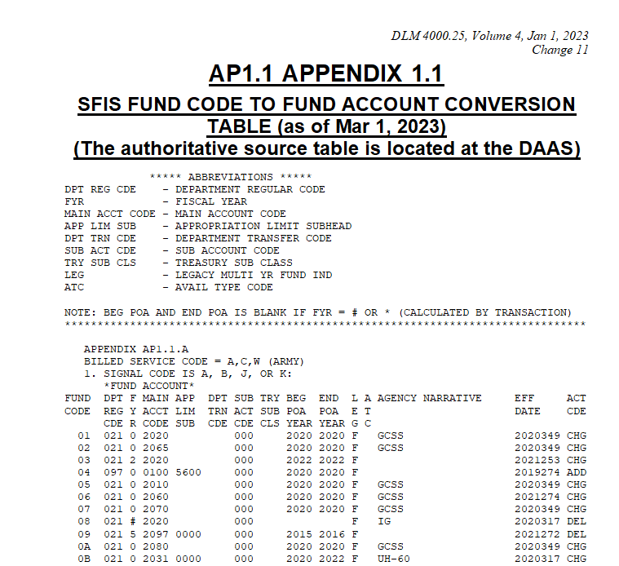
SFIS Fund Code to Fund Account Conversion Table
Explanation: The table links each DoD Component’s fund codes to an associated SLOA.
Each Component uses the Web Fund Code application to manage fund codes assigned to their Service or Agency (S/A) Code.
  For example, Army manages S/A codes A, C, W
  DLA manages S/A codes S and U
If a Component cannot send the SLOA via the DLMS transaction, DAAS extracts it from the fund code and add it to the transaction.
If the supplier cannot receive DLMS, they can pull the fund code/SLOA via a direct interface with DAAS.
https://www.dla.mil/Portals/104/Documents/DLMS/Manuals/DLM/V4/v4a1_01.docx

Slide 65
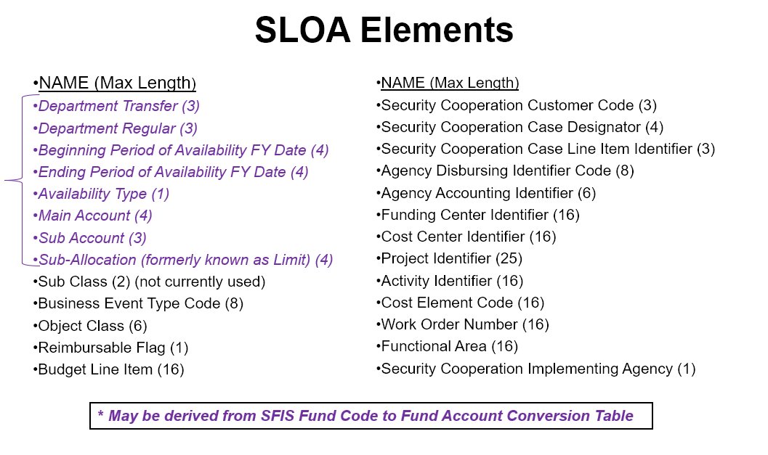
Deriving SLOA Elements from SFIS Fund Code Table

Slide 66
ADC 1043
Overview: DEDSO released ADC 1043, “DLMS Revisions for DoD Standard Line of Accounting (SLOA)/Accounting Classification” (Finance/Supply) on September 18, 2013.
Background: ADC 1043 revised DLMS to carry discrete SFIS data elements to comply with the 2012 SFIS/SLOA memo and the new Treasury Government-Wide Accounting (GWA) requirements.
Approved Changes: ADC 1043 added discrete /SLOA/Accounting Classification data elements to the following DLMS implementation conventions (ICs):
DLMS 511R Requisition
DLMS 511M Requisition Modification
DLMS 869F Requisition Follow-Up
DLMS 517M Materiel Obligation Validation
DLMS 810L Logistics Bill
DLMS 856S Shipment Status
DLMS 867I Issue
DLMS 180M Materiel Returns Reporting
DLMS 940R Materiel Release Order
DLMS 842A/W Supply Discrepancy Report (SDR)
ADC 1043, “DLMS Revisions for DoD Standard Line of Accounting (SLOA)/Accounting Classification” (2013)

Slide 67
Proposed DLMS Change (PDC) 1442 Update
This section provides a high-level conceptual overview of PDC 1442, the current status, and the proposed way-forward.

Slide 68
PDC 1442 Overview
Overview: DEDSO released PDC 1442 on behalf of DLA on December 21, 2023.
The intent of PDC 1442 is to allow supply sources to obtain the required data needed to generate a 7600EZ Invoice through the following changes:
Establish 7600EZ Order Table:
  Provide a table at DAAS to link fund codes to an associated line of accounting that contains the required Federal Intragovernmental Data Standards (FIDS) data elements. (referential data approach)
  Allows Federal Civilian agencies to use fund codes other than “XP.”
Add FIDS Data Elements to DLMS Transactions
  Update DLMS implementation conventions (ICs) to include the required FIDS data elements. (discrete data approach)
  Rename Standard Financial Information Structure (SFIS) data elements to FIDs names and adds FIDS fields not found in the Standard Line of Accounting (SLOA).
Link to PDC: https://intelshare.intelink.gov/sites/dlms/SitePages/PDC.aspx
PDC 1442, “G-Invoicing 7600EZ Order Information” (2022)

Slide 69
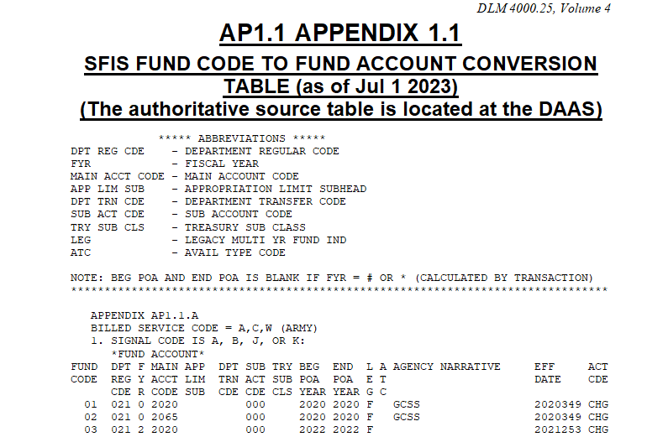
PDC 1442 Fund Code Approach
(SFIS Example)
https://www.dla.mil/Portals/104/Documents/DLMS/Manuals/DLM/V4/v4a1_01.docx

Slide 70
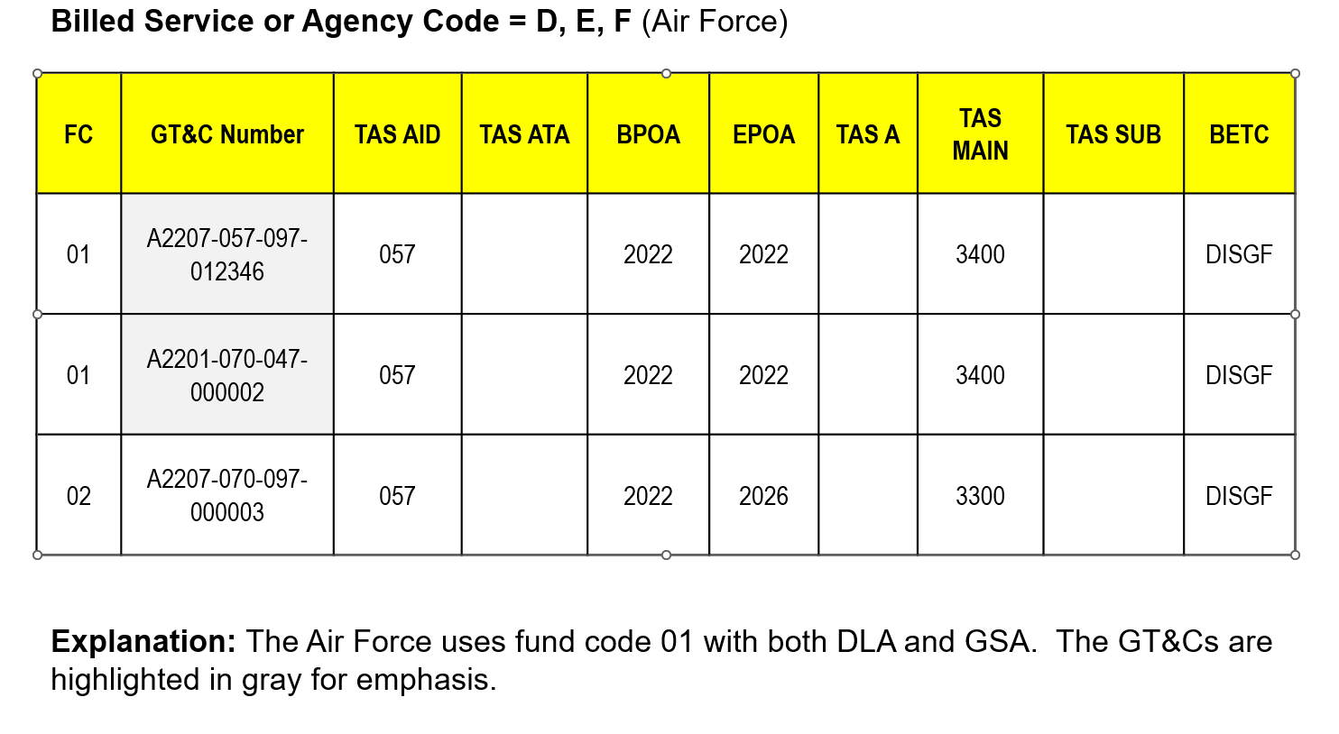
PDC 1442
7600EZ Order Table Concept

Slide 71
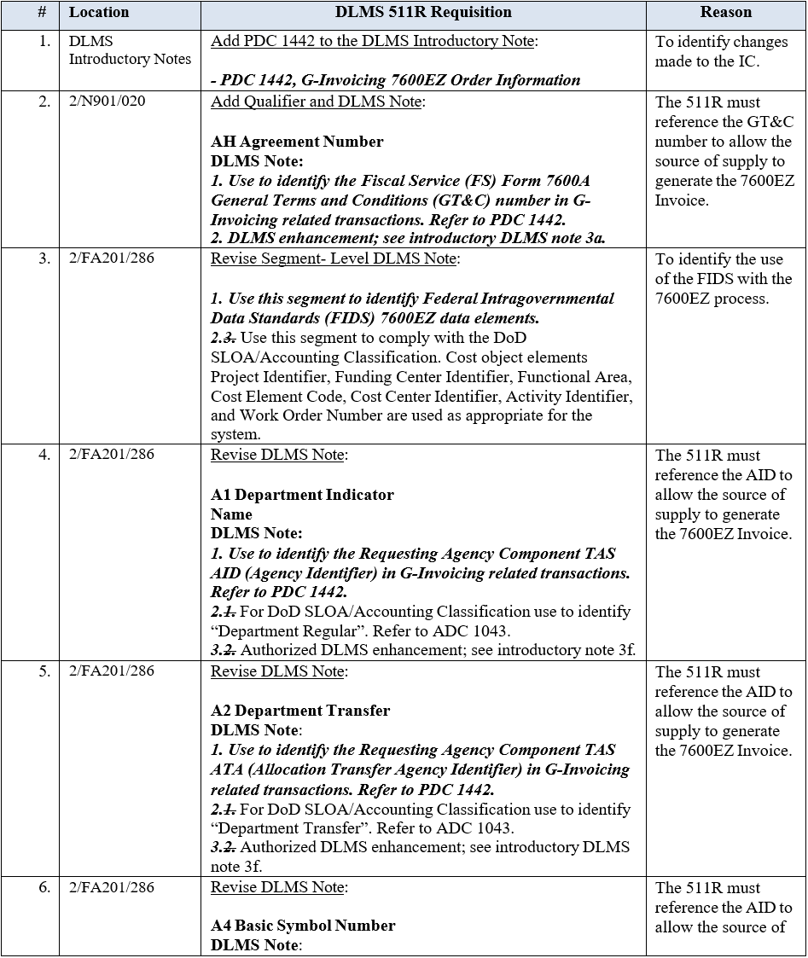
PDC 1442 DLMS IC Update
(511R Update Example)

Slide 72
PDC 1442 DoD and GSA Responses
(as of July 2023)
Department of Defense (Concur)
OUSD (Comptroller) concurred on March 2, 2023
Navy concurred with comment on January 26, 2023
Defense Logistics Agency concurred with comments on February 2, 2023
Marine Corps concurred with comments on May 5, 2023
Department of Defense (No Response)
Air Force (no response)
Army (no response)
General Services Administration (GSA) (pending)
GSA provided comments to DEDSO on February 3, 2023 (official response pending remediation of Federal Civilian agency concerns)

Slide 73
Navy
(Concur with Comments)
Navy Comments
Navy ERP has system limitations that prevents the process going forward with the intent on replacing IPAC systems, we agree with setting up the tables, but will not be able to accommodate the target date of April 2024.
  We have no timeline to prioritize and implement these tables by April 2024.
Implementation timeline cannot be determined until the requirement is finalized in an ADC and further determined.
There are no known non-DLM publications that require changes, or will be impacted, however, Navy Components may need to update local procedures.
  Any information relevant to Financial Improvement and Audit Remediation, to include notices of findings and recommendations, material weaknesses, corrective action plans, audits, etc.

Slide 74
Marine Corps
(Concur with Comments)
Marine Corps Comments
Recommend updating Standard Financial Information Structure (SFIS) and Standard Line of Accounting (SLOA) to include the Federal Intragovernmental Data Standard (FIDS) data elements required to execute appropriate DLMS transactions (e.g., 511R).
In accordance with reference DLM 4000.25 and ADC 1043, revitalize mandates for DoD business systems to send and receive SFIS/SLOA compliant data without the need for supplemental tables (e.g., fund code table).
Given this may be a major systematic change, recommend the establishment of a realistic attainable timeline to allow DoD components sufficient time to transition their respective business systems to SFIS/SLOA compliancy.
Recommend the establishment of a DoD led business process review of requisitioning procedures for all classes of supply.

Slide 75
General Services Administration (GSA) (Concurrence Pending)
GSA Overall Comment
GSA concurs with the overall concept of creating a 7600EZ table which can be queried to obtain data required for the 7600EZ invoices.
However, GSA would request that DLA and GSA discuss the approach with a portion of the Federal Civilian agencies on implementation details before final concurrence.
We estimate it would take at least 3 years to update GSA’s Supply and Financial systems to implement the 7600EZ process fully

Slide 76
Selected Outstanding Issues
(Not Exhaustive)
7600EZ FIDS Data Gaps (not exhaustive)
The 7600EZ lacks certain data in Interfund and Non-Interfund Logistics Bills that Requesting Agencies may need:
  Requisition Document Number (could leverage Requesting Agency Tracking Number)
  National Stock Number or CAGE + Part Number
  Unit of Issue
  Unit Price
Support for Non-Compliant and “Post-Post” Ordering Applications/Processes
Non-Compliant systems may not be able to process the FIDS data
Consideration must be given to scenarios where customers place orders through offline methods (call center, in-person, fuel pump, etc.)
  For example, how will offline customers provide FIDS data in absence of fund code or information system?
Unmatched Disbursements
Some agencies have issues reconciling orders placed in the supplier’s e-commerce platform with the invoice since they may not have a way to record the document number and associated details

Slide 77
Proposed 7600EZ Way-Forward
(as of July 2023)
Withdraw PDC 1442
  PDC as written has numerous unresolved issues.
  Federal Civilian agencies are unlikely to use the table and because the updating the existing SFIS Fund Code table is a viable option for DoD customers.
Update SFIS/SLOA to Support G-Invoicing and Enforce Mandate
  OUSD(C) enforce SFIS/SLOA mandate as described in the “Business Systems Financial Interoperability and the Standard Line of Accounting” memorandum dated 8/5/2020.
  OUSD(C) update SFIS/SLOA to include the FIDS data needed to allow the Servicing Agency to support the 7600EZ Invoice.
  OSD/DEDSO sponsor working group to update SFIS/SLOA to include FIDS data and develop approaches to transition Interfund and DoD Target Accounting Systems to the 7600EZ.
Add FIDS References to DLMS Transactions and Update SFIS Fund Code Table
  DEDSO originate new PDC to revise applicable DLMS transactions to identify required FIDS data to support the 7600EZ.
Update E-Commerce Applications to Comply with G-Invoicing
  Modify E-commerce web applications to capture buyer G-Invoicing information during registration and include that information in applicable transactions.
Establish Realistic Timeframe
  OUSD(C) and GSA formally ask Treasury to extend deadline for IGT Buy/Sell transactions (for example, 2026-2027) for business lines requiring the 7600EZ.

Slide 78
Application Types and Potential Implementation Strategies
This section segments potential G-Invoicing implementation strategies by application type.

Slide 79
7600EZ Problem Statement
Problem: The 7600EZ has no associated 7600B Order and the Servicing Agency cannot obtain the required data from existing front-end processes. Several questions posed are:
How do we get the customer’s Treasury Account Symbol (TAS) and Business Event Type Code (BETC)?
Customer do we derive the General Terms and Conditions (GT&C)?
How do we derive the customer’s Agency Location Code (ALC) and Group Name?
Desired Outcome: Enable Servicing Agencies to derive the information needed to generate the 7600EZ Invoice.

Slide 80
Application Types by Order Method
Accounting System of Record
Order placed via Agency ERP
Business-to-Business (B2B) eCommerce
Order placed in supplier’s eCommerce platform
Offline/Point of Sale
Order placed via phone call or e-mail or at point of sale (PoS)

Slide 81
Application Types
Accounting System of Record
  Examples: Service ERP(s)
  Analogous to SFIS Target Accounting System
B2B eCommerce
  Examples: FedMall, GSA Advantage, DMLSS, EEBP
  Analogous to SFIS Financial Business Feeder System
Legacy Applications/Offline Processes
  Examples: Applications that are not EDI-capable and slated for retirement or orders placed offline or via PoS
  Analogous to SFIS Legacy Accounting/Financial Business Feeder System
Accounting System of Record
B2B eCommerce
Legacy/Offline

Slide 82
Examples of B2B E-Commerce Applications
DLA
Document Services Online (DSO)
Enterprise External Business Portal (EEBP)
Federal Mall (FedMall)
Government Fuel Card Programs
Medical Electronic Catalog (ECAT)
Defense Health Agency (DHA)
Defense Medical Logistics Standard System – Retail (DMLSS-R)
Theater Enterprise-Wide Logistics System (TEWLS)
General Services Administration (GSA)
GSA Advantage
GSA Fleet
GSA Global Supply

Slide 83
B2B E-Commerce:
Current Payment Methods
Interfund Billing System
Requires MILSTRIP Fund Code
Applicable to DoD customers only
  Use “non-XP” fund codes to cross-reference the Treasury Account Symbol via the DoD SLOA format.
  Must use according to the DoD Financial Management Regulation (FMR)
Intra-Governmental Payment and Collection (IPAC)
Manual and Automated SF1080 Voucher for Transfers Between Appropriations and/or Funds
Use only fund code value “XP” to indicate non-Interfund billing.
Governmentwide Commercial Purchase Card (GPC):
Use only fund code value “XP” to indicate non-Interfund billing.
Federal entities may accept credit cards issued under the U.S. General Services Administration’s SmartPay contract for Buy/Sell transactions, subject to the maximum transaction limits, for intra-governmental collections.
  Please refer to TFM Volume 1, Part 5, Chapter 7000 for more information regarding credit card guidance.

Slide 84
B2B eCommerce:
New 7600EZ Payment Method
G-Invoicing (7600EZ)
User create Billing Profile(s) with the following fields during account registration:
  General Terms and Conditions (GT&C) Number
  Agency Location Code (ALC)
  Group Name
  Treasury Account Symbol (TAS)
    Agency Identifier (AID)
    Allocation Transfer Agency (ATA)
    Main Account Code (MAIN)
    Sub-Account Code (SUB)
  Bill-To Activity Address Code (AAC) or DoD Activity Address Code (DoDAAC)

Slide 85
Implementation Strategy by Application Type
Agency SOR
Funds Control
Derive FIDS from internal Agency funds control process
eCommerce Application
Billing Profile
Derive FIDS when user creates/updates billing profile(s) in their account
Legacy Application/Offline
Fund Code Tables
Send and receive FIDS after DAAS maps fund code entry to DLMS transaction
Send and receive FIDS via DLMS transactions
Send/Receive FIDS via DLMS or agency EDI transactions
Allow customer to input internal obligation reference number
Derive FIDS from fund code table to support customers unable to order from a compliant ERP or E-Commerce platform

Slide 86
Finance Wrap Up
Questions/Comments/Actions
ODASD/DPC/Comptroller

Slide 87
SUPPLY BACKUP

Slide 88
ADCs/PDCs in the Pipeline
PDC/ADC Number | Title | Area | Status
ADC 1307A | Add Global Trade Item Number Identifiers to the DLMS 810L Logistics Bill for Non-Appropriated Fund Activities and Non-DoD Customers | Finance | Routed to DASD(Log) for signature
ADC 1429 | Revise Defense Logistics Management Standards 856R 4030 Shipment Status Materiel Returns Transaction – Update Code Associations for Transaction Type Qualifiers | Supply | Routed to DASD(Log) for signature
PDC 1433 | Data Element Additions to Update DLMS 841W, DLMS 856S, and DLMS 824R | Supply | Draft, waiting on Component concurrence and comment adjudication
PDC 1434 | Assignment of Supply Condition Code U Serviceable - Limited Remaining Life Before Failure (Supply) | Supply | Draft, waiting on Component concurrence and comment adjudication
PDC 1448 | 1448, Department of Defense Causative Research Thresholds (Supply) | Supply | Draft PDC under development
PDC 1454 | Expand Use of Shop Service Center/Shop Store Code in Defense Logistics Management Standards Transactions (Supply) | Supply | Draft, waiting on Component concurrence and comment adjudication
PDC 1460 | Pre-positioned Release Orders Process | Supply | Routed to DASD(Log) for signature
PDC 1462 | Expand Usage of Item Unique Identification in the DLMS 940R Supporting Defense Logistics Agency Warehouse Management Functionality | Supply | Draft PDC under development
Supply Team, DEDSO
As of July 19, 2023, Office DLA Slide
Notes:
Complete list of DEDSO PDC/ADCs can be viewed at the following URL, https://www.dla.mil/Defense-Data-Standards/Resources/ADC/

Slide 89
ADCs/PDCs in the Pipeline
PDC/ADC Number | Title | Area | Status
PDC 1442 | G-Invoicing 7600EZ Order Information | Finance | Out for staffing
Supply Team, DEDSO
As of July 19, 2023, Office DLA Slide
Notes:
Complete list of DEDSO PDC/ADCs can be viewed at the following URL, https://www.dla.mil/Defense-Data-Standards/Resources/ADC/

Slide 90
DEDSO Upcoming Process Review Committee (PRC) Schedule
Upcoming PRCS meeting dates can be viewed at the below URL,
https://www.dla.mil/Defense-Data-Standards/Committees/
Area | Date | Status
Supply | July 19, 2023 | Confirmed
 | September 13, 2023 | Confirmed
ADC 1244B | October 2023 | Tentative
Finance | July 19, 2023 | Confirmed
 | December 6, 2023 | Confirmed
SDR | November 15, 2023 | Confirmed
PQDR | November 15, 2023 | Confirmed

