Slide 1
The Logistics Data Resources Management System (LOGDRMS) User Guide
Last Updated: August 07, 2017

Slide 2
Introducing LOGDRMS
LOGDRMS is the DLMS data repository on DLMS data standards, implementation conventions (IC), and associated metadata.
This presentation covers the functionality of LOGDRMS based in typical user scenarios that influenced the system requirements.
A basic understanding of DLMS and EDI will make LOGDRMS, and this presentation, much more useful. Refer to DLMS training at:
http://www.dla.mil/HQ/InformationOperations/DLMS/eApplications/Training/

Slide 3
DLMS Concepts Refresher
Defense Logistics Management Standards (DLMS): A broad base of process rules, data standards and electronic business objects (information exchange forms) designed to meet DoD’s requirements for total logistics support.
DLMS Change: A formal staffing of proposed DLMS changes (PDC) which seek Component coordination for an DOD enterprise solution to a business need within the scope of DLMS. Where a consensus is reached it is staffed as an approved DLMS Change (ADC) and consolidated into the DLMS.

Slide 4
DLMS Concepts Refresher (cont.)
Electronic Data Interchange (EDI): The computer-to-computer interchange of strictly formatted messages that represent business documents.
Transaction Set: A group of data segments in a predefined sequence needed to provide all the data required to define a complete transaction.
DLMS Implementation Convention (IC): The tailoring of a broad transaction set standard through the insertion of business rules that give it a specific business context for DOD trading partner usage.

Slide 5
DLMS Concepts Refresher (cont.)
Data Segment: An intermediate unit of information in a transaction set, composed of a unique segment ID and one or more logically related data elements.
Data Element: The smallest named unit of information in the standard and can represent a code, a value, or text.
X12 Data Element: The syntactical element of the X12 EDI standard used to provide content or transaction processing information.
DLMS Data Element: The DoD functional element needed for a business process.
DLMS Qualifier: A code list maintained by DLMS, or other stakeholder, outside the X12 standard.

Slide 6
Transaction Set Detail
Hierarchy of Relationship
Transaction Set
Data Segment
Data Element
Data Segment
Qualifiers/Codes
Notes:
Now, onto an examination of the hierarchy of the elements that comprise a DLMS transaction. This will be a deep dive into how transaction sets are structured and how they are made up of data segments, which are made up of data element, all under the X12 standard.

Slide 7
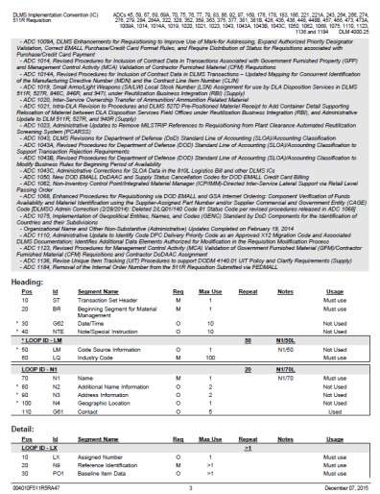
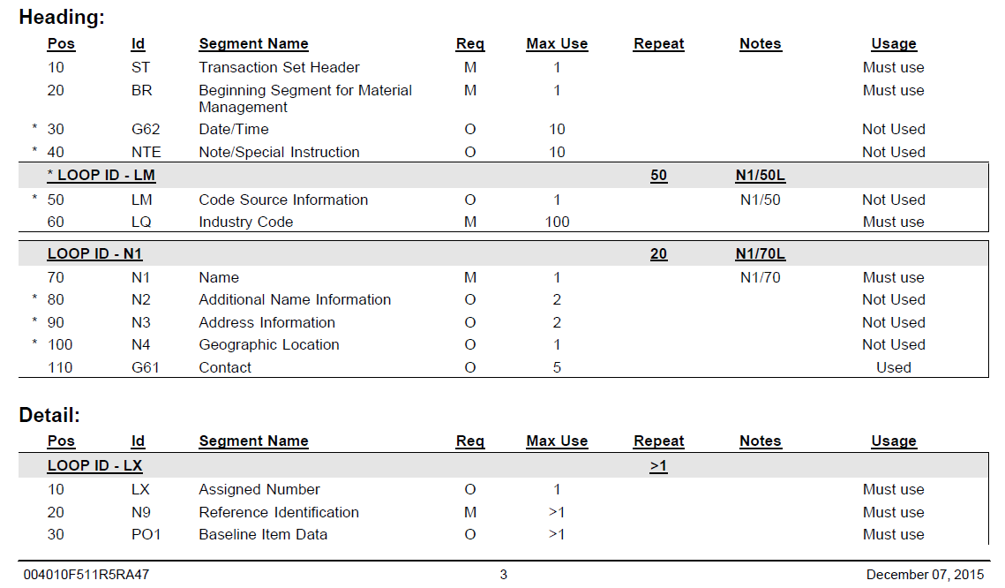
DLMS 511R IC - Transaction Set Table Diagram
  Transaction set table hierarchy diagram
    Identifies the segments and loops that are used in the DLMS 511R.
Notes:
Starting about halfway down on page three and continuing through page four you see the transaction set table hierarchy diagram for the DLMS 511R. The table hierarchy diagram was addressed in Module 2. So in the middle of page two, we see a bold title that says “Heading.“ Remember from Module 2 that means we’re in Table 1 of the IC. Directly below the Heading you see the segments contained in the Heading. The segments are listed with the positions they are in within Heading, that is Table 1, the two character ID of the segments, names of the segments, whether they are required or optional, the maximum times they can be used and the usage column. For Loops you see the LOOP ID, such as LM and the maximum number of times the LOOP can be repeated in the transaction. Under the LOOP ID you see the segments in the LOOP and all the information described for a segment with the addition of the Max Use identifying the number of times each segment can be repeated within a LOOP. Note that the first segment within the Heading is the ST or Transaction Set header that denotes the beginning of this 511R. Also note that it is in position 10 of the header.
A little further down you see the bold heading that says Detail, that’s the beginning of Table 2 and that portion of the diagram contains the same information for each segment and LOOP as discussed for the Heading. However, note that the position number starts over; so the first position within the Detail starts over with position 10 within Table 2.
This table hierarchy diagram gives you a quick overall view of this IC’s architecture.
The two primary differences between the ASC X12 standard we saw in Module 2 and the DLMS IC we’re looking at here are:
First, the critical DLMS notes that we’ve discussed give this 511R specific business context for use by the trading partners using it and;
Second the table hierarchy diagram above identifies the segments and loops that are used in the DLMS 511R. Any segments or loops that the ASC X12 standard itself may contain but are not used in the DLMS are either not shown or are labeled as not used.

Slide 8
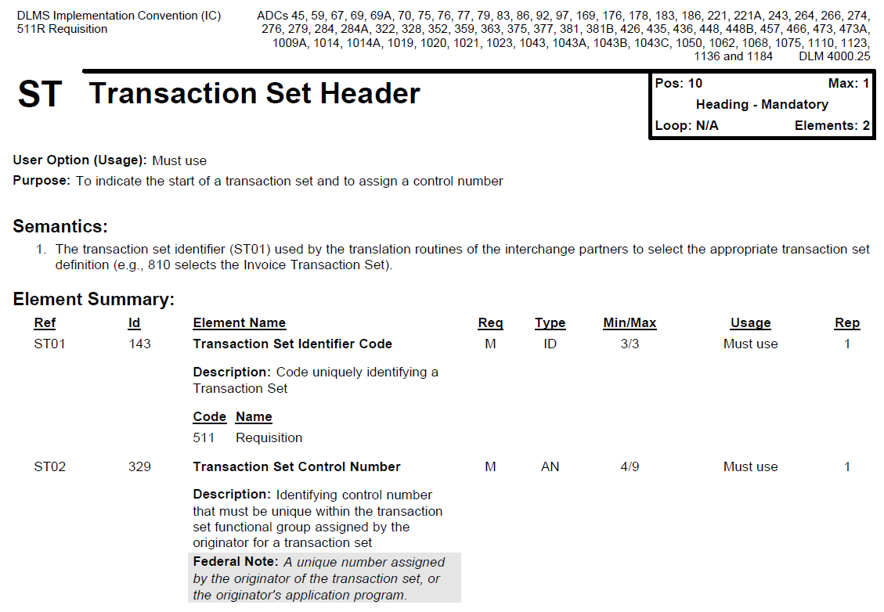
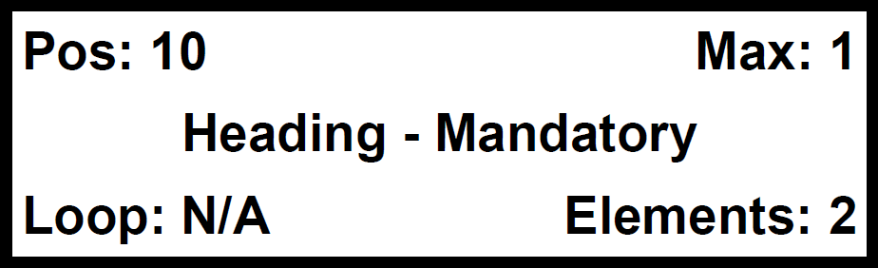
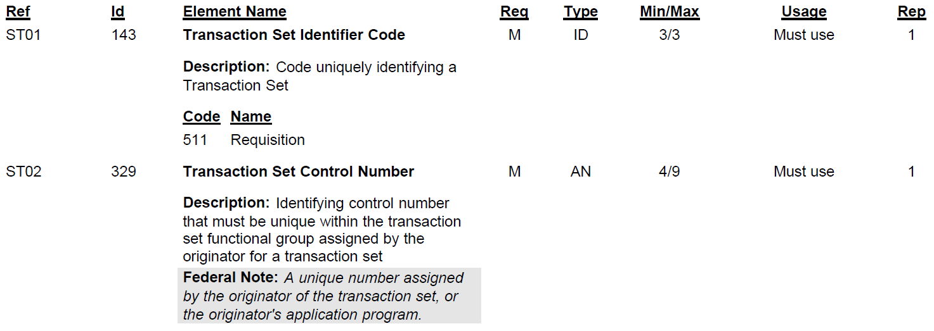
DLMS 511R IC - ST Segment
Notes:
Here’s the top of page five of the DLMS 511R Implementation Convention. Every segment that was marked “used” or “must use” in the transaction set table hierarchy diagram table is going to start at the top of a new page. This is the first segment of the 511R transaction, it’s the Transaction Set Header segment.
Let's look in the upper right hand corner. This box has a lot of valuable information in it. First thing it's going to tell you in the upper left of the box is, what position of the transaction set this segment is in. It's in position 10. Note, this coincides with the transaction set table diagram that we looked at on pages three and four. This box helps you to stay oriented with regards to where you are, relative to the entire transaction. So the box is telling you you’re in position 10 of the Heading, that its mandatory, and that the Maximum use is 1. This box also tells you the ST is in the heading, which means it's table 1. It's maximum use is 1. So you can only use this ST segment once, no repeating of it. The number of data elements that we are using from the ST segment will be annotated in the lower right-hand corner of the box. In this case, it's 2. If there was a loop associated with this segment, it's going to tell you the loop ID. In this particular case, there is no loop, therefore the loop is annotated as N/A.
So now let's go down to the ST01. Within X12 there are many transaction set standards, that is three character numeric codes, each identifying a different transaction. So If you were to look at data element 143 from the X12 standard versus the DLMS, you would see all numbers that the standard says are authorized. However, note that the DLMS IC only identifies one code value here. You see the 511 as the only authorized value. We're telling you in this IC, the only number you can use under this IC is 511. You can only use 511 because this is the DLMS IC for the 511R and nothing else is authorized. It’s important to note that in DLMS Ics. Regardless of the data element, only the authorized values will be shown, if it’s not listed in the IC then its not authorized for use within the IC. So what we do in the IC is, we pare down the list of authorized codes.
ST02 is where the transaction set control number is. And do you see grey notes box? That's an example of a note that provides amplifying information. It’s also an example of a note that will become a DLMS note; remember in the future there will be no separately identified Federal notes.
Now we will proceed to page six.

Slide 9
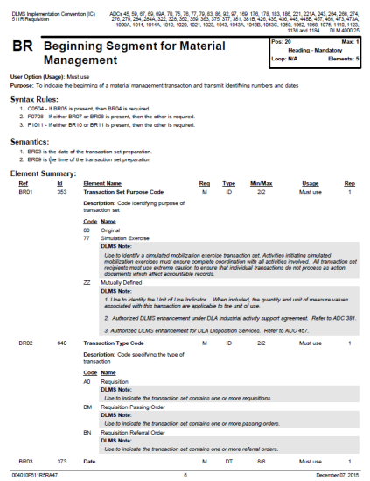
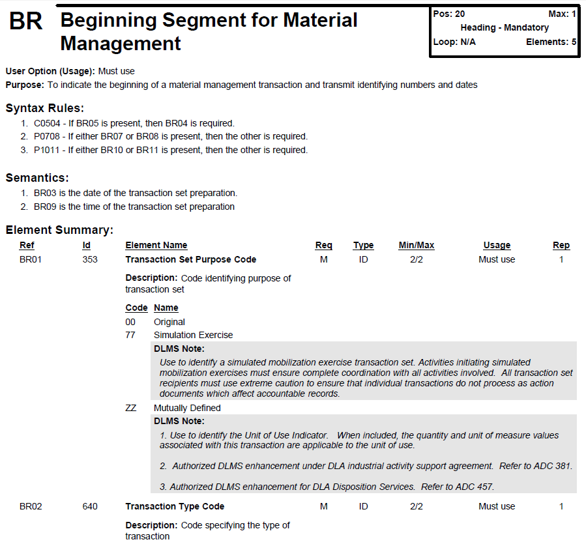
DLMS 511R IC - BR Segment
Notes:
On page six, we see the BR segment, which is the beginning segment. Notice, since it’s a new segment it started at the top of a new page. The top right hand box tells you that the BR segment is in position 20 of the heading and it is mandatory. It can only be used once, there is no associated loop, and this segment is using five data elements. The entire segment spans over pages six and seven and shows the data elements BR01, BR02, BR03, BR06, and BR09. Data elements BR04, BR05, BR07, and BR08 are not shown, which tells you that of the nine data elements in the ASC X12 standard, this DLMS IC is only authorizing the use of five.
Now let's look at data element BR01. Note that this IC is authorizing the use of only three code values for this particular data element. They are 00, 77, and ZZ. Also see the DLMS notes associated with 77 and ZZ. These notes are necessary to clarify the meaning of these values within the DLMS which differs from the definition of those code values within the X12 standard. No note is necessary for the code value 00, since the DLMS usage definition matches that of X12.
Let's look at code value ZZ. The ASC X12 definition is “Mutually Defined”. That’s not very precise. So that’s where the DLMS note comes into play. The first note says: Under DLMS, if we use a ZZ, it means it's a unit of use indicator. Now if you see a ZZ in a 511R in the BR01, that means that the person is telling you, I'm using unit of use in this transaction.
Notes two and three explain that this is an enhancement. So when it says authorized DLMS enhancement under DLA industrial activities supporting unit, it means, if you are implementing this transaction under the DLA industrialized support agreement, you can use this and it's going to mean unit of use. If you want details of how that's used, go to ADC 381. If you're operating this under DLA Disposition Services, they also have an authorized DLMS enhancement in place to use unit of use, and it is described within ADC 457.
Next we will take a look at page nine.

Slide 10
LOGDRMS Data Relationships
Better representation of data relationships.
Full DLMS notes.
Pending & Approved DLMS changes.
* Only represent enough X12 data to support accurate IC.
^ PDC/ADC may augment with local/migration codes.
Notes:
The new LOGDRMS is more robust. Data relationships are navigable from multiple directions making it clearer what the underlying DLMS functional data requirements are for the elements used in DLMS ICs. Content editors have less to enter from the underlying X12 and focus on DLMS specific content. And data quality is improved through the use of drop down selections, vice duplicative keyed entries. One of the most important design decisions was link changes to staffed PDCs/ADCs to allow for pending changes to be discoverable and allow traceability within LOGDRMS to changes. Unfortunately, DLMS change tracking will be only on a going forward basis. ADCs prior to this incarnation of LOGDRMS will not be searchable within LOGDRMS.

Slide 11
Role in DLMS Change Process
PDC data is identified by DLMS change number.
ADC data is integrated as production data, but can still be searched for under DLMS changes.
  ADCs with delayed implementation schedules have approved status, but are integrated into production on the implementation date.
Notes:
Going forward LOGDRMS will be a better tool for seeing not only the current DLMS data and IC standards, but changes in the pipeline and a developing source for researching prior DLMS changes. Impacts from DLMS changes to DLMS data elements, qualifier/code lists, and ICs are recorded as the PDC and ADC are signed out. Some ADCs that have a delayed, coordinated implementation to avoid errors (i.e. some Unit of Issue code changes) will have an ADC status, but will not be rolled into the current production standard until the identified implementation date.

Slide 12
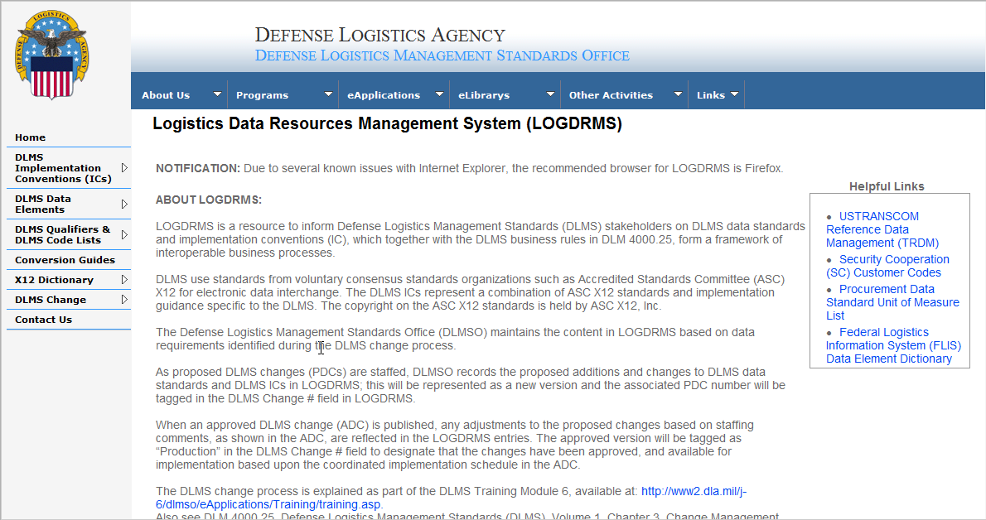
LOGDRMS Homepage
https://logdrms.dla.mil

Slide 13
LOGDRMS Functionality
DLMS Implementation Conventions (ICs)
  Browse DLMS ICs
  Search DLMS Data Element Usage in ICs
  Search X12 Element Usage in ICs
  Search X12 Code Usage in ICs
DLMS Data Element Dictionary
  Search/Browse DLMS Data Elements
DLMS Qualifiers & Code Lists
  Search/Browse Qualifiers and Code Lists
  Search Code Values
Conversion Guides
  Browse Conversion Guides
DLMS Changes
  Browse DLMS Summary

Slide 14
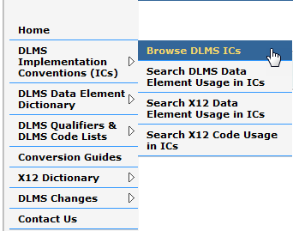
Browse DLMS ICs
This contains all DLMS Implementation Conventions (e.g. 511R) based on ANSI ASC X12 transaction sets. Details of DLMS ICs include applicable X12 version/release, data segments, simple/composite data elements and DLMS notes. Where applicable, the DLMS (logistics) data elements and code lists are also linked to the associated X12 data elements and X12 codes.
Step 2: The sub menu will appear, click on “Browse DLMS ICs”
Step 1: From the LOGDRMS Homepage, move the cursor to the navigation pane and point at “DLMS Implementation Conventions (ICs)”

Slide 15
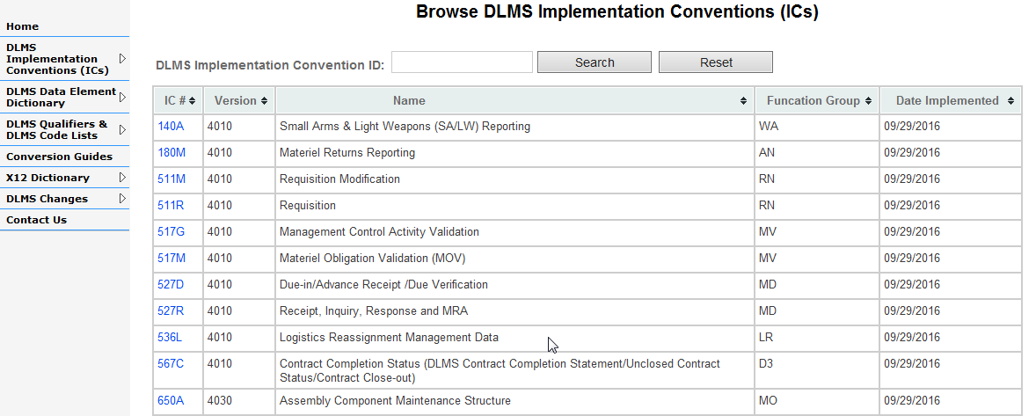
Browse DLMS ICs
This contains a listing of all DLMS Implementation Conventions (e.g. 511R) based on ANSI ASC X12 transaction sets.
Step 2: Alternatively, type the desired DLMS IC number (i.e. 140A, or 511M) in the search field and click “Search”
Step 1: Click on the desired DLMS IC number to view details

Slide 16
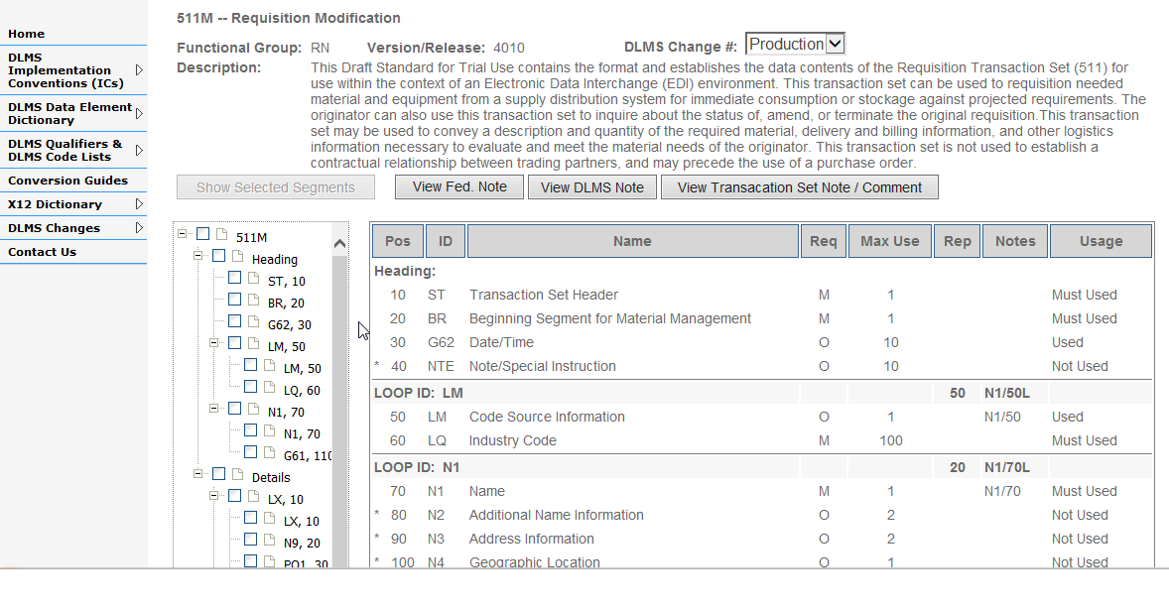
View DLMS IC Details
Step 2: This indicates if the IC is the production (approved) or proposed (PDC) change state
Step 1: This table is the summary view of DLMS IC
Step 3: Click on the desired notes to view details
Step 4: Click the desired boxes and click “Show Selected Segments to filter by segments

Slide 17
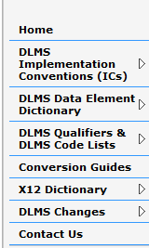
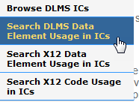
Search DLMS Data Element Usage in ICs
A user may search through or browse a listing of all DLMS data elements that are mapped to the DLMS ICs; clicking on a DLMS data element will provide the details of a DLMS data element including where it is mapped to in the DLMS ICs.
Step 1: From the LOGDRMS Homepage, move the cursor to the navigation pane and point at “DLMS Implementation Conventions (ICs)”
Step 2: The sub menu will appear, click on “Search DLMS Data Element Usage in ICs”

Slide 18
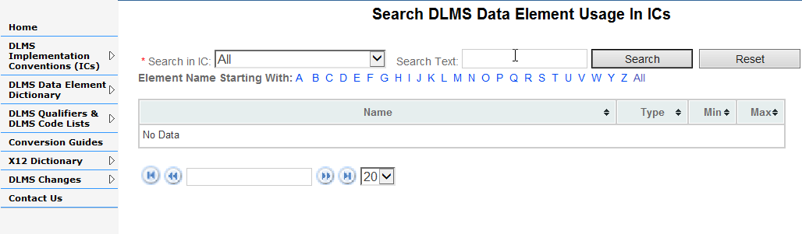
Search DLMS Data Element Usage in ICs
This contains a listing of DLMS data elements that are mapped in the DLMS ICs. Currently, DLMS data elements have not been mapped to the DLMS ICs yet. When they are mapped in the DLMS ICs, a listing of DLMS data elements will appear below.

Slide 19
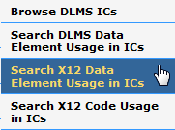
Search X12 Element Usage in ICs
A user may search through or browse a listing of all X12 data elements that are marked as being used in the DLMS ICs.
Step 1: From the LOGDRMS Homepage, move the cursor to the navigation pane and point at “DLMS Implementation Conventions (ICs)”
Step 2: The sub menu will appear, click on “Search X12 Data Element Usage in ICs”

Slide 20
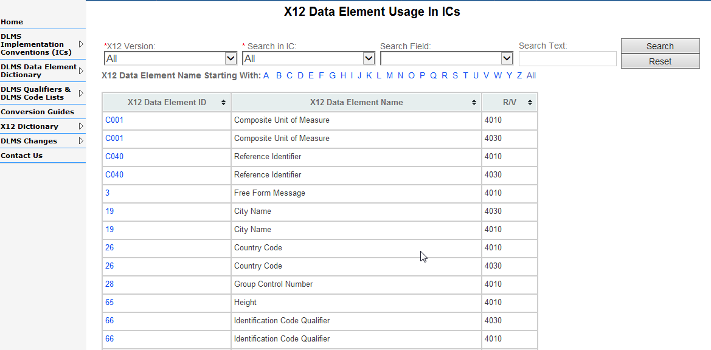
Search X12 Element Usage in ICs
This page contains a listing of all X12 data elements (including composite elements) that are marked as being used in the DLMS ICs. A DLMS data element may appear in multiple ICs, versions, or segments. User may perform keyword search or select the criteria to narrow down selection.
Step 3: Type the desired keyword to search
Step 2: Select the appropriate filter criterial to narrow down search
Step 1: Click on desired data element to view details

Slide 21
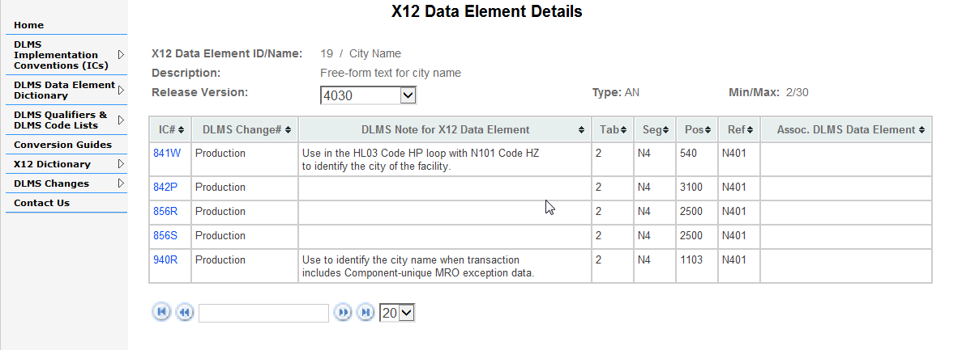
X12 Element Usage in ICs- Details
This page contains details of the selected X12 data element in the previous slide (screen). It provides the details of the X12 standard and associated DLMS data elements, DLMS notes, and the location where a particular X12 data element is mapped to in the DLMS IC. Generally, one X12 data element can appear in multiple segments within the same DLMS IC, or multiple DLMS ICs. The goal is to be able of understand its functional purpose based on the association between the X12 data element and the DLMS data element/DLMS notes in one or more DLMS ICs.

Slide 22
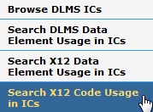
Search X12 Code Usage in ICs
A user may search through or browse a listing of all code values, that are assigned to the X12 data elements, and are used by one or more DLMS ICs. Clicking on an X12 code value will provide details of the code from the X12 standard and include the associated DLMS data element/DLMS notes, and its location in the DLMS IC. The goal is to be able to find a specific code value and understand its functional purpose based on the association of the DLMS data element/DLMS notes in one or more DLMS ICs.
Step 1: From the LOGDRMS Homepage, move the cursor to the navigation pane and point at “DLMS Implementation Conventions (ICs)”
Step 2: The sub menu will appear, click on “Search X12 Code Usage in ICs”

Slide 23
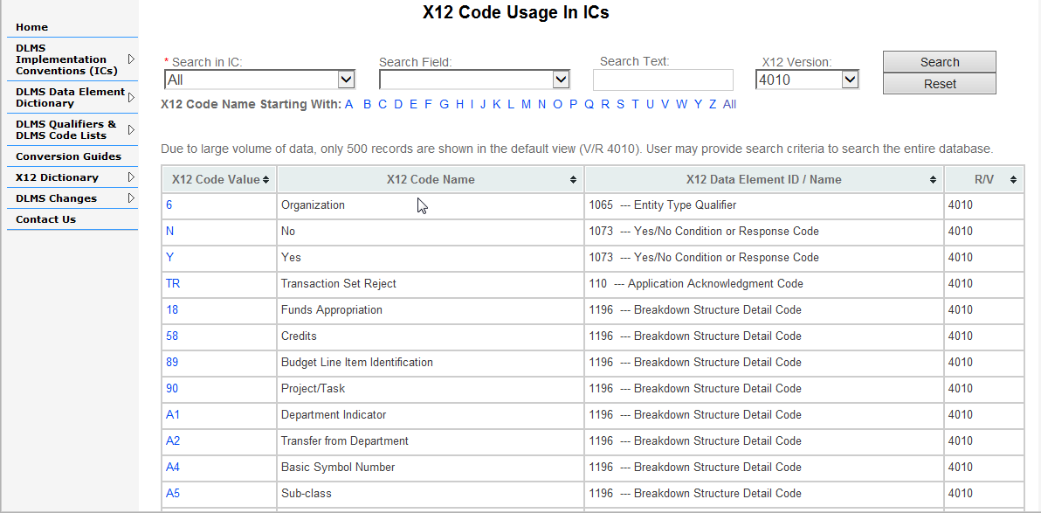
Search X12 Code Usage in ICs
One X12 Data Element may contain multiple code values to convey the business purpose or usage of that X12 data element. This page contains a listing of all X12 code values that are contained in the X12 data elements and are marked as being used in the DLMS ICs. User may perform keyword search or select the criteria to narrow down selection.
Step 3: Type the desired keyword to search
Step 2: Select the appropriate filter criterial to narrow down search
Step 1: Click on desired X12 code value to view details

Slide 24
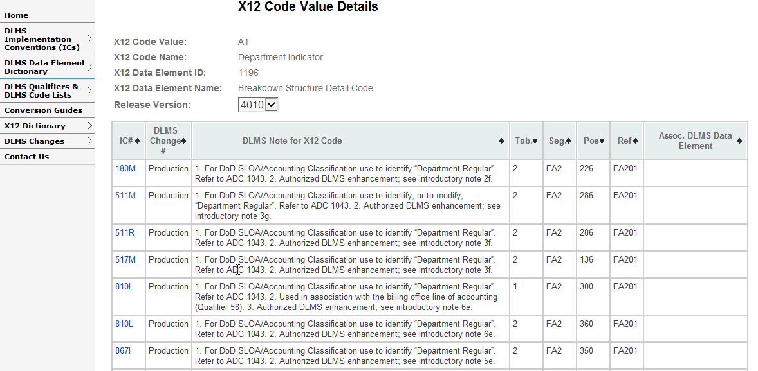
X12 Code Usage in ICs – Details
This page contains details of the selected X12 code value in the previous slide (screen). It provides the details from the X12 standard and associated DLMS data elements, DLMS notes, and the location where a particular X12 code is mapped to in the DLMS IC. Generally, multiple code values are contained in one X12 data element and the X12 data element can appear in multiple segments within the same DLMS IC, or multiple DLMS ICs. The goal is to be able of understand its functional purpose based on the association between the X12 code values, data element and the DLMS data element/DLMS notes in one or more DLMS ICs.

Slide 25

Search/Browse DLMS Data Elements
A user may navigate from the LOGDRMS homepage through the DLMS Data Element Dictionary to search or browse a listing of DLMS Data Elements.
Step 1: From the LOGDRMS Homepage, move the cursor to the navigation pane and point at “DLMS Data Element Dictionary”
Step 2: The sub menu will appear, click on “Search DLMS Data Elements”

Slide 26
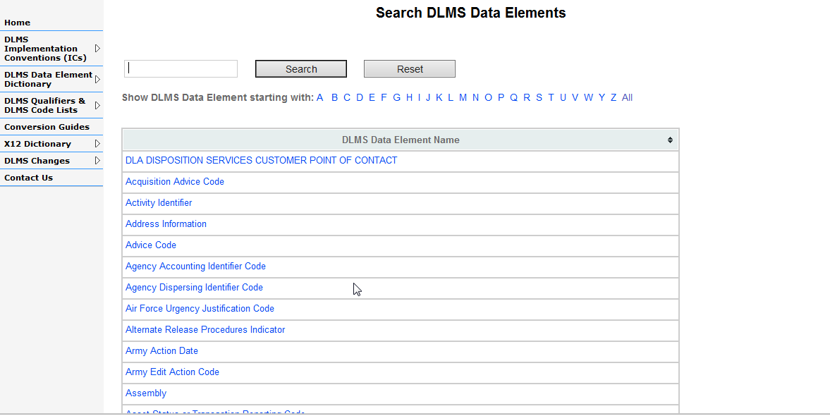
Search/Browse DLMS Data Elements
A user may search through or browse a listing of all DLMS data elements. Clicking on a DLMS data element will provide basic information such as description, min/max, data type, etc. When applicable the DLMS data element details will contain a mapping to associated X12 data element(s) and/or X12 code(s) in the DLMS ICs.
Step 2: Type the desired keyword to search
Step 1: Click on desired DLMS data element to view details

Slide 27
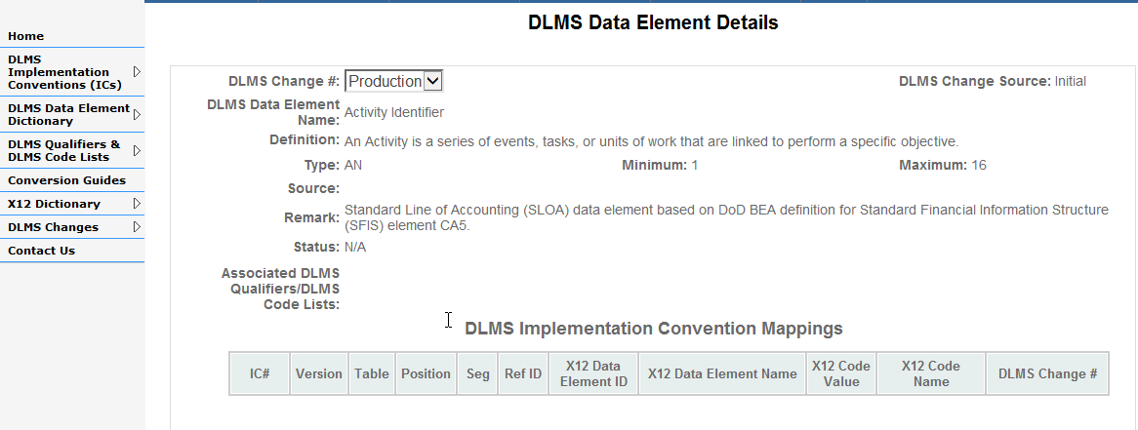
DLMS Data Element Details
This page contains details of the selected DLMS data element in the previous slide (screen). Clicking on a DLMS data element will provide basic information such as description, min/max, data type, etc. When applicable the DLMS data element details will contain a mapping to associated X12 data element(s) and/or X12 code(s) in the DLMS ICs. The goal is to understand how the DLMS data element is used within the X12 context.

Slide 28

Search/Browse Qualifier and Code Lists
A user may navigate from the LOGDRMS homepage through the DLMS Qualifiers and DLMS Code Lists to search or browse a listing of codes.
Step 1: From the LOGDRMS Homepage, move the cursor to the navigation pane and point at “DLMS Qualifiers & DLMS Code Lists”
Step 2: The sub menu will appear, click on “Search DLMS Qualifiers”

Slide 29
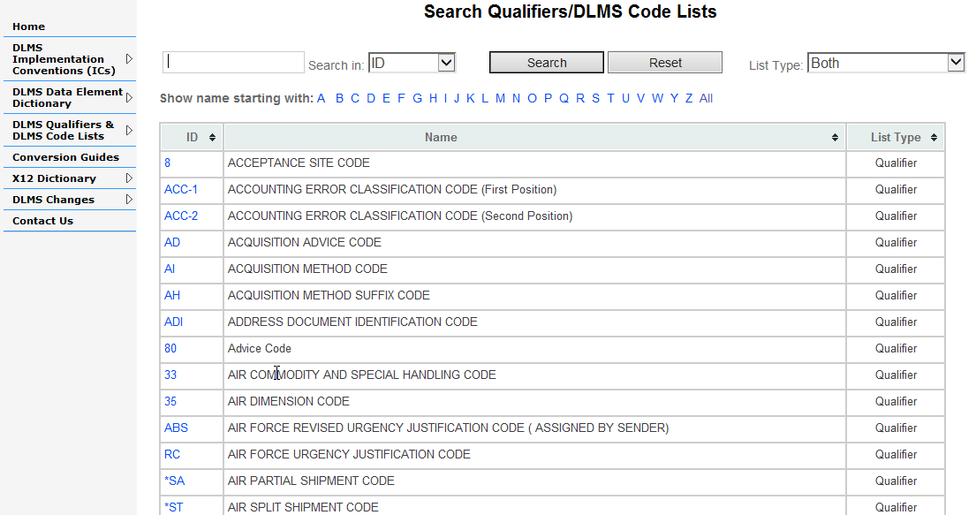
Search/Browse Qualifier and Code Lists
A user may search through or browse a listing of all DLMS Qualifiers and Code Lists applicable to the DLMS ICs. Clicking on the ID of a Qualifiers or DLMS Code List will provide information of valid values or direction to an authoritative source for the code values.
Step 2: Type the desired keyword to search
Step 3: Select the appropriate filter criterial to narrow down search
Step 1: Click on desired Code ID to view details

Slide 30
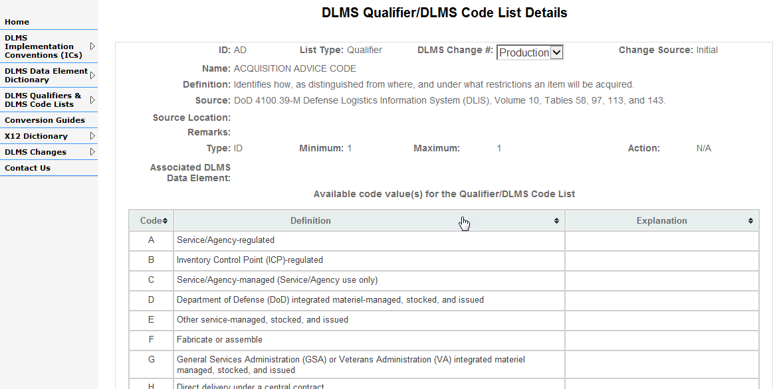
Qualifier and Code List Details
This page contains details of the selected DLMS Qualifier/DLMS Code List in the previous slide (screen). It provides information of valid values or direction to an authoritative source for the code list.

Slide 31

Search DLMS Code Values
A user may navigate from the LOGDRMS homepage through the DLMS Qualifiers and DLMS Code Lists to search for code values that are available within the DLMS Qualifiers and DLMS Code Lists.
Step 1: From the LOGDRMS Homepage, move the cursor to the navigation pane and point at “DLMS Qualifiers & DLMS Code Lists”
Step 2: The sub menu will appear, click on “Search DLMS Code values”

Slide 32
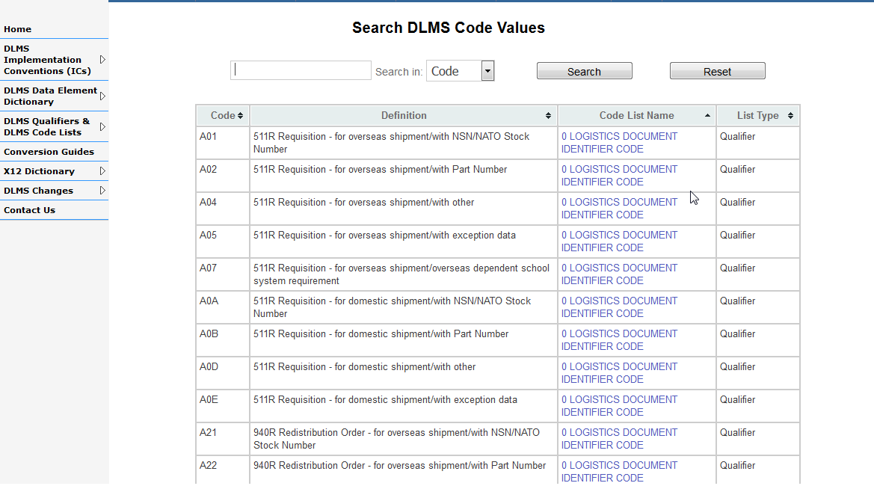
Search DLMS Code Values
A user may navigate from the LOGDRMS homepage through the DLMS Qualifiers and DLMS Code Lists to search for the code values that are available within the DLMS Qualifiers and DLMS Code Lists.
Step 2: Type the desired keyword and select criteria to narrow down search results
Step 1: Select the desired code list to view details

Slide 33
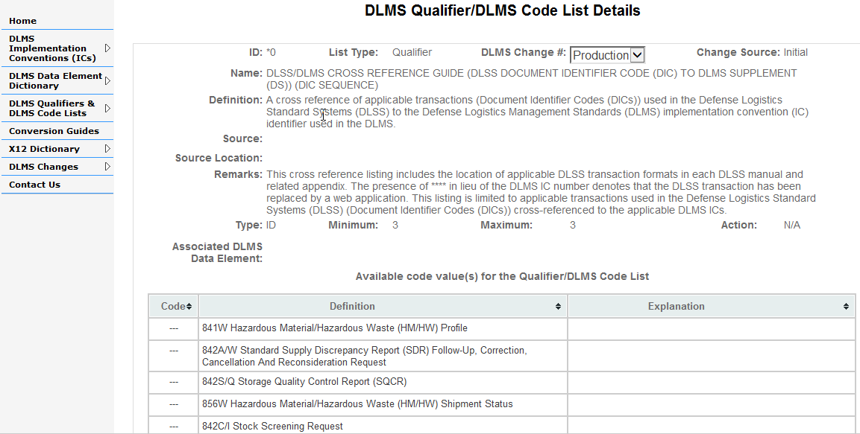
DLMS Code Values
This page contains details of the selected DLMS Qualifier/DLMS Code List in the previous slide (screen). It provides information of valid values or direction to an authoritative source for the code list.

Slide 34
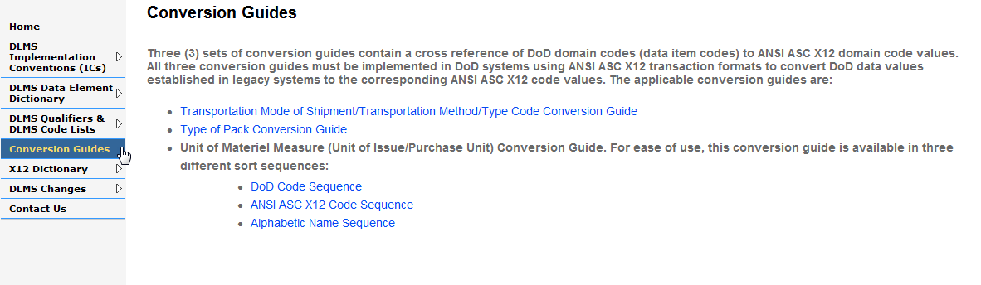
Browse Conversion Guides
Conversion guides contain a cross reference of DoD domain codes (data item codes) to ANSI ASC X12 domain code values. Conversion guides must be implemented in DoD systems using ANSI ASC X12 transaction formats to convert DoD data values established in legacy systems to the corresponding ANSI ASC X12 code values.

Slide 35

Search X12 Data Elements
A user may navigate from the LOGDRMS homepage through X12 Dictionary to search for the X12 Data Elements that are used in the DLMS ICs. This provide a different view of how X12 data elements are used in the DLMS ICs.
Step 1: From the LOGDRMS Homepage, move the cursor to the navigation pane and point at “X12 Dictionary”
Step 2: The sub menu will appear, click on “Search X12 Data Elements”

Slide 36
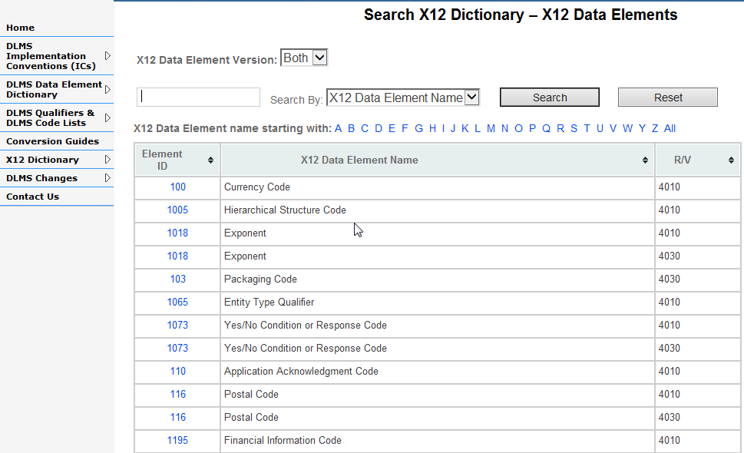
Search X12 Data Elements
To view the data element details, user may select the desired data element ID from the list below, perform keyword search, or narrow down the selection by release version.
Step 2: Type the desired keyword to search
Step 3: Select the appropriate search criterial
Step 1: Click on desired Data Element ID to view details

Slide 37
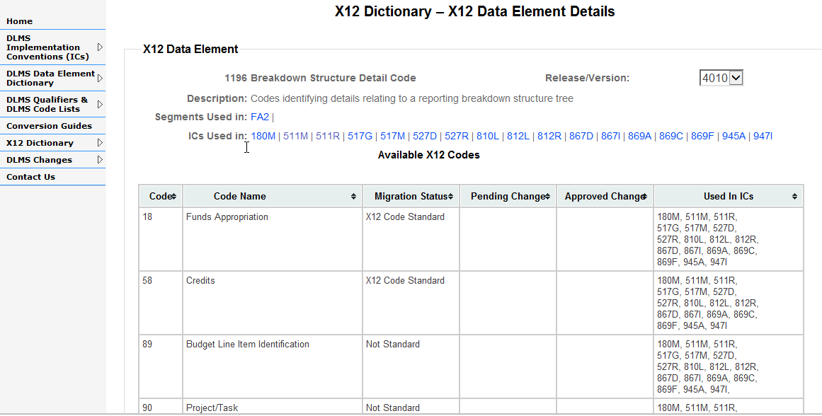
View X12 Data Element Details
The X12 data element details view provides an abbreviated view of where the data element is being used in the DLMS transactions and the associated segments. In addition, codes values that are used in the DLMS ICs are also listed as well as the migration status (borrowed codes or X12 standard), DLMS change status, and where these codes are used in the DLMS ICs.

Slide 38

Search X12 Segments
A user may navigate from the LOGDRMS homepage through X12 Dictionary to search for the X12 segments that are used in the DLMS ICs.
Step 1: From the LOGDRMS Homepage, move the cursor to the navigation pane and point at “X12 Dictionary”
Step 2: The sub menu will appear, click on “Search X12 Segments”

Slide 39
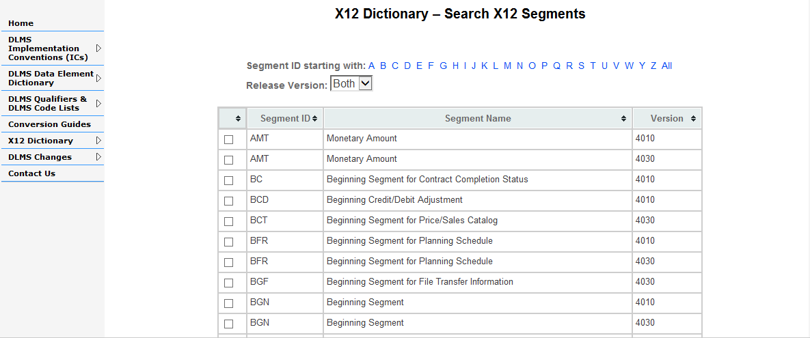

Search X12 Segments
To view the segment details, user may select the desired segment(s) from the list below, or narrow down the list by release version.
Step 1: Click on desired Segment ID to view details
Step 2: Click on “show Segment” to view details

Slide 40
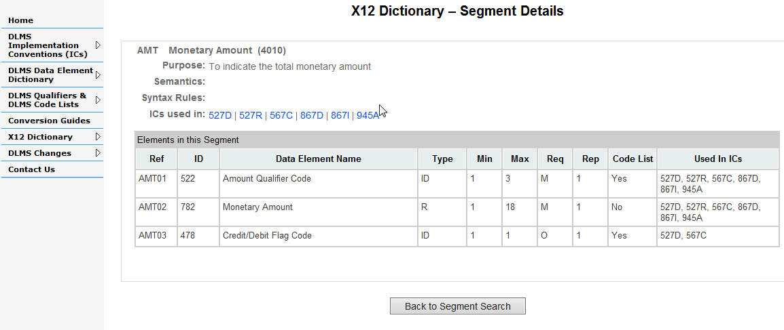
X12 Segment Details
The X12 Segment details provides an abbreviated view of the DLMS transactions that are associated with the segments. The X12 data elements that are used under the segment are also listed.

Slide 41
Browse DLMS Changes
A user may browse a listing of proposed and approved DLMS changes in LOGDRMS. Updates per a specific DLMS Change Number are captured in its change report. This functionality is currently not available at this time.

Slide 42
Questions?

