Slide 1
DoD WebSDR
User Guide
April 11, 2025

Slide 2

Learning Objectives
By the end of this brief, you will be able to:
Define and describe DOD procedures used in SDR processing
Define what “WebSDR” is and why it is important
Explain how “WebSDR” operates
Demonstrate or explain how to gain access to “WebSDR”, how to create an SDR and process through completion, including cancellation if appropriate and follow up
Run queries and obtain reports
Defense Logistics Management Standards

Slide 3
Table of Contents
DoD WebSDR User Guide Sections
Supply Discrepancy Reporting (SDR)
Obtaining System Access to DoD WebSDR
Initiating Activity Submission
How to Submit an SDR in DoD WebSDR
Special Business Rules for Transshipper-Prepared SDRs Document Type W Aerial Ports and CCPs Only
DoD WebSDR Action Activity Response Process
Follow-on Actions (General)
Follow-up on a Delinquent SDR Response
Making Corrections to Previously Submitted SDR
Submitting a Status Update (SU) on an existing SDR
Requesting Consideration of an Unfavorable Action Activity Response
Cancel a Previously Submitted SDR
Completion Notifications (CNs)
Queries and Management Reports
Queries Against Historical Records
DoD WebSDR User Guide Summary & Resources
Defense Logistics Management Standards

Slide 4
Supply Discrepancy Reporting
(SDR)

Slide 5
Table of Contents
Supply Discrepancy Reporting (SDR)
Defining DoD WebSDR
Purpose of SDR
The SDR Program
DoD Manual 4101.01, DoD Supply Chain Materiel Management Procedures
Justification of DoD WebSDR
DoD WebSDR Goals
SDR Transactions
DoD SDR Information Exchange Integrating Component SDR Applications
OPSEC Requirement – DLA-mandated Encryption
SDR Implementation Team
DoD WebSDR Current Status
SDR Support for Financial Improvement and Audit Readiness (FIAR)
Defense Logistics Management Standards

Slide 6
Defining DoD WebSDR
A web supported tool integrating business events to:
  Report supply discrepancies and route for action and/or trend analysis
  Provide SDR responses and resolution
  Standardize SDR transactional interfaces and data
  Capture and provide a life-cycle event audit trail
  Provide management reporting capabilities for analysis
Integrates Component SDR applications as required by the Defense Logistics Management Standards (DLMS)
  Supports web input pending DLMS implementation
Database of all actions producing reports
  View management reports and query results online
  Send reports to users’ email for detailed analysis
Notes:
What is DOD WebSDR?
WebSDR is a web-based support tool that integrates business events to report supply discrepancy reports known as SDRs, and route them for action and/or trend analysis.
It provides appropriate SDR responses and resolution, standardizes the SDR transactional interfaces, and captures data and provides a life-cycle events audit trail.
Also, WebSDR provides management reporting capabilities for analysis and corrective action.
WebSDR integrates Component SDR applications as required by the Defense Logistics Management Standards (DLMS) and supports web input pending Component DLMS implementation.
WebSDR has the ability to produce management reports and queries online and send the reports to a user’s email address for detailed analysis.

Slide 7
Defining DoD WebSDR, continued
  Use of the DLMS interface for SDR transaction exchange is required under DOD Supply Chain Materiel Management Manual (DODM 4140.01)
  Procedures are maintained in Defense Logistics Manual (DLM) 4000.25, Volume 2, Chapter 17, Supply Discrepancy Reporting
  The Defense Automatic Addressing System (DAAS) implements WebSDR procedures, hosts the database, and prepares reports
Notes:
Use of the DEDSO interface for SDR transaction exchange is required under DOD Supply Chain Materiel Management Manual (DODM 4140.01).
All procedures are maintained in the Defense Logistics Manual (DLM) 4000.25, Volume 2, Chapter 17, Supply Discrepancy Reporting.
Finally, the Defense Automatic Addressing System known as DAAS, is the organization that implements WebSDR procedures, hosts the database, and prepares reports.
MM Notes: This is a screen build. Add graphics as appropriate.

Slide 8

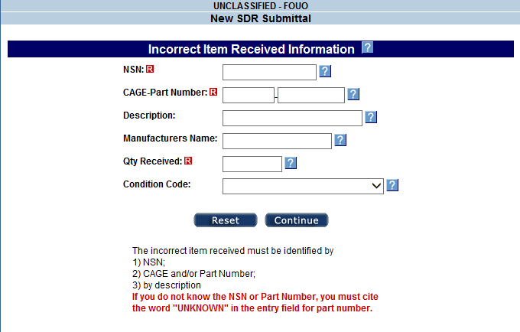
Purpose of SDR
An SDR is used to report shipping or packaging discrepancies attributable to the responsibility of the shipper (including Government sources, contractors and manufacturers, and vendors), and to provide appropriate responses and resolutions.
Notes:
We’ll begin to understand the role and functions of WebSDR when we understand the basic principles of SDRs. An SDR is a tool used to report shipping or packaging discrepancies attributable to the responsibility of the shipper (including Government sources, contractors, manufacturers and vendors), and to provide appropriate responses and resolution.
MM Notes: This is a screen build. Add graphics as appropriate.

Slide 9
Purpose of SDR, continued
Shipping discrepancies
  Discrepant condition of item, including expired shelf-life
  Overage/shortage/total non-receipt
  Discrepant unique item identification
  Improper documentation
  Misdirected shipments
Packaging discrepancies
  Improper packing
  Improper preservation
  Improper marking
  Improper unitization
  Detailed discrepancy codes are available to support better understanding of the discrepant condition and follow-up analysis.
Notes:
These discrepancies are generally categorized as either shipping discrepancies or packaging discrepancies.
Shipping discrepancies can include but are not limited to:
Issues with the condition of an item, including expired shelf-life
Overages or shortages on total non-receipt
Issues occurring with unique item identification (UII)
Improper and/or missing documentation, and
Misdirected shipments
Packaging discrepancies can include but are not limited to:
Improperly packaged items
Improperly preserved items
Improperly marked items (identification markings), and
Improperly unitized items
Detailed discrepancy codes have been developed and are used to support better understanding of the discrepant condition of the materiel being reported via the SDR.
MM Notes: This is a screen build. Add graphics as appropriate.

Slide 10
The SDR Program
Designed to promote evaluation, correction, and improvement of logistics operations
Assist DOD Components in their SDR quality programs
Data collected enables DOD Components to:
  Identify trends
  Establish volume and dollar values of SDRs
  Bring management’s attention to problems with shipping activities
  Improve the requisitioning and distribution process within logistics operations
  Monitor for vendor non-compliance with supply procedures
Official SDR guidance – DLM 4000.25, Vol. 2, Chapter 17
Notes:
The supply discrepancy reporting program is designed to promote evaluation, correction, and improvement of logistics operations. Data that is collected from SDRs enables DOD Components to monitor their SDR programs, in order to improve and assess the accuracy and quality of work processes applicable to the SDR program.
This data allows Components to:
Identify trends
Establish volume and dollar values of SDRs
Bring management attention to problems with shipping activities
Improve the requisitioning and distribution process within logistics operations, and
Monitor for vendor non-compliance with supply procedures
Additional information on the SDR program as well as official SDR guidance, is provided via the Defense Logistics Manual (DLM) 4000.25, Volume II, Chapter 17.
MM Notes: This is a screen build. Add graphics as appropriate.

Slide 11
DOD Supply Chain Materiel Management Procedures
DODM 4140.01, Volume 5, Enclosure 3
Storage activities will:
conduct physical inventories
initiate and conduct causative research
prepare supply discrepancy reports or storage quality control reports
resolve inventory discrepancies
investigate and assess liability for loss, damage, and destruction of government property
take applicable actions necessary to ensure that the physical on-hand quantity equals the total item property record quantity
Source: DoDM 4140.01, Volume 5, Enclosure 3
As of September 17, 2018
Notes:
Now let’s look at the DOD Supply Chain Materiel Management Manual known as DODM 4140.01.
A review of volume 5, enclosure 3, outlines the actions that should be taken by storage activities to maintain in-storage accountability. It states that storage activities will:
conduct physical inventories,
initiate and conduct causative research,
prepare supply discrepancy reports or storage quality control reports.
resolve inventory discrepancies
investigate and assess liability for loss, damage, and destruction of government property
take applicable actions necessary to ensure that the physical on-hand quantity equals the total item property record quantity.
MM Notes: This is a screen build. Add graphics as appropriate.

Slide 12
DODM 4140.01, continued
DOD Components will
report all discrepant receipts in accordance with established DOD issuances covering supply, transportation, or quality discrepancies.
design supply systems to report supply discrepancies as an integral and seamless part of the receiving process.
Integrating SDRs as part of receiving process will
eliminate “Swivel chair” input.
decrease manual effort to create an SDR (using Prepositioned Materiel Receipt (PMR) and the receipt recorded in the automated information system).
DOD Components will
establish a capability to automatically receive, store, and process deficiency reports; assign investigations; and automatically route and track disposition in each responsible DOD activity.
Notes:
DODM 4110.01 also states DOD Components will report all discrepant receipts in accordance with established DOD issuances covering supply, transportation, or quality discrepancies, and will design supply systems to report supply discrepancies as an integral and seamless part of the receiving process.
By integrating SDRs as part of the receiving process it will eliminate the need for “Swivel chair” input and decrease the manual effort needed to create an SDR since most of the required data elements for the SDR would be prepopulated by the receiving system using Prepositioned Materiel Receipt (PMR) and the receipt recorded in the automated information system.
Furthermore, DODM 4110.01 also states DOD Components will establish a capability to automatically receive deficiency reports, store and process (e.g., categorize, sort, and access related deficiencies), assign investigations, and automatically route and track disposition in each DOD activity responsible for resolving discrepancy reports.
MM Notes: This is a screen build. Add graphics as appropriate.

Slide 13
Justification of WebSDR
GOAL
To provide an effective means to report, resolve, and measure discrepancies related to pipeline performance while reducing paper and manual intervention.
BENEFITS
These include:
Near real time SDR reporting for immediate identification and speedy resolution of reported discrepancies
Facilitating of interoperability internal and external to DOD
Maximizing the economy, efficiency, and effectiveness of the reporting process
Notes:
The SDR transformation initiative was designed to move SDRs into an integrated electronic transactional environment within the framework of a standard logistics information exchange.
The goal is to provide an effective means to report, resolve, and measure discrepancies related to pipeline performance while reducing paper and manual intervention.
The derivative benefits of the initiative include:
near real time SDR reporting for immediate identification and speedy resolution of reported discrepancies
enabling Perfect Order Fulfillment computations
facilitating of interoperability internal and external to DOD
and maximizing the economy, efficiency, effectiveness of the reporting process.
MM Notes: This is a screen build. Add graphics as appropriate.

Slide 14
Justification of WebSDR, continued
DAAS Hub
Eliminates the need for numerous point-to-point communications links
Transaction driven process eliminates need to re-key SDRs within separate Component systems
Developed as a DLMS-compliant process
Allows phased development – continuous process improvement since initial operating capability February 2005.
Notes:
The WebSDR architecture is based upon a DAAS hub for communication and centralized data management. It eliminates the need for numerous point-to-point communications links. The transaction driven process eliminates the need to re-key SDRs within separate Component systems and was developed as a DLMS-compliant process.
WebSDR allows for a phased development and has supported continuous process improvement since its initial operating capability in February 2005.
MM Notes: This is a screen build. Add graphics as appropriate.

Slide 15
WebSDR Goals
Quicker Response/Less Effort
  Reduces delays resulting from misrouted SDRs or mailed documents
  Electronic interface eliminates data entry at action activity
Transaction exchange through DAAS logistics hub
  Working toward full DLMS compliant information exchange
  Transaction conversion to email
Notes:
Some of the goals of WebSDR are to provide quicker responses with less effort.
Because WebSDR is a web-based tool, it reduces delays resulting from misrouted SDRs or mailed documents. Having an electronic interface eliminates manual data entry at the action activity.
DAAS is the logistics hub for transaction exchange and for some Component transactions that are converted to email, until full DLMS compliant information exchange can be achieved.
WebSDR offers auto-fill features and uses DAAS requisition history to populate an SDR.
WebSDR also allows for automatic email reply to the customer triggered by a reply transaction which eliminates manual steps to print, mail, and fax replies.
WebSDR allows for data content targeted to a specific discrepant condition. Also, contractors may use WebSDR for discrepancies related to Government Furnished Material.
Note that Component rules for allowing their personnel to use WebSDR differ primarily based upon the availability of a Component mandated SDR system.
MM Notes: This is a screen build. Add graphics as appropriate.

Slide 16
WebSDR Goals, continued
Facilitated web-based entry available
  Auto-fill feature using DAAS requisition history to populate SDR
  Automatic email reply to customer triggered by reply transaction eliminates action activity manual steps to print/mail/fax
  Data content targeted to specific discrepant condition
  Contractors can use for discrepancies related to Government Furnished Material
  Different Component rules for use of direct web input
Notes:
MM Notes: This is a screen build. Add graphics as appropriate.

Slide 17
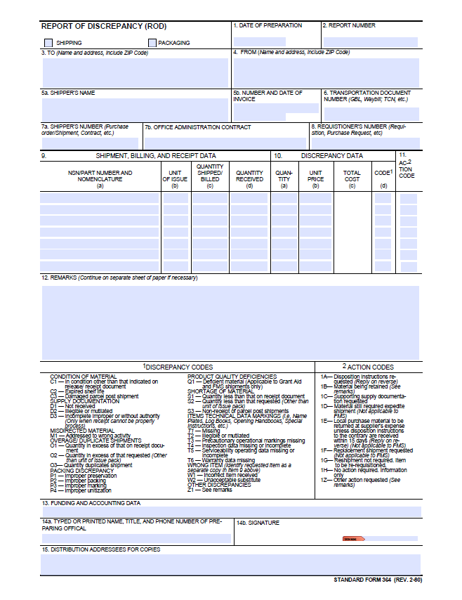
SDR Transaction derived from
Report of Discrepancy SF-364
Includes data fields from the original SF 364
DLMS codes to support transactional exchange
Component-unique data requirements
Enhancements, e.g., IUID
Notes:
The DLMS SDR transaction includes original data from the Standard Form 364, Report of Discrepancy, as well as DLMS data content to support transactional exchange, and selected Component-unique data requirements, and enhancements supporting emerging requirements such as item unique identification (IUID).
MM Notes: This is a screen build. Add graphics as appropriate.

Slide 18
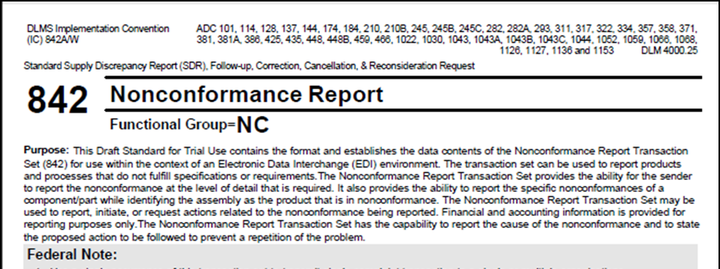
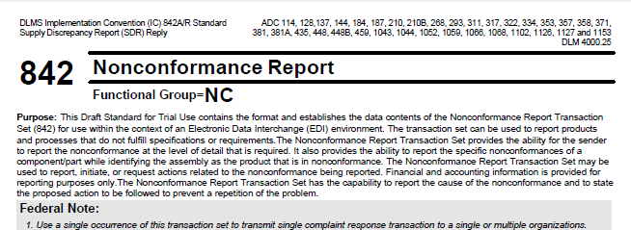
Implementation Conventions (ICs) that Support SDR
DLMS 842A/W—Standard SDR, Follow-up, Correction, Cancellation, and Reconsideration Request
DLMS 842A/R—Standard Supply Discrepancy Report (SDR) Reply
Notes:
There are two Implementation Conventions (ICs) provided to support the SDR process: the DLMS 842A/W, Standard SDR, Follow-up, Correction, Cancellation, and Reconsideration Request. And the DLMS 842A/R, Standard SDR Reply.
MM Notes: This is a screen build. Add graphics as appropriate.

Slide 19
Implementation Conventions (ICs) that Support SDR, continued
  Both ICs
  Establish the DOD standard format for an electronic equivalent of the SF 364/SDR
  Document specific business rules, conditions, and authorized codes necessary for appropriate use of the transaction within the DLM
  Are used to replace Component unique formats and paper form
Notes:
The IC establishes the DOD standard format for an electronic equivalent of the SF 364, Supply Discrepancy Report.
It documents specific business rules, conditions, and authorized codes necessary for appropriate use of this IC within the DLM.
MM Notes: This is a screen build. Add graphics as appropriate.

Slide 20
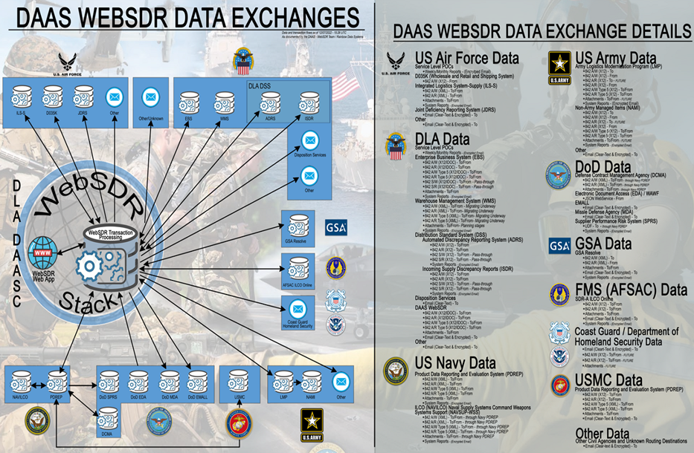
DoD SDR Information Exchange
Integrating Component SDR Applications

Slide 21
DLA-mandated Encryption
– OPSEC requirement
  SDRs and most SDR report data retrieved from the WebSDR application is labeled as “Controlled Unclassified Information (CUI)”. Mark and handle accordingly!
  Register DOD-approved email certificate when applying for a WebSDR account to enable full communication.
  When transmitting SDRs via email, WebSDR encrypts and digitally signs the outgoing transmissions using a Common Access Card (CAC) based DOD Public Key Infrastructure (PKI) Certificate.
Notes:
SDRs and most SDR report data retrieved from the WebSDR application are labeled as “Controlled Unclassified Information (CUI)”. Please mark and handle accordingly!
WebSDR notifies users of the need to register their DOD-approved email certificate when applying for a WebSDR account to enable full communication.
When transmitting SDRs via email, WebSDR encrypts and digitally signs the outgoing transmissions using a Common Access Card (CAC) based DOD Public Key Infrastructure (PKI) Certificate.
Recipients of the WebSDR email who have not registered their email certificate with DAAS will not be able to receive encrypted SDRs. Instead, they will receive a clear text version of the SDR with minimal data content. This email will include instructions on how to register the user’s email certificate with DAAS. Full data content can be viewed by logging into WebSDR. SDR reports cannot be transmitted to users without a registered certificate.
MM Notes: This is a screen build. Add graphics as appropriate.

Slide 22
DLA-mandated Encryption
– OPSEC requirement, continued
  Recipients of the WebSDR email who have not registered their email certificate with DAAS will not be able to receive encrypted SDRs. Instead, they will receive a clear text version of the SDR with minimal data content. This email will include instructions on how to register the user’s email certificate with DAAS.
  Full data content can be viewed by logging into WebSDR. SDR reports cannot be transmitted to users without a registered certificate.
Notes:
MM Notes: This is a screen build. Add graphics as appropriate.

Slide 23
SDR Implementation Team
SMEs and system developers collaboratively establish SDR business process rules, and procedures that enable DOD to improve automated supply discrepancy reporting on a global enterprise level.
  Defense Automatic Addressing System (DAAS)
WebSDR Program Manager
Database maintenance and programming support
  Defense Enterprise Data Standards Office (DEDSO)
    DOD SDR Administrator/Process Review Committee (PRC) Chair
    Development/coordination of requirements with SDR PRC and other impacted PRCs/organizations
    Publication of DOD guidance supporting the DoD SDR process
Notes:
The SDR implementation team consists of subject matter experts and system developers working in collaboration to establish SDR business process rules, and procedures that enable DOD to improve automated supply discrepancy reporting on a global enterprise level.
This team includes representation from:
The Defense Automatic Addressing System, or DAAS, which includes the WebSDR Program Manager and is responsible for database maintenance and programming support.
The Defense Enterprise Data Standards Office (DEDSO), which includes the DOD SDR Administrator, who develops and coordinates requirements with the SDR Process Review Committee (PRC) and other PRCs/organizations (e.g. Finance, Supply, Joint Physical Inventory Working Group). The DEDSO team is responsible for publication of DOD guidance supporting the DoD SDR process.
The Defense Logistics Agency (DLA) which includes HQ DLA, the DLA Supply Chains, and DLA Distribution
Military Services (Army, Navy, Air Force, Marine Corps)
The Defense Security Cooperation Agency and International Logistics Control Offices (ILCOs)
Participating Federal Agencies including General Services Administration and Federal Aviation Administration, and
The Coast Guard
MM Notes: This is a screen build. Add graphics as appropriate.

Slide 24
SDR Implementation Team, continued
  Defense Logistics Agency (DLA)
    HQ DLA and DLA Supply Chains
    DLA Distribution
  Military Services
    Army, Navy, Air Force, Marine Corps
  Defense Security Cooperation Agency and International Logistics Control Offices (ILCOs)
  Participating Federal Agencies: General Services Administration, Federal Aviation Administration
  Defense Contract Management Agency (DCMA)
  Coast Guard
Notes:
MM Notes: This is a screen build. Add graphics as appropriate.

Slide 25
WebSDR Current Status
Implemented
Web entry, standard transactions, database, flexible query and management report capability, process documentation, SDR User Guidance, and integration of multiple Component system interfaces
WebSDR processing statistics
  40-60K new SDRs (monthly)*
  145K-180K total SDR transactions (monthly)*
* Numbers are estimates based on historical averages.
Notes:
Since its deployment, WebSDR has implemented web entry, standard transactions, database, flexible query and management report capability, process documentation, SDR user guidance, and the integration of multiple Component system interfaces.
The SDR Database is continually growing each month. Currently, WebSDR is handling 40 to 60 thousand new SDRs monthly, and processing 145 thousand to 180 thousand total SDR transactions monthly.
Some of the ongoing challenges to the SDR program include:
Incomplete DLMS implementation or variations in DLMS implementation among Components which impedes interoperability and often necessitates work-arounds.
The continuous identification of new or evolving requirements layered on top of an incomplete baseline requirement.
Competing priorities as well as resource constraints
And mandated process enhancements and system interfaces such as:
Item Unique Identification
Capability to report contractor non-compliance to Past Performance Information Retrieval System – Statistical Reporting (PPIRS-SR) for contractor evaluation, and
Integration of new Component SDR applications as they are developed
MM Notes: This is a screen build. Add graphics as appropriate.

Slide 26
WebSDR Current Status, continued
On-going Challenges
Incomplete DLMS implementation and variations in DLMS implementation among Components
  Continuous identification of new/evolving requirements layered on top of incomplete baseline
  Competing priorities and resource constraints
  Mandated process enhancements and system interfaces such as:
    Item Unique Identification
    Capability to report contractor non-compliance to Past Performance Information Retrieval System-Statistical Reporting (PPIRS-SR) for contractor evaluation
    Integration of new Component SDR applications as they are developed
Notes:
MM Notes: This is a screen build. Add graphics as appropriate.

Slide 27

SDR Support for Financial Improvement and Audit Readiness (FIAR)
  The SDR Program provides a complete audit trail of evidential matter for:
  Physical Inventory and Financial Records adjustments
  Justification for the issue or non-issue of credit
Notes:
The SDR program supports Financial Improvement Audit Readiness or FIAR.
It provides a complete audit trail of evidential matter providing support to existence and completeness. It documents the auditable basis for Physical inventory and financial record adjustments as well as the justification for the issue or non-issue of credit.
MM Notes: This is a screen build. Add graphics as appropriate.

Slide 28
SDR Support for FIAR, continued
WebSDR’s Historical Database provides evidential matter that identifies:
  Process gaps and deficiencies requiring correction
  Internal controls and cross checks that need to be strengthened
  Execution deficiencies requiring remedial actions such as guidance or equipment
  WebSDR provides Business Process Application Controls in the SDR process
Internal Controls: actions taken to protect resources against waste, fraud, and abuse; ensure accuracy and reliability of the Agency’s financial data; ensure the Agency is complying with laws and regulations; evaluate the level of performance of the organization. Controls need to be designed properly, followed by employees, and tested to ensure they are effective at stopping problems.
Business Process Application Controls: Those controls incorporated directly into computer applications (or performed manually based on system generated information) to help ensure the completeness, accuracy, validity, confidentiality, and availability of transactions and data during application processing.
Notes:
WebSDR’s historical database facilitates the interrogation and analysis of a wide range of views and detail, providing evidential matter that identifies:
Process gaps and deficiencies requiring correction
Internal controls and cross checks that need to be strengthened
Deficiencies requiring remedial actions such as guidance or equipment
WebSDR provides Business Process Application Controls in the SDR process.
Internal controls are defined as actions taken to protect resources against waste, fraud, and abuse; ensure accuracy and reliability of the Agency’s financial data; ensure the Agency is complying with laws and regulations; evaluate the level of performance of the organization. Controls need to be designed properly, followed by employees, and tested to ensure they are effective at stopping problems.
Business Process Application Controls are defined as those controls incorporated directly into computer applications (or performed manually based on system generated information) to help ensure the completeness, accuracy, validity, confidentiality, and availability of transactions and data during application processing.
MM Notes: This is a screen build. Add graphics as appropriate.

Slide 29
SDR Support for FIAR, continued
  WebSDR enables a direct interface between DOD Component and participating partner systems for the systemic/automated exchange of data
  Provides evidential transactions that identify and correct inventory discrepancies (DoD SDR transactions automate hard copy SF 364)
  SDRs provide evidential matter for supply discrepancies and reasonable verification that these discrepancies are being appropriately recorded, reported, and resolved
  Systemic solutions are designed to help the sustainment of audit readiness over time and systemic evidentiary matter for discrepancies and resolutions instead of manual forms and records
Notes:
It also enables a direct interface between DOD Components and participating partner systems for the systemic/automated exchange of data.
WebSDR provides evidential transactions that identify and correct inventory discrepancies. The DoD SDR transactions automate the hard copy of SF 364.
SDRs provide evidential matter for supply discrepancies and reasonable verification that these discrepancies are being appropriately recorded, reported, and resolved.
Systemic solutions are designed to help the sustainment of audit readiness over time and systemic evidentiary matter for discrepancies and resolutions instead of manual forms and records.
MM Notes: This is a screen build. Add graphics as appropriate.

Slide 30
Obtaining System Access to DoD WebSDR

Slide 31
Table of Contents
Obtaining System Access to DoD WebSDR
DoD WebSDR Access
System Access Request for Submitter
System Access Request for Responder
System Access Request for Management Report
Defense Logistics Management Standards

Slide 32
WebSDR Access
Access to WebSDR is obtained by completing an online System Access Request (SAR) from the DAAS web page: DAAS (dla.mil)
Help Desk Support
Commercial: (614) 692-6672
DSN: 312-850-6672
You may also email: ITOC@dla.mil
DAAS Customer Service may be contacted 24 hours a day, 7 days a week. The WebSDR Help Desk should be utilized for routing issues and system application problems.
Notes:
Access to WebSDR is obtained by completing an online System Access Request (SAR) from the DAAS web page.
Assistance is available by contacting the WebSDR Help Desk Support.
DAAS Customer Services may be contacted 24 hours a day, 7 days a week. The WebSDR Help Desk should be utilized for routing issues and system application problems.
MM Notes: This is a screen build. Add graphics as appropriate.

Slide 33
WebSDR Access, continued
If status is needed on an SDR, please contact the action activity to which the SDR was sent. Resolution and functional questions should be directed to your Service or Agency SDR POCs.
For DLA, if you need someone to research the status of a reply or similar assistance, contact the DLA Customer Interaction Center (DLA CIC) email: dlacontactcenter@dla.mil or phone: 1-877-352-2255 or DSN 661-7766
Notes:
If status is needed on a SDR, please contact the action activity to which the SDR was sent. Resolution and functional questions should be directed to your Service or Agency SDR POCs.
For DLA, if you need someone to research the status of a reply or similar assistance, contact the DLA Customer Interaction Center (DLA CIC)
MM Notes: This is a screen build. Add graphics as appropriate.

Slide 34
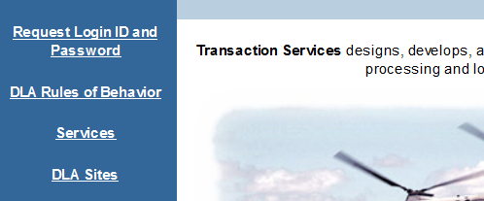
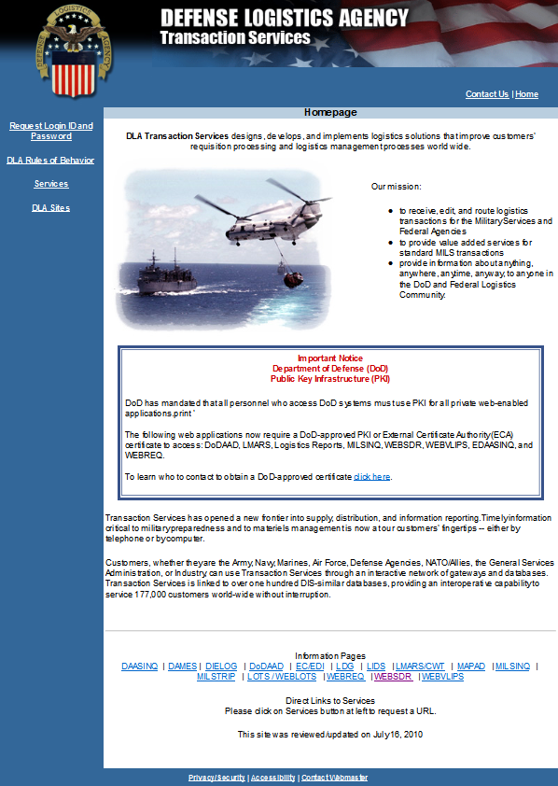
WebSDR Access, continued
Go to DAAS (dla.mil). Click on “Request Login ID and Password”. Click WebSDR. Complete the System Access Request (SAR) then Submit.
Along with your new logon ID and password, you will receive instructions via email to register your email certificate. You must register your email certificate in order to receive encrypted SDRs, management reports, and query results.
Remember that email certificates must be renewed when a new CAC is issued.
Notes:
This chart depicts the DAAS home page. The red arrow shows where the user requesting access needs to click.
Along with your new logon ID and password, you will receive instructions via email to register your email certificate. You must register your the email certificate in order to receive encrypted SDRs, management reports, and query results.
Remember that email certificates must be renewed when a new CAC is issued.
The System Access Request (or SAR) identifies three major categories of access to WebSDR, which we will discuss next.

Slide 35
SARs – Submitter Access
A submitter is authorized to input new SDRs and applicable follow-on actions (e.g. corrections, reconsiderations, cancellations, or follow-ups).
Submitter access is controlled by a combination of information provided on your SAR and Service/Agency guidance. If you are completing a new SAR for access to DOD WebSDR and request submitter access the following applies:
Explain why you need “submittal authorization.” Are there SDRs submitted or initiated by your activity? Do you need to submit SDRs for multiple activities?
If your location receives or transships materiel, and SDRs require submission by you for resolution, you will have authorized initiator capability for your activity, and will be able to submit to the source of supply or storage activity that shipped the materiel.
Notes:
The first category of access is for SDR submitters. This type of access allows the user to submit new SDRs and any necessary follow-on actions (such as, corrections, reconsiderations, cancellations, or follow-ups).
Submitter access is controlled by a combination of information provided on your SAR and Service/Agency guidance. If you are completing a new SAR for access to DoD WebSDR and request submitter access the following applies:
You will have to explain why you need “submittal authorization.” Are there SDRs submitted or initiated by your activity? Do you need to submit SDRs for multiple activities?
If your location receives or transships materiel, and SDRs require submission by you for resolution, you will be authorized the initiator capability for your activity and will be able to submit to the source of supply or storage activity that shipped the materiel.
You will identify the DoDAAC for the activity you represent in the submission. You may list multiple DoDAACs as appropriate. You will only be authorized to submit SDRs for the DoDAACs identified in your SAR. Approval by a DoD Focal Point will be required if you indicate that you are plan to submit for activities other than your own.
“Service/Agency Level Submitter” and “No Restriction Level” access are reserved for DOD Focal Points and their designated representatives. A "no restrictions" access is not usually authorized. Selecting this option may delay your SAR and system access.
IMPORTANT NOTE:
If you already have access to DOD WebSDR, do not complete another SAR for submitter, responder and/or report access. Call the DAAS Help Desk to ask for assistance in updating your current SAR.

Slide 36
SARs – Submitter Access, continued
You must identify the Department of Defense Activity Address Code (DoDAAC) for the activity you represent in the submission. You may identify multiple DoDAACs. Approval by a DoD Focal Point will be required if you indicate that you are plan to submit for activities other than your own.
“Service/Agency Level Submitter” and “No Restriction Level” access are reserved for DOD Focal Points and their designated representatives. A "no restrictions" access is not usually authorized. Selecting this option may delay your SAR and system access.
NOTE:
If you already have access to DOD WebSDR, do not complete another SAR for submitter access for another activity or to add responder and/or report access. Call the DAAS Help Desk to ask for assistance in updating your current SAR.

Slide 37
SARs – Responder Access
May provide resolution to SDR submitter/initiator in accordance with Component rules
Access is controlled by combination of information provided on SAR and Service/Agency guidance
The following applies when requesting responder access:
  Explain why you need “reply authorization”
  Provide Routing Identifier Codes (RICs) and/or Department of Defense Activity Address Codes (DoDAACs) for the activity you represent in the reply
  Approval by a DOD Focal Point will be required if you indicate that you are authorized to respond for activities other than your own.
“Service/Agency Level Responder” and “No Restriction Level” access are reserved for DOD Focal Points and their designated representatives. A "no restrictions" access is not usually authorized. Selecting this option may delay your SAR and system access.
Notes:
When applying for access to WebSDR, the user will also have an option to apply for responder access. A responder is an individual who provides resolution to the SDR submitter/initiator in accordance with Component rules, e.g., recommend or authorize credit; give disposition for discrepant materiel.
Responder access is controlled by a combination of information provided on your SAR and Service/Agency guidance. If you are completing a new SAR for access to WebSDR and request responder access, the following applies:
Explain why you need "reply authorization".
Please input Routing Identifier Codes (RICs) and/or Department of Defense Activity Address Codes (DoDAACs) for the activity you represent in the reply. Approval by a DOD Focal Point will be required if you indicate that you are authorized to respond for activities other than your own.
“Service/Agency Level Responder” and “No Restriction Level” access is reserved for DOD Focal Points and their designated representatives. A "no restrictions" access is not usually authorized. Selecting this option may delay your SAR and system access.
Please keep in mind that if you already have access to WebSDR, do not complete another SAR for responder and/or report access. Call the DAAS Help Desk to ask for assistance in updating your current SAR.
It is important to note that access controls are designed to ensure that only those authorized provide SDR disposition. If you need to respond to an SDR that is currently available in WebSDR, but it was incorrectly addressed and sent to the wrong action activity, the current action activity needs to forward the SDR to your RIC/DoDAAC. This is accomplished by using an SDR reply containing Reply Code 504.
The WebSDR help desk will not normally authorize access to respond on behalf of a Service/Agency that is not your own.
MM Notes: This is a screen build. Add graphics as appropriate.

Slide 38
SARs – Responder Access, continued
NOTES:
If you already have access to WebSDR, do not complete another SAR for responder and/or report access. Call the DAAS Help Desk to ask for assistance in updating your current SAR.
It is important to note that access controls are designed to ensure that only those authorized provide SDR disposition. If you need to respond to an SDR that is currently available in WebSDR, but it was incorrectly addressed and sent to the wrong action activity, the current action activity needs to forward the SDR to your RIC/DoDAAC. This is accomplished by using an SDR reply containing Reply Code 504 (some restrictions apply).
The WebSDR help desk will not normally authorize access to respond on behalf of a Service/Agency that is not your own.
Notes:
MM Notes: This is a screen build. Add graphics as appropriate.

Slide 39
SARs – Management Report Access
WebSDR will provide visibility of management reports and query results for those activities identified in your SAR. This is “view only” access. Approval from a DOD SDR Focal Point may be required if access is requested for other than your own location.
If you are completing a new SAR for access to DOD WebSDR and request management report access the following applies:
Explain why you need “management report authorization.” Does your role require that you monitor Component level or activity level metrics or trend analysis for supply discrepancies? Do you need access to metrics for both incoming and outgoing SDRs?
“Service/Agency Level Management Report” and “No Restriction Level” access are reserved for DOD Focal Points and their designated representatives. A "no restrictions" access is not usually authorized. Selecting this option may delay your SAR and system access.
Notes:
Report Access will provide visibility of management reports and query results for those activities identified in your SAR. This is “view only’ access. Approval from a DOD SDR Focal Point may be required if access is requested for other than your own location.
If you are completing a new SAR for access to DOD WebSDR and request report access the following applies:
Explain why you need “management report authorization.” Does your role require that you monitor Component level or activity level metrics or trend analysis for supply discrepancies? Do you need access to metrics for both incoming and outgoing SDRs?
“Service/Agency Level Management Report” and “No Restriction Level” access are reserved for DOD Focal Points and their designated representatives. A "no restrictions" access is not usually authorized. Selecting this option may delay your SAR and system access.
Once again, remember if you already have access to DOD WebSDR, do not complete another report access. Call the DAAS Help Desk to ask for assistance in updating your current SAR.

Slide 40
Initiating Activity Submission
Notes:
In this section you will gain a basic understanding of submission criteria and time standards for shipping and packaging SDRs.

Slide 41
Table of Contents
Initiating Activity Submission
DoD WebSDR Submission Criteria – Shipping Discrepancies
SDR Submission Criteria – Packaging Discrepancies
General SDR Guidance
DoD SDR Submission Time Standards
Defense Logistics Management Standards

Slide 42
WebSDR Submission Criteria –
Shipping Discrepancies
Customers report shipping discrepancies which exceed $100 per line item or for any dollar value when:
Shipper is DLA or GSA
Quantity is discrepant for controlled inventory (classified/sensitive), arms, arms parts, ammunitions, explosives
Total non-receipt (when not shipped via traceable means or not transportation related)
Incorrect item is received
Duplicate shipment
Notes:
Let’s talk about the submission criteria for shipping discrepancies first. Customers report shipping discrepancies which exceed $100 per line item or for any dollar value when any of the following applies:
Shipper is DLA or GSA
Quantity is discrepant for controlled inventory (classified/sensitive), arms, arms parts, ammunitions, or explosives
Total non-receipt (when not shipped via traceable means or not transportation related)
Incorrect item is received
Duplicate shipment
Misdirected shipment
Documentation is missing
Mismatch of unique item identifier (UII) or serial number for serially managed/tracked materiel, e.g., materiel associated with a Unique Item Tracking (UIT) program
Transshipper-prepared SDRs are applicable when missing, illegible, incomplete, etc., or supply or transportation documentation delays or prevents the forward movement of the shipment. Transshippers can be Consolidation and Containerization Points (CCPs) as well as aerial and water ports.
You will hear more about transshipper-prepared SDRs later in this module.
MM Notes: This is a screen build. Add graphics as appropriate.

Slide 43
WebSDR Submission Criteria –
Shipping Discrepancies, continued
Misdirected shipment
Documentation is missing
Mismatch of unique item identifier (UII) or serial number for serially managed/tracked materiel, e.g., materiel associated with a Unique Item Tracking (UIT) program
Transshipper-prepared SDRs are applicable when missing, illegible, incomplete, etc., or supply or transportation documentation delays or prevents forward movement of the shipment.
Notes:
MM Notes: This is a screen build. Add graphics as appropriate.

Slide 44
SDR Submission Criteria -
Packaging Discrepancies
Users should report when
Estimated or actual cost of corrective packaging exceeds $100 or the value of the item, shipment, or package exceeds $2,500
Hazardous material of any dollar value, when a potentially hazardous condition could result
All packaging discrepancies resulting in damaged materiel which may endanger life, impair combat or deployment operations, or affect materiel
DLA Distribution Centers’ SDRs are applicable when required under stock readiness procedures to document cost of corrective action
Transshipper-prepared SDRs are applicable when improper packaging or labeling delays, or prevents forward movement of the shipment
Notes:
Now, let’s talk about packaging discrepancies.
Users should report packaging discrepancies where the estimated or actual cost of corrective packaging exceeds $100, or the value of the item, shipment, or package exceeds $2,500.
Users should report packaging discrepancies involving hazardous material of any dollar value when a potentially hazardous condition could result.
Regardless of dollar value, packaging discrepancies resulting in damaged materiel which may endanger life, impair combat or deployment operations, or affect materiel have to be reported immediately.
DLA Distribution Centers’ SDRs are applicable when required under stock readiness procedures to document cost of corrective action performed by distribution center personnel.
Transshipper-prepared SDRs are applicable when improper packaging or labeling delays, or prevents the forward movement of the shipment.
MM Notes: This is a screen build. Add graphics as appropriate.

Slide 45
General SDR Guidance
Multiple requisitions received under a consolidated shipment cannot be combined for discrepancy reporting purposes!
Individual SDRs must be submitted for each discrepant requisition received in the shipment
An exception to this rule is authorized for transshippers:
  Consolidation and Containerization Points (CCPs)
  Aerial and water ports
Notes:
As a general guidance you should know that multiple requisitions received under a consolidated shipment cannot be combined for discrepancy reporting purposes!
Individual SDRs must be submitted for each discrepant requisition received in the shipment.
An exception to this rule is authorized for transshippers handling materiel at the container or shipment level. Transshippers may submit SDRs at the Transportation Control Number level. Transshippers include Consolidation and Containerization Points (CCPs), as well as aerial and water ports
MM Notes: This is a screen build. Add graphics as appropriate.

Slide 46
DOD SDR Submission Time Standards
SDR submission timeframes are:
  For shortage, overage, or wrong item receipt of controlled inventory (classified or sensitive), arms, arms parts, ammunitions, and explosives, and UIT items report within 24 hours of discovery
All other discrepancies:
  CONUS destinations: 60 days from shipment
  Overseas destinations: 120 days from shipment
Notes:
An important factor in the SDR process is time or to be more precise SDR submission timeframes.
For shortage, overage, or wrong item receipt of controlled inventory (classified/sensitive), arms, arms parts, ammunitions, and explosives, an SDR has to be submitted within 24 hours of discovery.
SDR submission timeframes for all other discrepancies are for CONUS destinations – report 60 days from shipment, for overseas destinations - report 120 days from shipment.
Time limits do not apply to shortage/overage, wrong item, or IUID discrepancies discovered upon opening a sealed vendor pack.
Late submission is authorized: If lacking justification, action activities may accept for use in reporting metrics and corrective action.
Note: Submission time standards for Security Assistance customers are defined by the Letter of Offer and Acceptance (LOA) and are enforced by the Service ILCO.
MM Notes: This is a screen build. Add graphics as appropriate.

Slide 47
DOD SDR Submission Time Standards, continued
  Time limits do not apply to shortage or overage, wrong item, or IUID discrepancies discovered upon opening a sealed vendor pack.
  Late submission authorized: If lacking justification, action activities may accept for use in reporting metrics and corrective action.
Note
Submission time standards for Security Assistance customers are defined by the Letter of Offer and Acceptance (LOA) and are enforced by the Service ILCO.
Notes:
MM Notes: This is a screen build. Add graphics as appropriate.

Slide 48
How to Submit an SDR in DoD WebSDR
Notes:
In this section you will gain a basic understanding of how to submit an SDR using WebSDR.

Slide 49
Table of Contents
How to Submit an SDR in DoD WebSDR
Log On to WebSDR
Initiate New SDR
SDR Document/Shipment Type
Previously Submitted SDRs
Partial or Split Shipments
Pre-filled Shipping and Requisition Information
Discrepancy Categories
Action, Reporting, and Shipping Activities
Business Rule Logic
Transportation Control Number(s)
Item Unique Identification (IUID) Information
Shipped, Received, and Discrepant Quantities
Expired Shelf Life Data
Incorrect Item Received Information
Appropriate Action/Requested Disposition
Supporting Images/Files
Remarks, Funding and Account Data, Preparing Official Information
Organizations to Receive Distribution Copy of SDR
Final Review and Submission
Print Copy
Email Action Copy
Standard SDR X12 842A/W Transaction
Email Distribution Copy Response
Defense Logistics Management Standards

Slide 50
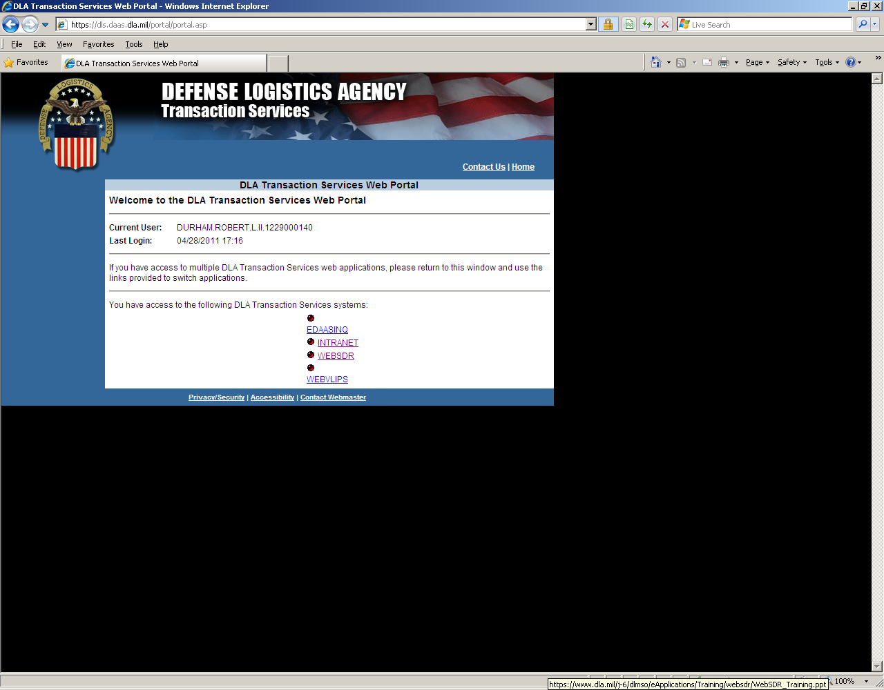
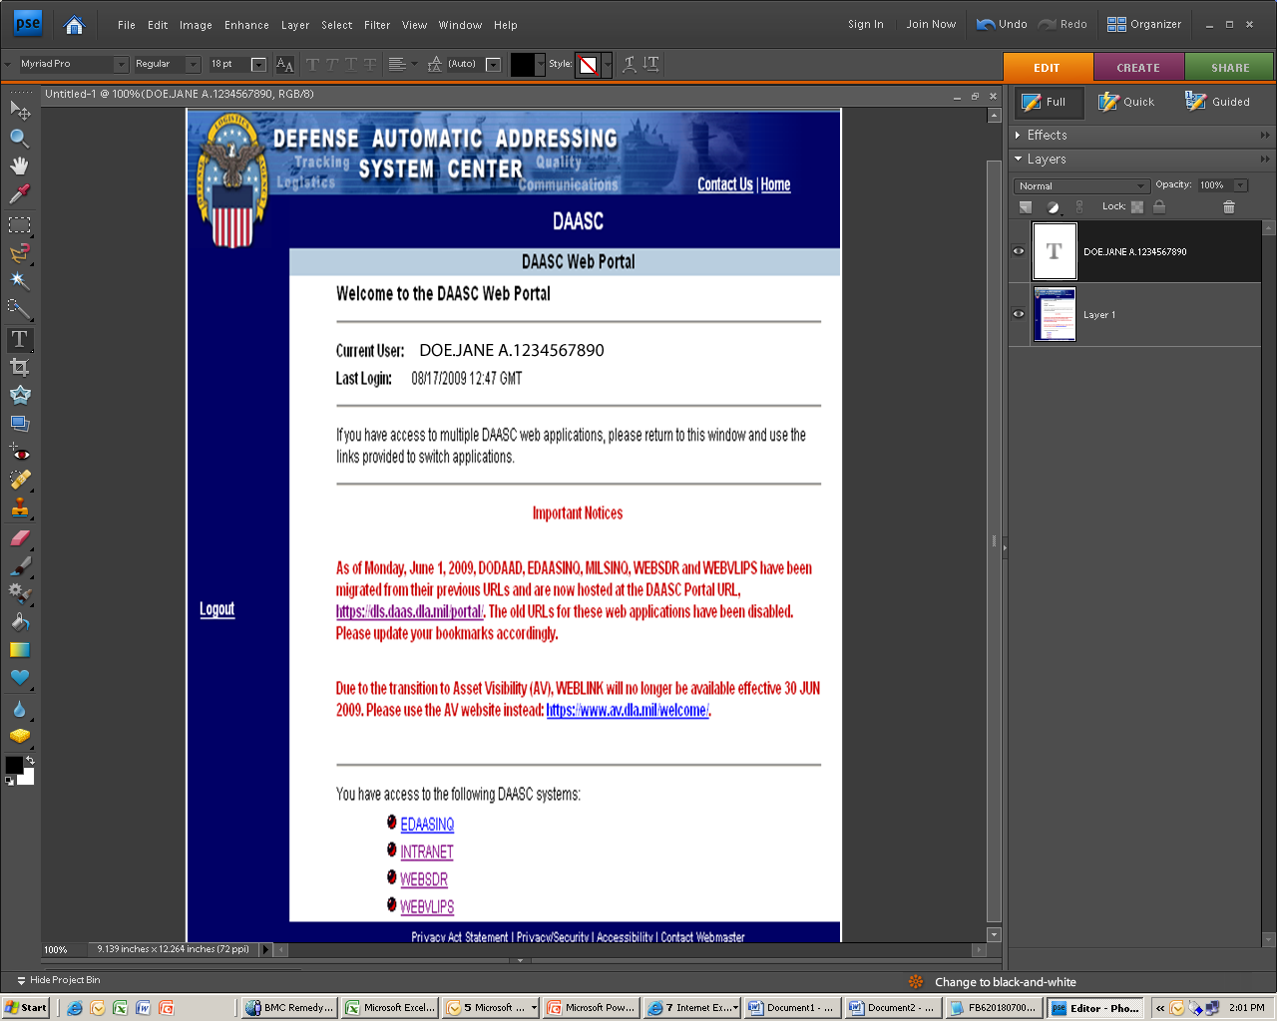
Log On to WebSDR
From https://www2.transactionservices.dla.mil,
access the WebSDR application.
WebSDR is Public Key Enabled (PKE).
When you see the portal page, click on WebSDR (each user’s system will show different options/systems available).
Notes:
Once you have submitted an SAR to gain access to WebSDR, you will log onto WebSDR from the DAAS web portal home page. Here you will see a list of applications that you have access to. From the list you will select “WebSDR”.
MM Notes: This is a screen build. Add graphics as appropriate.

Slide 51
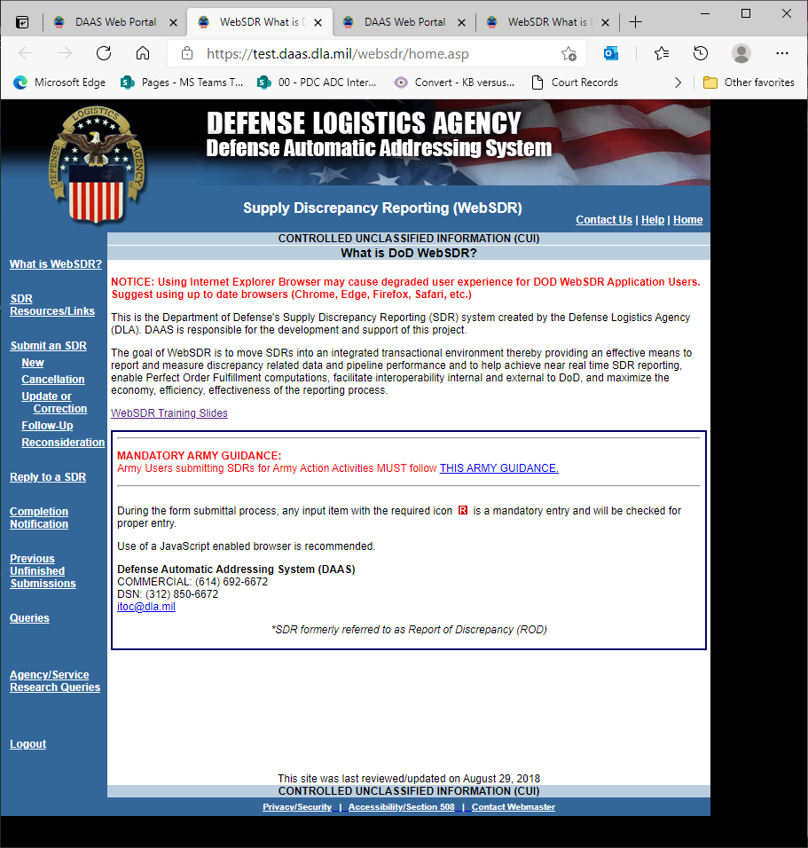
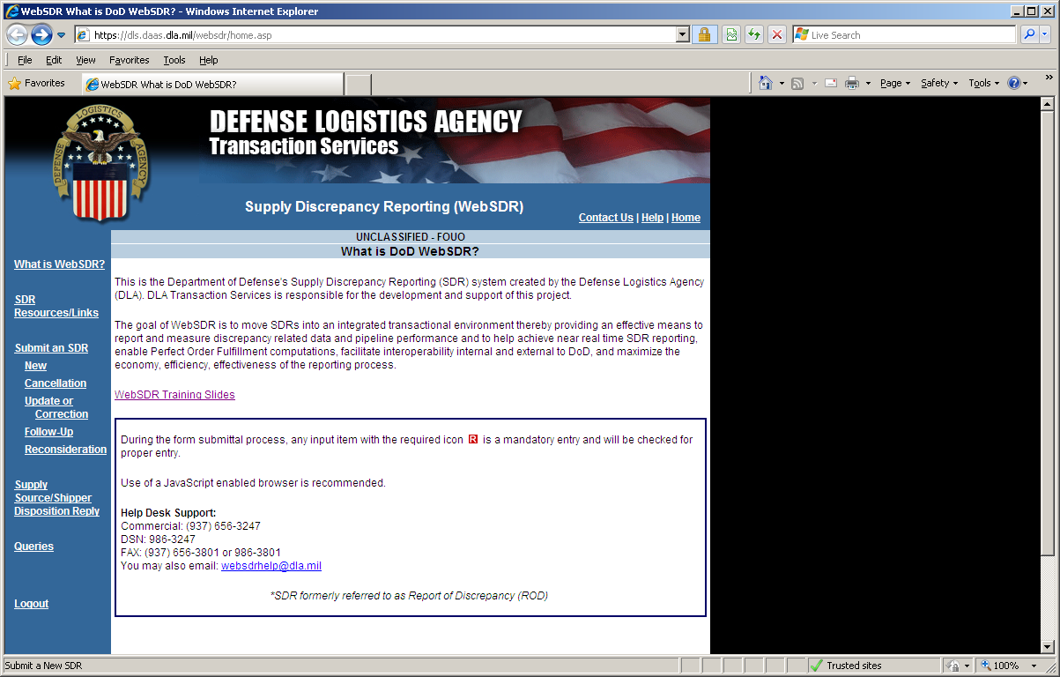
WebSDR Submittal Process
Initiate new SDR
Locate “Submit an SDR” on the left side of the screen. Next, select “New”. A list of possible SDR actions will appear: New, Cancellation, Update or Correction, Follow-up, and Reconsideration.
Notes:
Once you have clicked on “WebSDR” this page will appear. Click on “New” under “Submit an SDR” from the left side of your screen. A list of possible SDR actions appear including: New, Cancellation, Update or Correction, Follow-up, and Reconsideration. We will walk through each of these processes. But first, we will initiate a new SDR to report a shipping discrepancy.
MM Notes: This is a screen build. Add graphics as appropriate.

Slide 52
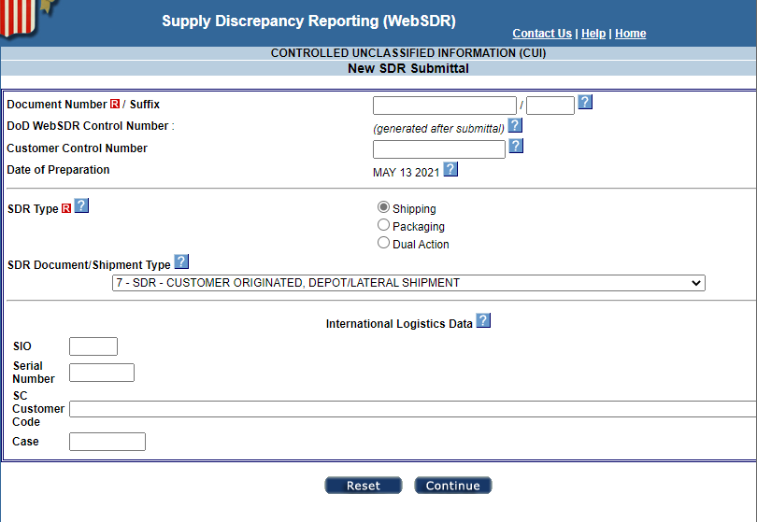
WebSDR Submittal Process, continued
Enter Doc Number
Notes:
You must enter the applicable document number to submit an SDR. The document number will be used to obtain DAAS historical information for the shipment when there is a match. A pseudo document number based upon the submitting activity DoDAAC may be used when a document number is not assigned or the SDR is being submitted at the shipment level by a transshipper.
Notice that a unique “WebSDR Control Number” is auto-assigned. If your local procedures include use of a control number configured differently, you may include it as your “Customer Control Number.” Both numbers will be retained for the life of the SDR.
U.S. Forces and DOD contractors will disregard the remaining entry blocks, as these are reserved for use by Service ILCOs entering SDRs related to Foreign Military Sales.
MM Notes: This is a screen build. Add graphics as appropriate.

Slide 53
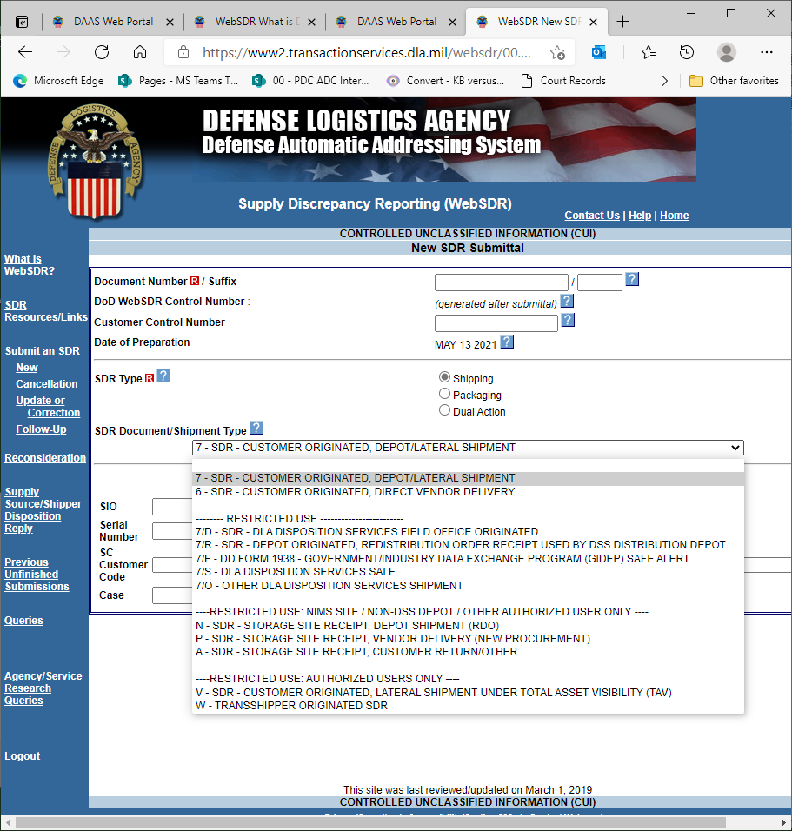
SDR Document/Shipment Type
Select the appropriate SDR type code to avoid delays and processing issues.
Notes:
It is important to select the correct SDR document type code to avoid delay and processing problems within the action activity’s application. More information about the document type codes can be found in DLM 4000.24, Volume 2, Chapter 17, and a list of the codes with definitions in Appendix 7.28 of the DLM Manual.
MM Notes: This is a screen build. Add graphics as appropriate.

Slide 54
SDR Document/Shipment Type, continued
Most SDRs submitted via WebSDR are customer initiated SDRs. These fall into Type 6 or Type 7.
Notes:
Most SDRs entered via WebSDR are customer SDRs which fall into Type 6 or Type 7.
Use Type 7 for distribution center shipments or lateral distributions at retail level
Use Type 6 for SDRs associated with “wholesale” level requisitions which are shipped directly by a vendor .
Other codes are intended for specialized use by pre-authorized personnel. For example, selected wholesale storage activities (e.g., those NOT using DLA Distribution Standard System or DSS) use Document Type Codes N, P, or A. DLA Distribution Services personnel are also authorized to use unique codes to explicitly identify the type of discrepant shipment involved.
Additional Document Type Codes support DLMS transaction input only. For example, SDRs submitted via DLA’s Distribution Standard System or DSS use the following Document Type Codes:
8 – Depot originated, depot receipt from non-procurement source (other than RDO)
9 - Depot originated, vendor delivery to depot
R - Depot originated, redistribution order receipt
Once you select the SDR type, hit continue.
MM Notes: This is a screen build. Add graphics as appropriate.

Slide 55
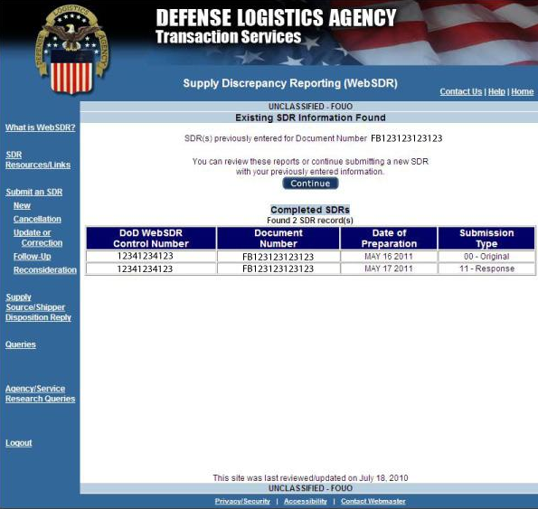
WebSDR Submittal Process, continued
Prior to creating a new SDR, WebSDR will search for any previously submitted SDRs that match the requested document number. You may review these or select “CONTINUE” to create a new SDR for this document number.
Notes:
Prior to creating a new SDR, WebSDR will search for any previously submitted SDRs matching the requested document number. You may review any of these or select “CONTINUE” to create a new SDR for this document number.
MM Notes: This is a screen build. Add graphics as appropriate.

Slide 56
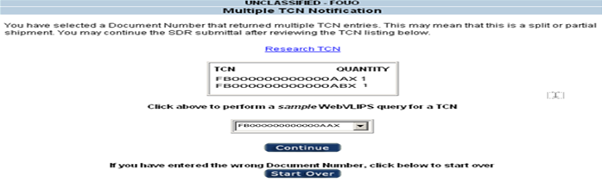
WebSDR Submittal Process, continued
Select shipment TCN in drop box
Multiple shipment TCN and quantity shipped displayed as WebVLIPS hyperlink.
FB250082610165
Often, WebSDR will find multiple (partial or split) shipments matching the document number. It’s up to the user to select the correct shipment.
Notes:
Often, WebSDR will find multiple (partial or split) shipments matching the document number, it’s up to the user to select the correct shipment. You have several choices from this screen:
You may select the Transportation Control Number (TCN) query into WebVLIPS (which provides a complete history for this shipment).
Or you may select the appropriate shipment using the TCN drop box and click “CONTINUE.”
You may “START OVER” if you realize the document number is not correct.
MM Notes: This is a screen build. Add graphics as appropriate.

Slide 57
Partial or Split Shipments
Source of Supply (SoS)
Required when using multiple shippers
Required when full quantity not immediately available
Each partial shipment has same document number and is identified by a unique document number suffix
Each shipment has a unique TCN
Document Number Suffix is in the 15th position of TCN
If no source of supply partial action, the 15th position will be an “X”
Notes:
What are partial or split shipments?
The Source of Supply (SoS) may create a “split shipment” to fill a requisitioned quantity when using multiple shippers or because not all of the materiel is immediately available. SoS split shipments are easily recognized by the document number suffix.
The distribution center may create separate shipments when individual pieces of the SoS-directed shipment may be separated during shipment (for convenience of the shipping activity or to prevent delays). Each shipment is assigned a unique TCN by using a Partial Code in the 16th position of the TCN. Each of these partial shipments will have the same requisition document number (and suffix when used). If there is no partial action, the 16th position will be an X.
A subsequent trans-shipment activity, such as a port, may "split" a shipment, moving each forward as a distinct shipment. This is identified by a "Split TCN Suffix" in the 17th position of the TCN.
MM Notes: This is a screen build. Add graphics as appropriate.

Slide 58
Partial and Split Shipments, continued
Distribution Center
  Create separate shipments for convenience or to prevent delays
  Each partial shipment has same document number and suffix when used
  Each shipment has unique TCN
  “Partial code” in 16th position
  If no partial action, the 16th position will be an “X”
Transshipment Activity (e.g., port)
  May split shipment
  “Split TCN Suffix” in 17th position of TCN
  If no transshipper split action, the 17th position will be an “X”
Notes:
MM Notes: This is a screen build. Add graphics as appropriate.

Slide 59
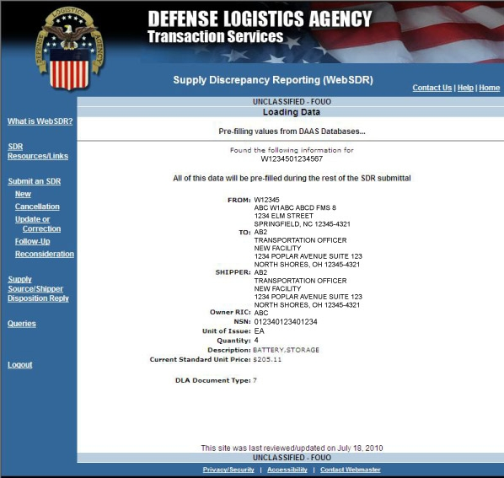
WebSDR Submittal Process
Retrieved
requisition information
WebSDR automatically pre-fills much of the shipping and requisition information for you. This information is taken from DAAS history files. In some cases, you may need to overwrite the pre-filled information when you reach the applicable input field.
Notes:
Let’s go back to the WebSDR submittal process and talk about the next step. WebSDR automatically pre-fills much of the shipping and requisition information for you. This information is taken from DAAS history files. In some cases, you may need to overwrite the pre-filled information when you reach the applicable input field .
MM Notes: This is a screen build. Add graphics as appropriate.

Slide 60
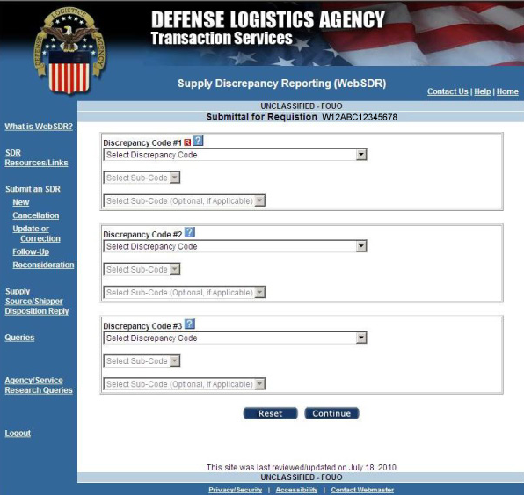
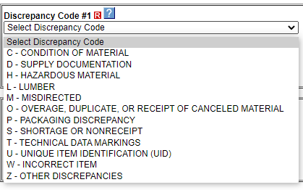
WebSDR Submittal Process, continued
Level 1 defines the discrepancy category
Level 1 Discrepancy Drop Down Window
Notes:
At this point, you must select the discrepancy code(s) applicable to the report. At least one discrepancy code must be entered, and a maximum of three may be entered. Due to the long list of available discrepancy codes, the codes are grouped according to categories. Sub-groupings within each category are used to clearly define the discrepant condition. Use the drop down menus in sequence to select the applicable two, three, or four position discrepancy code.
MM Notes: This is a screen build. Add graphics as appropriate.

Slide 61
WebSDR Submittal Process, continued
Level 1 defines the discrepancy category
Level 2 identifies conditions within selected category and completes the discrepancy code
Level 3 further defines packaging discrepancies
Select the “Discrepancy Code”.
Notes:
MM Notes: This is a screen build. Add graphics as appropriate.

Slide 62
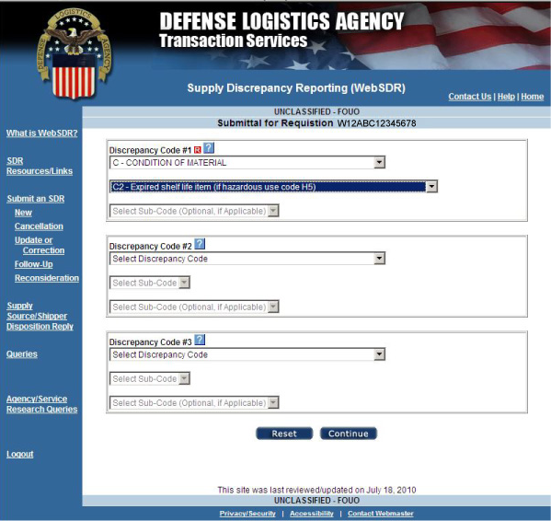
WebSDR Submittal Process, continued
C2 Discrepancy
reported
Notes:
Based on the discrepancy code you selected, WebSDR will automatically determine if unique information specific to the discrepant condition is required. For example, if you select discrepancy code “C2” for an expired shelf-life discrepancy, or “W1” for a wrong item discrepancy, WebSDR will provide an additional screen later in the submission portion for you to enter the associated shelf life information or specific incorrect item received information.
MM Notes: This is a screen build. Add graphics as appropriate.

Slide 63
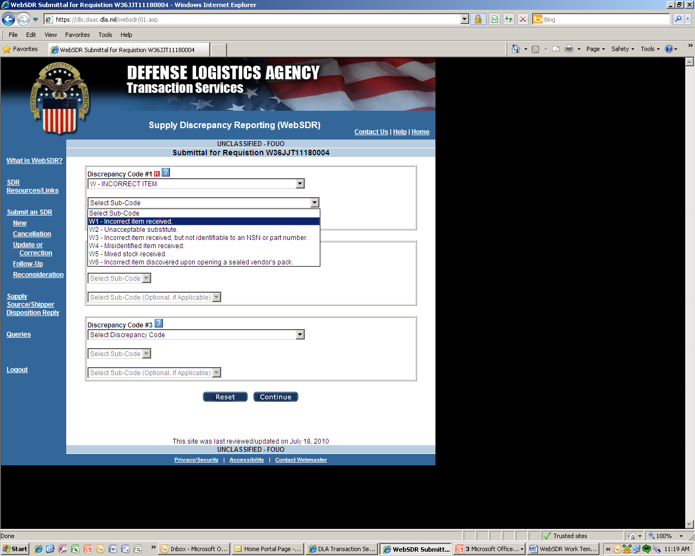
WebSDR Submittal Process, continued
W1 Discrepancy
Reported
Notes:
MM Notes: This is a screen build. Add graphics as appropriate.

Slide 64
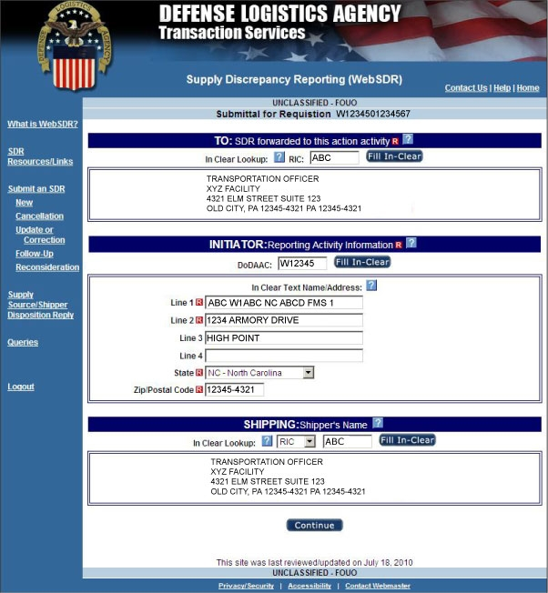
WebSDR Submittal Process, continued
Notes:
WebSDR has pre-filled the action activity, initiator, and shipping activity information from the DAAS requisition and shipping history. WebSDR will normally determine the correct action activity for your SDR and display it on screen. The system will fill in the addresses as recorded in the DOD Activity Address Directory (DoDAAD). When the user must enter the applicable code values for any of these activities, click on the button to fill in the clear text address. This gives you an opportunity to confirm that the correct activity code was entered.
Did you notice the blue question mark boxes? These indicate help information is available, including definitions and special rules. The help information can be accessed by simply clicking on the question marks.
MM Notes: This is a screen build. Add graphics as appropriate.

Slide 65
WebSDR Submittal Process, continued
  Business rule logic to determine the appropriate activity to receive SDR for action.
  Rules vary according to multiple factors, such as:
    the specific Service or Agency functioning as the Source of Supply
    who shipped the materiel - vendor or DLA Distribution Center
    the specific discrepancy code
Note:
Component SDR applications are required to apply business rules for SDR routing comparable to those used by WebSDR for SDRs entered via WebSDR online input.
Notes:
For SDRs input online via WebSDR, WebSDR uses business rule logic developed by the DOD Components to determine the most appropriate activity to receive the SDR for action. These rules vary according to multiple factors, such as the specific Service or Agency functioning as the Source of Supply. Or the action activity will be the one who shipped the materiel – a vendor or DLA Distribution Center. Another factor is the specific discrepancy code that was selected.
Note, Component SDR applications are required to apply business rules for SDR routing comparable to those used by WebSDR for SDRs entered via WebSDR online input.
MM Notes: This is a screen build. Add graphics as appropriate.

Slide 66
WebSDR Submittal Process, continued
  Your Service or Agency procedures should always be applied to the SDR process. You may override the pre-filled information because there may be situations which cannot be built into system processing. Use caution in doing so.
  When pre-filled information is not available, manually key in the remaining SDR data.
  If you identify the source of supply as the action activity, the source of supply may forward the SDR to the appropriate shipping activity.
Note:
When systemic forwarding is accomplished using Reply Code 504, the submitter is notified that the SDR has been forwarded to a new action activity and the new action activity receives a new original SDR (meaning the new action activity doesn’t have visibility of the forwarding remarks).
Notes:
You may override the pre-filled information because there might be situations which cannot be built into the system processing. But, use caution in doing so. Your Service or Agency procedures should always be applied to the SDR process.
Where pre-fill information is not available, you will have to manually key in the remaining SDR data.
If you identify the source of supply as the action activity, the source of supply may forward the SDR to the appropriate shipping activity.
Note, when systemic forwarding is accomplished using Reply Code 504, the submitter is notified that the SDR has been forwarded to a new action activity and the new action activity receives a new original SDR (meaning the new action activity doesn’t have visibility of the previous action activity’s reply and doesn’t see the forwarding remarks).
MM Notes: This is a screen build. Add graphics as appropriate.

Slide 67
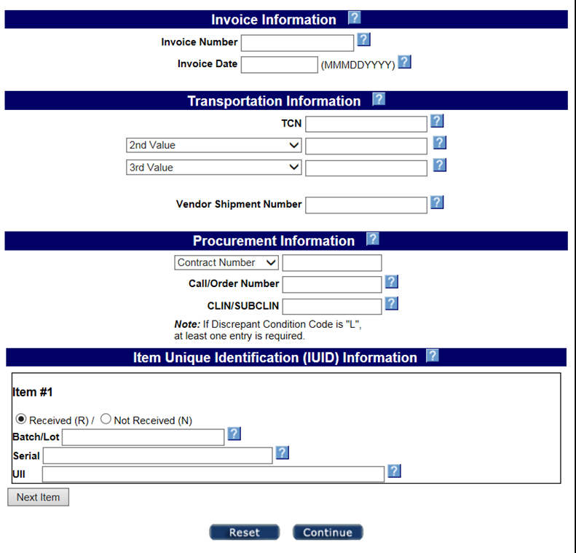
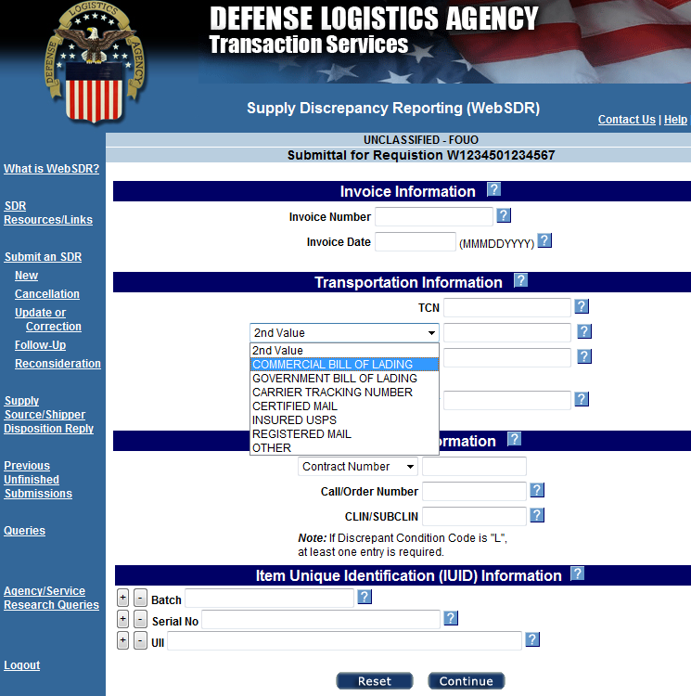
WebSDR Submittal Process, continued
Transportation Control Number (TCN) should always be included when available.
2nd and 3rd transportation numbers are optional.
Notes:
This screen allows you to enter additional information associated with the shipment such as transportation, procurement, and unique item identification information such as unique item identifier (UII) and/or serial number and/or batch number.
WebSDR will auto-fill as much historical information as available. Drop down menu’s will assist you in entering other related information. Just skip over any information not required or applicable.
The Transportation Control Number (TCN) should always be included when available. Other transportation numbers are optional.
MM Notes: This is a screen build. Add graphics as appropriate.

Slide 68
WebSDR Submittal Process, continued
Transportation Control Number (TCN) should always be included when available.
2nd and 3rd transportation numbers are optional.
Always include PIID or Contract Number and Line
Item Number, when known, for direct vendor
delivery (DVD) shipments (Document Type 6).
For storage activity procurement source receipts (e.g. Document Type P), contract information and the vendor shipment number (above) are required.
Unique identification should be included for items tracked under a UIT program or OSD Supply Policy.
See next slide for IUID details.
This screen allows you to enter additional information associated such as transportation, procurement, invoice and IUID information (received or not received indicator (Y/N), unique item identifier (UII) and/or serial number and/or batch number may be entered). WebSDR will auto-fill as much historical information as available. Drop down menu’s will assist you in entering other related information. Skip over any information not required or applicable.

Slide 69
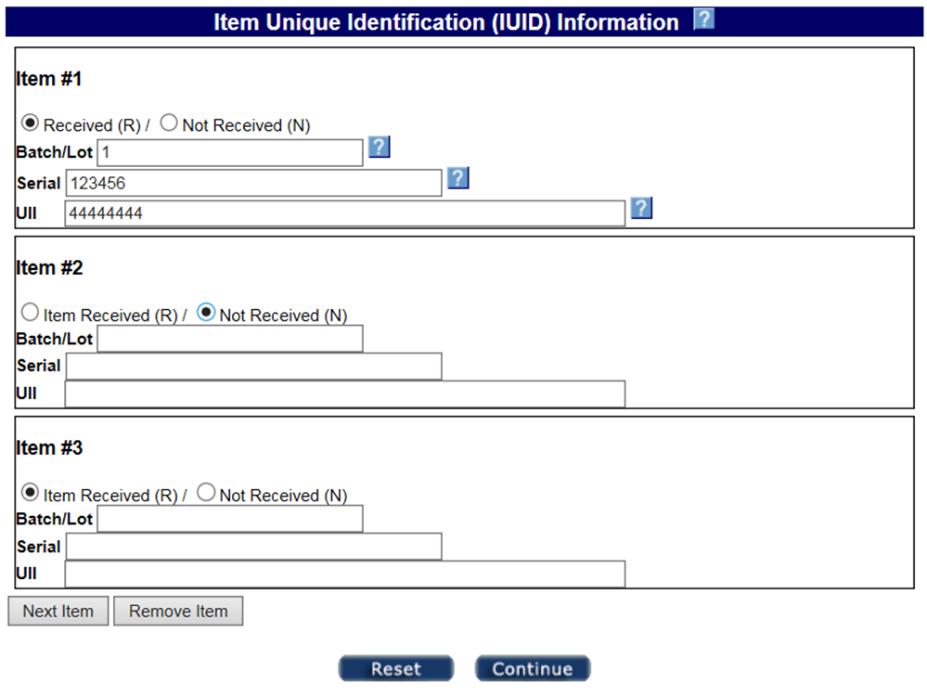
WebSDR Submittal Process, continued
IUID Entry
1234567
“Item Received/Not Received” indicator: A radial button or yes/no indicator, used with IUID values. It indicates when the IUID values are applicable to items that were received or not received.
DDCAGA33091234567
Notes:
This screen allows the user to indicate the status of each discrepant IUID as received (R) or not received (N) by clicking either indicator button. The submitter enters the tracked items with their associated IUID information.
MM Notes: This is a screen build. Add graphics as appropriate.

Slide 70
WebSDR Submittal Process, continued
IUID Entry
Batch/Lot Number: An identifying number assigned by the enterprise to a designated group of items.
1234567
DDCAGA33091234567
Serial Number: An identifying number assigned to an item.
Unique item identifier (UII): A globally unique and unambiguous identifier that distinguishes an item from all other items.
Notes:
The IUID data fields include batch/lot number, serial number and unique item identifier (UII). Serial number and UII (when available) are required entries for discrepancies involving an IUID mismatch involving serial number/UII associated with the item, packaging, documentation, or shipment transactions for serially-managed/tracked materiel. When identifying a mismatch, include the applicable IUID discrepancy code. Also include serial number and UII when reporting serially-managed/tracked materiel received in a condition other than identified in the shipment documentation.
MM Notes: This is a screen build. Add graphics as appropriate.

Slide 71
WebSDR Submittal Process, continued
IUID Entry
1234567
DDCAGA33091234567
Click “Remove Item” to remove data set from last item
Click “Next Item” to open additional data fields for multiple discrepant items under same document number.
Notes:
Use the “Next Item” button to continue adding items and the “Remove Item” button to remove items from the last available item box upward. Corrections can be made on entered items while continuing to enter additional items. Skip over any information not required or applicable.
MM Notes: This is a screen build. Add graphics as appropriate.

Slide 72
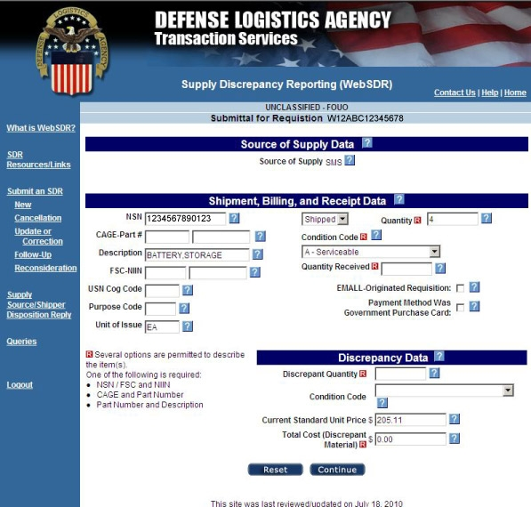
WebSDR Submittal Process, continued
Default setting “Shipped” is appropriate for U.S. Military customers.
If material identification is not pre-filled, you must populate this area with material identification as requisitioned. You don’t need to provide extra information unless required by your Service rules.
Condition code “shipped/billed” and condition code “actually received” are only required for condition discrepancies. Use drop box to select appropriate code.
IMPORTANT: Shipment, Receipt, and Discrepancy Data Screen. WebSDR will pre-fill information as available from DAAS historical records. Enter the actual shipped, received, and discrepant quantities. If applicable to the type of discrepancy, select the shipped and received condition codes.
indicate required information fields.
R
Notes:
This screen allows the user to input additional information that is not already pre-filled by WebSDR using information available from DAAS historical records.
You will enter the actual shipped, received, and discrepant quantities. If applicable to the type of discrepancy, you will need to select the shipped and received condition codes.
Did you notice the red “R” boxes above? These indicate required information fields. You cannot proceed unless this information is provided.
MM Notes: This is a screen build. Add graphics as appropriate.

Slide 73
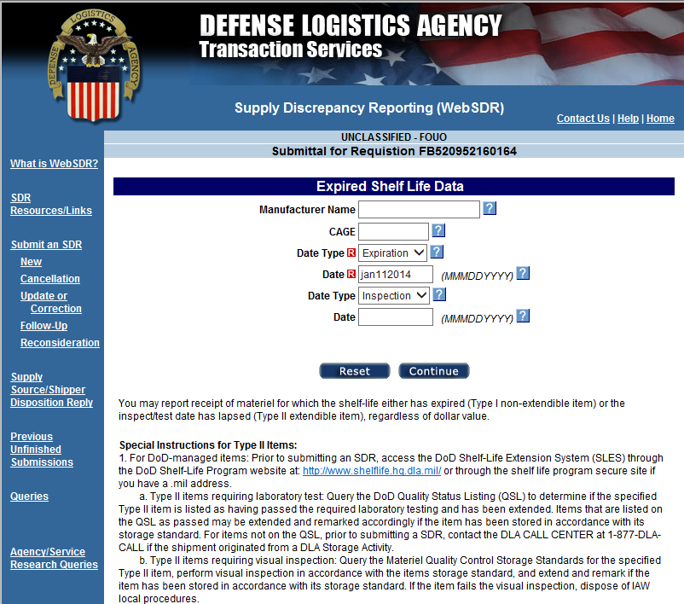
WebSDR Submittal Process, continued
Notes:
This screen shows the required additional fields the user needs to input for an expired shelf life SDR.
Prior to submitting an SDR for expired Type II (extendible) items, check the DLA website for possible authorized extensions and follow applicable procedures.
MM Notes: This is a screen build. Add graphics as appropriate.

Slide 74
WebSDR Submittal Process, continued
Notes:
This screen shows the required additional fields the user needs to input for a “wrong item received” SDR.
Although this information block is flexible for the user to identify the wrong item by various pieces of information, it is critical that the user provides sufficient information for the action activity to interpret the type of materiel received.
Remember to identify the part number as “UNKNOWN” if the only information available is a description.
MM Notes: This is a screen build. Add graphics as appropriate.

Slide 75
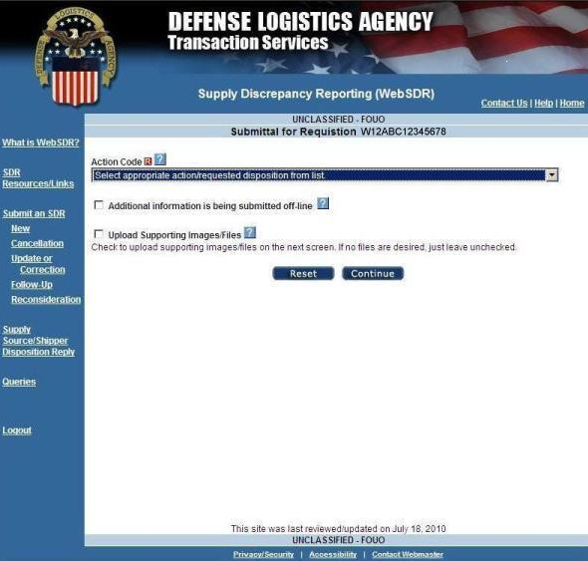
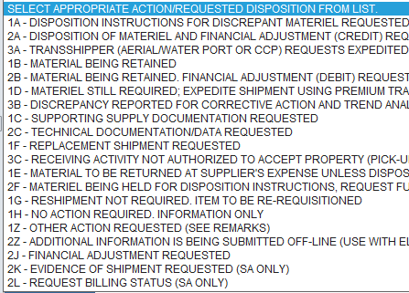
WebSDR Submittal Process, continued
Select appropriate “Action code”.
Select “Additional information is being submitted off line”.
Action code drop down menu view
Select “Upload Supporting Images/Files” and follow directions on screen.
Notes:
WebSDR will allow you to specify the action you would like taken to resolve your discrepancy. You must select one of the action codes from the drop down menu.
MM Notes: This is a screen build. Add graphics as appropriate.

Slide 76
WebSDR Submittal Process, continued
Browse files to choose one attachment file to upload and click on upload file icon.
Repeat as needed. Each file is uploaded separately.
Notes:
You may upload supporting images/files, such as pictures or shipping documents from your computer. If this is not possible, but you have hard copy information you would like included, check the box indicating additional information will be provided off line. This separate information may be mailed or faxed to the action point and a printed copy of the completed SDR must be included. However, the separate submission option is strongly discouraged.
MM Notes: This is a screen build. Add graphics as appropriate.

Slide 77
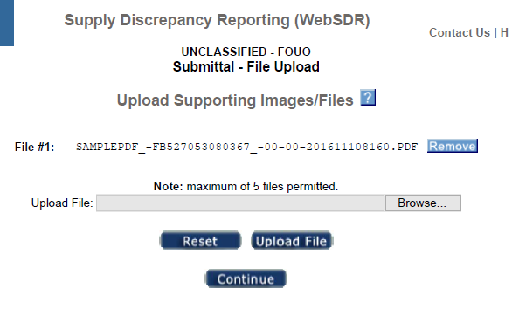
WebSDR Submittal Process, continued
Uploaded files will appear as shown here.
Once uploads are complete, click on ‘Continue’ to complete SDR submittal process.
Notes:
WebSDR allows you to upload up to 5 attachments for each SDR submission (new reports, corrections, requests for reconsideration, replies) with a maximum file size of 15 megabytes per attachment. Each file must be uploaded separately when using the direct web input method (although, when using a transactional interface, up to 5 files may be sent at once).
MM Notes: This is a screen build. Add graphics as appropriate.

Slide 78
WebSDR Submittal Process, continued
Prepare your files in advance to prevent time out during upload.
File names should include key words and be no more than 10 characters.
No special characters other than the underscore “_”. A period may be used preceding the file extension.
Maximum file size 15 MB.
Permitted file formats: bmp, doc, gif, jpg, jpeg, pdf, txt, docx, xls, and xlsx.
Supporting files may be uploaded to WebSDR or transmitted with the SDR transaction.
Up to 5 attachments may accompany each SDR submission (e.g. new reports, corrections, requests for reconsideration, replies).
WebSDR will push attachments to the SDR application used by the recipient, when this capability is supported; otherwise, the recipient will be notified that attachments are available for viewing in WebSDR.
Notes:
It is recommended you prepare your files in advance so that WebSDR does not time out during the upload process. When attaching files, you cannot use special characters other than the underscore in the file name. File names should include key words to facilitate identification and must be no more than 10 characters. By restricting the user controlled portion of the file name to 10 characters, this allows space for additional characters assigned by WebSDR for uniqueness, including a date/time stamp, and to associate the saved file with the appropriate SDR record for later retrieval or transmission.
Once uploads are complete, click on “Continue” to complete SDR submittal process. WebSDR will push the attachments to the SDR application used by the recipient, if this capability is supported; otherwise, the recipient will be alerted that attachments are available for viewing in WebSDR.
MM Notes: This is a screen build. Add graphics as appropriate.

Slide 79
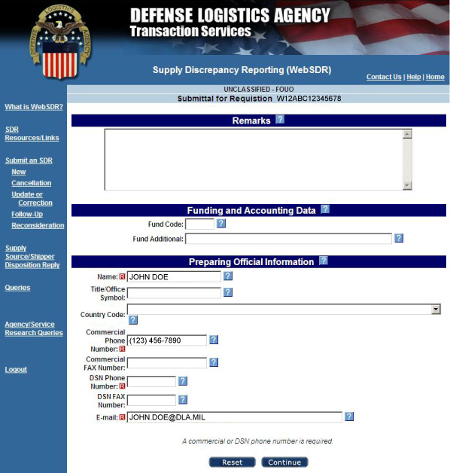
WebSDR Submittal Process, continued
Use the “Remarks” space to provide any clarifying information that will assist the action activity in processing the SDR. Remarks are required except for info only SDRs.
“Fund Code” information is not applicable except when requesting credit after discovery of a concealed discrepancy in a sealed vendor pack, and the original requisition document number is no longer available. This is an exception situation only authorized for U.S. Forces.
Although you can overwrite POC details, you must contact the WebSDR Help Desk if your contact information changes.
Notes:
Users are required to use this screen to enter remarks. Be sure to provide any clarifying information that will assist the action activity in processing your discrepancy report.
Fund code and supplemental funding information is not applicable except when requesting credit after discovering a concealed discrepancy in a sealed vendor pack and the original requisition document number is no longer available. This is an exception situation only authorized for U.S. Forces.
Your POC information will be pre-filled from your SAR. NOTE: This POC email address will be used by WebSDR to provide a confirmation copy, and will be used later to return an action activity reply directly to the submitter. You have the option to overwrite the pre-filled information if required by local procedures. If your contact information changes please call the DAAS Help Desk.
MM Notes: This is a screen build. Add graphics as appropriate.

Slide 80
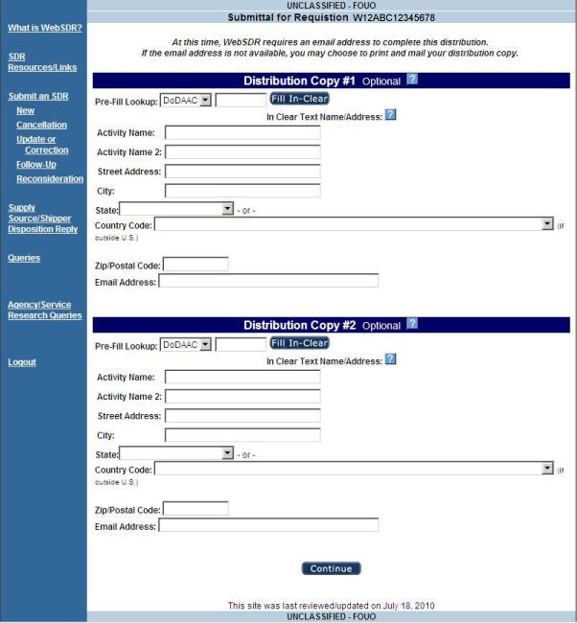
WebSDR Submittal Process, continued
Local procedures will determine when this option is needed.
Click to retrieve clear-text address for DoDAAC or Routing Identifier.
Notes:
You may identify two additional organizations to receive a distribution copy of your SDR. Use this option only when needed, based upon local procedures. WebSDR will automatically send information copies to the source of supply when SDRs are distributed to a DLA Distribution Center. Organizations that receive DLMS transactions to update their automated system generally do not want to receive email distribution.
Any organization identified here will also receive copies of future actions related to this SDR and the action activity reply. You may select Routing Identifier or DoDAAC from the drop down menu, enter the code, and WebSDR will fill the clear text for you.
MM Notes: This is a screen build. Add graphics as appropriate.

Slide 81
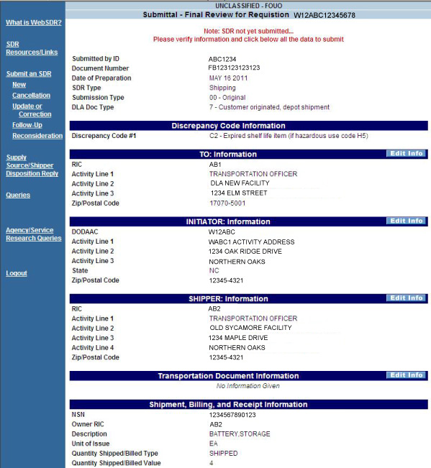
WebSDR Submittal Process, continued
SDR ready for final review or correction
Notes:
Your SDR submission is almost complete. WebSDR will provide one final view of the SDR you just created. You may review the SDR and make any changes or corrections prior to submission. Select edit to go back to the SDR screen where edits are required. If all the data is OK, select continue to go to the next screen.
MM Notes: This is a screen build. Add graphics as appropriate.

Slide 82
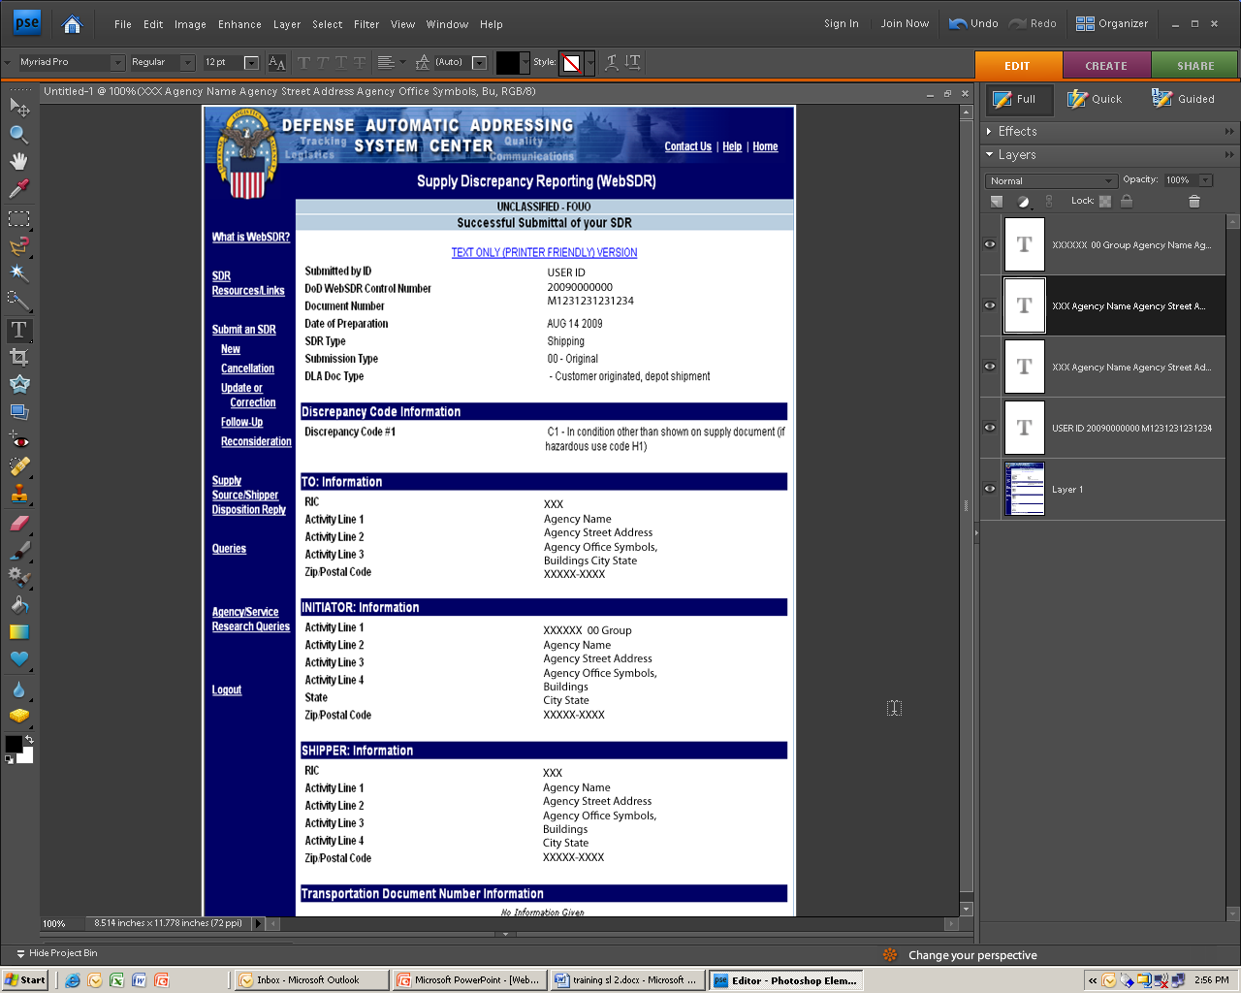
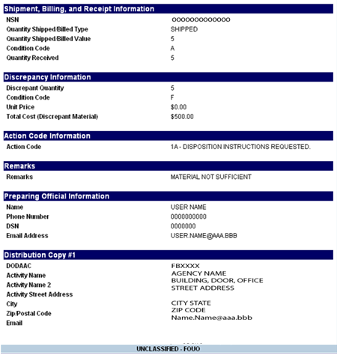
WebSDR Submittal Process, continued
    SDR successfully submitted
Print if local procedures require you to maintain a hard copy
Notes:
You have just completed your SDR submission. A printed version will include a signature line for use where local procedures require a signed document.
MM Notes: This is a screen build. Add graphics as appropriate.

Slide 83
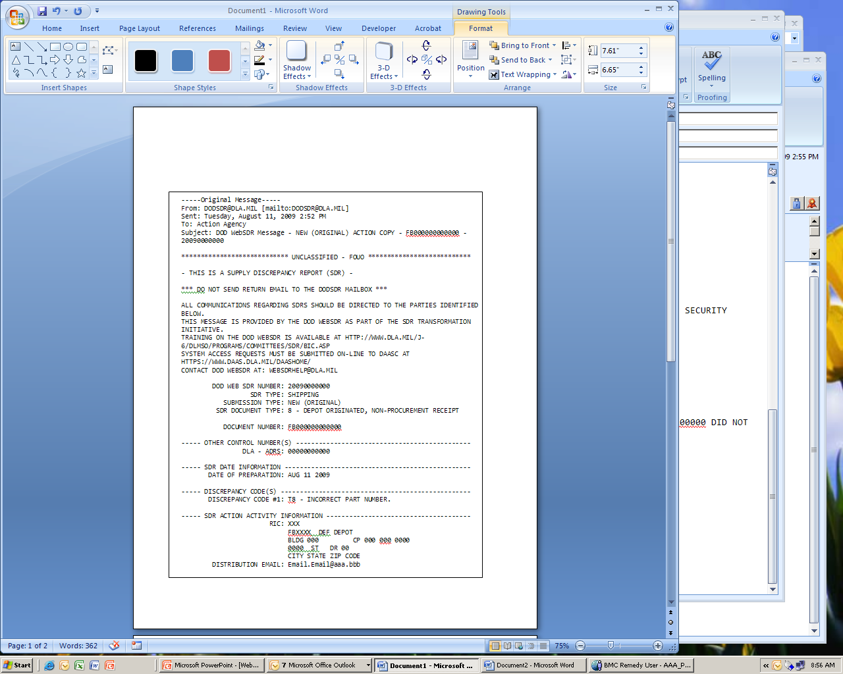
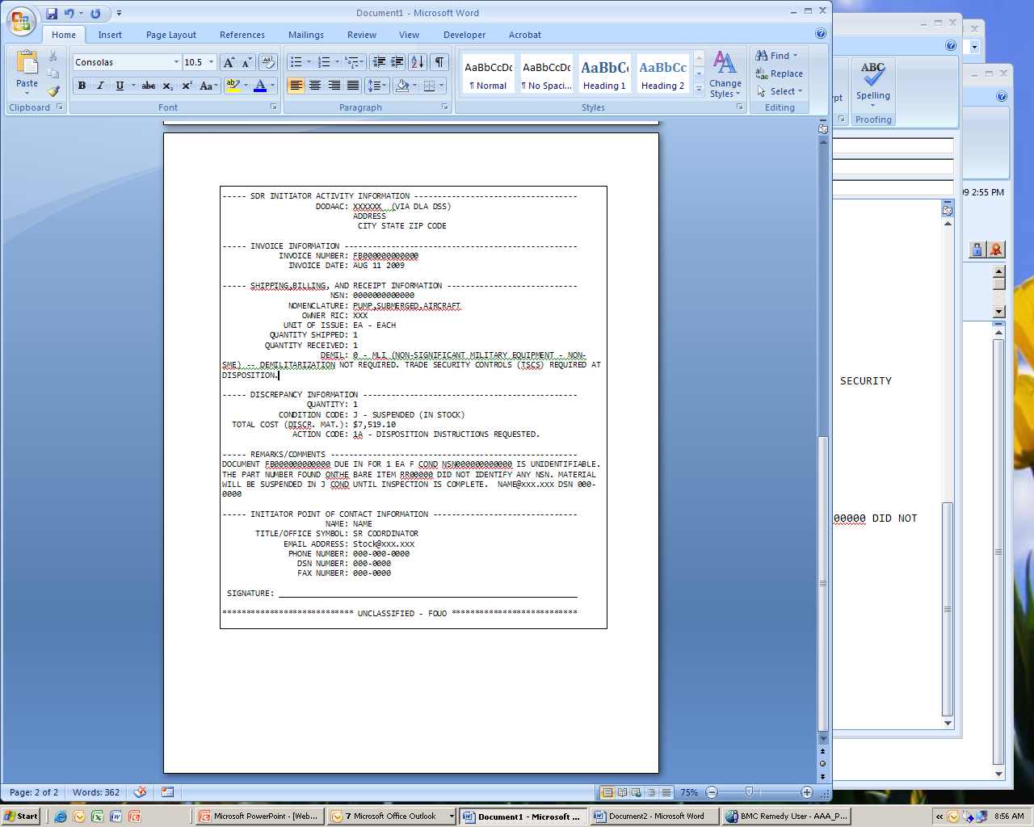
Email Action Copy
Page 1
Page 2
Notes:
This chart depicts a successful submission email action copy which will be provided to DOD Components which are not yet capable of receiving SDR transactions. Transaction enabled systems will receive SDR transactions in lieu of email.
MM Notes: This is a screen build. Add graphics as appropriate.

Slide 84
Standard SDR X12 842A/W Transaction
ISA*00*NONE *00*NONE *10*S00000 *10*SL0000 *080701*0000*^*00400*00000000000*P*>
GS*NC*S00000*SL0000*20080701*00000000*000000*X*000000
ST*842*000000001*004000F000A00000
BNR*00*Z*20080701*16161609**C1
N1*41**M4*AN5**FR
PER*PU*JUDITH LASTNAME*TE*7176051111***EM*EMAIL@aaa.bbb
PER*PU*JUDITH LASTNAME*AU*4000000
N1*ZD**M4*RIC**TO
HL*1**RP
LIN**FS*1005010000000
DTM*947*20000000
REF*87*S
REF*TN*FB000000000000
REF*NN*20080000000*WebSDR
REF*NN*82008000000*ADRS
LM*DF
LQ*D*8
LQ*HB*1H
LQ*EQ*7
NCD**5*1
NTE*RPT*NO DUE IN FOR NIIN 00 000 0000,WITH CONTRACTFB000000000000. POCSTOCKREAD
NTE*RPT*EMAIL@XXX.XXX.XXX
QTY*86*1*EA
QTY*87*1*EA
AMT*10*4467.18
N1*SUS**M4*RIC
N1*91**M4*RIC
LM*DF
LQ*HA*D3
LQ*83*A
SE*29*000000001
GE*1*688094
IEA*1*000688094
Notes:
Here you see a successful submission of an SDR X12 842A/W transaction, and the corresponding email distribution copy that was generated on the right. Users will not normally see the DL transaction which is designed to be machine readable.
Pending implementation of DLMS compliant SDR systems, WebSDR will continue to distribute SDRs via email as needed. The long-term goal for WebSDR is to eliminate emailing of SDR actions and distribution copies.
MM Notes: This is a screen build. Add graphics as appropriate.

Slide 85
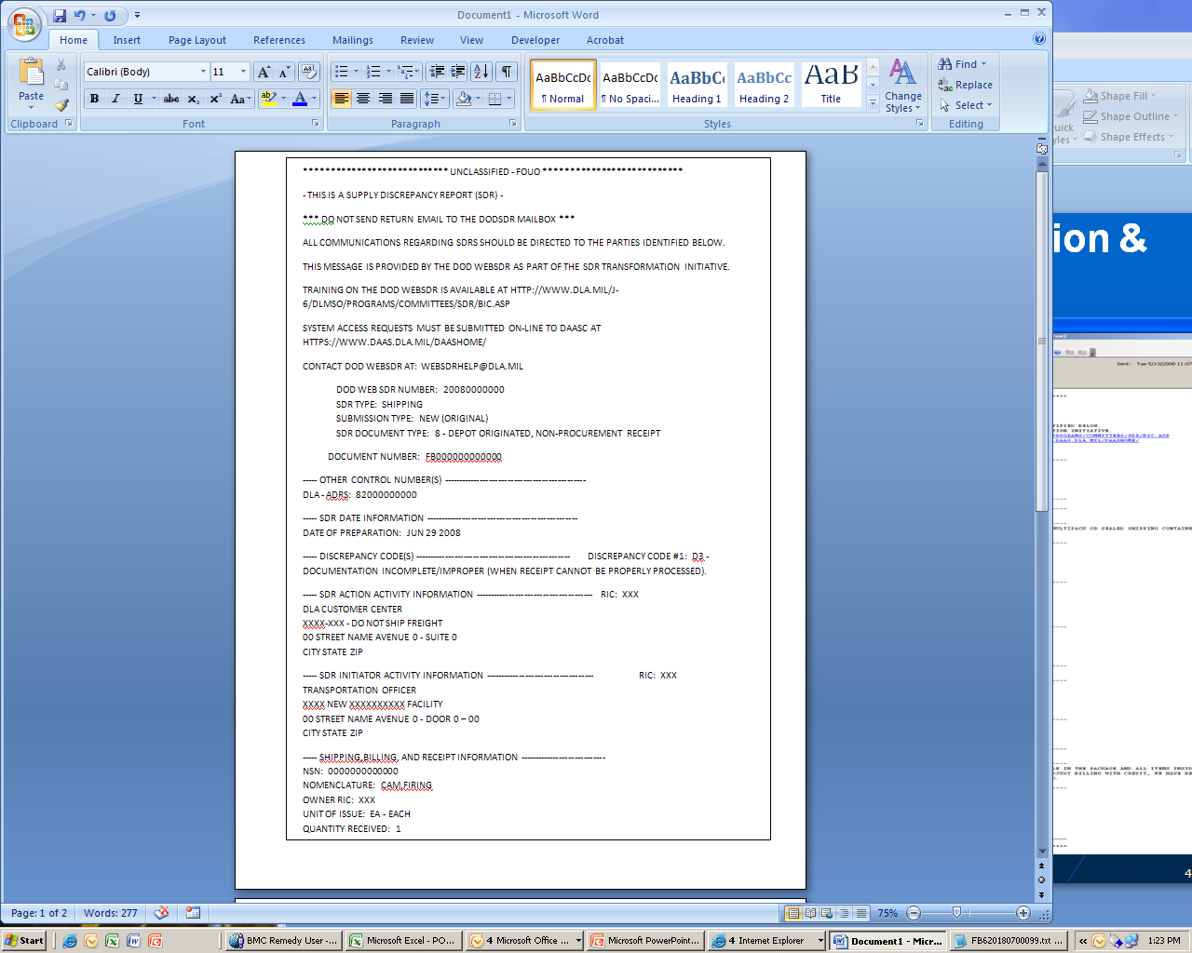
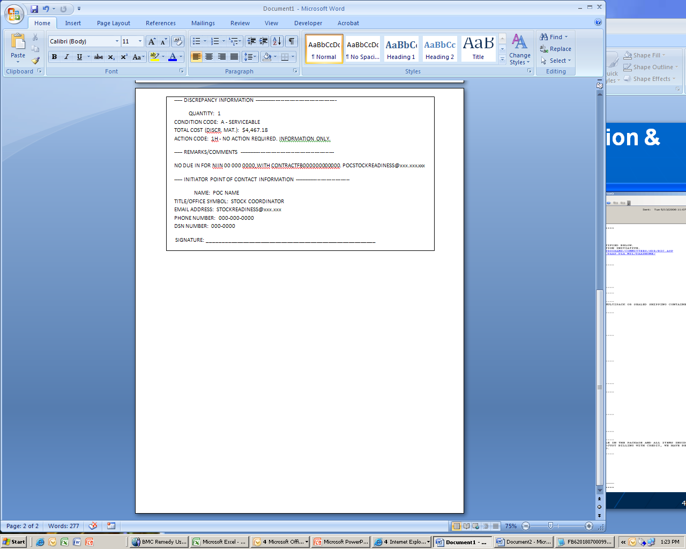
Email Distribution Copy Response
Notes:
MM Notes: This is a screen build. Add graphics as appropriate.

Slide 86
Special Business Rules for Transshipper-Prepared SDRs Document Type W Aerial Ports and CCPs Only
(This Section should be viewed using Slide Show to utilize additional functionality found on Slide 116.)
Notes:
In this section we will discuss the procedures for submitting a Transshipper SDR.

Slide 87
Discrepancy Types
Not prepared for Military Air
Missing Shippers Declaration of Dangerous Goods
Incorrect Shippers Declaration of Dangerous Goods
Inadequate/wrong/damaged packaging

Slide 88
WebSDR “HOW TO” Overview
How to start the process of filling an SDR.
The eDAASINQ System.
Other Resources that may help.

Slide 89
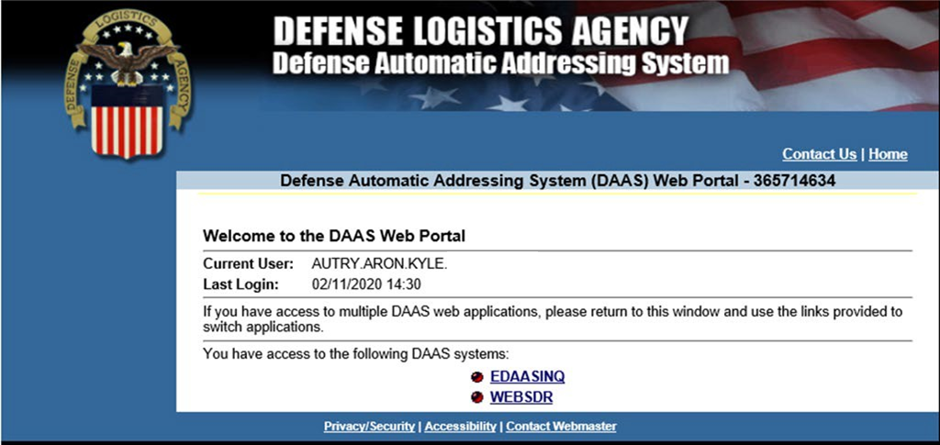
WebSDR “HOW TO” Overview
Use the Link below to get to the WebSDR site. You will need an account if you do not already have one.
To complete an SDR click WEBSDR
To look up RIC based off a DODAAC, click ESAASINQ. (Steps at the end) Slide 110

Slide 90

Aerial Port WebSDR “How-To” Guide
1. Click “New” to submit a new SDR.

Slide 91
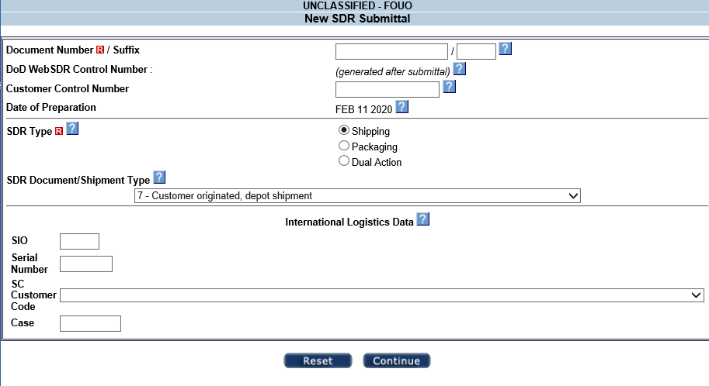
Aerial Port WebSDR “How-To” Guide
1. The transportation control number (TCN) will be the primary reference number for operational processes. If the shipment is received at the aerial port or CCP without a TCN, one will be assigned in accordance with the DTR. SDRs prepared at the shipment level may include multiple items, or there may not be due-in or documentation available. Because a document number is mandatory within DoD WebSDR, the aerial port, CCP, or other transshipment activity may need to generate a document number based upon the submitter’s DoDAAC if multiple documents are included or the original document number is unavailable.
Step 1
Step 2
2. Click the drop down to select the “SDR Doc/Shipment Type.”

Slide 92
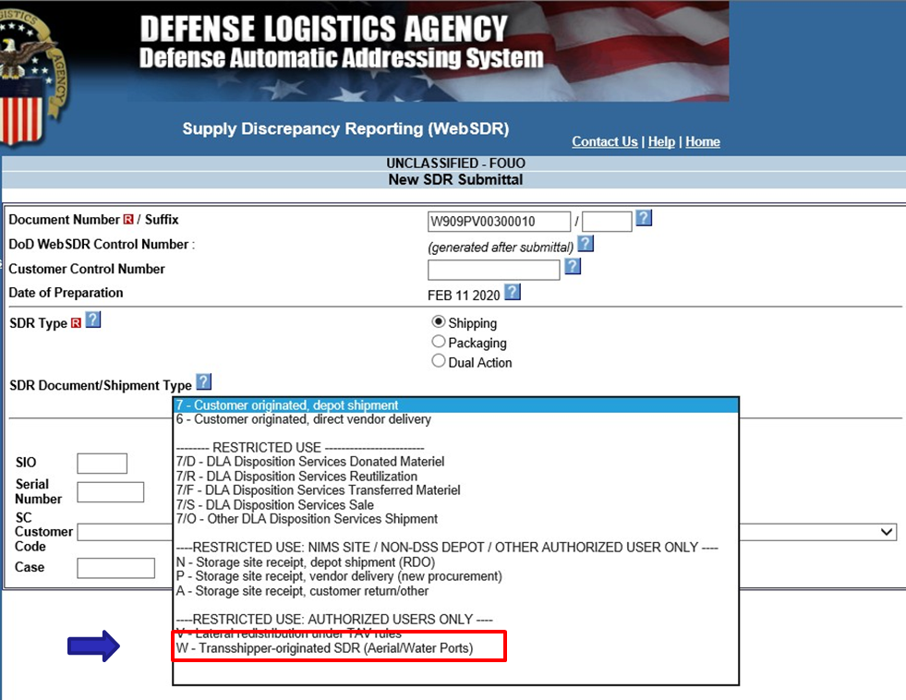
Aerial Port WebSDR “How-To” Guide
Select “W” for SDRs being completed at an Aerial/Water Port.
After selected click “Continue.”

Slide 93
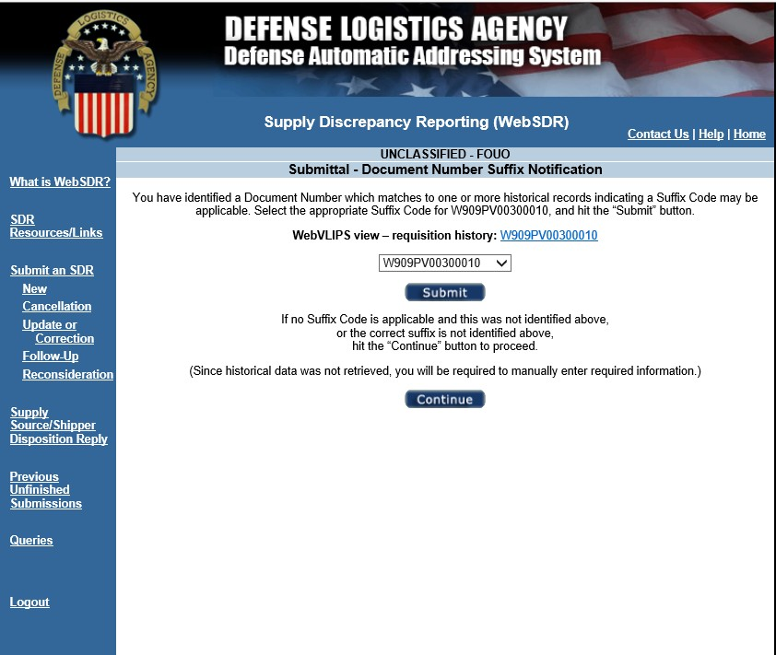
Aerial Port WebSDR “How-To” Guide
This screen will pop-up if you have suffixes attached to the TCN. (If not already added at the beginning) If there are suffixes, select the appropriate one from the drop down.
After selecting the correct TCN click “Submit.”

Slide 94
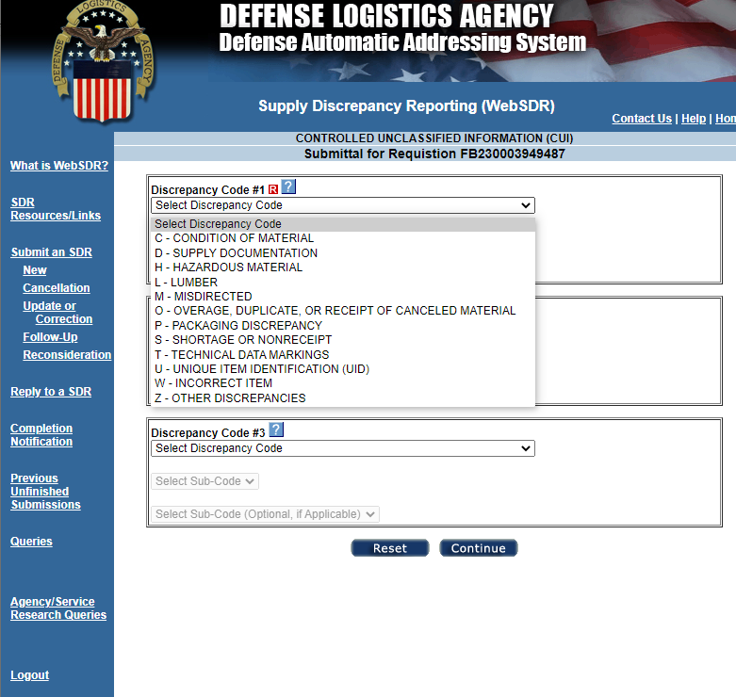
Aerial Port WebSDR “How-To” Guide
Each SDR can accept up to three discrepancy codes. Ensure the proper discrepancy codes are utilized. The next few steps/slides is where things can go down different paths.
There is a “Remarks” section later to explain why you are submitting the SDR.
The most common issue with cargo is
documentation (primarily hazmat) so the most
selected option is “D.”

Slide 95
Aerial Port WebSDR “How-To” Guide
Most Common Documentation Discrepancy Codes
D501 | Special Handling Data/Certification, DD Form 1387-2, omitted
D502 | Special Handling Data/Certification, DD Form 1387-2, incomplete or incorrect
D503 | Transportation Control and Movement Document (TCMD), DD Form 1384, omitted
D504 | TCMD, DD Form 1384, incomplete or incorrect
D505 | Shipper's Declaration for Dangerous Goods omitted
D506 | Shipper's Declaration for Dangerous Goods incomplete (including incomplete item description)
D507 | Shipper's Declaration for Dangerous Goods not appropriate for transportation mode
D508 | Department of Transportation Special Permit (DOT-SP) omitted
D509 | Competent Authority Approvals (CAA) omitted
D510 | Certificate of Equivalency (COE) omitted
D511 | Inert certification omitted
D512 | Drained and Purge Certificate/AFTO Form 20 omitted
D513 | Explosives Classification Approval (CA) (EX-Letter) omitted
D599 | Transportation-related documentation discrepancy (not identified by other code). See remarks.

Slide 96
Aerial Port WebSDR “How-To” Guide
Most Common Packaging Discrepancy Codes
P109 | Improper preservation of hazardous materiels (includes ammunitions/ explosives)
P209 | Improper packing of hazardous materiels (includes ammunitions/explosives)
P302 | Improper marking of hazardous materiels (includes ammunitions/explosives)
Additional discrepancy codes can be found here https://www.dla.mil/HQ/InformationOperations/DLMS/elibrary/manuals/v2/
Appendix 7.28

Slide 97

Aerial Port WebSDR “How-To” Guide
Once you have selected “D” the next break down most used is “D5” for transportation related documentation discrepancies..
In many cases, there may be multiple discrepancies. Up to three discrepancy codes can be utilized for each SDR

Slide 98
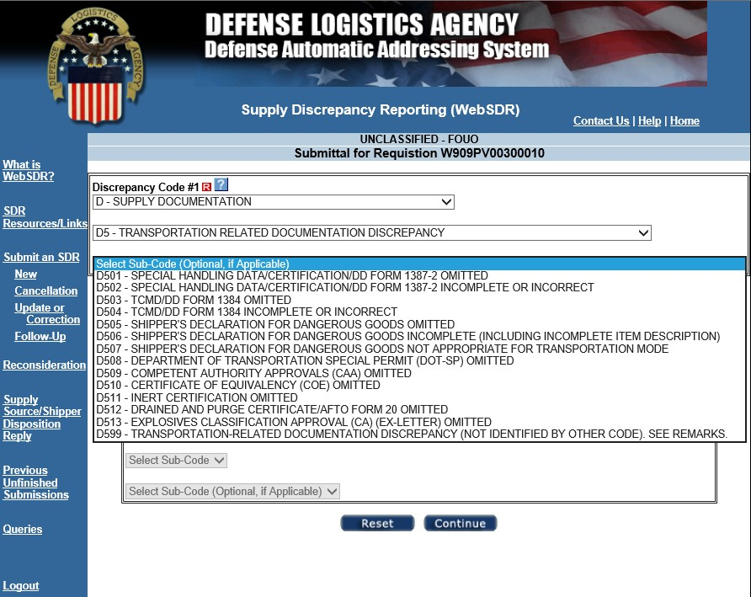
Aerial Port WebSDR “How-To” Guide
The following are descriptions for the common sub codes:
Use for no 1387-2 accompanying shipment.
1387-2 filled out incorrectly.
Used for no TCMD as well as if the cargo was not cleared for airlift. (No Hit)
No SDDG with shipment.
SDDG filled out incorrectly.
Any other document that you cant seem to find something that fits better. (I have used for no ATTLA)
1
3
2
4
5
6

Slide 99
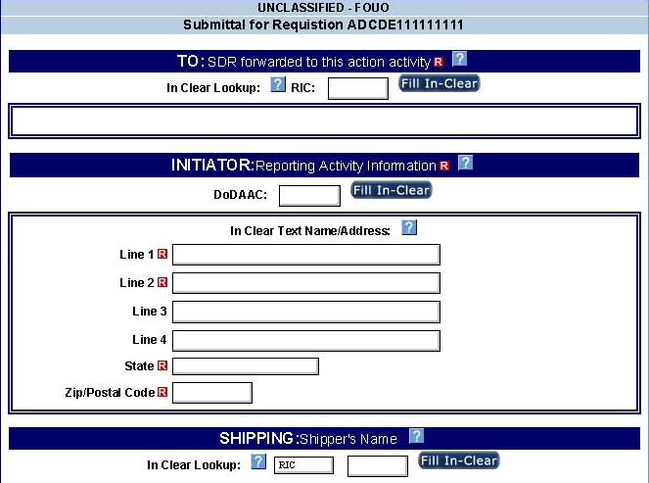
Transshipper SDR Submission
Verify the data from the 1348 (if with piece) or search the DoDAAC (consignor) in the ESAASINQ system.
DO NOT USE RICS SD9, S9D, S9W or vendor specific RICs for SDR submission.
For all DLA Customer Direct Shipments on DLA contracts, submit the SDR to the source of supply (SMS).
Enter the “RIC” field then press the “Fill In-Clear” button to verify the correct activity
Enter the “DoDAAC” of the port or CCP as the initiator, then press the “Fill In-Clear” button.
Input the “Shipper’s Name” when known.
Notes:
When creating any SDR users are reminded to use care to identify the correct action activity. Misrouted SDRs will not process properly and may slow down processing time.
Be sure to include the contract number for vendor shipments!
The user will need to identify the action activity and select the “fill” button to verify the correct activity. The action activity may be a DLA Distribution Center or the Inventory Control Point that directed the shipment.
Users will also need to enter the DoDAAC of the port or CCP as the initiator and, again, press the “fill” button.
When possible the user should Identify the shipped-from activity when known. For example, this may be the distribution center or the CAGE code of the vendor.
MM Notes: This is a screen build. Add graphics as appropriate.

Slide 100
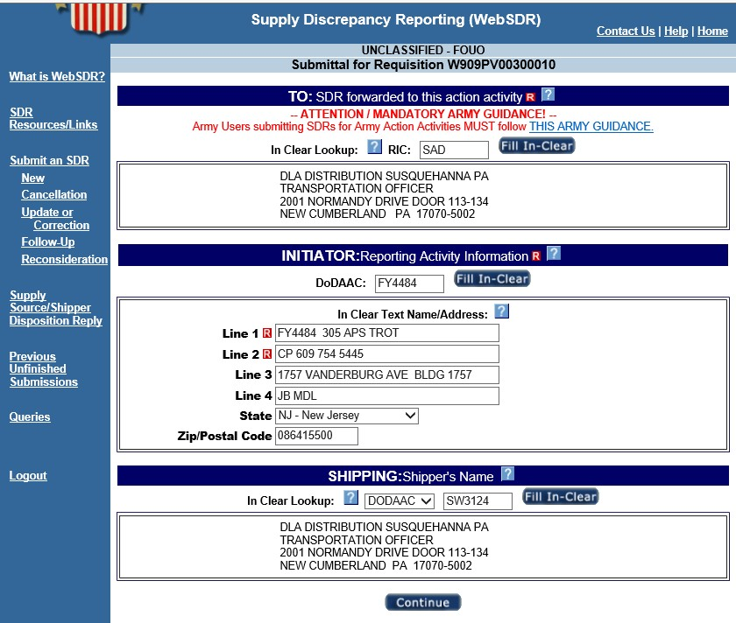
Aerial Port WebSDR “How-To” Guide
This is to show what it looks like once filled.

Slide 101
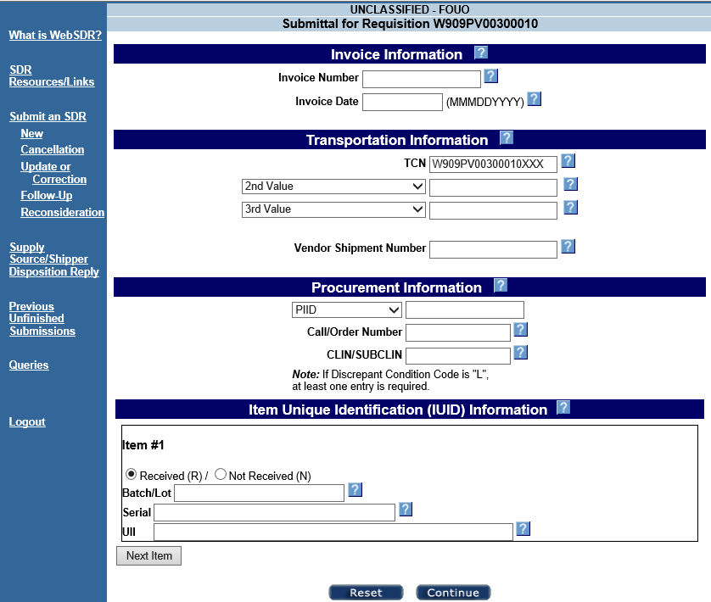
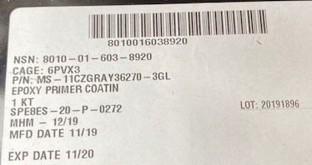
Aerial Port WebSDR “How-To” Guide
This page auto fills the required data. If you have more information from the piece, then you can fill more of it to assist the shipper in tracking down answers.
Procurement information is very important for customer direct shipments. If the PIID or contract number is not on the documentation received, review the MIL-STD-129 marking on the material.

Slide 102
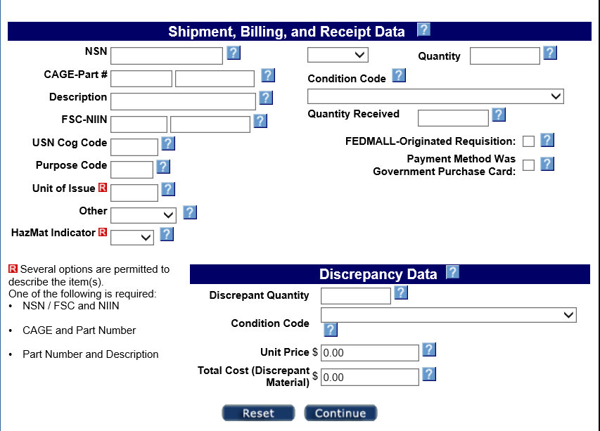
WebSDR Transshipper Submittal Process, continued
Put the NSN for the shipment, if it cannot be located you can use “Unknown”. In the “other” field”
Input CAGE if available.
Input description if available.
Input total quantity received.
Input discrepancy quantity.
“Unit of Issue” is how it is packed in the simplest sense. Ex: PT-Pint, KT-Kit, EA-Each, DR-Drum, etc.
Note if it is hazmat or not.
Make sure the cost amounts add up to the proper value based off unit cost/total number in shipment.
Complete the “Other” drop box to select “MIXED” for consolidated, mixed materiel shipments.
Or select “UNKNOWN” when documentation is not available to properly identify the materiel.
Notes:
On the this screen the user will need to identify the materiel. Transshippers are authorized two unique alternatives when identifying the shipment contents. Use the “Other” drop box to select “MIXED” for consolidated, mixed materiel shipments or select “UNKNOWN” when documentation is not available to properly identify the materiel.
MM Notes: This is a screen build. Add graphics as appropriate.

Slide 103
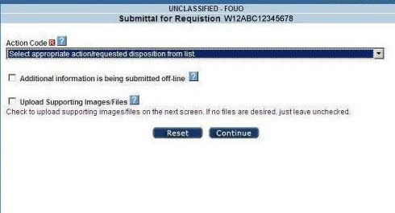

Aerial Port WebSDR “How-To” Guide
Select appropriate “Action code”.
Action code drop down
Select “Additional information is being submitted offline
Select “Upload Supporting Images/Files” and follow directions on screen.
WebSDR will allow you to specify the action you would like taken to resolve your discrepancy. You must select one of the action codes from the drop down menu.
3A when the material remains frustrated and needs a response before movement is possible.
3B when the issue is fixed and material has moved. The SDR for record only and may be addressed with shipper.

Slide 104




Aerial Port WebSDR “How-To” Guide
Browse files to choose one attachment file to upload and click on upload file icon.
Repeat as needed. Each file is uploaded separately. Up to 5 attachments may be uploaded.
It is highly encouraged that you provide supporting images/files to the SDR to expedite resolution (pictures or shipping documents).

Slide 105



Aerial Port WebSDR “How-To” Guide
Uploaded files will appear as shown here.
Once uploads are complete, click on ‘Continue’ to complete SDR submittal process.
WebSDR allows you to upload up to 5 attachments for each SDR submission (new reports, corrections, requests for reconsideration, replies) with a maximum file size of 5 megabytes per attachment. Each file must be uploaded separately when using the direct web input method (although, when using a transactional interface, up to 5 files may be sent at once).

Slide 106
Aerial Port WebSDR “How-To” Guide
Prepare your files in advance to prevent time out during upload.
File names should include key words and be no more than 10 characters.
No special characters other than the underscore “_”. A period may be used preceding the file extension.
Maximum file size 15 MB.
Permitted file formats: bmp, doc, gif, jpg, jpeg, pdf, txt, docx, xls, and xlsx.
Supporting files may be uploaded to WebSDR or transmitted with the SDR transaction.
Up to 5 attachments may accompany each SDR submission (e.g. new reports, corrections, requests for reconsideration, replies).
WebSDR will push attachments to the SDR application used by the recipient, when this capability is supported; otherwise, the recipient will be notified that attachments are available for viewing in WebSDR.

Slide 107

Aerial Port WebSDR “How-To” Guide
Remarks are mandatory and should accurately describe discrepancies. Include as much detail as possible.
All areas under “Preparing Official Info,” that have the “R” are required and most often some are auto filled.

Slide 108

Aerial Port WebSDR “How-To” Guide
If you want an organization to receive a copy of the SDR input the information.
Be sure to click the “Fill In- Clear” button after each input.

Slide 109


Aerial Port WebSDR “How-To” Guide
This page is for you to verify the information you entered. Once you are sure it is filled out to the best of your ability, click “Submit.” At this point you have completed the SDR submission.

Slide 110



Aerial Port WebSDR “How-To” Guide

Slide 111


Aerial Port WebSDR “How-To” Guide
Part 2
Part 1
What the printout looks like.

Slide 112

Aerial Port WebSDR “How-To” Guide
What the eDAASINQ link takes you to.
1. Click DoDAAC.

Slide 113


Aerial Port WebSDR “How-To” Guide
Click DoDAAC if you are looking for a RIC using a DoDAAC.

Slide 114

Aerial Port WebSDR “How-To” Guide
Enter DoDAAC
Click “View Results.”
2
1

Slide 115

Aerial Port WebSDR “How-To” Guide
Circled is the RIC assigned to that DoDAAC.
AN5

Slide 116





Additional Aerial Port WebSDR “How-To” Guidance
Click on each slide to review the associated guidance.

Slide 117
Aerial Port WebSDR “How-To” Guide
These links will assist w/ NSN lookups:
WebFLIS (Account Needed)
https://fp.logisticsinformationservice.dla.mil/webflis
Part Target
https://www.parttarget.com/

Slide 118
DoD WebSDR Action Activity
Response Process
Notes:
In this section we will discuss the SDR action activity response process.

Slide 119
Action Activity Response
SDR replies are used to pass pertinent information from the SDR action activity to the SDR initiator and other interested parties.
A typical response might provide the following:
Interim status during processing
Forwarding to re-direct the SDR to another action activity
Disposition instructions for discrepant materiel
Advice on debit/credit actions
Notes:
SDR replies are used to pass pertinent information from the SDR action activity to the SDR initiator and other interested parties.
A typical response might provide the following:
Interim status during processing
Forwarding to re-direct the SDR to another action activity (such as when the SDR was routed incorrectly by the originator).
Disposition instructions for discrepant materiel, such as dispose of materiel, return to vendor, or repackage or relabel.
Advice on debit/credit actions pertaining to discrepant materiel.
MM Notes: This is a screen build. Add graphics as appropriate.

Slide 120
SDR Standard Response Timeframes
Type of Time Standard | Number of Days
Standard Response: (Includes DLA Disposition Services) | 50 Days
Exceptions to Standard Response Times
Document Type Code W Transshipper SDR with Action Code 3A (frustrated shipment SDRs) | 5 Days
Document Type Code 7 Customer SDRs, Shipping Depot Response | 25 Days When forwarded to ICP for additional response add 25 days for a total of 50 days)
All UIT Program Items Items Classified SECRET or above, Nuclear Weapon Related Materiel (NWRM) Communications Systems | 24 hours, initial interim response, or acknowledgement. 25 Days, final
Note 1: SDR Response Time Standards are based upon the original submission date. Note 2: Misrouting of SDRs may extend total processing time beyond the authorized response time standard. Note 3: Army total processing time for Document Type 7 SDRs is 50 days
Notes:
Discrepant controlled inventory items (other than secret/NWRM), arms, arms parts, ammunitions, and explosives (shortage/overage/wrong item/misdirected): 25 days
Routine SDRs: 50 days total time.
When the SDR is directed to the DLA Distribution Center, the distribution center must respond within 25 days to allow time for the source of supply to process the SDR. DLA has identified a 30 day internal processing goal.
MM Notes: This is a screen build. Add graphics as appropriate.

Slide 121
SDR Response - Reporting Vendor
Non-Compliance/Performance Discrepancies
Applicable to SDR Document Type Codes 6/9/P/W (new procurement SDRs) (refer to ADC 1181A for further details as needed)
Action activities may include the applicable cause code in the SDR to provide better visibility of the underlying reason for the SDR; cause codes are required for SDRs associated with contractor/vendor noncompliance. Upon subsequent determination that contractor/vendor noncompliance is not applicable, (e.g., in response to a contractor challenge), the item manager must provide a new SDR reply containing Reply Code 151 (prior response is superseded) and no cause code (or a replacement cause code not associated with the contractor noncompliance).
DAAS will prepare and transmit the WebSDR Contractor Noncompliance Data Extract as an automated interface in support of contractor evaluation by Supplier Performance Risk System (SPRS). SDR records will be selected based upon inclusion of an SDR cause code indicating contractor/vendor noncompliance (Cause Codes CN, CP, or CS) in the final reply by the item manager for SDR Document Type Codes 6/9/P/W. WebSDR will monitor SDR updates for changes to the cause code and transmit the SDR Data Extract to SPRS if a previously assigned contractor noncompliance code has been removed or new noncompliance cause code has been added or updated. Applicable data content for transmission is identified in Appendix 8.56 in ADC 1181A. Transmission will occur on a daily basis containing only those SDRs validated since the previous transmission.

Slide 122
SDR Response - Reporting Vendor
Non-Compliance/Performance Discrepancies, cont.
The applicable cause code values for inclusion to SPRS data feed are:
CN - Contractor Noncompliance. Materiel received by the storage site, customer, transshipper (e.g., Consolidation and Containerization Point (CCP) or aerial port) is not in accordance with the contract requirements (e.g., shortage, wrong item, missing item unique identification (IUID), missing documentation, etc.).
CP - Contractor Packaging Noncompliance. Materiel received by the storage site, customer, transshipper (e.g., CCP or aerial port) with packaging/labeling that is not in accordance with the contract requirements (e.g., materiel damaged as a result of inadequate packing, noncompliant wood packaging material, etc.).
CS - Contractor Noncompliance (Subcontractor). Materiel received by the storage site, customer, transshipper (e.g., CCP or aerial port) is not in accordance with the contract requirements (e.g., shortage, wrong item, missing item unique identification (IUID), missing documentation, etc.) and was determined to be a subcontractor/vendor fault.
Note: Use of the Cause Code CS is optional; replying activities may choose to use the Cause Code CN or CP in lieu of CS.

Slide 123

Action Activity Response
Log into https://www2.transactionservices.dla.mil, select “WebSDR”
From the side menu, select “Reply to an SDR” to prepare a reply to an SDR you have received for action.
Using the document number or SDR control number, locate the SDR record.
Notes:
When no applicable Component SDR is available, upon receipt of an email notification of an SDR awaiting response, you will log on to WebSDR from the DAAS web portal home page. Here you will see a list of applications that you have access to. From the list you will select WebSDR.
From the initial screen, select “Supply Source/Shipper Disposition Reply” to prepare the action activity reply.
WebSDR will then require identification of the SDR to which you will reply. WebSDR can locate the SDR record by the document number or the WebSDR-assigned control number.
MM Notes: This is a screen build. Add graphics as appropriate.

Slide 124

Action Activity Response, continued
Select the appropriate SDR from the list provided and click continue. (If you are not sure which SDR is needed, select the hyperlink to view the entire SDR record).
Notes:
In some circumstances, WebSDR retrieves multiple SDRs applicable to the document number you entered. If this occurs, you should select the appropriate SDR from the list provided and click continue. If you are not sure, just select the hyperlink to view the entire SDR record.
MM Notes: This is a screen build. Add graphics as appropriate.

Slide 125

Action Activity Response, continued
Select at least one disposition reply code to assign to the discrepancy report.
Note: Discrepancy code(s) are pre-filled from the original SDR as reported by the submitter. The action activity is required to correct the discrepancy code, should the submitter have selected the wrong code to identify the discrepant shipment.
Select appropriate “Disposition Reply Status Code(s)” using the drop down menus.
Up to three codes may be selected.
It is vital that the responder update any erroneously assigned discrepancy code(s) since these codes are used later for metrics and trend analysis. Use the new onscreen REMOVE button to eliminate erroneous discrepancy codes.
Notes:
The top of this screen provides a view of the original report to facilitate preparation of the reply.
Using the drop down menu, the user must select at least one disposition reply code to assign to the discrepancy report. Up to three codes may be selected. You will notice the discrepancy code(s) are pre-filled from the original SDR as reported by the submitter. However, the action activity is required to correct the discrepancy code, should the submitter have selected the wrong code to identify the discrepant shipment.
Note, as WebSDR functionality expands, the responder’s responsibility for updating/correcting or supplementing the submitter’s SDR content also expands. Available data fields on the reply screens must be used (as they become available) to ensure the most accurate information is always included in the SDR and retained for future use in metrics and trend analysis. The source of supply will even be able to designate discrepancies as the result of contractor noncompliance when applicable, so WebSDR can share this information with the Enterprise automated tool used for contractor performance evaluation.
If you select a reply code requiring system forwarding of the SDR (Codes 301-309 (used by storage activities to forward to the source of supply) or Reply Code 504 (used by the responder to forward the SDR to a more appropriate action activity) you will be requested to enter the RIC of the activity to which the forwarding applies later in the reply input. Use of 504 Reply Code is restricted to certain business rules.

Slide 126

Action Activity Response – Cause Code
Use drop down menus to select appropriate disposition/reply code(s). Up to three codes may be selected for customer submitted SDRS. Only two should be used for DLA Distribution Center/DLA storage activity prepared SDRS at this time.
Use the REMOVE button option only when you need to eliminate or eliminate and correct an erroneously assigned discrepancy code submitted on the original SDR (click on blue button on the right and let application refresh automatically before adding a new code back in code 2 and 3. Only applicable for code 2 and 3/
Action activities must include the applicable cause code for SDR Document Type Code 6/9/P/W SDRs when it is determined to be contractor or vendor non-compliance.
The top of this screen provides a view of the original report to facilitate preparation of the reply. Using the drop-down menu, you must select at least one applicable cause code for Document Type Codes 6/9/P/W with their reply if it is determined to be vendor/contractor non-compliant otherwise leave blank.
You will notice the discrepancy code(s) are pre-filled from the original SDR as reported by the submitter. The action activity is required to correct the discrepancy code, should the submitter have selected the wrong code to identify the discrepant shipment.

Slide 127

Response to Contractor Challenge Entry by Source of Supply*
Select “Blank” option from Cause Code Selection Menu to remove the cause code entered on original submission here.
*Only applicable to Document Type 6/9/P/W SDRs
Upon subsequent determination that contractor/vendor noncompliance is not applicable, (e.g., in response to a contractor challenge), the Source of Supply must provide a new SDR reply containing Reply Code 151 (prior response is superseded) and “Blank (remove Cause Code) or a replacement cause code.

Slide 128

Action Activity Response, continued
Notice the POC information is pre-filled using the information derived from the responder’s System Access Request (SAR).
Notes:
In the preparing official information section, notice the POC information is pre-filled using the information derived from the responder’s System Access Request.
MM Notes: This is a screen build. Add graphics as appropriate.

Slide 129

Action Activity Response, continued
Use the “Comments” section to provide clarification for such things as ship-to address or to indicate that images, files or supporting documents are being provided offline.
Use this space to provide any clarifying information that will assist the submitter in understanding the SDR resolution and disposition instructions.
If you need to include additional distribution copies beyond those listed on the original report, they may be identified here.
Notes:
In addition to selecting the appropriate disposition/reply code(s), users should provide text comments for clarification. Many disposition/reply codes require explanation and/or additional information, such as a ship-to address. A subsequent screen will be provided to capture supplemental information based upon the specific disposition/reply code. You may upload images, pictures, or files with your response or indicate you are providing a hard copy supporting document off line.
MM Notes: This is a screen build. Add graphics as appropriate.

Slide 130

Action Activity Response, continued
The response action is still not completed until you click on “SUBMIT.”
Confirmation is then provided to the responder.
SDR Response not yet submitted
Notes:
WebSDR provides a final review prior to processing. Here you can review or edit your response before transmitting it to the SDR submitter. The response action is still not completed until you click on “SUBMIT”.
WebSDR will forward an email reply to the SDR submitter if the submitter is not supported by a Component SDR system. The email reply is triggered by a WebSDR-prepared reply or a transactional reply forwarded to WebSDR from a Component SDR processing system.
A confirmation copy is provided to the responder when prepared on the web.
Distribution copies are forwarded to parties identified on the original SDR or additional parties identified on the reply.
MM Notes: This is a screen build. Add graphics as appropriate.

Slide 131
Follow-on Actions (General)
Notes:
In this section we will discuss general routine follow-on actions that are facilitated by WebSDR.

Slide 132
Follow-up Actions
WebSDR is designed to assist customers in completing routine follow-on actions related to SDR submission.
These include:
Follow-up on delinquent SDRs. Requests an update from the action activity when a reply is not received within reply time standards.
Update/Correction. Allows the customer to correct erroneous information on a prior submission.
Cancellation. Cancels a prior submission determined to be unnecessary or erroneous.
Notes:
WebSDR is designed to assist customers in completing routine follow-on actions related to SDR submission. These include:
A follow-up on delinquent SDRs with which an update from the action activity is requested when a reply was not received within the reply time standards.
An update or correction, which allows the customer to correct erroneous information on a prior submission.
A cancellation, to cancel a prior submission determined to be unnecessary or erroneous.
A request for reconsideration, which allows the customer to provide additional supporting information when the action activity has denied the SDR as inappropriate or invalid.
We will review each of these types of follow-on actions in detail.
It should be noted, if your original report was not successfully processed by WebSDR, your follow-on transaction will be rejected immediately. Also, if your original report was not successfully processed by the action activity, your follow-up may be rejected by the Component SDR system.
MM Notes: This is a screen build. Add graphics as appropriate.

Slide 133
Follow-up Actions, continued
  Request for Reconsideration. Allows the customer to provide additional supporting information when the action activity has denied the SDR as inappropriate or invalid.
If your original report was not successfully processed by WebSDR, your follow-on transaction will be rejected immediately.
If your original report was not successfully processed by the action activity, your follow-up may be rejected by the Component SDR system.
Notes:
MM Notes: This is a screen build. Add graphics as appropriate.

Slide 134
Follow-up on a Delinquent
SDR Response
Notes:
In this section we will discuss the guidelines on when a user should submit a follow-up.

Slide 135
Follow-up on a Delinquent SDR Reply
Action points will generally provide interim and final replies in a timely manner well within the authorized timeframe. However, it is equally important for the submitter to be aware of processing time standards and follow-up when they are not met.
SDRs action activities are required to respond:
Within 24 hours, or up to 25 business days for final response, for classified SECRET or above or NWRM, for shortage, overage, wrong item, UIT items mismatched IUID, or misdirected shipment
Within 5 days for transshipper-reported frustrated freight
Routine SDRs, within 50 days from date of SDR receipt
Notes:
Action points will generally provide interim and final replies in a timely manner well within the authorized timeframe. However, it is equally important for the submitter to be aware of processing time standards and follow-up when they are not met. SDRs action activities are required to respond within 24 hours, or up to 15 business days for a final response, for classified SECRET or above or NWRM (shortage, overage, wrong item, mismatched IUID, or misdirected shipment).
The SDRs action activity is required to respond within 5 days for transshipper-reported frustrated freight, and within 25 days for controlled inventory items (other than SECRET or NWRM), arms, arms parts, ammunitions, and explosives (shortage, overage, wrong item, mismatched IUID, or misdirected shipment). For routine SDRs, a response is required within 50 days from date of SDR receipt.
MM Notes: This is a screen build. Add graphics as appropriate.

Slide 136
Follow-Up Guidance
Table C17.T3 SDR Follow-up Time Standards
Document Type Code of SDR | Day when initial follow-up allowed to be submitted | Number of Days to respond to follow-up or provide interim response. | Interval when subsequent follow-up generated | Maximum Number of follow-ups
6,8,9,R, A, N, P, V | 56 | 30 | 31 | 3
7 | 31 | 30 | 31 | 3
Turn-in activities (Disposition Services partial weapons SDRs) | Exception, none generated | N/A | N/A | N/A
W (Action Code 3A) | No timeframe for follow up due to urgency of request. | N/A | N/A | unlimited
Counterfeit Material Unauthorized Product Substitution Material | 56 | 30 | 365 after Interim Response Code 520 is received | unlimited
Suspected PQDR Material | 120 days after Interim Response code 521 is received | 30 | 60 | 3
Notes:
Users should submit an SDR follow-up when the action activity has not responded to your SDR within 55 days of report submission, or a maximum of 30 days if your report concerns a controlled inventory item (classified/sensitive/NWRM), arms, arms parts, ammunitions, explosives or a hazardous/priority situation.
Users should always follow up!
Also follow-up after 55 days from the date of an interim reply when no subsequent/final reply was received.
Be aware that very late follow-ups may be rejected (after 100 days from the last transaction) resulting in no subsequent processing on your discrepancy report.
Users should direct follow-ups to the current action activity (WebSDR will do this automatically for web-entered SDR replies and Component SDR applications are required to track forwarding actions so follow-ups can be addressed correctly).
Prior to preparing a second SDR follow-up, submitters are encouraged to use the WebSDR query function to see if a reply is already available. Sometimes replies have been provided, but did not reach the customer due to transmission failure or other technical issues. You may also find that your SDR has been forwarded to a new action activity. Forwarding of an SDR to a new action activity will restart the elapsed processing time.
MM Notes: This is a screen build. Add graphics as appropriate.

Slide 137
Follow-Up Guidance, continued
Look first: Prior to preparing a second SDR follow-up, submitters are encouraged to use the WebSDR query function to see if a reply is already available. Sometimes replies have been provided, but did not reach the customer due to transmission failure or other technical issues. You may also find that your SDR has been forwarded to a new action activity.
Forwarding of an SDR to a new action activity will restart the elapsed processing time.
Notes:
MM Notes: This is a screen build. Add graphics as appropriate.

Slide 138

WebSDR Follow-Up
Once you have successfully logged on to WebSDR, select “Follow-Up” under “Submit an SDR”.
Notes:
Now we will go through the process of submitting a follow-up in WebSDR. From the main screen within WebSDR, select “Follow-Up” under “Submit an SDR”.
MM Notes: This is a screen build. Add graphics as appropriate.

Slide 139

WebSDR Follow-Up, continued
WebSDR will locate the previous SDR submission using the SDR control number. Information from the previous submission will be used to pre-fill the follow-up action.
Notes:
WebSDR will locate the previous SDR submission using the WebSDR-assigned control number. Information from the previous submission will be used to pre-fill the follow-up action.
MM Notes: This is a screen build. Add graphics as appropriate.

Slide 140

WebSDR Follow-Up, continued
WebSDR checks for an active Follow-up in the system. If one exists, it will be listed, as in the example.
To view the entire SDR, click on the hyperlink.
Notes:
Once the WebSDR control number is input, WebSDR first checks to see if someone has already submitted or started working on a follow-up, as shown here. To view the entire SDR you would click on the hyperlink.
MM Notes: This is a screen build. Add graphics as appropriate.

Slide 141

WebSDR Follow-Up, continued
WebSDR will retrieve all matching SDR submissions and display for selection of the appropriate record. If you are not sure which one, just click the hyperlink to view the entire SDR record.
Click to view original SDR submission data
Click here to create your follow-up action
Notes:
This screen depicts that WebSDR will retrieve all matching SDR submissions and display for selection of the appropriate record. If you are not sure which one, just click the hyperlink to view the entire SDR record.
MM Notes: This is a screen build. Add graphics as appropriate.

Slide 142


Original SDR Reference for Follow-Up
Page 1
Page 2
Request assistance from the Source of Supply/Inventory Control Point or for
DLA Distribution Center shipments, contact DLA Distribution at DDC.ISDR@dla.mil
Notes:
If you click to view original SDR submission data, WebSDR returns the SDR record(s) for your review. Do not submit multiple follow-ups. If WebSDR history shows there is already an SDR follow-up for this record and no response was received to your initial follow-up within 30 calendar days, request assistance from the Source of Supply/Inventory Control Point.
MM Notes: This is a screen build. Add graphics as appropriate.

Slide 143

WebSDR Follow-Up, continued
If follow-up action is appropriate, proceed with creation of the follow-up. Enter comments explaining why you are submitting a follow-up. Click “SUBMIT” to transmit the follow-up.
All the other information from the prior submission is carried forward to the follow-up.
Notice your POC information is pre-filled based on your SAR.
Notes:
If follow-up action is still appropriate, proceed with the creation of the follow-up. You must enter comments explaining why you are submitting a follow-up. Notice your POC information is pre-filled based on your SAR. All the other SDR information from the prior submission will be carried forward to the follow-up. You must click “SUBMIT” to transmit the follow-up.
MM Notes: This is a screen build. Add graphics as appropriate.

Slide 144

WebSDR Follow-Up, continued
WebSDR will confirm the follow-up action has processed.
WebSDR will provide an email confirmation copy of the follow-up for your records.
Notes:
Once you submit the follow-up, this screen will appear confirming the follow-up action has processed.
WebSDR will also provide an email confirmation copy of the follow-up for your records.
MM Notes: This is a screen build. Add graphics as appropriate.

Slide 145
Making Corrections to Previously Submitted SDR
Notes:
Now we will go through the process of making corrections to a previously submitted SDR.

Slide 146
Correction Guidance
If an SDR is later determined to include erroneous information which might impact the proper resolution, the submitting activity should prepare an SDR correction.
Only the following data fields may be updated by a SDR CO:
      narrative comments, to include the International Logistics Control Office (ILCO) comments section,
      the repackaging corrective action cost,
      quantity,
      an uploaded attachment, and
      The supply condition code. An SDR CO must be sent when the distribution center receives reply code 608 to reclassify materiel. The CO may be sent either before, or after the distribution center transmits a Status Update (SU) with reply code 320: Reclassification of materiel complete. (Use only with status update.)
      the action code (which may be changed only by a Disposition Service Type D, with any subcategory, SDR).
Notes:
If an SDR is later determined to include erroneous information which might impact the proper resolution, the submitting activity should prepare an SDR correction.
Most data content in the SDR may be corrected. However, the controlling report numbers and the document number/suffix associated with the report cannot be changed. Additionally, the WebSDR team recommends that users do not attempt to update the SoS or materiel identification. Instead, cancel the SDR and resubmit.
If the report or document number is incorrect, or you later determine the SDR was submitted to the wrong action activity (and your SDR was not forwarded) , you must cancel and resubmit.
Significant corrections (e.g., something that might impact financial actions by the Source of Supply) should be reported at any time, even if a response has already been provided.
MM Notes: This is a screen build. Add graphics as appropriate.

Slide 147
Correction Guidance, continued
If the report or document number is incorrect, or you later determine the SDR was submitted to the wrong action activity (and your SDR was not forwarded), you must cancel and resubmit.
WebSDR direct input. Users relying on WebSDR input cannot overlay previously entered data content. Instead, users must specify in the SDR remarks what needs to be updated. Remarks will be read by an SDR specialist at the action activity, who will update the system record or take other appropriate action.
DLMS transaction exchange. Users of Component SDR applications have the capability to modify data content by changing individual data element (within limitations of DOD rules/system flexibility). The DLMS transaction will carry the revised data in the appropriate data field. However, Component system users must also use SDR remarks to clarify the intent of the change (since the action activity may not be supported by a Component system able to distinguish what has changed).
Notes:
It should be noted that System capabilities for corrections differ significantly at this time.
Users relying on WebSDR input cannot overlay previously entered data content. Instead, users must specify in the SDR remarks what needs to be updated. Remarks will be read by an SDR specialist at the action activity, who will update the system record or take other appropriate action.
You should note, as WebSDR functionality expands, the submitter’s responsibility for updating/correcting the original SDR content expands. Available data fields on the correction screens must be used to ensure the most accurate information is always included in the SDR and retained for future use in metrics and trend analysis.
Users of Component SDR applications have the capability to modify data content by changing individual data elements (within limitations of DOD rules/system flexibility). The DLMS transaction will carry the revised data in the appropriate data field. However, Component system users must also use SDR remarks to clarify the intent of the change (since the action activity may not be supported by a Component system able to distinguish what has changed).
MM Notes: This is a screen build. Add graphics as appropriate.

Slide 148
WebSDR Correction
Once you have successfully logged on to WebSDR, select “Update or Correction” under “Submit an SDR” to initiate the correction action for a previously submitted transaction.
Notes:
Now we will walk through the steps of making a correction using WebSDR. Once you have successfully logged on to WebSDR, select “Update or Correction.” under “Submit an SDR” to initiate the correction action for a previously submitted WebSDR transaction.
MM Notes: This is a screen build. Add graphics as appropriate.

Slide 149

WebSDR Correction, continued
WebSDR will locate the previous SDR submission using the WebSDR control number. Information from the previous submission will be used to pre-fill the correction transaction for you.
Notes:
WebSDR will locate the previous SDR submission using the SDR control number. Information from the previous submission will be used to pre-fill the correction transaction for you.
MM Notes: This is a screen build. Add graphics as appropriate.

Slide 150

WebSDR Correction, continued
WebSDR will retrieve all matching SDR submissions and display for selection of the appropriate record. If you are not sure which one, just click the hyperlink to view the entire SDR record.
Click “WebSDR Control Number” to view original SDR submission data
Click “PROCESS” to create correction action
Notes:
WebSDR will retrieve all matching SDR submissions and display for selection of the appropriate record. If you are not sure which one, just click the hyperlink to view the entire SDR record.
MM Notes: This is a screen build. Add graphics as appropriate.

Slide 151

WebSDR Correction, continued
Enter comments explaining why you are submitting a correction. You must Click “SUBMIT” to transmit the correction.
All the other SDR information from the prior submission will be carried forward to the correction SDR.
POC information is pre-filled based on your SAR
Notes:
You must enter comments explaining why you are submitting a correction. Notice your POC information is pre-filled based on your SAR. All the other SDR information from the prior submission will be carried forward to the correction SDR pending adoption of additional data entry blocks on the correction screens. Use these data entry blocks as they become available. You must click “SUBMIT” to transmit the correction.
MM Notes: This is a screen build. Add graphics as appropriate.

Slide 152

WebSDR Correction, continued
WebSDR will confirm the correction action has processed. An email confirmation will be provided to the submitter.
Notes:
Once you submit the correction, this screen will display.
WebSDR will confirm the correction action has processed and an email confirmation will be provided to the submitter.
MM Notes: This is a screen build. Add graphics as appropriate.

Slide 153
Submitting a Status Update (SU) on an existing SDR

Slide 154

Status Update (SU)
SUs are used to respond to an interim reply code 104 (Additional information required from submitter; see remarks.) or 608 (Reclassify materiel as instructed; final disposition instructions will be provided upon confirmation of reclassification. (Do not use in combination with other reply codes.).
Notes:
MM Notes: This is a screen build. Add graphics as appropriate.

Slide 155

Status Update, continued
Insert the WebSDR control number, then click Continue.

Slide 156

Status Update, continued
A SU response to a 104 reply code will contain reply code 321 to notify the action activity the requested information is being provided or the submitter may provide clarification via off-line communication.
Notes:
Note: No more than three request/response transactions per SDR will be allowed. A fourth transmission of Reply Code 104 or 321 will result in systemic rejection and will require manual attention.

Slide 157

Status Update, continued
A SU response to a 608 reply code will contain a 320 reply code.
Notes:
Note: Reply code 608 may not be used in conjunction with other reply codes. When using reply code 608, the action activity must provide final disposition separately on a subsequent SDR reply after the reclassification action is reported as complete. No more than three request/response per SDR will be allowed. A fourth transmission of Reply Code 608 or 320 will result in systemic rejection and will require manual attention.

Slide 158

Status Update, continued
Insert comments, then click Continue.

Slide 159

Status Update, continued
Verify data is correct and then click Submit.

Slide 160
Requesting Consideration of an Unfavorable Action Activity Response
Notes:
In this section we will walk through the reasons and steps for submitting a request for reconsideration of an unfavorable action activity response.

Slide 161
Request for Reconsideration
Guidelines for exception process
Reporting activity does not concur with the reply/disposition SDR response
may request reevaluation based on new information
or greater clarification of the circumstances of the discrepancy
the reporting activity must clearly state the basis for requesting reconsideration
Source of Supply will review all data related to the problem and provide a response to the reporting activity within 45 days. This decision will be final.
(Exception: Security Assistance SDRs)
Notes:
When a reporting activity does not concur with the reply or disposition received in response to an SDR, it may request reevaluation based upon new information or greater clarification of the circumstances of the discrepancy. The reporting activity must clearly state the basis for requesting reconsideration.
The Source of Supply will review all data relating to the problem and provide a response to the reporting activity within 45 days. This decision will normally be final (with the exception of Security Assistance SDRs as discussed next).
Bear in mind that this is an exception process and should not be used when not warranted!
MM Notes: This is a screen build. Add graphics as appropriate.

Slide 162
Security Assistance (SA)
Request for Reconsideration
An SA customer will work with their International Logistics Control Office (ILCO) to obtain reconsideration.
  The customer must submit a request for reconsideration to the ILCO within 45 days from the date the ILCO forwarded the SDR response.
      An exception is authorized allowing 90 days for the customer to provide a request for reconsideration when an exhibit is returned to the customer and must be re-inspected subsequent to U.S. evaluation/testing/repair.
  The ILCO is permitted 20 days for review and processing.
Notes:
Security Assistance or SA customer will work with their International Logistics Control Office or ILCO, to obtain reconsideration. Let’s follow the steps needed to do this.
To begin, the customer must submit a request for reconsideration. This goes to the ILCO and should be done within 45 days from the date that the ILCO forwarded the SDR response.
An exception to this occurs when an exhibit is returned to the customer and must be re-inspected prior to U.S. evaluation, testing, and/or repair. In this case 90 days is authorized to provide a request for reconsideration.
Once the ILCO receives the request for reconsideration, they are permitted 20 days to review and process the request.
MM Notes: This is a screen build. Add graphics as appropriate.

Slide 163
Security Assistance (SA)
Request for Reconsideration, continued
  The Source of Supply will review all data relating to the problem and provide a response to the request for reconsideration to the ILCO within 50 days.
  An additional 45 days is allowed when the SDR is directed to the shipping activity prior to review by the Source of Supply
When an initial Request for Reconsideration has not produced the desired result, the FMS customer may work with their ILCO to formally contest the reconsideration decision.
  The customer must contest the decision within 45 days from the date of the ILCO reply to the request for reconsideration.
Note:
A contested reconsideration request cannot be prepared using WebSDR (online), but can be communicated via SDR transaction originated in an SDR application designed to support Security Assistance customers.
Notes:
Next, the Source of Supply will review all the data relating to the problem and then provide a response to the reconsideration request. This response is sent to the ILCO within 50 days. An additional 45 days is allowed when the SDR is directed to the shipping activity prior to the review by the Source of Supply.
When an initial request for reconsideration has not produced the desired result, the FMS customer may work with their ILCO to formally contest the reconsideration decision. The customer must contest the decision within 45 days from the date of the ILCO reply to the reconsideration request. The ILCO is permitted 20 days for review and processing. The Source of Supply or designated focal point will then review all data and provide a response to the ILCO within 50 days.
One final note. A contested reconsideration request cannot be prepared using WebSDR (on-line), but can be communicated via SDR transaction originated in an SDR application designed to support Security Assistance customers.
MM Notes: This is a screen build. Add graphics as appropriate.

Slide 164
Request for Reconsideration
Once you have successfully logged on to WebSDR, select “Reconsideration” under “Submit an SDR”.
Notes:
Now we will walk through the steps for submitting a Request for Reconsideration using WebSDR.
Once you have successfully logged on to WebSDR, you may select “Reconsideration” under “Submit an SDR” to get started.
MM Notes: This is a screen build. Add graphics as appropriate.

Slide 165

Request for Reconsideration, continued
WebSDR will locate the previous SDR submission using the SDR control number. Information from the previous submission will be used to pre-fill the follow-up action.
Notes:
WebSDR will locate the previous SDR submission using the WebSDR-assigned control number. Information from the previous submission will be used to pre-fill the follow-up action.
MM Notes: This is a screen build. Add graphics as appropriate.

Slide 166

Request for Reconsideration, continued
WebSDR will retrieve all matching SDR submissions and display for selection of the appropriate record. If you are not sure which one, just click the hyperlink to view the entire SDR record.
Click “WebSDR Control Number” to view SDR data from original SDR submission.
Click “PROCESS” to proceed with Reconsideration Request creation.
Notes:
WebSDR will retrieve all matching SDR submissions and display for selection of the appropriate record. If you are not sure which one, just click the hyperlink to view the entire SDR record.
MM Notes: This is a screen build. Add graphics as appropriate.

Slide 167

Request for Reconsideration, continued
When you request to view the SDR data from original SDR submission, WebSDR returns the previous SDR record for your review.
Page 1
Notes:
When you request to view the SDR data from original SDR submission, WebSDR returns the previous SDR record for your review.
MM Notes: This is a screen build. Add graphics as appropriate.

Slide 168

Request for Reconsideration, continued
When you request to view the SDR data from original SDR submission, WebSDR returns the previous SDR record for your review.
Page 2
Notes:
MM Notes: This is a screen build. Add graphics as appropriate.

Slide 169

Request for Reconsideration, continued
Proceed with creation of your request and enter justification for your request in the “Reconsideration Comments” section. Click “SUBMIT” to transmit the reconsideration request.
Be sure to upload any supporting documentation/pictures not previously provided.
All other SDR information from prior submissions will be carried forward to the request for reconsideration.
Your POC information is pre-filled based on your SAR.
Notes:
Once you select the appropriate record, you may proceed with creation of your request. You must enter comments with justification for your request in the remarks block. Your POC information is pre-filled based on your SAR. All other SDR information from prior submissions will be carried forward to the request for reconsideration. Be sure to upload any supporting documentation/pictures not previously provided. You must click “SUBMIT” to transmit the reconsideration request.
MM Notes: This is a screen build. Add graphics as appropriate.

Slide 170

Request for Reconsideration, continued
WebSDR will confirm the request for reconsideration action has processed.
An email confirmation copy will be returned to the submitter.
Notes:
Once you submit the request for reconsideration, this screen will display.
WebSDR will provide an email confirmation copy to the submitter.
MM Notes: This is a screen build. Add graphics as appropriate.

Slide 171
Cancel a Previously Submitted SDR
Notes:
In this section we will walk through the steps on how to cancel a previously submitted SDR using WebSDR.

Slide 172
WebSDR Cancellation
If a submitting activity determines an SDR to be invalid, it must be cancelled. This occurs when the reported discrepancy information is no longer considered to be accurate or the SDR cannot be corrected (and must be resubmitted for proper processing).
For example:
  Missing shipment quantity is located
  SDR is submitted to wrong action activity (and was not forwarded)
  Wrong document number was identified
The action activity should be notified of the SDR cancellation at any time, even if a response from the action activity has already been received.
Notes:
If a submitting activity determines an SDR to be invalid, it must be cancelled. This occurs when the reported discrepancy information is no longer considered to be accurate or the SDR cannot be corrected (and must be resubmitted for proper processing). For example:
Missing shipment quantity is located
SDR is submitted to wrong action activity (and was not forwarded)
Wrong document number was identified
The action activity should be notified of the SDR cancellation at any time, even if a response from the action activity has already been received.
MM Notes: This is a screen build. Add graphics as appropriate.

Slide 173

WebSDR Cancellation, continued
Once you have successfully logged on to WebSDR, you may select “Cancellation” under “Submit an SDR” to get started and initiate the cancellation request.
Notes:
Now we will walk through the steps for submitting a request for cancellation using WebSDR. Once you have successfully logged on to WebSDR, you may select “Cancellation” under “Submit an SDR” to get started and initiate the cancellation request.
MM Notes: This is a screen build. Add graphics as appropriate.

Slide 174

WebSDR Cancellation, continued
WebSDR will locate the previous SDR submission using the SDR control number. Information from the previous submission will be used to pre-fill the cancellation.
Notes:
Users must search by the WebSDR control number to submit a request for cancellation. WebSDR will locate the previous SDR submission using the SDR control number. Information from the previous submission will be used to pre-fill the cancellation for you.
MM Notes: This is a screen build. Add graphics as appropriate.

Slide 175

WebSDR Cancellation, continued
WebSDR will retrieve all matching SDR submissions and display for selection of the appropriate record. If you are not sure which one, just click the hyperlink to view the entire SDR record.
Click “WebSDR Control Number” to view original SDR submission data
Click “PROCESS” to create your cancellation action
Notes:
WebSDR will retrieve all matching SDR submissions and display for selection of the appropriate record. If you are not sure which one, just click the hyperlink to view the entire SDR record.
MM Notes: This is a screen build. Add graphics as appropriate.

Slide 176

WebSDR Cancellation, continued
You must enter comments explaining why you are submitting a cancellation. You must click “SUBMIT” to transmit the cancellation.
Additional SDR information from the prior submission will be carried forward to the cancellation.
Your POC information is pre-filled based on your SAR.
Notes:
You must enter comments explaining why you are submitting a cancellation. Your POC information is pre-filled based on your SAR. Additional SDR information from the prior submission will be carried forward to the cancellation. You must click “SUBMIT” to transmit the cancellation.
MM Notes: This is a screen build. Add graphics as appropriate.

Slide 177

WebSDR Cancellation, continued
WebSDR will confirm the SDR cancellation request has processed.
WebSDR will automatically provide you with an email notification of your cancellation request.
Notes:
Once you submit the request for cancellation, this screen will display.
WebSDR will provide an email confirmation copy to the submitter.
MM Notes: This is a screen build. Add graphics as appropriate.

Slide 178
Completion Notifications (CNs)

Slide 179
WebSDR Completion Notification (CN)
Once you have successfully logged on to WebSDR, select “Completion Notification”.
Only the submitter is authorized by user their roles and access to generate the Completion Notification (CN). Users without appropriate access will not be allowed to generate the CN.

Slide 180

WebSDR Completion Notification, continued
Input the WebSDR control number for the SDR you wish to generate the CN for.
WebSDR will locate the previous SDR submission using the SDR control number. Information from the previous submission will be used to pre-fill the completion notification action.

Slide 181

WebSDR Completion Notification, continued
Complete the required fields and click “Continue”

Slide 182

WebSDR Completion Notification, continued
Verify all Screen Completion Notification data is correct. If correct, click submit.

Slide 183

Once submitted you will see your Completion Notification
WebSDR Completion Notification, continued

Slide 184
Queries and Management Reports
Notes:
In this section we will provide a high level overview of the different types of queries and management reports available in WebSDR.

Slide 185
WebSDR Query and Report Capability
Queries and management reports makes it possible to:
Locate specific SDRs by various criteria
  WebSDR or Component system-assigned control numbers
  Component or by specific activity
  Materiel identification
  Contract number
  Monitor trends
  Establish volume and dollar value of SDRs
  Measure compliance with SDR timeframes
  Measure and report vendor performance discrepancies for new procurement deliveries and receipts
Notes:
Using the queries and management reports makes it possible to locate specific SDRs by various criteria. For example you can search:
By WebSDR or Component system-assigned control numbers
By Component or by specific activity
By materiel identification, or
By contract number
Users can use the reports to monitor trends, establish volume and dollar value of SDRs, and measure compliance with SDR timeframes
MM Notes: This is a screen build. Add graphics as appropriate.

Slide 186
Management Reports
  Assist individuals and activities that are engaged in research and resolution of specific SDRs.
  Provide analysis tools to manage SDR workload and determine broader policy, procedures, or user guidance changes that will improve customer satisfaction by reducing future discrepancies.
  Management report requirements are identified by the SDR Committee members.
  To obtain report access, contact the DAAS WebSDR Help Desk at Commercial: (614) 692-6672 or .DSN: 312-850-6672.
Notes:
These management reports assist those individuals and activities that are engaged in the research and resolution of specific SDRs.
The reports provide analysis tools to manage SDR workload and determine broader policy, procedures, or user guidance changes that will improve customer satisfaction by reducing future discrepancies.
Management report requirements are identified by the SDR Committee members.
To obtain report access, contact the DAAS WebSDR Help Desk at (614) 692-6672.
MM Notes: This is a screen build. Add graphics as appropriate.

Slide 187
Management Report
Design Goals
Meet the requirements of users from various perspectives and functional areas:
  Dynamic query/standard output views
    Drill down capability from one report level to another – cascading reports
    Immediate online response to queries
    Download to user email in Excel file format
  User friendly
    Single query choice page to make selections
    Offers variable search parameters resulting in the flexibility to have thousands of possible report criteria.
Notes:
The goals of the management reports and queries are to meet the requirements of users from various perspectives and functional areas while providing standard features such as:
Capability to drill down from one report level to another – also known as cascading reports
Immediate online response to queries and the
Capability to download reports to user email in Excel file format
WebSDR is user friendly in that it provides a single query choice page to make selections, which offers variable search parameters resulting in the flexibility to have thousands of possible report criteria.
MM Notes: This is a screen build. Add graphics as appropriate.

Slide 188
WebSDR Query Composite View
  Locates all records associated with an SDR
  Displays abbreviated content in reverse chronologic order (most recent on top)
  Allows quick overview of each action from original submission through each subsequent action
  Used as a primary management tool or as one of the drill-down levels in more complex management reports
  Contains links for drill down to each individual record
Notes:
Another user friendly capability of WebSDR is composite view.
Composite view allows the users to locate all records associated with an SDR.
The records are displayed with abbreviated content in reverse chronologic order with the most recent being at the top.
The composite view also allows for a quick overview of each action from the original submission through each subsequent action.
It is used as a primary management tool or as one of the drill-down levels in more complex management reports.
The composite view contains links for drill down to each individual record.
MM Notes: This is a screen build. Add graphics as appropriate.

Slide 189
Management Report “Canned” Queries
  Pre-scheduled, repetitive reports with pre-defined criteria
    Excel worksheets distributed to designated Component representatives by email
    Plan to also make available via the web
  Example: monthly report on transshipper-prepared SDRs (Document Type W) distributed to USTRANSCOM and ICP representatives
  Components may identify recurring report requirements by Proposed Standards Change (PDC)
Notes:
WebSDR also has “canned” queries.
These are pre-scheduled, repetitive reports with pre-defined criteria.
These reports are distributed to designated Component representatives by email in excel file format.
An example of a canned query is the monthly report on transshipper-prepared SDRs (Document Type W) distributed to USTRANSCOM and ICP representatives
The goal for future canned reports is to make them available via the web.
If a Component would like a new recurring report developed, the Component must submit a Proposed Standard Change or PDC.
MM Notes: This is a screen build. Add graphics as appropriate.

Slide 190
Service/Agency Implementation Team
Research Queries
  Restricted access to limited number of Component representatives providing access to research SDR processing history and other normally “hidden” information
    Displays tracking of each transaction associated with the WebSDR control number through various steps during processing
    Separate query identifies web user who entered a specific SDR
Notes:
WebSDR also has several research queries reserved for use by Service or Agency implementation team members.
Access is restricted to a limited number of Component representatives providing access to research SDR processing history and other normally “hidden” information.
One query tracks each transaction associated with the WebSDR control number through various steps during processing and another query can be used to identify the web user responsible for entering a specific SDR.
MM Notes: This is a screen build. Add graphics as appropriate.

Slide 191
Queries Against Historical Records
Notes:
In this section we will walk through the steps on how to perform queries in WebSDR.

Slide 192

WebSDR Queries
Once you have successfully logged on to WebSDR, you may select “Queries” to get started.
Notes:
Once you have successfully logged on to WebSDR, you may select “Queries” to get started.
MM Notes: This is a screen build. Add graphics as appropriate.

Slide 193

WebSDR Queries, continued
Select “Composite View” — an overview of all actions related to the SDR, from submission through action activity reply.
Select “WebSDR Report Preparation” — to identify report criteria for any other type of management report. This option requires SAR access.
Access Restricted
Call the DAAS Help Desk at Comm: (614) 692-6672 or DSN: 312-850-6672 to request access.
Notes:
Based upon your research goals you will select the most appropriate option.
Select “Composite View” to obtain an overview of all actions related to the SDR, from submission through action activity reply. From here, you will be able to drill down to the individual SDR transactions.
Select “WebSDR Report Preparation” to identify report criteria for any other type of management report. From here, you will be able to drill down to a summary report or to a detailed listing of SDRs. From the detail view, you will be able to drill down to the composite view.
Note, that the Report Preparation option requires SAR access.
Call the DAAS Help Desk at : (614) 692-6672 or DSN: 312-850-6672 to request access.
MM Notes: This is a screen build. Add graphics as appropriate.

Slide 194

Composite View
Once “Composite View” has been selected, search by the WebSDR control number, Component control number, or enter the document number with or without the suffix.
Notes:
Once you have selected “composite view”, you can now search by the WebSDR control number, Component control number, or you can enter the document number with or without the suffix.
MM Notes: This is a screen build. Add graphics as appropriate.

Slide 195

Composite View, continued
CUI
Scroll down the screen for an overview of each individual action related to the original SDR submission.
These are shown in chronologic sequence (with the newest submission at the top)
Click on links to drill down for full SDR record display
Click on Outbound Transaction Summary for the expandable distribution detail tree
CUI information has been obscured for user guidance use.
Notes:
The composite view presents an abbreviated summary (or snapshot) of all the transactions associated with the identified SDR.
WebSDR allows to scroll down the screen for an overview of each individual action related to the original SDR submission. These are shown in chronologic sequence with the newest submission at the top. Just scroll to the bottom of the page to see the first transaction submitted.
If you would like to see the individual transactions used to create the composite, you can click on the link titled “view transaction detail”
A useful feature of the composite view is the “Outbound Transaction Summary Information” When you click on this block you will see the dissemination details for each SDR including the nature of the transaction provided (action or distribution copy), how the SDR was communicated (email or transaction), and the system to which transaction was sent. This information provides immediate visibility of SDR distribution and is helpful when trouble shooting a suspected communication gap.

Slide 196
Agency/Service Research Queries
The Agency/Service Research Queries are limited to Service/Agency implementation team members.
Notes:
In this section we will walk through the steps on how to perform Service/Agency research queries in WebSDR.
As a reminder these queries are limited to Service or Agency implementation team members. Once you have successfully logged on to WebSDR, authorized representatives will be able to select “Agency/Service Research Queries” to get started.
MM Notes: This is a screen build. Add graphics as appropriate.

Slide 197

Service/Agency Research Queries, continued
“WebSDR Report Preparation” takes the user to the standard report selection screen. “Who submitted this SDR?” query will show the initiator POC information. “SDR Processing History” query will display processing details for transactions associated with a specific WebSDR control number.
Notes:
On this screen the user has several options.
By selecting “WebSDR Report Preparation” WebSDR will take the user to the standard report selection screen. By selecting “Who submitted this SDR?” the query will show the initiator POC information. By selecting “SDR Processing History” the query will display processing details for transactions associated with a specific WebSDR control number. Much of the information contained in the processing history is also available in the “Outbound Transaction Summary Information” found in the Composite view.
MM Notes: This is a screen build. Add graphics as appropriate.

Slide 198

Service/Agency Research Queries, continued
Authorized users may select the second option to bring up a flexible search criteria screen to create the desired report.
For information or access to the WebSDR Report Preparation screens, call the DAAS WebSDR Help Desk at Comm: (614) 692-6672 or DSN: 312-850-6672.
Notes:
Authorized users may select “WebSDR Report Preparation” to bring up a flexible search criteria screen to create the desired report. For information or access to the WebSDR Report Preparation screens, call the DAAS WebSDR Help Desk at : (614) 692-6672 or DSN: 312-850-6672.
MM Notes: This is a screen build. Add graphics as appropriate.

Slide 199

Management Report Selection Screen
“Select Report Type” provides a menu of reports each with various column headings for a specific report.
Use multiple drop box lists to select criteria for your search.
Notes:
From the management report selection screen the user has a wide array of variables to chose from to determine the output content of the report.
The “Initial View” contains the column headings for the summary report. If you are not sure which “view” will work best for you, don’t worry about it, because the view can be changed once the data has been gathered and displayed on the next screen.
You can narrow the scope of the report by identifying specific values from the drop down menu. For example, you can select the action activity Service/Agency, the submitter Service/Agency, the owner or manager Service/Agency, or from among the SDR information such as Document Type Code, Discrepancy Code or Disposition/Reply Code.
A specific date range should also be identified. Regardless of the search criteria, the results will be configured in the standard output hierarchy.
Many of the drop box options will allow the user to select multiple values from the available code list (just hold down the control key when selecting). Many data entry blocks also permit wildcard searches. Simply enter an asterisk at the end of the known value. For example, when searching for a contract number or procurement instrument identifier, you can enter the first digit, first two digits, or the first six characters of the contract number (the procurement activity DoDAAC) as S*, SP*, or SPM4A7*.
MM Notes: This is a screen build. Add graphics as appropriate.

Slide 200

Management Report Selection Screen –
Default User View
The “View” determines column headings for the summary report.
Use the selection options to narrow the scope of your report.
Regardless of the search criteria, the results will be configured in the standard output hierarchy.
Use Shipper drop down to search for SDRs by CAGE Code. Choose user specified CAGE
Use multiple drop box lists to select criteria for your search.
Enter CAGE Code here

Slide 201
Management Report Selection Screen, continued
Use the selection options to narrow the scope of your report.
Regardless of the search criteria, the results will be configured in the standard output hierarchy.
Notes:
MM Notes: This is a screen build. Add graphics as appropriate.

Slide 202

Management Report Selection Screen Criteria –
Vendor Performance Data
Must choose Document Type Code 6/9/P/W for results that include vendor performance cause code data.
Optional - User enters PIID or Contract Number related to the discrepant materiel.
Use the selection options to narrow the scope of your report.
Queries selection can include one or all cause code options. Select from listed menu.
Hold control key for multiple selections.
Use multiple drop box lists to select criteria for your search.

Slide 203

Management Report — Summary View
First level of standard output management report hierarchy.
Highlighted values may be selected to view all SDRs for the selected value.
Totals are calculated for all rows and all columns
Notes:
This is the management report summary view.
The Summary View is the first level of management report output.
Only the first 1,000 records will be displayed on the screen, but approximately 65,000 records can be downloaded for email transmission of your report.
MM Notes: This is a screen build. Add graphics as appropriate.

Slide 204
Management Report — Summary View, continued
Click “Send The Report…” and WebSDR will forward an Excel version of the report to the user’s email.
Notes:
The user can click on the hyperlink to send the report to the email address associated with the user’s SAR. WebSDR will forward an excel version of the report directly.
MM Notes: This is a screen build. Add graphics as appropriate.

Slide 205
Management Report — Summary View, continued
You will be able to change the view (how data is arrayed as indicated by column headers) while viewing the online report display.
Notes:
From the summary view, you can drill down by selecting any of the highlighted values in the body of the report. This will show you all the SDRs that were used to compose the selected value. The drill down results will be displayed in the detail level view format as shown on next screen.
Here’s a hint, to see the detail level report for the entire scope of SDRs selected for your report, just click on the grand total value in the lower right corner of the report.
MM Notes: This is a screen build. Add graphics as appropriate.

Slide 206

Management Report – Detail View
Click the highlighted value and WebSDR will forward an Excel version of the report directly to the user’s email account on file.
Notes:
This screen depicts the management report detail view.
This level of the management report is our most used research tool. It displays the maximum amount of detailed information for the SDR from initial submission to the latest reply and any subsequent transactions.
All highlighted values may be selected to view the text name associated with the code.
You can ask for the detail report to be sent to your SAR email address by clicking on the hyperlink. WebSDR will forward an Excel version of the report directly to your email.
MM Notes: This is a screen build. Add graphics as appropriate.

Slide 207
Management Report – Detail View, continued
Select any of the SDR control numbers to drill down to the Composite View for that SDR
CUI information has been obscured for user guidance use.
Notes:
From this level, you can select any of the SDR control numbers to drill down to the Composite View for that SDR.
MM Notes: This is a screen build. Add graphics as appropriate.

Slide 208

WebSDR Report Download Capability
Instructions for downloading SDR Management Reports Go to the DoD WebSDR Home Page, https://www2.transactionservices.dla.mil/portal/portal.asp
Click “Queries”

Slide 209

WebSDR Report Download Capability, Continued
Click “WebSDR Report Preparation”

Slide 210


WebSDR Report Download Capability, Continued
Enter Required Report Information, Click Submit at bottom of page.

Slide 211

WebSDR Report Download Capability, Continued
After report has completed, click “Download/View Report” at top left of page.

Slide 212

WebSDR Report Download Capability, Continued
User will receive a message with instructions (see below)

Slide 213

WebSDR Report Download Capability, Continued
User will receive an Email with instructions when the report is available on-line for pick up. Follow the instructions in your email (Example below) to retrieve your report.

Slide 214

WebSDR Report Download Capability, Continued
After following the email instructions on previous training slide, choose/click on the report required.
USER Downloaded Report
(Can have more than one report)

Slide 215

WebSDR Report Download Capability, Continued
A download option to “OPEN” or “SAVE” will come up at bottom of page. Suggestion: When saving the file change the file name to a shorter file name.
Choose “OPEN” or “SAVE”

Slide 216

WebSDR Report Download Capability, Continued
The downloaded report is now accessible.

Slide 217
DoD WebSDR Summary
The WebSDR is offered as a multi-purpose tool to facilitate SDR processing within the Department.
Your Service or Agency may direct use of other automated support tools instead of, or in addition to, WebSDR.
Development of new system interfaces and enhancements to existing interfaces are ongoing—reducing reliance on email, expanding functionality, and improving the user experience. WebSDR is achieving its goal for DOD-wide visibility of SDRs.
If you encounter errors or problems, please use the DAAS WebSDR Help Desk to report errors or make suggestions for future enhancements.
Help Desk Support:
Commercial: (614) 692-6672 or DSN: 312-850-6672; Email: ITOC@dla.mil
Notes:
In summary, WebSDR is offered as a multi-purpose tool to facilitate SDR processing within the Department. Your Service or Agency may direct the use of other automated support tools instead of, or in addition to, WebSDR.
Development of new system interfaces and enhancements to existing interfaces are ongoing—reducing reliance on email, expanding functionality, and improving the user experience. WebSDR is achieving its goal for DOD-wide visibility of SDRs.
If you encounter errors or problems, please use the DAAS WebSDR Help Desk to report errors or make suggestions for future enhancements.
MM Notes: This is a screen build. Add graphics as appropriate.

Slide 218
Learn More About SDRs
SDR Procedures: DLM 4000.25, Volume 2, Chapter 17
DEDSO POC: DEDSO.SDR@dla.mil
Reference Resource: SDR Committee web page:
https://www.dla.mil/Defense-Data-Standards/Committees/SDR/
Access to WebSDR may be obtained by completing an online System Access Request (SAR), from the DAAS web site: https://home.daas.dla.mil/daashome/websdr.asp
DAAS Help Desk
  Help Desk Support:
  Commercial: (614) 692-6672 or DSN: 312-850-6672
  Email: ITOC@dla.mil
For additional resources please visit: https://www.dla.mil/Defense-Data-Standards/Committees/SDR/
Notes:
To access more information about the content covered in this module, select any of the resource websites.
MM Notes: This is a screen build. Add graphics as appropriate.

