Slide 1
Defense Logistics
Management Standards
DLMS Functional Financial
Transaction Life-Cycle
Notes:
Narrator: This module provides basic awareness of the Financial Transaction Life-Cycle in the logistics/financial information exchange. Specifically, the financial concepts and transactions that support the Military Billing Systems (or MILSBILLS) Interfund billing process. This process is used by global supply systems to bill customers and collect for the materiel and related charges they have supplied in response to customer requisitions.

Slide 2
DLMS Training Catalog
Module 1 - Introduction to the DLMS
Module 2 - Electronic Data Interchange (EDI) Basics and ASC X12 EDI Definitions and Concepts
Module 3 - DLMS Functionality & Transaction Life-Cycle
Module 4 - DLMS Implementation Convention Content
Module 5 - IUID & RFID - Emerging Technologies
Module 6 - Creating/Reengineering DOD Logistics Business Processes
Module 7 - Enterprise Interoperability Tools
Module 8 - DOD Activity Address Directory (DoDAAD)
Module 9 - Supply Discrepancy Reporting (SDR)
Module 10 - DLMS Functional Financial Transaction (standalone)
Module 11 - Creating/Reengineering DOD Logistics (standalone)
See www.dla.mil/does/DLMS
Notes:
Narrator: This is the full catalog of DLMS Training Modules that are available as part of the DLMS Training. Module 10 is a standalone course designed with a specific end-user in mind. The target audience for this Module is functional experts and system analysts requiring knowledge of the DLMS for Interfund billing. It also includes an overview of some key DLMS concepts. For those desiring a more in-depth understanding of DLMS and the relationship of Interfund billing to supply processes, Modules 1, 2, 3, and 4 are recommended.

Slide 3
Finance Module Structure
DLMS Governance
DLMS 810L Logistics Bill, 812R Billing Adjustment Request and 812L Billing Adjustment Request Reply
Key Concepts Associated with DLMS Financial Transactions
Common Requisition Lifecycle
Interfund Reimbursement
Adjustments Transaction Flow
SFIS/SLOA
Signal Code, Fund Code and DoDAAC
DAAS Web-Enabled Applications (MILSINQ, etc.)
Overview of DLMS Concepts
    Introduction to EDI and Transaction Structure
    MILS to DLMS Data Element Mapping
Review of DLMS 810L, Logistics Bill
Quiz
Notes:
Narrator:
This module starts with an overview of DLMS Governance and a review of the three DLMS financial transactions
The Finance concepts begin with a discussion of financial relevant events in the requisition lifecycle which concludes with bill payment. Then we will take a closer look at the DLMS 810L billing transaction flow, and the billing adjustment flows using the DLMS 812R and 812L.
We will see how DLMS supports auditability, business process improvement, and DOD strategic initiatives, including Standard Financial Information Structure, or SFIS, and Standard Line of Accounting, or SLOA, which cannot be done in a MILS 80 record position transaction.
Next we will see how two DLMS coded elements, the Signal Code and Fund Code, work together with the bill-to party DoDAAC, enabling legacy MILS implementations to exchange line of accounting data and achieve a minimum level of auditability.
This is followed by an overview of the Web Fund Code Application, which automates fund code maintenance and improves the timeliness and accuracy of appropriation data in transactions.
Next is an explanation of DoDAAC authority codes and routing rules and how they impact billing, followed by short overview of Select DAAS Web-Enabled Applications that provide information that is germane to DLMS financial transactions
Then, there is a brief overview of DLMS Electronic Data Interchange Concepts followed by a detailed review of the 810L Logistic Bill to tie everything together.
Finally, there is a short quiz to refresh what we have learned.

Slide 4
Finance Module Objectives
Students will gain basic understanding of:
Supply and financial transaction process relationships
Introduction to the DLMS 810L, 812R and 812L
DLMS support for business process improvement, DOD strategic initiatives and auditability
Major DLMS financial concepts associated with the transactions
Interoperability between MILS and DLMS line of accounting data
DAAS Web resources
How the DLMS 810L Logistics Bill works
Notes:
Narrator: In this Module you’ll gain basic understanding of:
The relationships between the supply and financial transaction and processes.
The DLMS 810L, 812R and 812L transaction implementation conventions that support the financial life-cycle process.
How DLMS supports business process improvement, DoD strategic initiatives and auditability.
The major DLMS financial concepts associated with the transactions.
How interoperability is facilitated between MILS and DLMS implementations.
DAAS Web resources related to billing
How to read and understand the DLMS 810L Logistics Bill Implementation Convention, including mapping to legacy MILS summary and detail bills

Slide 5
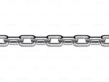
Functional Services Providers
Commodities
Transport
USTRANSCOM
International
Logistics
DSCA
DLMS
DAAS
DLIS
Weapon Systems
Acquisition
DCMA
Finance
DFAS
Supply Chains
DLA
Disposition
Services
Others
DLA
Distribution
DLMS Global Services Providers
Notes:
Narrator:
To start, let’s consider the value of DLMS Enterprise Service Providers. Here they are represented by the gears on the screen. These depict a set of organizations that provide common enterprise support services to support various DoD supply chains. These enterprise service providers reduce inefficiencies from duplication if they that did not exist at the enterprise level.
The Defense Finance and Accounting Service is one such enterprise support provider, utilizing several systems to provide financial services, such as processing bills, making payments and interfacing with the Department of Treasury systems. The challenge of interoperability is how to integrate the supply chains with the enterprise service providers, so that they seamlessly operate in an efficient, effective manner at the lowest possible cost. The answer is to introduce enterprise service enablers.
Three enterprise service enablers, EBSO, DAAS, and DLIS form the foundation or technical service oriented architecture that provides a type of connected tissue, to ensure interoperable business operations among the supply chain systems with the enterprise service provider systems. Without these three distinct organizations and the services they provide, all of these supply chains and enterprise service providers would have to replicate the capabilities hundreds of times, making the process of interoperability more expensive and time consuming.
The Enterprise Business Standards Office (or EBSO) manages the process for the development and syndication of standards that form the foundation of interoperability support to business systems. The standards are collaboratively developed to document standard business processes founded on standard business rules, transactions and data. Adherence to the standards by system developers is the underpinning of interoperability.
DAAS maintains and operates the Defense Automatic Addressing System, or DAAS, which is an extensive suite of hardware and software providing electronic connectivity and other interoperable value added services to the systems transacting business operations in the Materiel Supply Services Management, or MSSM domain. Services include routing, validation, translation, archiving, testing, hosting of transaction related reference repositories, etc. There are 9 billion transactions annually through DAAS.
The Defense Logistics Information Service, or DLIS, hosts and provides access to large master data reference repositories such as catalog data that are essential to the operations of the systems in the MSSM domain.

Slide 6


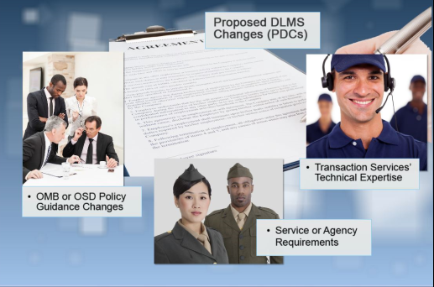


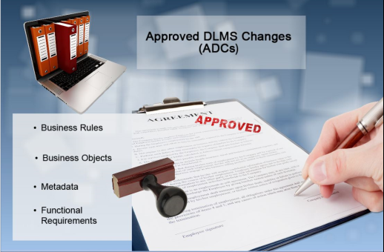
DLMS Change Management Process
Process
Review
Committee
Notes:
Now we'll take a look at the DLMS Process Review Committees and see how ideas for change are transformed through a collaborative process into approved DLMS changes to improve processes and enable DOD strategic initiatives.

Slide 7


DLMS Process Review Committees
INPUTS
OUTPUTS
A Structured Collaboration
Model
OMB/OSD Policy Guidance
Service/Agency Requirements
DAAS’ Technical Expertise
Business Rules
Business Objects
Meta Data
Functional Requirements
MANAGED
TRANSFORMATION
PROCESS
DAAS & Components Implement
Artful Negotiation & Consensus Building
Proposed DLMS
Changes (PDCs)
Approved DLMS
Changes (ADCs)
http://www.dla.mil/HQ/InformationOperations/DLMS/committees/
Notes:
Narrator:
This graphic portrays the DLMS process review committee (PRC) methodology. The committee Chairs follow a structured, collaborative process to develop, manage, and maintain the DLMS processes. Most of DLMS Training Module 6 is devoted to detailing the proposal of DLMS changes, staffing of the change, and the issuing of approved changes and maintenance of the DLMS manuals and supporting documentation.
There are several means of inputs to the DLMS PRCs. A proposed DLMS change, commonly referenced in short as a PDC, can be initiated due to a new or revised policy, or derive from a committee representative’s recommendation to create a new capability, modify an existing process or to provide remedy to an observed operational problem. Alternatively, DAAS technical expertise may uncover necessary changes based on the flow of business transactions in and out of DAAS. The participants in the DLMS committee process are all subject matter experts on the functional business process being worked.
All these inputs are received into a collaboration hub. This is where the magic of artful negotiations and problem solving takes place. The resolution of differences of opinion and approach are a challenge given the number of different players, different perspectives, and differing priorities. It is rare that at first pass there is total agreement. However the knowledge and experience of the committee chairs and willingness of the members to support improved processes allows for a common standard to be achieved almost every time. When agreement cannot be reached, the issue is resolved by the functional proponent at the Office of the Secretary of Defense level, such as OUSD Comptroller. The need to seek resolution at that level is rare. The committees meet periodically, but the work of the committees (including the Finance PRC), goes on every single day via teleconference and email. EBSO averages two teleconferences per day; collaboration is a continuous, every day process.
Out of this collaboration hub come the results and deliverables, a documented agreement that is published as an approved DLMS change, or ADC. This is where the basic rules get written down and stated: what are the changes in procedures, definition of new business objects, changes or new data elements, and other metadata requirements. The ADC is essentially a contract among trading partners, a documented negotiated agreement on how all the trading partners have agreed to do business with one another that can be used to support business system changes. Any process changes to DLMS manuals are included in the ADC, and are incorporated into the manuals during the next update cycle.

Slide 8
Finance PRC Mission
  Forum through which the DOD Components and other organizations may participate in the development, expansion, improvement, maintenance, administration of billing and adjustment procedures for DOD logistics
  Has cognizance over the Interfund Billing System and other financial requirements for the Military Standard Billing System (MILSBILLS)
  The FPRC Chair, in coordination with other FPRC members, is responsible for the contents of the MILSBILLS procedures of DLM 4000.25, Volume 4, Finance. Refer to DLM 4000.25, Volume 1, Chapter 1, for DLMS PRC functions and responsibilities
See http://www.dla.mil/HQ/InformationOperations/DLMS/DLMSPrograms/finance/
Notes:
Narrator:
The DLMS Finance Process Review Committee or FPRC includes representatives from the military departments, OUSD Comptroller, DFAS, Defense Agencies, and Federal trading partner agencies, including GSA, FAA, and NOAA, who are sources of supply that participate in Interfund billing.
The FPRC coordinates process improvements, including changes to the MILS and DLMS finance transaction requirements transaction validation/edits and billing procedures. Changes are documented in DLM 4000.25, Volume 4, Military Standard Billing System (or MILSBILLS).
More information regarding FPRC representatives, upcoming meetings, and documents, such as archived meeting minutes, may be found on the DLMS web site under the FPRC Committees page.

Slide 9
Why DLMS?
  MILS 80 Record Position Fixed Length Transactions
    Limited data content conveyed in transactions; 80 record positions (rp)
    Necessary billing data is derived by linking codes in transactions with business rules and external relational Fund Code Tables, using:
    Service Agency Code
    Signal Code
    Fund Code
  DLMS Variable Length Transactions
    Convey all MILS data to support legacy environment
    Offer great flexibility to convey additional data beyond MILS 80 RP needed for financial compliance, audit and process improvement
    Also uses relational Fund Code Tables to effectively convey consistent data among business partners
    DLMS is based on industry Electronic Data Interchange (EDI) standards ASC X12 Implementation Conventions (ICs) release 4010 and 4030
    DLMS Video: https://www.youtube.com/watch?v=kC13t3m3yHs&feature=youtu.be
Notes:
Narrator:
The legacy MILS transactions are 80 Record Position Fixed Length Transactions, which severely limits data content in transactions.
Data content that can’t be carried in the legacy transaction must be derived by linking codes in transactions with business rules and external relational tables, such as the fund code tables.
The three codes below are all within the customer’s MILS requisition; these three codes are used in combination to identify the bill-to party and to map to the appropriate appropriation within the fund code tables, which will be discussed later in this module.
The Service/Agency Code is a one character code identifying the Military Service/Defense Agency to whom the customer is affiliated and which Service/Agencies Fund Code Tables apply.
The Service Code is the first character of the DoDAAC, which is the first character of the document number of the requisition and the bill-to party.
The Signal Code is a one character code in the customer’s requisition that designates which data fields contain the intended consignee (ship-to DoDAAC) and the activity to receive and effect bill payment.
The Fund Code is a two character code within the customer’s requisition that relates to an appropriation line of accounting in the SFIS Fund Code to Fund Account Conversion table for a particular Service/Agency. In some cases the fund code also identifies the bill-to party through another relational table, the Fund Code to Billed DoDAAC Table. It also identifies which defense agencies are authorized to use Interfund billing. These relational fund code tables, external to the transactions themselves, were originally developed as a result of MILS 80 record position limitations. Fund code tables are discussed later in this module.
The DLMS Variable Length Transactions make it possible to carry as much information to support financial compliance, audit and business process improvement.
Unlike the legacy MILS transactions which are limited to 80 characters of data the DLMS have an unlimited data capability.
The DLMS transactions also carry and use the Fund Code to assure consistent, approved line of accounting data exchange between trading partners, to assure consistency between the resulting Summary level bill and supporting detail bills, to enable DAAS edits and to support conversion between business partners while in a mixed MILS and DLMS transition environment.
DLMS electronic data interchange (EDI) is based on American National Standards, Accredited Standards Committee X12 standards.
Later in this module, we will examine EDI and the DLMS 810L Logistics Bill Implementation Convention along with DAAS maps for conversion between MILS and DLMS in more detail.

Slide 10
810L, Logistics Bill
PURPOSE:
  Used to bill for sales of material, reimbursable logistics services, and related refunds between DOD Components and participating Federal Agencies
  Incorporates the Summary bill and all legacy Detail Bill transactions into a single IC
DLMS Enhancements
  Standard Line of Accounting (SLOA)
  Point of Contact information
Notes:
Narrator:
The DLMS 810L, Logistics Bill, is used to bill for sales of materiel, reimbursable logistics services, and related refunds between DOD Components and participating Federal Agencies.
The billing processes that the DLMS 810L supports are documented in DLM 4000.25, Volume 4, or MILSBILLS. The primary use is for interfund billing, but the DLMS 810L can also be used to transmit non-interfund bills.
Some DLMS enhancements over the MILS formats include the discrete SLOA data elements and Point of Contact information.

Slide 11
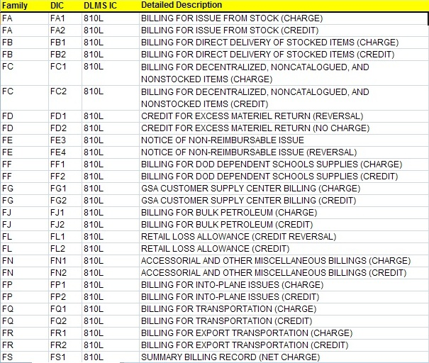
MILS - DLMS Cross Reference
Extract from MILS-DLMS Cross Reference
Available from
DLMS
Website
Notes:
Narrator:
The DLMS 810L provides the functionality to replace over 60 F and G series MILS financial transaction formats.
The DLMS 812R and 812L are the DLMS equivalents of 15 MILS billing adjustment request and reply transaction formats.
A cross-reference of all MILS to DLMS formats is available on the DLMS website. On the website’s navigation menu, select the DLSS-DLMS Cross ref link and you will be taken to a page were you can select to see the cross-reference in order by either the MILS document identifier or the DLMS implementation convention ID.

Slide 12
812R, Billing Adjustment Request
    PURPOSE
  Used to request adjustment of a Logistics Bill; using billing advises code that identifies the nature of the request or problem.
  Used to request or follow-up on a promised (validated) discrepancy report adjustment for:
    Supply Discrepancy - Reply promised Financial Adjustment
    Product Quality Discrepancy - Report Accepted
    Transportation Discrepancy - Report Accepted
  Used to follow up on promised credit for materiel return, including storage quality control report
  Used to request copies (retransmission) of bills
    Only Table 1 is used. Requests normally done by Web in MILSINQ
Notes:
Narrator:
When a billed Component believes there is an error with a bill, they have to request an adjustment from the billing office.
The DLMS 812R Billing Adjustment Request is used to request a change to or reversal of a logistics bill, or follow-up on a previous request for adjustment. Accepted discrepancy reports should trigger the Seller to automatically adjust a bill, but the Buyer may use the 812R to follow-up on promised adjustments.
The 812R is also used to follow up on promised credit for material returns, including storage quality control report or request copies (retransmission) of bills.
The processes for using the DLMS 812R are documented in DLM 4000.25, Volume 4, Chapter 4.

Slide 13
812L, Reply to Billing Adjustment Request
PURPOSE
  Used to reply to requests for adjustment of a Logistics Bill; using billing status codes to respond
    Replies can be directed to other than the requester
Billing offices must reply to requests for adjustments and follow-up requests
  Use the prescribed automated transactions
  Sent to the office identified in the request
  The actual financial adjustment or refund is provided as part of the normal billing process
    Sent to the TAC 3 of the DoDAAC originally charged or TAC 1 if no TAC 3 exists
    Same amount as originally charged
Notes:
Narrator:
The Seller will respond to a request for adjustment with an DLMS 812L, Billing Adjustment Reply. The sender of the request can direct replies to be sent to another party.
The Billing office must reply to requests for adjustments and follow-up requests using prescribed transactions and send them to the office identified in the request.
The actual adjustment or refund is provided as part of the normal billing process. The adjustment is sent to the TAC 3 (billing address) of the bill to party DoDAAC.

Slide 14
Financial Concepts – Essential Data
  Who is the Customer?
  Who is the Supplier?
  Who gets the Bill?
  What Product/Service was provided?
  What was the value?
  What financial account should be debited?
  What financial account should be credited?
Notes:
Narrator: The items shown on this chart are the essential data that is within or derived from the transactions involved in the billing and interfund reimbursement process.
Who is the Customer?
Who is the Supplier?
Who gets the Bill?
What Product/Service was provided?
What was the value?
What financial account should be debited?
What financial account should be credited?”

Slide 15
Order Submission and Financial Events
Many financial events occur during these processes:
  Obligation of the requisition/order
  Seller’s acceptance of the order and the creation of an undelivered order
  Seller’s issue of the materiel
  Buyer’s receipt of the materiel
  Buyer’s acceptance for vendor shipments
  Materiel Receipt Acknowledgement
The data needed during the billing process is provided by or derived from transactions used in these and other processes.
Notes:
Narrator: During the course of requisition and new procurement processes many financial events occur, such as:
Obligation of the requisition/order
Seller’s acceptance of the order and the creation of an undelivered order
Seller’s issue of the material
Buyer’s receipt of the material
Buyer’s acceptance for vendor shipments
Buyer’s receipt/receipt acknowledgement of materiel
The data needed during the billing and payment/adjustment process is provided by or derived from transactions used in these and other processes, which provide essential audit evidentiary matter for demonstrating/reconciling what was obligated, ordered, received, billed and disbursed.
These transactions also effect the balance and financial valuation or inventory on hand.

Slide 16
DLMS Requisition Cycle
Retail Base
Defense Finance and Accounting Service
Source of Supply (SOS)
ICP/IMM
Distribution Depot
or Vendor
USTRANSCOM
Notes:
Narrator:
The following series of slides are drawn from Module 3 and show how DLMS transactions support the life-cycle of a requisition. The slides are intended to show the process flows by transaction identification; they do not illustrate the details of the business process involved in the requisition life-cycle. The detailed DLMS business procedures of the requisition life-cycle are contained in DLM 4000.25, Volume 2, Chapters 4, 5, 10& 13 and Volume 4.
This slide displays the logistics activities that are involved in the life-cycle of a requisition: the retail base or customer, the Source of Supply or Inventory Control Point, the Distribution Depot or vendor storage activity, United States Transportation Command, and the Defense Finance and Accounting Service.

Slide 17
DLMS Requisition Cycle
1. Requisition
DLMS 511R
Retail Base
MILS/DICs A0_, A3_, A4_ &
C0_, CH_, CQ_, YRZ
SOS
Notes:
Narrator: The first action that occurs in the requisition life-cycle is the customer at the retail base creates and sends the requisition to the source of supply. In this chart as well as all of the remaining transaction flows, the sending system transmits the transaction(s) to DAAS who will route it onward to the appropriate system that should receive the transaction. While DAAS is not shown on the chart it is understood to be in the middle between systems sending and receiving transactions. The requisition is identified by DLMS 511R. The R denotes the DOD DLMS standard implementation of the ANSI ASC X12 511 standard. The various MILS document identifier code families that represent a requisition are the series beginning with A0, A3, A4, C0, CH, CQ, and the YRZ.

Slide 18
DLMS Requisition Cycle
1. Requisition
Retail Base
DLMS 940R
DICs A5_
2b. Material Release Order
SOS
2a. Supply Status
DLMS 870S
DICs AE_
Distribution Depot
or Vendor
Notes:
Narrator: In this example the item being requisitioned by the customer is a stocked item, so the source of supply system determines which distribution depot should pick, pack and ship this requirement to the customer based on the priority, the on-hand inventory and the proximity of the customer to the storage activity that have the item in inventory. Upon identification of the storage activity, the source of supply system sends a supply status transaction back to the customer/retail base system, providing the customer supply status on how the requisition is being supported. The DLMS 870S transaction is used to provide supply status to the customer. In the MILS legacy environment supply status is provided via an AE document identifier code family of transactions. In addition to sending supply status back to the customer, the source of supply system also generates a material release order using the DLMS 940R which is sent to the distribution depot to pick, pack and ship the requested materiel. The DLMS 940R replaces the legacy A5 document identifier series of MILS transactions.

Slide 19
DLMS Requisition Cycle
1. Requisition
Retail Base
2b. MRO
SOS
3a. Material Release Confirmation
2a. Supply Status
3b. Shipment Status
DLMS 945A
DICs AR_
DLMS 856S
Distribution Depot
or Vendor
DICs AS_
Notes:
Narrator: Upon shipment of the item to the customer, the distribution depot provides a materiel release confirmation back to the source of supply indicating that it shipped the materiel and provides the related transportation data to the source of supply. The materiel release confirmation (MRC) is sent by the depot to the source of supply using the DLMS 945A, which is equivalent to the legacy MILS AR series document identifier code transactions. Additionally, the distribution depot system generates a DLMS 856S, which is the shipment status transaction that is provided to the customer via Transaction Service. The DLMS 856S is the equivalent transaction for the legacy MILS AS document identifier series transactions.

Slide 20
DLMS Requisition Cycle
1. Requisition
Retail Base
2b. MRO
SOS
2a. Supply Status
3a. MRC
3b. Shipment Status
Distribution Depot
or Vendor
Materiel Shipment
4. Movement Document Transaction
Notes:
Narrator:
Now transportation takes over. The Defense Transportation Regulation covers the rules for the transportation processes. There is a whole set of transactions that are used to manage and track shipments as they move through the transportation pipeline. These transactions are also based upon the ANSI ASC X12 standards.
The implementation conventions for these transactions are managed by the Defense Transportation Electronic Business (DTEB) committee under the leadership of the United States Transportation Command. Like EBSO, USTRANSCOM is working to achieve the goal of a paperless business environment using e-Business, such as ANSI ASC X12. The DOD has an enterprise data warehouse which houses both the supply and transportation transactions, therefore providing the customer cross-domain logistics intelligence.

Slide 21
DLMS Requisition Cycle
Requisition
5. Material
Receipt
Acknowledgement
Retail Base
DLMS 527R
DIC DRA
2b. MRO
SOS
2a. Supply Status
3a. MRC
3b. Shipment Status
Distribution Depot
or Vendor
Materiel Shipment
4. Movement Document Transaction
Notes:
Narrator: Once the materiel is delivered by transportation to the local supply activity, the supply activity records the receipt in its property books, and either puts it in local stock or provides it to the requesting customer. The local supply system that received the materiel closes the loop back to the source of supply, notifying the source of supply that the original requisition has been satisfied. The materiel receipt of acknowledgment (MRA) transaction sent is the DLMS 527R that replaces the legacy MILS document identifier code DRA.

Slide 22
DLMS Requisition Cycle
Requisition
6. Logistics Bill
DLMS 810L
DICs F__
Retail Base
$
DFAS
(Acting as
Customer’s Agent)
MRA
2b. MRO
SOS
3a. MRC
2a. Supply Status
3b. Shipment Status
Distribution Depot
or Vendor
Material Shipment
4. Movement Document Transaction
Notes:
Narrator:
The last step in the process is the preparation of the logistics bill by the source of supply to the customer’s bill paying activity. Note that for an issue from stock, the source of supply may bill at any time after the materiel is dropped from inventory, while receipt and acceptance is required for items delivered directly from vendors (DVD shipments).
The DLMS 810L is the logistics bill that replaces the MILS legacy transactions in the F series document identifier family of transactions.

Slide 23
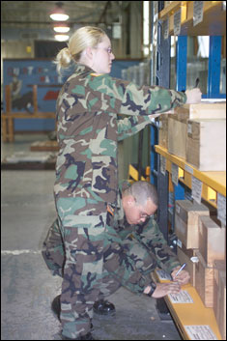
Order Submission and Fulfillment
Buyer CAO
Treasury
Seller CAO
B UYER | Finance
 | Supply
Finance | S E L L E R
Supply
6. (810L)
DAAS
*6 .(810L)
1
2. (870S)
2. (870S)
1. (511R)
1. (511R)
5. (527R)
5. (527R)
4b. (856S)
4a. (945A)
3. (940R)
4d. (867I)
Retail Base
4b.(856S)
Distribution Depot
4c. Item shipped
* Stock – may bill on drop from inventory; 527R is not required
DVD - bill on receipt acknowledgement/acceptance
511R: Requisition (Order)
527R: Material Receipt Acknowledge
867I: Issue
870S: Supply Status
810L: Logistics Bill
856S: Shipment Status
940R: Material Release
945A: Material Release Confirmation
Notes:
Narrator:
Let’s review the DLMS requisition lifecycle leading to the DLMS 810L Logistics bill. Understanding the lifecycle is useful in researching bills and providing evidentiary matter for audit. The bill is the financial transaction that closes out the requisition lifecycle, but it is not the only transaction that has a financial impact. Information to support bills, billing adjustments and financial inventory valuation originates in supply transactions.
[Click 1] In our example for an issue from stock, the 511R requisition from the buyer is sent to DAAS for validation, editing and routing to the designated inventory control point.
[Click 2] The source of supply inventory control point, or ICP, acknowledges the order with an 870S supply status transaction indicating intent to fill this order from on-hand depot stock and in step 3
[Click 3] sends a materiel release order to the depot.
[Click 4] Multiple things happen in step 4
The depot confirms release to the materiel to the ICP
Shipment status is sent to the customer
The item is shipped.
An issue transaction is sent to the ICP updating inventory balance and financial valuation records
Remember that the source of supply or billing office may bill for an item issued from stock when it is dropped from inventory, but billing may not occur for Direct Vendor Delivery, or DVD, items until they are received and accepted.
[Click 5] In step 5 the customer acknowledges receipt of the materiel to close out the source of supply in transit record. Depending on source of supply billing cycle, the bill may actually precede the Materiel Receipt Acknowledgment for items issued from stock.
[Click 6] And, in step six the source of supply bills the bill-to party designated in the order, which may not always be the requisitioner. We will see later that DAAS performs several validations on the source of supply bills and rejects any bills failing edits back to the source of supply with the reason for reject for rework and rebilling. We will show you later how to see and download copies of rejected bills

Slide 24
Billing and Interfund Reimbursement
The issue of materiel on a reimbursable basis ends the order fulfillment process and begins the billing and reimbursement process.
  Interfund: The interfund billing process is required for capable trading partners and is the predominant reimbursement system used within logistics.
    It is both an automated billing process and a means by which the Seller can immediately reimburse his/her organization from the funds identified by the Buyer on the order. It may be considered a point of sale (POS) debit transaction.
    For the Buyer, the bill is really a bill and a notice of funds withdrawn (payment) from his account. Buyer must accept a billing or charge and may seek adjustment if needed.
    Seller reports the funds transfer between the Buyer’s and Seller’s accounts to Treasury.
    Buyer may adjust transfers between his accounts, but may not “charge back” or adjust Seller’s account.
Notes:
Narrator: These are high level business rules associated with the billing and reimbursement process.
The issue of material on a reimbursable basis ends the order fulfillment process and begins the billing and reimbursement process. For material issues from stock, a source of supply is authorized to bill the customer when shipment occurs.
The interfund billing process is required by policy for capable trading partners; it is the primary reimbursement system used within DOD logistics.
It is both an automated billing process and a means by which the Seller can immediately reimburse his/her organization from the funds identified by the Buyer on the order. It may be considered a point of sale debit transaction.
For the Buyer, the bill is really a bill and a notice of funds withdrawn from his account. The Buyer must accept a billing or charge and clear the in-transit disbursement but may seek an adjustment, if needed.
The Seller reports the funds transfer between the Buyer’s and Seller’s accounts to the US Department of Treasury.
The Buyer may adjust transfers between his accounts at Treasury, but may not “charge back” or adjust the Seller’s account.

Slide 25
Billing and Interfund Reimbursement
Key features of Interfund
  Seller’s Central Accounts Office (CAO)
    Reports the funds transfer to Treasury at the summary level
    Only authorized to report transfers for bills which passed DLA Logistics Management Standards Office prescribed DAAS edits
    Notifies the Buyer’s Central Accounts Office of the transfer by sending summary and detail billing records
  Buyer’s Central Accounts Office
    Ensures that the Buyer processes the payment
  The Buyer must process the charge
    Use adjustment procedures to request adjustment of charges, if needed
Notes:
Narrator:
The Seller’s Central Accounts Office or CAO Reports the funds transfer to Treasury at the summery level. No detail or line item billing records are sent to Treasury.
Sellers are only authorized to report transfers through their Central Accounts Offices for bills which passed DLMS prescribed edits.
The Seller CAO notifies the Buyer’s by sending summary and detail billing records to the Central Accounts Office.
Buyer’s Central Account Office must accept the Sellers charge and ensure that the Buyer processes the disbursement.
The Buyer must process the charge and request that the Seller initiate any required adjustments to correct billing errors or to follow up on authorized credits resulting from approved discrepancy reports, etc.

Slide 26
Billing and Interfund Payment
7. Stm of Trans
10. Stm of Trans
8. Collection
Buyer CAO
Seller CAO
Treasury
6a. (810L)
9. Buyer Interfund Report
6c. (810L)
6. Seller Interfund Report
B UYER | Finance
 | Supply
6. (810L)
Finance | S E L L E R
Supply
6b (810L)
DAAS
1
Retail Base
810L Logistics Bill
Distribution Depot
Notes:
Narrator:
This slide depicts interfund billing at a high level following the order fulfillment process. Remember that all transactions pass through DAAS for editing and routing.
The Seller’s interfund bill is transmitted through DAAS for editing and onward routing. Bills that fail DAAS edits are rejected back to the billing office and do not reach the billed office. Bills that fail DAAS edits are not eligible for Treasury reporting and revenue recorded by the Seller at the time of billing must be reversed, pending rebilling.
Routing via DAAS is determined by Communication Routing Identifiers associated with the bill-to party DoDAAC and the DoDAAC TAC 3. There will be more on this latter in this training.
The Seller’s Central Accounts Office (or DFAS Center for DOD entities) reports both the disbursement of Buyer funds and collection of Seller funds to Treasury.
The Buyer CAO must accept the Seller CAO reporting ensure that the Buyer records the charges and reconcile any differences and request any required adjustments from the seller. Note that Treasury reporting is only done at the Summary level, for interfund billing.

Slide 27
Billing and Discrepancy Report Adjustment
Requests and Replies
Buyer CAO
Seller CAO
Treasury
B UYER | Finance
 | Supply
Reply (812 L)
6
Reply (812 L)
6
Finance | S E L L E R
Supply
Request (812R)
5
DAAS
5
Request (812R)
Bill (Credit) (810 L)
3
3
SDR Reply 842AR
Bill (Credit) (810 L)
2a
SDR Reply 842AR
1
2b
Retail Base
SDR Discrepancy Report
Submission (842AW)
SDR Reply 842AR
2
Discrepancy related
1
SDR (842 AW)
Distribution Depot
Financial related
4
*Return Wrong Item
(*Sequence for US. For FMS mat’l returned prior to credit)
Notes:
Narrator:
This slide depicts the credit adjustment request and reply process involving a Supply Discrepancy Report or SDR.
[Click] In this case, the Buyer has submitted an SDR for wrong item received and is requesting financial credit in step 1. In DLMS this is an 842AR; there is no MILS equivalent.
[Click] In step 2, the distribution depot conducted an inventory and determined that in fact the wrong item was shipped and replied to both the Buyer and the Inventory Control Point recommending that credit be granted.
[Click] The inventory control point promised credit in step 3, [Click] and the Buyer returned the wrong item in step 4.
[Click] When the Buyer did not receive the promised credit on the next billing cycle, the Buyer submitted a request for adjustment in step 5 using the DLMS 812R to (Request for Billing Adjustment) and citing the appropriate billing advice code.
[Click] The Seller acknowledged that the promised credit had not been granted in step 6 using the DLMS 821L (Reply to Request for Billing Adjustment).
The promised credit would be issued using the DLMS 810L Logistics Bill in the next billing cycle.

Slide 28
Financial Concepts
Standard Financial Information Structure (SFIS)
  Common Business Language of DOD supporting information and data requirements for budgeting, financial accounting, cost/performance management, and external reporting across the enterprise:
    Standardizes financial reporting across DOD
    Allows revenues and expenses to be reported by programs that align with major goals versus by appropriation categories
    Enables decision-makers to efficiently compare programs and their associated activities and costs across DOD
    Provides a basis for common valuation of DOD programs, assets, and liabilities
Notes:
Narrator:
The Standard Financial Information Structure is the common business language that DOD has developed to support the information and data requirements needed to perform budgeting, financial accounting, cost/performance management, and external reporting across the enterprise:
The SFIS standardizes financial reporting across DOD, establishing the standard terms, definitions, data elements and codes to be used for financial reporting.
The implementation of SFIS also allows revenues and expenses to be reported by programs that align with major goals, rather than just by appropriation categories.
Decision-makers are empowered with information to efficiently compare programs and their associated activities and costs across DOD.
Lastly, SFIS provides a basis for common valuation of DOD programs, assets, and liabilities.

Slide 29
Financial Concepts
Enforcing SFIS Through the BEA and IRB
  Part of the DOD Business Enterprise Architecture (BEA) managed by Office of Deputy Chief Management Office (ODCMO)
  Investment Review Board (IRB) compliance requirement for target systems (e.g. Enterprise Resource Systems and feeder systems with financial implications)
  For more SFIS resources & information go to:
  http://dcmo.defense.gov/products-and-services/standard-financial-information-structure/
Notes:
Narrator:
The SFIS (like the DLMS) is an enterprise standard within the DOD Business Enterprise Architecture (or BEA) managed by Office of Deputy Chief Management Office (or DCMO).
The Investment Review Board ensures compliance as part of program milestone decision and funding approval for major systems. SFIS is applicable to target systems, which include both Enterprise Resource Systems and feeder systems with financial implications.
Additional SFIS resources & information is available on the DCMO website.

Slide 30
Financial Concepts
Standard Line of Accounting (SLOA)
  Joint Deputy Chief Management Officer and Under Secretary of Defense (Comptroller) Chief Financial Officer memorandum issued on September 14, 2012
  SLOA reuses many SFIS elements, and added some new ones to BEA for SFIS compliance
  SLOA can only be fully achieved by using DLMS variable length transactions
  Goals are to:
    Improve financial information
    Improve interoperability between business systems
    Provide better end-to-end funds traceability
    Improve linkage between budget and expenditures
    Comply with new Treasury requirements
    Achieve audit readiness through business process reengineering
Notes:
Narrator:
The Standard Line of Accounting, or SLOA as it is more commonly known, was mandated in a memorandum issued on September 14, 2012. The SLOA prescribes specific SFIS data elements used for the line of accounting.
Full SLOA implementation can only be achieved by using DLMS. The old MILS based transactions cannot carry all the information. The DLMS variable length transactions can carry the additional information needed to meet the goals set by SLOA, which include:
Improved finance information
Improved interoperability between business systems
Better end-to-end funds tractability
Improved linkage between budget and expenditures
Compliance with new Treasury requirement, and
Achieving Audit Readiness through business process reengineering.

Slide 31
Financial Concepts
DLMS Support of SFIS & SLOA
  The vast majority of logistics business events and DLMS transactions have a financial implication
  DLMS Implementation Conventions support the “Target Environment” exchange of SLOA data elements as discrete data
  Major process and systems changes will be required where the customer’s order is initiated outside the Service-sponsored ordering system
Notes:
Narrator: Most logistics business events have financial implications. SLOA and SFIS support the exchange of discrete data elements, which supports the collection of costs across the department for the purchasing of products and services, thereby improving financial management tracking. But, major process and system changes are required to both logistics and financial systems in order to reap the benefits.

Slide 32
SLOA Elements
Financial Concepts
NAME (Max Length)
Department Transfer (3)
Department Regular (3)
Beginning Period of Availability FY Date (4)
Ending Period of Availability FY Date (4)
Availability Type (1)
Main Account (4)
Sub-Allocation (formerly known as Limit) (4)
Sub Account (3)
Sub Class (2) (not currently used)
Business Event Type Code (8)
Object Class (6)
Reimbursable Flag (1)
Budget Line Item (16)
NAME (Max Length)
Security Cooperation Customer Code (3)
Security Cooperation Case Designator (4)
Security Cooperation Case Line Item Identifier (3)
Agency Disbursing Identifier Code (8)
Agency Accounting Identifier (6)
Funding Center Identifier (16)
Cost Center Identifier (16)
Project Identifier (25)
Activity Identifier (16)
Cost Element Code (15)
Work Order Number (16)
Functional Area (16)
Security Cooperation Implementing Agency (1)
* May be derived from SFIS Fund Code to Fund Account Conversion Table
Notes:
Narrator: The SLOA data elements are shown here. Highlighted data elements are available referentially from the SFIS Fund Code to Fund Account Conversion Table, enabling exchange of the minimum date elements essential for Interfund billing and Treasury reporting in both a legacy 80 record position MILS environment and in DLMS. Let’s take a look at how the fund code process works.

Slide 33
Financial Concepts – Fund Code
  DLM 4000.25-M, Volume 4, Military Standard Billing System (MILSBILLS) prescribes use of Fund Code
  The fund code and other data in a requisition, in conjunction with the Fund Code Tables:
    Identifies the appropriation chargeable or non-interfund billing. The service code of the billed office DoDAAC determines the section of the table for identifying the appropriation chargeable.
    Identifies the bill-to party (billed office) when the signal code is “C” or “L”. The service code of the requisitioner DoDAAC determines the section of the table for identifying the billed DoDAAC.
    Limits use for Defense Agencies to specific DoDAACs
  Each Service and Agency has appointed fund code monitors to assign and manage it’s series of fund codes via the Web Fund Code Application.
  The official “authoritative” fund tables are maintained by DAAS
Notes:
Narrator: The two record position Fund Code identifies the chargeable appropriation for the bill-to party in a logistics transaction. The service code, (or first position) of the bill-to DoDAAC, determines the correct section of the SFIS Fund Code to Fund Account Conversion table to use. In addition, the fund code may also designate the bill-to DoDAAC based on the service code of the requisitioner. Only a limited number of Federal agency DoDAACs are authorized to use interfund billing. Each Service and Agency has appointed fund code monitors to establish and maintain their fund codes using a controlled, web application at DAAS. Let’s see how this works.

Slide 34
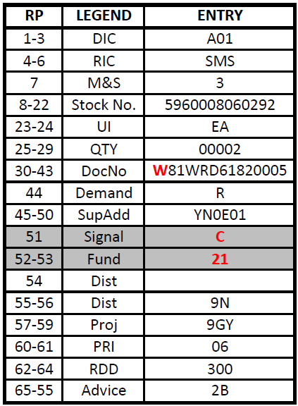
Financial Concepts - Signal Code
Designates which data fields contain the intended consignee (ship-to) and the activity to receive and effect payment of bills for Signal Codes C or L.
When material is to be shipped to activity identified in document number (rp 30-35), Signal Code will be:
  Code A – Bill to activity in 30-35
  Code B – Bill to activity in 45-50
  Code C – Bill to activity in 52-53
  Code D – No billing required - free issue
  Code W – Intra-Service use only
When material is to be shipped to the activity identified in the Supplemental Address (rp 45-50), Signal Code will be:
  Code J – Bill to activity in rp 30-35
  Code K – Bill to activity in 45-50
  Code L – Bill to activity in rp 52-53
  Code M – No billing required – free issue
  Code X – Intra-Service use only
Notes:
Narrator:
The developers of MILS in the 1960s were brilliant in conveying essential data within the 80 record position punch card technology limitations that existed at the time. Key to this success is the single character signal code that identifies both the bill-to activity and the ship-to activity in a requisition, which can be the requisitioner in legacy MILS record positions 30 through 35 or the supplementary address in legacy MILS record positions 45 through 50.
The MILS developers also enabled the capability to designate a third party (typically a DFAS Center) as the bill-to party by having the fund code do double duty. We call this “third party billing.” In the case of Signal Codes C and L shown here, the Fund Code determines both the chargeable appropriation and the bill-to party. It is the service code of the requisitioner that determines the correct portion of the table to use to identify the bill-to party and the service code of the bill-to party that determines the appropriation.
Of course in DLMS, we are able to designate the requisitioner, bill-to party, ship-to party and line of accounting as discrete data elements without relying on the signal code and Fund Code. Let’s see how this works using a MILS format example.
Here, we have an Army requisitioner identified in MILS record positions 30-35, with Signal Code C, which says to ship the materiel to the requisitioner and determine the bill-to party billing using fund code 21 in the Army portion of the Fund Code to Billed DoDAAC Table for Army Service Code W. Fund Code 21 will also give us the appropriation chargeable, but we first need to determine the bill-to party.

Slide 35
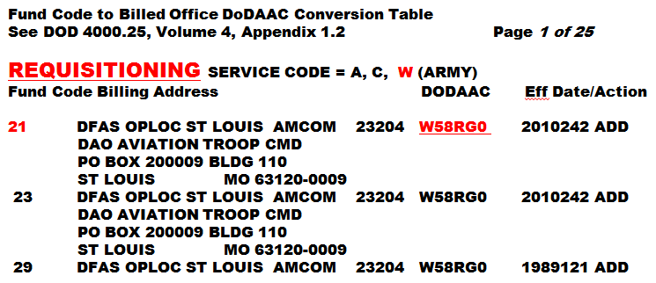
Fund Code/Billed Activity
Fund Code as Billed Activity
  Signal Code C or L point to Fund Code for identification of the bill-to activity
  Under MILSBILLS, a Fund Code may equate to the DoDAAC of bill-to activity
  Conversion from Fund Code to DoDAAC is dependent upon the requisitioning Service
Notes:
Narrator: Using service code W for the requisitioning DoDAAC, we see that Army Fund Code 21 specifies DoDAAC “W58RG0”, or DFAS St Louis, as the bill-to party. We also see that this fund code was added in 2010 on Julian date 242. Note that we used the service code of the requisitioning DoDAAC to determine which portion of the table to use

Slide 36
Fund Code to Billed Office DoDAAC Conversion Table
APPENDIX AP1.2.A
REQUISITIONING SERVICE CODE = A,C,W (ARMY)
FUND BILLING
CODE ADDRESS DODAAC
21 DFAS COLUMBUS 23204 W58RG0 2010242 ADD
DFAS JDCBB CO
PO BOX 182559
COLUMBUS OH 43218-2559
23 DFAS COLUMBUS 23204 W58RG0 2010242 ADD
DFAS JDCBB CO
PO BOX 182559
COLUMBUS OH 43218-2559
29 DFAS COLUMBUS 23204 W58RG0 1989121 ADD
DFAS JDCBB CO
PO BOX 182559
COLUMBUS OH 43218-2559
2B DFAS COLUMBUS 23204 W58RG0 2010242 ADD
DFAS JDCBB CO
PO BOX 182559
COLUMBUS OH 43218-2559
  Extract from MILSBILLS
  Authoritative source is DAAS
  DoDAAC address comes from DoDAAD
Notes:
Narrator:
While we are showing an extract from MILSBILLS Appendix 1.2 in this example, MILSBILLS is only updated once each month. DAAS is the authoritative source for fund codes and maintains current data in near real time.
Also note that the DoDAAC address is taken directly from the authoritative DoDAAD data base, also maintained by DAAS.

Slide 37
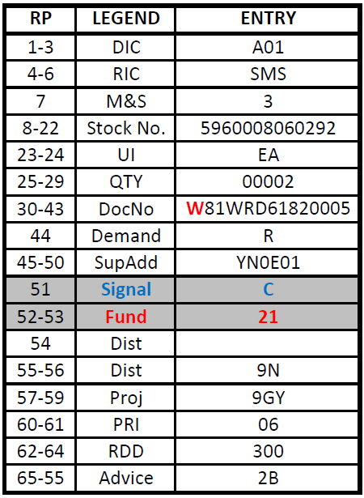
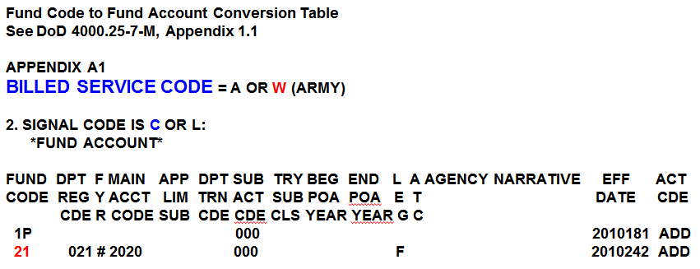
Fund Code to Fund Accunt Conversion
  Conversion for any given fund code is dependent upon the Service Code of the billed office
Notes:
Narrator:
Once we have determined the bill-to party, we can determine the bill-to party line of accounting or determine if billing and payment will be non-interfund billing from the SFIS Fund Code to Fund Account Conversion Table using the bill-to party service code. The bill-to party may not be the same as the requisitioner.
Remember the bill-to party may be the requisitioner DoDAAC, the supplementary address DoDAAC or the DoDAAC identified by the fund code in the Fund Code to Billed DoDAAC Conversion Table, as is the case in this example. Since our billed DoDAAC here is W58RG0, we refer to the section for Billed Service Code = A or W (Army) under signal code group C or L to find the line of accounting data elements for fund code 21.
In this example, Fund Code 21 in conjunction with signal code C did double duty, providing both the bill-to party and the line of accounting.

Slide 38
Fund Code to Fund Account
Conversion Table
APPENDIX AP1.1.A
BILLED SERVICE CODE = A,C,W (ARMY)
1. SIGNAL CODE IS A, B, J, OR K:
*FUND ACCOUNT*
FUND DPT F MAIN APP DPT SUB TRY BEG END L A AGENCY NARRATIVE EFF ACT
CODE REG Y ACCT LIM TRN ACT SUB POA POA E T DATE CDE
CDE R CODE SUB CDE CDE CLS YEAR YEAR G C
01 021 # 2020 000 F 2014066 CHG
03 021 0 2040 000 2010 2011 F 1986314 ADD
DD 097 X 1030 18E1 019 000 F X 2014037 ADD
2. SIGNAL CODE IS C OR L:
2P BILL VIA NONINTERFUND 2010181 ADD
2U 021 # 2035 000 T 2010242 ADD
21 021 # 2020 000 F 2014066 CHG
YT 021 # 1082 011 000 F 2014108 CHG
APPENDIX AP1.1.F
BILLED SERVICE CODE = D,E,F (AIR FORCE)
1. SIGNAL CODE IS A, B, J, OR K:
Fund Code Dept. Regular Code Fiscal Year Indicator Main Account Limit/Subhead Dept. Transfer Code | Sub-Account Treasury Subclass Beginning Period of Availability Ending Period of Availability Legacy Multi-Year Indicator Availability Type Code
Notes:
Narrator:
This is an extract of the Fund Code to Fund Account Conversion Table as it appears in MILSBILLS Appendix 1.1. Note that we use the billed party service code and signal code group.
Signal Codes A, B, J, or K are grouped together because the bill-to DoDAAC is contained in the transaction as either the requisitioner or supplementary address activity. Signal Codes C & L are grouped together, because the bill-to DoDAAC is not in the MILS transaction, but is determined from the Fund Code to Billed DoDAAC Conversion Table.
Immediately following the fund codes for Army Service Codes A, C, W, under AP1.1.A, the table moves to AP1.1.F for Air Force Fund Codes under Service Codes D, E, F. Air Force fund codes are then shown by signal code group A, B, J, K or C, L, and the process repeats for the remaining Component service codes.
Here we again see Army fund code 21 with a line of accounting. Note that no period of availability is shown, because the fiscal year indicator # allows systems to compute the beginning and ending periods of availability from the Julian date of the order. This does not work perfectly for multi-year appropriations, so there is legacy multi-year indicator T or F (true or false) to highlight those fund codes.
We also see fund code 2P, which is designated as Bill VIA NONINTERFUND with no line of accounting provided in this table.

Slide 39
Fund Code/Recap
Concept
  Combination of Signal Code, DoDAAC and Fund Code provides:
    A line of accounting for interfund billing
    Identity of a bill-to party
Signal Code
  Identifies both the ship-to party and the bill to party
  Bill-to party may be:
    Requisitioning DoDAAC (Signal Code A or J)
    SUPPAD DoDAAC (Signal Code B or K)
    DoDAAC Identified by the Fund Code (Signal Code C or L)
Fund Code Tables
  Fund Code to Fund Account Conversion Table
  Fund Code to Billed Office DoDAAC Conversion Table
  Table of H Series DoDAACs Authorized Interfund Billing
Notes:
Narrator:
Let’s review what we have learned about fund codes and introduce one more table.
First, in a DLMS variable length transaction we can identify the requisitioner, ship-to party and bill-to party as discrete data elements and we can also identify the discrete data elements for the line of accounting.
In MILS, the combination of Signal Code, DoDAAC and Fund Code:
Identifies a line of accounting for interfund billing or specifies non-interfund billing;
Identifies the bill-to party
The Signal Code:
Identifies both the ship-to party and the bill to party
The bill-to party may be:
The Requisitioning DoDAAC (Signal Code A or J);
The DoDAAC in the Supplementary Address (Signal Code B or K); or
The DoDAAC identified by the Fund Code (Signal Code C or L)
There are three Fund Code Tables:
Fund Code to Fund Account Conversion Table (MILSBILLS APP 1.1)
Fund Code to Billed Office DoDAAC Conversion Table (MILSBILLS APP 1.2)
Table of H Series DoDAACs Authorized Interfund Billing (MILSBILLS APP 1.3)

Slide 40
Fund Code/Recap cont’d
DLM 4000.25, Volume 4, April 12, 2012
AP1.1 APPENDIX 1.1
FUND CODE TO FUND ACCOUNT CONVERSION TABLE (as of May 1, 2014)(The authoritative source table is located at the DAAS)
***** ABBREVIATIONS *****
DPT REG CDE - DEPARTMENT REGULAR CODE
MAIN ACCT CODE - MAIN ACCOUNT CODE
APP LIM SUB - APPROPRIATION LIMIT SUBHEAD
DPT TRN CDE - DEPARTMENT TRANSFER CODE
SUB ACT CDE - SUB ACCOUNT CODE
TRY SUB CLS - TREASURY SUB CLASS
LEG - LEGACY MULTI YR FUND IND
ATC - AVAIL TYPE CODE
FYR - FISCAL YEAR
NOTE: BEG POA AND END POA IS BLANK IF FYR = # OR * (CALCULATED BY TRANSACTION)
********************************************************************************
Notes:
Narrator: This shows the header information for MILSBILLS Appendix 1.1 with the abbreviations for the table headings. Note again that if the fiscal year indicator is either hashtag (#) or asterisk (*), the beginning and ending periods of availability will be blank in the table and will be computed by the Julian date of the order or bill respectively.

Slide 41
Fund Code/Recap cont’d
APPENDIX AP1.1.A
BILLED SERVICE CODE = A,C,W (ARMY)
1. SIGNAL CODE IS A, B, J, OR K:
DPT F MAIN APP DPT SUB TRY BEG END CODE REG Y ACCT LIM TRN ACT SUB POA POA E T DATE CDE
CDE R CODE SUB CDE CDE CLS YEAR YEAR G C
01 021 # 2020 000 F 2014066 CHG
03 021 0 2040 000 2010 2011 F 1986314 ADD
DD 097 X 1030 18E1 019 000 F X 2014037 ADD
2. SIGNAL CODE IS C OR L:
2P BILL VIA NONINTERFUND 2010181 ADD
2C 021 # 2035 000 T 1986314 ADD
21 021 # 2020 000 F 2014066 CHG
YT 021 # 1082 011 000 F 2014108 CHG
APPENDIX AP1.1.F
BILLED SERVICE CODE = D,E,F (AIR FORCE)
1. SIGNAL CODE IS A, B, J, OR K:
Notes:
Narrator:
The Fund Code to Fund Account Conversion Table, or MILSBILLS Appendix 1.1, is grouped by billed service code group and by signal code group within each service code.
Here are the two examples discussed earlier for fund code 21 and 2P.
On the table following the Army billed service codes under AP1.1.A, the table moves to Air Force billed service codes under AP1.1.F.

Slide 42
Fund Code/Recap cont’d
AP1.2 APPENDIX 1.2.
FUND CODE TO BILLED OFFICE DODAAC CONVERSION TABLE (as of May 1, 2014) FUND (The authoritative source table is located at the DAAS)
Fund Code Billing Address DoDAAC Eff Date/Action
APPENDIX AP1.2.A
REQUISITIONING SERVICE CODE = A,C,W (ARMY)
FUND BILLING
CODE ADDRESS DODAAC
2P DFAS COLUMBUS 23204 W58RG0 1989121 ADD
DFAS JDCBB CO
PO BOX 182559
COLUMBUS OH 43218-2316
FUND BILLING
CODE ADDRESS DODAAC
21 DFAS COLUMBUS 23204 W58RG0 2010242 ADD
DFAS JDCBB CO
PO BOX 182559
COLUMBUS OH 43218-2559
APPENDIX AP1.2.B
REQUISITIONING SERVICE CODE = B (ARMY)
How it works:
Send bill to DFAS
Get DFAS DoDAAC
Use LOA from AP1.1
  2P BILL VIA NON-INTERFUND
  21
  021 # 2020
Notes:
Narrator:
In the case of signal codes C or L the fund code does double duty, also providing the bill-to party of the requisitioning Service Code.
In both examples here the requisitioner was Army Service Code W and the bill-to party is DFAS Columbus with DoDAAC W58RG0, which is also an Army Service Code.
We would use MILSBILLS Appendix 1.1 with Army bill-to Service Code W to determine the line of accounting or non-interfund billing.

Slide 43
Fund Code/Recap cont’d
Multi-year Appropriations
  The fund code table may cite # (use - Req’n date) or * (use - Bill date) to compute beginning and ending periods of availability
  This allows the same fund code to be reused each year
  Works well for a single year appropriation where the beginning and ending POA are the same fiscal year
  Prone to error for multi-year appropriations
  DAAS is unable to validate or populate from MILS to DLMS
  Seller may report POA incorrectly; Buyer must adjust his funds transfer LOA at Treasury
  Web Fund Code has a Multi-year to Indicator identify applicable fund codes as Multi-year: True or False
  Full DLMS implementation of SLOA by all will resolve this
Notes:
Narrator:
The fund code table may cite # (use - Requisition date) or * (use - Bill date) to compute beginning and ending periods of availability.
Since the fund code is only two characters in length, there are only 1296 possible fund code combinations for each service code. Using the hash tag or asterisk allows the same fund code to be reused each year so that Components do not exhaust the number of available fund codes.
This convention works well for a single year appropriation where the beginning and ending Periods of Availability are the same fiscal year.
However, this convention is prone to error for multi-year appropriations. In the case of the hash tag (#), the Seller’s billing system will select the current fiscal year as the beginning period of availability and ending period of availability is determined by the length of the appropriation for the Treasury appropriation main account. DAAS is unable to determine the correct periods of availability for editing or populating them from legacy MILS transactions into discrete DLMS data elements.
Thus, the Seller may report the beginning and ending periods of availability for the main account incorrectly. The Buyer’s Central Accounts Office must then adjust the beginning period of availability and ending period of availability associated with funds transfer at Treasury.
To identify which fund codes using the hashtag or asterisk are multi-year appropriations Web Fund Code has a Multi-year to Indicator identify applicable fund codes as Multi-year either True or False.
Since the beginning and ending periods of availability are discrete data elements in DLMS, full DLMS implementation of SLOA by all DoD trading partners will resolve this.

Slide 44
Fund Code/Recap cont’d
Multi-year Appropriation Adjustment
BILLED SERVICE CODE = A,C,W (ARMY)
1. SIGNAL CODE IS C, L:
*FUND ACCOUNT*
FUND DPT F MAIN APP DPT SUB TRY BEG END L A AGENCY NARRATIVE EFF ACT
CODE REG Y ACCT LIM TRN ACT SUB POA POA E T DATE CDE
CDE R CODE SUB CDE CDE CLS YEAR YEAR G
2C 021 # 2035 000 T 1986314 ADD
Notional Billing Adjustment at Treasury
(Department Code 021)
Appropriation Reimbursements Disbursements
21 2005 2007 2035 000 .00 -143,216.28
21 2007 2009 2035 000 00 55,848.27
21 2008 2010 2035 000 00 191,193.53
21 2009 2011 2035 000 00 364,775.27
21 2010 2012 2035 000 00 1,387,974.05
21 2011 2013 2035 000 00 -2,682,147.90
** For a bill in 2007, which appropriation applies?
Notes:
Narrator:
Let’s look at a notional example of a central accounts office correcting the Buyer side funds transfer at Treasury.
We see that if Army fund code 2C is used, the hashtag is entered as the fiscal year indicator. So, the beginning period of availability will be computed by the Seller’s billing system from the Julian date of the requisitions. There are no entries in the Fund Code Appropriation Table for beginning and ending periods of availability and the legacy fiscal year indicator is T or True to note that this is a multi-year appropriation.
DAAS will be unable to validate any periods of availability entered as discrete data elements in an incoming DLMS transaction or to populate the beginning and ending periods from an incoming MILS transaction that is being passed to a DLMS trading partner. If the Buyer requisition is submitted as a DLMS transaction with the correct beginning and ending periods of availability as discrete data elements, and if the Seller’s bill perpetuates the Buyer’s beginning and ending periods of availability, funds transfer at Treasury will be reported correctly.
In the notional example shown here, the Army Central Accounts Office is adjusting the beginning and ending period of availability at Treasury for main account 2035 that were incorrectly reported to Treasury by the Seller’s CAO.
DLMS implementation by all trading partners and DFAS centers will resolve this issue. In the interim, Components may consider if there are sufficient fund codes to assign a unique fund code for each new multi-year appropriation. Thus, there would be one fund code for 2005-2007 and a different fund code for 2007 to 2009, etc.

Slide 45
Fund Code/Recap cont’d
AP1.3 APPENDIX 1.3
TABLE OF H SERIES DoDAACS AUTHORIZED INTERFUND BILLING (as of May 1, 2014)
(The authoritative source table is located at the DAAS)
DODAAC BILL-TO ADDRESS
H91253 FINANCE AND ACCOUNTING OFFICE
MENWITH STATION
APO AE 09468
H98230 FINANCE AND ACCOUNTING OFFICE
9800 SAVAGE ROAD
ATTN BF211
FORT MEADE MD 20755-6000
DAAS edits prevent Interfund billing to unauthorized DoDAACs.
Notes:
Narrator:
This shows an excerpt of MILSBILLS Appendix 1.3 for H Series DoDAACs that are authorized to use interfund billing
Requisitions and bills citing interfund billing for H Series Defense Agency DoDAACs that are not listed in this table will be rejected by DAAS edits.

Slide 46
Fund Code – DAAS Edits
  Transactions with Signal Code C/L that do not have a fund code on the Fund Code to Billed Office DoDAAC Conversion Table for that Service Code will reject
  Under Standard Line of Accounting (SLOA) ADC 1043 Series, SLOA data will be inserted from the Fund Code to Fund Account Conversion Table into select DLMS transactions where it is missing; transactions containing SLOA data that does not match fund code data will reject
  Transactions citing an invalid fund code for Signal Codes A, B, J, K were not previously edited, but will now fail SLOA edits
  Transactions for H Series bill-to DoDAACs not on the Table of H Series DoDAACs Authorized Interfund Billing citing other than Fund Code XP (non-interfund) will reject
Notes:
Narrator:
Logistics transactions with Signal Code C or L that do not have a fund code on the Fund Code to Billed Office DoDAAC Conversion table for a Service have always been rejected, because DAAS is unable to determine the bill-to party in order to route the bills.
A new edit will validate the fund code on the SFIS Fund Code to Fund Account Conversion table for Signal Codes A, B, J, and K, as well as C and L.
Since all MILS transactions and many DLMS transactions are not currently SLOA compliant, SLOA data will be inserted where it is missing from the Fund Code to Fund Account Conversion Table into select DLMS transactions during DAAS processing. Additionally, DLMS transactions containing SLOA data that does not match the fund code in the transaction will fail DAAS edits and be rejected back to the transmitter. As part of this edit, a fund code that is not valid on the SFIS Fund Code to Fund Account Table for the bill-to Service Code will reject. Note that DAAS edits cannot determine if the correct fund code is used in the transaction, only that it is a valid fund code for the Component.
Transactions for H series Service Codes that are not authorized Interfund billing as identified on the Table of H Series DoDAACs Authorized Interfund Billing will reject if a fund code citing interfund billing is used. The only fund code currently authorized for non-Interfund billing by Defense Agencies is “XP”.

Slide 47
Web Fund Code
Web Application used by Component Fund Code Monitors appointed in writing to maintain fund codes in real time
  Facilitates legacy and future processes
  Supports Treasury Account Symbol (TAS) & SFIS/SLOA for key data elements added to SFIS Fund Code to Fund Account Conversion Table
  Enhances edits to improve financial processes and audit readiness
  Allows for staging fund codes for future effective dates
  Facilitates replacing email distribution of fund code updates with near real-time system-to-system synchronization
Notes:
Narrator:
The web application used by Component Fund Code Monitors allows changes to fund codes in near real time. The application facilitates legacy and future processing, providing key SFIS/SLOA data elements needed for billing and Treasury reporting.
The application also improves financial process, facilitates additional edits to improve data accuracy and enhance audit readiness. The system supports future effective dates, so changes can be added into the database that will not go into effect until a certain date is reached. This is particularly useful at the start of a new fiscal year.
The fund code database is available for system-to-system synchronization, replacing the need to email updates to the users of the data.

Slide 48
Web Fund Code
-----Original Message-----
From: j6d-seduser@dla.mil [mailto:j6d-seduser@dla.mil]
Sent: Saturday, March 08, 2014 9:25 AM
To: Trans Svcs Fund Code External
Subject: FUNDCODE MESSAGES
SUBJ: INTERIM CHANGE 0314 TO DOD 4000.25-7-M 08 MAR 2014
THE FOLLOWING CHANGES ARE EFFECTIVE 07 MARCH 2014
AND WILL BE INCLUDED IN THE NEXT UPDATE TO THE DAAS WEB SITE.
IN THE FUND CODE COL.; **=OTHERWISE.
APPENDIX AP1.1 UPDATES
ACTION APP. PAR. FUND APPROPRIATION RESERVED FOR
CODE USE OF
CHANGE 1.1.A 1 01 21#2020
CHANGE 1.1.A 1 02 21#2065
CHANGE 1.1.A 1 05 21#2010
CHANGE 1.1.A 1 06 21#2060
CHANGE 1.1.A 1 07 21#2070
Numerous changes omitted on slide
--------------------------------------------------------------------------
APPENDIX AP1.2
ACTION APP. FUND CLEAR TEXT ADDRESS BILLED OFFICE
CODE DODAAC
NO APPENDIX 1.2 UPDATES
How it works today:
1.1 = Appendix 1.1
A = Army Service Code
1 = Signal Code Group
01= Fund Code
21#2020 = LOA
Notes:
Narrator:
This is an example of the legacy process for updating fund codes. In this process, fund code changes are emailed to an ever-changing group of Component and trading partner points of contact, who enter the data into financial systems. It is untimely and prone to error, so near real time system-to-system exchange of fund code data is the preferred approach.
Using what we have learned so far, we see the first group of changes shown here are to MILSBILLS Appendix 1.1, the SFIS Fund Code to Fund Account Conversion Table. The service code is Army. The signal code group is group 1 for signal codes A, B, J or K. the Fund code is 01 and the concatenated legacy line of accounting is 21#2020.
If there were changes to signal code group 2 for signal codes C or L a corresponding entry would be required in Appendix 1.2 for the Fund Code to Billed DoDAAC table for “third party” billing.

Slide 49
DoDAACs In Billing
Proper DoDAACs must be used in ordering and billing
  DoDAAC Central Service Points designated in writing by each Component or Federal Trading Partner assign and manage DoDAACs
  Authority codes restrict the use of a DoDAAC
  In order for a bill to pass DAAS edits, DoDAACs must be valid (active) in the DAAS Authoritative DoDAAD database. The ordering DoDAAC must have an authority code allowing ordering and the bill-to party DoDAAC must have an authority code allowing billing
  The most commonly used authority code is “00” which allows both
  Not all orders pass through DAAS for editing, but all Interfund bills do. Bills that fail DAAS edits are rejected back to the billing office and may not be included in funds transfer at Treasury
  If the billing office records revenue at the time the bill is transmitted, a journal voucher entry must be made to reverse revenue recognition and the bill must be reprocessed.
Notes:
Narrator:
DoDAACs used in ordering and billing must be active in the authoritative DAAS database and must have the appropriate authority code for their intended use.
While not all orders pass through DAAS for routing and editing, all Interfund bill do. Those that fail DAAS edits are rejected back to the billing office and must be reworked and rebilled before revenue can be properly recorded and funds transfer reported to Treasury. The bill-to party will not have received the rejected bill.
If the billing office records revenue at the time the bill is transmitted, a journal voucher entry must be made to reverse revenue recognition.
We will look at an example of a DoDAAC using EDAASINQ, which is one of many Web resources maintained by DAAS.

Slide 50
DAAS Web Resources
  Logistics Data Gateway (LDG)
    Full Transaction History with DLMS Extended Data
  Web Visual Logistics Information Processing System (WEBVLIPS)
    Query Supply Transactions/History
  Military Standard System Inquiry (MILSINQ)
    Query and Retrieve Logistics Bills
  Enhanced Defense Automatic Addressing System Inquiry (eDAASINQ)
    Query DoDAACs and RICs
    Download SFIS Fund Code to Fund Account Conversion Table
  Logistics Reports
    Query & Retrieve Logistics Reports including:
    Fund Code Tables
    Requests for Billing Adjustment and Replies
  More training on Select DAAS Web Resources is at:
  http://www.dla.mil/HQ/InformationOperations/DLMS/DLMSPrograms/finance/
Notes:
Narrator:
There are the many Web resources that DAAS supports. We will look at five that provide particular insight into MILSBILLS transactions: LDG, WEBVLIPS, eDAASINQ, MILSINQ and Logistics Reports.

Slide 51
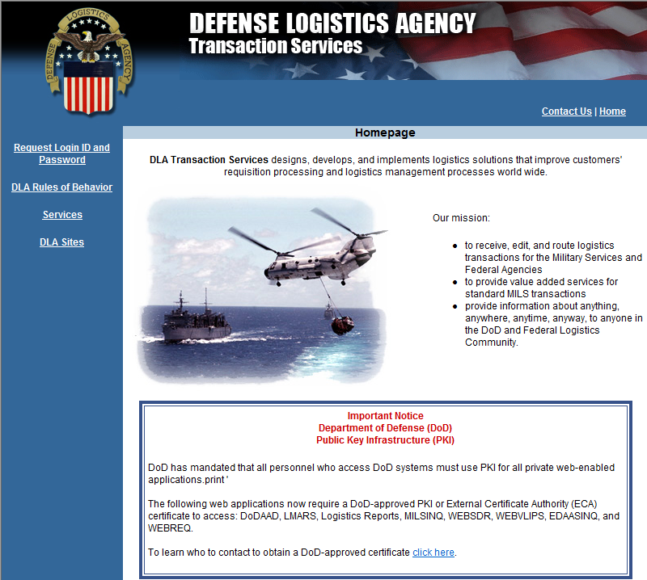
https://www.transactionservices.dla.mil/daashome/homepage.asp
Notes:
Narrator: Before you can access any of these, you must complete a System Access Request (SAR) identifying which system you want access to and provide justification for granting access.

Slide 52
Access to Web Resources and Customer Support
  Access (CAC required)
    https://www.transactionservices.dla.mil
    To submit System Access Request (SAR) choose Request Login ID and Password, navigate to appropriate SAR page.
    Applications are accessed through the DAAS Portal once a System Access Request (SAR) is approved.
  You must log-on every 30 days or account will become be revoked; after 60 days it is deleted. For revoked accounts contact Customer Support.
    https://www.transactionservices.dla.mil
    Link to send an email under "Contact Us"
    or daashelp@dla.mil
    For 24 hour 7 days-a-week Phone Support:
    Telephone: (937) 656-3247
    DSN: 986-3247
Notes:
Narrator: When access is granted, your common access card (CAC) will be able to log you into the DAAS Web Portal, which will display links to each system. Note that each system must be accessed within 30 days of your last login or access to that system will be revoked. Once account access is revoked, you have an additional 30 days to contact the DAAS Help Desk to request access be restored or the SAR process has to be restarted to regain access.

Slide 53
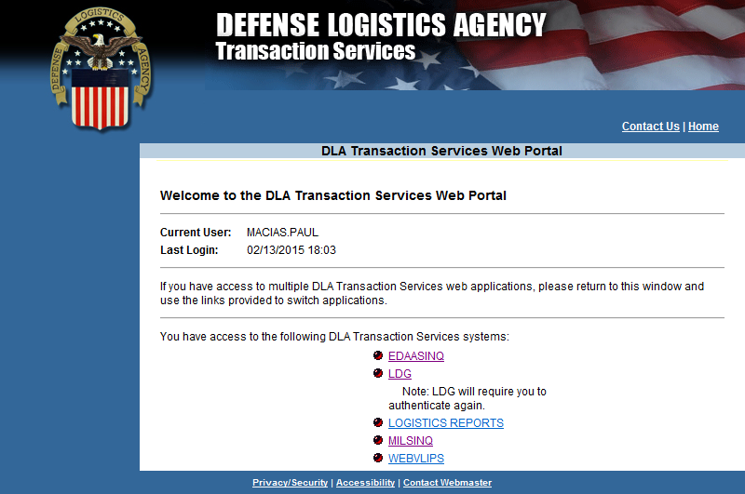
Notes:
First resource we’ll look at is the Logistics Data Gateway.

Slide 54
Logistics Data Gateway
Overview
  LDG is a data warehouse environment that provides users the ability to access DAAS-managed data/information using business intelligence tools or a web browser.
  Data is generally retained for 3 years
  Billing transactions are retained as far back as 1 April 2005
  LDG queries are restricted to a 31-day search range.
  Unlike WEBVLIPS, LDG can query all Document Identifier Codes (DIC) that route through DAAS (not restricted to requisitions).
  Retransmitted bills are visible in LDG (unlike MILSINQ)
  Password is required due to the COTS software.
  Reports can be saved in several formats: e.g., PDF, .CSV, Crystal Reports, etc.
Notes:
Logistics Data Gateway (LDG) is a data warehouse environment that provides users the ability to access DAAS-managed data/information using business intelligence tools or a web browser. The LDG provides easy web access to the current and historical data that flows through the DAAS and provides this data in an integrated fashion. Unlike the other CAC-enabled applications, LDG requires password authentication due to the Business Objects COTS software.

Slide 55
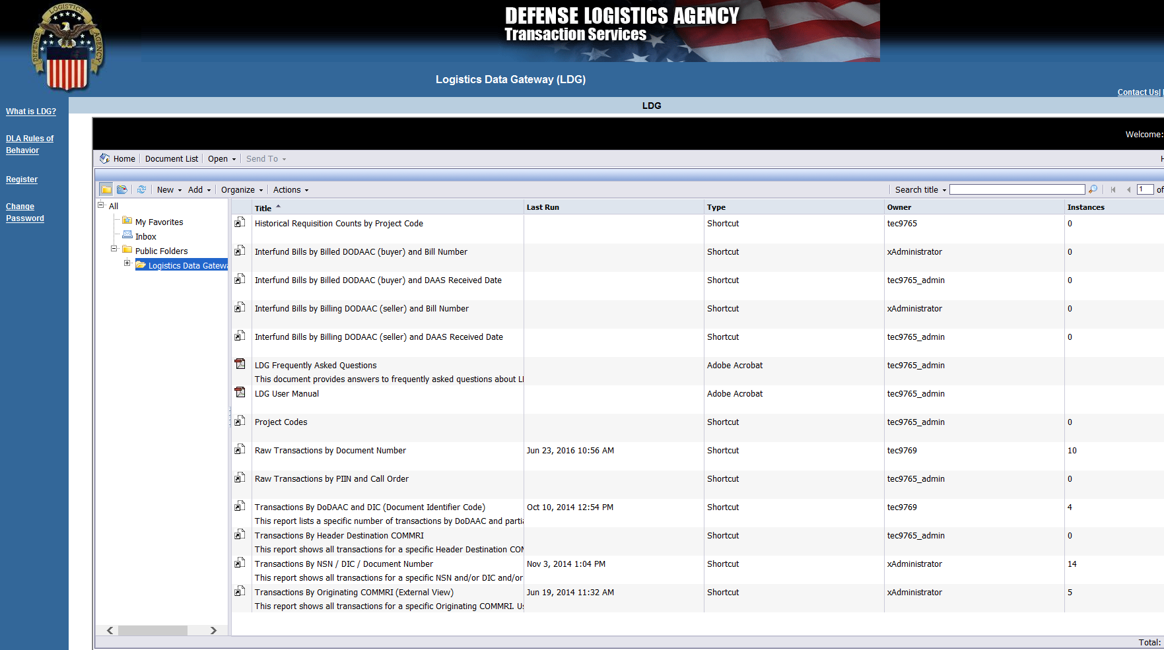
Logistics Data Gateway
Notes:
After logging in, click “Document List, “Public Folders” and then click “Logistics Data Gateway.” The list of available queries to external LDG users will appear. DAAS personnel have access to a greater number of queries.
For the purpose of this training, we will use the Raw Transactions by Document Number query and use document N6911752375645. A requisition document number is constructed using the requisitioner’s DoDAAC for the first six characters, followed by a four character Julian ordinal date, and then a four character serial number.

Slide 56
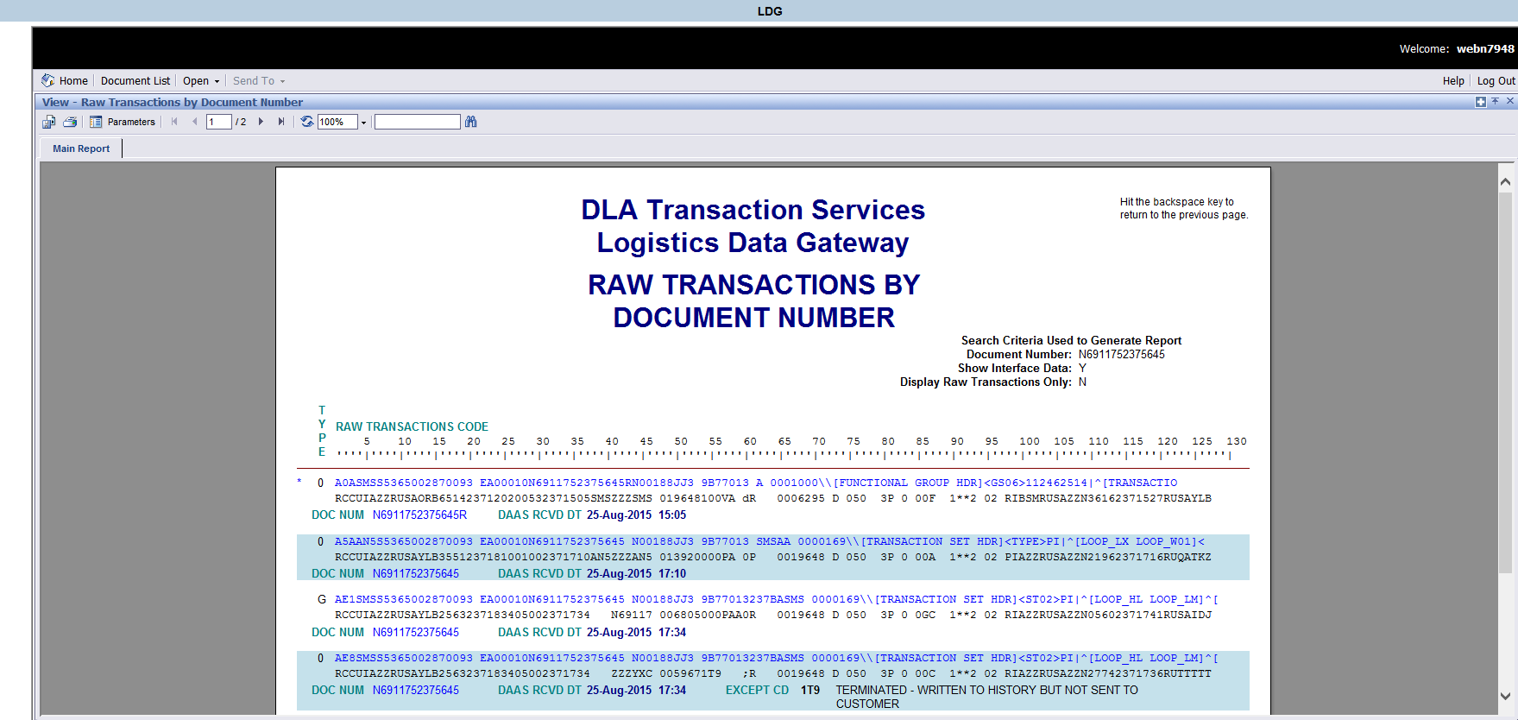
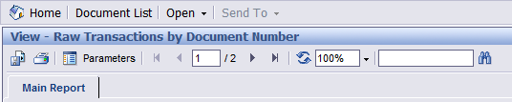
Logistics Data Gateway
Notes:
This slide is just a snapshot of the document we queried: N6911752375645. You can save the report in several formats: PDF, Excel, .CSV, Crystal Reports, Rich Text Format, XML, etc.
You can navigate through the pages of the report, zoom in and out, or use the search function (field with the binoculars).
The search function is useful for queries that return large results. Some queries allow you to search for up to 60,000 records, but be aware that the application may time out once you get over 40,000 records.

Slide 57
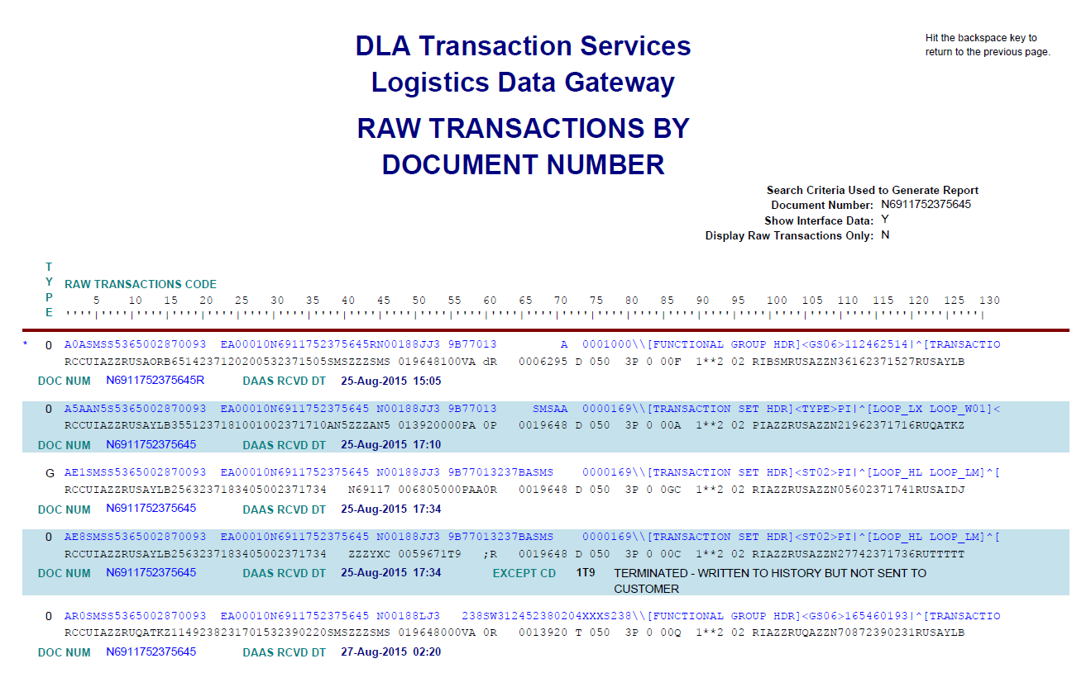
Logistics Data Gateway
Notes:
Here’s the chronological history for document N6911752375645. The transactions are shown by the date/time that they were received by DAAS (Greenwich Mean Time – GMT). The A0A was received first, followed by an A5A Materiel Release Order (MRO), AE_ Supply Status, AR0 Materiel Release Confirmation.
Note: DAAS allows for interoperability between DLMS and non-DLMS applications. At this time, all transactions in LDG and other DAAS applications appear in the legacy MILS format. However, LDG does append the DLMS transaction data

Slide 58
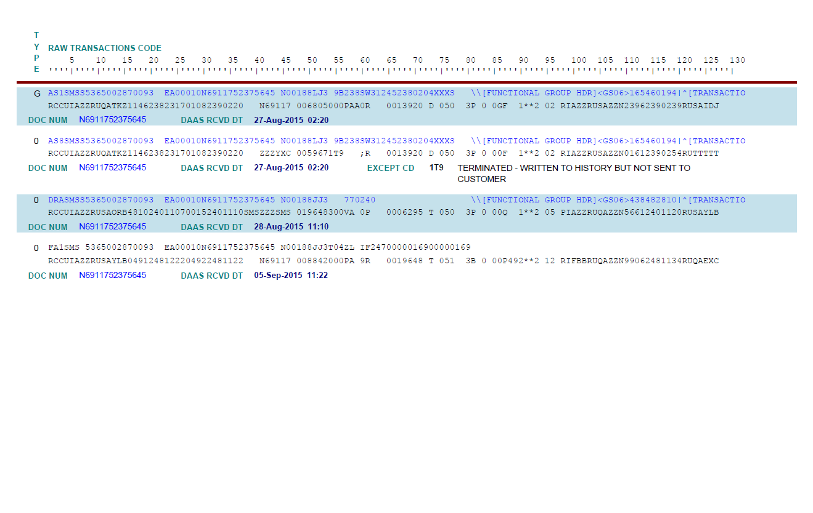
Logistics Data Gateway
Notes:
This slide shows page two of the transaction history. You can see that an AS_ Shipment Status is sent immediately following the Material Release Confirmation. A DRA Material Receipt Acknowledgment is shown, and finally, an FA1 Interfund Bill from Stock. In a later slide, we will use the LDG query “Interfund Bills by Buyer DoDAAC and Bill Number” search to query the billing information for this document.
Some transactions are processed by DAAS simultaneously. In our example, the source of supply sends the AS8 (DLMS 856S) to DAAS, and based on MILSTRIP distribution rules, DAAS creates the AS1. Although the AS1 is displayed above the AS8, the time stamp for both is 27-Aug-2015 02:20 GMT. Other times, the AS8 might appear on top.
This is important to remember since sometimes transactions are rejected by DAAS, and an AE9 with negative supply status will process at the same time as the requisition, etc. Therefore the AE9 might appear before the transaction that rejected, but they will have the same timestamp.

Slide 59
Logistics Data Gateway
Notes:
Starting in late Spring 2015, transactions sent to DAAS in DLMS format that are addressed to DLMS-compliant systems appear as hyperlinks.
Clicking on the hyperlink opens a sub-report that displays the DLMS segments within the “extended data.” Extended data is denoted by the ‘\\’ in legacy record position (rp) 81-82 followed by select DLMS data segments. Extended data is data present in the DLMS transaction that cannot be mapped into MILS, but nonetheless must be delivered to a DLMS-capable trading partner.
In some queries, the extended data runs off the screen, in this case, the data is not fully displayed. The LDG developers are generally aware of this.

Slide 60
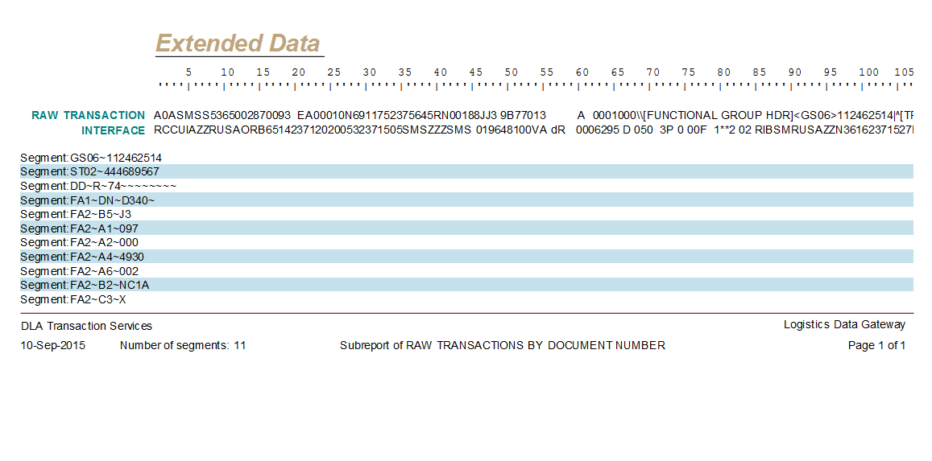
Logistics Data Gateway
Notes:
This slide shows the extended data sub-report.
The A0A came out of Navy ERP, which is a DLMS compliant system; therefore it is a clickable hyperlink.
As a result of ADC 1043, requisitions must contain Standard Line of Accounting (SLOA) data, and DAAS must valid discrete SLOA data elements. Because of this, the FA2 Accounting Segments (which contains SLOA data elements) are included in the extended data and therefore are viewable in the extended data sub-report.

Slide 61
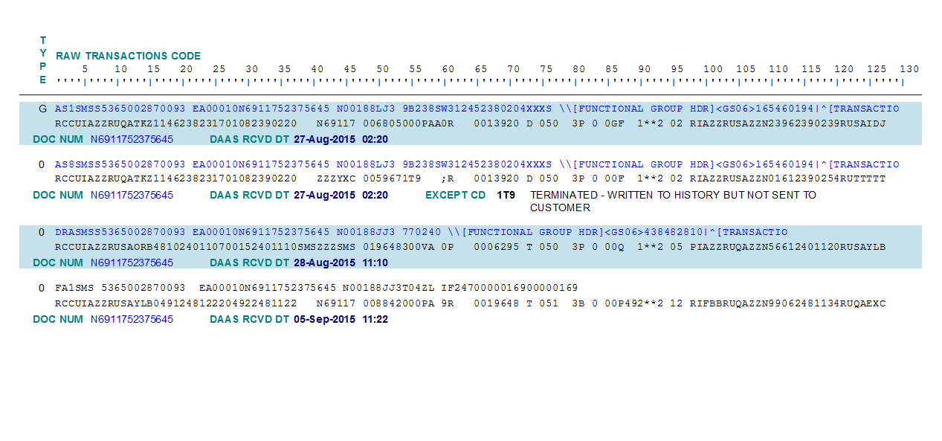
Logistics Data Gateway
Notes:
On this slide, notice how the FA1 Interfund Bill does not display as a hyperlink.
Although it was generated by EBS, which is a DLMS compliant system, the destination system (DFAS Cleveland) is not capable of processing DLMS transactions. Therefore, DAAS converts the DLMS transaction to an 80 character MILS transaction. The extended data is not carried, and thus there is no need to show the transaction as a hyperlink.

Slide 62
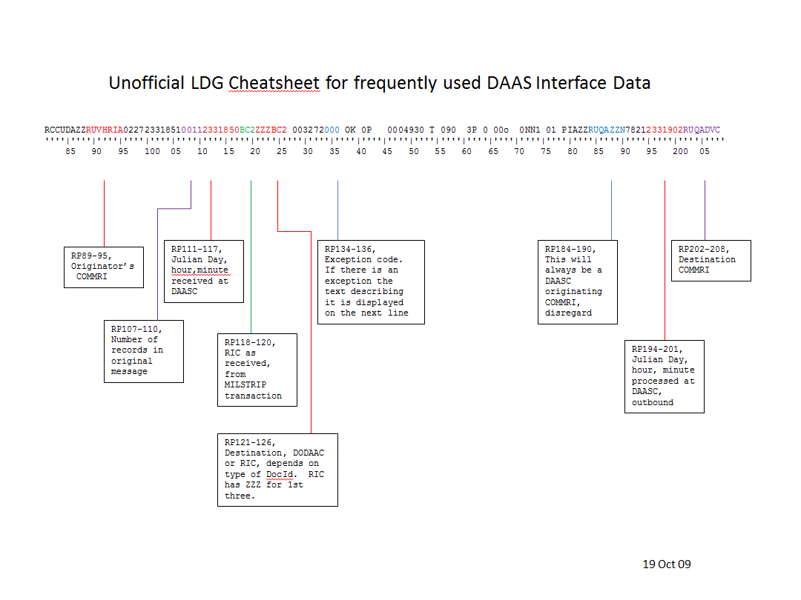
Logistics Data Gateway
Notes:
Those of you that work on the systems side of the house may be interested in understanding what’s referred to as the DAAS interface data. This is the string of data directly below the transaction displayed in LDG. Here is a screenshot of the interface data “cheat sheet.”
Interface data is useful for researching the system (identified by COMMRI) that sent or received the transaction. You can query the COMMRI using another DAAS application, EDAASINQ. Bills that were retransmitted by MILSINQ will show COMMRI “RUSAZZQ” as the Originator.
Interface data is also useful if you are researching a transaction that may have routed to a different source of supply than expected. For example, the order may have used Army CECOM, Routing Identifier Code (RIC) B16, but was redirected to DLA EBS RIC “SMS.” Rp 118-120 would display “B16” (RIC as received) while RP 121-126 will show ZZZSMS (ZZZ placeholder for RICs followed by SMS) (destination RIC). Alternatively, a transaction that routes to a DODAAC, such as a status, will show the DODAAC in this field.
DAAS personnel use this information to identify the originating or destination Communication Routing Identifier, or the unique message serial number when looking for specific messages within a file transmission.

Slide 63
Logistics Data Gateway
Notes:
Recall the FA1 Interfund Bill From Stock in document N6911752375645. We will use the Interfund Bills by Billed DoDAAC (buyer) and Bill Number query.
Despite the use of the term “Interfund Bill,’’ you can query Non-Interfund bills as well.

Slide 64
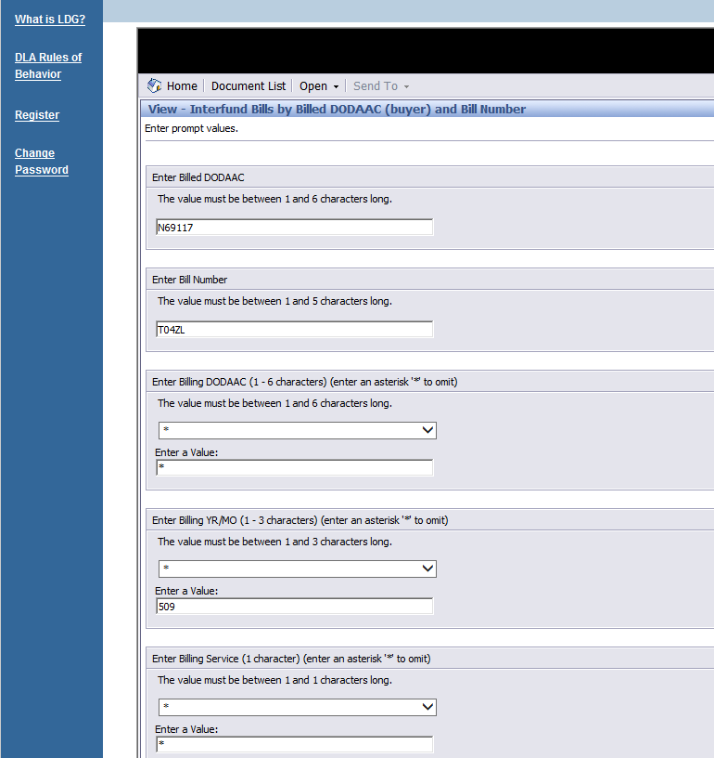
Logistics Data Gateway
Notes:
This is the query form. Due to the “J” signal code in the FA1, we derive the billed DoDAAC from the DLMS requisition DoDAAC (rp 30-35) and the Bill Number from rp 54-58 of the detail billing record in this case.
Though optional, entering the date (YMM) in the Billing YR/MO field is a good idea, since bill numbers may be reused from year to year.

Slide 65
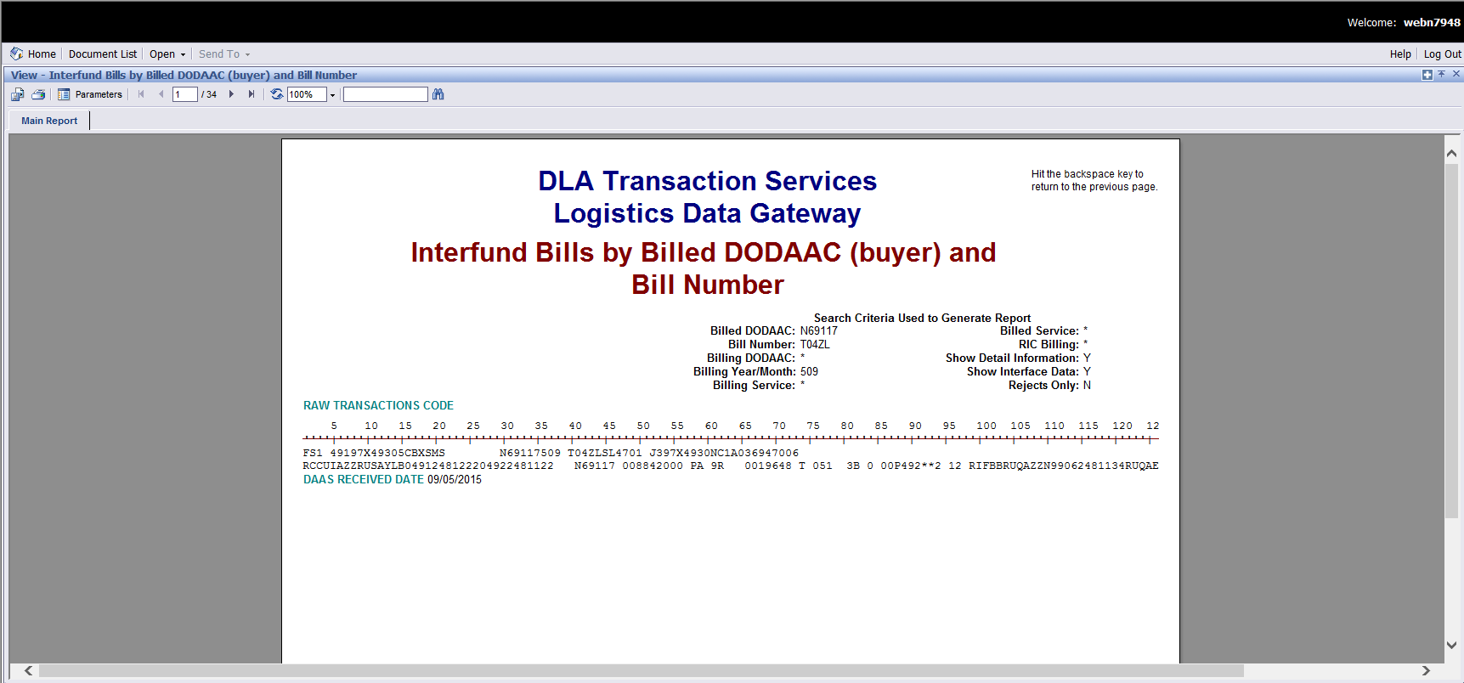
Logistics Data Gateway
Notes:
This slide is a snapshot of the bill we queried. We’re looking at the summary billing record, or SBR.

Slide 66
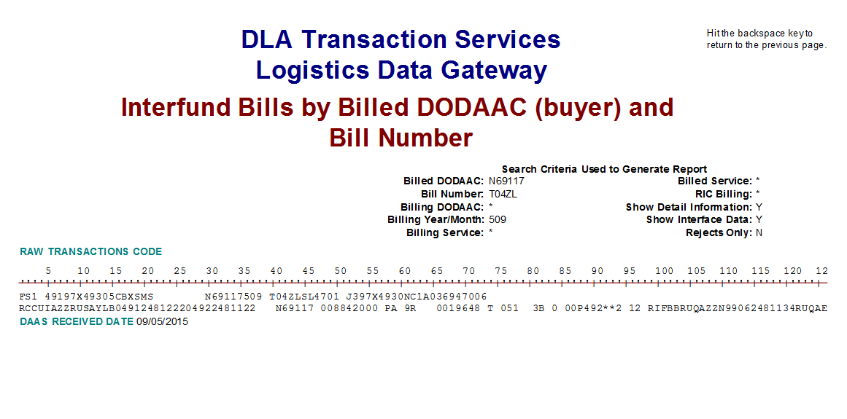
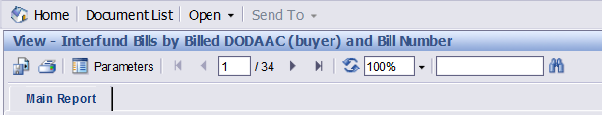
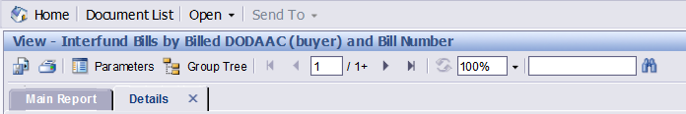
Logistics Data Gateway
Notes:
Interfund Bill queries will always display the Summary Billing Record (SBR), Document Identifier Code FS_ (Interfund) or GS_ (Non-Interfund).
An SBR can contain up to 494 detail bills. Therefore, your results will likely contain several pages of data; our example contains 34 pages. Clicking on the next page arrow, or manually entering a page number will display that page of detail billing information.

Slide 67
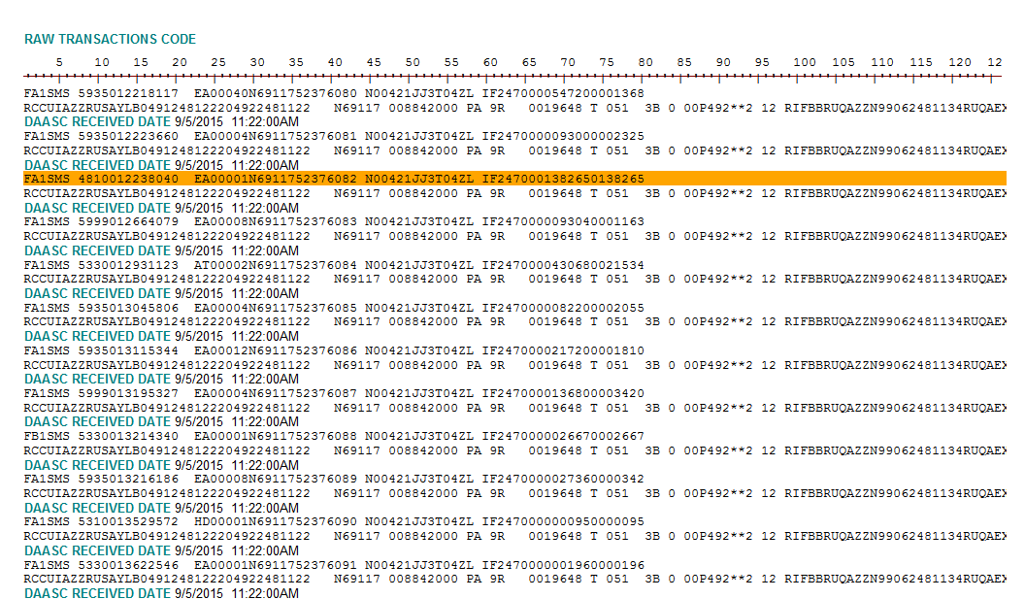
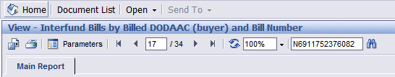
Logistics Data Gateway
Notes:
You can use the search field (similar functionality to “ctrl-F”) to quickly find information. This is useful when LDG returns large amounts of data.
Our FA1 detail bill for document N6911752375645 is highlighted. The transaction containing the information you search will always be highlighted in orange. This transaction was on page 17!

Slide 68
Notes:
Web Visual Logistics Information Processing System (WEBVLIPS) is the next application we’ll look at for querying logistics transaction data.

Slide 69
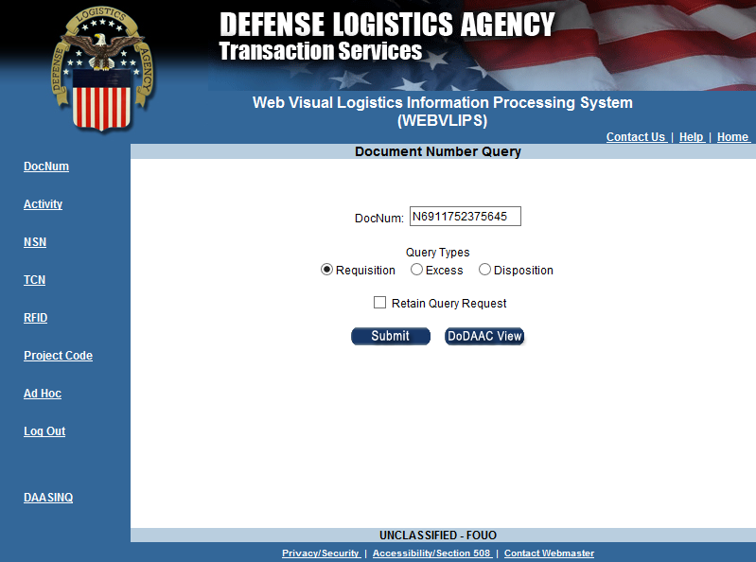
WEBVLIPS
Notes:
Like LDG, WEBVLIPS has set query capabilities based on how you want to be the focus of your results. Here we’ll look at the WEBVLIPS version of the query we did in LDG for the same document number.

Slide 70
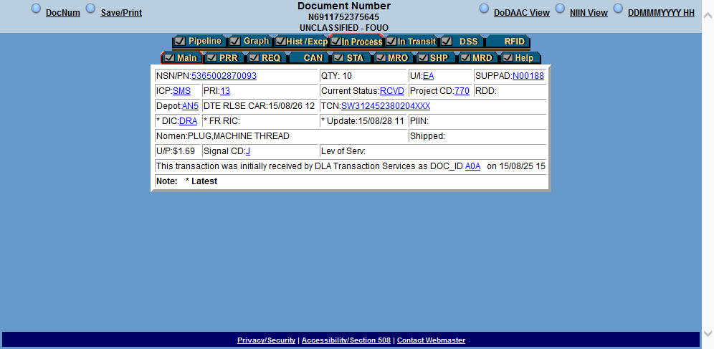
WEBVLIPS
Default View is the “In Process” > “Main” tab.
Notes:
WEBVLIPS displays the data in forms that make it easier to read than the raw transaction data. The Main view provides a summary of pertinent information about the requisition. Here we see the data for document number N6911752375645 that we examined in LDG.
The hyperlinks on the page perform one of three functions: 1) generate a pop-up explaining what a code means; 2) executes a table look-up for an identifier to get more related information to show in a pop-up (for example, the SUPPAD DoDAAC and the depot RIC); or 3) executes a query for transactions associated with that piece of data and presents in a new browser window (for example, NSN or TCN).

Slide 71
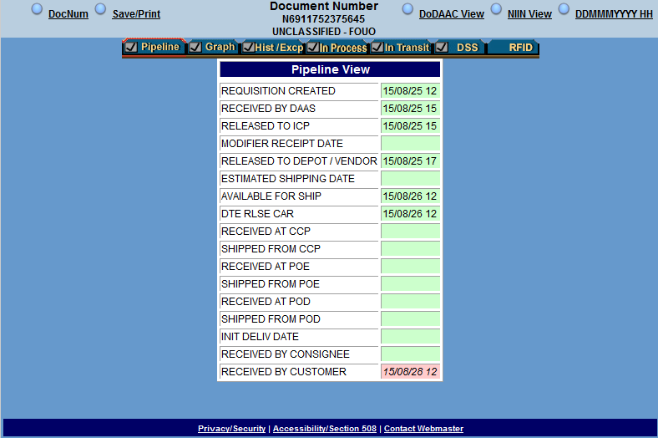
WEBVLIPS
Notes:
The Pipeline tab provides a snapshot of milestones based on transaction data.

Slide 72
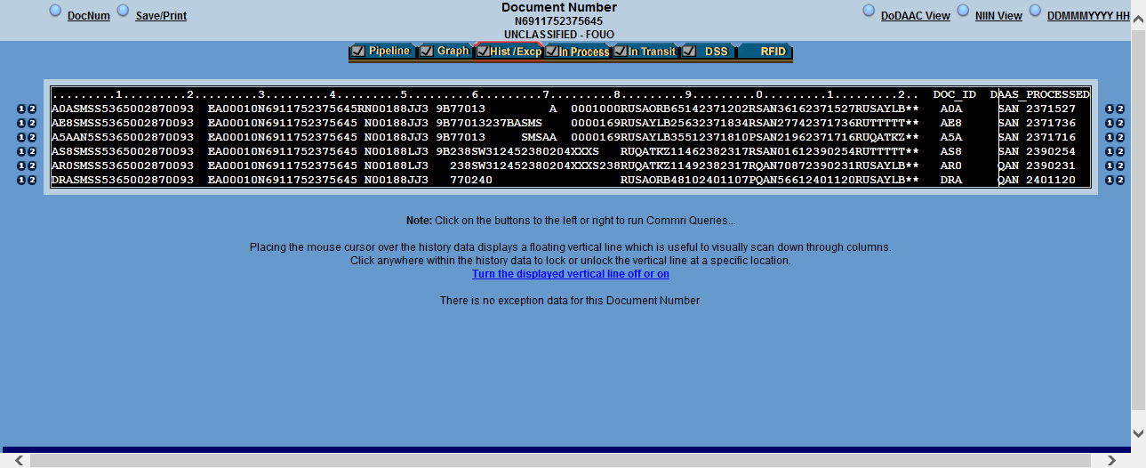
WEBVLIPS
Notes:
The History tab presents the transaction data in MILS format, even for transactions sent in DLMS format. Unlike LDG, WEBVLIPS does not have the ability to see the additional DLMS data. The information displayed beyond the 80 characters of the MILS format is DAAS processing information.

Slide 73
Bills< 1 year;
FMS< 2 years.
Others, use LDG
Notes:
Narrator:
In MILSINQ we can conduct a billing transaction search.
However, MILSINQ generally retains data no longer than one year (two years for FMS). Older bills and the supply transactions that support billing transactions may be researched in Logistics Data Gateway or LDG. We will not be reviewing LDG in this module.
Similarly, WEBVLIPS, which provides Supply transaction information, is not covered in this module.

Slide 74
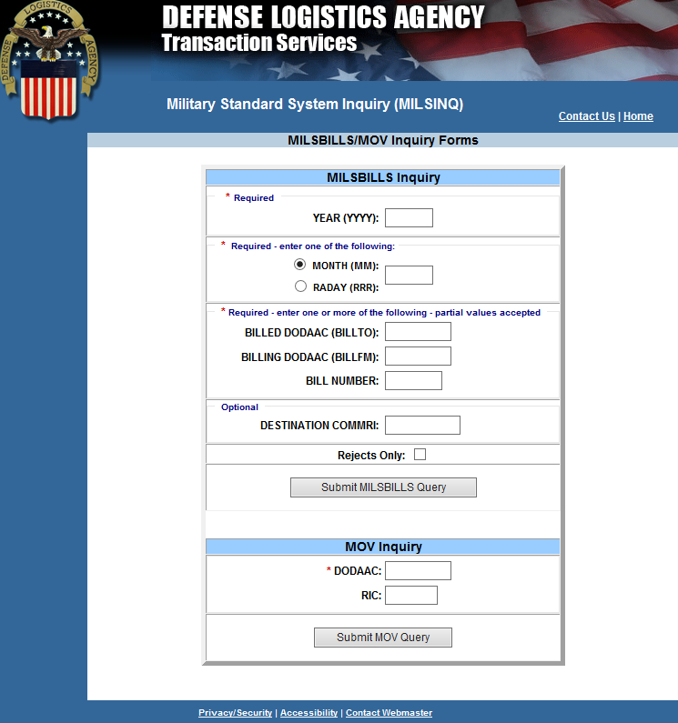
MILSINQ
YYYY (Year): 4 characters, all numeric
MONTH (Month):2 characters, all numeric
RADAY (Day of the Year): 3 Characters, all numeric
BILLED DODAAC (BILLTO): 6 characters , alphanumeric
BILLING DODAAC (BILLFM): 6 characters, alphanumeric
BILL NUMBER: 6 characters, alphanumeric
DESTINATION COMMRI: 6 characters alphanumeric
Notes:
Narrator:
MILSINQ has two options for searching by Summary Bill date. First is the Year and Month. The second option, RADAY, looks at the interface data and shows only data received on a particular Julian date.
The DESTINATION COMMRI is for searching bills based on where DAAS routed the bill. Will look closer at COMMRIs when discussing the eDAASINQ system.

Slide 75
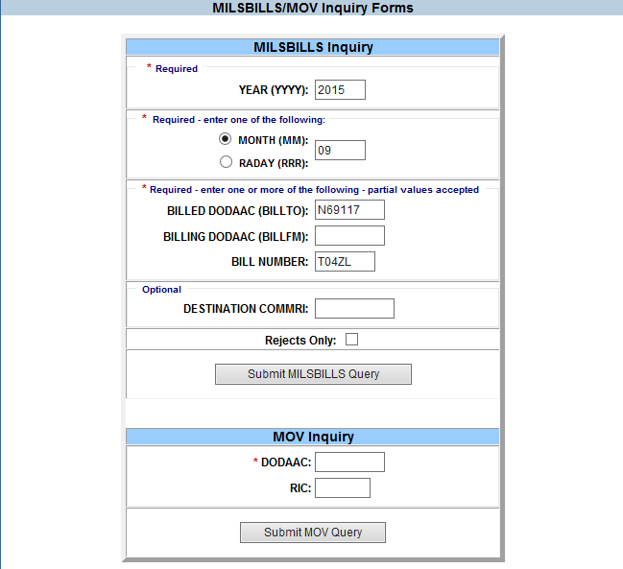
MILSINQ
Notes:
Narrator:
In the example shown here, we have selected to receive all bills for Billed DoDAAC N69117 processed in September 2015.

Slide 76
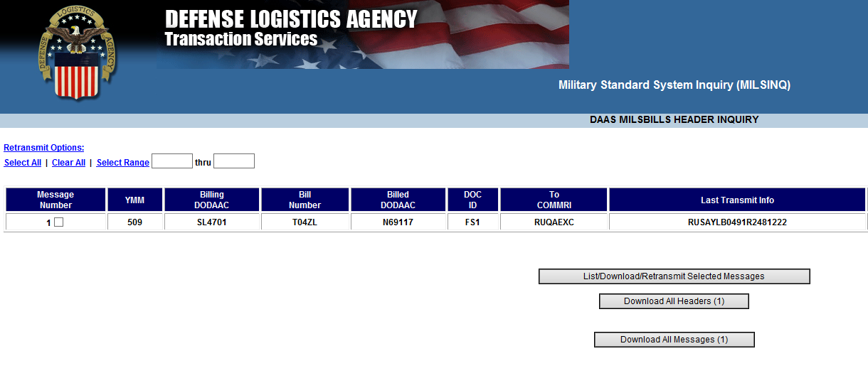
MILSINQ
Notes:
Narrator:
Our query returns the DAAS MILSBILLS Header Inquiry screen shown here.
In our example, there is only one Summary Bill. We will select this bill and then we will click “List/Download/Retransmit Selected Messages.”

Slide 77
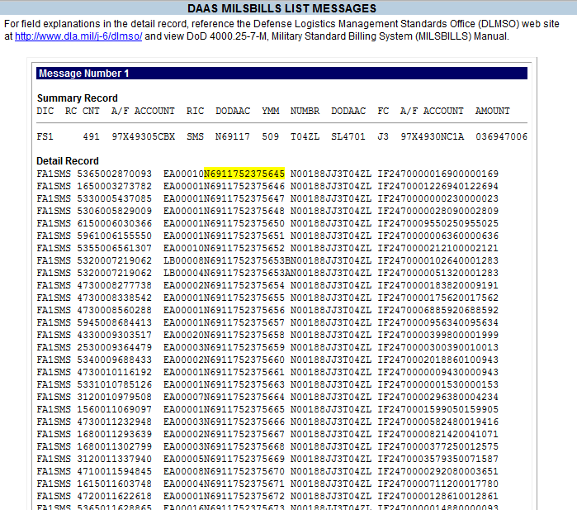
MILSINQ
Notes:
Narrator:
This is the DAAS MILSBILLS List Messages screen.
You can see the Interfund Summary billing record for charges (FS1) followed by the detail billing records. Our example will use document (N6911752375645) which is the first detail bill shown.

Slide 78
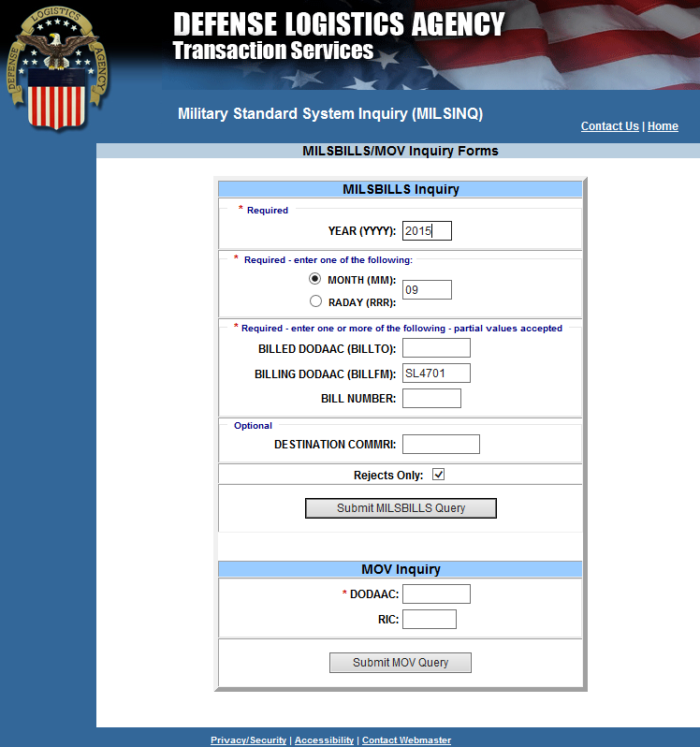
MILSINQ
Notes:
Narrator: Now, we’ll demonstrate a Seller researching rejected bills. In this case we have selected all rejected bills sent from DLA Enterprise Business System (EBS) billing DoDAAC “SL4710” during September 2015.

Slide 79
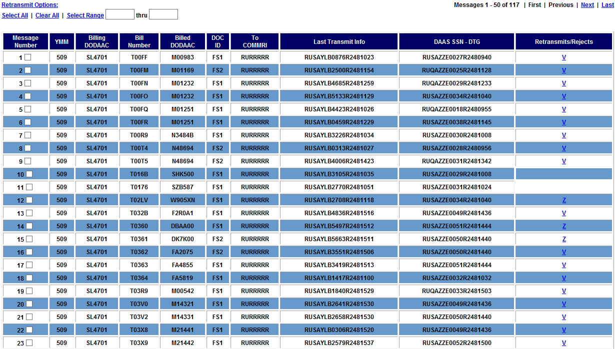
MILSINQ
Notes:
Narrator:
Note that the TO COMMRI of RURRRRR indicates all of these bills failed an edit during processing at DAAS and were rejected. The bill-to party never got these bills.
Our query identifies several rejected bills where DoDAACs used in the ordering process were either not valid in the DAAS authoritative database or lacked the proper authority code for their intended purpose as an ordering or bill-to party. The “Transaction Rejects” column contains a code identifying the reason for the reject.
Let’s look at this further.

Slide 80
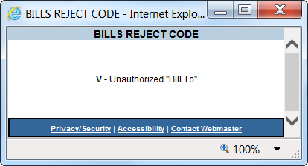
MILSINQ
Notes:
Narrator:
Clicking on the Reject code in the right most column provides the reason for rejection. Code V is used when the identified Bill-To DoDAAC does not have an Authority Code that allows that activity to act as a bill-to party. We will look at the authority code for the bill-to DoDAAC N48694 using eDAASINQ a later in this module to see the cause of the rejected bill.

Slide 81
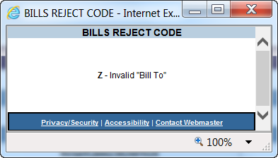
MILSINQ
Notes:
Narrator:
Looking at row 15 we see a anther rejected bill scenario.
Code Z means the Bill-To DoDAAC is not recorded in DAAS. We see that the bill to party identified by DoDAAC DK7K00 is not recognized in the DAAS DoDAAC database and this transaction failed citing code Z. DK7K00 is actually a MAPAC used for Security Assistance and not a DoDAAC.

Slide 82
MILSINQ
Notes:
Narrator:
[Click] Next we see for SZB587 there is no reject code.

Slide 83
MILSTRAP Appendix 2.8 | MILSINQ
BU Rejected. Discrete values for the SLOA data elements in the transaction do not match data elements from the SFIS Fund Code to Fund Account Conversion Table for the Fund Code cited in the transaction. BV Rejected. DoDAAC in the transaction does not have the appropriate authority code for its intended use BW Rejected. Suspense account is not authorized for Interfund use BX Rejected. Total dollar value of detail bills is not equal to total dollar value of the summary bill BY Rejected. Count of detail bills is not equal to the count in the summary bill (MILS RP 5-7, DLMS 810L 3/CTT01/070) BZ Rejected. DoDAAC is not valid in DAAS | U – SLOA ELEMENTS INVALID IAW SFIS FUND CODE TABLE V - Unauthorized "Bill To" ADDR BILL TO NOT AUTHORIZED FOR INTERFUND USE BILL OFC ADDR NOT AUTHORIZED FOR INTERFUND USE VALIDATE VALUE OF FE/GE ENTRY W - F3885 Not Authorized ACCOUNT UNAUTHORIZED FOR USE IN INTERFUND BILL X - Dollar Value Summary not equal to Details DOLLAR VALUE OF DETAIL NOT EQUAL TO SUMMARY Y - Card Count Summary not equal to Details DOC COUNT NOT EQUAL TO COUNT IN RP 5-7 OF SBR Z - Invalid "Bill To" BILLING ADDRESS IN RP 30-35 NOT IN DAAS RECORDS ADDR BILL TO IS INVALID FOR DOCUMENT ID
Notes:
Narrator:
Here we see the DLMS reject codes from MILSTRAP Appendix 2.8 along with the legacy MILS reject codes shown in MILSINQ
The DLMS billing related codes in in MILSTRAP Appendix 2.8, Reject Reason Codes equate to the second position of the legacy MILSINQ reject code preceded by the letter “B” for Bill. In legacy MILS transactions, the single character MILSINQ reject code is contained in record position 4 of the rejected Summary billing transaction. In DLMS, the 824R reject transaction is used with the MILSTRAP Reject Advice Code, which allows additional data content.
[Click] Here we see our MILSINQ example reject codes for a DoDAAC that does not have the appropriate authority code for what the transaction identified the DoDAAC to be used for: “BV” from MILSTRAP Appendix 2.8 or “V” from MILSINQ
In legacy MILS transactions, the single character MILSINQ reject code is contained in record position 4 of the rejected Summary billing transaction.

Slide 84
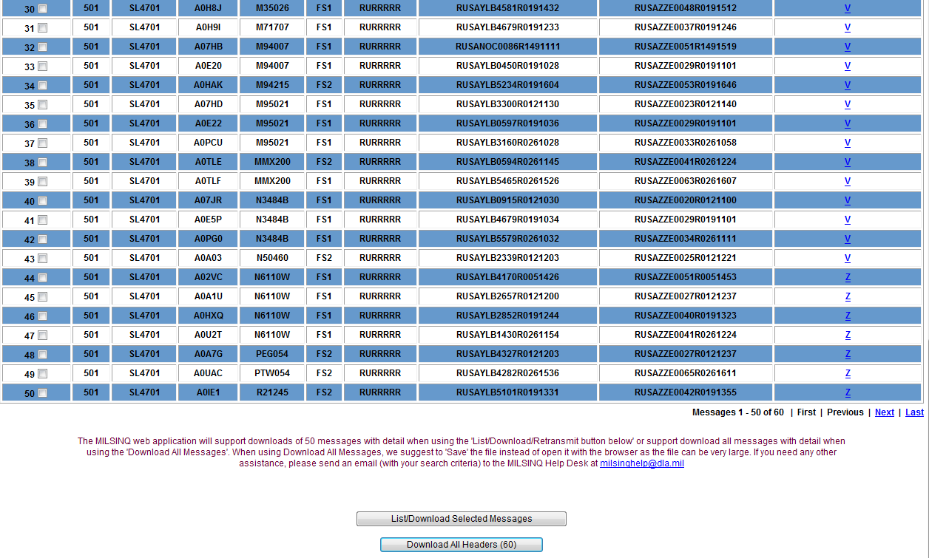
MILSINQ
Notes:
Narrator: The List/Download Selected Messages button formats a report for the selected bills to include the individual detailed bills.

Slide 85
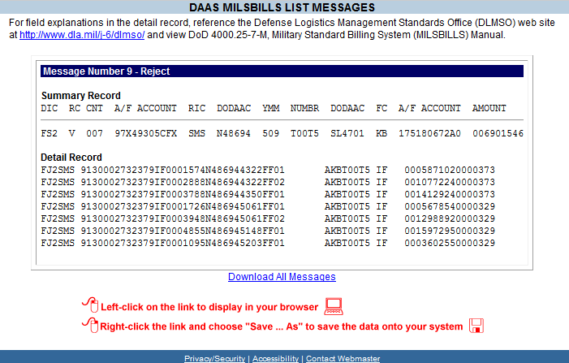
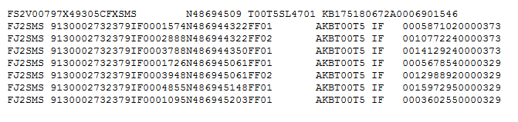
MILSINQ
Notes:
Narrator:
Here is the report for the bill we checked. Clicking on the Download All Messages creates a text file of the transactions.
Note the RC reject code of “V” from our example, noting that bill-to DoDAAC is not authorized as a bill-to party in DAAS.
in this case DLA is attempting to provide credit for bulk petroleum purchases that are rejecting because DoDAAC N486494 does not have the correct authority code to requisition or to process bills.
This is an example where Navy is using this DoDAAC in an offline ordering process where the orders do not pass through DAAS, but the Interfund bills do and the bills are rejecting.
The authority code was likely changed at some time after this customer profile was established in the DLA Fuels Customer Master. Billing transactions will continue to reject until this is changed, either by changing the authority code for this DoDAAC or by replacing it with an appropriate DoDAAC.
Remember, In legacy MILS transactions, the single character MILSINQ reject code is contained in record position 4 of the rejected Summary billing transaction. In DLMS a DLMS 824R Reject Transaction is used.

Slide 86
Notes:
Narrator: Next we’ll look at eDAASINQ and compare it to the publicly accessible DAASINQ.

Slide 87
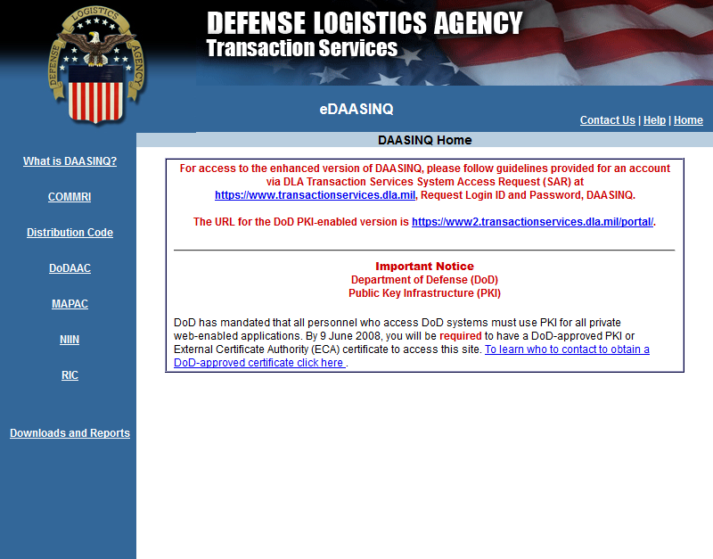
eDAASINQ
EDAASINQ Home Page
Notes:
Narrator: Displayed here is the eDAASINQ home page.

Slide 88
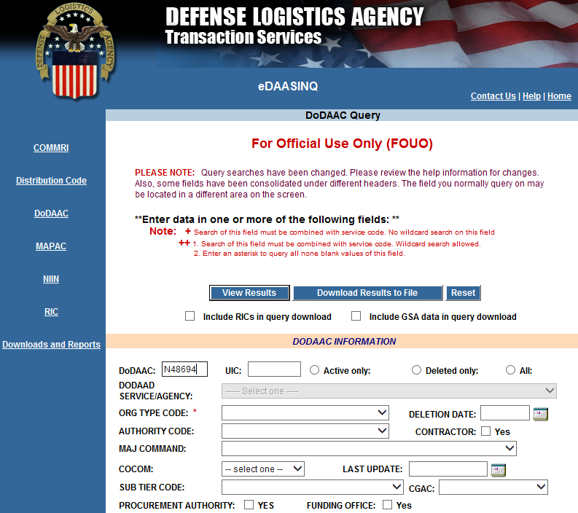
eDAASINQ
Notes:
Narrator: This slide displays the MILSBILLS header inquiry for the bill we looked at as part of the rejected bills earlier in MILSINQ. The Bill-to DoDAAC, N48694 , populates DoDAAC field.

Slide 89
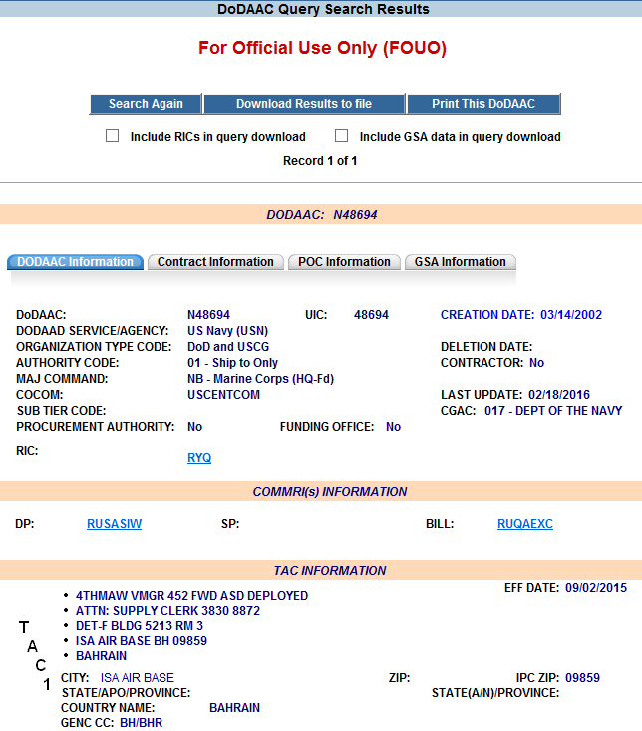
DoDAAC Authority Code
DoDAAC Central Service Points assign authority codes to restrict the use of a DoDAAC.
Authority codes are applicable to all Components/Agencies, and there are many supply and finance business process edits based on the authority code.
Authority Code 00 allows unrestricted use of the DoDAAC.
This DoDAAC has authority code 01 and may be used for shipping, but not for ordering or bill payment
Notes:
Narrator:
We are looking at the DoDAAC Information tab in eDAASINQ.
The top section displays important information including the Authority Code. The DoDAAC must have the proper authority code for how it is used in the transaction for requisitioning, billing, shipping or administrative purposes.
Note here that the authority code for this DoDAAC is 01, which means that this DoDAAC may be identified as an activity to receive materiel, but cannot requisition materiel or process bills. DAAS edits will reject transactions where the authority code is invalid as a requistioner or bill-to party. While not all orders pass though DAAS – bearer walk through for example – all Interfund bills do. So orders with improper DoDAACs or DoDAACs where the authority code has been changed after the order was processed but before billing will reject.
We will see later how the bill-to party is identified in both a legacy 80 record position MILS transaction and as a discrete data element in a DLMS variable length transaction

Slide 90
DoDAAC COMMRI/TAC 3
Transactions are routed to the communications routing identifier or COMMRI
Bill COMMRI here is RUQAEXC which identifies DFAS Cleveland
DP COMMRI is RUSAIDJ, where all other transactions will be routed.
If no BILL COMMRI exists, the billing transaction will be delivered to the DP COMMRI.
COMMRI Mismatch. Should be RUTTTT for Terminate; do not route.
Notes:
Narrator:
This DoDAAC has an authority code of 01, which indicates that it may be used as a ship-to only DoDAAC and may not be used for ordering or billing. Bills citing this DoDAAC will fail DAAS authority code edits and will not be routed .
Bills with an authority code that allows Interfund billing will route to the Bill Communications Routing Identifier (or COMMRI) if there is one; else they will route to the Data Processing COMMRI where all other transactions will Route.
Occasionally, DoDAACs may contain incorrect information. In this example, the authority code 01 indicates that this is a ship-to DoDAAC, such that the correct Bill COMMRI should be RUTTTT for terminate at DAAS and do not route. This DoDAAC should not have a TAC 3.
In our example, the correct Bill COMMRI would be RUTTTT for terminate, do not route.

Slide 91
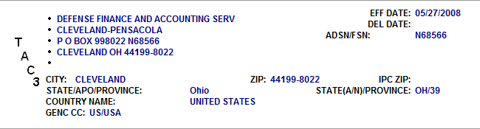
DoDAAC TAC 3 for N48694
The DoDAAC TAC 3 provides bill addressing information.
In some cases DoDAACs have old TAC3 data that was not removed when the Authority Code was changed.
Per prior slide, N48694 has authority code 01 “ship-to”, so the TAC 3 should be blank.
Notes:
Narrator:
The DoDAAC TAC 3 provides bill addressing information.
In some cases DoDAACs have old TAC3 data that was not removed when the Authority Code was changed.
Per prior slide N48694 has authority code 01 “ship-to”, so the TAC 3 should be blank.

Slide 92
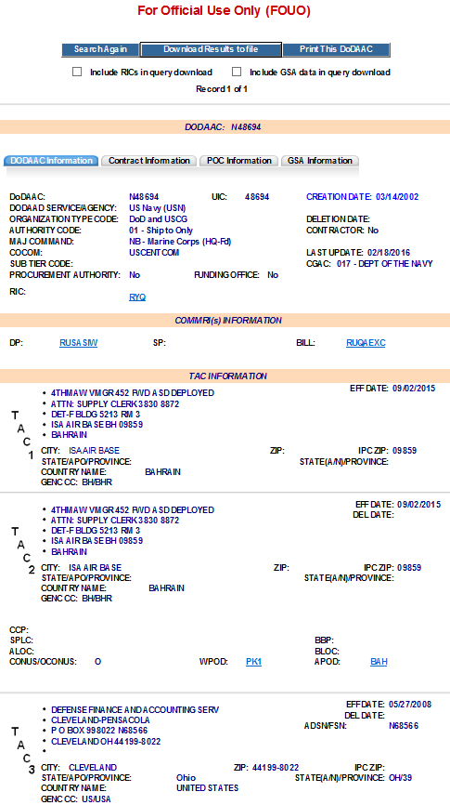
DoDAAC N48694 TACs 1 - 3
Bill COMMRI should be RUTTTT – terminate
TAC 3 should be blank
Notes:
Narrator:
Here we see TACs - -3 for our DoDAAC. The bill COMMRI should be RUTTTT for terminate and the TAC 3 should be blank

Slide 93
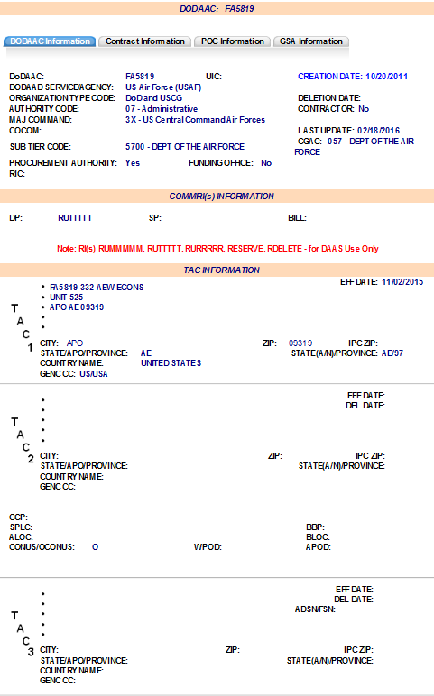
DoDAAC FA5819 - Administrative
POC tab provides DoDAAC POC; else see
http://www.dla.mil/HQ/InformationOperations/DLMS/allpoc/
This is another example of a bill that was rejected for an unauthorized Bill-To Party
As you can see, DoDAAC FA5819 has authority code 07, “Administrative”
COMMRI is “RUTTTT”
All transactions (including bills) will terminate at DAAS and not be routed
TAC 3 is blank
Notes:
Narrator:
This is the DoDAAC for another one of our rejected bills from MILSINQ.
Here the Bill COMMRI is correctly set to RUTTTT for terminate and the TAC3 is blank.
Again, if this DoDAAC is used in offline ordering, bills will reject at DAAS after the materiel has been delivered. DLA will have to continue making Journal Voucher entries to reverse the revenue that was recognized when the bill was processed in order to reverse the revenue back to an account receivable. The rejected bill will have to be worked manually.
[Click] In eDAASINQ the “POC Information” tab may provide a POC for this DoDAAC, including name, email and phone number. If there is no POC information, you may contact the DoDAAD POC for the Component on the DLMS website at the hyperlinked URL shown here.

Slide 94
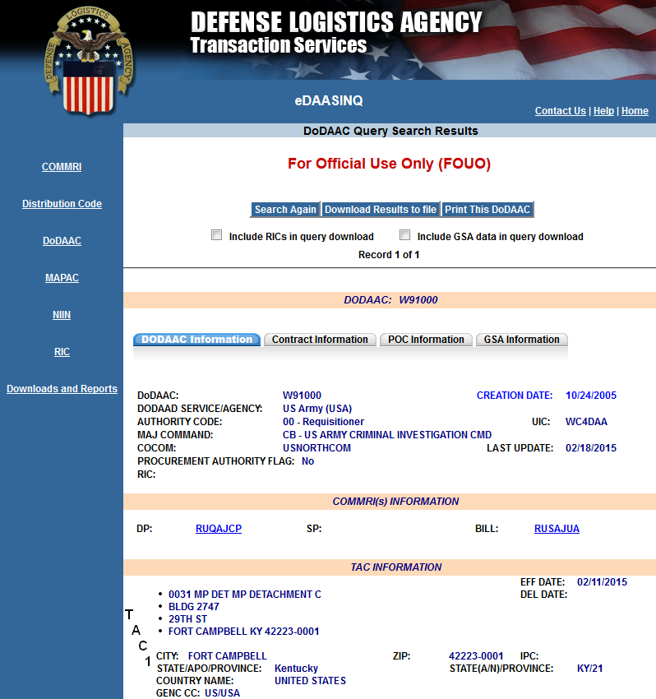
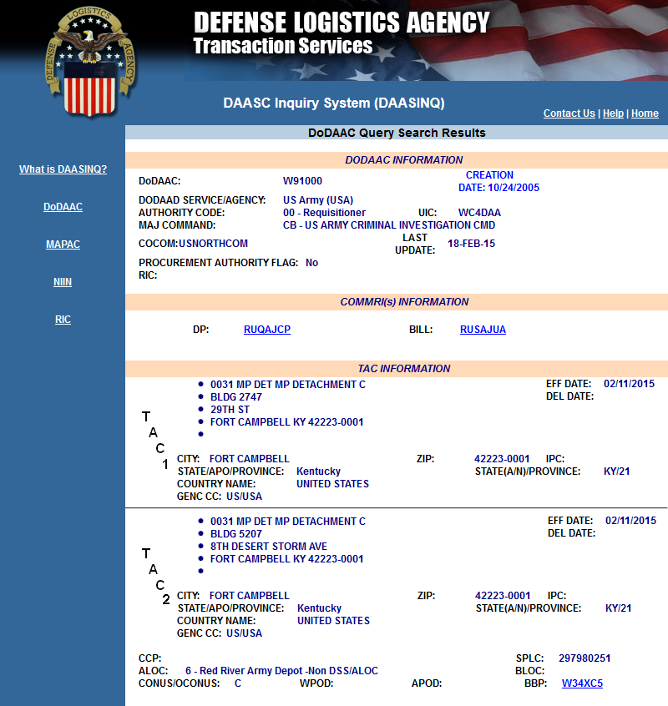
eDAASINQ vs DAASINQ
eDAASINQ
DAASINQ
Notes:
This slide shows eDAASINQ and DAASINQ side-by-side
Notice the additional menu options in eDAASINQ along with the additional tabs on the query display

Slide 95
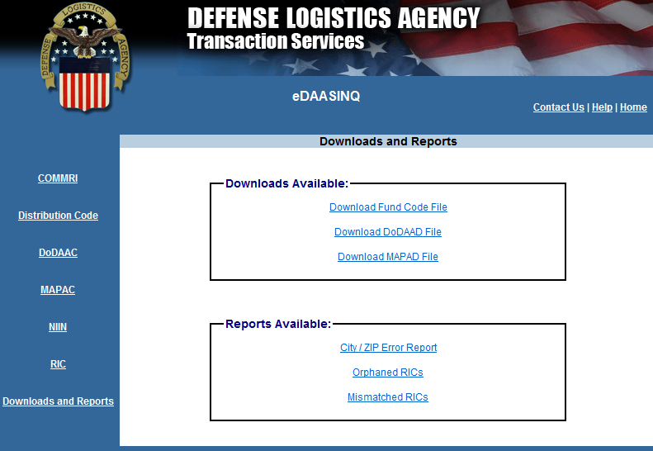
eDAASINQ Downloads
Download files are available for the SFIS Fund Code to Fund Account Conversion Table data as well as DoDAAD/MAPAD
Notes:
Download files are available for the SFIS Fund Code to Fund Account Conversion Table data as well as DoDAAD/MAPAD
MAPAD or Military Assistance Program Address Directory (MAPAD) is for Security Assistance Programs.

Slide 96
Notes:
Narrator: The last DAAS web application we’ll look at is Logistics Reports.

Slide 97

Logistics Reports
Notes:
Narrator: Here is the home page for Logistics reports. There are links to jump to the five sections for reports. Each section has a dropdown of caned reports that can be run for an identified month. All reports are available for the past twelve completed months.

Slide 98

Logistics Reports
Select the last completed month.
Notes:
Narrator: For this example we will select the Fund Code publication. We we are going to treat January 2016 as the most recently completed month, i.e. the current date would be in February 2016.

Slide 99

Logistics Reports
This report is used to update DLMS Vol. 4, Appendix 1. All three parts of the appendix are included in this fund code report.
Notes:
Narrator:
This is the top of the report. This single report is split into three sections for DLMS Volume 4, Appendix 1:
1.1 – SFIS Fund Code to Fund Account Conversion Table
1.2 – Fund Code to Billed Office DoDAAC
1.3 –Table of H Series DoDAACs, Authorized Interfund Billing
Here we are showing the Fund Code to Fund Account Conversion Table. Note the “as of date” of January 1, 2016.

Slide 100
Logistics Reports
Select the desired month to be queried.
Notes:
Narrator: The MILSBILLS section has a number of reports pulled from billing transactions.

Slide 101

Logistics Reports
Buyer Billing Advice Code - Adjustment Request (DLMS 812R)
(19/41) seeks the bill to be resent: 19 credit, 41 debit
(21/24/26) request credit refund due to a discrepancy report (i.e. TDR/PQDR/SDR)
(34) missing bill for received materiel.*Unrealized billing office revenue.
(DD) Billing or adjustment was rendered under a bill number being provided back
(EL/EM) report the cited discrepancy report not found
Seller Billing Status Code –
Adjustment Request Reply (DLMS 812L)
(AH) discrepancy report required the return of the discrepant or deficient materiel, before credit can be provided
(DF) no record of cited document number or bill number is on file
(CA/DM) Duplicate, adjusted, or corrected bill will be sent in the next billing cycle
(DD) adjustment was rendered under bill number in the Reply
(EL/EM) report the cited discrepancy report not found
Unrealized revenue
Notes:
Narrator:
Here is an example of the Billing Adjustments report by billing office Routing Identifier Code.
On the left, highlighted in the blue outline box, billing advice codes for the DLMS 812R Billed Office Billing Adjustment Requests are totaled for the month by the Billing Office RIC. Billing Advice Codes are displayed as follows:
(19/41) seeks bill retransmission, 19 provide credit bill, 41 for debit bill.
(21/24/26) request seeks credit for a validated discrepancy report (i.e. TDR/PQDR/SDR)
(34) missing bill for received materiel. Notice that the grand total is 18,,970 instances where the Billed Office designated in the requisition reports receipt of materiel without a corresponding bill to clear the accounts payable. This represents delayed revenue recognition for the Billing Office.
“Other” groups the remaining billing advice codes that would be contained in the DLMS 812R Bill Adjustment Requests
[Click] On the right, highlighted in the red outlined box, is the total DLMS 812L billing office Replies during the month displayed as shown
Total requests by Routing Identifier Code or RIC and billing advice code are shown on the left, while replies are shown on the right.

Slide 102

Logistics Reports
Notes:
Narrator: Here are some of the other billing reports that can be generated.

Slide 103
Definition of EDI and ASC X12
  Electronic Data Interchange EDI is:
    The computer-to-computer interchange of strictly formatted messages that represent business documents
    A sequence of messages between two parties, either of whom may serve as originator or recipient
    The formatted data representing the documents transmitted from originator to recipient via telecommunications
    Independent of originator/recipient systems. When routed through Defense Automatic Addressing System (DAAS), may be edited, validated and mapped to alternative format (i.e. MILS)
  DLMS based on EDI standards ASC X12 Implementation Conventions (ICs) release 4010 and 4030
Notes:
Narrator:
EDI stands for electronic data interchange. DOD has been doing electronic data interchange since the early 1960s, in the form of MILS fixed formatted transactions. So, MILS are a form of EDI, as are the DLMS. Data is exchanged electronically in both formats between different automated information systems. By using a disciplined electronic data exchange standard, data may be exchanged among all participating trading partners, regardless of the logistics and financial systems that they are using.
MILS are an 80-card column fixed format structure, built off of the IBM punch card capability of the 1960s whereas the DLMS are based on a variable length mature commercial American National Standard Institute, Accredited Standards Committee X12 standard, you may hear this referred to as ANSI X12.
The MILS interchange transaction formats work together, sharing data with business events triggering the next transaction in a sequence in a largely automated manner. For example, Requisition Data is seamlessly passed to the source of supply, inventory control point, to the depot, back to the customer in the former supply status and the logistics bill and back when materiel is dropped from inventory while the customers receipt of goods __ the requisition due in data triggers the materiel receipt acknowledgment back to the seller. In this process all of the disparate supply, inventory and finance systems share common data to update accountable inventory and financial records.
The DLMS variable length transaction affords us the capability to exchange unlimited data unconstrained by the 80 record position restriction of the MILS to support ever changing business requirements, such as standard line of accounting.

Slide 104





DLMS 810L, Logistics Bill
TRANSACTION TABLES
PURPOSE: Used to invoice material and equipment from a supply distribution system for immediate consumption or stockage against projected requirements.
TABLE 1, Header Section. Contains information common to all bills such as; transaction type, transaction set control number, code identifying type of bill, date and time, etc.
TABLE 2, Detail Section. Contains detailed data specific to the specific billing transaction. Examples of data in the detail section are; identity of invoicing (billing) office, purchase unit, quantity, currency, who will pay, date, product description, billing address, etc.
TABLE 3, Summary Section. Contains summaries of the details contained in table 2. Most frequently used in financial transactions.
Notes:
Narrator:
All X12 transactions have at a minimum a header table and detail table. The header or heading is always defined as Table 1 and the detail is always Table 2. Some transactions will have three tables and those are usually finance transactions, where there will be a summary Table 3. The reason this mostly occurs in the finance world is finances passes multi-line bills, so the summary record contains a rollup of the detailed billing and this is important to verify all the detail information has been received in its entirety.
This is the cover page and table structure of the DLMS implementation convention for the logistics bill. The logistics bill contains three tables. Table 1 is the header section, containing information common to all the bills including the summary bill. Table 2 is the detail section which repeats for each detailed bill. Table 3 is the summary section which applies any allowances and credits to the total bill and counts the number of detail bills for the recipient and the total dollar value of the detail bills to validate all bills were received. This example gives you a feel for the kinds of data segments that are contained within the 810 and its three` table structure.

Slide 105
Use of the Tables In DLMS Changes
Revisions to DLMS 812L IC
Item # | Location | 812L Logistics Bill Adjustment Request Reply | Reason
1. | DLMS Introductory Notes | Add ADC 1213 - ADC 1213, Clarification of Bill Numbers in DLMS | Identifies DLMS Changes included in the DLMS IC
2. | 1/BCD07/020 | Replace the Existing Federal Note with a DLMS Note: Invoice Number Federal Note: Cite the invoice number which applies to both the request and reply. DLMS Note: 1. Cite the bill number which applies to both the request and reply. 2. If the request did not cite a bill number (i.e. Materiel Returns Program credit requests) the reply will cite a generated bill number conforming to DLM 4000.25, Volume 4, MILSBILLS and may not be duplicated by the issuer within a calendar year. 3. When replying to an adjustment request for credit due to a duplicate bill (i.e. Billing Advice Code = 11, 43 or 44) cite the original bill in 2/N9/200, code OI. 4. When the requested adjustment has already been furnished previously (Bill Status Code = AI or DD), cite the adjustment bill number in 2/N9/200, code C9. | Clarify the definition and use of a Bill Number.
Table
ID
Pos
DLSS/DLMS Map
Reply to Summary Bill Adjustment Request Reply to Summary Bill Adjustment Request Follow-up
Legacy DIC | Bill Number RP | Populated From | Original Bill Number RP | Populated From | Adjustment Bill Number RP | Populated From | DLMS IC | Mapped
FDR/FDS | 11-15 | Request | 25-29 | Request | 51-55 | When status codes AI & DD | 812L | RP11-15 = 2/N901/200 (Code: IV) 1/BCD07/020 RP25-29 = 2/N901/200 (Code: OI) RP74-78 = 2/N901/200 (Code: C9)
ADC 1213, Change to DLMS 812L, Clarification of Bill Numbers
Notes:
Narrator:
This is an extract from ADC 1213, documenting a change to the DLMS 812L to clarify the proper mapping of multiple bill numbers that may appear in a reply to Bill Adjustment Requests. This example shows two tables, the upper table displaying revisions to the DLMS 812L Logistics Bill Adjustment Request Reply Implementation Convention, the lower table displaying mapping at DAAS between MILS and DLMS. DAAS mapping may not always be contained in DLMS PDCs and ADCs. DAAS maps will be discussed more, later.
Lets look at the revisions to the DLMS 812L displayed in the upper table. The first column is the issue number and the second column is the location within the implementation convention where the change is to be applied. The third column shows the change to be made. The fourth column summarizes the reason for the change. In this example, the change replaces a Federal Note with a detailed DLMS note about the proper bill number to cite, in the BCD07 data element, at segment position 20 of table 1. This three-part designation identifies exactly where in the IC that change is to occur.

Slide 106
The MILS Fixed Format
Summary Billing Record (FS1/FS2/GS1/GS2)
0102030405060708091011121314151617181920212223242526272829303132333435363738394041424344454647484950515253545556575859606162636465656768697071727374757677787980
RPs Field Legend
01-03 Document Identifier Code
04 *Internal Service Use
05-07 Record Count
08-18 Appropriation (Seller)
19-21 Billing Office (RIC)
22-27 Internal Use
28-29 FMS Country Code
30-35 Billed Office (DoDAAC)
36-38 Bill Preparation Date (YMM)
*In MILS, RP 4 contains reject code for bills failing DAAS edits rejected back to Seller. In DLMS, the 824R Reject Advice transaction is used to identify the reason.
RPs Field Legend
39 Information Indicator
40-44 Bill Number
45-50 Billing Office (DoDAAC)
51 Blank
52-53 Fund Code
54-64 Appropriation (Buyer)
65-73 Amount
77-79 Leave Blank
80 Billed Office Identifier
Notes:
Narrator:
To understand DAAS mapping between MILS and DLMS, let’s first look at the 80 record position MILS Summary Billing record and a detail bill for an issue from stock. This is an example of a MILS fixed format summary bill transaction. RP stands for record position and the field legend documents the data contained within each position. DAAS uses the maps to know what DLMS element occurs at each record position within the MILS and vice versa. The summary bill format is the same for a seller Interfund debit and credit bill and for a non-Interfund bill.
The data of the MILS summary billing format maps functionally to Table 1 of the DLMS 810L. The fund code in record positions 52 to 53, identifies the appropriation being billed for the service or agency identified in record position 30 of the Billed Office (DoDAAC). The Billing Office bill number in record position 40-44 is unique within a calendar year and is contained in all of the detail bills that support the total dollar amount of the summary bill.
Note that when a summary bill transaction fails DAAS edits, DAAS returns the transaction to the sender with the rejection code inserted in record position four. In DLMS, the DLMS 824R, Reject Advice, is routed to the sender identifying the reason for rejecting the 810L.

Slide 107
The MILS Fixed Format
Billing For Issue From Stock (FA1)
RPs Field Legend
01-03 Document Identifier Code
04-06 RIC (Billing Office)
07 Sales Price Condition Code
08-22 Stock Number
23-24 Unit of Issue
25-29 Quantity
30-43 Document No
44 Suffix
45-50 Supplementary Address
*Bill Number matches Summary Bill to link up to 494 detail bills. A Detail Bill is required for each line item.
RPs Field Legend
51 Signal Code
52-53 Fund
54-58 *Bill Number
59 Mode/Method Code
60-61 Type of Bill Code
62-64 Day of Year
65-73 Amount
74-80 Unit Price of Item
Notes:
Narrator:
The FA1 format shown here is an example of a MILS detail bill format. In DLMS, all detail bills are part of Table 2 of the DLMS 810L.
DAAS can process up to 495 detail bills supporting a summary bill. All detail bills supporting a summary bill share the same bill number in record positions 54 to 58, with the summary bill’s record positions 40 to 44 and are exchanged in DLMS in a single 810L transaction.
A detailed bill is required for each item-level requisition. The document number uniquely identifying each line-item is assigned when requisitioning and perpetuates through the supply-chain process to track progress and facilitates auditability.
The signal code and fund code are also perpetuated from the requisition and the fund code is consistent with the summary bill and among all the associated detailed bills. There is a more detailed examination of the signal code and fund code later in this module.

Slide 108
MILS to DLMS Mapping
  The Defense Automatic Addressing System (DAAS) program logic accommodates conversion between MILS and DLMS
  Identifies data content and location within MILS and DLMS formats
  Reflects conditional data impacting data content and location
  Extended DLMS data supporting new and enhanced business processes cannot be mapped to MILS
  DAAS maintains the data conversion maps.
Notes:
Narrator:
The next topic is mapping, which is covered in more detail as part of DLMS Training Module 4. This is a huge mission that DAAS supports which provides the foundation for interoperability in a mixed DLMS/legacy MILS environment.
DAAS program translates MILS to DLMS and DLMS to MILS transaction formats depending upon the sending and receiving system capability for that particular transaction. The logic is very detailed and not only addresses field-to-field mapping, but the conditional data requirement embedded within the transactions that dictates what fields are required and how to mine the data needed to satisfy those requirements.
Does this mean that systems don’t have to be DLMS compliant, because DAAS will handle the translation? No. DLMS implementation is mandated to be achieved by 2019. DAAS is handling translation to support interoperability as an interim transition measure. There are many process improvements that require additional data content that cannot be mapped to legacy 80 record position transactions and can only be achieved in DLMS variable length transactions.

Slide 109

810L Logistics Bill – DAAS Map
Extract from MILS-DLMS Mapping
(Available only at DAAS)
Notes:
Narrator:
This is an example of the DAAS mapping document for the transition of data between MILS and DLMS. The mapping document shows the logic used by the DAAS conversion software to ensure we have interoperability -- the customer may requisition in MILS while the source of supply is operating in a DLMS environment.
The mapping documents are provided by DAAS upon request by the Government lead and are typically only of interest to information operation systems personnel.

Slide 110

DLMS
How to Read the DLMS 810L IC
Conventions
DLMS ICs:
http://www.dla.mil/HQ/InformationOperations/DLMS/elibrary/Transformats/140_997/
Notes:
Narrator: Now lets look at the DLMS 810L Implementation Convention in some detail to see how this all fits together. In the slides that follow, we will see how the transaction conveys the legacy MILS 80 record position format data as well as enhanced DLMS data, such as SLOA. We will see sample DLMS transaction data with associated mapping to legacy MILS data.
http://www.dla.mil/HQ/InformationOperations/DLMS/elibrary/Transformats/140_997/
MM Notes: This is just a separation page as these next slides are all examples. Use graphic support as you see fit.

Slide 111

DLMS 810L IC, Logistics Bill
Notes:
Narrator: What you’re looking at, is the first page of the DLMS 810L IC . Every page of a DLMS implementation convention is packed with valuable information. For the purpose of this course we will go into enough detail to give you some familiarity and hand’s on experience reading the DLMS 810L IC. The format, notations, and methodology for reading this particular implementation convention is the same for all the DLMS ICs.
MM Note: Provide graphics as needed to support narrative.

Slide 112

DLMS 810L IC, Logistics Bill - Page 1
A
B
C
D
E
  Specific DLMS Implementation Convention
  ADC numbers that have caused revisions to this IC
  ASC X12 assigned transaction set number and name
  ASC X12 assigned Functional Group, which is RN
  ASC X12 defined purpose of this transaction set
  Note the words “Draft Standard for Trial Use”. This is standard ASC X12 terminology that appears on all transaction sets since they tend to have frequent changes. You can ignore this phrase, any published DLMS IC is available for use.
Notes:
Narrator:
Here’s the top of the first page of the DLMS 810L Implementation Convention. Notice in the top left corner where it says DLMS Implementation Convention 810L Logistics Bill directly above the larger print 810L Invoice; the L after the 810 indicates, that DLMS has tailored the broad generic X12 810 transaction standard through the application of specific business rules for DOD trading partner usage. The X12 standard can be tailored and used for more than one type of business event.
Now look to the right; there you see a long series of ADC numbers listed on three lines. These are the numbers of each of the approved DLMS changes that have caused revisions to this DLMS 810L IC. You can consider this the ADC change history of the 810L. These lines at the very top are repeated at the top of every page.
Moving down the next thing you see is the large font 810 and the word Invoice, this is the ASC X12 standard number and name given to this transaction set.
Below that you see the words Functional Group = IN. This tells you that this is a member of a group of functionally related transaction sets. What’s significant about this is, that the X12 standard allows transactions within a functional group to be transmitted together within the same functional group header segment (GS) and a functional group trailer segment (GE). Each transaction set is assigned a functional identifier code, which is the first data element of the header segment. Functional groups must contain like transaction sets for a single trading partner.
• Below that you see the ANSI standard purpose statement for the 810. This reads exactly as it does in the ANSI standard. If there is any extension, clarification, modification of this stated purpose, that information would be documented in the DLMS notes which follow the purpose section. Note the words Draft Standard for Trial Use; this is standard ASC X12 terminology that is software generated at the beginning of the purpose on all transaction sets since they tend to have frequent changes. You can ignore this phrase, any published DLMS Implementation Convention published on the DLMS web site is available for use.
MM Note: Provide graphics as needed to support narrative.
EBSO Note: By highlighting and zooming in to the parts of the IC that are being talked about, the directional instructions in the narration might not have to be as detailed.

Slide 113

DLMS 810L IC, Logistics Bill - Page 1, cont.
DLMS Introductory Notes are applicable to the entire IC.
Federal notes will be eliminated or renamed as DLMS Notes if applicable, since DLMS ICs are now for Federal-wide use.
Notes:
Narrator:
Moving down the first page you’ll see the gray background area that tells you your in the notes section. These notes at the front of the IC are applicable to the entire IC.
The Federal notes you see on this DLMS 810L IC will be eliminated or renamed as DLMS notes if applicable, since DLMS ICs are now for Federal-wide use.
Now lets take a look to the bottom of these starting DLMS notes.
MM Note: Provide graphics as needed to support narrative.

Slide 114

DLMS 810L, Logistics Bill - Page 1, cont.
All ADCs that have affected the IC are listed by number and name.
Word searches can be preformed to determine ADCs that may be
of particular interest.
ADCs may be found at:
http://www.dla.mil/HQ/InformationOperations/DLMS/eLibrary/Changes/approved1200/
Notes:
Narrator:
Two slides ago, we saw the list of ADC numbers for change history on the top of the first page and that list appears at the top of every page. However, here and continuing into page two of this IC, we see in the notes section both the ADC number and the actual titles of those ADCs.
The titles allow you to do a word search on the PDF document posted on the DLMS website. For example if you were interested in ADCs dealing with SLOA you could do a search on a word like “accounting” and find some hits on the ADC list that you might want to note and then go to the DLMS web site to take a look at those specific ADCs.
MM Note: Provide graphics as needed to support narrative.

Slide 115


DLMS 810L IC, Logistics Bill - Page 2
The IC structure diagram can define Heading, Detail and Summary sections (a.k.a. Tables 1, 2, and 3 respectively). Heading is shown here.
Note the “N1” loop. The first segment of a loop starts the loop.
The N1 loop can “Repeat” up to 200 times before going to the next
used segment, DTM at 140. Loops can be nested inside other loops.
Notes:
Narrator:
Starting about a third of the way down page two and continuing through page three and four you see the transaction set table hierarchy diagram for the DLMS 810L. The diagram begins with the bold title that says “Heading”, also referred to as Table 1 of the IC. Directly below the Heading you see the segments contained in the Heading. The segments are listed with their positions within the Heading, or Table 1, the two character ID of the segments, names of the segments, whether they are required or optional, the maximum times they can be used and the usage column. For Loops you see the LOOP ID, such as N1 and the maximum number of times the LOOP can be repeated in the transaction. Under the LOOP ID you see the segments in the LOOP and all the information described for a segment with the addition of the Max Use identifying the number of times each segment can be repeated within a LOOP. In a transaction, segments are processed in the order shown in the hierarchy. A loop is repeated as many times as allowed and needed to convey the business information, before proceeding to the next segment in order and then to the next table. There may be nested loops, or loops within loops, which process in a similar fashion.
Note that the first segment within the Heading is the ST or Transaction Set header that denotes the beginning of this 810L, which is in position 10 of the header and can only be provided one time before moving on to the next segment, BIG at position 20.
This table hierarchy diagram gives you a quick overall view of this IC’s architecture.
The two primary differences between the ASC X12 standard we saw in Module 2 and the DLMS IC we’re looking at here are:
First, the critical DLMS notes that we’ve discussed give this 810L specific business context for use by the trading partners using it and;
Second the table hierarchy diagram above identifies the segments and loops that are used in the DLMS 511R. Any segments or loops that the ASC X12 standard itself may contain but are not used in the DLMS are either not shown or are labeled as not used.
MM Note: Provide graphics as needed to support narrative.
EBSO Note: Suggest to highlight or zoom in to the parts of the transaction set table hierarchy diagram that are addressed by the narrator at the time.
EBSO Note: You could possibly create a separate sub-slide for this part of the narration.

Slide 116


DLMS 810L IC, Logistics Bill - Page 3
Detail section is for the individual Detail Bills.
Notes:
Narrator:
A little further down you see the bold heading that says Detail, that’s the beginning of Table 2 and that portion of the diagram contains the same information for each segment and LOOP as discussed for the Heading. However, note that the position number starts over; so the first position within the Detail starts over with position 10 within Table 2.
The details section contains all of the detail bills supporting the summary bill in the Header and the detail bill loop repeated once for each detail bill, which is required. Each contains a unique document number perpetuated from the initiating supply transaction, along with all of the detail bill information.
MM Note: Provide graphics as needed to support narrative.

Slide 117


DLMS 810L IC, Logistics Bill - Page 4
The Summary section provides summary information. Counts the number of detail bills and summarizes the bill total.
Notes:
Narrator:
This is page four of the 810L where you see the rest of the transaction set table hierarchy diagram. Note the last segment is the SE, Transaction Set Trailer, denoting the end of the transaction set.
The entire 810L IC is 46 pages long, so this diagram provides a quick summary of the remaining detail segment pages. Sometimes, in reading an IC, it’s difficult to keep in mind where you are in the context of the entire IC. It’s oftentimes helpful to flip back to the this diagram to help orient yourself.
On the following series of charts we’re going to look at select pages of the 810L detailed information.
MM Note: Provide graphics as needed to support narrative.

Slide 118
DLMS 810L, Sample Logistics Bill
ISA*00*NONE *00*NONE *ZZ*DTDN *ZZ*Unknown
*151120*0822*U*00401*000110419*0*P*/
GS*IN*DAASC*Unknown*20151120*082200*107888*X*004010
ST*810*0001
BIG*20151031*U005A*****PP*00
N1*BT**10*FB2502**TO
N1*II**M4*570**FR
N1*II**10*6973AE
LM*DF
LQ*0*FS1
LQ*DG*6C
FA1*DY
FA2*18*97X4930FC0C
FA2*58*FC0C0007808
IT1*1*1*EA*19.14*ST*FS*4130014187439
REF*TN*FB250252520080
DTM*168*20151009
SAC*C*D350***1914
LM*DF
LQ*0*FA1
LQ*DE*A
LQ*DG*6C
IT1*2*1*EA*399.39*ST*FS*5920014520916
REF*TN*FB250252720065
DTM*168*20151009
SAC*C*D350***39939
LM*DF
LQ*0*FA1
LQ*DE*A
LQ*DG*6C
TDS*41853
CTT*2
SE*29*0001
GE*1*107888
IEA*1*000110419
Example Logistics Bill Segments {and Codes}:
ST = Transaction Set Identifier
BIG = Beginning Segment
{PP = Interfund}
N1 = Name
{BT = Bill-To}
{10 = DoDAAC}
{II = Issuer (Billing)}
{M4 = RIC}
{FR = From}
{TO = To}
LM = Agency Qualifier for Code Source
{Department of Defense}
LQ = Industry Code
{0 = Document Identifier Code}
{DG = Fund Code}
{DE = Signal Code}
FA1 = Type of Financial Accounting Data
{DY = Department of Air Force}
FA2 = Accounting Data
{18 = Funds Appropriation}
IT1 = Baseline Item Data (Invoice)
{EA = Each}
{ST = Standard}
{FS = National Stock Number}
REF = Reference Identification
{Transaction reference Number}
DTM = Date/Time Reference
{168 = Release}
SAC = Service, Promotion, Allowance, or Charge Information
{C = Charge}
{D350 = Goods and Services Credit Allowance}
TDS = Total Monetary Value Summary
CTT = Transaction Totals
SE = Transaction Set Trailer
Sample 810L transaction showing the Summary Bill and two Detail Bills.
Notes:
Narrator:
Before we look at the first segment description, take note of this sample EDI transaction. While an actual transaction would be one long string, we have placed carriage returns to the end of each segment’s data to make it easier to use these segments as part of explaining the DLMS 810L.
MM Notes: Add graphic support as required by narrative.

Slide 119



DLMS 810L IC, Logistics Bill - Page 5
Heading is Table 1, which is the Summary Bill
Transaction Code is 810 Invoice
Ex: ST*810*0001
Says that this is the first (0001) 810 Bill.
Notes:
Narrator:
Here’s the top of page five of the DLMS 810L Implementation Convention. Every segment that was marked “used” or “must use” in the transaction set table hierarchy diagram table is going to start at the top of a new page. This is the first segment of the 810L transaction, it’s the Transaction Set Header segment.
[Click] Let's look in the upper right hand corner. This box has a lot of valuable information in it. First thing it's going to tell you in the upper left of the box is, what position of the transaction set this segment is in. It's in position 10. Note, this coincides with the transaction set table diagram that we looked at on pages two through four. This box helps you to stay oriented with regards to where you are, relative to the entire transaction. So the box is telling you you’re in position 10 of the Heading, that its mandatory, and that the Maximum use is 1. This box also tells you the ST is in the heading, which means it's table 1 and is applicable to the entire transaction. It's maximum use is 1. So you can only use this ST segment once, no repeating of it. The number of data elements that we are using from the ST segment will be annotated in the lower right-hand corner of the box. In this case, it's 2. If there was a loop associated with this segment, it's going to tell you the loop ID. In this particular case, there is no loop, so the loop is annotated as N/A.
[Click] So now let's go down to the ST01. Within X12 there are many transaction set standards, that is three character numeric codes, each identifying a different transaction. So If you were to look at data element 143 from the X12 standard versus the DLMS, you would see all numbers that the standard says are authorized. However, note that the DLMS IC only identifies one allowed code value here. You can only use 810 because this is the DLMS IC for the 810L Logistics Bill and nothing else is authorized. It’s important to note that in DLMS ICs. Regardless of the data element, only the authorized values will be shown. If it’s not listed in the IC then its not authorized for use within the IC. Again, the maximum length is one. There is only one Summary Bill for all of the Detail Bills that will follow in the detail section, or Table 2.
ST02 is where the transaction set control number is. And do you see grey notes box? This is an example of a note that provides amplifying information. It’s also an example of a note that will become a DLMS note. In the future there will be no separately identified Federal notes.
Now we will proceed to page six.
MM Note: Provide graphics as needed to support narrative.

Slide 120



DLMS 810L IC, Logistics Bill - Page 6
Heading is Table 1, which is the Summary Bill
Indicates the bill is either:
Non-Interfund
or Interfund
Code as Original or Simulation bill
Ex: BIG*20151031*U005A*****PP*00
Says bill number U005A is an original Interfund bill issued on 2015 10 31.
In MILS, “Year” is single year digit. So, Year & Month Billed = RP36-38; Bill No = 40-44
Notes:
Narrator:
On page six, we see the BIG segment, which is the beginning segment. Notice, since it’s a new segment it started at the top of a new page.
[Click] The top right hand box tells you that the BIG segment is in position 20 of the heading and it is mandatory. It can only be used once, there is no associated loop, and this segment is using five data elements. The entire segment spans over pages six and seven and shows the data elements BIG01, BIG02, BIG07, BIG07, and BIG09. Data elements BIG03, BIG04, BIG05, BIG06 and BIG10 are not shown, which tells you that of the ten data elements in the ASC X12 standard, this DLMS IC is only authorizing the use of five.
[Click] Now let's look at data element BIG02. This is a mandatory element that uniquely identified the bill. All the detailed lines of the bill, which will be provided in the detail part of the transaction (a.k.a. Table 2), share this bill number.
[Click] Next, refer to BIG07. Note that this IC is authorizing the use of only two code values for this particular data element. They are CA and PP. Also see the DLMS notes associated with each. These notes are necessary to clarify the meaning of these values within the DLMS which differs from the definition of those code values within the X12 standard.
Reading the DLMS note for the X12 code CA, Cash, we learn that this code informs when the bill is to processed as a Noninterfund Bill. A billing office processing an 810L transaction with this code must perform some follow-up action to issue funds to the payee. Whereas using the code PP, Prepaid Invoice, has a DLMS note explaining that it is used to signal the bill is an Interfund Bill and serves notice that funds are automatically disbursed to the payee.
In this case, DLMS has “borrowed” codes from the X12 standard and added notes to clarify their meaning in our business context, which is understood by all of our DLMS trading partners.
So, in our example transaction at the bottom, we see both the DLMS and mapping to MILS
Next we will take a look at page twelve.
MM Note: Provide graphics as needed to support narrative.

Slide 121



DLMS 810L IC, Logistics Bill - Page 12
Identifies this segment is part of a loop
“BT” indicates that the information of the N1 will be for the bill-to or “billed office”
Another iteration will use “II” to indicate the issuer or billing office information
Notes:
Narrator:
[Click] Here we have the N1 segment. Looking at the top right hand box, you will see that we are still in the Header of Table 1 and that the segment is optional. It is the trigger segment is required to kick off the use of the N1 loop, if it is used. You can use it only once per iteration of the loop. This DLMS IC is using four data elements 1, 2, 3, 4. The N1 segment exists within the loop named N1.
[Click] Let's go further down and look at the N101. This data element has both a Federal note as well as a DLMS note. At first glance it looks like they conflict with one another. But the Federal notes as we said earlier will either be removed or modified as a DLMS note. In this case the Federal note might become a DLMS note that could read that Federal non-DOD users can use any code, but DOD DLMS users are only authorized the codes listed below.
Looking at the DLMS notes for the first two codes, BT (or Bill-to Party) and II (or Issuer of Invoice), we see that an N1 instance is required for each in order to identify the billed office and the billing office. On the next page we’ll look at how the billed and billing offices are identified by their DoDAACs in the N2 and N3.
MM Note: Provide graphics as needed to support narrative.

Slide 122


DLMS 810L IC, Logistics Bill - Page 13
Using code "10" indicates the type of identifier in N104 is a DoDAAC.
Ex: N1*BT**10*FB2502**TO
The Billed office DoDAAC is FB2502 and we are sending the bill TO them. RP 30-35 in MILS.
N1*II**M4*570**FR
The billing office’s RIC is 570 where the bill is coming from. RP 19-21 in MILS.
N1*II**10*6973AE
The Billing Office DoDAAC is 6973A where the bill is coming from. RP 45-50 in MILS.
Notes:
Narrator:
To identify the billing office, we must indicate that we will be using a DoDAAC and then provide the DoDAAC of the billing office. And then we will repeat segment to identify the billed office DoDAAC or Bill-to party N1 code BT.
Let’s see how this works. Here is a sample DLMS transaction data for this segment.
N103 is a code qualifier to explain what kind of identifier will be provided in N104. While there are four code qualifiers, Interfund bills will use code 10 for a DoDAAC in identifying the billing offices. The actual DoDAAC will be the values in N104.
We will repeat this loop.
MM Note: Provide graphics as needed to support narrative.

Slide 123


DLMS 810L IC, Logistics Bill - Page 15
LM, Code Source Information. We need to know who’s “Agency Qualifier Code” List we will be using.
This is telling us who the entity is for the code list external to X12 in the LQ segment that follows. This is mandatory for using this loop, for obvious reasons.
Ex: LM*DF
We limit what can be used in DLMS to DF for Department of Defense.
Notes:
Narrator:
DOD makes use of many codes and code values that are unique to the DOD business and understood only by DOD trading partners. These code values are not maintained within ASC X12. Instead, ASC X12 has made provision for the industry users of the standard to establish and maintain their own code values. ASC X12 makes this provision through the use of the LM and LQ segments and looping structure.
Step one of introducing industry specific codes is accomplished by the LM segment you see here. In the case of DOD, the LM segment points to the Department of Defense as the code value source and specifically to DLM 4000.25, the DLMS manual.
Note that this segment only has one data element and it is within the LM Loop
As you can see in the element summary, there is a ASC X12 data element LM01. If you were to look up element 559 for LM01 in the ASC X12 standard you would find a very large list of codes for the various industry sources. In the case of the DLMS and this DLMS 810L only one code is authorized and that is DF – Department of Defense. The source information is DLM 4000.25, available from DLMS web site. The DLMS Manual provides a comprehensive set of concepts, general guidance, and codes related to EDI processing in the DOD logistics system in ASC X12 syntax.
So the Department of Defense is the ASC X12 designated source of the code values that will be identified in the LQ segment.
Let’s look at the LQ segment on page 16 next.
MM Note: Provide graphics as needed to support narrative.

Slide 124


DLMS 810L IC, Logistics Bill - Page 16
Code “0” is for Doc Id Code. Summary Bill is FS1, etc.
DG, “Fund Code” here is the billed fund code.
The value is entered in LQ02
Ex: LQ*0*FS1
The Document Identifier Code is FS1, which maps to RP 1-3 in the Summary Bill in MILS.
LQ*DG*6C
The fund code for this Summary Bill is 6C, which maps to RP 52-53 in MILS.
Notes:
Narrator:
Here’s the LQ segment. This is where the DOD unique codes are identified. Remember the source of the values that any of these codes can have is maintained within DLM 4000.25. There are two data elements in this segment - the LQ01 and LQ02. Notice the syntax rule that states that if the LQ01 is present, the LQ02 must also be present. This makes perfect sense, since the LQ01 will identify the code name or qualifier and the LQ02 will identify the specific value from the DLM 4000.25. On this chart you see the first data element LQ01. If you were to go to the ASC X12 table for LQ01, which is ID 1270, you would find the Code List Qualifier Codes and the code value sources. For example, code 0 identifies the Document Identification Code, and the DLMS note specifies that the only values allowed are FS1, FS2, GS1 or GS2. This is because the financial information of the header relates to these legacy summary bill formats.
The code DG is used to provide the billed fund code which maps to the summary bill.
Next we’ll take a look at some of the codes that are available for use in the FA2 segment for accounting data in summary bills.
MM Note: Provide graphics as needed to support narrative.

Slide 125


DLMS 810L IC, Logistics Bill - Page 17
What agency assigned the DoDAAC?
No MILS equivalent
Ex: FA1*DY
Department of Air Force is responsible for the controlling DoDAAC
Notes:
Narrator:
In X12, we need to know the party that assigned the controlling code values. In our example, Air Force assigned the controlling DoDAAC.
There is no MILS equivalent
MM Note: Provide graphics as needed to support narrative.

Slide 126


DLMS 810L IC, Logistics Bill - Page 18
Code "18" indicates FA202 is the appropriation of the billed office.
Code "58" indicates FA202 is the account of the billing office.
Other codes of FA201 (e.g. A1) are for distinct SLOA data for the billing office.
Ex: FA2*18*97X4930FC0C
The billed office appropriation charged is 97X4030FC0C (RP 54-64 in MILS Summary Bill)
FA2*58*FC0C0007808
The billing office appropriation credited is FC0C0007808 (RP 8-18 in MILS Summary Bill)
Notes:
Narrator:
[Click] The code "18" in FA201 indicates that the value in FA202 that follows that is required to go with Code 18 will be the appropriation of the billed office.
[Click] In another iteration of FA201, Code "58" indicates that the value in FA202 that follows will be the account of the billing office.
[Click] Other iteration of FA201/FA202 are used to exchange additional billing office data elements as needed, which are all SLOA, with the exception of FA1 Codes "C2" and "ZZ“ with their accompanying FA2 values.
Note that billed office fund code is not in the FA2 Segment where you might expect it to be. We will see that fund code has been retained in the LM Code Source Information Loop where it was originally established.
Also note that Table 2 (detail bills) has an FA1 loop to provide the detailed bill SLOA billing information for the billed office, while the fund code is also retained in the Table 2 LM loop.
[Click] Sample transaction data
MM Note: Provide graphics as needed to support narrative.

Slide 127


DLMS 810L IC, Logistics Bill - Page 19
FA201 continued; more billing office SLOA data…
When Availability Type Code (“C3") is "X", a year entered for code "YB" is interpreted as providing the Program Year.
Notes:
Narrator:
On this page, there is an unusual business rule explained under code YB, Beginning Period of Availability. When Availability Type Code ("C3") is "X", a year entered for code "YB" is interpreted as providing the Program Year. Usually, DLMS would have a distinct qualifier for the program year, but the DOD Comptrollers office requested employing this since it is already well established among DoD financial systems.
MM Note: Provide graphics as needed to support narrative.

Slide 128



DLMS 810L IC, Logistics Bill - Pages 21- 23
Detail is Table 2, IT1 initiates each Detail Bill
Need one Detail Bill for each order/document number.
Increments by one for each Detail Bill.
Ex: IT1*1*1*EA*19.14*ST*FS*4130014187439
This first Detail Bill: 1 each at standard unit price $19.14 for Federal Stock # 5920014520916
Notes:
Narrator:
As depicted in the upper right of the page, you can see this IT1 segment is in the Detail, or Table 2, of the transaction.
It is also the part of the transaction that provides the detail bills that make up the summary bill. The DLMS note for the segment explains that an IT1 loop is to be created for each detail bill. It also requires each line of billing to cite a unique transaction document number, particularly the requisition document number in response to a requisition. Let’s look at where the document number is carried.
MM Note: Provide graphics as needed to support narrative.

Slide 129




DLMS 810L IC, Logistics Bill - Page 25&26
Code TN in REF01 signals REF02 will be the requisition document number.
Ex: REF*TN*FB250252520080
The document number of the order/requisition being payed by this bill is FB250252520080.
Notes:
Narrator:
Lets take a look at the code TN and read the notes. This is another good example where ASC X12 has named and defined the code value one way and in DOD we are using it to represent something different but meaningful to DLMS users. The notes explain that in the DLMS the code value TN is the document number. That's another good example of where we define very specifically; while X12 calls it transaction reference number, in the DLMS world, we call it the document number, which is the back bone of the supply world.
Now let's jump the LQ segment of the Detail on page 33 of the DLMS 810L IC.
MM Note: Provide graphics as needed to support narrative.

Slide 130


DLMS 810L IC, Logistics Bill - Page 27
Code 168 is used to indicate the drop from inventory date in DTM02
Ex: DTM*168*20151009
The item was dropped from inventory on 2015 10 09. No MILS equivalent.
Notes:
Narrator:
This DTM segments has a number of DLMS enhancements for dates associated with a detail bill, but the key code in DTM01 is 168 which is the common scenario of a billing date related to the day the materiel was dropped from inventory. The actual date is provided in DTM02.
MM Note: Provide graphics as needed to support narrative.

Slide 131




DLMS 810L IC, Logistics Bill - Page 29&30
Provides for allowable charges
Ex: SAC*C*D350***1914
This is a charge (FA1, FB1, FC1...) for $19.14. RP 65-63 of the MILS Detail Bill.
Notes:
Narrator:
Here we see the SAC segment which records the monetary charge or credit as appropriate.
MM Note: Provide graphics as needed to support narrative.

Slide 132






DLMS 810L IC, Logistics Bill - Page 33-36
LQ segment in Detail has the Detail Bill Doc Id Code, Signal Code, Fund Code and many enhancements
Ex: LQ*0*FA1
This is a MILS FA1 Document Identifier Code, which is RP 1-3 in the MILS detail bill
LQ*DE*A
The Signal Code is A, which is RP 51 in the FA1 detail bill
LQ*DG*6C
The Fund Code is 6C, which is RP 52-53 in the FA1 Detail Bill and matches the Fund Code of the Summary Bill
Notes:
Narrator:
If you look at your hard copy or PDF of the IC beginning on page 33 and running through page 36, you can see all of the codes that are currently authorized for use within the DLMS 810L in the detail section LQ segment.
Here are just a few of the codes that can be in the LQ02. Notice that code 0 is the Document identifier Code or DIC, which identifies the legacy MILS detail bill transactions that the 810L is replacing. Like the LQ of the Header, the MILS DIC is retained here as a data element within the DLMS to support interoperability and to facilitate the DAAS Maps.
You also see code 54,Type of Bill Code, using the bill purpose codes from MILSBILLS.
On page 35 are the qualifier codes for the signal code and fund code. As shown in the N1 above, DLMS has enhancements to specifically call out the shipping and billing parties among others. And the FA2 segment provides distinct elements for the line of accounting. These legacy codes support legacy mappings and community norms.
MM Note: Provide graphics as needed to support narrative.

Slide 133


DLMS 810L IC, Logistics Bill - Page 38
This FA2 is for SLOA data of the Detail Bill. DAAS will either populate the FA2 with SLOA data available from SFIS Fund Code to Fund Account Conversion Table per a comparison of the Fund Code in the prior LQ segment, or will validate that SLOA data in this FA2 matches the SFIS table data for the Fund Code.
Notes:
Narrator:
Speaking of the FA2, here is the Table 2 instance of the FA2 to provide full standard line of accounting data for each detail bill.
The DLMS note points out the SLOA elements which may vary according to the systems involved, since the SLOA memo included elements required for specific Enterprise Resource Planning system solutions.
MM Note: Provide graphics as needed to support narrative.

Slide 134


DLMS 810L IC, Logistics Bill - Page 42
Use TD1 to enter the total amount of all detail bills in the Summary Bill
Ex: TDS*41853
The total dollar amount of all Detail Bills for this Summary Bill is $418.53, which is RP 65-73 of the MILS Summary Bill.
Notes:
Narrator:
Here we have the start of the Summary section. The 810L is one of the few to have a Summary, or Table 3, section to the transaction.
The TDS segment is where the total amount of all the detail bills is summed for the summary bill.
Next we’ll wrap up the 810L transaction.
MM Note: Provide graphics as needed to support narrative.

Slide 135


DLMS 810L IC, Logistics Bill - Page 42
Provides the record count for the Number of Detail Bills for the Summary Bill in the transaction.
Ex: CTT*2
The total number of all Detail Bills for this Summary Bill is 2, which is RP 5-7 of the MILS Summary Bill. Cannot exceed 494.
Notes:
Narrator:
This CTT segment identifies the number of detailed bills that the recipient should have received. As noted in the review of MILSINQ, DAAS performs select edit checks on bills and makes the bills available for retrieval for a year. Thus, even the DLMS 810L abides by the restriction to not exceed 494 detail bills per summary bill.
MM Note: Provide graphics as needed to support narrative.

Slide 136


DLMS 810L IC, Logistics Bill - Page 42
This segment closes out the 810L transaction. It provides a count of generated segments for the receiver to validate that all were received and repeats the transaction number of the ST to identify that the transaction is completed.
Ex: SE*29*0001
There are 29 segments for this transaction set functional group assigned number 0001 by the transaction originator
Notes:
Narrator:
The last segment of every DLMS transaction is the SE segment. It totals up the number of segments sent in the transaction for the recipient to verify they got all segments, and repeats the control number from the ST segment at the beginning to close out the transaction.
So we’ve looked at several segments, data elements, codes, and code values, as well as DLMS notes in the DLMS 810L implementation convention.
Hopefully you’re more comfortable on how to read a DLMS IC. We’re not trying to make you an expert in one sitting but now you should be able to look at the IC shown here and see how that standard causes the data on the right to form the DLMS 810L EDI transaction that gets transmitted.
The last topic in this module will be about the DAAS Maps.
MM Note: Provide graphics as needed to support narrative.

Slide 137

MILS to DLMS Mapping
MILS
DLMS
RPs | Field Legend | Sample Data
1-3 | DIC | FS1
4 | Internal Service Use
5-7 | Record Count | 2
8-18 | Appropriation/Fund Account (Credit) | FC0C0007808
19-21 | Billing Office (RIC) | 570
22-27 | Internal Use
28-29 | FMS Country Code
30-35 | Billed Office (DoDAAC) | FB2502
36-38 | Year Within Decade and Month Billed | 510
39 | Information Indicator
40-44 | Bill Number | U005A
45-50 | Billing Office (DoDAAC) | 6973AE
51 | Blank
52-53 | Fund Code | 6C
54-64 | Appropriation/Fund Account (Charge) | 97X4930FC0C
65-73 | Amount | 41853
74-76 | Year/Month Reported
77-79 | Blank
80 | Billed Office Identifier | X
DAAS
ISA*00*NONE *00*NONE *ZZ*DTDN *ZZ*Unknown
*151120*0822*U*00401*000110419*0*P*/
GS*IN*DAASC*Unknown*20151120*082200*107888*X*004010
ST*810*0001
BIG*20151031*U005A*****PP*00
N1*BT**10*FB2502**TO
N1*II**M4*570**FR
N1*II**10*6973AE
LM*DF
LQ*0*FS1
LQ*DG*6C
FA1*DY
FA2*18*97X4930FC0C
FA2*58*FC0C0007808
IT1*1*1*EA*19.14*ST*FS*4130014187439
REF*TN*FB250252520080
DTM*168*20151009
SAC*C*D350***1914
LM*DF
LQ*0*FA1
LQ*DE*A
LQ*DG*6C
IT1*2*1*EA*399.39*ST*FS*5920014520916
REF*TN*FB250252720065
DTM*168*20151009
SAC*C*D350***39939
LM*DF
LQ*0*FA1
LQ*DE*A
LQ*DG*6C
TDS*41853
CTT*2
SE*29*0001
GE*1*107888
IEA*1*000110419
Notes:
Narrator:
Exactly what is mapping? We aren’t talking about cartography. Maps have been used historically to define, explain, and navigate. Maps have generally been pictorial but looking at them in a broader sense, they are a series of directions to get us from point A to point B and back again.
Mapping is a huge mission that DAAS supports and they provide the foundation for interoperability. DOD is currently in a period of transition from the MILS to the DLMS. Some systems are using DLMS X12 transactions and some system are still using the MILS transactions and have not yet transitioned to the DLMS.
The Maps allow each system to operate, using the transaction format that it is currently programed to use, without regard for the format that the other systems it interfaces with are using. All transactions pass through the Defense Automatic Addressing System (DAAS) operated by an organization that goes by the same identifier. DAAS has profiles of all the systems that to it.
One of the things in a system’s profile is what format it uses, MILS or DLMS. That profile knowledge and the use of the DAAS Maps allow DAAS to receive one format from system A and convert it to the format that system B uses, in case they are different.
The maps are also useful to system program managers who are migrating a MILS transaction based system to the DLMS. They are helpful because the maps allow the developers to identify MILS data element by MILS data element and see exactly which DLMS data elements need to be used and populated to carry the same data in the DLMS transaction that replaces that MILS transaction.
One last thing to remember, DAAS Maps are specific to a system and the precise Map versions to be used for a system are specified by the performance based agreement between DAAS and the program office responsible for the system. The map used by DAAS for a system does not change until the system program office requests a change and updates the performance based agreement for its system interface with DAAS.
MM Notes: Use graphic support as appropriate to narrative.
EBSO Notes: This narration could be broken up in two charts.

Slide 138

MILS / DLMS Conversion
  DAAS
  Implements program logic to accommodate conversion between MILS and DLMS
  Identifies data content and location within MILS and DLMS
  Uses conditional rules to determine data content and location
  Maps available at DAAS
Notes:
Narrator: DAAS stores the program logic to handle the translation of MILS to DLMS and DLMS to MILS transaction formats. The logic is very detailed and not only addresses field-to-field mapping, but the conditional rules applied to the data embedded within the transactions that dictates what fields are required and how to mine and reformat the data needed to satisfy the appropriate output format.
Does this mean that systems don’t have to be DLMS compliant, because DAAS will handle the translation? No. DAAS is handling translation to support interoperability as an interim transition measure to provide a minimum baseline of interoperability. However, DAAS cannot replace the need for Components to attain DLMS compliance, because the DLMS include hundreds of enhancements to processes supported by data that cannot be mapped to a MILS transaction.
MM Notes: Use graphic support as appropriate to narrative.

Slide 139
Module 10 Quiz
  Question 1: What is true about DLMS Variable Length Transactions?
    Can carry additional data beyond legacy 80 record position MILS transactions
  Uses relational Fund Code Table to ensure consistent financial data
  Enabler for DOD business process improvement & strategic initiatives
  All of the above
  Question 2: What is true about Standard Financial Information Structure?
  SFIS is a comprehensive data structure
  Part of the DOD Business Enterprise Architecture (BEA)
  Investment Review Board compliance requirement for target systems
  All of the above

Slide 140
Module 10 Quiz
  Question 3: Which is not true of Standard Line of Accounting (SLOA)
    SLOA data elements are SFIS data elements
    The SFIS Fund Code to Fund Account Conversion Table contains some SLOA data elements
    SLOA is directed jointly by Joint Deputy Chief Management Officer and Under Secretary of Defense (Comptroller) Chief Financial Officer.
    All SLOA data elements are contained in legacy 80 record position MILS transactions; does not require DLMS
    Question 4: Where do you get MILS to DLMS Data Conversion Maps?
  DLMS Web Site
  DAAS
  DISA

Slide 141
Module 10 Quiz
Question 5: Where can you find the MILS to DLMS transaction Cross Reference Table?
  EBSO Web Site
  MILSBILLS
  Federal ASC X12 IC
  DOD Financial Management Regulation
Question 6: True or False: The Interfund billing process is required for capable trading partners.
  True False
  Question 7: True or False: The vast majority of logistics business events and DLMS transactions have a financial implication.
    True False

Slide 142
Module 10 Quiz
  Question 8: What Signal Codes designate “third party billing” where the bill-to party is identified on the Fund Code to Billed DoDAAC table?
  a) A & J
  B & K
  C & L
  W & X
  Question 9: Which DLMS implementation convention is used to follow request a billing adjustment from the billing office?
  a) 810L
  812R
  812L

Slide 143
Module 10 Quiz
  Question 10: Which DLM 4000.25, Defense Logistics Management Standards (DLMS) Volume documents the processes and business rules for interfund billing?
  a) DLM 4000.25 Volume1
  DLM 4000.25 Volume 2
  DLM 4000.25 Volume 4
  DLM 4000.25 Volume 6
  Question 11: Which of the following is responsible for the content of the MILSBILLS procedures and the DLMS ICs 810L, 812L, 812R?
  OUSD(C)
  Enterprise Business Standards Office
  U.S. Treasury Department
  DLA

Slide 144
Module 10 Quiz
  Question 12: In the SFIS Fund Code to Fund Account Conversion Table, which is true about a hash (#) symbol in the Fiscal Year Indicator
  Beginning and ending periods of availability derived from transaction
  May be inaccurate for multi-year appropriations
  Allows fund codes to be reused each year
  All of the above
  Question 13: True or False: The SFIS Fund Code to Fund Account Conversion Table maps all the SLOA data elements to a Fund Code.
    True False

Slide 145
Module 10 Quiz
  Question 14: Which of the following may be the reason for a bill to be rejected during processing at DAAS:
  An identified bill-to DoDAAC does not exist at DAAS
  The sum dollar value of processed detail bills does not equal the summary bill dollar amount
  The authority code for an identified bill-to DoDAAC does not allow the activity to receive and process bills
  All of the above
  Question 15: Which is not true regarding MILSINQ:
    Display/download bills by billing or bill-to DoDAAC
    Display/download rejected bills
    Retransmit a bill processed through DAAS within the past year
    Contains three years of bills

Slide 146
Module 10 Quiz
  Question 16: True or False: A single DLMS 810L transaction includes all the detail bills supporting the summary bill.
    True False
  Question 17: Which of the following is not part of a summary bill?
  Fund Code
  Signal Code
  Bill Number
  Requisition Document Number

Slide 147
Module 10 Quiz
  Question 18: The part of a DLMS 810L transaction that provides the receiver with data to validate the complete bill information and transaction has been received?
  Header (Table 1)
  Detail (Table 2)
  Summary (Table 3)
  Question 19: The DAAS resource on the Web for downloading Fund Code table data?
  eDAASINQ
  LDG
  Logistics Reports
  MILSINQ

Slide 148
Module 10 Quiz
  Question 20: The maximum number of detail bills associated to a single summary bill?
  99
  494
  1000
  Unlimited

Slide 149
End of Module 10

