Slide 1

DoD Activity Address Directory (DoDAAD)
Enterprise Business Standards Office
Notes:
This class will provide an introductory level instruction in EDI as applied under the Defense Logistics Management System (DLMS). The DLMS is a broad base of business rules supported by American National Standards institute (ANSI) Accredited Standards Committee (ASC) X12 commercial standards and is designed to meet DoD’s requirements for total logistics support.
The target audience for this class is function experts and system analysts requiring knowledge of the DLMS application of ASC X12.).
“The right item at the right place at the right time.”

Slide 2
Overview
In this presentation, you will learn the basics of the DoDAAD and gain a more comprehensive understanding of what it is and its role in Government business systems.
You will also gain an understanding of where to go for DoDAAD information and how to contact your respective Service/Agency points of contact on matters pertaining to the DoDAAD.

Slide 3
Learning Objectives
At the completion of this presentation, you should have a working knowledge of the DoDAAD to include:
The overall function of the DoDAAD.
The governance of the DoDAAD.
The two main types of records that compose the DoDAAD.
The structure of each record type.
How the records are used.
The procedures for searching the DoDAAD.
The procedures for updating the DoDAAD.

Slide 4
What is the DoDAAD?
The Department of Defense Activity Address Directory (DoDAAD) is an interactive, relational database serving as the single authoritative source of addressing, routing, and related information for activities of the Federal Government, including DoD Components, Federal Agencies, authorized contractors, and authorized state and local governments. It is the repository of activity information used for business transactions throughout Government business systems.
It is maintained by Defense Automatic Addressing System (DAAS) and is accessible through the Enterprise DoDAAD website.

Slide 5
What is the DoDAAD?
DoDAAD supports business application systems data and interoperability requirements, including (but not limited to) supply chain, materiel management, distribution, transportation, maintenance, finance, contracting, procurement, and acquisition systems.
DoDAAD information is used throughout the federal acquisition and supply systems for identification, grant awards, procurement, funding, requisitioning, shipping and billing.
The DoDAAD is comprised of both Department of Defense Activity Address Code (DoDAAC) and Routing Identifier Code (RIC) records.

Slide 6
History of the DoDAAD
In 1949, Congress passed the Federal Property and Administrative Services Act which, among other things, created the General Services Administration (GSA) and established the National Supply System of the Federal Government and directed the mutually supporting roles of the GSA and the DoD for maintaining and facilitating the System. Part of the DoD responsibility for this effort included providing standardization and cataloging of Supply information. The requirement for standardization is what ultimately led to the development of such things as the National Stock Number (NSN) and eventually, the Military Standard (MILS) methodology for standardization in business transactions.

Slide 7
History of the DoDAAD
(continued)
Prior to 1960, and before the advent of Information Technology, the identification of activities relied upon manually-maintained five-digit codes called Unit Identification Codes (UIC). There was no central repository for these codes, and there was no way to differentiate them from one DoD Component to another. With the advent of information technology, and with the requirement for standardization, the ability to accommodate interoperability requirements in a joint environment was possible by the introduction of a sixth digit added to the front of a 5-character UIC that identified the Service to whom the UIC belonged. This Service Code coincided with the advent of the Military Standard (MILS) information technology implementation (i.e., MILSTRIP/TRAP/BILLS/TAMP/CAP) of the 1960s, and the birth of the DoDAAC as the six-character code that identified an activity across the DoD Supply Chain enterprise. While many people continue to refer to it as a UIC, the DoDAAC is now the DoD business system standard for identifying an activity, and this same code was also used by the GSA for its supply chain system needs.

Slide 8
History of the DoDAAD
(continued)
From its birth in the early 1960s, the DoDAAF (as it was originally called) was a mainframe-based flat file directory of addresses for activities, which could be printed out for end users but in very large and unmanageable computer printouts. It was maintained through a network of users who would submit MILS TA_ transactions to the Defense Automatic Addressing System (DAAS) in order to keep addressing information current. These transactions were originally keypunched on hard punch cards at local communications centers. With advances in information technology, the DoDAAF was eventually re-engineered in 2005 into its current form, as an interactive, relational database with unlimited potential for further modernization to meet ever increasing IT demands. It is now maintained by a series of Central Service Points who are responsible for real-time updating of the database on behalf of their respective Components and Agencies.

Slide 9
History of the DoDAAD
(continued)
While the DoDAAD was originally conceived to facilitate supply chain business system processes, today, the DoDAAC is used by nearly every functional domain of the DoD Business Enterprise Architecture and expanding uses by the Federal Government.
The DoDAAD is administered by the Defense Logistics Management Standards Office of the Defense Logistics Agency, on behalf of the DoD. From a policy perspective, the Under Secretary of Defense for Acquisition, Technology, and Logistics is the sponsor of the DoDAAD, and through the longstanding Agreement with GSA, the DoD maintains Federal Agency equities of the DoDAAD as well.

Slide 10
History of the DoDAAD
(continued)
The UIC still exists today, but it too is now a six-character code created by the DoD Components to identify an activity in manpower and readiness reporting systems. Prior to the advent of the DoDAAC, the UIC was a five-digit code used for financial resources, readiness, and manpower. When the DoDAAC was conceived, the use of the UIC also changed to a 6-character construct, but its use and maintenance was kept separate from that of the DoDAAC (in the DoDAAD). In spite of the 6-character UIC’s continued use, certain Services and systems maintained use of the 5-character construct (Navy), while others simply used the DoDAAC as the UIC. This has obviously caused confusion over the years.

Slide 11
History of the DoDAAD
(continued)
The Office of the Under Secretary of Defense for Personnel and Readiness (OUSD P&R) is the DoD policy owner of the UIC. The database that contains all DoD UICs is the Unit Identification Code Search System (UICSS) which is administered by the Defense Manpower Data Center (DMDC) of the Defense Human Resource Activity (DHRA). This system obtains data from the Components’ manpower systems. The Army uses the 6-digit UIC. Navy uses a 5-digit UIC and applies an “N” to the beginning of their codes. Air Force uses the Personnel Accounting System (PAS), and the Marine Corps uses the Reporting Unit Code (RUC) for personnel reporting, and the UIC for reporting of structure requirements. Currently, however, the Marine Corps system that provides data to UICSS is the Marine Corps Total Force System (MCTFS) which provides the RUC information. Suffice it to say that while the DoDAAC is a very specific code which can only be found in one Authoritative Data Source (ADS) – the DoDAAD – the UIC is less specific and from where it is derived depends upon the DoD Component, and the use in question. In many cases, when people refer to the “UIC,” they are often really intending the DoDAAC.

Slide 12
History of the DoDAAD
(continued)
This directory was made available largely to anyone who asked for a copy of it. It was considered unclassified, and, as such, during the 1970’s and 1980’s, there was little concern for security of the information contained within the directory, even as it related to Operational Security (OpSec). Over time, with modernization of the DoD’s logistics systems, the use of the codes within the directory began to evolve into uses beyond the DoD Supply Chain. In the 1990’s, the use of the DoDAAC grew prolifically as further modernization efforts were undertaken by the DoD across all functional business domains. With each of these, and with the growth of the internet, information assurance protocols in DoD systems became more prevalent.

Slide 13
History of the DoDAAD
(continued)
Recognizing the sensitivity of DoD information technology (IT) systems, in 1999, at the direction of Congress, the Defense Manpower Data Center (DMDC) began to implement smart card technology within DoD as a means to control access to systems. In 2001, efforts were set in motion to reengineer the DoDAAD from the manual, batch transaction updated flat file directory into the dynamic, unlimited, and online updated database it is today. Those efforts culminated in the release of the re-engineered DoDAAD database in 2005.
Shortly after the release of this new DoDAAD, the DoD launched a new CAC in 2006, in compliance with Homeland Security Presidential Directive-12 (HSPD- 12), which established a new federal standard for identification credentials issued to all federal employees and eligible contractors. In keeping with this, when the reengineered DoDAAD was released, access to the system was based largely on the requestor having a CAC and submitting a System Access Request (SAR) to the DAAS Help Desk. These basic access requirements remain unchanged.

Slide 14
What is a DoDAAC?
A Department of Defense Activity Address Code (DoDAAC) is a six-character, alpha-numeric code that uniquely identifies a unit, activity, or organization within the DoDAAD. It is used to identify that entity in systems that facilitate the functional business operations of the entity (e.g., accounting, shipping, requisitioning, contracting, etc.).
A unit, activity, or organization may have more than one DoDAAC for different authority codes, purposes, or functions.
Each activity that requisitions, contracts for, receives, has custody of, issues, or ships DoD assets, or funds/pays bills for materiel and/or services is identified by a six-position alphanumeric DoDAAC in the DoDAAD.

Slide 15
What is a DoDAAC?
The DoDAAC is a six-position, alphanumeric field that uses all available characters (0-9 and A-Z), except for the letters “O” & “I”, which are not permitted for use in any “position”.
DoDAACs are structured by DoDAAD Series (1st and/or 2nd and 3rd characters of the code) iaw DLM 4000.25, Vol 6, Ch2 to create a Series unique to each Service/Agency that uses DoDAACs. They include 2-digit numeric Series for Federal Civilian Agencies, and all alpha codes, except for B, D, K, P, and T, which are used for MAPACs, and letters X and Y, which are not permitted for use.
DoDAAD Series Table
DoDAAC
Series | Service/Agency
M | US Marine Corps
N | US Navy
O | Not Used
P | US Navy – FMS and Grant Aid use only
Q | US Navy Contractors
R | US Navy
S | Defense Logistics Agency
M00027
Series
Service Defined

Slide 16
What is a DoDAAC?
All six positions of the DoDAAC are significant:
  DoDAACs beginning with an alpha character belong to a DoD activity or a contractor sponsored by a DoD activity:
  DoDAACs beginning with two numeric characters belong to civil agency activity:
  DoDAACs beginning with numeric followed by an alpha belong to authorized special programs, including state, local or other entity:
  DoDAACs may be structured at a lower level by CSPs for additional meaning, as documented in the DoDAAC Assignment Logic in DLM 4000.25, Volume 6, Chapter 2 (available on the DoDAAD PRC webpage).
M00027
(DoD – Hqtrs, US Marine Corps)
130170
(Federal – NOAA, Dept of Commerce)
2YTAW0
(Barnsdall Police Dept, OK)

Slide 17
What is a DoDAAC?
There are over 100 data elements that comprise the pedigree of a DoDAAC:
  Requisitioner, ship-to, and bill-to addresses;
  Electronic Communications Routing Identifier Code;
  Break Bulk Point Code; Port of Debarkation Code;
  Authority Code; CAGE Code; Major Command Code;
  Points of Contact; etc.
The DoDAAC is the basis for determination of:
  Ship to location for all systems for all shipments from:
    DoD Shippers
    Vendor Shippers
    Federal Agency Shippers
  Wide Area Work Flow business event processing
  The bill-to office for interfund billing
The DoDAAC is the basis of Business Partner Number to identify Intergovernmental buyers and sellers for financial statement eliminations & account reconciliations.

Slide 18
TAC – Type of Address Code
Currently, a DoDAAC may have up to three distinct addresses associated with it in the DoDAAD database. The Type of Address Code differentiates the addresses as follows:
TAC 1 – Official mailing address of the activity from USPS/MPSA. This address is mandatory and is essentially the record address.
TAC 2 – Ship-to Address – the shipping address of the activity.
TAC 3 – Billing Address – the billing address of the activity (e.g., Interfund billing).
A RIC has only one TAC – that of its DoDAAC’s TAC1.

Slide 19
DoDAAC Authority Code*
Authority Code assigned by CSP limits authorized use:
00 - Requisition, full authority
01 - Ship-to Only
02 - Finance, Bill-to Only
03 - Do Not Ship to
04 - DLA Disposition Services Only
05 - Non-Requisition
06 - Free Issue
07 - Administrative
* RICs do not have Authority Codes, as they are used for routing.

Slide 20



DoAAC Authority Codes
Like a series of dams in a river
Authority Code edits work as restrictions (negatives) to block certain conditions of the flow of all transactions in full authority.
Authority Codes
00
01
02
03
04
05
06
07
REQUISITIONING
DLA DISPOSITION SERVICES
FREE ISSUE
SHIPPING
BILLING
ADMINISTRATIVE
Full
Ship-To
Bill-To
Do Not Ship-To
DDS
Non-Requisition
Free Issue
Administrative
All Business Processes (transactions)

Slide 21
DoDAAC Purpose Flags
With the continual modernization of the DoDAAD, Purpose flags have been introduced as a means to identify various rights, authorities, or uses for which the DoDAAC is used. Eventually, these flags will replace the Authority Codes, since they facilitate broader applications than just those of the Supply business domain (e.g., requisition, shipping, billing). Currently, these flags include:
Procurement Authority. Authority to award contracts (a.k.a. ‘issuing office,’ ‘contracting office,’ etc.).
Grant Authority. Authority to award grants.
Funding Office. Fund awards.
Contract Administration Office. Activity that administers contracts.
Coming soon:
Payment Office. Authorized to make payments.
And more…

Slide 22
Other DoDAAC Data Elements
In addition to address information, other codes and data elements that comprise a DoDAAC include:
Unit Identification Code (UIC).
Major Command Code (MAJCOM)
Combatant Command (COCOM)
Accounting Disbursing Station Number/Fiscal Station Number (ADSN/FSN)
Consolidation and Containerization Point (CCP)
Standard Point Location Code (SPLC)
Break Bulk Point (BBP)
Aerial Port of Debarkation (APOD)
Water Port of Debarkation (WPOD)
Contractor Information: Contract Number, CAGE, CAO, Sponsor, Expiration Date
Point of Contact Information: Name, Email, 10-digit phone number
And more…

Slide 23
What is a RIC?
A Routing Identifier Code (RIC) is a 3-character, alpha-numeric code that uniquely identifies a unit, activity, or organization that requires system ability to route transactions or receive transactions routed to it (e.g., source of supply) within logistics and financial business systems within both Defense Logistics Management System (DLMS) and legacy 80 record position format Defense Logistics Standard System (DLSS) MILSTRIP transactions.
The RIC was originally conceived as an abbreviated form of a DoDAAC in order to identify a routing entity (from/to) for a DLSS 80rp transaction, but its use has since expanded. The first position designates the particular service/agency ownership, the second and third characters are determined by the Central Service Point (CSP).
N84
(NSWC Port Hueneme)
Series
Service Defined

Slide 24
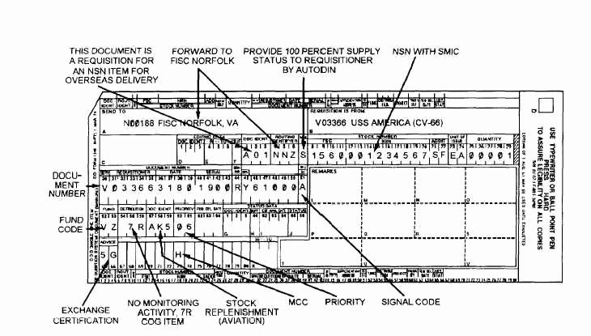
What is a RIC?
Example of the RIC as a shortened form of a DoDAAC. Note the 1348 identifies to whom the transaction (A01) is being sent (N00188 FISC NORFOLK, VA), and in the 80rp transaction, rp’s 4-6 identify N00188 by using its RIC NNZ, since space limitations of the 80rp transaction did not afford using the DoDAAC of the entity to whom the transaction was being routed. The RIC was implemented for this purpose.
Activity: FISC Norfolk, VA
DoDAAC: N00188
RIC: NNZ

Slide 25
RIC Data Elements
Since the RIC is a shortened version of a DoDAAC for an activity that routes DLSS transactions, the RIC’s TAC must be the same as that of the DoDAAC to which the RIC is associated. This is because not every MILS-related procedure was automated, and in some instances, it was necessary to mail documents to a routing activity. The address of the RIC was used for this purpose, which is why its address had to be the same as the activity’s DoDAAC TAC1 – the official mailing address of the activity.

Slide 26
Other RIC Data Elements
All of the data elements of the RIC are included in the data elements of that RIC’s DoDAAC. In addition to the TAC, they include:
The RIC_DODAAC. It is the DoDAAC to which the RIC is associated. Every RIC is associated to a DoDAAC, but not every DoDAAC has a RIC.
MAJ_COMMAND. Major Command Code (MAJCOM).
COCOM (derived from the TAC2 of the RIC_DODAAC).
CREATE_DATE. The date the RIC was created.
T1_DELDTE. The Delete Date of the RIC.

Slide 27
Who uses the DoDAAD?
All DoD, Federal, and Commercial shippers, use the DoDAAD for address information.
Some business application systems requiring DoDAAD data to support their business processes include (but are not limited to): supply chain, materiel management, distribution, transportation, maintenance, financial management, human resources, installations, contracting, and procurement/acquisition systems.
Each Service/Agency has a Central Service Point (CSP) authorized to add, change, or delete DoDAACs and RICs for their particular Service/Agency.

Slide 28
DoDAAC Usage
  Some of the uses for a DoDAAC include the following:
  First 6 Characters of Every requisition Document Number
    Occurs at least once in nearly all logistics transactions
    First 6 characters of a Standard Document Number (SDN)
    First 6 Characters of Every Contract Number (Procurement Instrument Identifier – PIID)
  Password to the Federal Supply Systems – used to obtain materiel from DoD or federal sources
  Last 6 characters of DoD Business Partner Number (BPN)
      Basis for identifying DoD Buying and Selling activities
      BPN is used for financial eliminations and account reconciliations

Slide 29
Who can create a DoDAAC or RIC?
Central Service Points (CSPs) are assigned to create and maintain DoDAACs and RICs by Service & Agency Code.
Each Service/Agency assigns a CSP at the Service/Agency level.
General Services Administration (GSA) serves as the CSP for all Federal Civilian Agencies.
Some Services/Agencies also have Monitors which are subordinate to a CSP and have limited access to a Service’s/Agency’s DoDAACs (i.e., the MAJCOM).
The list of CSPs and Monitors is on the DoDAAD web site.

Slide 30
Interesting DoDAAD/DoDAAC Stats
Critical reference repository for nearly 60 years
>325,000 Total DoDAACs in the DoDAAD.
>218,000 are DoD Service and Agency DoDAACs.
>110,000 are Federal Agency DoDAACs
>25,000 are State and local level DoDAACs
>17,000 are Contractor DoDAACs
>90 CSPs and Monitors control data content
>9,000 data maintenance actions monthly
>1 Million Component application system accesses daily
>500,000 monthly Web queries from over 25,000 customers
DoDAACs exist at least once in nearly every DoD business event transaction.
Hundreds of Component business systems rely upon it

Slide 31
DoDAAD – Governance
DoDAAD System Administrator ensures the DoDAAD meets user requirements by:
  Chairing the DoDAAD Process Review Committee (PRC)
  Coordinating DoDAAD Changes
  Publishing DoDAAD policy & procedures in DLM 4000.25
DLA Transaction Services is responsible for ensuring 24x7 DoDAAD availability by:
  Maintaining the hardware, software & authoritative database
  Controlling access to DoDAAD and data distribution
  Implementing functional requirements/approved changes
  Providing help desk services and operation procedures
Component PRC Representatives provide requirements for, and review changes affecting, the DoDAAD through the PRC process.
Component CSPs and Monitors maintain accuracy and currency of data content

Slide 32
DoDAAD – Governance
(continued)
CSPs are responsible for ensuring the accuracy and currency of their authoritative data within the DoDAAD by:
  Complying with DLM 4000.25 DoDAAD procedures
  Establishing supporting Component policies/processes
  Participating in the DoDAAD Process Review Committee
  Maintaining close relationships with their customers
  Establishing & overseeing DoDAAD monitors as needed
  Using the real-time DoDAAD Web update capability

Slide 33
DoDAAD Environment
The DoDAAD uses an Oracle database running 24/7 at DLA Transaction Services allowing for real-time data maintenance actions, application system data access, and web based queries
Strict database maintenance and access controls are applied by DLA Transaction Services
DoDAAD database available to applications via Automatic database-to-database replication process maintaining constant synchronization of the DAAS authoritative database and all copies

Slide 34

DoDAAD Architecture
Army
CSP
Updates
USAF CSP
Updates
CSP
Update Application
CSP
Update Application
CSP
Update Application
CSP
Update Application
GSA
Update Application
CAF
Application
USAF LTS
(USAF DoDAAD Repository)
SAR Accounts
AESIP
(Army DoDAAD Repository)
Consolidated Address File (CAF) GSA DoDAAD Repository)
DAAS
Master DoDAAD
Repository
Constant bidirectional
Update via ORACLE
Enterprise replication
software*
“Materialized View” (ORACLE
Enterprise replication)
SAR Accounts
Other Enterprise
Authoritative Data
Sources
Open Access
DAAS Firewall
FLIS Portfolio Data Warehouse (FPDW)
eDAASINQ
Web Services
DAASINQ
Service/
Agency
Business Applications
Public Users
*Army receives all but Army records, and pushes back only Army updates.

Slide 35
Defense Automatic Addressing
System Inquiry
(DAASINQ)

Slide 36
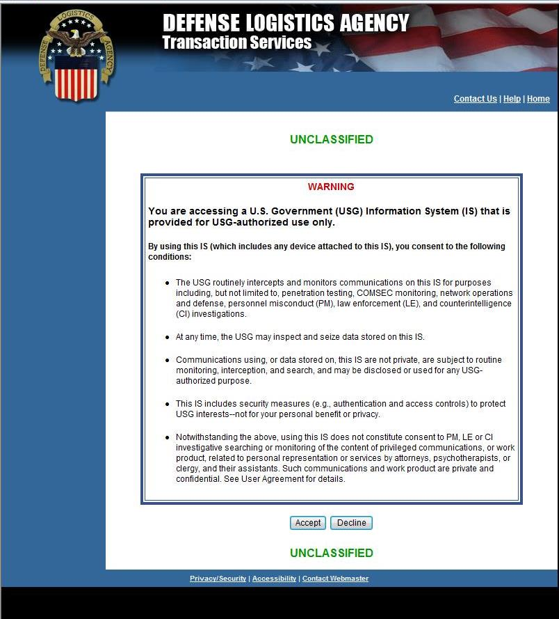
Warning Page
The first page is the U.S. Government warning page that prompts the user to Accept or Decline the terms.

Slide 37
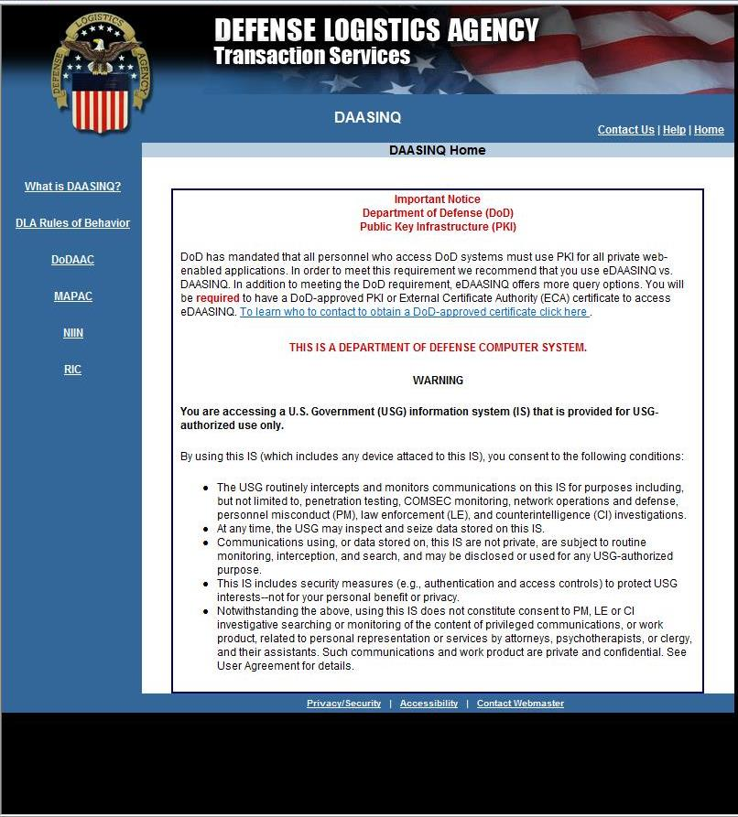
Navigation Page
The next page provides the various types of single queries. For this demo the focus will be on the DoDAAC.

Slide 38
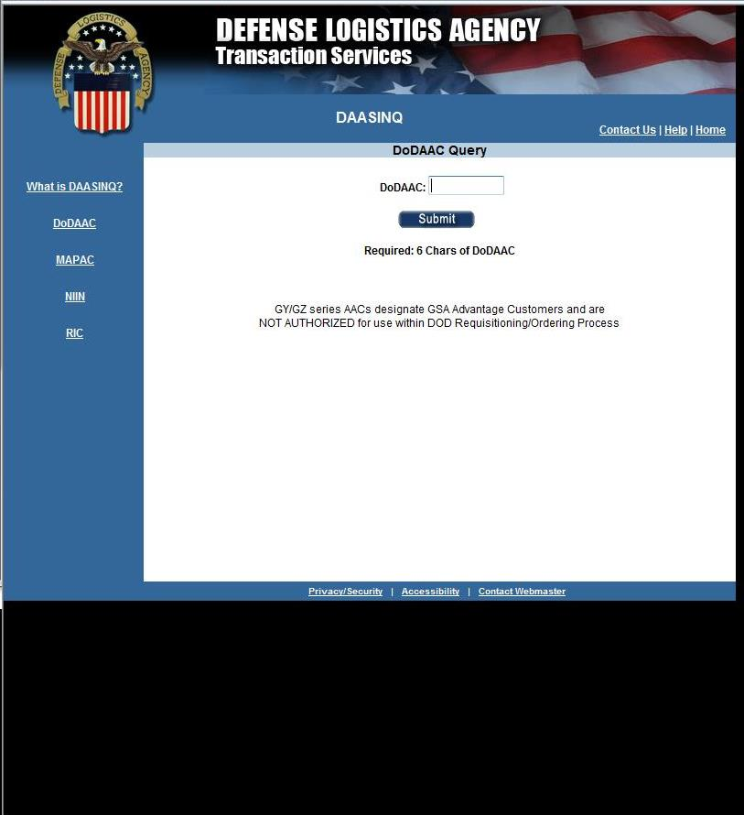
Query Page
The DoDAAC query in DAASINQ allows for only a single search of a DoDAAC. Enter the DoDAAC to be searched.

Slide 39
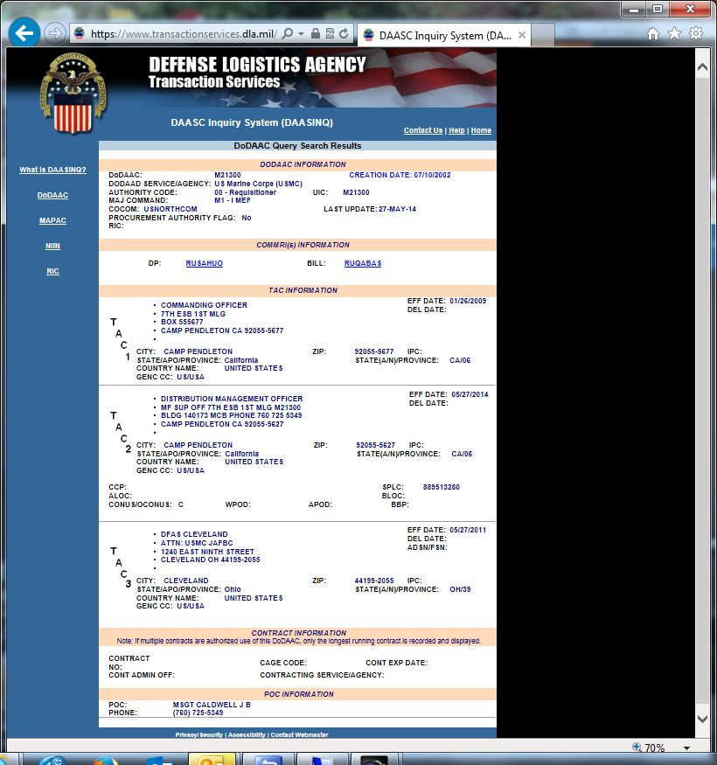
DAASINQ Search Results
The DAASINQ DoDAAC query results provide all the data elements associated with the DoDAAC searched.

Slide 40
Enhanced Defense Automatic Addressing System Inquiry
(eDAASINQ)

Slide 41
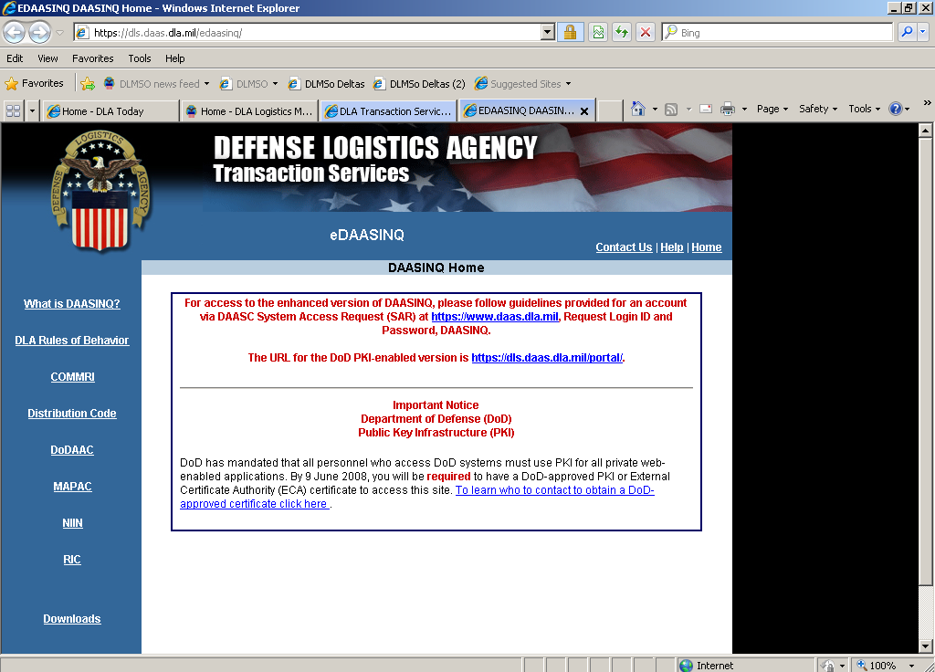
Navigation Page
The first page determines your search. For this demo the focus will be on the DoDAAC.

Slide 42
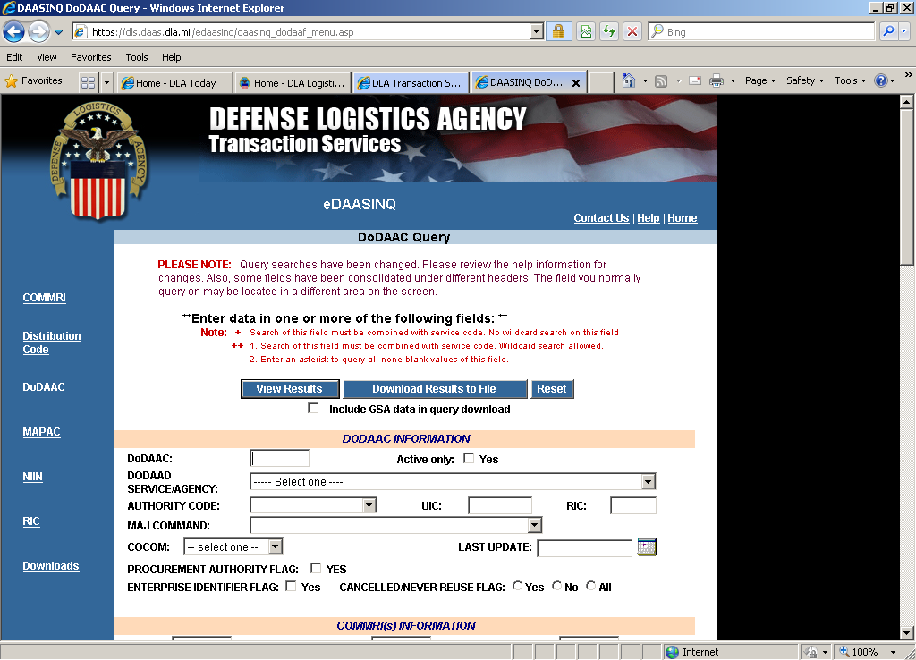
eDAASINQ Query Screen
The DoDAAC query allows searching on every field in the table. Each new value is a logic “AND”. This means if you enter a state, you can narrow your search by also adding a city. More about this later…

Slide 43
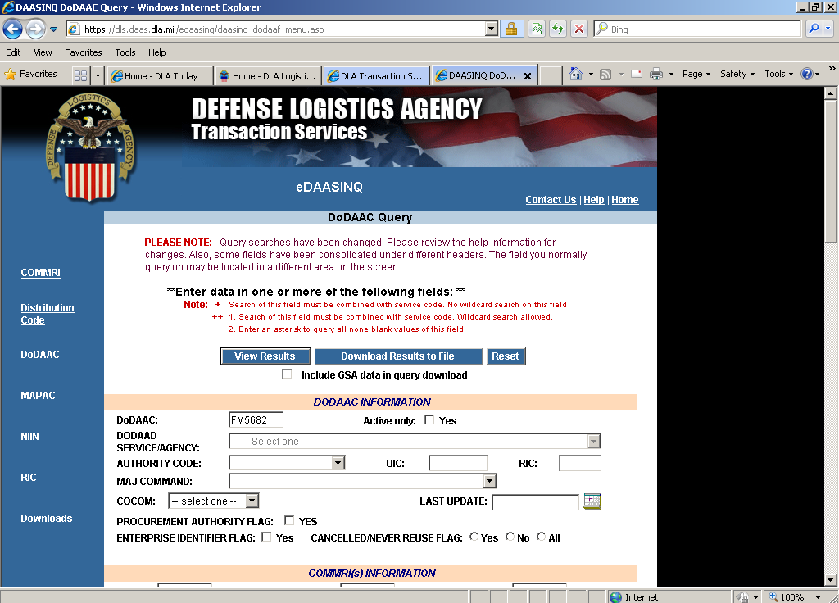
DoDAAC Search
Simple search for a single DoDAAC. Notice the value of “FM5682” in the DoDAAC field…

Slide 44
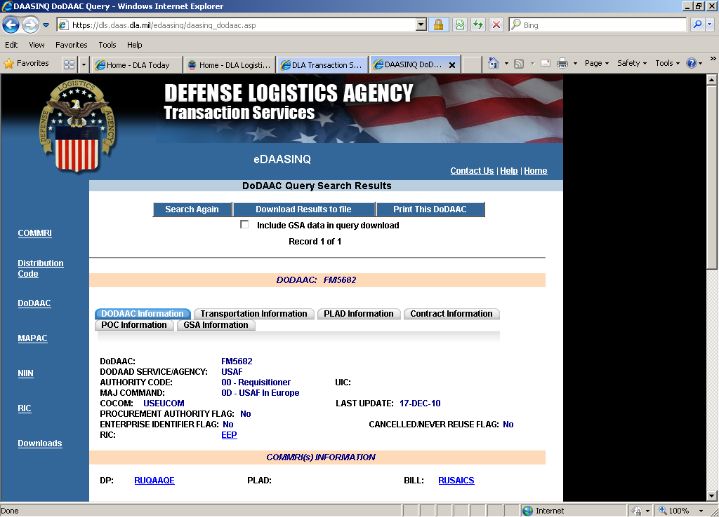
DoDAAC Results
This is the result of you single DoDAAC search, after the user clicks the “View Results” button.

Slide 45
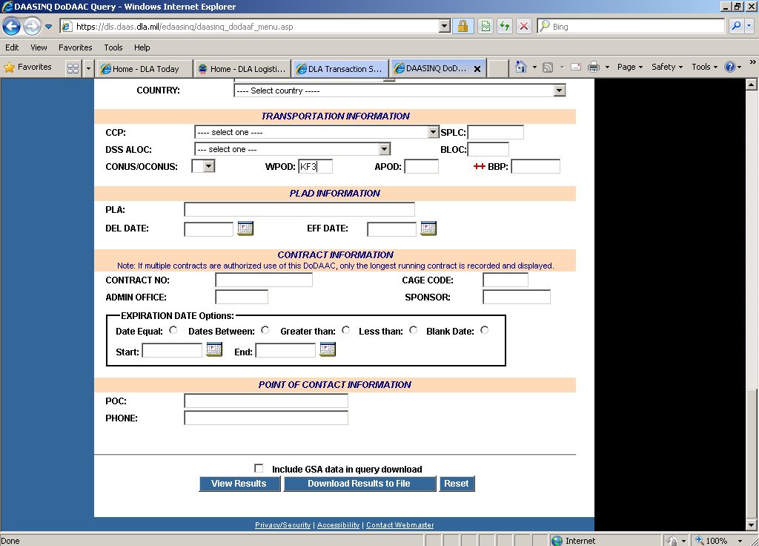
Focused Search
Next, how to “narrow” a query. The first search is for all WPOD located at KF3…

Slide 46
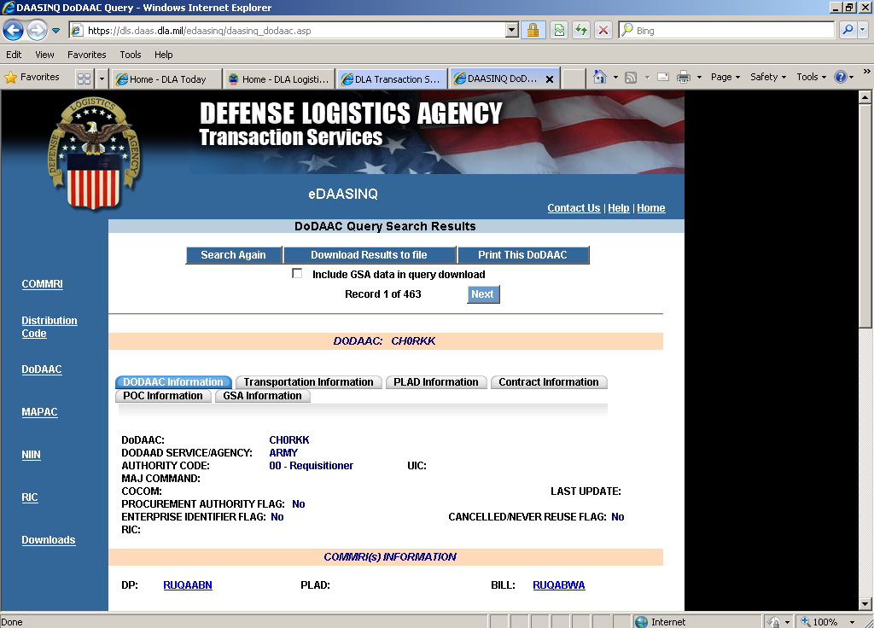
Focused Search (cont)
The query found 483 records for WPOD KF3…

Slide 47
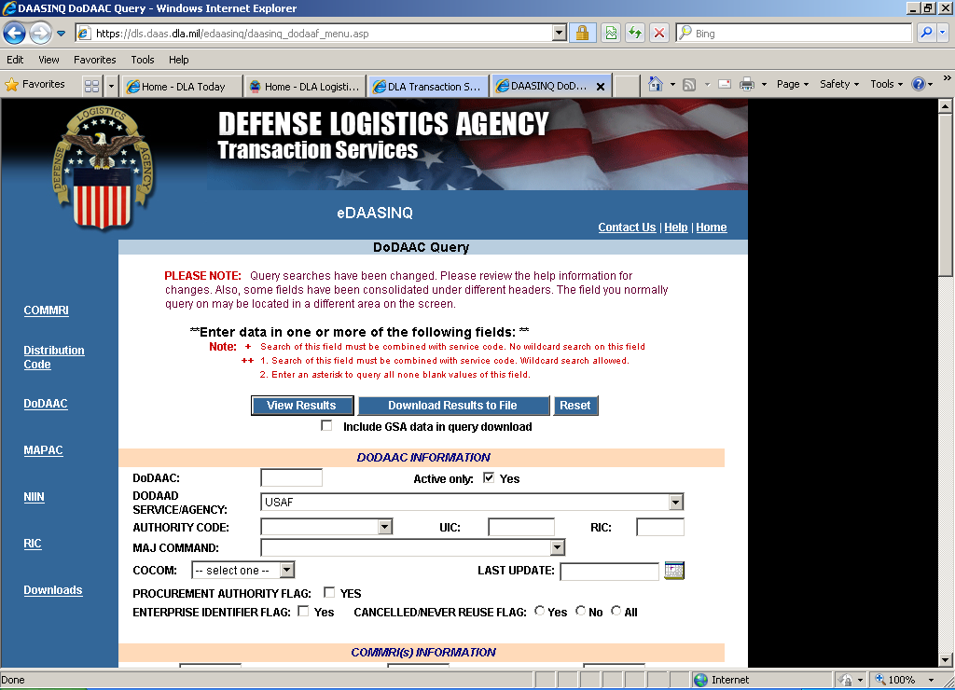
KF3 and USAF
For this search we entered “KF3” in the WPOD and selected “USAF” from the Service/Agency drop down list…

Slide 48

KF3 and USAF
This time only 32 records were found, because the WPOD and Agency criteria were combined to limit the number of records found.

Slide 49

Wildcard Search
There are two types of wildcard searches available:
Percent sign '%' is for any number of characters
Underscore for a single character.
Since the % is pretty intuitive, here is an example of how to find DoDAACs that start with “S” and end with “A”. Here we have entered “S____A”…

Slide 50
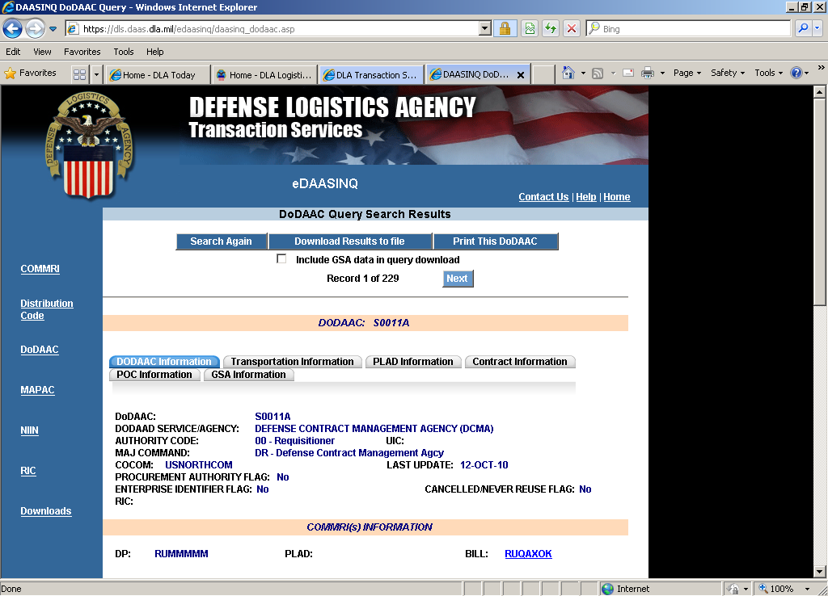
Wildcard Results
The query found 229 records that begin with “S” and end with “A”.

Slide 51
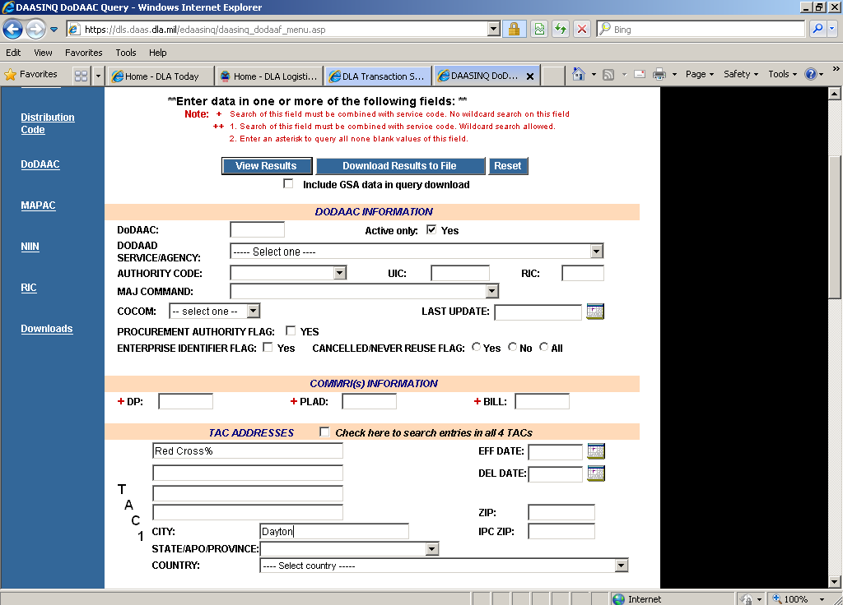
Search for Red Cross
Finally, a simple query to find where the Red Cross is in Dayton. The first line of the address contains “Red Cross%”, so it will search for anything that begins with “Red Cross”. In the city field, we have entered Dayton…

Slide 52
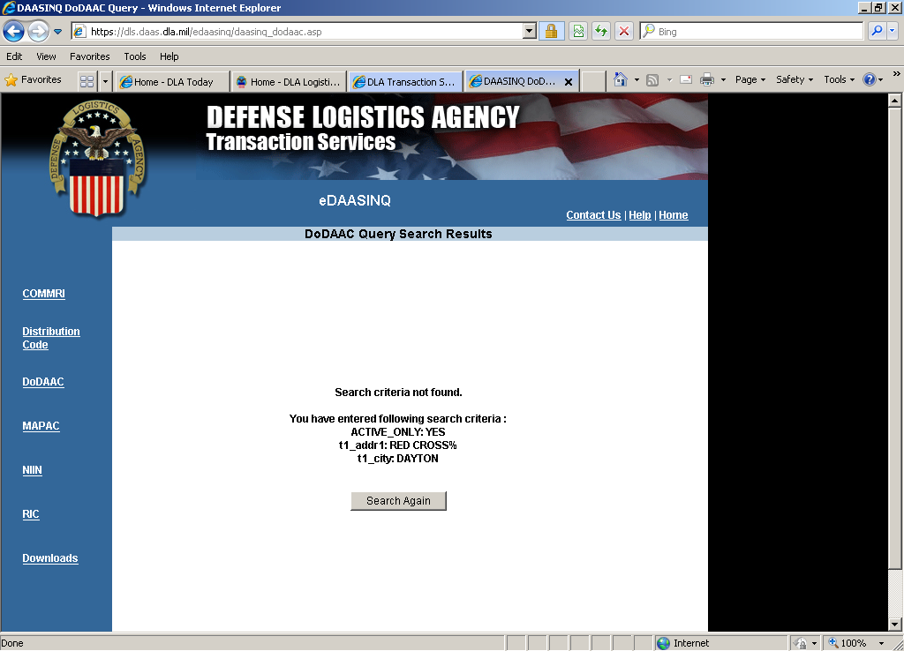
Results of Red Cross Query
Nothing was found, because our criteria didn’t account for the fact that the official name is the “American” Red Cross…

Slide 53

Search for Red Cross
This time the search for the first line of the address contains “%Red Cross%”, so it will find the phrase “Red Cross” anywhere in the line. In the city field, Dayton…

Slide 54
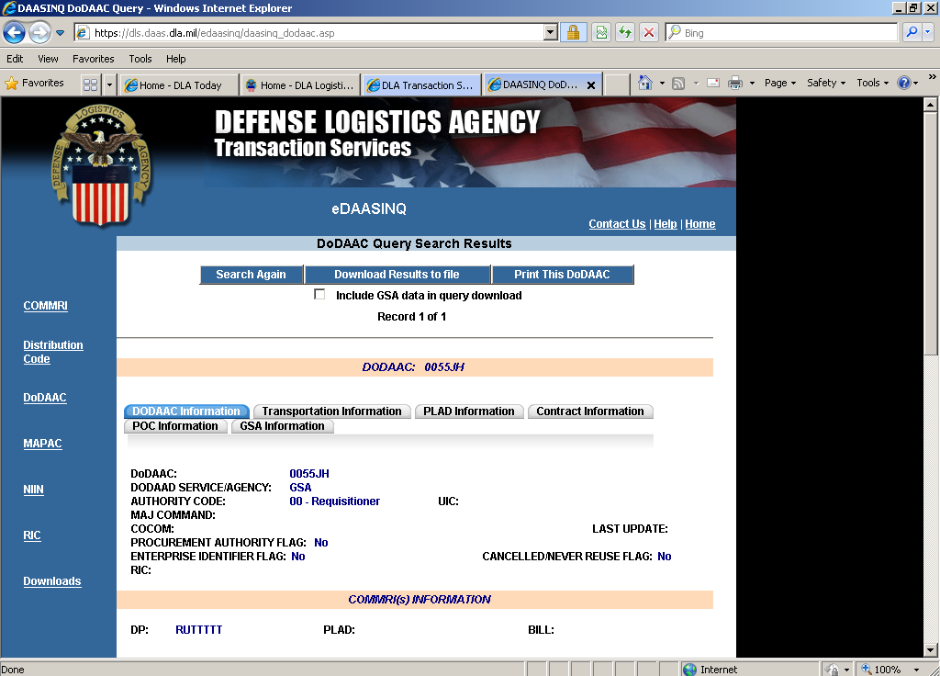
Results of Red Cross Query
Only one record found – success!

Slide 55
DoDAAD Update Application (Reserved for Central Service Point and Monitor Access Only)

Slide 56
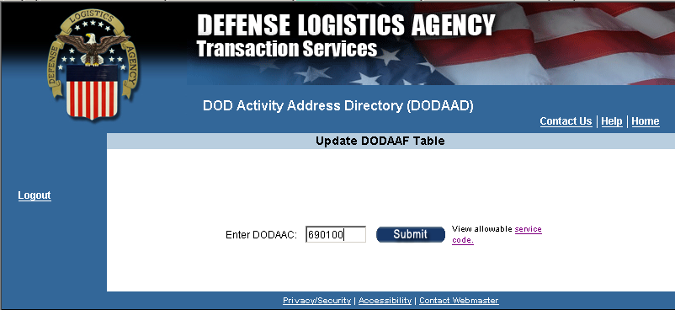
DoDAAD – Adding a new DoDAAC
After Login, the first screen prompts for a DoDAAC. If an existing DoDAAC is entered, you will be presented an update screen. If a non-existing DoDAAC is entered, you will be presented with a add screen.

Slide 57
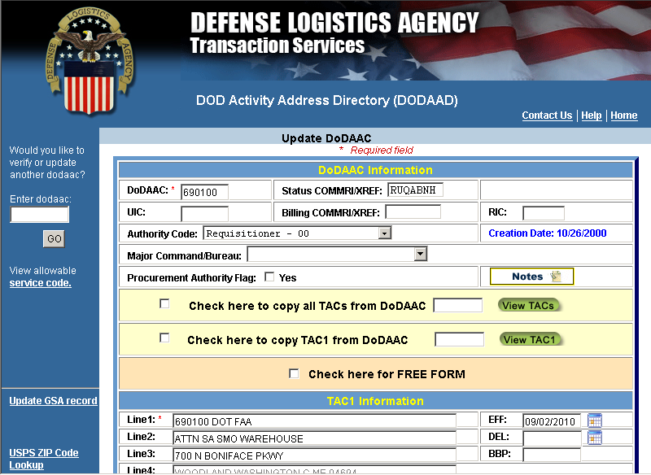
DoDAAD – Adding DoDAAC (cont.)
Basic information required to create a DoDAAC is DoDAAC, COMMRI, and TAC 1 address.
To speed up the creation process, TAC information may be copied from another DoDAAC

Slide 58
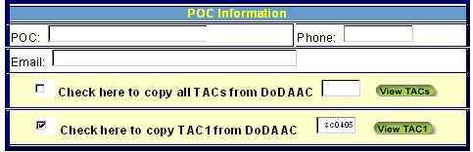

DoDAAD – “Copy To”
There are multiple methods to copy information:
  To copy from a TAC address from another DoDAAC, check the copy and enter a TAC
To copy a TAC address from within the same DoDAAC, click the red button

Slide 59
DoDAAD – Modify
To modify an existing DoDAAC, you simply start by entering the specific DoDAAC (6 positions) & click submit
After you have changed the record, click the “Save” button to write your changes back to the DoDAAD master

Slide 60

DoDAAD – Delete function
The Delete function is similar to the Modify function. Fill in an existing DoDAAC and click submit to retrieve the record
Tab to the “DEL” field and enter the Julian date of when the delete should occur (e.g., 2007213)

Slide 61
DoDAAD – Future Effective Dates
The DoDAAD also supports future effective dates. If the change should not be applied immediately, enter the Julian date of when the change event should occur (e.g., 2007213) and the change will wait in a pending state until the date occurs

Slide 62
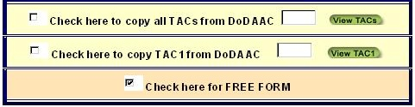
DoDAAD – Free Form function
Sometimes the goal is to enter something other than an address (i.e. telephone numbers for deployed ships, ‘CALL NAVSUP GLS’, etc.) . The “Free Form” indicator will bypass the City/State/Zip code edits to allow message data to be entered into the DoDAAD.

Slide 63
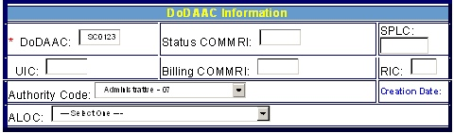
DoDAAD – Authority Code
The Authority code controls how the DoDAAC can be used. A dropdown list provides the allowable options. If nothing is selected, the use will default to “00 - Requisition”
00 – Requisition
01 – Ship-To Only
02 – Bill-To Only
03 – Do Not Ship-To
04 – DDS Only
05 – Non-Requisition
06 – Free Issue
07 - Administration

Slide 64
Additional DoDAAD Training
For more specialized Central Service Point and Monitor training, see the DoDAAD Update Application Standard Operating Procedures located on the DoDAAD Process Review Committee webpage under DoDAAD References and Other Resources, Policy and Procedures:
https://www.dla.mil/does/DLMS-DoDAAD

Slide 65
Learn More About The DoDAAD
DoDAAD Process Review Committee webpage:
https://www.dla.mil/does/DLMS-DoDAAD
DoDAAD Policy & Procedures: DLM 4000.25, Volume 6, Chapter 2
DoDAAD Training: Website DLMS Training Module 8
DLMSO Support POCs:
  Mr. Richard Morrow (703) 767-5256/DSN 427-5256 or EBSO.DoDAAD@dla.mil
  Mr. Tad DeLaney (703) 767-6885/DSN 427-6885 or EBSO.DoDAAD@dla.mil
  Mr. Larry Tanner (614) 310-6059 or EBSO.DoDAAD@dla.mil
  DLA Transaction Services Support POC:
Ms. Lisa Tonkin (937) 503-4526 or Lisa.Tonkin@dla.mil

Slide 66
DoDAAD Links
Public View to the DoDAAD (Everyone):
https://www.transactionservices.dla.mil/eDODAAD/
DoDAAD Updates (CSPs and Monitors Only):
https://www2.transactionservices.dla.mil/portal/portal.asp
eDAASINQ (enhanced query – account required):
https://www2.transactionservices.dla.mil/portal/portal.asp
DAASINQ (single query):
https://www.transactionservices.dla.mil/daasinq
DoDAAD PRC / Policy, Procedures, and Other References:
https://www.dla.mil/does/DLMS-DoDAAD

Slide 67
Module Quiz
Question 1: The DoDAAC is used for:
  Obtaining materiel from the federal supply system
  Specific purposes depending on DoDAAC Authority Code
  Assignment of the appropriate address for a particular situation (e.g., shipping, billing)
  All of the above
Question 2: The DoDAAD only contains Military address information?
  True
  False
Question 3: Defense Logistics Management Standards Office is the:
  System Administrator of the DoDAAD
  Chairs the DoDAAD PRC developing procedures & system requirements
  Both of the above
  None of the above
Question 4: DLA Transaction Services maintains:
a) The hardware, software & authoritative DoDAAD database
b) 24/7 Control of the access and distribution of DoDAAD data
c) Both of the above
d) None of the above

Slide 68
End of Module

