Slide 1
Defense Logistics Management Standards (DLMS)
Introductory Training
Electronic Data Interchange (EDI) Basics and ASC X12 EDI Definitions and Concepts
Notes:
This Module provides an understanding of American National Standards institute (ANSI) Accredited Standards Committee (ASC) X12 Standard and its foundational building blocks that compose the commercial standard used by DLMS. ANSI is an acronym for the American National Standards Institute; ASC stands for the accredited Standards Committee and X12 is the type of standard maintained.

Slide 2
DLMS Training Catalog
Module 1 - Introduction to the DLMS
Module 2 - Electronic Data Interchange (EDI) Basics and ASC X12 EDI Definitions and Concepts
Module 3 - DLMS Functionality & Transaction Life-Cycle
Module 4 - DLMS Implementation Convention Content
Module 5 - IUID & RFID - Emerging Technologies
Module 6 - Creating/Reengineering DOD Logistics Business Processes
Module 7 - Enterprise Interoperability Tools
Module 8 - DoD Activity Address Directory (DoDAAD)
Module 9 - Supply Discrepancy Reporting (SDR)
Module 10 - DLMS Functional Financial Transaction (standalone)
Module 11 - Creating/Reengineering DOD Logistics (standalone)
www.dla.mil/does/DLMS
Notes:
This is the full Catalog of DLMS training Modules that are available as part of the DLMS Training. Each Module is a building block for those that follow it. The Catalog allows for course progress tracking. While it is recommended that the Modules be taken in sequence, it’s not mandatory.

Slide 3
Module Structure
Module 2 - ASC X12 EDI Definitions and Concepts
  EDI Components and Structure
    Data Elements
    Data Segments
    Segment Loops
    Transaction Sets
    Functional Groups
    Interchange Groups
Notes:
ASC X12 EDI Definitions and Concepts. This module will cover the structure and components that make up an EDI transaction – data elements, data segments, segment loops, transaction sets, functional groups, and interchange groups.
During this module, these components will be reviewed in detail, from data elements all the way down through interchange groups.
Just a point of note, a data element in the context of X12 is different than a data element in an application system. The data elements referenced in this module are X12 data elements. They will -- in some way that will be highlighted later -- become the functional data elements that are stored in application databases.

Slide 4
Module 2 Objectives
Students will gain a basic understanding of:
  The components that form the building blocks of ASC X12 EDI
  How the highly structured nature of X12 EDI provides the flexibility and versatility needed to communicate complex functional data content
  How to interpret simple raw data expressed in X12 EDI format
Notes:
This Module provides a basic understanding of:
The components that form the building blocks of ASC X12 EDI
How the highly structured nature of X12 EDI provides the flexibility and versatility needed to communicate complex functional data content
How to interpret simple raw data expressed in X12 EDI format.

Slide 5
EDI Components
Notes:
The goal of this module is to introduce the X12 language, define the building blocks, and show how all these pieces come together to form a transaction that's very flexible and powerful in its data content.

Slide 6
Definition of EDI
Electronic Data Interchange EDI is:
  The computer-to-computer interchange of strictly formatted messages that represent business documents
  A sequence of messages between two parties, either of whom may serve as originator or recipient
  The formatted data representing the documents transmitted from originator to recipient via telecommunications
Notes:
So what is EDI? Simply put, electronic data interchange. While some folks think electronic data interchange is a relatively new concept/capability, as a matter of fact, DOD has been doing electronic data interchange since the early 1960s, in the form of MILS fixed formatted transactions (DLSS). So, MILS are a form of EDI, as are the DLMS. Data is exchanged electronically in both formats between different automated information systems; the difference is MILS are an 80-card column fixed format structure, built off of the IBM punch card capability that became ubiquitous by the early 1960s and the DLMS are based on a variable length mature commercial standard.
DLMS is a more modern form of electronic data interchange. So what is it? It is a computer to computer interchange of data, which has strict formatting rules and comes in the form of the X12 standard.
It is possible to have a sequence of messages. Those familiar with the Military Standard Requisitioning and Issue Procedures (MILSTRIP) know that it's not just one transaction that gets an order fulfilled; it's a series of transactions, and they all build on one another. Sometimes, an EDI transaction could be representing an actual paper form that may be used. In the transportation world, transportation went into the EDI business under X12 long before anybody else did. There were far fewer MILS transactions formats for transportation than those that support supply. One of the reasons is most of transportation was originally a paper-based system. When the transportation community went to automate, they bypassed the legacy MILS formats and migrated from paper directly to the EDI X12 standard. Supply, on the other hand, has been highly automated since the early 1960s using its legacy MILS format. However, while the MILS provided the benefits of automation, it was in a rigid format and was unique to DOD. Due to that lack of flexibility, supply is transitioning from a fixed format to the ANSI ASC X12 based EDI format in the form of the DLMS, with a direct mapping between the fixed formatted MILS to the flexible DLMS.
In some ways Supply had a more difficult transition because Supply had to deal with interoperability and transformation; whereas transportation had no interoperability issues because they are were migrating from paper documents to electronic transactions.
Under DLMS, for every EDI implementation convention under the X12 commercial standard, there is an equivalent XML schema, one for one. That is how Supply maintains interoperability between legacy systems and modernized systems, moving forward.

Slide 7
MILS vs. DLMS EDI
MILS Format (DLSS)
DLMS EDI Format
RPs | Field Length | Sample Data
01-03 | Document Identifier | A01
04-06 | Routing Identifier | SMS
07 | Media and Status | B
08-22 | Stock Number | 5910001234567
23-24 | Unit of Issue | EA
25-29 | Quantity | 1
30-43 | Document No | FB230093070001
44 | Demand | R
45-50 | Supplementary Address
51 | Signal | A
52-53 | Fund | KZ
54-56 | Distribution
57-59 | Project | 9GF
60-61 | Priority | 08
62-64 | Reqd. Delivery Date | 777
65-66 | Advice | 2A
67-69 | Blank (Date of Rcpt on Referral/Passing Order)
70-80 | Blank (Intra-Service use)
ST*511*00000001^
BR*00*A0*20000729******131708^
N1*OB**10*FB2300**FR^
LX*1^
N9*TN*FB230093070001^
PO1**1*EA***FS*5910001234567^
DD*R*74^
LM*DF^
LQ*0*A01^
LQ*78*9GF^
LQ*79*08^
LQ*80*2A^
LQ*DE*A^
LQ*DF*B^
LQ*AL*777^
N1*Z4**M4*SMS**TO^
FA1*DY*D340^
FA2*B5*KZ^
SE*19*00000001^
Notes:
• The underlying theme throughout this module is that everything that can do done in MILS can be done under the DLMS. Here we see a graphical depiction showing the relationship between the MILS and DLMS formats for the same data content. Everything on the left-hand side under the "MILS format" headers is representative of a typical 80-card column transaction. All the data content on the left can be found under the DLMS header on the right, albeit in a different structure and order, but the data content is all accounted for.
• It is this minimum capability that preserves the interoperability of different logistics systems operating in a mixed MILS-DLMS environment, Now while all the MILS data content is accounted for in the equivalent DLMS transaction, the opposite is not true. DLMS provides the capability to carry extra data in a more flexible format. Since EDI prescribes mandatory and optional information for a particular document and gives the rules for the structure of the document, two systems from different industry communities like insurance and rental car provider may use the same X12 standard as the base transaction but their varying requirements and the flexibility built into the standard allow for tailoring to support a particular user community. More on this later.
• A quick review of this example will demonstrate the interoperability of a MILS-DLMS crosswalk. In the center is sample data for a requisition. This is indicated by the document identifier code A01. The document identifier code prescribes the data content associated with a particular business event, in this case the requisition. Everything in the MILS format is record-position oriented and there are no data field names, per se, in the MILS transaction. Specific data elements are known to begin and end, based on their order in the transaction and the field length allocated to the data element.
• So, in the MILS transaction, the first three positions are the document identifier code. The document identifier of A01 is also within the EDI side transaction, but it is stored in a completely different place, the detail of the transaction. More about that later. The beauty of the DLMS EDI side of the graphic is the field names are explicitly identified. The field name actually is transmitted with its associated data value in the transaction, where it doesn't on the MILS.

Slide 8
ASC X12 EDI Versions/Releases
Versions are released approximately every five (5) years
New releases of ASC X12 Draft Standards for Trial Use (DSTU), referred to as the ‘Standards’, are published annually
DLMS based on ASC X12 version/release 4010 and 4030
Notes:
• The first thing to understand about the DLMS is that they are underpinned by the X12 standard, which is a commercial standard. Just like with software applications, there are versions and releases. The X12 standard works much the same way. So versions issued by the American National Standards Institute (ANSI) come out approximately every five years. In between ANSI will issue releases. The releases are fixes and minor patches to the version standard. Approximately every five years, the releases are combined and a new version is issued.
• How does someone know what's a version and what's a release in the transaction when working with it? X12 has a four-digit number associated with each transaction. The first character is the release and the second through fourth represent the version. At this time 4010 is the most widely used release/version, accounting for approximately 87% of all usage, both commercial and Federal.
• Under DLMS, all transactions are primarily operating with either 4010 or 4030.
• The current X12 standard is 7010; so why is DLMS not migrating to that standard? Short answer is cost. DMLSO monitors the progression of the X12 standard. As of today, DLMS requirements are fully satisfied within the 4010 and 4030 version/releases. Now if for some reason there is a new capability that were needed and cannot be satisfied by the 4010/4030, at that point EBSO will look into an upgrade to a higher X12 standard, such as 7010, but the odds of that are pretty slim. As mentioned earlier, most of the commercial industry is also operating at the 4010 and 4030. The cost to coordinate implementation of a new standard and synchronize all impacted systems so they implement simultaneously is prohibitive, and also very time-consuming.
• How did 4010 become the standard for the DLMS? Prior to 4010, DOD was on 3050. DOD made the change to 4010 for one reason -- Y2K. The change to the new millennium meant the shorthand dates everyone used were going to fail. The century had to be added to the year to ensure a unique identification of the date, so the eight position date (i.e., CCYYMMDD) became the new standard with version 4010.
• Module 4 will revisit this topic of version with additional information.

Slide 9


How EDI Supports Interoperability
Defense Automated Addressing System
(DAAS)
EDI is the computer-to-
computer exchange of
routine business info in
a standard format.
ASC X12 EDI provides a means for exchanging
information between dissimilar computer
systems via a standard file structure.
The information, in the form of a
transaction set, is generally patterned
after a conventional document,
such as a requisition or invoice.
Notes:
To help us better understand how EDI helps achieve interoperability between disparate automated systems, we can take a look at this graphic. The process flow contains a computer application on the upper left, with another computer application on the lower right. Two systems can be totally different, with different operating systems, interfaces and databases. However, the two systems can communicate with each other because the Defense Automatic Addressing System (DAAS) will handle the translation of the data formats as the transactions pass through. The software programs of DAAS transform the data content for routing to the downstream trading partners that need to receive that information based on standard business rules, routing and transportation services. DAAS is the intermediary that makes interoperability possible. It simplifies programming at the application level, but places a great burden on DAAS. No longer do systems have to build point-to-point interfaces to multiple trading partners; they just need to interface with DAAS. This is a much cheaper way to maintain systemic interoperability in our ever-changing operating environment.

Slide 10
Transaction Set Detail
Hierarchy of Relationship
Transaction Set
Data Segment
Data Elements
Notes:
Now, onto an examination of the hierarchy of the elements that comprise a DLMS transaction. This will be a deep dive into how transaction sets are structured and how they are made up of data segments, which are made up of data element, all under the X12 standard.

Slide 11
Standard File Structure
Interchange
Outer Envelope
Functional Group
Folder
Transaction Set
Written Document
Segment Loop
Paragraph
Data Segment
Sentence
Data
Element
Word
Notes:
• The standard file structure is easier to understand with an analogy, so one can see how this builds out as one progress through this module.
• On the left are the building blocks of an X12 standard and on the right is the structure of a written document in the form of a letter to be mailed. Parallels will be draw to highlight how the X12 data elements relate to one another through the concept of a written document. Each component of the structure will be dealt with one at a time, starting with the data element.

Slide 12
Data Elements
The data element is the smallest named unit of information in the standard
Each data element is identified by a number
Data elements can represent a code, a value, or text (such as a description)
Each data element has both a minimum and maximum length
Data elements can be mandatory, optional, or relational
Data Element Word
Notes:
42
• First, at the most fundamental level is the X12 data element. In a written document, think of a data element as a single word. It is the smallest named information in the standard. It is as basic as it gets. Now in the X12 standard, every X12 data element has a number that is assigned to it. That number is like a table number. And in that table number, there is going to be metadata about the characteristics of that X12 data element.
• What can a data element represent? It can be a code value. It could be some text, alphanumeric. Could be numbers, a numeric value. What is important is everything else is built upon the defined data element.
• The data element has attributes. Every data element in X12 has to have a minimum field length and a maximum field length. If the minimum and maximum field lengths are the same, this would be considered a fixed length element. All data elements must have a minimum and maximum field length attribute.
• All data elements in the standard will be designated as either mandatory, optional, or relational. These terms are literal. Mandatory means it must be present, Optional means it can use be used or not, relational means the requirement is contingent on a relationship between two or more data elements. If there is a certain value in one, then it may influence what happens in the other one.

Slide 13

Data Element Types
There are seven types of data elements:
AN | Alphanumeric string including special characters
B | Binary (example: 010101101)
DT | Date in YYMMDD or CCYYMMDD format based on EDI version being used (DLMS Baseline is 004010)
ID | Identifier (works with a code list specified by the dictionary)
Nn | Numeric (implies the number of decimal points, e.g., N2 would be two decimal positions)
R | Decimal Numeric (decimal points must be transmitted if used)
TM | Time in HHMMSSDD format
1.5627
A6B7C
15627
Data Element Word
Notes:
• Every data element has a type attribute assigned to it. We will cover only the ones that are the most frequently used in DLMS. The rest are here as reference.
• The one used most frequently is AN or alphanumeric. It is the catchall type used for combining alpha, numeric and special characters within a single element (for example, an address containing a house number and street name).
• Binary is not used. It is a data element that's available under the X12 standard, but not used within the DLMS.
• Date is an element type used quite often. Dates come in variety of formats; however the baseline format used by the DLMS is an 8-position date, 2-position century, 2-position year within the century, 2-position month, and 2-position day within the month. Everything in the DLMS is eight positions, so it is crystal clear what the date is, without any guess work or conversions.
• The ID element identifier. is the backbone to X12. As we discussed earlier, X12 will explicitly designate the field names that are being passed. Many times the field name is stored within the ID or identifier element. Think of the identifier as an adjective is to a noun; it’s a descriptor. Another name for identifier in X12 is X12 qualifier; both are used synonymously. Whenever there is an identifier, the associated value is going to be a code.
• Numeric can contain multiple formats. The lowercase “n” in the standard will be filled in with a number. Whatever that number is, will imply how many decimals are in the value that was passed. It represents an implied decimal point. So if an N2 is identified in the standard for a data element that means the value passed has two decimal positions from the right in that value. So for example here, 15627. If that was passed in data element type N2, that would translate to one-hundred fifty-six, decimal point, twenty-seven.
• If there is a data element type of R that means it is a decimal numeric. That means if there's a decimal as a part of that value to insure it's properly interpreted, the value within the element must explicitly pass the decimal in the transaction. So let's take the same example of 15627. If the data element type was R, 15627 would be interpreted as fifteen-thousand six-hundred twenty-seven. Huge difference, so the data element type is very important.
• Under X12, time can be tracked down to a tenth of a second. This level of granularity has not been used anywhere in the DLMS, but it is available for use in the standard. This may be useful in the future, so DLMS logistics response time metrics reports could specify time to the millisecond.

Slide 14
Data Element Size
How Does It Work?
Indicating Min: 6 Max: 6
6/6
must be
Or Where
123456
{
Min: 4 Max: 6
4/6
6 positions
must be
or
or
1234
12345
123456
Length
of Field
Data Element Word
Notes:
• Data element size is pretty straight forward. Remember, every data element has to have a minimum and a maximum field length. If there is a minimum of six and a maximum of six, that basically means that the field is fixed length and must contain six positions.
• If the field had a minimum of four and a maximum of six, any value passed must be four, five or six positions in length. So 12345 would be valid, but 123 would not.
• The X12 standard will explicitly state the minimum and maximum field length of every field. If the value passed exceeds the maximum or falls short of the minimum, it will fail with a syntax error.

Slide 15
Data Element Use
Data Elements may be:
  M = Mandatory
  O = Optional
  X = Syntax note applies
  Z = Semantic note applies
  Combinations may be applicable
Data Element Word
Notes:
• Data element use defines how a particular element will be used within a given EDI transaction.
• Mandatory (M) means it must be used. Don’t leave home without it.
• Optional (O) means it is not required, but may be used; the opposite of mandatory which indicates it must be used.
• Syntax (X) and Symantic (Z) notes in the standard deal with relational usage and dependencies of data elements on one another. We will discuss more about how syntax and semantic notes are used to define relations. For now, just note that syntax and semantic notes, if they are annotative for usage, mean there is a relationship defined.

Slide 16
Simple and Component
Data Elements
Data elements are identified as either:
  Simple
  Component
    Used to form composite data structures -- a group of two or more component (simple) data elements linked together to form a single data element
    The component data elements may be optional, mandatory, or relational
Data Element Word
Notes:
• Data elements can be simple or composite. Most data elements are all simple, containing a single value.
• Composite is where two or more elements are combined because they are related. For example, the DLMS data element document number is sometimes appended with a suffix code. To make sense of that suffix code, it is paired with the document number. X12 provides the capability through the use of composite data element types to combine related simple elements.

Slide 17
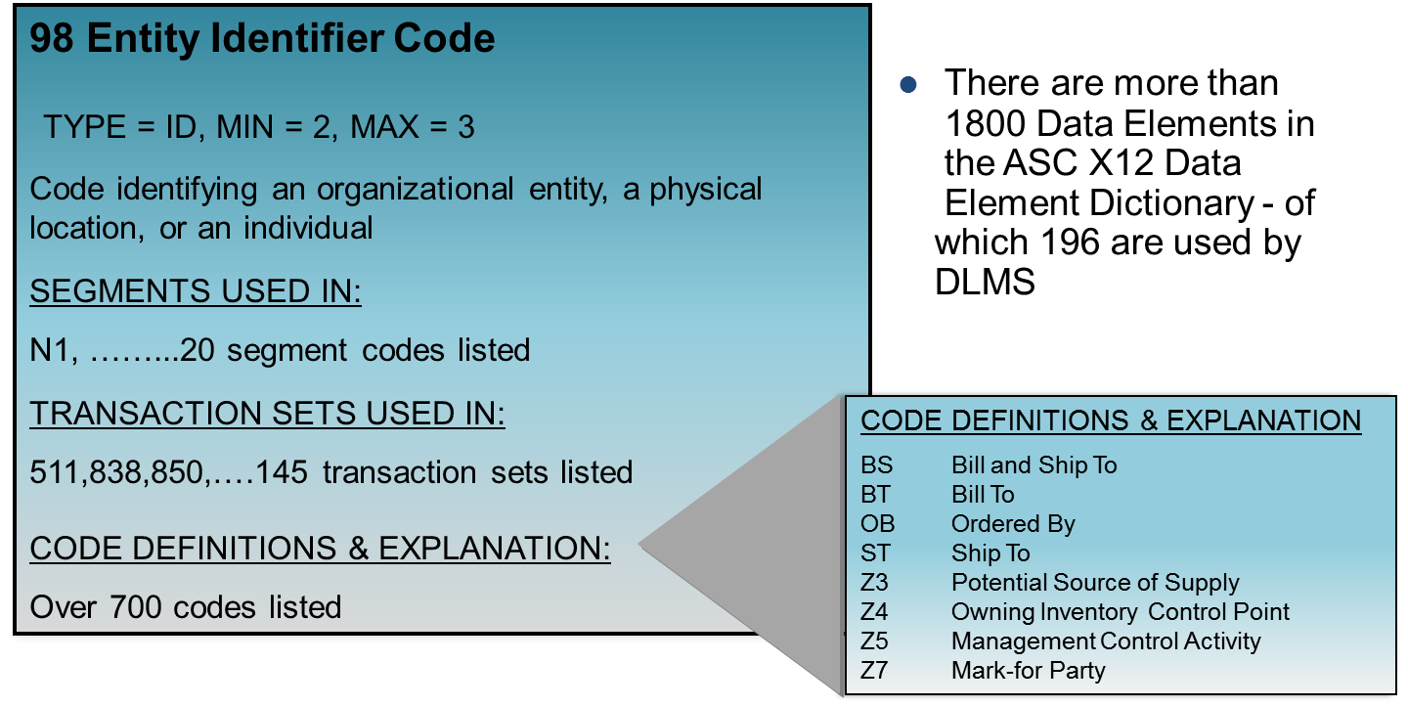
Data Element Dictionary Example
Data Element Word
Notes:
• This is an extract of a data element table from the X12 standard. On the left are the data element and its table number. Every X12 data element has a table number. So Entity Identifier Code is assigned table number 98. In this table is where you will find all the metadata associated with this particular data element.
• Notice that the data element name is pretty broad and generic. It doesn't carry a whole lot of meaning. The data element type is ID, which is an Identifier. So this data element serves as a qualifier in the X12 standard. This particular data element will have a code list that is found in table 98 of the X12 standard. The minimum/maximum field lengths are two and three, respectively.
• The definition, “code identifying an organization entity…” is pretty broad. That's done on purpose by X12. X12 is designed for multi-use across many different entities and many different functional domains (e.g., transportation, health care, logistics, acquisition, insurance industry, the finance industry) to support a variety of industries using the X12 standard. X12 is trying to come up with a broad set of standards with enough flexibility built into them to build out of that standard without substitution for specific needs.
• The other thing X12 does in the data element table is to indicate what X12 data segments it is used. In this example, it is used in an N1 segment; there are a total of 20 segments that use that same data element. So the data elements are multi-use and that is why the definitions are so broad.
• Also, X12 identifies how often a data element will appear in the transaction set standards. In this case, 145 transaction sets make use of data element 98.
• In this example, there are over 700 codes listed for data element 98. We’ve extracted a couple of the codes to demonstrate how they are comparable to data elements we recognize from MILSTRIP. The first code, BS, means it is a bill and ship-to code. If you are familiar with MILSTRIP transactions, sometimes the bill-to and ship-to is the same entity. BS is the code used to assign the code value to the bill-to and ship-to entity.
• OB is the code to say "ordered by". In DLMS parlance, that would be the requisitioner. If the ship-to is unique, it would be identified by an ST. Owning inventory control point is a Z4. These codes are the building block for how the metadata in a data element will establish its usage in practice.

Slide 18
Standard File Structure
Interchange
Outer Envelope
Functional Group
Folder
Transaction Set
Written Document
Segment Loop
Paragraph
Data Segment
Sentence
Data
Element
Word
Data Segment Sentence
Notes:
• Now let’s move up to the next level in the X12 hierarchy – the Data Segment. Think of the data segment as a sentence in a written document. Just like a sentence is composed of words, a data segment is composed of data elements.
• This is an intermediate unit of information in a transaction set and is made up of one or more data elements. Every data segment will have a unique segment ID assigned to it. Just as every data element has a table number assigned to it, every segment has a segment ID assigned to it, and what the data segment does is convey functionally related data elements into a single coherent thought.

Slide 19
Data Segment
The data segment is an intermediate unit of information in a transaction set
Each data segment is composed of:
  A unique segment ID
  One or more logically related data elements
The data segment is used to convey a grouping of functionally-related user information
Data Segment Sentence
Notes:
41
Within the segment, the data elements that comprise it are in a predefined sequence, per the standard. The standard will indicate the sequence. Every data element within that segment will be identified by the segment ID that it's in, and its position within the segment.

Slide 20
Data Segment Characteristics
The data is organized in a defined sequence within the segment
Each data element in the segment is identified by a reference designator composed of the unique segment identifier and the element’s sequence number
Each data element is separated by a data element delimiter character
A segment terminator character identifies the end of the segment
Data Segment Sentence
Notes:
41
Every data element within a data segment is going to be separated by a delimiter. That way when the computer reads this string of data, it knows where a data element begins and where it ends. While it's usually called a delimiter; sometimes it's called a separator; both terms are synonymous. The end of every segment has a terminator on it. That way the computer knows where the segment ends and the next one begins, like the period in a sentence.

Slide 21
Data Segment Diagram
N1 Name
N101
N102 93
Identification
Code
Qualifier
98
N103 66
Entity
Identifier
Code
N1 *
*
Name
*
M ID 2/3
X AN 1/60
X ID 1/2
N104 67
N105 706
N106 98
Identification
Code
Entity
Relationship
Code
Entity
Identifier
Code
*
*
*
^
X AN 2/80
O ID 2/2
O ID 2/3
Data Segment Terminator
Separator = Element
Delimiter
Notes:
27
• For training purposes, I am going to provide you a pictorial description to help you understand the concepts of data segments and the relationship to data elements. This representation is a data segment diagram. It shows a graphical depiction of the N1 segment. The N1 Name segment is very generic. First thing to note here are the six boxes, 1, 2, 3, 4, 5, and 6. All six represent an individual data element within the data segment.
• Every data element is separated by a delimiter. In this example here, the key delimiter is represented by an asterisk. This is what the arrow is pointing to within the chart. All element delimiters are represented by an asterisk, except for the last data element. The last element is followed by a carat, representing the segment terminator. When a computer is reading this string of data, there is an ID and a delimiter to represent the start of the data element. Each subsequent element is followed by an element delimiter, until the last data element and that is followed by a segment terminator.

Slide 22
Data Segment Diagram
Reference Designator
N101
N102
N103
98
93
66
N1 *
Entity
Identifier
Code
*
*
Identification
Code
Qualifier
Name
M ID 2/3
X AN 1/60
X ID 1/2
N104
N105
N106
67
706
98
*
*
Entity
Relationship
Code
*
Entity
Identifier
Code
^
Identification
Code
X AN 2/80
O ID 2/2
O ID 2/3
Data Segment Sentence
Notes:
33
• Every data element within a segment has an ID assigned to it. In this example, entity identifier code, which is data element 98 in the X12 standard, is inside the N1 segment and it is the first data element of the segment. This is the referenced designator in the segment ID, which in this case is the N1 segment and is in the 01 position of the sequence within that segment that it resides.
• So in this case, the first instance of any identifier code data element 98 is in the N101 position. This becomes important, especially for the DAAS folks, to help with the mapping. Because when mapping, it is important to know exactly where these data elements and business rules are being applied.
• Looking at the third box, the reference designator of N103 can quickly be parsed within the string. The N1 represents the segment ID and the zero-three represents the third position within the segment.

Slide 23
Data Segment Diagram
Data Element Number
66
98
93
N101
N102
N103
N1 *
Entity
Identifier
Code
*
*
Identification
Code
Qualifier
Name
M ID 2/3
X AN 1/60
X ID 1/2
67
706
98
N104
N105
N106
*
*
Entity
Relationship
Code
*
Entity
Identifier
Code
^
Identification
Code
X AN 2/80
O ID 2/2
O ID 2/3
Data Segment Sentence
Notes:
33
• Next, let’s look at the data element numbers that comprise the N1 data segment. In this example, the data element numbers are in the upper right-hand corner of the boxes.
• In this example, there are five different X12 data element tables that are used in the construction of this segment – 98, 93, 66, 67, and 706.
• If you will note, the data element number 98 is used twice, once in the N101 data element and another time in the N106 data element. What has happened here is that the same data element is being used, but will have different qualifiers chosen to represent different values.

Slide 24
Data Segment Diagram
Type of Data Element
98
N102 93
N103 66
Identifier
N1 *
*
Name
*
Identification
ID
AN
ID
M 2/3
X 1/60
X 1/2
N104 67
N105 706
N106 98
*
*
*
Entity
^
Identification
Entity
AN
ID
ID
X 2/80
O 2/2
O 2/3
Data Segment Sentence
Notes:
34
• Next we’ll look at the data element types for the data elements contained within the N1 data segment. Every data element must have a data element type associated with it. The highlighted element indicates ID for Identifier, the next one shows AN for Alphanumeric. These are the only two types used within this segment and they represent the two most commonly used data element types within X12.

Slide 25
Data Segment Diagram
Data Element
Length
N101
N102 93
N103 66
Entity
Identifier
*
*
Identification
Code
N1 *
Name
2/3
1/60
1/2
M
X
X
N104 67
N105 706
N106 98
*
*
Entity
Relationship
*
Entity
Identifier
^
Identification
2/80
2/2
2/3
X
O
O
Data Segment Sentence
Notes:
36
Next we see the maximum and minimum element length is highlighted. For the N101 data element the minimum length is two and the maximum is three, usually depicted as “2/3”. All the elements in this segment are variable length with the exception of N105, which is a fixed length of two.

Slide 26
Data Segment Use
Condition Designator
98
N106 98
N104 67
Entity
Identifier
Code
Entity
Identifier
Code
N1 *
*
*
Identification
Code
M
O
ID 2/3
ID 2/3
X
AN 2/80
M = Mandatory
O = Optional
X = Syntax note applies
Z = Semantic note applies
Combinations may be applicable
Data Segment Sentence
Notes:
30
The Condition designator defines how the element is to be used. Mandatory and Optional are self-evident. X and Z indicate either a syntax or semantic note applies. More on this topic later.

Slide 27
Data Segment Diagram -
Data Dictionary Format
N1 Name
To identify a party by type of organization, name and code
Transaction Sets used in:
104 110 120 128 130 131 135 140 180 511 517
527 536 561 567 568 810 812 824 830 842
Ref. Ele. No. Name Attributes
01 98 Entity Identifier Code M ID 2/3
02 93 Name X AN 1/60
03 66 Identification Code Qualifier X ID 1/2
04 67 Identification Code X AN 2/80
05 706 Entity Reference Code O ID 2/2
06 98 Entity Identifier Code O ID 2/3
Data Segment Sentence
Notes:
Now that we’ve completed the pictorial review of the Data Segment Diagram, it is time to show you an extract of the Data Segment Diagram in data dictionary format from the actual X12 standard. Everything in the six boxes on the previous slides is portrayed here in the actual X12 standard itself. The data dictionary format is just another view of the same information. At the top, you will see the Data Segment ID (N1) and its title (NAME), along with a generic definition. Next you will see all the X12 transaction sets that contain an N1 segment.

Slide 28
Data Segment Diagram
N1 Name
To identify a party by type of organization, name and code
Transaction Sets used in:
104 110 120 128 130 131 135 140 180 511 517
527 536 561 567 568 810 812 824 830 842
Order of Element
Ref. Ele. No. Name Attributes
01 98 Entity Identifier Code M ID 2/3
02 93 Name X AN 1/60
03 66 Identification Code Qualifier X ID 1/2
04 67 Identification Code X AN 2/80
05 706 Entity Reference Code O ID 2/2
06 98 Entity Identifier Code O ID 2/3
Data Segment Sentence
Notes:
• The data segment diagram is a list of all the metadata for all the data elements in a segment. Reading from the left, the first piece of metadata is the “reference.”
• Zero One through zero six indicates both the order and the sequence of the data elements within the data segment.

Slide 29
Data Segment Diagram
N1 Name
To identify a party by type of organization, name and code
Transaction Sets used in:
104 110 120 128 130 131 135 140 180 511 517
527 536 561 567 568 810 812 824 830 842
Data Element Number
Ref. Ele. No. Name Attributes
01 98 Entity Identifier Code M ID 2/3
02 93 Name X AN 1/60
03 66 Identification Code Qualifier X ID 1/2
04 67 Identification Code X AN 2/80
05 706 Entity Reference Code O ID 2/2
06 98 Entity Identifier Code O ID 2/3
Data Segment Sentence
Notes:
Next is the element number. Every data element is assigned a number, that refers to a table in X12 containing the metadata for that data element.

Slide 30
Data Segment Diagram
N1 Name
To identify a party by type of organization, name and code
Transaction Sets used in:
104 110 120 128 130 131 135 140 180 511 517
527 536 561 567 568 810 812 824 830 842
Data Element Name
Ref. Ele. No. Name Attributes
01 98 Entity Identifier Code M ID 2/3
02 93 Name X AN 1/60
03 66 Identification Code Qualifier X ID 1/2
04 67 Identification Code X AN 2/80
05 706 Entity Reference Code O ID 2/2
06 98 Entity Identifier Code O ID 2/3
Data Segment Sentence
Notes:
Following the reference and element number is the data element name in the third column.

Slide 31
Data Segment Diagram
N1 Name
To identify a party by type of organization, name and code
Transaction Sets used in:
104 110 120 128 130 131 135 140 180 511 517
527 536 561 567 568 810 812 824 830 842
Element Usage
Ref. Ele. No. Name Attributes
01 98 Entity Identifier Code M ID 2/3
02 93 Name X AN 1/60
03 66 Identification Code Qualifier X ID 1/2
04 67 Identification Code X AN 2/80
05 706 Entity Reference Code O ID 2/2
06 98 Entity Identifier Code O ID 2/3
Data Segment Sentence
Notes:
Next is the data element attributes associated with the data element. First is the usage. In this case, three usage types can be found in the data elements comprising the N1 segment: mandatory, syntax and optional.

Slide 32
Data Segment Diagram
N1 Name
To identify a party by type of organization, name and code
Transaction Sets used in:
104 110 120 128 130 131 135 140 180 511 517
527 536 561 567 568 810 812 824 830 842
Format & Size of Data Element
Ref. Ele. No. Name Attributes
01 98 Entity Identifier Code M ID 2/3
02 93 Name X AN 1/60
03 66 Identification Code Qualifier X ID 1/2
04 67 Identification Code X AN 2/80
05 706 Entity Reference Code O ID 2/2
06 98 Entity Identifier Code O ID 2/3
Data Segment Sentence
Notes:
The last two columns contain the format of the elements. The data element type and the size of the value stored.

Slide 33
Data Segment Notes
Three types of segment level notes:
  Syntax: Define dependencies based on the presence or absence of other data elements in the segment
  Semantic: Provide additional information about the data element including any dependence based on the data value in another data element in the segment
  Comments: Clarify the intended use of the segment - comments are not part of the standard
Data Segment Sentence
Notes:
• As we previously encountered in our examples, occasionally X12 has syntax and semantic notes associated with a particular X12 data element. These two types of notations are used to establish relationships among two or more data elements.
• So what is a syntax note? It is basically defining the dependencies based on the presence or absence of data elements.
• A semantic note is providing additional information about a data element, sometimes including dependence on the value of another data element.
• Comments are not part of the standard, but comments are used to explain applicable business rules for a particular data element.

Slide 34
Data Elements
Within a Segment
The same data element may be used in many different segments
Most data elements are generic with their meaning determined by either the context of the segment they are used in or by the presence of a qualifier data element within the segment
Data Segment Sentence
Notes:
Earlier, we demonstrated that the same data element can be used in many different segments and sometimes can be repeated within the same segment. In the previous example, data element 98 shows up twice in the N1 data segment, and it is used in 20 other X12 data segments.

Slide 35
Generic Data Elements
Example 1 - Generic data element 373, Date, used with a semantic note.
BR03 373
DATE
M/Z DT 8/8
BR01
353
BR02 640
BR03 373
BR04 67
BR
*
TRANSACTION
SET PURPOSE
CODE
*
TRANSACTION TYPE CODE
*
DATE
*
Identification
Code
M ID 2/2
M ID 2/2
M/Z DT 8/8
X AN 2/80
Semantic Note: BR03 is the date of the transaction set preparation
Data Segment Sentence
Notes:
• Most data elements are very generic and their meaning or their context is derived through relationships, semantic or syntactic notes.
• This is an example of a generic data element for date. The date element appears in the BR03. BR is the segment ID and the zero three is the position of the data element within the BR segment. In the lower left corner of the BR03 box, there are two key bits of information: M for mandatory and Z for a semantic note associated with the data element.
• The semantic note reads: BR03 is the date of the transaction set preparation. The semantic note defines the date and the context in which it is used,; in this case it is the day the transaction set was prepared

Slide 36
Generic Data Elements
Example 2 – Generic data element 373, Date, used with a qualifying data element.
G6202 373
DATE
X DT 8/8
G6201 432
G6202 373
G6203 176
G6204 337
G62
DATE
QUALIFIER
TIME
QUALIFIER
*
*
DATE
*
*
TIME
X ID 2/2
X DT 8/8
X ID 1/2
X TM 4/8
Date Qualifier type = ID (codes list available)
(e.g. “68” = Requested Delivery Date, or
“BD” = Required By)
Data Segment Sentence
Notes:
• This is another example of the generic data element -- date. It is eight positions just like the previous example, but this time we’re looking at the G6202 data element. G62 is the segment ID and zero two is the position of the element within the segment.
• In this data element the data element type is X, which means a syntax note applies. A syntax note means there is a dependency between one or more data elements based on the presence or absence of that data element.
• In this case, the dependency for G6202 is with the G6201. There will be another slide later to show this relationship, but for now just know the dependency exists. There's no semantic note in this case because this contains an X instead of a Z. This means it is going to derive its context from its partner; in this case, the G6201, which is a data element type of ID – in other words a code. If you look up data element 432 in the X12 data element dictionary, you’ll find a code list. In that list, it will indicate that the value 68 means the requested date is a required delivery date.

Slide 37
Relational Conditions
Defines a relationship between two or more data elements in a segment.
Expressed in syntax note by letter code followed by the last two digits of the reference designator of the effected data elements (e.g. P0203).
Examples: P0203; R0203
P | Paired | If any specified data element is present, then all the specified data elements must be present
R | Required | At least one of the specified data elements must be present
E | Exclusive | Not more than one of the specified data elements may be present
C | Conditional | If the first specified data element is present, then all other specified data elements must be present
L | List Conditional | If the first specified data element is present, then at least one of the remaining specified data elements must be present
Data Segment Sentence
Notes:
• In that last scenario with the G62 data segment, there were two data elements – G6201 and G6201 -- in the segment that had a relationship to one another; the question is, how does one know from a syntactical perspective what that relationship is; what's the nature of it? There could be many kinds of relationships. The two that are used most frequently in DLMS are paired and required.
• A paired relationship, basically says if one of the data elements is present, then they all must be present. It is an all or nothing scenario.
• Required means that at least one of the data elements has to be present. All may exist, but only one is required to satisfy the condition.
• So how does one know in the standard if something is paired or required? In the example here, the syntax note reads P0203. P stands for paired, the 02 and 03 means that the second and third data element in that segment are paired. Looking at it another way, if there is something in the second position (element 02), there must also be a value in the third (element 03).
• Required. If the relationship is required instead of paired, it would contain an R. So one could conceivably see R0203. That means that at least one of 02 or 03 has to be present. Can something be in both the second and the third position if it's an R? Yes. Can there be nothing in the second and third position? No, since it is required one must be present.

Slide 38
N1 Segment
N1 Name
To identify a party by type of organization, name, and code.
N101
98
N102 93
N103 66
N1 *
Entity
Identifier
Code
Identification
Code
Qualifier
*
Name
*
M ID 2/3
X AN 1/60
X ID 1/2
N104 67
N105 706
N106 98
Identification
Code
Entity
Relationship
Code
Entity
Identifier
Code
*
*
*
^
X AN 2/80
O ID 2/2
O ID 2/3
Syntax:
N102 R0203 – At least one of N102 or N103 is required.
N103 P0304 – If either N103 or N104 are present, then the other is required.
Comments:
This segment, used alone, provides the most efficient method of organizational identification. To obtain this efficiency the “ID Code” (N104) must provide a key to the table maintained by the transaction processing party.
N105 and N106 further define the type of entity in N101.
Data Segment Sentence
Notes:
• Now that we understand how a syntax note is defined in a data segment, let’s look at an example of a syntax note and its impact on usage of data elements within the data segment.
• So in this example we have the N1 segment again. In the N102, there is a data element type X, which if you read at the bottom of the diagram, indicates a required relationship between data elements two and three; this means that the data segment must contain at least one of the N102 and the N103.
• In the N103, the data element type X indicates that there is a paired relationship between the N103 and the N104. So if either is present, both have to be present.
• So, let’s review how the syntax notes can impact one another in this N1 data segment.
• If I have something in the N102, do I have to have something in the N103? No.
• If I have something in the N103, do I have to have something in the N104? Yes.
• Taking that situation one step further, if I have something in both the N103 and the N104, do I have to have something in the N102? No.

Slide 39
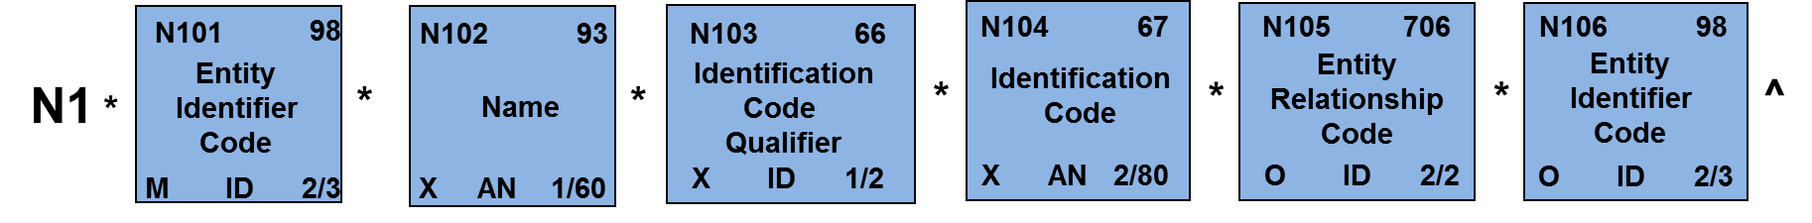
Data Segments
N1*Z4**M4*N35**TO^
Z4 = “Owning Inventory Control Point”
M4 = “Routing Identifier Code (RIC)”
N35 = “Naval ICP Mechanicsburg PA”
TO = “Message To”
Data Segment Sentence
Notes:
• In this example, we are going to decompose an N1 data segment to ascertain in layman’s terms what information it is conveying using X12 standards.
• At the top of the chart, The asterisks represent data element delimiters and a carat for the data segment terminator.
• To breakdown the example, here are the six boxes for the N1 segment. The first thing to note is there are only four values, but there are six boxes in the standard. Why? Because not all values are required. The optional values are not used. If there is no value to pass, then the delimiters would be adjacent to one another, meaning the data element wasn't used. You may wonder why we cannot skip it all together; the reason is that we have to account for every position within the data segment, so that the computer properly interprets the data content against the X12 standard.
• So in this case, the first data element is Z4 - zulu-4. This value is in the N101. When reviewing the X12 standard and table 98, you will see that this is an Identifier which means it's a code value -- if searching table 98 and looking up Z4, it will show the definition as owning inventory control point. This means the N1 segment is going to pass some information about the owning ICP. This provides a functional context for the data segment.
• The second data element is N102. This element contains no value. That means it was skipped. Note there is a required relationship between the N102 and N103, so either N102 or N103 is required. So since N102 was not used, N103 must be entered. The value in 103 is M4 - Mike-4. Upon examination of table 66 in the standard and looking up Mike-4, it will define it as Routing identifier code.
• The fourth data element is N35 - November-35. As noted earlier, there is a paired relationship between N103 and N104, which means if one of the data elements is used, both must be used. Since a value appears in N103, there must also be a value in N104. Knowing N103 is the RIC, it stands to reason N104 contains the value of the RIC and in this case that value is N35. Looking up N35 at DAAS in their RIC table, you would see it defined as Naval ICP Mechanicsburg, Pennsylvania.
• The next element is N105 and again, there is no value, so it is skipped. This is allowed because the standard indicates it is an optional data element.
• The Last data element is N106 and the value is TO. What does TO mean? If you look up TO in table 98 of the X12 standard, you will see it defined as Message-to.
• So, in layman's terms, what information was just passed in this N1 data segment? The first position indicates that this N1 segment is carrying information identifying the owning ICP. The ICP can be identified by its RIC, which is N35. N35 is Mechanicsburg, PA. And the message-to says that transaction is going to N35.

Slide 40
Composite Data Structure Within a Segment
N9*TN*FB205000210001*****W8B^
N901 128
N902 127
N907 C040
Reference
Identification
Qualifier
Reference Identification
Reference
Identifier
N9
*
*
*
*
*
*
^
*
M ID 2/3
X AN 1/30
O/Z ID
C04001 128
C04002 127
C04003 128
C04004 127
C04005 128
C04006 127
Reference
Identification
Qualifier

Reference Identification

Reference
Identification
Qualifier

Reference Identification

Reference
Identification
Qualifier

Reference Identification
M ID 2/3
M AN 1/30
X ID 2/3
X AN 1/30
X ID 2/3
X AN 1/30
Example – Composite data element C040, Reference Identifier, used in N9, Reference Identification segment
Data Segment Sentence
Notes:
• In this example, we are going to review a composite data structure within a segment. A composite is where there is more than one data element and these elements are all associated into a single data element called a composite.
• In this example, we will look at an N9 segment. The first data element value is TN, stored in the N901 element. If you lookup TN in table 128 in the X12 standard, and it basically says a transaction reference number, which in DLMS parlance is the document number.
• There is an data element type of X in the N902 and the syntax shows a relationship between N901 and N902. So, if the N901 has the code TN defined as document number and there is a paired relationship between the N901 and N902, then the value FB205000210001stored in the N902 data element can logically be deduced to be the actual document number.
• Next are five asterisks next to each other. This indicates the next four values are skipped. This takes us to the last position of the data segment which contains a W8 - whiskey 8 which is in the 7th position of the N9 segment. The N9 segment, N907, in the upper right-hand corner, says C040 - Charlie-040. The C means it's a composite. It's a combination data. So what it's saying in that one position of the data element, the next six elements (in this case) are to be counted as one.
• How is composite portion of the N907 determined? The delimiter is a different special character, in this case a circle with a crosshair through it. So that's how the computer knows that what follows is the composite of, in this example, the N907. The unique delimiter is the automatic flag for the computer that's been set up under X12 to ensure the composite is properly interpreted.

Slide 41
Standard File Structure
Interchange
Outer Envelope
Functional Group
Folder
Transaction Set
Written Document
Segment Loop
Paragraph
Data Segment
Sentence
Data
Element
Word
Notes:
Now it’s time to look at segment loops. These are the paragraphs in our writing analogy.

Slide 42
Repeating Data
Specific sets of data may be used in multiple occurrences to support a functional requirement or to enhance efficiency of communications
  Items requisitioned by a single activity
  Dates applicable to a particular process
  Addresses – shipper, receiver, bill-to, status recipients
ASC X12 transactions provide multiple methods to accomplish this:
  Repetition of a single segment
  Loop of a group of segments
  Hierarchical loops
Segment Loop Paragraph
Notes:
• There are many occasions in the DLMS functional business processes where there is a need to repeat data elements. Dates are a good example of repeating an element multiple times within a particular process. Another good example is an address. If you look at the data content of a requisition, you will find the need for a bill-to address, a ship-to address, a commercial address, etc. So X12 gives us lots of different capabilities on how to handle repeating data.
• X12 provides the ability to repeat a single segment. For example, if the X12 transaction standard authorizes multiple N1 data segments, then the N1 can be repeated to identify different entities.
• X12 also allows you to group several data segments as a family and then repeat the group. For example, X12 may allow the N1, N2, N3, and N4 data segments to be looped together and then repeat the loops; this combination yields a complete address for an entity; repeating the loop yields multiple addresses.
• It is also possible to create a hierarchical group, which basically a group of related data segments that are then identified as a parent or child to another group of related data segments.

Slide 43
Segment Repetition
A single segment may sometimes be repeated in multiple occurrences
Each segment within a transaction set has a specified maximum number of occurrences (e.g. 1 or 100) or may be specified as having an unlimited number of occurrences (noted as “>1”) --also referred to as the “max use”
Segment Loop Paragraph
Notes:
First let’s examine a repeating data segment. X12 will indicate if the segment is repeatable in the standard and how often it can be repeated. This is done by a numeric value in the X12 table to identify the number of repetitions authorized. If the value is 1, the data segment can only occur once. If the value is 10, the data segment can be repeated up to a maximum of 10 times, each time conveying different information. If there is a greater than 1 shown, the repeating data segment is unlimited.

Slide 44
Data Segment Loops
{
}
{
}
Name
Street
City
State
By definition, loops are groups of two or more related segments which may be repeated
The name of the loop is indicated by the Loop ID which is named for the first segment in the loop
Loops have a specified maximum number of occurrences or may be specified as having an unlimited number of occurrences (noted as “>1”) -- referred to as the loop repeat
There is a specified sequence of segments in the loop
The first segment in the loop has a max use of 1 -- all other segments in the loop may be repeated as specified
Name
Street
City
State
Segment Loop Paragraph
Notes:
• Next, let’s discuss Data segment loops. X12 supports a group of segments that go together and X12 also supports repeating that grouping. The best example of this concept is address information. The name of the address goes in the N1. The N2 segment is additional information about that name. The N3 is a street address. N4 is a city, state, zip code, country code. If these four individual data segments are tied together, it becomes a way to convey an address. If the requirement is to convey multiple addresses, it would not make sense to pass all N1's, followed by N2's, then N3's and lastly the N4's. It would be difficult to string them together. A better approach is to define a data segment loop and repeat the loop for each address passed. So, the first data segment loop of N1, N2, N3, and N4 represents a unique address. A second repetition of the data segment loop represents a different address, and so on.
• X12 defines the segment loop and how many times the loop can be repeated. For example, a one would indicate the loop can only be used once. A greater than symbol followed by a one indicates the loop can be used as often needed.
• Note the first segment in a segment loop can only be used once in that loop. Logically this makes sense, because if the first segment could be repeated there were be no way to indicate which of the N1s is associated to the remaining data segments in that loop. So the first instance of the N1 can only be used once.

Slide 45
N1 Loop
Req Max Use Repeat
Loop ID – N1 100
N1 Name M 1
N2 Additional Name Information O 2
N3 Address Information O 2
N4 Geographic Location O 1
G61 Contact O 5
Segment Loop Paragraph
Notes:
• Here is a graphic example in a hierarchy diagram of what a data segment loop would look like within X12. In this case, we are looking at the N1 loop.
• First, notice the three-sided box. That's X12's way of indicating a loop of data segments. Inside of the loop, you will see five data segments used by the loop: N1, N2, N3, N4, and G61.
• This particular loop may occur up to one hundred times.
• There is only one mandatory element, the N1 or name. All the others are optional.

Slide 46
Nested Loops
Loops may have subordinate loops nested within them
The name of the nested loop is indicated by the Loop ID which is named for the first segment in the subordinate loop
Nested loops cannot begin with the same first segment as the previous (or outer) loop
Nesting may occur up to an indefinite number of levels
Segment Loop Paragraph
Notes:
• Nested loops take the previous concept of a loop having multiple related data segments in it, and creating other data segment loops nested within it. So that's a loop within a loop, within a loop.
• The X12 standard contains loops, nested segment loops and subordinate loops. This structure allows nested loops to occur an indefinite number of levels. The name of the loop is indicated by the loop ID. The nested loops cannot begin with the same first data segment as its parent loop.

Slide 47
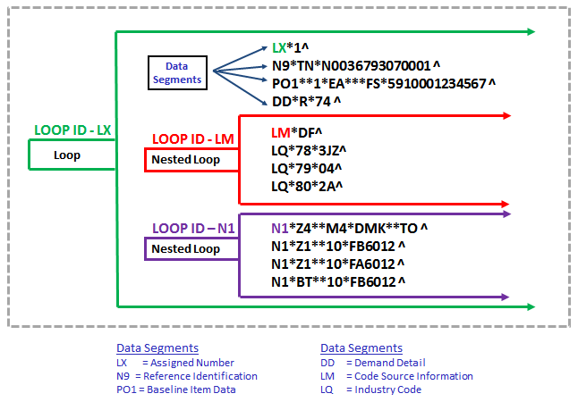
Loops and Nested Loops
Segment Loop Paragraph
Notes:
• In this graphic depiction, the outer loop is defined as an LX data segment loop. Why is it LX? Because that's the first segment in the loop.
• Inside the LX loop, the first segment is an LX, followed by N9, PO1, and DD data segments.
• The next entity within the LX data segment loop is a nested loop; in this case, it's an LM nested data segment loop because the first segment is an LM. Inside the LM loop are three LQ data segments.
• The next nested loop is the N1 loop, also nested within the LX data segment loop. In this N1 nested loop, the N1 data segment is repeated four times. There are no more nested loops or data segment, so this is the end of the LX data segment loop.
• In this example, the LX data segment loop is comprised of four data segments and two nested loops, the LM and N1 data segment loops. Now, let's take a look at what is passed here. The N9 has a reference indicator of TN, which we learned earlier is defined as Document number. Based on the first position of the document number, this looks to be a Navy document number. The PO1 segment contains the item data. The PO102 and PO103 contain the values “1” and “EA” which mean quantity of one and unit of issue each. In the PO106, there is a value of FS, which if you look that up in the X12 standard is defined as national stock number. The PO107 contains the value 5910001234567, which is the national stock number for the item.
• The nested loop contains three industry code qualifiers: 78, 79, and 80. When you look up these code values in the X12 standard, you will find that 78 with a value of 3JZ is a project code. 79 with a value of 04 is a priority designator and 80 with a value of 2A is an advice code.
• The next nested loop is an N1 segment. As we learned earlier, the Z4 with an M4 and DMK defines the owning ICP as RIC DMK. The Z1 with a 10 and FB6012 defines the party to receive status as DoDAAC FB6012; the additional Z1 defines DoDAAC FA6012 as another party to receive status. The BT with a 10 and FB6012 identifies the Bill-To DoDAAC as FB6012.

Slide 48
Non-ASC X12 Code Lists
DOD/Agency/Industry may reference specific code lists maintained outside ASC X12
Tool to accomplish this provided by the LM Loop
  Composed of two segments:
LM Code Source Information
To transmit standard code list identification information
LQ Industry Code
To transmit standard industry codes
LM01 559
LM02 822
LQ01 1270
LQ02 1271
Agency
Qualifier
Code
Source
Sub-qualifier
^
Code
List
Qualifier Code
Industry
Code
^
LM *
*
LQ *
*
M ID 2/2
O AN 1/15
O ID 1/3
X AN 1/30
COMMENTS: LM02 identifies the applicable industry code list source information
SYNTAX NOTES: C0102 - If LQ01 is present, then LQ02 is required
Segment Loop Paragraph
Notes:
• In the previous we discussion, we introduced a special type of data segment called LM and LQ. These are commonly referred to as non-ASC X12 codes list. One of the nice things that X12 did to help support unique code lists requirements for various industries, such as defense, medical, transportation, finance, and insurance, was to create the LM loop with LQ data segments inside the loop. What this allows is the ability to pass non-X12 code lists (industry based lists) within the X12 transaction. So all those unique DOD codes that we are familiar with, typically get passed in the LQ segments.
• So in these examples, there will be an X12 code that will be passed in the LM01 data element that signifies the usage of a particular industry code list. In the LQ data segment, you will see that there's a data element type X in the LQ02, meaning a conditional relationship. In other words, if there is an LQ01, then there must be a value passed in the LQ02.

Slide 49
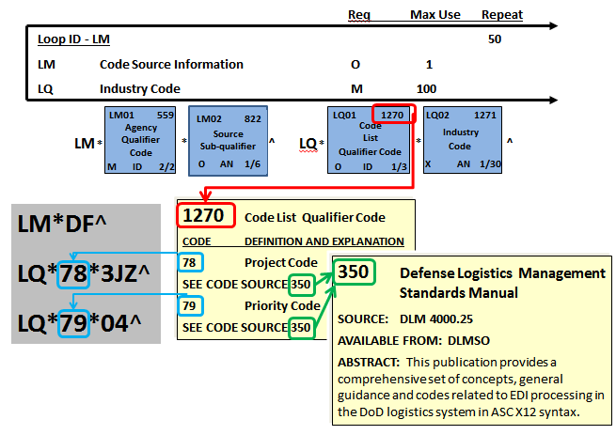
LM Loop
EBSO
Segment Loop Paragraph
Notes:
• Here is a graphical depiction of the LM loop. First thing to observe is that the LM loop can be repeated up to fifty times and within each LM loop the LQ segments can occur one-hundred times. This means conceivably there could be up to five-thousand different codes passed.
• In this example, the LM01 contains the source of the industry code list; the value DF tells us this is a DOD owned code list. The LQ01 is an identifier, which means three is a code list to be found in the X12 data element 1270 table The example indicates the use of two different LQ01 codes: 78 is project code and 79 is priority code. So, to determine the source of the authorized code list associated with codes 78 and 79, the X12 standard indicates that the code source is 350. When you look up code source 350 it indicates that the list of authorized project codes and priority codes can be attained from EBSO.
• As you can see, the LM/LQ data segment functionality gives industries some latitude to pass unique codes that are associated to just their industry, without having to go to X12 to seek approval for code changes. Each industry maintains their own code lists for use in the LM and LQ segments.

Slide 50
Hierarchical Level Loops
HL Hierarchical Level
To identify dependencies among, and the content of, hierarchically related groups of data segments.
HL01 628
HL02 734
HL03 735
HL04 736
Hierarchical
ID Number
Hierarchical Parent ID Number
Hierarchical
Level Code
Hierarchical
Child Code
HL
*
*
*
*
^
M AN 1/12
O AN 1/12
M ID 1/2
O ID 1/1
Shipment
Parent
Parent
Child
Item 1
Item 2
Item 3
Child
Component 1
Component 2
Segment Loop Paragraph
Notes:
• The hierarchical level loops are basically the establishment of parent/child relationships between loops.
• If we look at a shipment as an example, we can see how the shipment, the items in the shipment, and unique information about each of the items can be hierarchically arrayed in a parent-child relationship. The shipment is the parent, and items 1, 2 and 3 are included in the shipment; those items are children of the parent. Hierarchical levels do not have to stop at one level deep. For example, item three in this shipment has two components. Those two components are children of item three, which means they are grandchildren of the shipment parent. It is possible to drill this down indefinitely.
• In X12, each of the entities will have a separate HL loop assigned to describe the information about it. So, we could think of the shipment as the first loop HL. HL01 contains the sequential loop number, HL02 contains the loop number of the parent, HL03 is the code that describes the nature of the loop (e.g., shipment, item, pack), and HL04 can be used to indicate if there is a subordinate HL loop to the child. In order to keep track of the relationships, the parent ID's for each child will be annotated in the HL02. So in this example if the parent ID is one and represents the overall shipment, then three items in the shipment will be identified in separate HL loops two, three and four respectively; the parent ID will be one to show that they are items in the shipment. Item three is noted to have two components, so those two components will be identified in separate HL loops five and six, respectively. The parent ID for those two loops will be four to show that they are children of item three.

Slide 51
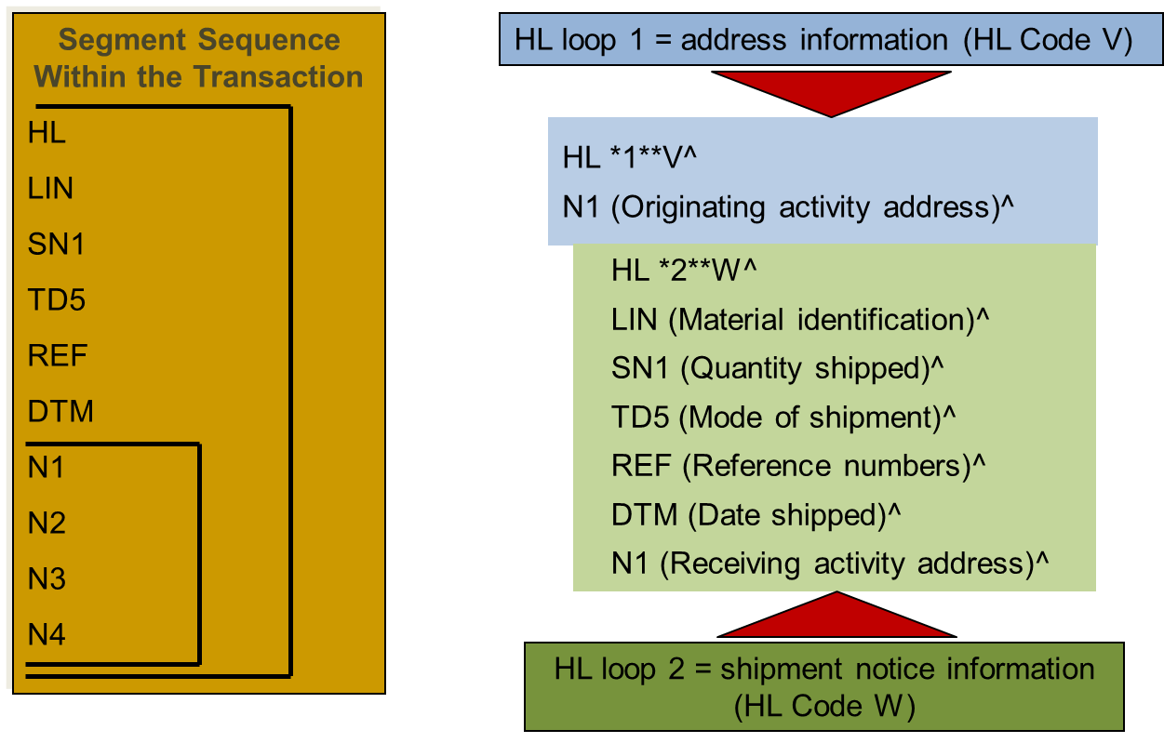
Hierarchical Level Loops
Segment Loop Paragraph
Notes:
• Here we are going to take a look at what kinds of information can be passed within an HL loop. In this example, we have two HL loops. The first HL loop only has one data segment, the N1. The V in HL03 means that the information within this HL loop is address information.
• The second HL loop contains information about a shipment as identified by the W in the HL03. There are five data segments and one data segment loop that comprise this second HL loop. The LIN data segment denotes the materiel identification; the SN1 data segment denotes the quantity shipped; the TD5 data segment denotes the mode of shipment; the REF data segment denotes the reference numbers associated with the shipment; the DTM denotes the date shipped; and lastly, the N1 data segment loop provides the receiving activity’s address

Slide 52
Standard File Structure
Interchange
Outer Envelope
Functional Group
Folder
Transaction Set
Written Document
Segment Loop
Paragraph
Data Segment
Sentence
Data
Element
Word
Notes:
Now it’s time to look at the transaction set or what would be the document file in the writing analogy.

Slide 53
Transaction Set
A group of data segments in a predefined sequence needed to provide all the data required to define a complete transaction
Uniquely identified by a three-digit number and a name
Begins with an ST segment and ends with an SE segment
Must contain a beginning segment
Transaction Set Written Document
Notes:
23
• The transaction set is a group of data segments in a predefined sequence. X12 uniquely identifies a transaction set by a three-digit number and name. For example, 511 is called Requisition.
• Every transaction set begins with an ST segment (header) and ends with an SE segment (trailer). The first segment after the header is the beginning segment. This segment describes the purpose and intent of the transaction set.

Slide 54
Transaction Set
- Header and Trailer -
ST Segment, Transaction Set Header
    Transaction Set ID (e.g., 511, 527, 810)
    Control number (assigned by sender’s computer)
    Example: ST*511*00000001
SE Segment, Transaction Set Trailer
    Segment counts
    Same control number used in ST segment
    Example: SE*19*00000001
v
v
Transaction Set Written Document
Notes:
• Here is an example of the ST and the SE segments.
• The ST segment is the transaction set header. In the ST segment, the first data element is the transaction set ID. In this example, the transaction set ID is 511, which means we’re talking about a Requisition. If we had passed the 527 that would be a Materiel Due-In and Receipt; an 810 would indicate Invoice. The next data element is the control number that's assigned by the sending computer. In this example, the control number is all zeroes followed by a one.
• The SE segment is the transaction set trailer. The first data element is the number of segments in the transaction. In this case there were 14 segments. After the segment count is the control number; this number must always match the control number in the ST or header segment. The passing of the segment count and the control number serve as cross-checks to ensure that the transaction set was transmitted and received in its entirety/intact. If the control number in the SE segment does not match the control number in the ST segment or there is another ST before the SE segment, the transaction is invalid. If the ST and SE control numbers are the same, but the number of segments actually received is something other than the segment count in the SE segment, the transaction is invalid; this means that the transaction either lost data or acquired data from another transaction. Mismatches in the control number and/or the segment count must be researched with DAAS to determine if they have an intact transaction. If they do, then they can retransmit the transaction.

Slide 55
The Beginning Segment
A segment at the beginning of each transaction set which defines the purpose, type and action, date, and unique identification
Indicates additional processing that may be required
Transaction Set Written Document
Notes:
19
The beginning segment is the first segment following the header. This segment defines the purpose, type, action, date, unique identification and any additional process that may be required for the transaction.

Slide 56
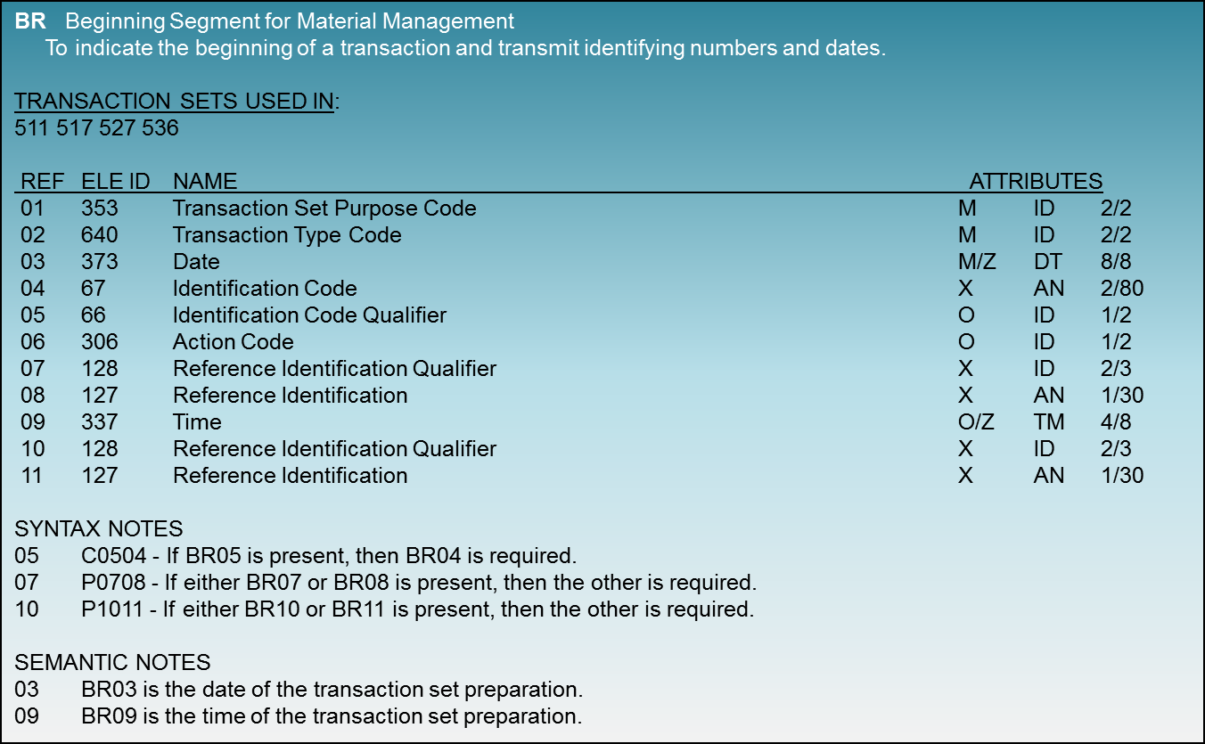
BR Segment
Transaction Set Written Document
Notes:
• Here is an example from the X12 standard of a beginning segment. The first thing to look at is to identify how many data elements are in this BR segment? They are listed in order, each prefaced by a reference number. Looking down the left column, notice there are eleven data elements in this transaction.
• Each reference number is followed by the element ID, Name and element attributes.
• The last two critical items to note are the syntax and semantic notes.
• If we take a look at the BR03, we see that the name is date and the data element type is Z, which means there is a semantic note associated with this data element. At the bottom of the page, it states that the BR03 is the date of the transaction set preparation. You now have context for the kind of date value desired in the BR03.

Slide 57
Transaction Set Table Diagram
Identifies the purpose of the transaction set
Identifies all the segments which comprise the transaction set in sequence by position number
Identifies the structure of the transaction set as heading (table 1) or detail (table 2) or summary (table 3)
Identifies the loop and nested loop structure
Indicates which segments are Mandatory or Optional
Indicates the maximum use of repeating segments
Transaction Set Written Document
Notes:
The transaction set table diagram contains the architecture of the transaction. This diagram will outline the purpose of the transaction set, list all the segments and loops that are contained within it and present the order of the element within the transaction. It will also define which segments are mandatory or optional and how many times any of the segments and/or loops can be repeated.

Slide 58
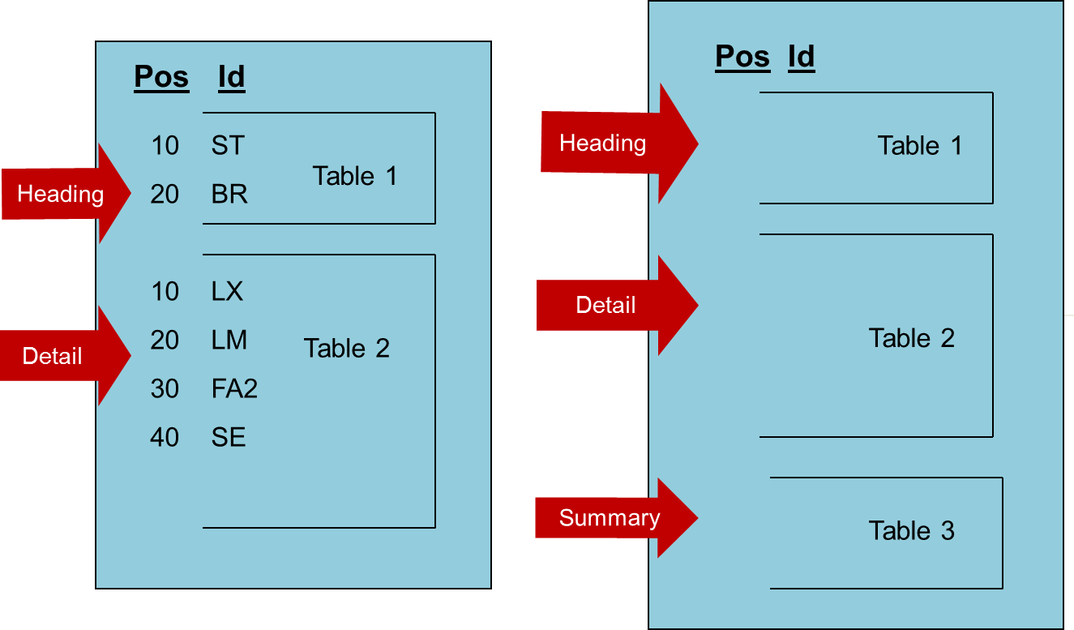
Transaction Set Tables
Transaction Set Written Document
Notes:
• All X12 transactions have at a minimum a header table and detail table. The header or heading is always defined as table 1 and the detail is always table 2. Some transactions will have three tables and those are usually finance transactions, where there will be a summary table 3. The reason this mostly occurs in the finance world is finances passes multi-line bills, so the summary record contains a rollup of the detailed billing and this is important to verify all the detail information has been received in its entirety.
• On the left in this example, notice there are just two tables. Table 1 consists of the ST data segment and the beginning segment. Table 1 always has the ST segment. Table 2 has all the detail, with the SE data segment as the last data element segment in table 2.
• On the right is an example of a transaction with three tables. Table 1 is the heading, containing the ST data segment and the beginning data segment. Table 2 contains the data segment providing the detail of the transaction. Table 3 is the summary. Note that in this case, the SE data segment is in table 3, as it must be the last data segment of the transaction.

Slide 59
Transaction Table Diagram
511 Requisition Functional Group: RN
This Draft Standard for Trial Use contains the format and establishes the data contents of the Requisition Transaction Set (511) for use within the context of an Electronic Data interchange (EDI) environment.
Heading:
Pos No Seg ID Name Req Des Max Use Loop Repeat
10 ST Transaction Set Header M 1
20 BR Beginning Segment M 1
. . . . .
Detail:
Loop ID-LX >1
10 LX Assigned Number O
20 N9 Reference Identification M >1
. . . . .
. . . . .
Loop ID-LM 50
270 LM Code Source Information 0 1
280 LQ Industry Code M 100
Transaction Set Written Document
Notes:
• This is an extract from the X12 standard. In the upper left corner you will see the transaction set number 511 and the name of the transaction “requisition.”
• Notice in the description within the X12 it says this is a draft standard for trial use. This is a draft from the standards perspective because the standard is always being updated. As draft implies, none of these versions is locked in stone; it can be enhanced or modified and will be released as a new version release when those change occur. For that reason draft doesn't mean it's not available for authorized use, this is just X12 terminology to indicate that the standard is a living standard; it is in fact authorized for use in implementation conventions.
• Next you will see that X12 has "heading". As we discussed earlier, this is table 1. Under the header are the first two segments: ST and BR. If you look in the far left column it says "position number." The ST position is 010 and the BR the position is 020.
• Since the order of data segments within a transaction is important, X12 assigns a unique position number to each data element within a table . You will notice that X12 skips numbers between positions, the reason position is to preserve room in the future to add other segments in between the existing segments.
• After the heading comes the detail, which is also known as Table 2. The first thing we see is Loop ID of LX. You will also see a three sided box surrounding the positions contained within the LX loop. In the LX loop, the first data segment is an LX at position number is 10. This appears to duplicate the position number used in the header. This is not the case since position numbers are only required to be unique within a table.
• We also can see that the LX loop can be repeated infinitely as denoted by the greater than 1 designation on the far right. The next thing see after the data segments that start off the LX loop, is a nested data segment loop, LM. The far right column of the nested loop indicates this loop can only occur fifty times. The LQ data segment within the LM nested loop can be repeated 100 times.

Slide 60
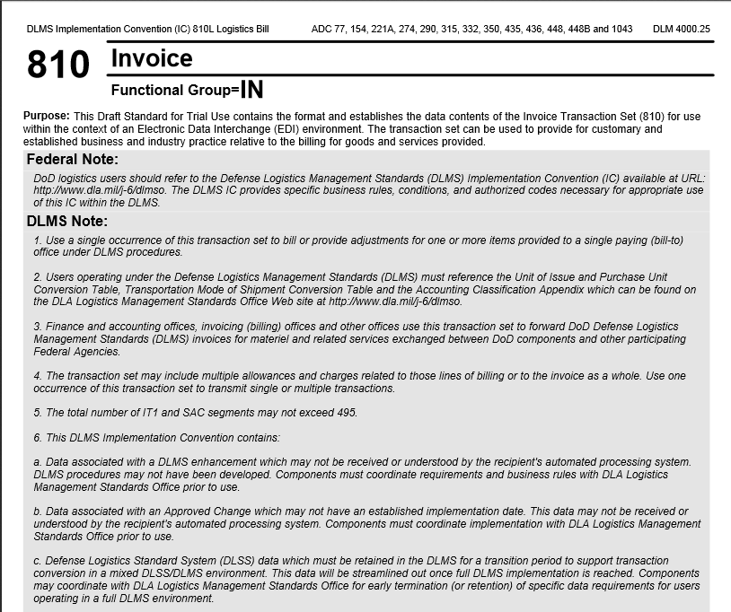
DLMS 810L, Logistics Bill
TRANSACTION SET SECTIONS
PURPOSE: Used to invoice material and equipment from a supply distribution system for immediate consumption or stockage against projected requirements.
TABLE 1, Header Section. Contains information common to all bills such as; transaction type, transaction set control number, code identifying type of bill, date and time, etc.
TABLE 2, Detail Section. Contains detailed data specific to the specific billing transaction. Examples of data in the detail section are; identity of invoicing (billing) office, purchase unit, quantity, currency, who will pay, date, product description, billing address, etc.
TABLE 3, Summary Section. Contains summaries of the details contained in table 2. Most frequently used in financial transactions.
Transaction Set Written Document
Notes:
This is an example of the Logistics bill. The logistics bill contains three tables. Table 1 is the header, table 2 is the detail and table 3 is the summary. This example gives you a feel for the kinds of data segments that are contained within the 810 and it’s three table structure.

Slide 61
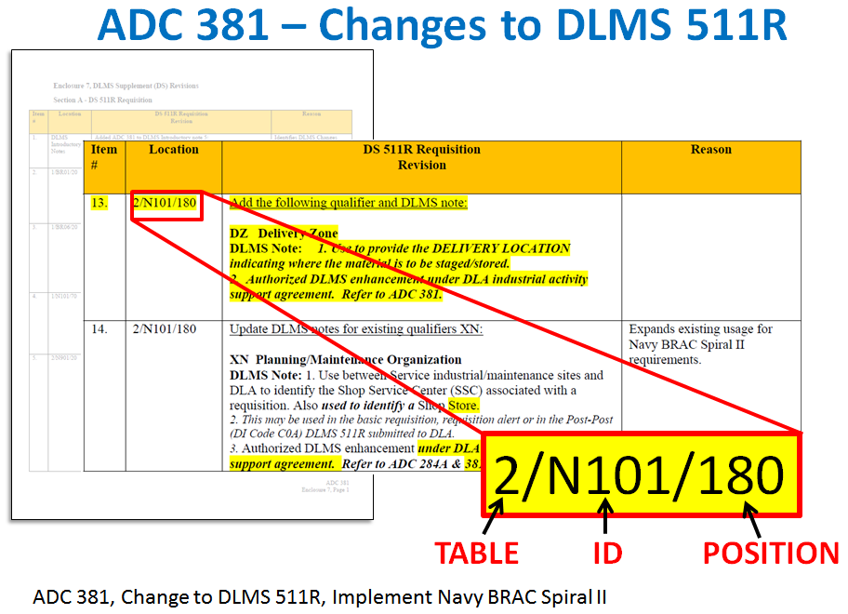
Transaction Set Written Document
Notes:
• One of the reasons the table numbers, segment IDs, positions, etc. are so important is because that is the shorthand used to talk about a specific location within the standard by data element within a specific segment within a transaction set.
• This is an extract from an Approved DLMS Change. The first column is the issue number and the second column is the location within the implementation convention where the change is to be applied. In this example, the change is being made to the 511R, requisition. The change is to a DLMS note in table 2, the N101 data element, at position 180. By using this three-part designation, it is known exactly where in the IC that change is to occur.

Slide 62
MILS vs. DLMS EDI
MILS Format (DLSS)
DLMS EDI Format
RPs | Field Length | Sample Data
01-03 | Document Identifier | A01
04-06 | Routing Identifier | SMS
07 | Media and Status | B
08-22 | Stock Number | 5910001234567
23-24 | Unit of Issue | EA
25-29 | Quantity | 1
30-43 | Document No | FB230093070001
44 | Demand | R
45-50 | Supplementary Address
51 | Signal | A
52-53 | Fund | KZ
54-56 | Distribution
57-59 | Project | 9GF
60-61 | Priority | 08
62-64 | Reqd. Delivery Date | 777
65-66 | Advice | 2A
67-69 | Blank (Date of Rcpt on Referral/Passing Order)
70-80 | Blank (Intra-Service use)
ST*511*00000001^
BR*00*A0*20000729******131708^
N1*OB**10*FB2300**FR^
LX*1^
N9*TN*FB230093070001^
PO1**1*EA***FS*5910001234567^
DD*R*74^
LM*DF^
LQ*0*A01^
LQ*78*9GF^
LQ*79*08^
LQ*80*2A^
LQ*DE*A^
LQ*DF*B^
LQ*AL*777^
N1*Z4**M4*SMS**TO^
FA1*DY*D340^
FA2*B5*KZ^
SE*19*00000001^
Notes:
• Now that we’ve gone through the basics of data elements, segments and transaction sets, we can revisit this graphic to better understand how all the legacy MILS content is contained within the DLMS EDI, just in a different format.
• In this example, the Document number within the requisition is carried in record positions 30 to 43. This same value exists in the EDI formats in the N9 data segment and is the second data element with a TN qualifier in the N901.

Slide 63
Transaction Set Composition
- 511 Requisition -
ST*511*00000001^
BR*00*A0*20000110******131708^
N1*OB**10*FB6012**FR^
LX*1^
N9*TN*N0036793070001^
PO1**1*EA***FS*5910001234567^
DD*R*74^
LM*DF^
LQ*80*2A^
LQ*0*A0A^
LQ*AL*777^
LQ*DF*S^
LQ*DE*A^
LQ*78*XZZ^
LQ*79*02^
LQ*A9*YBLDG1^
LQ*AK*F^
N1*Z4**M4*DMK**TO^
N1*Z1**10*FB6012^
N1*Z1**10*FB6012^
N1*BT**10*FB6012^
FA1*DY*D340^
FA2*B5*KZ^
SE*24*00000001^
Data Segment
Transaction Set
Data Element
Transaction Set Written Document
Notes:
This is an example of a 511 requisition, with examples of the transaction set identification, a data segment and data element highlighted. The variable length record was designed for efficient machine-to-machine exchange. This is not easy to read and honestly that is okay. There will rarely be a need for someone to translate raw EDI data.

Slide 64
Standard File Structure
Interchange
Outer Envelope
Functional Group
Folder
Transaction Set
Written Document
Segment Loop
Paragraph
Data Segment
Sentence
Data
Element
Word
Notes:
Now it’s time to look at the functional group or inner envelope. This would be considered a folder in the writing analogy.

Slide 65
Envelopes
Envelopes are specialized segments that enclose groups of documents or transaction sets
Envelopes provide:
  Verification of proper transmission
  Time and date stamping of transmission
  Routing information
  Version control information
There are two levels of envelopes….
Functional Group Folder
Notes:
Envelopes are literally what the name implies. They are very specialized segments that enclose the transaction sets and provide verification of proper transmission. To verify proper transmission, there is a date/time stamp of transmission in the envelope, routing information and version control information.

Slide 66
Functional Group Envelope
The inner envelope is used to group like documents or transaction sets within a transmission
This envelope is defined by the Functional Group Header (GS) and Functional Group Trailer (GE) segments
  Contains a functional group ID (e.g., RN (511), MD (527))
  Contains transaction set counts and functional group control numbers
  Contains a time/date stamp of when the group was generated
  Provides format, version, and release specifications of the transactions within the group
Functional Group Folder
Notes:
• The first envelope is a functional group envelope, or otherwise known as the inner envelope. The inner envelope begins with a GS segment and ends with a GE segment. Within the inner envelope is where the transaction ID is stored and you can only have the same type of transactions in an inner envelope. So you can't have a mix of 511s and 527s. They have to be all 511s or all 527s. Here is where you convey how many transaction sets are used and what is the functional control number for tracking the envelope.
• The inner envelope contains a date/time stamp for when that envelope was generated and provides format, version and release specifications for the transactions that are in that group.

Slide 67
Functional Group Envelope
Folder = Functional Group
GS*RN*APPSENDERCODE*APPRCVRCODE*20010110*1653*000000044*X*004010D511R0
ST*511*1001
.
.
.
SE*17*1001
GE*3*000000044
=
Functional Group Folder
Notes:
The functional group envelope is the same as a folder. This is where X12 identifies how many documents or transactions are stored inside.

Slide 68
Standard File Structure
Interchange
Outer Envelope
Functional Group
Folder
Transaction Set
Written Document
Segment Loop
Paragraph
Data Segment
Sentence
Data
Element
Word
Notes:
The last part of the file structure is the Interchange Envelope. This would be considered the outer envelope in the writing analogy.

Slide 69
Interchange Envelope
The outer envelope is used to group one or more folders or functional groups within a transmission
This envelope is defined by the Interchange Control Header (ISA) and Interchange Control Trailer (IEA) segments
  Contains the structured mailbox address of the sender and the receiver
  Contains control numbers and counts of the different types of folders or functional groups inside
  Contains a time/date stamp
  Specifies the format and version of the interchange envelopes
  Specifies what characters are being used for data element delimiters (separators) and segment terminators
Interchange Outer Envelope
Notes:
• The outer envelope is the interchange envelope in X12. There are two data segments in the outer envelope: ISA is the header segment and the IEA is the ending segment. This is where the transaction set is addressed with the sender and receiver information, control numbers for the outer envelope, a count of how many functional groups are inside that outer envelope and a date/time stamp.
• The outer envelope also contains critical information about how to interpret all the data within the transaction. This is where the delimiter and terminator characters for the segments are defined.

Slide 70
Interchange Envelope
Envelope = Interchange
DLA ICP
[electronic address]
ISA*00*0000000000*01*HAPPYDAYS2*01*SENDERDUNSNUMBR*01*RECVRDUNSNUMBER*010110*1653*U*00400*000000030*0*P*\
GS...
ST...
.
.
SE...
GE...
IEA*1*123456789^
=
ABC Company
[electronic address]
Interchange Outer Envelope
Notes:
• This is an illustration of how the interchange envelope works. Think of the outer envelope as the envelope used to mail a letter.
• On the right is the X12 transaction. In the first line is the ISA segment, which is the start of the outer envelope level and at the bottom is the IEA to end or close the envelope.

Slide 71
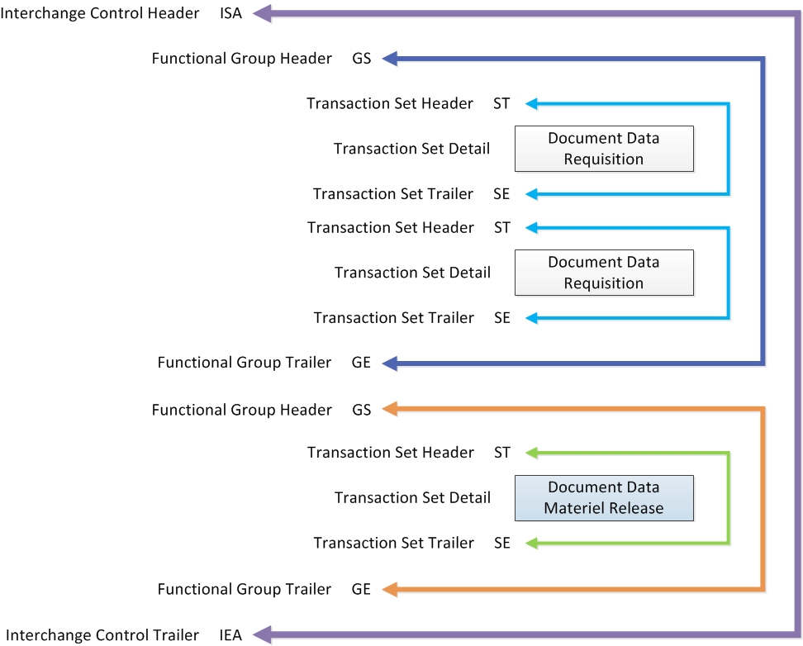
EDI Data Levels
Notes:
• Here is a diagram depicting the relationship of outer envelopes to inner envelopes to individual transaction set headers and trailers.
• The outer purple three-sided box represents the outer envelope. This is readily identifiable as the ISA is the first data segment that you see; the last data segment is the IEA. Inside the outer envelope are two inner envelopes. This known because there are two pairs of GS/GE headers and trailers. The first inner envelope contains two transactions, represented by the two sets of ST/SE transaction headers/trailers. The detail is titled document data requisitions, so this indicates a 511 transaction.
• The second inner envelope contains only one transaction since there is only one ST/SE data segment pair; the detail is marked as materiel release data, so this is a 940 transaction.
• One additional observation to note is that each inner envelope only has similar transaction sets. The first inner envelope has two 511 requisitions. The second inner envelope has one 940 materiel release transaction. You can combine 511 and 940 transactions in a single inner envelope.
• In summary, there are three transaction sets we're sending, the two 511s in the first inner envelope and one 940 material release is in the second inner envelope. Both of those inner envelope folders are wrapped in an interchange envelope.

Slide 72
Module 2 Summary
What’s been covered:
  The components and structure of EDI
    Data Elements
    Data Segments
    Segment Loops
    Transaction Sets
    Functional Groups
    Interchange Groups
Notes:
Summary of training. This module reviewed data elements, data segments, segment loops, transaction sets, functional groups and interchange groups.

Slide 73
Data Element within a
Data Segment
Data Element
Reference Designator
Data Element
Identification Number
N101
98
Entity
Identifier
Code
Data Element
Name
M
ID
2/3
MIN / MAX
Data Element
Requirement Designator
Data Element
Type – “Identifier”
Notes:
We began with the data element and learned its basic attributes. We discussed how data elements are grouped to form a data segment. And then we saw how data segments were grouped to form the transaction set.

Slide 74
Transaction Table Diagram
511 Requisition Functional Group: RN
This Draft Standard for Trial Use contains the format and establishes the data contents of the Requisition Transaction Set (511) for use within the context of an Electronic Data interchange (EDI) environment.
Heading:
Pos No Seg ID Name Req Des Max Use Loop Repeat
10 ST Transaction Set Header M 1
20 BR Beginning Segment M 1
. . . . .
Detail:
Loop ID-LX >1
10 LX Assigned Number O
20 N9 Reference Identification M >1
. . . . .
. . . . .
Loop ID-LM 50
270 LM Code Source Information 0 1
280 LQ Industry Code M 100
Notes:
We looked at the structure of the transaction set, covering techniques for managing data such as max use, loops, and nested loops.
And we briefly discussed enveloping structures.

Slide 75
Module 2 Quiz
Question 1: Which of the EDI Components is equivalent to a written document?
    Interchange groups
    A novel
    Transaction set
Question 2: The three types of segment level notes are:
a) Fictional
b) Syntax
c) Comments
d) Semantic
Question 3: Using pages from the X12 511R handout, describe the meaning of the following X12 string of characters:
a) N1*Z4**M4*DMK**TO^
b) 2/N101/180
c) PO1**1*EA***FS*5910001234567^
d) N9*TN*FB230093070001^

Slide 76
End of Module 2

