Slide 1
Web Fund Code
by Bob Hammond
Chair, Finance Process Review Committee
Robert.hammond@dla.mil 703-767-21171

Slide 2
Web Fund Code Purpose
Facilitate legacy and future processes
Support Treasury Account Symbol (TAS) & SFIS/SLOA; add key data elements to SFIS Fund Code to Fund Account Conversion Table
Enhance edits to improve financial processes; improve audit readiness
Facilitate real time update of fund codes by Fund Code Monitors
Allow for staging fund codes for future effective dates
Replace email distribution of fund code updates with system-to-system synchronization
DLA has completed this; working with other Components & Agencies
Notes:
Narrator:
The developers of MILS in the 1960s were brilliant in conveying essential data within the 80 record position punch card technology limitations that existed at the time. Key to this success is the single character signal code that identifies both the bill-to activity and the ship-to activity in a requisition, which can be the requisitioner in legacy MILS record positions 30 through 35 or the supplementary address in legacy MILS record positions 45 through 50.
The MILS developers also enabled the capability to designate a third party (typically a DFAS Center) as the bill-to party by having the fund code do double duty. We call this “third party billing.” In the case of Signal Codes C and L shown here, the Fund Code determines both the chargeable appropriation and the bill-to party. It is the service code of the requisitioner that determines the correct portion of the table to use to identify the bill-to party and the service code of the bill-to party that determines the appropriation.
Of course in DLMS, we are able to designate the requisitioner, bill-to party, ship-to party and line of accounting as discrete data elements without relying on the signal code and Fund Code. Let’s see how this works using a MILS format example.
Here, we have an Army requisitioner identified in MILS record positions 30-35, with Signal Code C, which says to ship the materiel to the requisitioner and determine the bill-to party billing using fund code 21 in the Army portion of the Fund Code to Billed DoDAAC Table for Army Service Code W. Fund Code 21 will also give us the appropriation chargeable, but we first need to determine the bill-to party.

Slide 3
Web Fund Code Module Structure
Finance Concepts
SFIS
SLOA
Fund Code
Multi-year Appropriations
DoD Agency Fund Codes
DAAS Edits
Web Fund Code Entry
FCA (Fund Code to Fund Account)
FCB (Fund Code to Billed DoDAAC)
Web Fund Code Business Rule Checks
Quiz
Notes:
Narrator:
This module starts with an overview of DLMS Governance and a review of the three DLMS financial transactions
The Finance concepts begin with a discussion of financial relevant events in the requisition lifecycle which concludes with bill payment. Then we will take a closer look at the DLMS 810L billing transaction flow, and the billing adjustment flows using the DLMS 812R and 812L.
We will see how DLMS supports auditability, business process improvement, and DOD strategic initiatives, including Standard Financial Information Structure, or SFIS, and Standard Line of Accounting, or SLOA, which cannot be done in a MILS 80 record position transaction.
Next we will see how two DLMS coded elements, the Signal Code and Fund Code, work together with the bill-to party DoDAAC, enabling legacy MILS implementations to exchange line of accounting data and achieve a minimum level of auditability.
This is followed by an overview of the Web Fund Code Application, which automates fund code maintenance and improves the timeliness and accuracy of appropriation data in transactions.
Next is an explanation of DoDAAC authority codes and routing rules and how they impact billing, followed by short overview of Select DAAS Web-Enabled Applications that provide information that is germane to DLMS financial transactions
Then, there is a brief overview of DLMS Electronic Data Interchange Concepts followed by a detailed review of the 810L Logistic Bill to tie everything together.
Finally, there is a short quiz to refresh what we have learned.

Slide 4
Financial Concepts Standard Financial Information Structure (SFIS)
Common Business Language of DOD supporting information and data requirements for budgeting, financial accounting, cost/performance management, and external reporting across the enterprise:
Standardizes financial reporting across DOD
Allows revenues and expenses to be reported by programs that align with major goals versus by appropriation categories
Enables decision-makers to efficiently compare programs and their associated activities and costs across DOD
Provides a basis for common valuation of DOD programs, assets, and liabilities
Notes:
Narrator:
The Standard Financial Information Structure is the common business language that DOD has developed to support the information and data requirements needed to perform budgeting, financial accounting, cost/performance management, and external reporting across the enterprise:
The SFIS standardizes financial reporting across DOD, establishing the standard terms, definitions, data elements and codes to be used for financial reporting.
The implementation of SFIS also allows revenues and expenses to be reported by programs that align with major goals, rather than just by appropriation categories.
Decision-makers are empowered with information to efficiently compare programs and their associated activities and costs across DOD.
Lastly, SFIS provides a basis for common valuation of DOD programs, assets, and liabilities.

Slide 5
Financial Concepts Enforcing SFIS Through the BEA and IRB
Part of the DOD Business Enterprise Architecture (BEA) managed by Office of Deputy Chief Management Office (ODCMO)
Investment Review Board (IRB) compliance requirement for target systems (e.g. Enterprise Resource Systems and feeder systems with financial implications)
For more SFIS resources & information go to:
http://dcmo.defense.gov/products-and-services/standard-financial-information-structure/
Notes:
Narrator:
The SFIS (like the DLMS) is an enterprise standard within the DOD Business Enterprise Architecture (or BEA) managed by Office of Deputy Chief Management Office (or DCMO).
The Investment Review Board ensures compliance as part of program milestone decision and funding approval for major systems. SFIS is applicable to target systems, which include both Enterprise Resource Systems and feeder systems with financial implications.
Additional SFIS resources & information is available on the DCMO website.

Slide 6
Financial Concepts Standard Line of Accounting (SLOA)
Joint Deputy Chief Management Officer and Under Secretary of Defense (Comptroller) Chief Financial Officer memorandum issued on September 14, 2012
SLOA reuses many SFIS elements, and added some new ones to BEA for SFIS compliance
SLOA can only be fully achieved by using DLMS variable length transactions
Goals are to:
Improve financial information
Improve interoperability between business systems
Provide better end-to-end funds traceability
Improve linkage between budget and expenditures
Comply with new Treasury requirements
Achieve audit readiness through business process reengineering
Notes:
Narrator:
The Standard Line of Accounting, or SLOA as it is more commonly known, was mandated in a memorandum issued on September 14, 2012. The SLOA prescribes specific SFIS data elements used for the line of accounting.
Full SLOA implementation can only be achieved by using DLMS. The old MILS based transactions cannot carry all the information. The DLMS variable length transactions can carry the additional information needed to meet the goals set by SLOA, which include:
Improved finance information
Improved interoperability between business systems
Better end-to-end funds tractability
Improved linkage between budget and expenditures
Compliance with new Treasury requirement, and
Achieving Audit Readiness through business process reengineering.

Slide 7
Financial Concepts DLMS Support of SFIS & SLOA
The vast majority of logistics business events and DLMS transactions have a financial implication
DLMS Implementation Conventions support the “Target Environment” exchange of SLOA data elements as discrete data
Major process and systems changes will be required where the customer’s order is initiated outside the Service-sponsored ordering system
Notes:
Narrator: Most logistics business events have financial implications. SLOA and SFIS support the exchange of discrete data elements, which supports the collection of costs across the department for the purchasing of products and services, thereby improving financial management tracking. But, major process and system changes are required to both logistics and financial systems in order to reap the benefits.

Slide 8
SLOA Elements
Financial Concepts
NAME (Max Length)
Department Transfer (3)
Department Regular (3)
Beginning Period of Availability FY Date (4)
Ending Period of Availability FY Date (4)
Availability Type (1)
Main Account (4)
Sub Account (3)
Sub-Allocation (formerly known as Limit) (4)
Sub Class (2) (not currently used)
Business Event Type Code (8)
Object Class (6)
Reimbursable Flag (1)
Budget Line Item (16)
NAME (Max Length)
Security Cooperation Customer Code (3)
Security Cooperation Case Designator (4)
Security Cooperation Case Line Item Identifier (3)
Agency Disbursing Identifier Code (8)
Agency Accounting Identifier (6)
Funding Center Identifier (16)
Cost Center Identifier (16)
Project Identifier (25)
Activity Identifier (16)
Cost Element Code (16)
Work Order Number (16)
Functional Area (16)
Security Cooperation Implementing Agency (1)
* May be derived from SFIS Fund Code to Fund Account Conversion Table
Notes:
Narrator: The SLOA data elements are shown here. Highlighted data elements are available referentially from the SFIS Fund Code to Fund Account Conversion Table, enabling exchange of the minimum date elements essential for Interfund billing and Treasury reporting in both a legacy 80 record position MILS environment and in DLMS. Let’s take a look at how the fund code process works.

Slide 9
Financial Concepts – Fund Code
DLM 4000.25-M, Volume 4, Military Standard Billing System (MILSBILLS) prescribes use of Fund Code
The fund code and other data in a requisition, in conjunction with the Fund Code Tables:
Identifies the appropriation chargeable or non-interfund billing. The service code of the billed office DoDAAC determines the section of the table for identifying the appropriation chargeable.
Identifies the bill-to party (billed office) when the signal code is “C” or “L”. The service code of the requisitioner DoDAAC determines the section of the table for identifying the billed DoDAAC.
Limits use for Defense Agencies to specific DoDAACs
Each Service and Agency has appointed fund code monitors to assign and manage it’s series of fund codes via the Web Fund Code Application.
Official “authoritative” Fund Code Tables maintained by DAAS
Notes:
Narrator: The two record position Fund Code identifies the chargeable appropriation for the bill-to party in a logistics transaction. The service code, (or first position) of the bill-to DoDAAC, determines the correct section of the SFIS Fund Code to Fund Account Conversion table to use. In addition, the fund code may also designate the bill-to DoDAAC based on the service code of the requisitioner. Only a limited number of Federal agency DoDAACs are authorized to use interfund billing. Each Service and Agency has appointed fund code monitors to establish and maintain their fund codes using a controlled, web application at DAAS. Let’s see how this works.

Slide 10
Financial Concepts Fund Code
Concept
Combination of Signal Code, DoDAAC and Fund Code provides:
A line of accounting for interfund billing
Identity of a bill-to party
Signal Code
Identifies both the ship-to party and the bill to party
Bill-to party may be:
Requisitioning DoDAAC (Signal Code A or J)
SUPPAD DoDAAC (Signal Code B or K)
DoDAAC Identified by the Fund Code (Signal Code C or L)
Fund Code Tables
Fund Code to Fund Account Conversion Table
Fund Code to Billed Office DoDAAC Conversion Table
Table of H Series DoDAACs Authorized Interfund Billing
Notes:
Narrator:
Let’s review what we have learned about fund codes and introduce one more table.
First, in a DLMS variable length transaction we can identify the requisitioner, ship-to party and bill-to party as discrete data elements and we can also identify the discrete data elements for the line of accounting.
In MILS, the combination of Signal Code, DoDAAC and Fund Code:
Identifies a line of accounting for interfund billing or specifies non-interfund billing;
Identifies the bill-to party
The Signal Code:
Identifies both the ship-to party and the bill to party
The bill-to party may be:
The Requisitioning DoDAAC (Signal Code A or J);
The DoDAAC in the Supplementary Address (Signal Code B or K); or
The DoDAAC identified by the Fund Code (Signal Code C or L)
There are three Fund Code Tables:
Fund Code to Fund Account Conversion Table (MILSBILLS APP 1.1)
Fund Code to Billed Office DoDAAC Conversion Table (MILSBILLS APP 1.2)
Table of H Series DoDAACs Authorized Interfund Billing (MILSBILLS APP 1.3)

Slide 11
Financial Concepts Fund Code
APPENDIX AP1.1.A
BILLED SERVICE CODE = A,C,W (ARMY)
1. SIGNAL CODE IS A, B, J, OR K:
FUND DPT F MAIN APP DPT SUB TRY BEG END L A AGENCY NARRATIVE EFF ACT
CODE REG Y ACCT LIM TRN ACT SUB POA POA E T DATE CDE
CDE R CODE SUB CDE CDE CLS YEAR YEAR G C
01 021 # 2020 000 F 2014066 CHG
03 021 0 2040 000 2010 2011 F 1986314 ADD
DD 097 X 1030 18E1 019 000 F X 2014037 ADD
2. SIGNAL CODE IS C OR L:
2P BILL VIA NONINTERFUND 2010181 ADD
2C 021 # 2035 000 T 1986314 ADD
21 021 # 2020 000 F 2014066 CHG
YT 021 # 1082 011 000 F 2014108 CHG
APPENDIX AP1.1.F
BILLED SERVICE CODE = D,E,F (AIR FORCE)
1. SIGNAL CODE IS A, B, J, OR K:
Notes:
Narrator:
The Fund Code to Fund Account Conversion Table, or MILSBILLS Appendix 1.1, is grouped by billed service code group and by signal code group within each service code.
Here are the two examples discussed earlier for fund code 21 and 2P.
On the table following the Army billed service codes under AP1.1.A, the table moves to Air Force billed service codes under AP1.1.F.

Slide 12
Financial Concepts Fund Code
AP1.2 APPENDIX 1.2.
FUND CODE TO BILLED OFFICE DODAAC CONVERSION TABLE (as of May 1, 2014) FUND (The authoritative source table is located at the DAAS)
Fund Code Billing Address DoDAAC Eff Date/Action
APPENDIX AP1.2.A
REQUISITIONING SERVICE CODE = A,C,W (ARMY)
FUND BILLING
CODE ADDRESS DODAAC
2P DFAS COLUMBUS 23204 W58RG0 1989121 ADD
DFAS JDCBB CO
PO BOX 182559
COLUMBUS OH 43218-2316
FUND BILLING
CODE ADDRESS DODAAC
21 DFAS COLUMBUS 23204 W58RG0 2010242 ADD
DFAS JDCBB CO
PO BOX 182559
COLUMBUS OH 43218-2559
APPENDIX AP1.2.B
REQUISITIONING SERVICE CODE = B (ARMY)
How it works:
Send bill to DFAS
Get DFAS DoDAAC
Use LOA from AP1.1
2P BILL VIA NON-INTERFUND
21 021 # 2020
Notes:
Narrator:
In the case of signal codes C or L the fund code does double duty, also providing the bill-to party of the requisitioning Service Code.
In both examples here the requisitioner was Army Service Code W and the bill-to party is DFAS Columbus with DoDAAC W58RG0, which is also an Army Service Code.
We would use MILSBILLS Appendix 1.1 with Army bill-to Service Code W to determine the line of accounting or non-interfund billing.

Slide 13
Financial Concepts Multi-year Appropriations
The fund code table may cite # (use - Req’n date) or * (use - Bill date) to compute beginning and ending periods of availability
This allows the same fund code to be reused each year
Works well for a single year appropriation where the beginning and ending POA are the same fiscal year
Prone to error for multi-year appropriations
DAAS is unable to validate or populate from MILS to DLMS
Seller may report POA incorrectly; Buyer must adjust his funds transfer LOA at Treasury
Web Fund Code has a Multi-year to Indicator identify applicable fund codes as Multi-year: True or False
Full DLMS implementation of SLOA by all will resolve this
Notes:
Narrator:
The fund code table may cite # (use - Requisition date) or * (use - Bill date) to compute beginning and ending periods of availability.
Since the fund code is only two characters in length, there are only 1296 possible fund code combinations for each service code. Using the hash tag or asterisk allows the same fund code to be reused each year so that Components do not exhaust the number of available fund codes.
This convention works well for a single year appropriation where the beginning and ending Periods of Availability are the same fiscal year.
However, this convention is prone to error for multi-year appropriations. In the case of the hash tag (#), the Seller’s billing system will select the current fiscal year as the beginning period of availability and ending period of availability is determined by the length of the appropriation for the Treasury appropriation main account. DAAS is unable to determine the correct periods of availability for editing or populating them from legacy MILS transactions into discrete DLMS data elements.
Thus, the Seller may report the beginning and ending periods of availability for the main account incorrectly. The Buyer’s Central Accounts Office must then adjust the beginning period of availability and ending period of availability associated with funds transfer at Treasury.
To identify which fund codes using the hashtag or asterisk are multi-year appropriations Web Fund Code has a Multi-year to Indicator identify applicable fund codes as Multi-year either True or False.
Since the beginning and ending periods of availability are discrete data elements in DLMS, full DLMS implementation of SLOA by all DoD trading partners will resolve this.

Slide 14
Financial Concepts Multi-year Appropriation Adjustment
BILLED SERVICE CODE = A,C,W (ARMY)
1. SIGNAL CODE IS C, L:
*FUND ACCOUNT*
FUND DPT F MAIN APP DPT SUB TRY BEG END L A AGENCY NARRATIVE EFF ACT
CODE REG Y ACCT LIM TRN ACT SUB POA POA E T DATE CDE
CDE R CODE SUB CDE CDE CLS YEAR YEAR G
2C 021 # 2035 000 T 1986314 ADD
Notional Billing Adjustment at Treasury
(Department Code 021)
Appropriation Reimbursements Disbursements
21 2005 2007 2035 000 .00 -143,216.28
21 2007 2009 2035 000 00 55,848.27
21 2008 2010 2035 000 00 191,193.53
21 2009 2011 2035 000 00 364,775.27
21 2010 2012 2035 000 00 1,387,974.05
21 2011 2013 2035 000 00 -2,682,147.90
** For a bill in 2007, which appropriation applies?
Notes:
Narrator:
Let’s look at a notional example of a central accounts office correcting the Buyer side funds transfer at Treasury.
We see that if Army fund code 2C is used, the hashtag is entered as the fiscal year indicator. So, the beginning period of availability will be computed by the Seller’s billing system from the Julian date of the requisitions. There are no entries in the Fund Code Appropriation Table for beginning and ending periods of availability and the legacy fiscal year indicator is T or True to note that this is a multi-year appropriation.
DAAS will be unable to validate any periods of availability entered as discrete data elements in an incoming DLMS transaction or to populate the beginning and ending periods from an incoming MILS transaction that is being passed to a DLMS trading partner. If the Buyer requisition is submitted as a DLMS transaction with the correct beginning and ending periods of availability as discrete data elements, and if the Seller’s bill perpetuates the Buyer’s beginning and ending periods of availability, funds transfer at Treasury will be reported correctly.
In the notional example shown here, the Army Central Accounts Office is adjusting the beginning and ending period of availability at Treasury for main account 2035 that were incorrectly reported to Treasury by the Seller’s CAO.
DLMS implementation by all trading partners and DFAS centers will resolve this issue. In the interim, Components may consider if there are sufficient fund codes to assign a unique fund code for each new multi-year appropriation. Thus, there would be one fund code for 2005-2007 and a different fund code for 2007 to 2009, etc.

Slide 15
Financial Concepts DoD Agency Fund Codes
AP1.3 APPENDIX 1.3
TABLE OF H SERIES DoDAACS AUTHORIZED INTERFUND BILLING (as of May 1, 2014)
(The authoritative source table is located at the DAAS)
DODAAC BILL-TO ADDRESS
H91253 FINANCE AND ACCOUNTING OFFICE
MENWITH STATION
APO AE 09468
H98230 FINANCE AND ACCOUNTING OFFICE
9800 SAVAGE ROAD
ATTN BF211
FORT MEADE MD 20755-6000
DAAS edits prevent Interfund billing to unauthorized DoDAACs.
Notes:
Narrator:
This shows an excerpt of MILSBILLS Appendix 1.3 for H Series DoDAACs that are authorized to use interfund billing
Requisitions and bills citing interfund billing for H Series Defense Agency DoDAACs that are not listed in this table will be rejected by DAAS edits.

Slide 16
Financial Concepts DAAS Fund Code Edits
Transactions with Signal Code C/L that do not have a fund code on the Fund Code to Billed Office DoDAAC Conversion Table for that Service Code will reject
Under Standard Line of Accounting (SLOA) ADC 1043 Series, SLOA data will be inserted from the Fund Code to Fund Account Conversion Table into select DLMS transactions where it is missing; transactions containing SLOA data that does not match fund code data will reject
Transactions citing an invalid fund code for Signal Codes A, B, J, K were not previously edited, but will now fail SLOA edits
Transactions for H Series bill-to DoDAACs not on the Table of H Series DoDAACs Authorized Interfund Billing citing other than Fund Code XP (non-interfund) will reject
Notes:
Narrator:
Logistics transactions with Signal Code C or L that do not have a fund code on the Fund Code to Billed Office DoDAAC Conversion table for a Service have always been rejected, because DAAS is unable to determine the bill-to party in order to route the bills.
A new edit will validate the fund code on the SFIS Fund Code to Fund Account Conversion table for Signal Codes A, B, J, and K, as well as C and L.
Since all MILS transactions and many DLMS transactions are not currently SLOA compliant, SLOA data will be inserted where it is missing from the Fund Code to Fund Account Conversion Table into select DLMS transactions during DAAS processing. Additionally, DLMS transactions containing SLOA data that does not match the fund code in the transaction will fail DAAS edits and be rejected back to the transmitter. As part of this edit, a fund code that is not valid on the SFIS Fund Code to Fund Account Table for the bill-to Service Code will reject. Note that DAAS edits cannot determine if the correct fund code is used in the transaction, only that it is a valid fund code for the Component.
Transactions for H series Service Codes that are not authorized Interfund billing as identified on the Table of H Series DoDAACs Authorized Interfund Billing will reject if a fund code citing interfund billing is used. The only fund code currently authorized for non-Interfund billing by Defense Agencies is “XP”.

Slide 17
Web Fund Code
Web Application used by Component Fund Code Monitors appointed in writing to maintain fund codes in real time
Facilitates legacy and future processes
Supports Treasury Account Symbol (TAS) & SFIS/SLOA for key data elements added to SFIS Fund Code to Fund Account Conversion Table
Enhances edits to improve financial processes and audit readiness
Allows for staging fund codes for future effective dates
Facilitates replacing email distribution of fund code updates with near real-time system-to-system synchronization
Notes:
Narrator:
The web application used by Component Fund Code Monitors allows changes to fund codes in near real time. The application facilitates legacy and future processing, providing key SFIS/SLOA data elements needed for billing and Treasury reporting.
The application also improves financial process, facilitates additional edits to improve data accuracy and enhance audit readiness. The system supports future effective dates, so changes can be added into the database that will not go into effect until a certain date is reached. This is particularly useful at the start of a new fiscal year.
The fund code database is available for system-to-system synchronization, replacing the need to email updates to the users of the data.

Slide 18
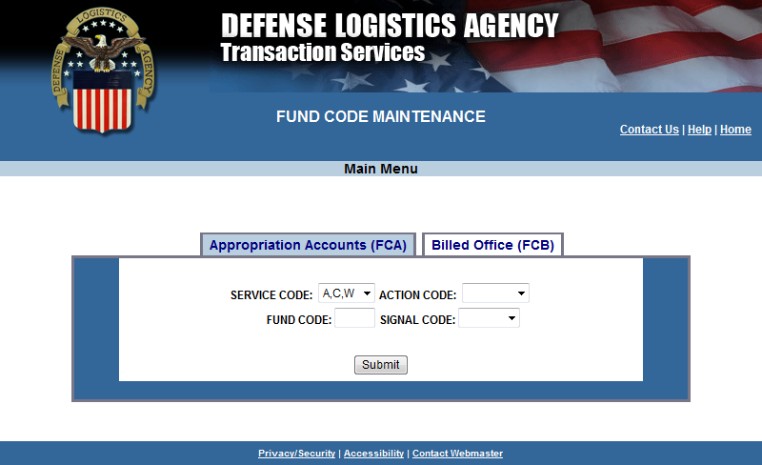
Main FCA Page
Notes:
Narrator:
The web application used by Component Fund Code Monitors allows changes to fund codes in near real time. The application facilitates legacy and future processing, providing key SFIS/SLOA data elements needed for billing and Treasury reporting.
The application also improves financial process, facilitates additional edits to improve data accuracy and enhance audit readiness. The system supports future effective dates, so changes can be added into the database that will not go into effect until a certain date is reached. This is particularly useful at the start of a new fiscal year.
The fund code database is available for system-to-system synchronization, replacing the need to email updates to the users of the data.

Slide 19
FCA – Service Code
Notes:
Narrator:
The web application used by Component Fund Code Monitors allows changes to fund codes in near real time. The application facilitates legacy and future processing, providing key SFIS/SLOA data elements needed for billing and Treasury reporting.
The application also improves financial process, facilitates additional edits to improve data accuracy and enhance audit readiness. The system supports future effective dates, so changes can be added into the database that will not go into effect until a certain date is reached. This is particularly useful at the start of a new fiscal year.
The fund code database is available for system-to-system synchronization, replacing the need to email updates to the users of the data.

Slide 20
FCA - Action Code
Notes:
Narrator:
The web application used by Component Fund Code Monitors allows changes to fund codes in near real time. The application facilitates legacy and future processing, providing key SFIS/SLOA data elements needed for billing and Treasury reporting.
The application also improves financial process, facilitates additional edits to improve data accuracy and enhance audit readiness. The system supports future effective dates, so changes can be added into the database that will not go into effect until a certain date is reached. This is particularly useful at the start of a new fiscal year.
The fund code database is available for system-to-system synchronization, replacing the need to email updates to the users of the data.

Slide 21
FCA - Signal Code
Notes:
Narrator:
The web application used by Component Fund Code Monitors allows changes to fund codes in near real time. The application facilitates legacy and future processing, providing key SFIS/SLOA data elements needed for billing and Treasury reporting.
The application also improves financial process, facilitates additional edits to improve data accuracy and enhance audit readiness. The system supports future effective dates, so changes can be added into the database that will not go into effect until a certain date is reached. This is particularly useful at the start of a new fiscal year.
The fund code database is available for system-to-system synchronization, replacing the need to email updates to the users of the data.

Slide 22
FCA – Add (Legacy Multi-Year Indicator)
Notes:
Narrator:
The web application used by Component Fund Code Monitors allows changes to fund codes in near real time. The application facilitates legacy and future processing, providing key SFIS/SLOA data elements needed for billing and Treasury reporting.
The application also improves financial process, facilitates additional edits to improve data accuracy and enhance audit readiness. The system supports future effective dates, so changes can be added into the database that will not go into effect until a certain date is reached. This is particularly useful at the start of a new fiscal year.
The fund code database is available for system-to-system synchronization, replacing the need to email updates to the users of the data.

Slide 23
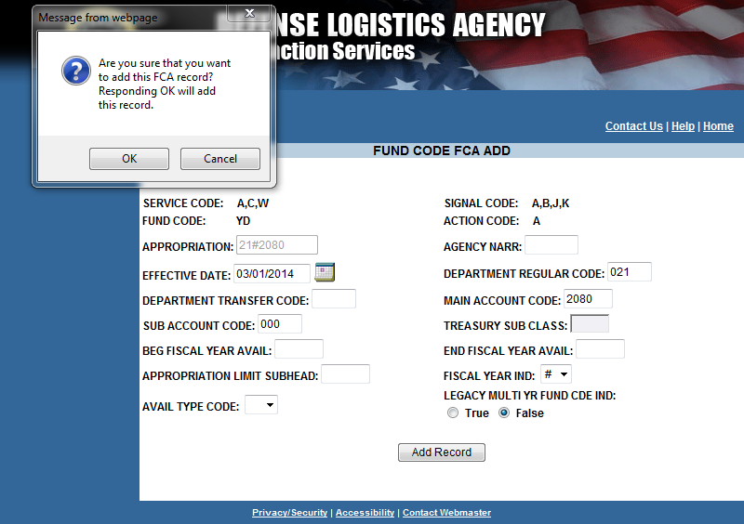
FCA – Add Successful (Legacy Multi-Year Indicator)
Notes:
Narrator:
The web application used by Component Fund Code Monitors allows changes to fund codes in near real time. The application facilitates legacy and future processing, providing key SFIS/SLOA data elements needed for billing and Treasury reporting.
The application also improves financial process, facilitates additional edits to improve data accuracy and enhance audit readiness. The system supports future effective dates, so changes can be added into the database that will not go into effect until a certain date is reached. This is particularly useful at the start of a new fiscal year.
The fund code database is available for system-to-system synchronization, replacing the need to email updates to the users of the data.

Slide 24
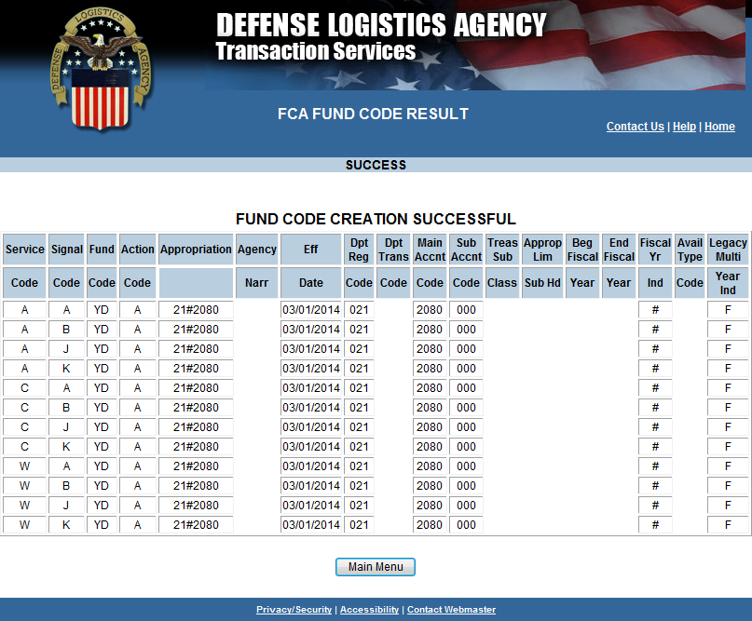
FCA – Add Successful (Legacy Multi-Year Indicator)
Notes:
Narrator:
The web application used by Component Fund Code Monitors allows changes to fund codes in near real time. The application facilitates legacy and future processing, providing key SFIS/SLOA data elements needed for billing and Treasury reporting.
The application also improves financial process, facilitates additional edits to improve data accuracy and enhance audit readiness. The system supports future effective dates, so changes can be added into the database that will not go into effect until a certain date is reached. This is particularly useful at the start of a new fiscal year.
The fund code database is available for system-to-system synchronization, replacing the need to email updates to the users of the data.

Slide 25
FCA – Add (Availability Type Code “X”)
Notes:
Narrator:
The web application used by Component Fund Code Monitors allows changes to fund codes in near real time. The application facilitates legacy and future processing, providing key SFIS/SLOA data elements needed for billing and Treasury reporting.
The application also improves financial process, facilitates additional edits to improve data accuracy and enhance audit readiness. The system supports future effective dates, so changes can be added into the database that will not go into effect until a certain date is reached. This is particularly useful at the start of a new fiscal year.
The fund code database is available for system-to-system synchronization, replacing the need to email updates to the users of the data.

Slide 26
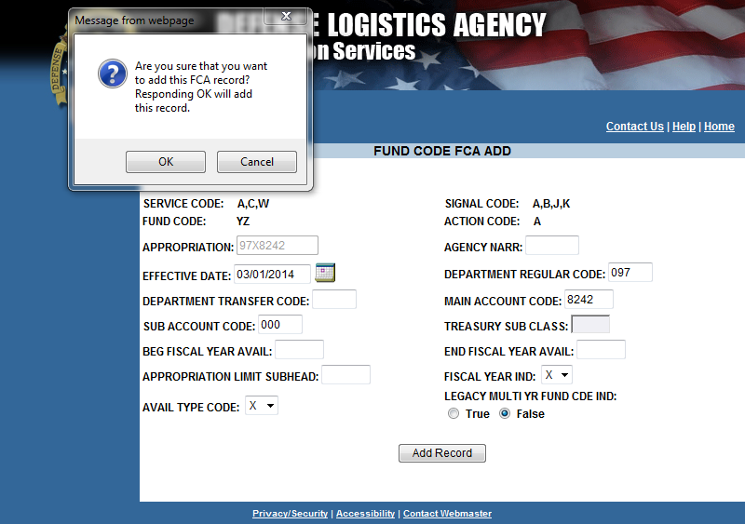
FCA – Add Confirmation (Availability Type Code “X”)
Notes:
Narrator:
The web application used by Component Fund Code Monitors allows changes to fund codes in near real time. The application facilitates legacy and future processing, providing key SFIS/SLOA data elements needed for billing and Treasury reporting.
The application also improves financial process, facilitates additional edits to improve data accuracy and enhance audit readiness. The system supports future effective dates, so changes can be added into the database that will not go into effect until a certain date is reached. This is particularly useful at the start of a new fiscal year.
The fund code database is available for system-to-system synchronization, replacing the need to email updates to the users of the data.

Slide 27
FCA – Add Successful (Availability Type Code “X”)
Notes:
Narrator:
The web application used by Component Fund Code Monitors allows changes to fund codes in near real time. The application facilitates legacy and future processing, providing key SFIS/SLOA data elements needed for billing and Treasury reporting.
The application also improves financial process, facilitates additional edits to improve data accuracy and enhance audit readiness. The system supports future effective dates, so changes can be added into the database that will not go into effect until a certain date is reached. This is particularly useful at the start of a new fiscal year.
The fund code database is available for system-to-system synchronization, replacing the need to email updates to the users of the data.

Slide 28
FCA – Add (Beg & End Availability Dates)
Notes:
Narrator:
The web application used by Component Fund Code Monitors allows changes to fund codes in near real time. The application facilitates legacy and future processing, providing key SFIS/SLOA data elements needed for billing and Treasury reporting.
The application also improves financial process, facilitates additional edits to improve data accuracy and enhance audit readiness. The system supports future effective dates, so changes can be added into the database that will not go into effect until a certain date is reached. This is particularly useful at the start of a new fiscal year.
The fund code database is available for system-to-system synchronization, replacing the need to email updates to the users of the data.

Slide 29
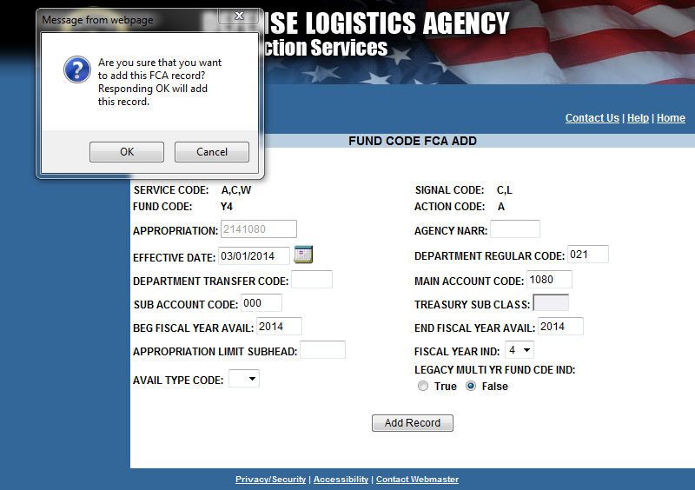
FCA – Add Confirmation (Beg & End Availability Dates)
Notes:
Narrator:
The web application used by Component Fund Code Monitors allows changes to fund codes in near real time. The application facilitates legacy and future processing, providing key SFIS/SLOA data elements needed for billing and Treasury reporting.
The application also improves financial process, facilitates additional edits to improve data accuracy and enhance audit readiness. The system supports future effective dates, so changes can be added into the database that will not go into effect until a certain date is reached. This is particularly useful at the start of a new fiscal year.
The fund code database is available for system-to-system synchronization, replacing the need to email updates to the users of the data.

Slide 30
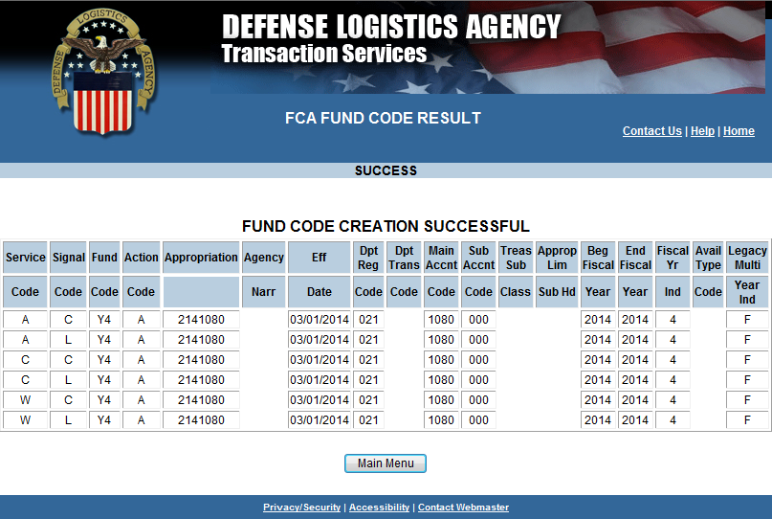
FCA – Add Successful (Beg & End Availability Dates)
Notes:
Narrator:
The web application used by Component Fund Code Monitors allows changes to fund codes in near real time. The application facilitates legacy and future processing, providing key SFIS/SLOA data elements needed for billing and Treasury reporting.
The application also improves financial process, facilitates additional edits to improve data accuracy and enhance audit readiness. The system supports future effective dates, so changes can be added into the database that will not go into effect until a certain date is reached. This is particularly useful at the start of a new fiscal year.
The fund code database is available for system-to-system synchronization, replacing the need to email updates to the users of the data.

Slide 31
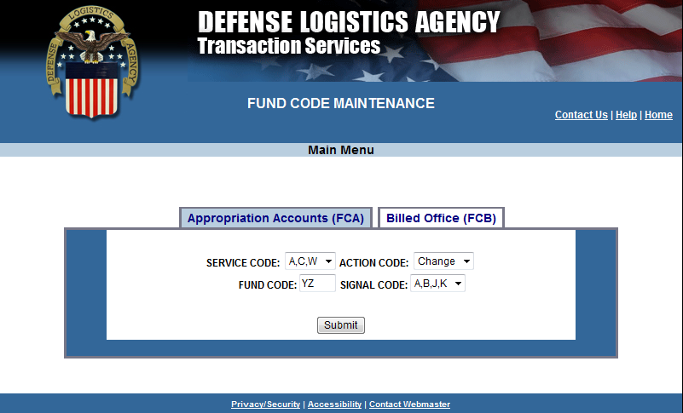
FCA - Change
Notes:
Narrator:
The web application used by Component Fund Code Monitors allows changes to fund codes in near real time. The application facilitates legacy and future processing, providing key SFIS/SLOA data elements needed for billing and Treasury reporting.
The application also improves financial process, facilitates additional edits to improve data accuracy and enhance audit readiness. The system supports future effective dates, so changes can be added into the database that will not go into effect until a certain date is reached. This is particularly useful at the start of a new fiscal year.
The fund code database is available for system-to-system synchronization, replacing the need to email updates to the users of the data.

Slide 32
FCA – Confirm Change Edit
Notes:
Narrator:
The web application used by Component Fund Code Monitors allows changes to fund codes in near real time. The application facilitates legacy and future processing, providing key SFIS/SLOA data elements needed for billing and Treasury reporting.
The application also improves financial process, facilitates additional edits to improve data accuracy and enhance audit readiness. The system supports future effective dates, so changes can be added into the database that will not go into effect until a certain date is reached. This is particularly useful at the start of a new fiscal year.
The fund code database is available for system-to-system synchronization, replacing the need to email updates to the users of the data.

Slide 33
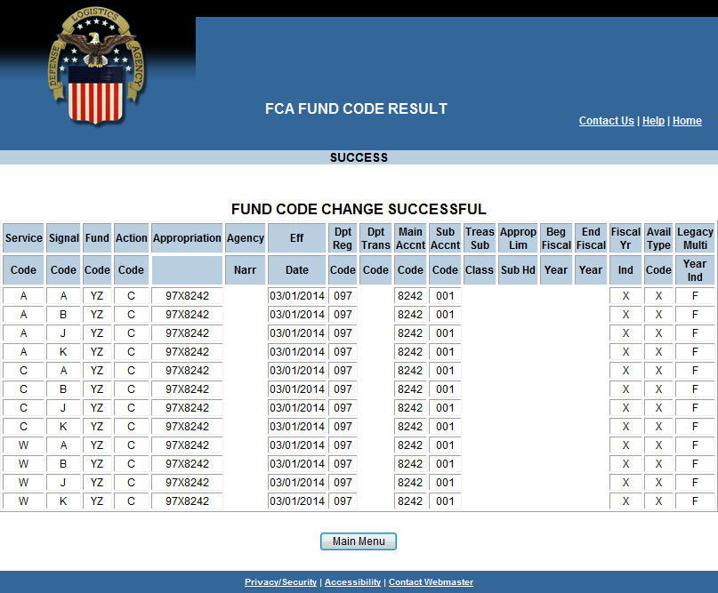
FCA – Change Successful
Notes:
Narrator:
The web application used by Component Fund Code Monitors allows changes to fund codes in near real time. The application facilitates legacy and future processing, providing key SFIS/SLOA data elements needed for billing and Treasury reporting.
The application also improves financial process, facilitates additional edits to improve data accuracy and enhance audit readiness. The system supports future effective dates, so changes can be added into the database that will not go into effect until a certain date is reached. This is particularly useful at the start of a new fiscal year.
The fund code database is available for system-to-system synchronization, replacing the need to email updates to the users of the data.

Slide 34
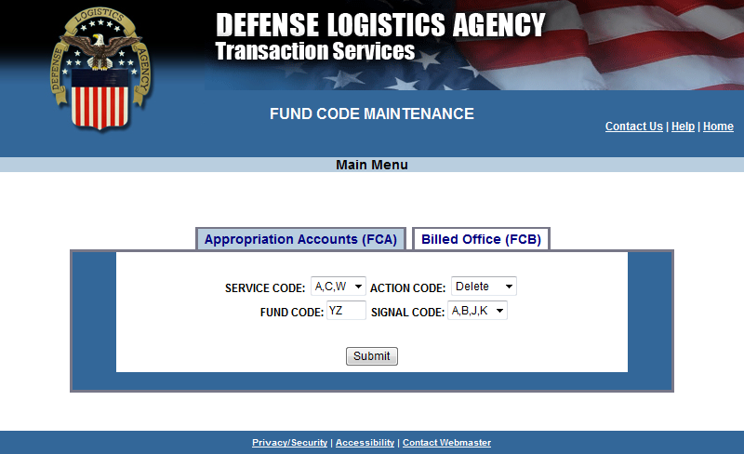
FCA - Delete
Notes:
Narrator:
The web application used by Component Fund Code Monitors allows changes to fund codes in near real time. The application facilitates legacy and future processing, providing key SFIS/SLOA data elements needed for billing and Treasury reporting.
The application also improves financial process, facilitates additional edits to improve data accuracy and enhance audit readiness. The system supports future effective dates, so changes can be added into the database that will not go into effect until a certain date is reached. This is particularly useful at the start of a new fiscal year.
The fund code database is available for system-to-system synchronization, replacing the need to email updates to the users of the data.

Slide 35
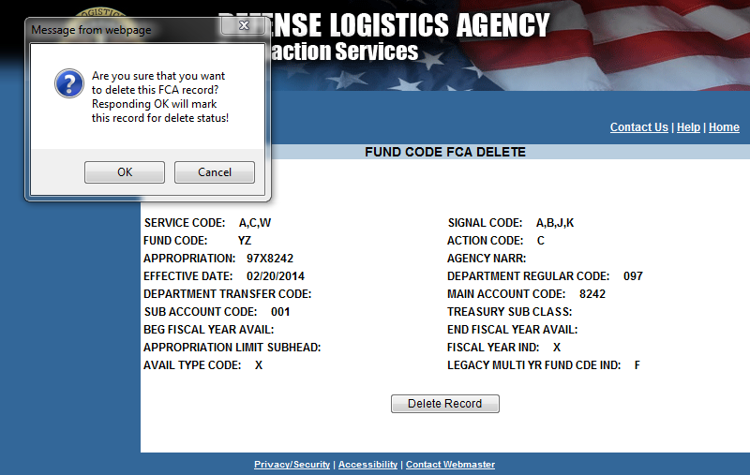
FCA – Confirm Delete Record
Notes:
Narrator:
The web application used by Component Fund Code Monitors allows changes to fund codes in near real time. The application facilitates legacy and future processing, providing key SFIS/SLOA data elements needed for billing and Treasury reporting.
The application also improves financial process, facilitates additional edits to improve data accuracy and enhance audit readiness. The system supports future effective dates, so changes can be added into the database that will not go into effect until a certain date is reached. This is particularly useful at the start of a new fiscal year.
The fund code database is available for system-to-system synchronization, replacing the need to email updates to the users of the data.

Slide 36
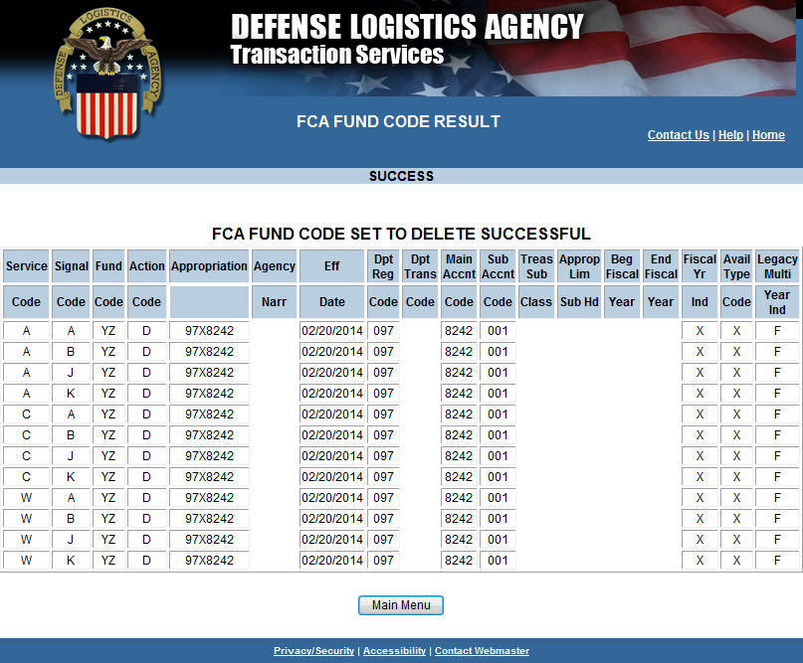
FCA – Delete Successful
Notes:
Narrator:
The web application used by Component Fund Code Monitors allows changes to fund codes in near real time. The application facilitates legacy and future processing, providing key SFIS/SLOA data elements needed for billing and Treasury reporting.
The application also improves financial process, facilitates additional edits to improve data accuracy and enhance audit readiness. The system supports future effective dates, so changes can be added into the database that will not go into effect until a certain date is reached. This is particularly useful at the start of a new fiscal year.
The fund code database is available for system-to-system synchronization, replacing the need to email updates to the users of the data.

Slide 37
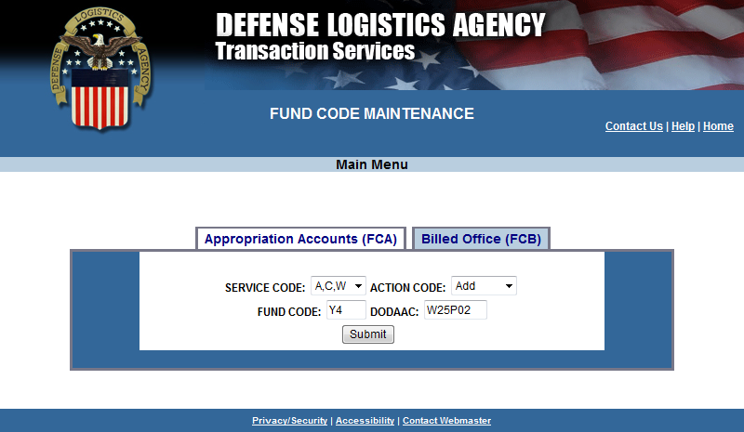
FCB - Add
Notes:
Narrator:
The web application used by Component Fund Code Monitors allows changes to fund codes in near real time. The application facilitates legacy and future processing, providing key SFIS/SLOA data elements needed for billing and Treasury reporting.
The application also improves financial process, facilitates additional edits to improve data accuracy and enhance audit readiness. The system supports future effective dates, so changes can be added into the database that will not go into effect until a certain date is reached. This is particularly useful at the start of a new fiscal year.
The fund code database is available for system-to-system synchronization, replacing the need to email updates to the users of the data.

Slide 38
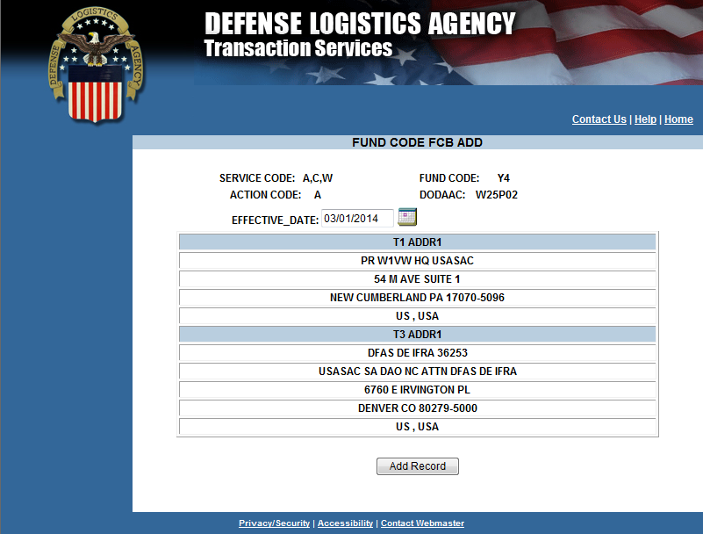
FCB – Add Effective Date
Notes:
Narrator:
The web application used by Component Fund Code Monitors allows changes to fund codes in near real time. The application facilitates legacy and future processing, providing key SFIS/SLOA data elements needed for billing and Treasury reporting.
The application also improves financial process, facilitates additional edits to improve data accuracy and enhance audit readiness. The system supports future effective dates, so changes can be added into the database that will not go into effect until a certain date is reached. This is particularly useful at the start of a new fiscal year.
The fund code database is available for system-to-system synchronization, replacing the need to email updates to the users of the data.

Slide 39
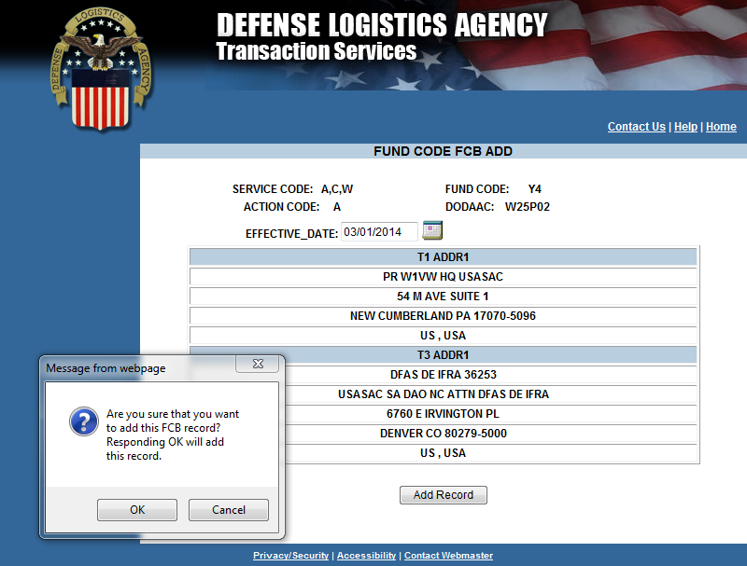
FCB - Add Confirmation
Notes:
Narrator:
The web application used by Component Fund Code Monitors allows changes to fund codes in near real time. The application facilitates legacy and future processing, providing key SFIS/SLOA data elements needed for billing and Treasury reporting.
The application also improves financial process, facilitates additional edits to improve data accuracy and enhance audit readiness. The system supports future effective dates, so changes can be added into the database that will not go into effect until a certain date is reached. This is particularly useful at the start of a new fiscal year.
The fund code database is available for system-to-system synchronization, replacing the need to email updates to the users of the data.

Slide 40
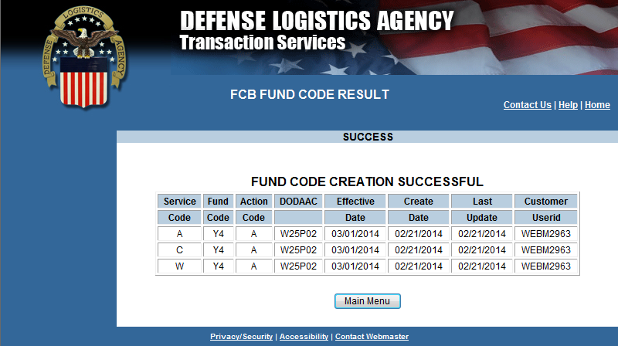
FCB – Add Successful
Notes:
Narrator:
The web application used by Component Fund Code Monitors allows changes to fund codes in near real time. The application facilitates legacy and future processing, providing key SFIS/SLOA data elements needed for billing and Treasury reporting.
The application also improves financial process, facilitates additional edits to improve data accuracy and enhance audit readiness. The system supports future effective dates, so changes can be added into the database that will not go into effect until a certain date is reached. This is particularly useful at the start of a new fiscal year.
The fund code database is available for system-to-system synchronization, replacing the need to email updates to the users of the data.

Slide 41
FCB - Change
Current DODAAC
Notes:
Narrator:
The web application used by Component Fund Code Monitors allows changes to fund codes in near real time. The application facilitates legacy and future processing, providing key SFIS/SLOA data elements needed for billing and Treasury reporting.
The application also improves financial process, facilitates additional edits to improve data accuracy and enhance audit readiness. The system supports future effective dates, so changes can be added into the database that will not go into effect until a certain date is reached. This is particularly useful at the start of a new fiscal year.
The fund code database is available for system-to-system synchronization, replacing the need to email updates to the users of the data.

Slide 42
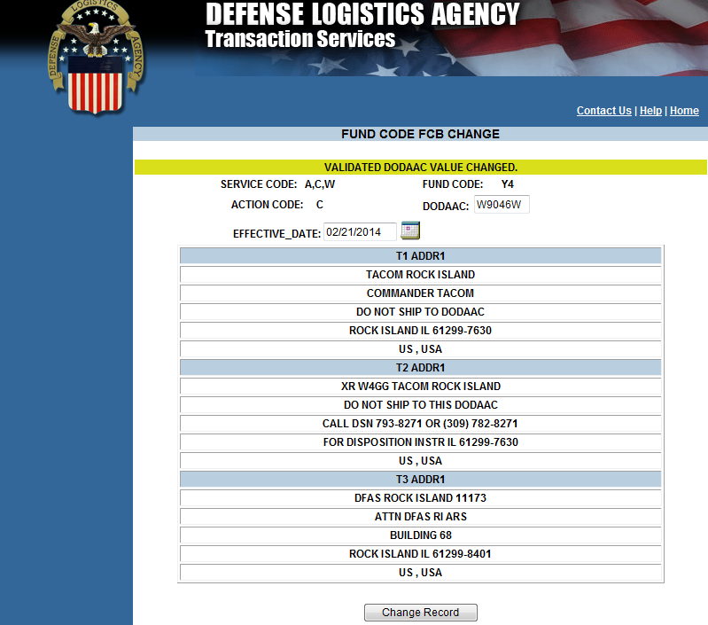
FCB – Verify DODAAC Should Change
Edited DODAAC
Notes:
Narrator:
The web application used by Component Fund Code Monitors allows changes to fund codes in near real time. The application facilitates legacy and future processing, providing key SFIS/SLOA data elements needed for billing and Treasury reporting.
The application also improves financial process, facilitates additional edits to improve data accuracy and enhance audit readiness. The system supports future effective dates, so changes can be added into the database that will not go into effect until a certain date is reached. This is particularly useful at the start of a new fiscal year.
The fund code database is available for system-to-system synchronization, replacing the need to email updates to the users of the data.

Slide 43
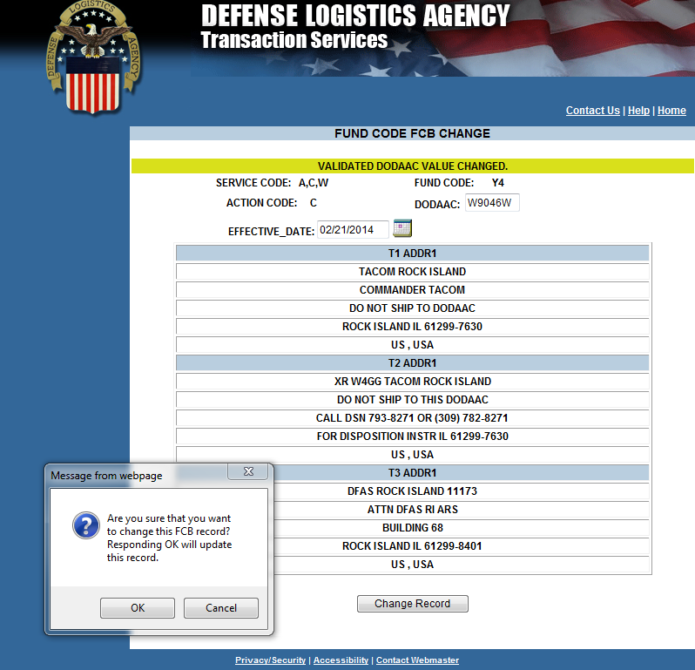
FCB – Change Confirmation
Notes:
Narrator:
The web application used by Component Fund Code Monitors allows changes to fund codes in near real time. The application facilitates legacy and future processing, providing key SFIS/SLOA data elements needed for billing and Treasury reporting.
The application also improves financial process, facilitates additional edits to improve data accuracy and enhance audit readiness. The system supports future effective dates, so changes can be added into the database that will not go into effect until a certain date is reached. This is particularly useful at the start of a new fiscal year.
The fund code database is available for system-to-system synchronization, replacing the need to email updates to the users of the data.

Slide 44
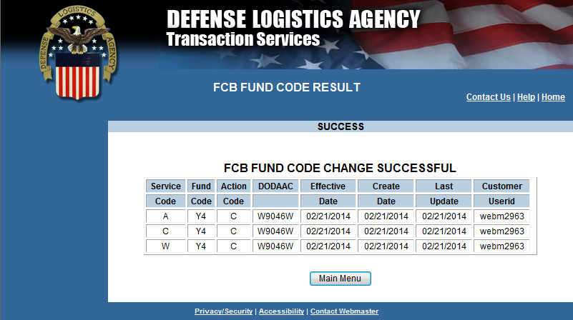
FCB – Change Successful
Notes:
Narrator:
The web application used by Component Fund Code Monitors allows changes to fund codes in near real time. The application facilitates legacy and future processing, providing key SFIS/SLOA data elements needed for billing and Treasury reporting.
The application also improves financial process, facilitates additional edits to improve data accuracy and enhance audit readiness. The system supports future effective dates, so changes can be added into the database that will not go into effect until a certain date is reached. This is particularly useful at the start of a new fiscal year.
The fund code database is available for system-to-system synchronization, replacing the need to email updates to the users of the data.

Slide 45
FCB - Delete
Notes:
Narrator:
The web application used by Component Fund Code Monitors allows changes to fund codes in near real time. The application facilitates legacy and future processing, providing key SFIS/SLOA data elements needed for billing and Treasury reporting.
The application also improves financial process, facilitates additional edits to improve data accuracy and enhance audit readiness. The system supports future effective dates, so changes can be added into the database that will not go into effect until a certain date is reached. This is particularly useful at the start of a new fiscal year.
The fund code database is available for system-to-system synchronization, replacing the need to email updates to the users of the data.

Slide 46
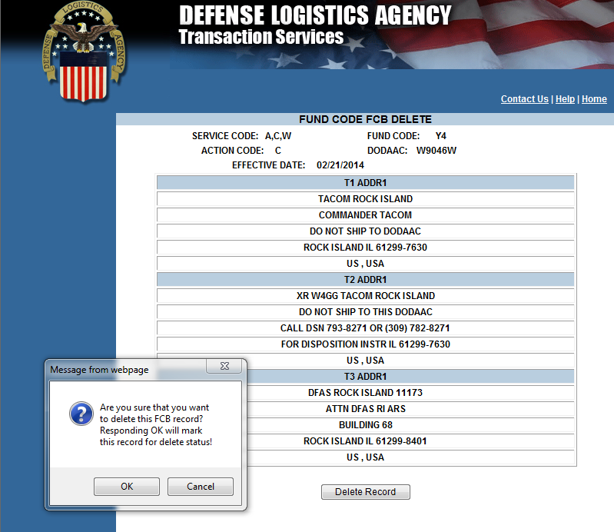
FCB – Confirm Delete
Notes:
Narrator:
The web application used by Component Fund Code Monitors allows changes to fund codes in near real time. The application facilitates legacy and future processing, providing key SFIS/SLOA data elements needed for billing and Treasury reporting.
The application also improves financial process, facilitates additional edits to improve data accuracy and enhance audit readiness. The system supports future effective dates, so changes can be added into the database that will not go into effect until a certain date is reached. This is particularly useful at the start of a new fiscal year.
The fund code database is available for system-to-system synchronization, replacing the need to email updates to the users of the data.

Slide 47
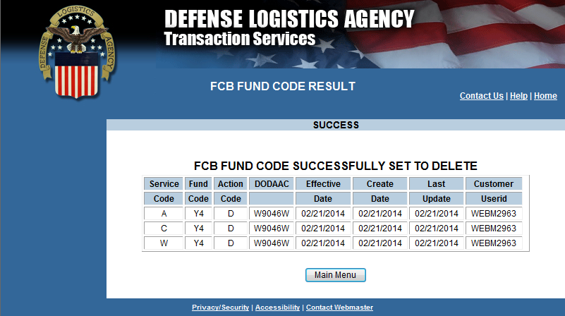
FCB – Delete Successful
Notes:
Narrator:
The web application used by Component Fund Code Monitors allows changes to fund codes in near real time. The application facilitates legacy and future processing, providing key SFIS/SLOA data elements needed for billing and Treasury reporting.
The application also improves financial process, facilitates additional edits to improve data accuracy and enhance audit readiness. The system supports future effective dates, so changes can be added into the database that will not go into effect until a certain date is reached. This is particularly useful at the start of a new fiscal year.
The fund code database is available for system-to-system synchronization, replacing the need to email updates to the users of the data.

Slide 48
Web Fund Code
Business Rule Checks

Slide 49
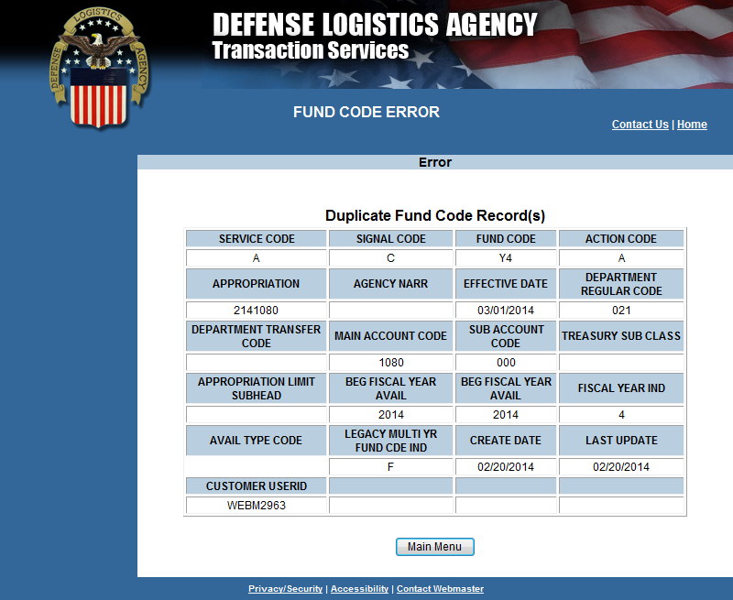
FCA Edit Check – Duplicate Fund Code Exists
Notes:
Narrator:
The web application used by Component Fund Code Monitors allows changes to fund codes in near real time. The application facilitates legacy and future processing, providing key SFIS/SLOA data elements needed for billing and Treasury reporting.
The application also improves financial process, facilitates additional edits to improve data accuracy and enhance audit readiness. The system supports future effective dates, so changes can be added into the database that will not go into effect until a certain date is reached. This is particularly useful at the start of a new fiscal year.
The fund code database is available for system-to-system synchronization, replacing the need to email updates to the users of the data.

Slide 50
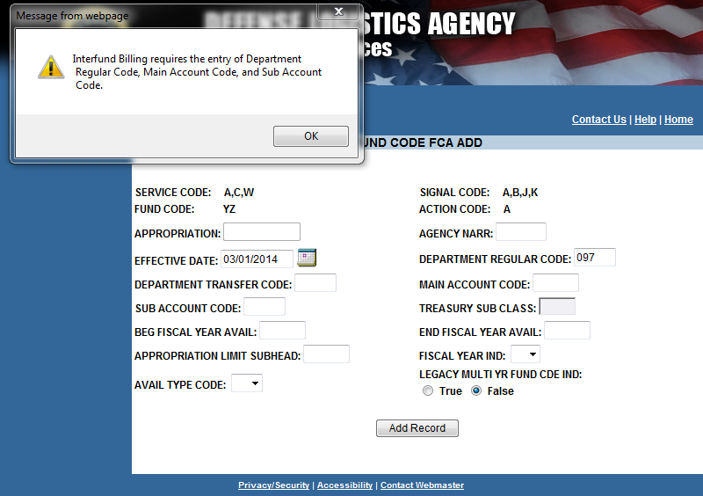
FCA Edit Check – Appropriation Data Dependency
Notes:
Narrator:
The web application used by Component Fund Code Monitors allows changes to fund codes in near real time. The application facilitates legacy and future processing, providing key SFIS/SLOA data elements needed for billing and Treasury reporting.
The application also improves financial process, facilitates additional edits to improve data accuracy and enhance audit readiness. The system supports future effective dates, so changes can be added into the database that will not go into effect until a certain date is reached. This is particularly useful at the start of a new fiscal year.
The fund code database is available for system-to-system synchronization, replacing the need to email updates to the users of the data.

Slide 51
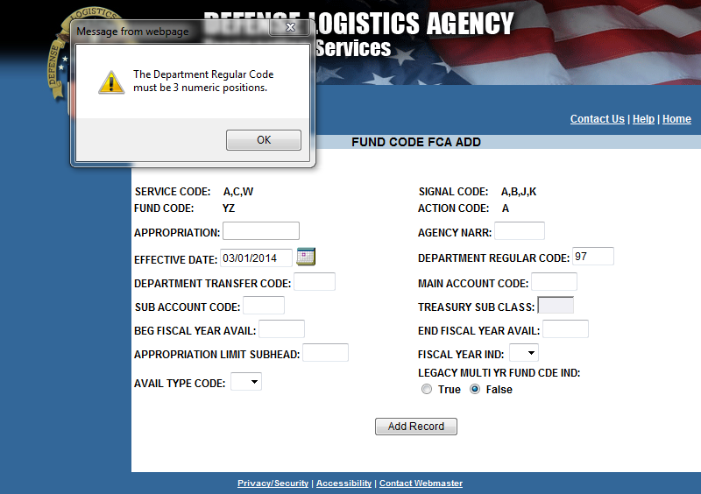
FCA Edit Check – Department Regular Code Format
Notes:
Narrator:
The web application used by Component Fund Code Monitors allows changes to fund codes in near real time. The application facilitates legacy and future processing, providing key SFIS/SLOA data elements needed for billing and Treasury reporting.
The application also improves financial process, facilitates additional edits to improve data accuracy and enhance audit readiness. The system supports future effective dates, so changes can be added into the database that will not go into effect until a certain date is reached. This is particularly useful at the start of a new fiscal year.
The fund code database is available for system-to-system synchronization, replacing the need to email updates to the users of the data.

Slide 52
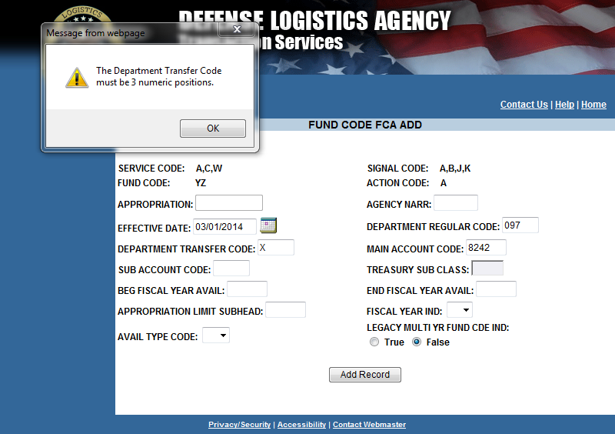
FCA Edit Check – Department Transfer Code Format
Notes:
Narrator:
The web application used by Component Fund Code Monitors allows changes to fund codes in near real time. The application facilitates legacy and future processing, providing key SFIS/SLOA data elements needed for billing and Treasury reporting.
The application also improves financial process, facilitates additional edits to improve data accuracy and enhance audit readiness. The system supports future effective dates, so changes can be added into the database that will not go into effect until a certain date is reached. This is particularly useful at the start of a new fiscal year.
The fund code database is available for system-to-system synchronization, replacing the need to email updates to the users of the data.

Slide 53
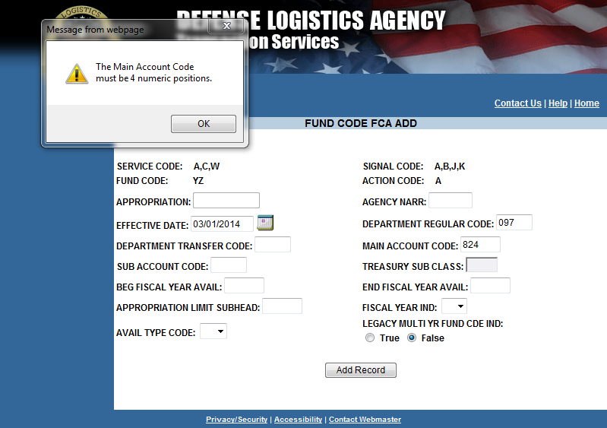
FCA Edit Check – Main Account Format
Notes:
Narrator:
The web application used by Component Fund Code Monitors allows changes to fund codes in near real time. The application facilitates legacy and future processing, providing key SFIS/SLOA data elements needed for billing and Treasury reporting.
The application also improves financial process, facilitates additional edits to improve data accuracy and enhance audit readiness. The system supports future effective dates, so changes can be added into the database that will not go into effect until a certain date is reached. This is particularly useful at the start of a new fiscal year.
The fund code database is available for system-to-system synchronization, replacing the need to email updates to the users of the data.

Slide 54
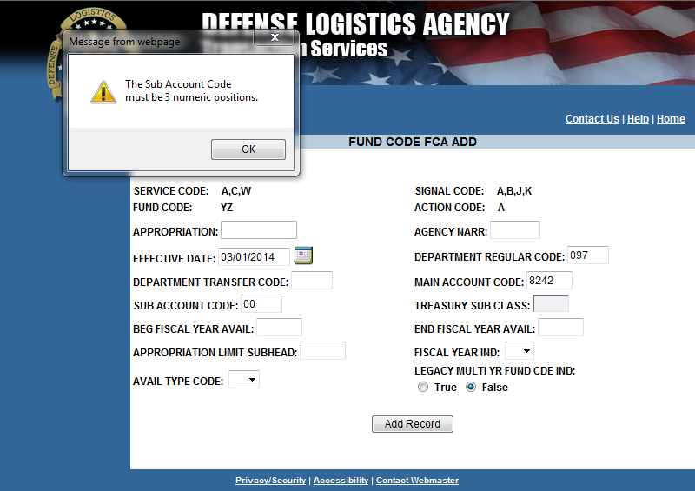
FCA Edit Check – Sub Account Format
Notes:
Narrator:
The web application used by Component Fund Code Monitors allows changes to fund codes in near real time. The application facilitates legacy and future processing, providing key SFIS/SLOA data elements needed for billing and Treasury reporting.
The application also improves financial process, facilitates additional edits to improve data accuracy and enhance audit readiness. The system supports future effective dates, so changes can be added into the database that will not go into effect until a certain date is reached. This is particularly useful at the start of a new fiscal year.
The fund code database is available for system-to-system synchronization, replacing the need to email updates to the users of the data.

Slide 55
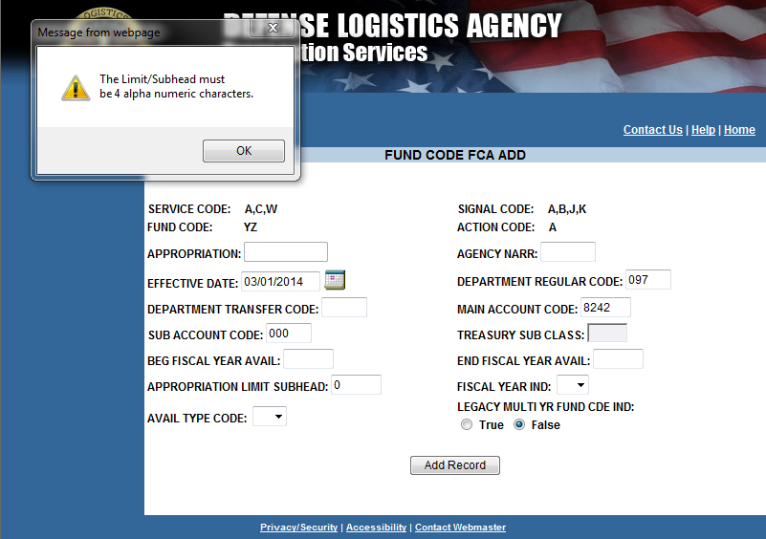
FCA Edit Check – Limit/Subhead Format
Notes:
Narrator:
The web application used by Component Fund Code Monitors allows changes to fund codes in near real time. The application facilitates legacy and future processing, providing key SFIS/SLOA data elements needed for billing and Treasury reporting.
The application also improves financial process, facilitates additional edits to improve data accuracy and enhance audit readiness. The system supports future effective dates, so changes can be added into the database that will not go into effect until a certain date is reached. This is particularly useful at the start of a new fiscal year.
The fund code database is available for system-to-system synchronization, replacing the need to email updates to the users of the data.

Slide 56
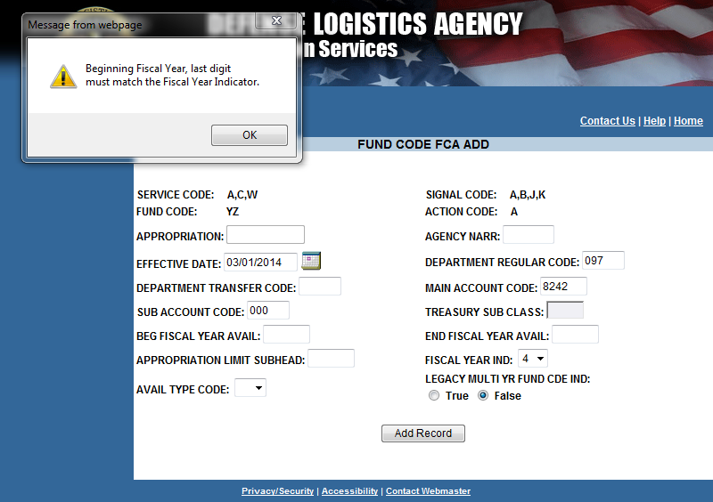
FCA Edit Check – FY Indicator Matches Beginning FY
Notes:
Narrator:
The web application used by Component Fund Code Monitors allows changes to fund codes in near real time. The application facilitates legacy and future processing, providing key SFIS/SLOA data elements needed for billing and Treasury reporting.
The application also improves financial process, facilitates additional edits to improve data accuracy and enhance audit readiness. The system supports future effective dates, so changes can be added into the database that will not go into effect until a certain date is reached. This is particularly useful at the start of a new fiscal year.
The fund code database is available for system-to-system synchronization, replacing the need to email updates to the users of the data.

Slide 57
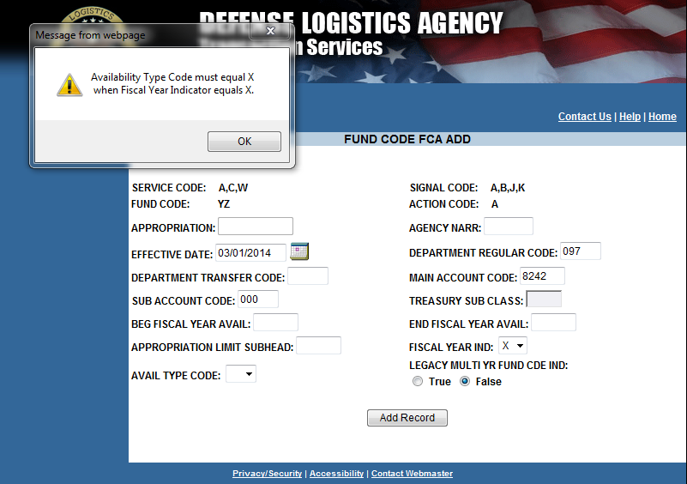
FCA Edit Check – FY Indicator ‘X’ = Avail Type Code ‘X’
Notes:
Narrator:
The web application used by Component Fund Code Monitors allows changes to fund codes in near real time. The application facilitates legacy and future processing, providing key SFIS/SLOA data elements needed for billing and Treasury reporting.
The application also improves financial process, facilitates additional edits to improve data accuracy and enhance audit readiness. The system supports future effective dates, so changes can be added into the database that will not go into effect until a certain date is reached. This is particularly useful at the start of a new fiscal year.
The fund code database is available for system-to-system synchronization, replacing the need to email updates to the users of the data.

Slide 58
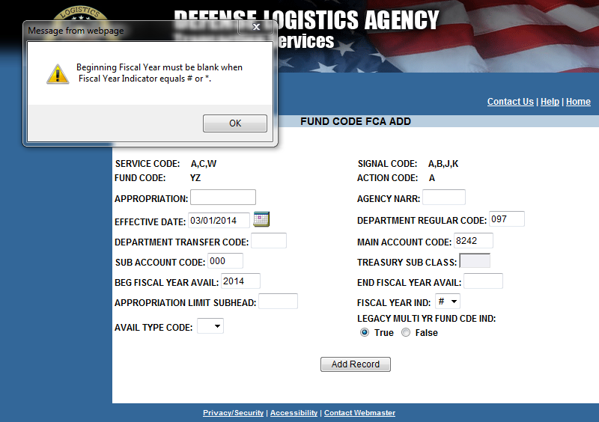
FCA Edit Check – No Beg FY If FY Indicator = ‘#’ or ‘*’
Notes:
Narrator:
The web application used by Component Fund Code Monitors allows changes to fund codes in near real time. The application facilitates legacy and future processing, providing key SFIS/SLOA data elements needed for billing and Treasury reporting.
The application also improves financial process, facilitates additional edits to improve data accuracy and enhance audit readiness. The system supports future effective dates, so changes can be added into the database that will not go into effect until a certain date is reached. This is particularly useful at the start of a new fiscal year.
The fund code database is available for system-to-system synchronization, replacing the need to email updates to the users of the data.

Slide 59
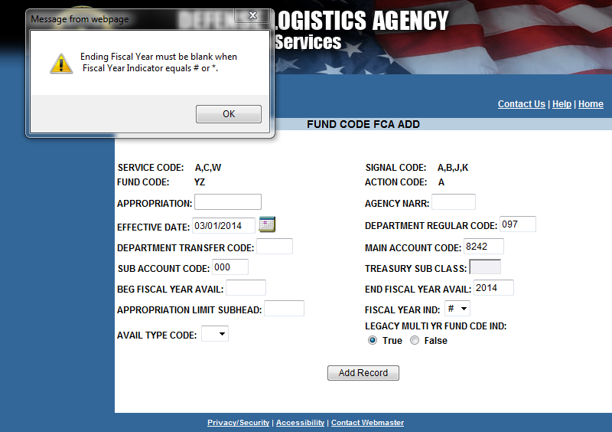
FCA Edit Check – No End FY If FY Indicator = ‘#’ or ‘*’
Notes:
Narrator:
The web application used by Component Fund Code Monitors allows changes to fund codes in near real time. The application facilitates legacy and future processing, providing key SFIS/SLOA data elements needed for billing and Treasury reporting.
The application also improves financial process, facilitates additional edits to improve data accuracy and enhance audit readiness. The system supports future effective dates, so changes can be added into the database that will not go into effect until a certain date is reached. This is particularly useful at the start of a new fiscal year.
The fund code database is available for system-to-system synchronization, replacing the need to email updates to the users of the data.

Slide 60
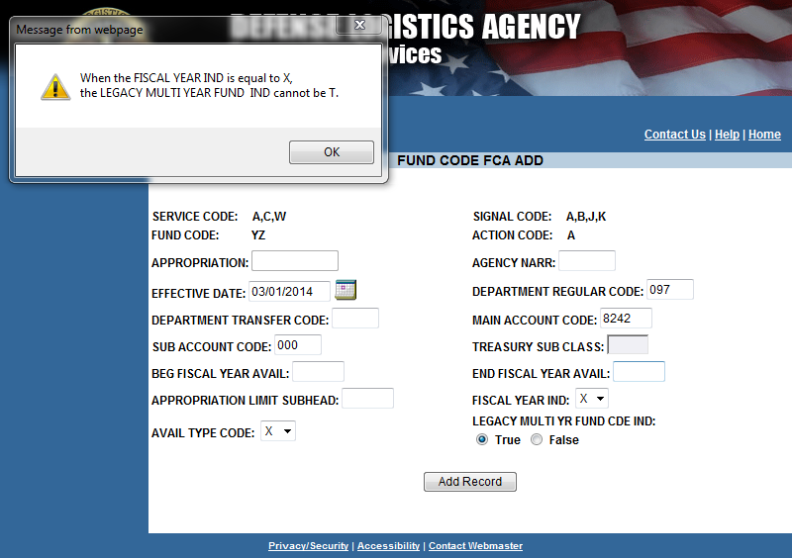
FCA Edit Check – If FY Indicator = ‘X’, Multi Year ≠ ‘T’
Notes:
Narrator:
The web application used by Component Fund Code Monitors allows changes to fund codes in near real time. The application facilitates legacy and future processing, providing key SFIS/SLOA data elements needed for billing and Treasury reporting.
The application also improves financial process, facilitates additional edits to improve data accuracy and enhance audit readiness. The system supports future effective dates, so changes can be added into the database that will not go into effect until a certain date is reached. This is particularly useful at the start of a new fiscal year.
The fund code database is available for system-to-system synchronization, replacing the need to email updates to the users of the data.

Slide 61
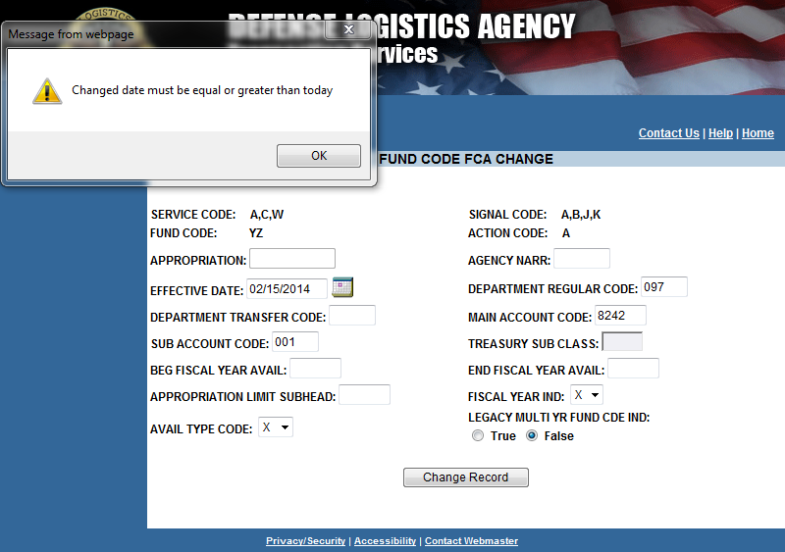
FCA Edit Check – Change Date ≥ Today
Notes:
Narrator:
The web application used by Component Fund Code Monitors allows changes to fund codes in near real time. The application facilitates legacy and future processing, providing key SFIS/SLOA data elements needed for billing and Treasury reporting.
The application also improves financial process, facilitates additional edits to improve data accuracy and enhance audit readiness. The system supports future effective dates, so changes can be added into the database that will not go into effect until a certain date is reached. This is particularly useful at the start of a new fiscal year.
The fund code database is available for system-to-system synchronization, replacing the need to email updates to the users of the data.

Slide 62
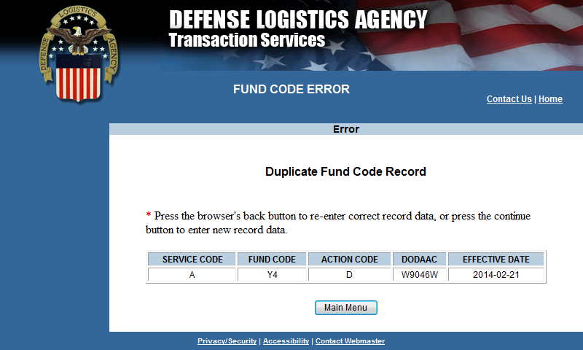
FCB Edit Check – Duplicate Fund Code Exists
Notes:
Narrator:
The web application used by Component Fund Code Monitors allows changes to fund codes in near real time. The application facilitates legacy and future processing, providing key SFIS/SLOA data elements needed for billing and Treasury reporting.
The application also improves financial process, facilitates additional edits to improve data accuracy and enhance audit readiness. The system supports future effective dates, so changes can be added into the database that will not go into effect until a certain date is reached. This is particularly useful at the start of a new fiscal year.
The fund code database is available for system-to-system synchronization, replacing the need to email updates to the users of the data.

Slide 63
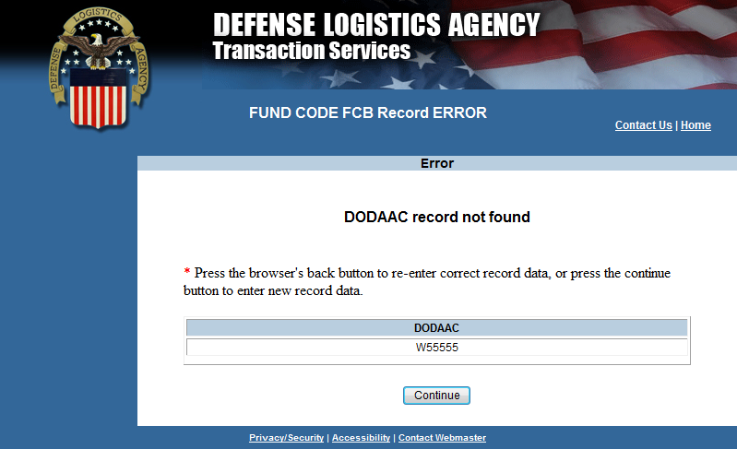
FCB Edit Check – DoDAAC Not Found
Notes:
Narrator:
The web application used by Component Fund Code Monitors allows changes to fund codes in near real time. The application facilitates legacy and future processing, providing key SFIS/SLOA data elements needed for billing and Treasury reporting.
The application also improves financial process, facilitates additional edits to improve data accuracy and enhance audit readiness. The system supports future effective dates, so changes can be added into the database that will not go into effect until a certain date is reached. This is particularly useful at the start of a new fiscal year.
The fund code database is available for system-to-system synchronization, replacing the need to email updates to the users of the data.

Slide 64
FCB Edit Check – Invalid DODAAC
Notes:
Narrator:
The web application used by Component Fund Code Monitors allows changes to fund codes in near real time. The application facilitates legacy and future processing, providing key SFIS/SLOA data elements needed for billing and Treasury reporting.
The application also improves financial process, facilitates additional edits to improve data accuracy and enhance audit readiness. The system supports future effective dates, so changes can be added into the database that will not go into effect until a certain date is reached. This is particularly useful at the start of a new fiscal year.
The fund code database is available for system-to-system synchronization, replacing the need to email updates to the users of the data.

Slide 65
Master File Layout
Field Name | Type | Use | Definition | Business Rule
SERVICE_CODE | VARCHA2(2) | Mandatory | Service and Agency Code. Designates the military service or other government element of ownership or sponsorship. The code is used to identify the service or agency monitoring the fund code. | • Per MILSTRIP Appendix 2.2, the service and agency (S/A) code is a one or two character alphanumeric.
SIGNAL_CODE | VARCHAR2(1) | Mandatory | Signal Code. A code designation identifying the intended consignee and activity to receive and effect bill payment. | Allowed values are A, B, C, J, K and L Refer to MILSTRIP Appendix 2.10 for an explanation of signal code.
FUND_CODE | VARCHAR2(2) | Mandatory | Fund Code. Designation of the fund account to be charged (disbursed) or credited (refunded). When used with Signal Code C or L also designates the Billed Office DoDAAC. | • Must be unique per SERVICE_CODE and SIGNAL_CODE. • A fund code of ** is an indicator of the default account. One per S/A + Signal code. *When used with Signal Code C or L an entry is required on the Fund Code to Billed Office DoDAAC Table.
APPROPRIATION | VARCHAR2(11) | Constructed/ *Conditional | Appropriation/Fund Account. Constructed line of accounting | • Constructed from: Last 2 characters of DEPARTMENT_REGULAR_CODE + FISCAL_YEAR_INDICATOR + MAIN_ACCOUNT_CODE + APPROPRIATION_LIMIT_SUBHEAD. (NOTE that DEPTARTMENT_REGULAR_Code is actually 3 characters, but the leading zero is concatenated for purposes of this element.) • Blank appropriation data displays as NONINTERFUND on reports
AGENCY_NARR | VARCHAR2(20) | Optional | Agency Narrative. Name or common acronym for further agency delineation from the Service code. Generally, a breakdown for H-series fund code assignments. | Web Application input is limited to 5.This is to conform to report format limitations.
*Conditional = Must use unless NONINTERFUND billing
Notes:
Narrator:
The web application used by Component Fund Code Monitors allows changes to fund codes in near real time. The application facilitates legacy and future processing, providing key SFIS/SLOA data elements needed for billing and Treasury reporting.
The application also improves financial process, facilitates additional edits to improve data accuracy and enhance audit readiness. The system supports future effective dates, so changes can be added into the database that will not go into effect until a certain date is reached. This is particularly useful at the start of a new fiscal year.
The fund code database is available for system-to-system synchronization, replacing the need to email updates to the users of the data.

Slide 66
Master File Layout
Field Name | Type | Use | Definition | Business Rule
DEPARTMENT_REGULAR_CODE | VARCHAR2(3) | *Conditional | Department Regular Code. US Treasury designated code representing the government agency accountable for one or more fund accounts established and maintained by the Treasury. | • Department Regular Code must be 3 numeric characters. ex. 097 (NOTE: This element used to be 2 characters. Current codes are going to be pre-fixed by a zero.) • If any of DEPARTMENT_REGULAR_CODE, MAIN_ACCOUNT_CODE and/or SUB_ACCOUNT_CODE are present than the others are required. • Blank field indicates NONINTERFUND.
DEPARTMENT_TRANSFER_CODE | VARCHAR2(3) | Optional | Department Transfer Code. Identifies the federal agency of obligation authority to the DoD or one of its components | • Department Transfer Code must be 3 numeric characters. ex. 097 (Note: Programs may use the two character code and derive the three character version - with a leading zero - at time of reporting if the software system in use has not yet been updated). • May be blank if no department transfer is applicable
MAIN_ACCOUNT_CODE | VARCHAR2(4) | *Conditional | Main Account. A four digit numeric data element representing a specific appropriation or fund account established by the U.S. Treasury for expenditure or receipt authority issued by the U.S. Congress. | • Each Main Account Code must be associated with only one Fund Type Code. • Each Main Account Code must be associated with only one Budget Function/Sub-Function Code. • Main Account Code must be 4 numeric characters. • If any of DEPARTMENT_REGULAR_CODE, MAIN_ACCOUNT_CODE and/or SUB_ACCOUNT_CODE are present than the others are required. • Blank field indicates NONINTERFUND.
*Conditional = Must use unless NONINTERFUND billing
Notes:
Narrator:
The web application used by Component Fund Code Monitors allows changes to fund codes in near real time. The application facilitates legacy and future processing, providing key SFIS/SLOA data elements needed for billing and Treasury reporting.
The application also improves financial process, facilitates additional edits to improve data accuracy and enhance audit readiness. The system supports future effective dates, so changes can be added into the database that will not go into effect until a certain date is reached. This is particularly useful at the start of a new fiscal year.
The fund code database is available for system-to-system synchronization, replacing the need to email updates to the users of the data.

Slide 67
Master File Layout
Field Name | Type | Use | Definition | Business Rule
SUB_ACCOUNT_CODE | VARCHAR2(3) | *Conditional | Sub-account Code. Specify subsidiary level accounts associated to the main account of the TAFS. | • Every financial transaction processed must have a valid Sub-Account Code. • The Sub-Account Code must be defaulted to “000” when one of the Treasury Sub-Account Code conditions does not apply. • Sub-Account Code must be 3 numeric characters. ex. 97X4930.001 (last 3 positions following period) • If any of DEPARTMENT_REGULAR_CODE, MAIN_ACCOUNT_CODE and/or SUB_ACCOUNT_CODE are present than the others are required. • Blank field indicates NONINTERFUND.
TREASURY_SUB_CLASS | VARCHAR2(2) | Optional | Treasury Sub Class Code. Assigned in certain cases for grouping designated disbursement and/or receipt transactions below the level of appropriation or fund account represented by the main account, Reference Item A3, Main Account) for an Appropriation, Fund, or Receipt Account. | May be blank. Business Rules need to be developed. Business Event Type Code (BETC) in effect replaces the transaction codes and standard sub-classes that were used on the old central accounting reports, such as the Statements of Transactions (FMS Form 224) and the Undisbursed Ledger and Trial Balance Reports (FMS Forms 6653 and 6654). As a result, the subclass field is being renamed to “Sub-level Prefix” and will only be used for programmatic breakdowns of the TAS for Treasury publication purposes. Sub-level Prefixes have a unique meaning or a unique need for sub classification that is NOT based on transaction types or business events as described previously.
*Conditional = Must use unless NONINTERFUND billing
Notes:
Narrator:
The web application used by Component Fund Code Monitors allows changes to fund codes in near real time. The application facilitates legacy and future processing, providing key SFIS/SLOA data elements needed for billing and Treasury reporting.
The application also improves financial process, facilitates additional edits to improve data accuracy and enhance audit readiness. The system supports future effective dates, so changes can be added into the database that will not go into effect until a certain date is reached. This is particularly useful at the start of a new fiscal year.
The fund code database is available for system-to-system synchronization, replacing the need to email updates to the users of the data.

Slide 68
Master File Layout
Field Name | Type | Use | Definition | Business Rule
APPROPRIATION_LIMIT_SUBHEAD | VARCHAR2(4) | Optional | Limit/Subhead. Legacy identifier of an organization to which funds have been sub-allocated. | May be blank.
FISCAL_YEAR_INDICATOR | VARCHAR2(1) | *Conditional | Fiscal Year Indicator. Denotes fiscal year chargeable | Values: {numeric}, or X = no year funding, or; # = BEG_FISCAL_YEAR_AVAIL and END_FISCAL_YEAR_AVAIL determined by FY of transaction document number, or; * = BEG_FISCAL_YEAR_AVAIL and END_FISCAL_YEAR_AVAIL determined by FY of the Summary billing transaction or; Blank field indicates NONINTERFUND. if Fiscal Year Indicator is “X” AVAILABILITY_TYPE_CODE will also be “X”
LEGACY_MULTI_YR_FUND_CDE_IND | VARCHAR2(1) | *Conditional | Legacy Multi Year Fund Code Indicator. Used to indicate that funding is associated with a multi-year appropriation for which the BEG_FISCAL_YEAR_AVAIL and END_FISCAL_YEAR_AVAIL is blank due to overlapping periods of multiple periods of availability associated with the fund code. | *Default to false. * If true accounting systems cannot accurately derive the beginning and ending periods of availability for this fund code solely from the fund code.
*Conditional = Must use unless NONINTERFUND billing
Notes:
Narrator:
The web application used by Component Fund Code Monitors allows changes to fund codes in near real time. The application facilitates legacy and future processing, providing key SFIS/SLOA data elements needed for billing and Treasury reporting.
The application also improves financial process, facilitates additional edits to improve data accuracy and enhance audit readiness. The system supports future effective dates, so changes can be added into the database that will not go into effect until a certain date is reached. This is particularly useful at the start of a new fiscal year.
The fund code database is available for system-to-system synchronization, replacing the need to email updates to the users of the data.

Slide 69
Master File Layout
Field Name | Type | Use | Definition | Business Rule
AVAILABILITY_TYPE_CODE | VARCHAR2(1) | Conditional | Availability Type Code. Identifies no-year TAS, clearing/suspense TAS, and canceled TAS. | • Availability Type Code must be 1 alpha character. • Valid values include: “C”, “F”, or “X” • If used for canceled Main Accounts, Availability Type Code C may be derived at the time of reporting.• For Annual or Multi-Year funding, Availability Type Code must be blank. *if Availability Type Code is “X”, FISCAL_YEAR_INDICATOR will also be “X”
BEG_FISCAL_YEAR_AVAIL | VARCHAR2(4) | Conditional | Beginning Period of Availability Fiscal Year Date. In annual and multi-year accounts, identifies the first year of availability under law that an account may incur new obligations. | • If AVAILABILITY_TYPE_CODE is either “F”, or “X”, then Beginning Period of Availability must be must be blank. • If the Beginning Period of Availability is associated with an unavailable receipt account, then it must be blank. If FY_IND is either # or * then Beginning Period of Availability must be must be blank
END_FISCAL_YEAR_AVAIL | VARCHAR2(4) | *Conditional | Ending Period of Availability Fiscal Year Date. In annual and multi-year accounts, identifies the last year of availability under law that an account may incur new obligations. | • If AVAILABILITY_TYPE_CODE is either “F”, or “X”, then Beginning Period of Availability must be must be blank. • If the Ending Period of Availability is associated with an unavailable receipt account, then it must be blank. If FY_IND is either # or * then Ending Period of Availability must be must be blank
EFFECTIVE_DATE | DATE | Mandatory | Effective Date. The start date for the latest action taken on a record. | • The record is not valid until the effective date.
ACTION_CODE | VARCHAR2(1) | Mandatory | Action Code. System maintained code indicating type of action last taken on a record. | Values: A, C, D (Add, Change, Delete)
CREATE_DATE | DATE | Mandatory | Creation Date. System maintained date a record was created.
*Conditional = Must use unless NONINTERFUND billing
Notes:
Narrator:
The web application used by Component Fund Code Monitors allows changes to fund codes in near real time. The application facilitates legacy and future processing, providing key SFIS/SLOA data elements needed for billing and Treasury reporting.
The application also improves financial process, facilitates additional edits to improve data accuracy and enhance audit readiness. The system supports future effective dates, so changes can be added into the database that will not go into effect until a certain date is reached. This is particularly useful at the start of a new fiscal year.
The fund code database is available for system-to-system synchronization, replacing the need to email updates to the users of the data.

Slide 70
Master File Layout
Field Name | Type | Use | Definition | Business Rule
LAST_UPDATE | DATE | Mandatory | Last Update Date. System maintained date a record was last updated.
CUSTOMER_USERID | VARCHAR2(20) | Mandatory | Customer User Identifier. System maintained identifier of a system user who updated the record.
*Conditional = Must use unless NONINTERFUND billing
Notes:
Narrator:
The web application used by Component Fund Code Monitors allows changes to fund codes in near real time. The application facilitates legacy and future processing, providing key SFIS/SLOA data elements needed for billing and Treasury reporting.
The application also improves financial process, facilitates additional edits to improve data accuracy and enhance audit readiness. The system supports future effective dates, so changes can be added into the database that will not go into effect until a certain date is reached. This is particularly useful at the start of a new fiscal year.
The fund code database is available for system-to-system synchronization, replacing the need to email updates to the users of the data.

Slide 71
Potential Future DLMS Changes
Synchronize FCA/FCB Tables for Signal Codes C/L: No FCA without an FCB
Remove Sub-Class as an unused data element
No new multi-year fund codes citing Legacy Indicator = True
Migrate to discrete fund codes for each period of availability
Sunset existing Fund Codes with Legacy Indicator =True
Address Foreign Military Sales use of Availability Type Code X (no year) fund codes for transactions with expiring appropriations
Sunset outgoing fund code emails
Notes:
Narrator:
The web application used by Component Fund Code Monitors allows changes to fund codes in near real time. The application facilitates legacy and future processing, providing key SFIS/SLOA data elements needed for billing and Treasury reporting.
The application also improves financial process, facilitates additional edits to improve data accuracy and enhance audit readiness. The system supports future effective dates, so changes can be added into the database that will not go into effect until a certain date is reached. This is particularly useful at the start of a new fiscal year.
The fund code database is available for system-to-system synchronization, replacing the need to email updates to the users of the data.

Slide 72
Web Fund Code Module Quiz
Question 1: True/False, SLOA can only be fully achieved in logistics transactions by using DLMS?
True
False
Question 2: Which SLOA Data Element can NOT be derived from the SFIS Fund Code to Fund Account Conversion Table?
Department Transfer
Availability Type
Sub Account
Budget Line Item

Slide 73
Web Fund Code Module Quiz
Question 3: A signal code of “C” indicates the bill-to party is based on:
DoDAAC identified by the Fund Code to Billed DoDAAC table
Supplementary Address DoDAAC
Requisitioning DoDAAC
Question 4: A “#” character in the fiscal year indicator field of the SFIS Fund Code to Account Conversion Table means:
No year appropriation
Compute beginning & ending periods of availability based on the bill date’s year
Compute beginning & ending periods of availability based on the requisition date’s year
Multi-year appropriation

Slide 74
Web Fund Code Module Quiz
Question 5: The Web Fund Code application facilitates?
Legacy and future processes
Enhances edits to improve financial processes and audit readiness
Allows for staging fund codes for future effective dates
All of these
Question 6: The Legacy Multi-year Indicator flags which potential issue?
Expired fund code
Fund codes where the DAAS may not be able to match the proper beginning and ending periods of availability
Cannot be billed through Interfund
Obligations against the fund code are about to expire

Slide 75
Web Fund Code Module Quiz
Question 7: True/False, fund codes can be staged in the Web Fund Code application and set to activate on a specific date?
True
False
Question 8: If Fiscal Year is “X”, then the value of Availability Type must be?
C
F
X
null

Slide 76
Questions?
Notes:
Narrator:
The web application used by Component Fund Code Monitors allows changes to fund codes in near real time. The application facilitates legacy and future processing, providing key SFIS/SLOA data elements needed for billing and Treasury reporting.
The application also improves financial process, facilitates additional edits to improve data accuracy and enhance audit readiness. The system supports future effective dates, so changes can be added into the database that will not go into effect until a certain date is reached. This is particularly useful at the start of a new fiscal year.
The fund code database is available for system-to-system synchronization, replacing the need to email updates to the users of the data.

