Slide 1
Turn-in Guidance for Disposition of
Sensitive Property

Slide 2
Policy and Requirements
DLA Disposition Services may NOT accept (either physically or on its account)
CLASSIFIED, TOP SECRET, SECRET property
COMSEC or Cryptographic material that has not been Declassified or Demilitarized
Property containing Personal Identifiable Information (PII)
It is very important to REMOVE all CLASSIFIED, CONFIDENTIAL, TEMPEST, PRIVACY ACT INFO and LABELS before turn in of equipment
2

Slide 3
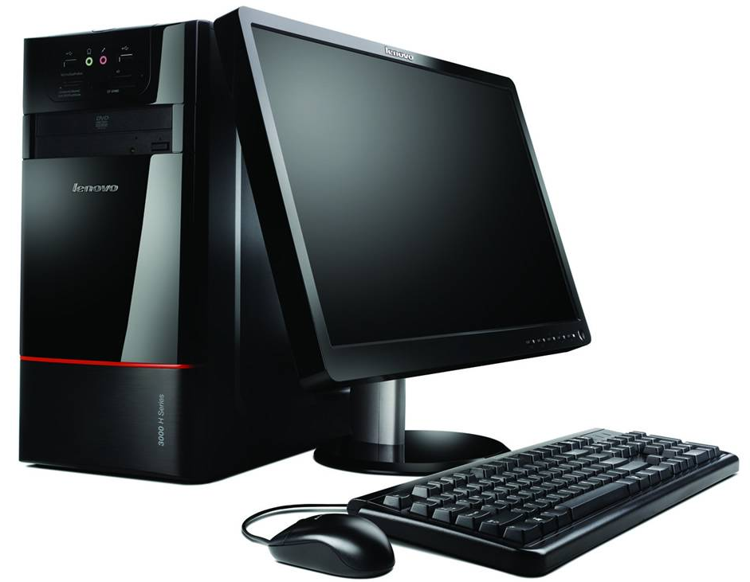
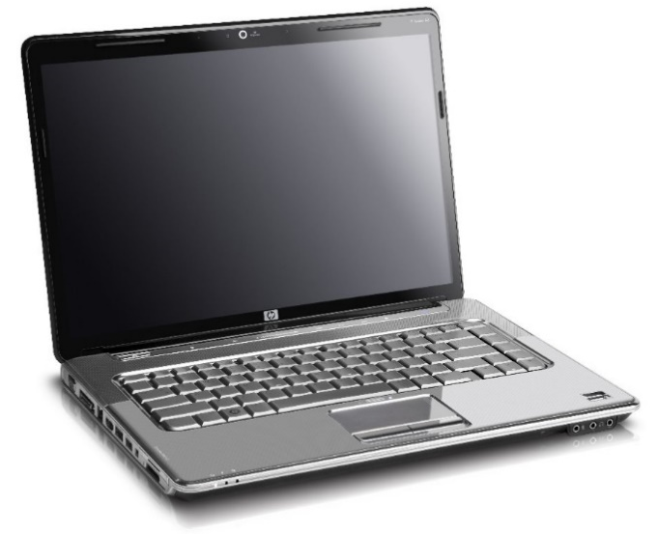
CPU Quick Guide
CPU Turn-In Requirements without Hard Drives
DD Form 1348-1A (filled-out completely)
CPU chassis serial number in block 26 (optional)
1 required statement either on/or with the DD Form 1348-1A
Label on chassis (equivalent to/or) DLA Form 2500
CPUs Turn-In Requirements with Hard Drives
DD Form 1348-1A (filled-out completely)
CPU chassis serial number or hard drive serial number in block 26 (optional)
1 required statement either on or with the DD Form 1348-1A in block 27
Label on chassis(equivalent to/or) DLA Form 2500
3

Slide 4
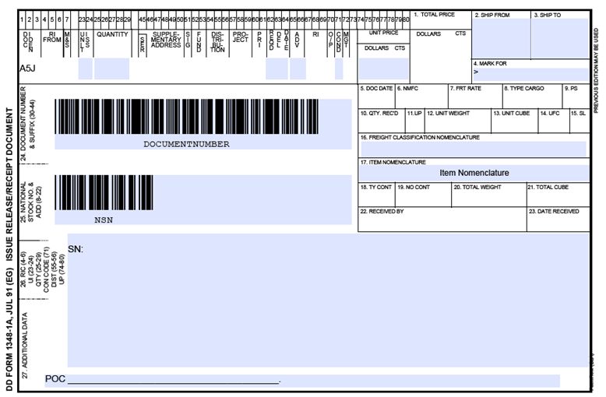
Disposal Turn-in Document
A DD Form 1348-1A must accompany all property. A separate turn in document is required for each National Stock Number (NSN) or Federal Supply Group (FSG)/Federal Stock Class (FSC) w/nomenclature.
The turn in document
must be properly filled-out
POC information should
be included, (i.e. print name, signature, phone number and email address
HARD DRIVE(S) HAVE BEEN REMOVED (optional)
CPU(S) CONTAINS NO CLASSIFIED, CONFIDENTIAL OR HAZARDOUS MATERIALS (optional)
“The equipment described by this document meets the disposition requirements IAW DoDI, 8500.01, Cybersecurity, March 14,2014
(required on/with the DD Form 1348-1A)
4

Slide 5
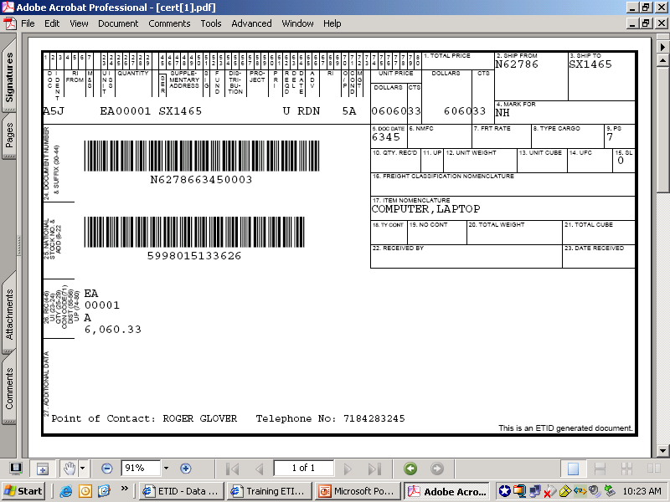
DD 1348-1A Laptop, Computer
DD Form 1348-1A Instructions
http://www.dla.mil/DispositionServices/DDSR/TurnIn/1348Help/
In this example, the Item is coded “7” because the Demil Code is other than “A”, “B”, or “Q” AND another CIIC may be appropriate. In this case the laptop probably held classified or secret data.
See DoDI 8500.01, DoDM 4160.21-V4, Encl 3, Information Technology
5
Notes:
Presenter
2013-07-18 16:12:37
--------------------------------------------
Disposal Turn-in Document

Slide 6
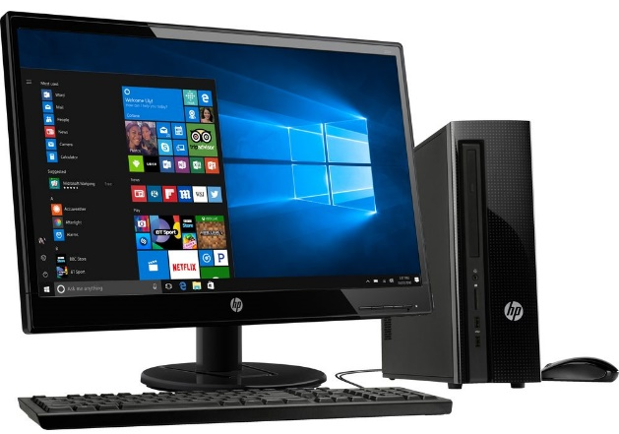
Remove Before Turn In
Ensure the following are removed from the computer equipment:
Backup Tapes
CD-ROM/DVD-ROM Media
Compact Flash Cards
Floppy Diskettes
Memory Sticks
Micro-drives
Multi-media Drives
PCMCI Cards
Secure Data Cards
Smart Card Media
Zip Media
ALL classification stickers and/or markings must be removed PRIOR to turn-in to DLA Disposition Services
6

Slide 7
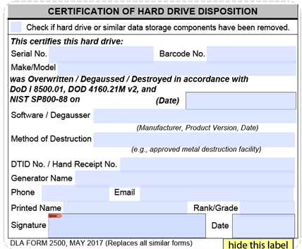
Hard Drive Turn In
Ensure hard drive is Labeled with the DLA Form 2500 (or equivalent)
Ensure DTID No. is recorded
Fill out label completely
ALL classification stickers and/or markings must be removed PRIOR to turn-in to DLA Disposition Services
7

Slide 8
CPUs Without Hard Drives
Ensure hard drive is removed
Label CPU chassis/housing with the DLA Form 2500 (or equivalent)
Internal devices (e.g. graphic, sound, network or
controller hard may stay in CPU
NOTE: When hard drive is removed, use chassis serial number
8

Slide 9
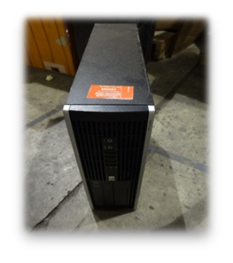
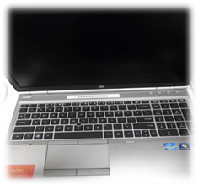
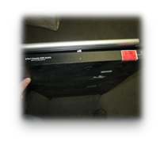
CPUs With Hard Drives
Ensure the hard drive has been degaussed or overwritten
IAW the DoDI 8500.01, Cybersecurity, March 14, 2014
Label CPU chassis/housing with the DLA Form 2500 or equivalent
Ensure hard drives from other forms of computer equipment,
i.e., notebooks, desktops, laptops, and docking stations are
degaussed/over-written
Internal devices (e.g. graphic, sound, network or controller hard may stay in CPU
Ensure CPU contains no CLASSIFIED, CONFIDENTIAL or HAZARDOUS material
ALL classification stickers and/or markings must be removed prior to turn-in to DLA Disposition Services
9

Slide 10
Hard Drive Scrap Turn-In
A label is not required if hard drive is destroyed and turned in as Scrap.
The following statement must be on/or with the turn in document if the Generator requires verification that the hard drive was turned into DLA Disposition Services as Scrap:
"The residue, identified by this document, is derived from the processing of computer hard drives based on the requirements of the DoDI 8500.01, Cybersecurity, March 14, 2014"
Complete standard fields:
Box 2 - SHIPPED FROM BLOCK
Field 24 - DOCUMENT NUMBER
Field 26 - POC Information
Not required:
Quantity, Price or NSN annotation
10

Slide 11
Other Related Devices
Filled-out DD Form 1348-1A
No label is required
No serial numbers required
(unless required by your
Supply element)
Each NSN, FSG/FSC type property require it’s own turn in document (DD Form 1348-1A https://www2.dla.mil/officialForms/files1/DL2500.pdf)
11

Slide 12
Standard Turn in for Devices
Monitors
Printers/Plotters (toner cartridges must be removed)
Keyboards/Speakers/Mouse
CPUs/Laptops
Modems
Mouse/Mice
Projectors
Phones
Ethernet switches/Servers
ALL classification stickers and/or markings must be removed prior to turn-in to DLA Disposition Services
12

Slide 13
TEMPEST Technology Items/Equipment (TTIE)
DoD Manual 4160.21 Volume 4, October 22, 2015
https://www.esd.whs.mil/Portals/54/Documents/DD/issuances/dodm/416021_vol4.pdf
Definition - TEMPEST is a term used to denote measures for preventing compromising emanations (electronic/ electromagnetic) from electrically operated devices. More simply put, TTIE has been manufactured with additional devices built in to prevent monitoring.
The turn-in document will be annotated that item has TEMPEST application and has been sanitized prior to turn-in.
DoDI 8500.01, Cybersecurity, March 14, 2014
The generating activity will sanitize the equipment of all classified/sensitive data and software prior to turn-in to the Disposition Service Site. These items will then be considered Strategic List Items and incorporate all appropriate controls.
13
Notes:
Presenter
2013-07-18 16:12:40
-------------------------------------------- TTIE

Slide 14
TTIE
The following indicators may assist in the identification of TEMPEST Technology Items/Equipment (TTIE):
Documentation sometimes is marked with the word “TEMPEST”
Attached SF Form 120, Reports of Excess Personal Property, cleared by DISA may reflect IT is “TEMPEST”
Review of data plate on rear of property reveals the word “TEMPEST”
Equipment is embossed with “TEMPEST warnings”
Manufacturer model number puts the letter “T” within the number, e.g., CPT Corp., Model 8000T
Tags may be glued to equipment stating, “This machine processes up to
TOP SECRET”, or lower classification such as CONFIDENTIAL
14

Slide 15
COMSEC AND CONTROLLED CRYPTOGRAPHIC ITEMS (CCI)
Disposal of items under the 5810 (COMSEC) and 5811 (cryptologic) FSCs with a Controlled Inventory Item Code (CIIC) of 9 CANNOT be accepted for turn in
Without a Declassification Statement or Certificate
“I CERTIFY THE ITEM(S) HEREON HAS BEEN DECLASSIFIED / SANITIZED AND TO THE BEST OF MY KNOWLEDGE AND BELIEF CONTAIN NO SENSITIVE DATA/MARKINGS.” (Ref: DoDM 4160.28-V3, Encl 3, Appendix, Figure 2)
5810 (COMSEC) and 5811 (cryptologic) FSCs with a Controlled Inventory Item Code (CIIC) of 9 Must be processed in accordance with National Security Agency (NSA) regulations prior to turn-in of residue
All other items, NON CIIC 9, MAY BE ACCEPTED for example:
Brackets
Dials
Access panels
Retainers
15
Notes:
Presenter
2013-07-18 16:12:37
--------------------------------------------
Disposal Turn-in Document

Slide 16
PRIVACY ACT PII
Blackberries, copiers, hard drives, laptops that may create, process, store or transmit personally identifiable information (PII) must be sanitized to make the recovery of PII impossible
Medical devices, scanners, radiography that commonly hold patient privacy PII must be sanitized to make the recovery of PII impossible
Other:
NSA-managed material that is assigned DEMIL codes F, G, or P CANNOT BE ACCEPTED, unless the material has been demilitarized and is accompanied by a demilitarization certificate
16
Notes:
Presenter
2013-07-18 16:12:37
--------------------------------------------
Disposal Turn-in Document

Slide 17
Quick Links
Disposition Services Website https://www.dla.mil/DispositionServices.aspx
Everything you Need for Turn In, “Smart Book” https://www.dla.mil/DispositionServices/Offers/CustomerSupport/Library/Handbooks.aspx
Finding your Disposition Services Representative/DSR http://www.dla.mil/DDSR/
Service Level Briefs http://www.dla.mil/DispositionServices/networkoptimization/
DLA Customer Assistance Handbook CAC-enabled https://headquarters.dla.mil/DLA_Customer/Operations/Publications.aspx
Let us know how we are doing! https://ice.disa.mil/index.cfm?fa=card&s=683&sp=128709&dep=%2aDoD
17

Slide 18
References
DoD Manual 4160.21 Volume 4 https://www.esd.whs.mil/Portals/54/Documents/DD/issuances/dodm/416021_vol4.pdf
DoDM 4160.28-V3, Defense Demilitarization, June 7, 2011
DoD Instruction 8500.01, Cybersecurity, March 14, 2014
DoD 5400.11-R, Department of Defense Privacy Program, May 14, 2007
18

Slide 19
Property needs to be turned in as individual line items with their assigned, valid National Stock Number (NSN). Several items can be turned in under one line item, however they must be the same NSN. NSNs can usually be located on a serial plate or stamped on property. Find the Federal Supply Class of your property: https://public.logisticsinformationservice.dla.mil/H2/search.aspx
Find Your Property NSN
Find Information on your property by using:
19

Slide 20
20

