Slide 1
DLA Distribution Industry Engagement Plan Refresh
Margaret Ross, Director J7
July 31, 2022

Slide 2
DLA Distribution J7
MISSION
Deliver comprehensive acquisition solutions to the global distribution network
VISION
To be the leader in every facet of acquisition
OUR COMMITMENT
Our Team is First Provide opportunities for professional and personal growth establishing an environment for success. Team members are our most valuable resource, professional
acquisition employees cannot be mass produced.
Our Customers Satisfy our customers in terms of cost, quality and timeliness of the delivered product or service. Deliver superior results with initiative, consistently exceeding expectations.
Leadership Know, value and be accountable to our team. Be the organization’s greatest champion, celebrating accomplishments. Talk the talk and walk the walk.
Stewardship Safeguard taxpayer’s dollars, conducting business with integrity, fairness, and openness; minimizing operating costs. Meet public policy objectives and deliver quality work with personal responsibility and accountability.
Communication Information will be passed up down and across the organization to enhance productive interpersonal relationships among team members, leadership, and customers.
Knowledge Sharing Build positive relationships among and across the team through collaboration, sharing best practices, and embracing diverse perspectives to strengthen decision making. Knowledge sharing is an asset and vital to our success.
2

Slide 3
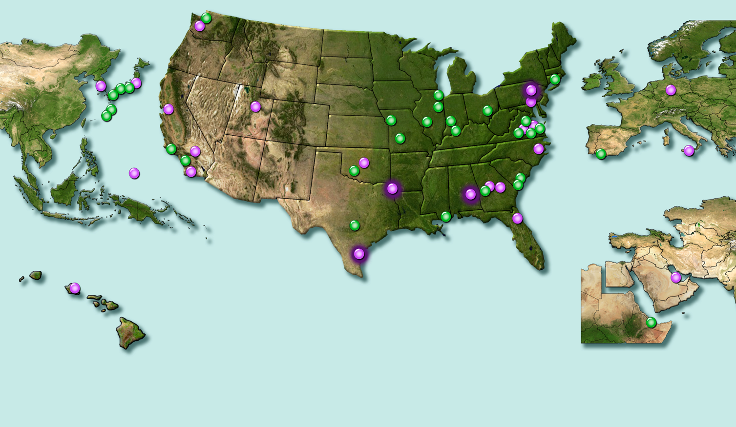
DLA Distribution
Locations
A Global Footprint
More than 50 locations in 20 states and eight countries, including:
Storage and distribution functions
Consolidation and containerization points
Theater consolidation and shipping points
Materiel processing centers
Recruit training centers
Meals ready to eat storage sites
Distribution centers
Distribution sites
(specialized services/capabilities for local customers)
Notes:
DLA Distribution employs almost 10,000 people and has more than 50 locations worldwide. Those locations include distribution centers, an expeditionary team that serves as a mobile distribution center, consolidation and containerization points, theater consolidation and shipping points, materiel processing centers, recruit training centers and meals ready to eat storage sites.
DLA Distribution supply centers manage materiel and offer services including storage, distribution, custom kitting, specialized packaging as well as transportation support and technology development—all aimed at increasing warfighter readiness. The centers and sites have more than 2.5 million item numbers in stock worth more than $142 billion.
In fiscal year 2020, DLA Distribution shipped almost 12,000 containers and more than 8,500 air pallets.
To ease the delivery of materiel and prevent breaking down and building up of pallets, DLA Distribution uses a “pure pallet” concept, which simplifies and speeds up airlift shipments to the customer. It involves building and shipping individual aircraft pallets with cargo for a specific customer, unlike mixed pallets, where a customer's cargo is normally loaded onto an aircraft pallet with cargo for other customers within the same region.
As of June 2021

Slide 4
DLA Distribution Location Acronyms
DDAA – Anniston, AL
DDAG – Albany, GA
DDBC – Barstow, CA
DDCN – Cherry Point, NC
DDCT – Corpus Christi, TX
DDDA – Djibouti, Africa
DDDC – San Diego, CA
DDDE – Europe
DDDK – Korea
DDGM – Guam
DDHU – Hill, UT
DDJC – San Joaquin, CA
DDJF – Jacksonville, FL
DDNB – Bahrain
DDNV – Norfolk, VA
DDOO – Oklahoma City, OK
DDPW – Puget Sound, WA
DDPH – Pearl Harbor, HI
DDRT – Red River, TX
DDRV – Richmond, VA
DDSI – Sigonella, Italy
DDSP – Susquehanna, PA
DDTP – Tobyhanna, PA
DDWG – Warner Robins, GA
DDYJ – Yokosuka, Japan

Slide 5
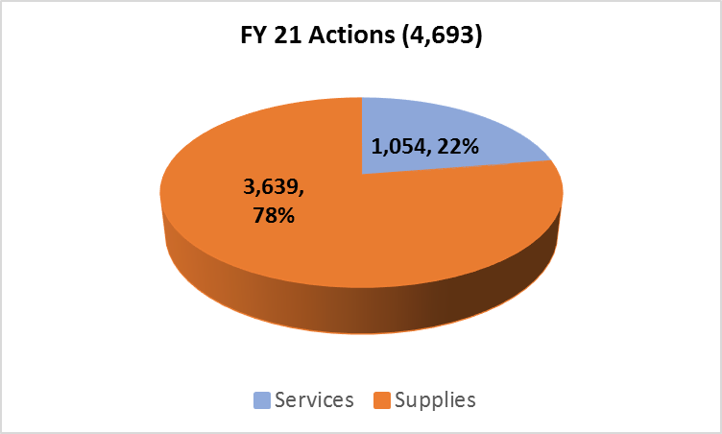
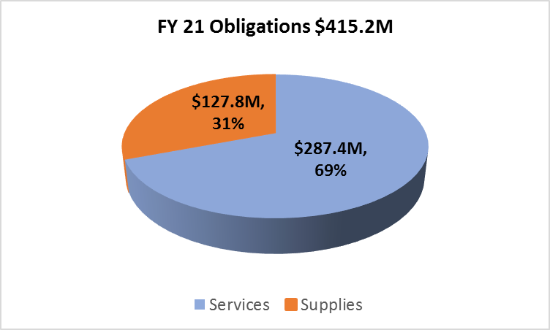
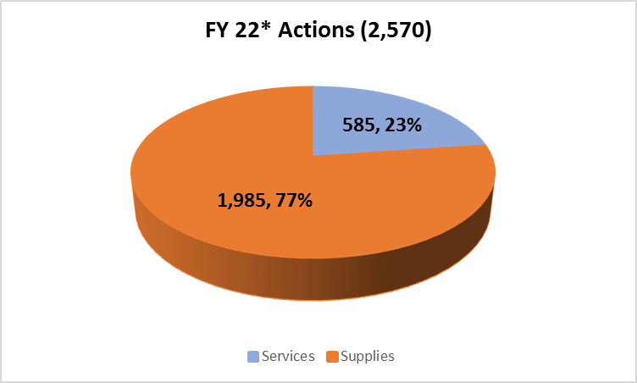
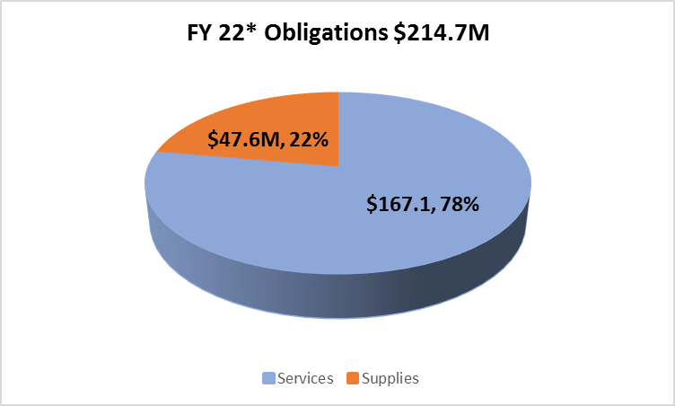
How We Approach Business
DLA Distribution J7 Procurement Profile
* YTD 4/30/2022
5

Slide 6
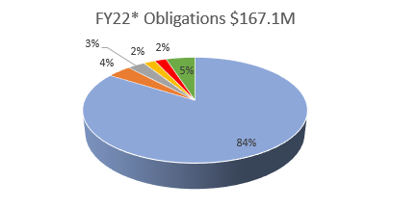
DLA Distribution
Spend Profile - Services
Distribution Operations
  12 GOCOs/COCOs
  S&D of MRE, FF&V
  Labor Augmentation
  3PL Haz Material Support
Global Distribution Expeditionary Contract
Professional Services
Facilities
  Equipment Maintenance & Repair
  Janitorial
  Facilities Maintenance & Repair
Construction
*YTD 4/30/22
Notes:
Professional, Management Support – Accenture services

Slide 7
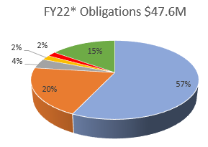
DLA Distribution
Spend Profile - Supplies
Operational
  Boxes & Envelopes
  Packaging Material (bubble wrap, sealed air)
  Pallets
COVID Related & Cold Chain
Automated Material Handling Equipment
Modernization/Communications (i.e. Voicepick)
Office Supplies (i.e. Tape, labels)
Facilities (i.e. Racking)
*YTD 4/30/22
Notes:
Deleted
Facilities
Racking
UNICOR Racking IDIQ –
Awarded June 2017
30 Day Turnaround
5 year contract/$65M ceiling

Slide 8
How We Approach Business
How We Buy
Actions – 2,361
Amount - $414M
FY21
Source: SAM.gov
8

Slide 9
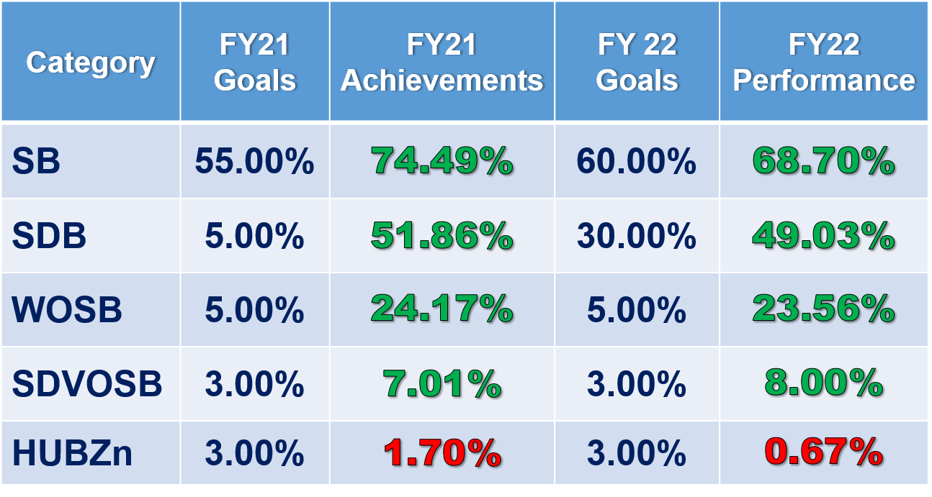
How We Approach Business Small Business
YTD 6/21/2022

Slide 10
How We Approach Business
FY22 Competition Data
Goal 88%*
FY 22 Overall Achievement**
96.47% ($211,449,614.35) Competed
3.53% ($7,729,422.01) Not Competed
100% ($219,179,036.36)
*Pending Approval
**FY21 Overall Achievement 92.17%
YTD 6/16/2022

Slide 11
How We Approach Business Market Research
Searches
  Internet - search engine
  GSA
  Small Business Dynamic Search (NAICS search)
  Small Business tracking spreadsheet
    Locally maintained
    Contact DLA.Distribution.OSBD@dla.mil to be added
  History – within Distribution procurement tool/FPDS
Sources Sought Postings (SAM.GOV)
Past Performance (Informal Offeror List)
Potential New Market Intelligence Tools
  FactSet
  ThomasNet
Capabilities Info/Line Cards sent to DistributionJ7@dla.mil will be
provided to appropriate Contracting Officers
11

Slide 12
DLA Distribution J7 Information
Solicitations and Requests for Information are advertised at SAM.GOV
  Search for DLA Distribution under DODAAC SP3300
  Contact information will be available within each Solicitation/Request for Information
  Vendors can setup searches and turn on notifications (See GSAFSD_kb_articles - GSA Federal Service Desk Service Portal)
Oral quotes may be used for items under $25k
The Procurement Technical Assistance Center (PTAC) in your region may be able to assist in finding contracting opportunities
  Their contact information may be found at http://www.dla.mil/HQ/SmallBusiness/PTAP/PTAC
Please contact us at DistributionJ7@dla.mil if you have any questions

Slide 13

DLA Distribution J7
Industry Engagement (IE) Plan
DLA Director’s Intent
Warfighter Always is our #1 priority
DLA’s Strategic Plan meets the evolving requirements of the Warfighter and the Nation with a target transformative approach encompassing the most critical priorities for the next five years
To reflect current conditions, DLA introduced a refreshed Industry Engagement Plan to supplement the DLA Strategic Plan 2021-2026
DLA Distribution J7’s IE Plan builds off of
DLA HQ’s IE 5 Focus Areas (FA)
Supplier Communication and Interaction
Balancing Business Decisions and Fiduciary Responsibilities
Supplier Feedback Management and Advocacy
Drive Efficiencies and Innovation in Our Business
Assess and Mitigate Supply Chain Risk
Metrics to performing against this plan include:
Manage acquisition performance
Meet SB (60%) and Competition (88%) Goals
Refresh DLA Distribution IE Plan
Participate in DLA HQs Industry Association Webinar – Demand Forecast
Conduct DLA Distribution Industry Day FY 23 3rd Qtr
Monitor DLA HQs LOE 4.1.1 (Strategic Suppliers) pilot for lessons learned
Participate in DLA HQs LOE 4.3 (AMIDA) meetings

Slide 14
FA I: Supplier Communication
and Interaction
IE ACTIVITY | PURPOSE | DATE | STATUS
Industry Guide | Provides constant market outreach | Jun 2023
Business Opportunities Forecast | Semi-annual communication of upcoming requirements posted to SAM.GOV | Jul & Jan
Industry Day | Meet with vendors to grow Distribution’s industrial base | Jun 2023
One-on-one Event | Provides vendors an opportunity to meet Contracting Officers | Jun 2023
Vendor Networking Event | Facilitate dialogue between vendors to encourage partnering/teaming opportunities | Jun 2023
Demonstration Agreements | Establishes procedures between DLA Distribution personnel and vendors seeking to demonstrate their company’s capabilities with DLA Distribution | Ongoing
G
G
G
G
G
G

Slide 15
FA I: Supplier Communication
and Interaction (continued)
IE ACTIVITY | PURPOSE | DATE | STATUS
Strategic Suppliers | Monitor LOE 4.1.1 (Strategic Suppliers) pilot for lessons learned | Ongoing
Market Intelligence | Participate in LOE 4.3 (AMIDA) meetings and post sources sought to SAM.GOV | Ongoing
Pre-proposal Conferences (AB-AF) | Vendors learn the specifications and requirements of a solicitation | Ongoing
Post-award Conferences | Allows for mutual understanding of all contract requirements | Ongoing
Program Management Reviews | Regular Program Management reviews with Strategic Supplier Business Leaders | Ongoing
Other DLA Activities | Participate in HQs/other Industry events | Ongoing
DistributionJ7@dla.mil | Monitor for communication from vendors | Ongoing
G
G
G
G
G
G
G

Slide 16
FA II: Balancing Business Decisions
and Fiduciary Responsibilities
IE ACTIVITY | PURPOSE | DATE | STATUS
Small Business Goals | Defined acquisition metrics used to maintain and strengthen the overall economy | Ongoing
DLA Small Business Offices | Grow interaction & communication with HQs & local offices | Ongoing
Competition Goal | Defined acquisition metric used to foster competition and reduce costs | Ongoing
Public Private Partnership Model | Partner with industry on product support bids as the storage & distribution provider | Ongoing
G
G
G
G

Slide 17
FA III: Supplier Feedback Management
and Advocacy
IE ACTIVITY | PURPOSE | DATE | STATUS
Increased Coordination with the Procurement Technical Assistance Center | Onsite training, participation in our Industry Day, and increase SB referrals (Network of procurement professionals that provides individualized counseling to assist businesses in competing successfully in the government marketplace) | Ongoing
Industry Feedback Survey | Survey Industry Day participants to obtain feedback for consideration of topics/training for inclusion in future Industry Day events | Jun 23
DLA Supplier Survey | Develop action plan to address any areas needing improvement | FY 23
G
G
G

Slide 18
FA IV: Drive Efficiencies and Innovation
in Our Business
IE ACTIVITY | PURPOSE | DATE | STATUS
Long Term Contract Maximization | Look for opportunities to combine customer’s recurring requirements into long term contracts so delivery/task orders may be used to fill needs quicker | Ongoing
Benchmarking with Industry | Look for opportunities to combine training with industry (onsite visits & training courses) | Ongoing
Strategic Contracts | Provides additional capability when conditions warrant | Ongoing
Acquisition Assistance | Provides assistance to customers in researching industry and developing requirements in a strategic E2E process | Ongoing
Business Development | Support Business Development’s interaction with industry | Ongoing
Understand Industry | Participate with associations such as NCMA, NDIA, NIB, etc | Ongoing
G
G
G
G
G
G

Slide 19
FA V: Assess and Mitigate
Supply Chain Risk
IE ACTIVITY | PURPOSE | DATE | STATUS
Training & Development | Classes provided in LMS and administration of a Workforce Training & Development Program | Ongoing
Prevention of CAGE Hopping | Notify when vendors change CAGE codes | Ongoing
Compliance & Oversight (ARB, APM, CQR, and Pricing) | Monitors for compliance with acquisition regulations and provides recommendations to mitigate risk | Ongoing
Post Award Oversight (CPARS & COR) | Proactive approach to mitigate risk by properly reporting performance | Ongoing
Contract Quality Assurance Team | Monitors contract quality performance and reports results to Command | Ongoing
Audit Advancement | Enables responses to auditor’s requests for evidential matter | Ongoing
G
G
G
G
G
G

