Slide 1
Construction & Equipment
September 19, 2018

Slide 2
Agenda
Leadership and Organization
Who we are
Big Picture
Division / Program Overview
Conclusion

Slide 3
Construction & Equipment Organization
Construction & Equipment
Director Gerald Raia, CAPT, USN
Deputy Director Tom Grace
Customer Operations
Director Marko Graham
Supplier Operations
Director Howard (Tom) Page
Customer Facing Division
Lighting, Comml Hardware, HVAC Div
CRM Cells
Collective Customer Facing Div
MRO & Metals Division
Exec Agent Program Office
Fire & Marine Division
Move & Store Division
23 ISTs
Misc Equipment Division
Class IV Division
SMSG
Supplier Support Division
Notes:
C&E has 8 Supplier Operations Divisions that support a diverse range of products. Major positions are:
1102s = 144 / 111 Kos (most warrants under SAT, some $1 mil, some $6.5, handful of unlimited)
2010s = 42 Supply Planners
1910s = 36 Product Specialists
C&E has 3 Customer Operations Divisions and an Executive Agent Program Office. Major positions are:
301s = 60
2010s = 12 Demand Planners

Slide 4
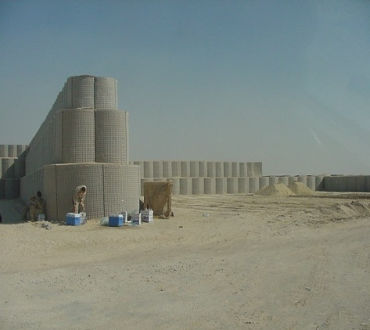
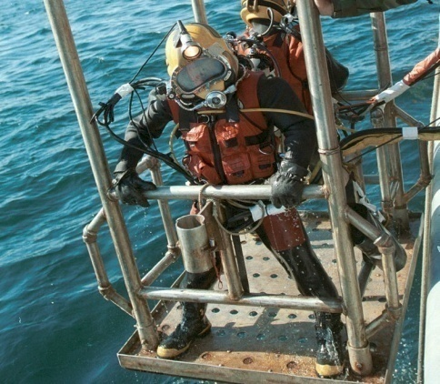

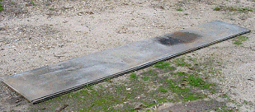
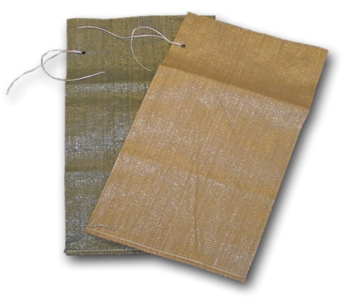
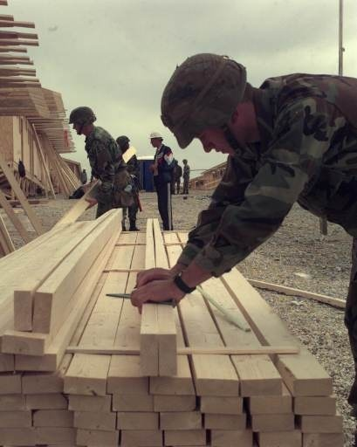
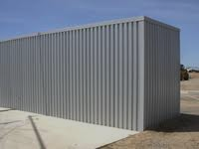
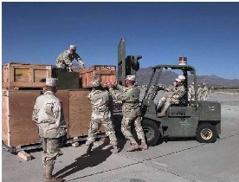
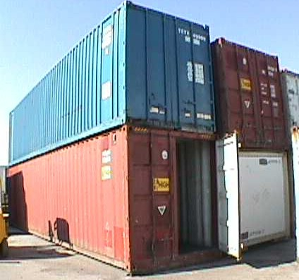
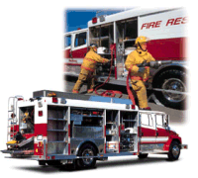
Construction & Equipment Supply Chain
“Lightbulbs to Bulldozers”
Barriers
Concertina Wire
Diving Equipment
Metals
AM2 Matting
Sandbags
Lumber
Revetments
Forklifts
Containers
Fire Trucks
Lighting
Notes:
C&E is a unique supply chain supporting the warfighter with a wide range of items from light bulbs to bulldozers.
One size does not fit all so we employ several types of acquisition approaches based on market research on customers’ needs and industry capability.
Tailored Logistics Support Contracts (81% of Obligations)
(MRO/SPEC OPS/Metals/Lumber/Fire Fighting and Emergency Services)
Long Term Contracts (14% of Obligations)
(HEPP)
Traditional Contracting (5% of Obligations)
(Lighting)
85%+ of obligations on Long Term Contracting vehicles that leverage commercial supply chains to decrease direct material costs and inventory levels (BIG IDEAS)

Slide 5
Class IV… Construction & Equipment
FY18 Projection
$4.8B
The Big Picture
Customers & Items
Sales
Inventory
Personnel & Vendors
$Billions
Customers: 15,000
Orders: 1M annually
Items: 295,000
344 Federal Stock Classes
$Millions
Employees (FY17 Actual):
363 civilian
+ 8 military
Suppliers: 2,387
Notes:
FY18 Midyear Projection $4.245B
FY09 FY10 FY11 FY12 FY13 FY14 FY15 FY16
Sales 2.695B 3.246B 2.918B 2.834B 2.362B 2.252B 3.028B 3.146B
Obligations 2.599B 2.935B 2.522B 2.321B 2.043B 2.336B 2.758B 2.993B
Inventory 475.5M 511.5M 521.4M 464.1M 410.3M 397.49M 442.8M 589.1M
POC: Adam Kopcho – sales
Jamie Hagan – inv
Personnel POC:, Amelia McGarvey, Gary Lefebvre, Cathy Kelley
FY17 civ authorization used FY16 actuals 351 (interns not incl)
FY17 mil auth used FY16 actuals 8
FY17 business statistics POC: Kathleen Sheehan
Customers: 15,000
Orders: 1.1M annually
Items: 295,000 (344 Fed Stock Classes)
Suppliers: 2,387

Slide 6
Construction & Equipment Business
FY17 Sales @ Standard
FY17 actual
$3.530B
Notes:
* FY 17 Forecast is pending mid-year adjustment.

Slide 7
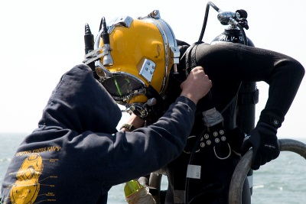
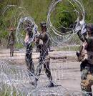
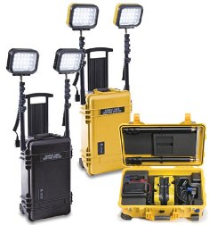
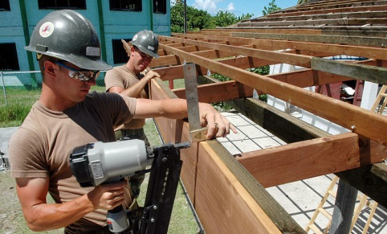

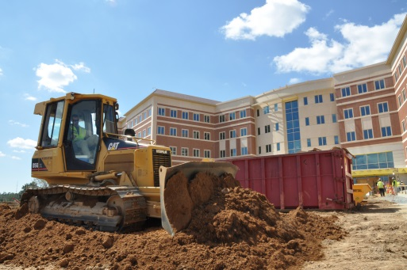
Construction & Equipment
A Unique DLA Supply Chain
…effective and efficient logistical support
Three Types of Programs
Tailored Logistics Support
Special Operational Equipment
Maintenance, Repairs and Operations Supplies
Metals
Lumber
Fire & Emergency Services
Long Term Contracts
Heavy Equipment Procurement Program
FEMA Generator Leasing Contract
Traditional
Safety & Rescue Equipment
Containers & RFID Tags
Lighting
Material Handling Equipment
Notes:
Construction & Equipment is a unique supply chain supporting the war fighter on a large variety of items from fire extinguishers to fire trucks
C & E has several types of Acquisition Programs, which focus’s on the needs of the war fighter
Prime Vendor / Tailored Logistics Support Contracts are long term contract with a commercial distributor, original equipment manufacturer (OEM), or third party logistics provider for integrated logistics support that may include forecasting, inventory management, distribution, engineering support, technical services or other services to support customer needs and normally include performance metrics. The benefits of the PV and TLSP programs include brand name preference, competitive pricing, commercial warranties, and 24 customer support. The program has also resulted in reductions in lead-times and significant processing cost savings An example is the Fire & Emergency Services Program includes a wide range of equipment, incidental services and training in support of the “First Responders” and “Domestic Preparedness” groups
Long Term Contracts / Traditional – these are the traditional forms of contracting that focus’s on contracting direct with OEMs. The Heavy Equipment Program commonly referred to as HEPP allows customers to customize their purchases of items like Fire Trucks based on their needs. Also within the area of traditional support the C&E Lighting Team offers the full range of commercial lighting and a full catalog of portable and hand held lighting such as self generated lighting towers, tent lights, flash lights and drop lights.

Slide 8
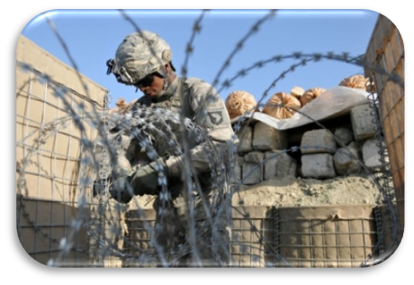
High Level Projects - C&E
Puerto Rico Temporary/ Emergency Power
Support FEMA with leased generators, actively partnered with FEMA and US Army Corps of Engineers (USACE)
Provided 1,261 leased generators,
28 transformers, and purchase of 3 BOMs and 9 fuel tanks
Puerto Rico Power Grid Reconstruction
Primary material provider to USACE in support of Hurricane Maria
Provided all materiel required to reconstruct the severely damaged electrical grid
Wildland Fire Protection Program FY17
Provided $29.3M of materiel support spanning 150 items
  28% of sales attributed to 5 critical
  Fire Hoses
  Over 7,000 orders filled to support federal, state and local entities during the fiscal year
Filled over 700 emergency orders during peak fire season
  National Preparedness Level remained heightened for 75 days, exceeding the
  10-year average of 27 days
  Emergency orders increased 128% from 2016 fire season
Class IV Equipment and Force Protection barriers
Globally Postured for Military Readiness

Slide 9
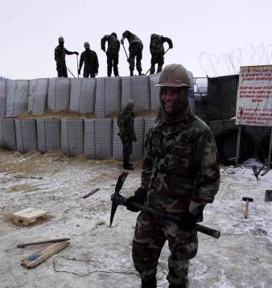
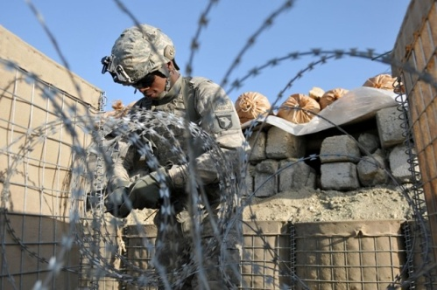
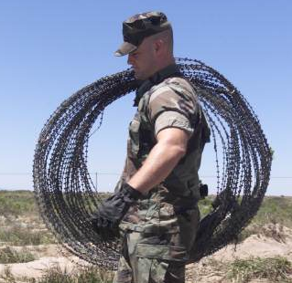
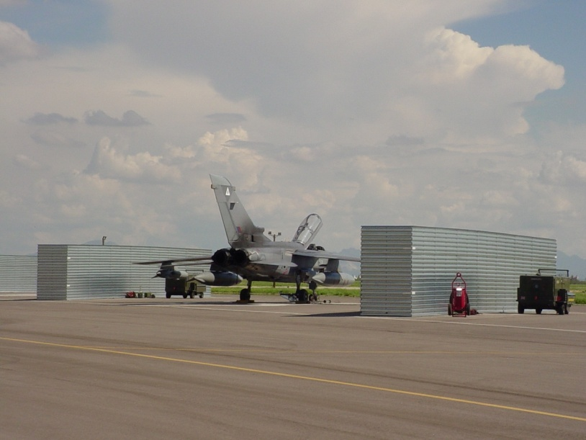
Executive Agent for Class IV
Construction & Barrier Material
DLA provides E2E support to the customer
Oversight of Construction & Barrier material
Construction Material
    Lumber/Plywood
Barrier Material
    Concertina/Barbed Wire
    Fence Posts (Pickets)
    Barriers
    Sandbags
Ground Stabilization Material
    AM2 Landing Mat
    Sand Grids
Notes:
Executive Agent for Class IV:
Class IV Executive Agent (EA) Program Office established
EA Program Office currently 70% staffed
- Project Managers actively working the gap resolution process
- Troop Support Planners actively engaging the COCOMs and providing CL IV
specific support to COCOM planning conferences and exercises
Way Ahead:
- Ensure E2E supply chain support by continuous planning and coordinating with
COCOM planners, TRANSCOM, and Industry
- Enhance support through increase of Material Availability and reduction of
Customer Wait Time in partnership with the DPO
- Build system and information functionality and capabilities to support a cohesive
E2E supply chain
- Establish a joint planning tool in place to support daily operations and
requirements
- Establish joint processes to support total asset visibility in place to support daily
operations and requirements

Slide 10


MRO / Metals Division
Maintenance Repair & Operations (MRO) Supplies
Tailored Logistics Support
Electrical
Plumbing
HVAC
Paint
Lumber
Major Customers | Suppliers
AMC ARCENT NAVFAC | Supply Core SAIC Theodor Wille Intertrade ADS Noble Supply
Tools
Hardware
Building Supplies
Incidental Services
FY17 Sales $681M
Notes:
Tailored Logistics Support Contracts with integrated suppliers
Scope: Broad range of building supplies and items required for facilities maintenance.
CONUS suppliers: Graybar/SAIC/SupplyCore
CENTCOM Suppliers: TWI/Seven Seas/SupplyCore
Japan: SupplyCore/Korea-Universal SODEXHO
Features:
1. Leveraged buying: LTC with integrated suppliers
2. Improved Customer Service:
95% fill rates
Delivery BOMs JIT = reduce time and costs
Incidental services/Tech support
Reduce inventory-Manage supply chains eliminating need for wholesale/retail inventory
Other NSNs already on PV Programs:
2227 NSN with annual sales of $58.9 million
Metals – 268 NSN / $7.7 mil
Spec Ops – 527 NSN / $44.3 mil
Metal – 1432 NSNs / $6.9 mil

Slide 11
MRO Support
SupplyCore. - Alaska
CENTCOM – ADS; Noble
Noble – MRO North of the Alps
ADS -
MRO Mediterranean
SupplyCore – Japan & Korea; supports contingency operations in PACOM to include Philippines, Australia, etc.
10 contracts CONUS support – SAIC; SupplyCore; Graybar; Noble
SAIC – Hawaii, Guam, Marshall Islands
SOUTHCOM AOR traditionally supported through South Central U.S. and Southeast U.S. MRO Contractors
Noble Supply & Logistics – MRO Eastern Africa
Atlantic Diving Supply (ADS) – MRO Western Africa

Slide 12



Fire and Marine Division
Special Operational Equipment
Tailored Logistics Support
Masks
Diving Helmets
Regulators
Dry/Wet Suits
Cylinders
Umbilical Lines
Life Vests
Life Rafts
Sonar Devices
Search Lights
Eyewear
Sights and Mounts
Assault Ladders
Tactical Lights
Major Customers | Suppliers
PEO Soldier NAVSUP USA Rapid Equipping Force Naval Special Forces | ADS Inc Tactical & Survival Specialties WS Darley & Co Federal Resources Quantico Tactical Unifire
Worldwide Coverage
FY17 Sales $1.430B
Notes:
SOE TLSP Awarded as a Total Small Business Set-Aside March 7, 2014 with a maximum value of $10 Billion
Broad scope
Multiple Award TLS Program where Delivery Orders are competed amongst the six (6) Vendors under Contract
Atlantic Diving Supply (ADS)
Federal Resources
Tactical & Survival Specialties, Inc. (TSSi)
Quantico Tactical
Source One Distributors
W.S. Darley
All Delivery Orders are competed for a Best Value determination
LPTA
Trade-Off (higher price for expedited delivery)
As industry experts the TLS Vendors have established relationships with most manufacturers and truly have leveraged buying power
Repeat purchase of items allows the Vendors to attain lowest price/discounts based on sales/order volume, which is passed onto Government
SOE TLSP embraces “Better Buying Power” initiative by Frank Kendall (Undersecretary for Acquisition, Technology, & Logistics)
TLS Vendors maintain inventory of high demand/high frequency items to reduce lead times and attain lower price based on order quantity/values
Reduction in DLA inventory
FOB Destination pricing and TLS Vendors have established partners with major carriers (DHL, Fedex, and UPS) for rapid delivery to end locations
Bill Of Material (BOM) ordering allows for numerous items/quantities to be ordered at the same time from multiple manufacturers with various shipping destinations for the customer
Routine customer interaction by TVLS’s to ensure customer satisfaction
Delivery Orders are competed and awarded between 7-14 days
Emergency Orders can be awarded in 24 hours or less
24/7 Vendor Support (example: OUA and Hurricane Sandy)
Personal Protective Equipment (goggles, boots, gloves, aprons, personal air purifying respirators-PAPR, etc…)
Latest and greatest commercial items are supported besides traditional DLA business managed by NSN
Army
PEO Soldier Ft. Belvoir, VA
Natick (Expeditionary Equipment such as Tents, Shelters, and power generation equipment)
Navy
Naval Surface Warfare Center (NSWC) Crane, Indiana (acquisition engineering, in-service engineering and technical support for sensors, electronics, electronic warfare and special warfare weapons.) FMS Ordering is done from NSWC
SPAWAR (thermal imaging equipment, lasers, sensors, diving equipment)
Marine Corps
MARCORSYSCOM
Consolidate Equipment Division, Albany Georgia
Air Force
PEO Aviation - Unmanned Aerial Vehicles (UAVs)
Major Items
Small unmanned Ground Vehicles (SUGV), Unmanned Aerial Vehicles (UAV), Green Laser Interdiction System (GLIS), Night Vision Goggles (NVG), Thermal Imaging Equipment, Communication Devices, Ballistic Eyewear, and HDT Expeditionary Equipment (Commercial Tents, Shelters, and Power Generation Accessories)
Major Manufacturers
L3 Insight Technologies, iRobot, Aerovironment, BAE Systems, Thales Communications, Harris Communications, Revision, Eye Safety Systems, and HDT Expeditionary Systems

Slide 13

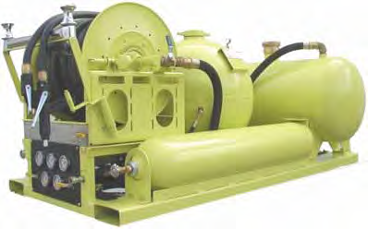
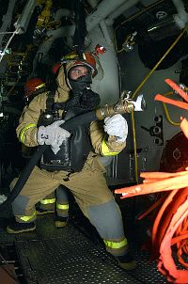
Fire and Marine Division
Fire & Emergency Services Equipment
Tailored Logistics Support
Fire alarm systems
Suppression, Surveillance, Emergency Station Vehicle Exhaust & Vent Systems
Major Customers | Suppliers
Shaw AFB US NORTHCOM Wright Patterson AFB Navy Expeditionary Combat Command Fort Bliss Forest Service | ADS Inc WS Darley & Co L.N. Curtis & Sons Mallory Co Federal Resources Unifire
Breathing Apparatus
Hoses
Nozzles
Thermal imaging equipment
Ladders
Extinguishers
First Responder Training
Repair & Overhaul of items provided
Worldwide Coverage
FY17 Sales $258M
Equipment
Training
Notes:
F&ESE TLSP Awarded as a Total Small Business Set-Aside October 31, 2013 with a maximum value of $872 million
Broad scope
Multiple Award TLS Program where Delivery Orders are competed amongst the six (6) Vendors under Contract
Atlantic Diving Supply (ADS)
Federal Resources
L.N. Curtis & Sons
Unifire
The Mallory Company
W.S. Darley
All Delivery Orders are competed for a Best Value determination
LPTA
Trade-Off (higher price for expedited delivery)
As industry experts the TLS Vendors have established relationships with most manufacturers and truly have leveraged buying power
Repeat purchase of items allows the Vendors to attain lowest price/discounts based on sales/order volume, which is passed onto Government
F&ESE TLSP embraces “Better Buying Power” initiative by Frank Kendall (Undersecretary for Acquisition, Technology, & Logistics)
TLS Vendors maintain inventory of high demand/high frequency items to reduce lead times and attain lower price based on order quantity/values
Reduction in DLA inventory
FOB Destination pricing and TLS Vendors have established partners with major carriers (DHL, Fedex, and UPS) for rapid delivery to end locations
Bill Of Material (BOM) ordering allows for numerous items/quantities to be ordered at the same time from multiple manufacturers with various shipping destinations for the customer
Routine customer interaction by TVLS’s to ensure customer satisfaction
United States Department of Agriculture (USDA) Forest Service (FS) Wildland Fire Protection Program (WFPP)
150+ NSNs transferred from GSA to DLA in May 2014
Delivery Orders are competed and awarded between 7-14 days
Emergency Orders can be awarded in 24 hours or less
24/7 Vendor Support (example: OUA and Hurricane Sandy)
Personal Protective Equipment (boots, goggles, etc…)
Latest and greatest commercial items are supported besides traditional DLA business managed by NSN

Slide 14
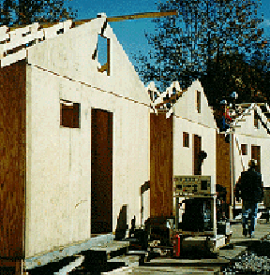
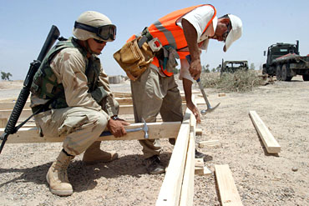
Class IV Division
Wood Products
Tailored Logistics Support
Diversified Product Line
  Softwood
  Hardwood
  Plywood
  Treated
Major Customers | Suppliers
DLA Distribution Susquehanna McAlester Army Ammo Plant Sierra Army Depot | Sylvan Industries S&S Forest Products FPD Forest Products Mid Atlantic Wholesale Lumber
Fire retardant
Poles
Pilings
Crossarms & ties
Bulk lumber
Worldwide Coverage
FY17 Sales $49M
Notes:
Program complements the MRO Program with LTCS to suppliers specializing in these product lines
Items provided include both softwood and hardwood lumber and plywood
Specialty items include fire retardant products/poles/pilings
Regional contracts are in place with orders completed.

Slide 15
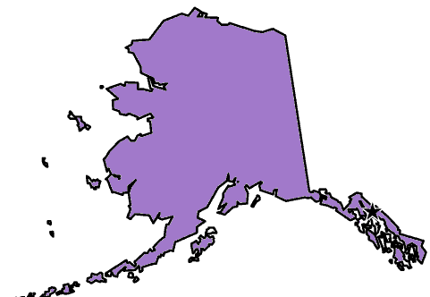




CONUS – Wood Products TLSP
West
Central
East
SPM8E611D0004 - Sylvan (0P0E1)
SPM8E611D0005 - S & S (4MD36)
SPM8E611D0006 - Buie (3RWY9)
SPM8E611D0007 - Forest (0K935)
SPM8E612D0001 - Forest (0K935)
SPM8E612D0002 - Pelican (0DSA3)
SPM8E612D0003 - S & S (4MD36)
SPM8E615D0003 - Buie (3RWY9)
SPM8E615D0004 - MA (02YC4)
SPM8E615D0005 - Forest (0K935)
SPM8E615D0006 - S & S (4MD36)
Alaska TLSP West
WA
VT
ME
MT
ND
WV
Japan/Korea
OR
MN
NH
ID
SD
WI
NY
MA
TLSP West region
WY
MI
RI
NV
NE
IA
PA
CT
OH
NJ
IN
UT
IL
DE
Hawaii/Guam
CA
CO
KS
MO
KY
TN
NC
MD
AZ
NM
OK
AR
SC
VA
AL
MS
GA
TX
LA
FL
TLSP West region
OCONUS- CENTCOM/EUCOM/AFRICOM LTC
SPE8E613D0001 - Buie (3RWY9)
SPE8E613D0002 - Forest (0K935)
SPE8E613D0003 - Haroldson (1YMJ8)
SPE8E613D0004 - Progressive (3JEM1)
SPE8E613D0005 - S & S (4MD36)
SPE8E613D0006 – Bridgewell (5YR06)

Slide 16

Class IV Division
Barriers & Stabilization Material
Long Term Contracts
Ground Stabilization Material
    AM2 Landing Matting
    Durabase Mats
    Sand Grids
Major Customers | Suppliers
CENTCOM | Allied Tube & Conduit ALFAB Inc. HESCO Bastion Infrastructure Defense Technologies Maccaferri, Inc.
Barrier Material
    Expeditionary Barriers
    Concertina/Barbed Wire
    Fence Posts (Pickets)
    Metal Revetments
    Sandbags
FY17 Sales $100M
Notes:
Purpose: To provide essential go-to-war type items to the military and primarily for CENTCOM support.
Individual long term contracts with established industry entities
Bastions – HESCO
Concertina and other Barbed Wire – Allied and Cobra
Metal revetments – IDT Infrastructure
AM2 Matting – AlFab
Items are all competitive, NSN based

Slide 17
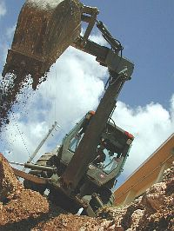
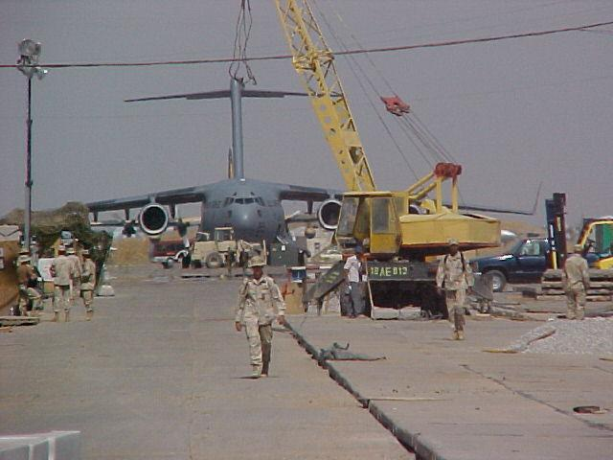
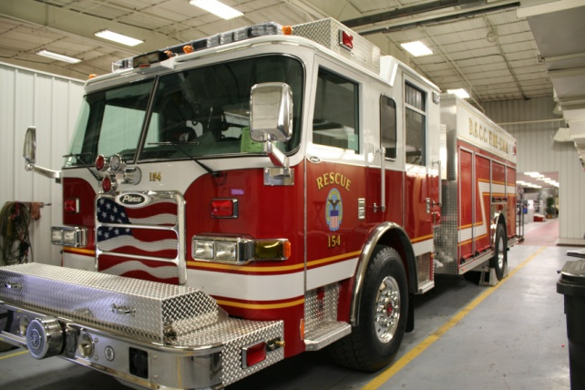
Move & Store Division
Heavy Equipment
Long Term Contracts
Major Customers | Suppliers
Warner Robins ALC NAVSUP WSS Navy Port Hueneme TACOM | Caterpillar Hyster John Deere Oshkosh Link-Belt Volvo
Construction Equipment
Material Handling Equipment
Fire Fighting & Rescue Vehicles
Environmental Products
Agriculture
Cranes
Trucks and Trailers
Sweepers and Scrubbers
Power Generation
FY17 Sales $311M
Notes:
Obtain commercial heavy equipment for military and federal services.
Accomplished w/ LTC Rqmts contracts with established commercial industry. Multiple award contracts - competes customer reqmts.
There are 7 Product Groups
Construction Equipment - Dozers, graders / Caterpillar, CASE, John Deere, Bobcat
Cranes - Construction cranes, gantry cranes / Link Belt, Grove
Material Handling - Forklifts, man lifts, articulating trucks / Hyster, Yale, Terex
Agricultural - Tractors, reapers, mowers / John Deere
Trucks and Trailers - Construction trucks and tow trailers / Mack, Caterpillar
Environmental - Compactors, runway sweepers, snow plows, water well drilling rigs / Atlantic Machinery
Fire Fighting and Rescue Equipment - Fire trucks, rescue vehicles / Pierce, KME, Kovatch
- Hundreds of major models available with thousands of optional equipment and configurations that the customer’s order.
- Commercial Warranties
- Delivery Worldwide
- 160 proposals have been received that have been and are under evaluation. Continuous open solicitation for 4 years to allow new vendors to submit proposals for evaluation. Last solicitation closed September 22, 2015. 65 contracts awarded.

Slide 18
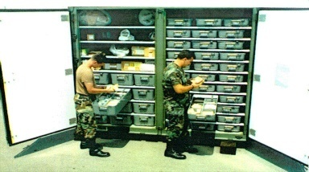
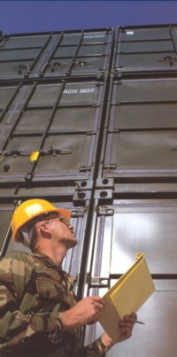
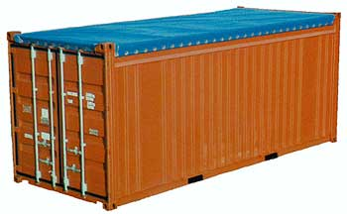
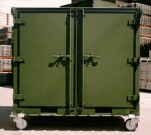
Move & Store Division
Containers
Traditional support
Container Customization services include
Racks
Shelving
Kits
A/C
Dehumidifiers
Accessory configuration kits for a variety of material weapons
Major Customers | Suppliers
Navy Norfolk USAF Guam ASALRCTR Rock Island TACOM MI | AAR BOH Sea Box W&K North American
Containers range from small oil sample bottles to 20’ and 40’ dry freight, steel cargo containers
FY17 Sales $132M
Notes:
The Container Support Program provides specialized containers for individual customer needs. Long Term Contracts with vendors cover their entire commercial catalogs of containers and related items. Warfighters use the Defense Logistics Agency’s automated system or can call their Customer Account Specialist to place their orders.

Slide 19
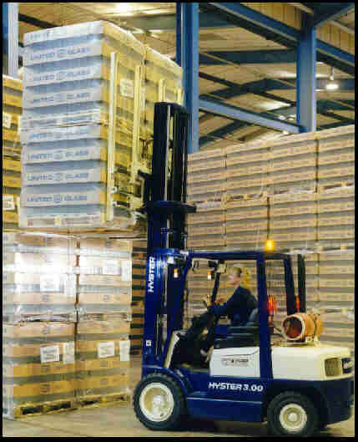
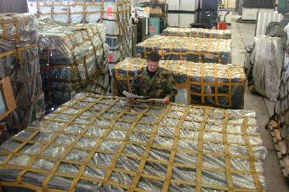

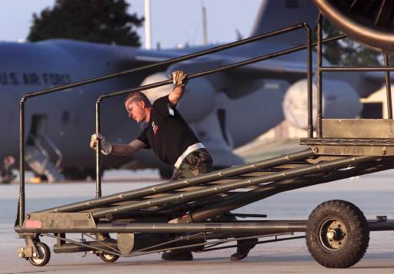
Move & Store Division
Ground Support
Traditional support
Aircraft Servicing Equipment
Dehydrators and Desiccants
Tie Downs & Load Binders
Pallets & Pallet Covers
Boxes, Tote, Shipping
Specialized Warehouse Shelving
Radio Frequency Identification Devices
Major Customers | Suppliers
DLA Distribution Rock Island Arsenal Letterkenny Army Depot PA | Treen Box Savi Technology Cutter Lumber Honeywell
FY17 Sales $62M
Notes:
The Ground Support IST at DLA Troop Support provides a wide variety of equipment support, from shelving and warehouse supplies, to Aircraft Ground Support Equipment, to certain air purification supplies and filters, including materials for submarines and aircraft.
This IST also manages active RFID tags, supplied to DDC and all branches of the military to track shipments of material world wide.
Ground Support IST has numerous SMS agreements/partnerships to provide best possible service to our customers.

Slide 20
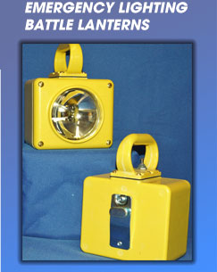
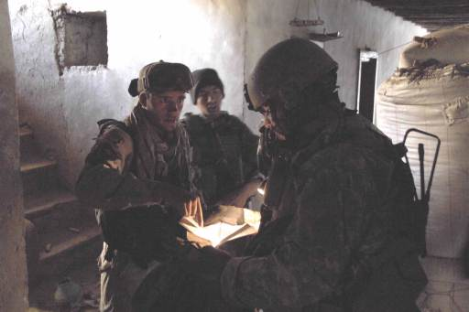
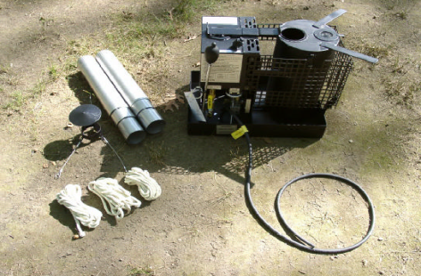
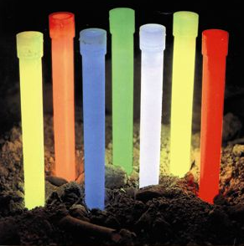
Lighting, Commercial Hardware, HVAC,
NESO Division
Traditional support
Flashlights
Tube Lamps
Space Heaters
Air Filters
Impeller Fans
Labels and Markers
Battle Lanterns
Tent Lighting
Major Customers | Suppliers
Red River Army Depot, TX Navy Yokosuka Navy Mechanicsburg PA Letterkenny Army Depot PA | Jamison Armor Decal Boeing Jay Moulding L.C. Doane
FY17 Sales $336M
Notes:
The C&E Lighting Team offers a full range of commercial portable and hand held lighting items such as self generated lighting towers, tent lights, flash lights and drop lights. In addition, we also provide support for various Navy shipboard lighting applications. We also carry an extensive line of portable heating products such as portable space heaters. Our HVAC team specializes in supporting requirements for various Impeller Fans, Van Axiel Fans and Air Filters used on specific weapons system applications.

Slide 21

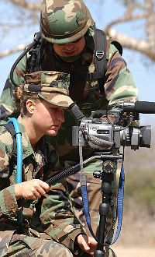

Miscellaneous Equipment Division
Technology & Information Equipment, FSG 80
Traditional support
ADP Equipment
Imaging
Telecommunications
Targets
Rope
Ammo Slings
Adhesives, Sealants, Paints
Major Customers | Suppliers
NSWC Indian Head MD Red River Army Depot AK Anniston Army Depot AL Norfolk Naval Shipyard VA | Kodak HP Whitehill Lynn Electronics Northrup Grumman Goodrich
FY17 Sales $81M
Notes:
This business segment incorporates an extensive variety of material ranging from computers to targets. Some of the most interesting items that we buy include surveillance and spy cameras, aerial film that records flight information from the nose cone of an F16, HUMVV driving simulators, paint ball guns, dog boots and shipboard photo-reflective labels to help sailors find their way below deck in an emergency. Many of these items represent the latest technology has to offer while other items would seem to be relics from the past, but nevertheless, essential to the men and women who use them during our military operations. Prices for these items range from under $1 to as much as $250K each.
While many products managed by this segment are readily available at local office and electronics stores, others are custom built to fit a particular application such as the $13K keyboard that must fit into the console controlling shipboard operations and is needed to perform critical functions within that environment. In fact, the most important role of this group has been in support of the warfighters on ships and in the field who need both common and specialized equipment and who have little if any access to the commercial marketplace. To receive a phone call from a supply sergeant in Bagdad letting us know that his laptop computers have arrived is priceless!

Slide 22
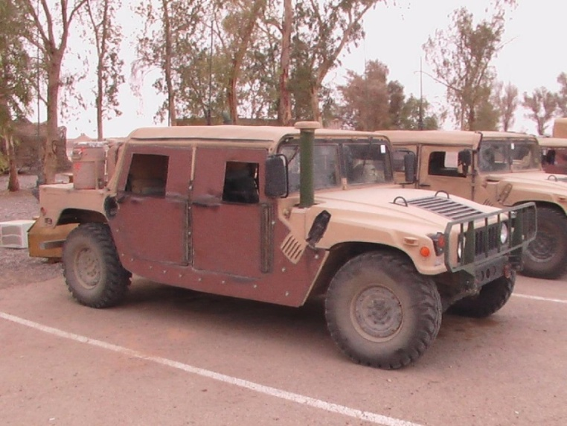

Metals Program
Tailored Logistics Support
Major Customers | Suppliers
USA Afghanistan Rock Island Norfolk Naval Shipyard Puget Sound Naval Shipyard USA Depot Letterkenny | Metals USA TW Metals
Ferrous, non-ferrous and specialty metals
Angle, Bar, Extrusions, Sheet, Strip, Screen, Plate
Related incidental services:
    Cutting, shearing, testing, scrap removal and salvage
FY17 Sales $89M
Notes:
Provides tailored logistics support with 2 integrated suppliers: METALS USA and TW METALS
Key program features are volume discounts/JIT deliveries/and incidental services such as cutting and testing
Customer Service
Mill certifications are provided with every order
Major customers include Naval Shipyards where agile response to requirements in exact sizes and specifications eliminates inventory and waste.

Slide 23
Metals Program
Coverage
Metals USA
TW Metals
4 CONUS Regions
Region | Vendor | Award Date
Northeast | TW Metals | 25 Mar 2015
Southeast | TW Metals | 9 Apr 2015
Central | Metals USA | 9 Jun 2015
West | Metals USA | 30 Jun 2015
OCONUS requirements through consolidation points (East/West)

Slide 24

Construction & Equipment
What We Want to Leave You With
Actively engaged in warfighter readiness
Matching industry capability with customer requirements
Focus on improving metrics and reducing costs
Providing the right item at the right time in the right place for the right price, every time
Notes:
C&E is committed to the Warfighter.

