Slide 1
DLA Demand Forecast Industry Association Leadership Meeting
November 17, 2025

Slide 2
Meeting Agenda
Opening Remarks (0930 - 0935)
Mr. Bunn
DLA Capstone Events (0935 – 0940)
Ms. Croll
FY25 Acquisition Performance (0940 – 0955)
Mr. Beebe Ms. Kurze
Demand Forecast (0955 - 1015)
Mr. Morefield Ms. Ahmadi
DLA Strategic Plan Discussion (1015 - 1025)
LTG Simerly
Supply Chain & Digital Strategies (1025 - 1105)
Ms. Croll (Moderator) Open Discussion
Cybersecurity Maturity Model Certification (CMMC) (1105-1125)
Ms. Wunderly
Closing Comments & Group Photo (1125 – 1130)
LTG Simerly

Slide 3

DLA Capstone Events
Calendared for FY 26
Event Name | Frequency | Date | Location
DLA Troop Support Clothing and Textiles Joint Advanced Planning Brief for Industry (JAPBI) | Annual | Mar 2-4, 2026 | Cherry Hill, NJ (Double Tree by Hilton)
Defense Industrial Base in Indications & Warnings, Conflict, and Post-Conflict Phases | Annual | Mar 4-5, 2026 | DLA HQ (Ft. Belvoir, VA), Recurring Agency wargaming activities, targeting inclusion of an Industry cell
DLA Energy Worldwide | Biennial | Apr 21-23, 2026 | Crystal City, VA (Hyatt Regency)
DLA Disposition Services Industry Day | Annual | May 19-20, 2026 | Battle Creek, MI (DoubleTree by Hilton)
NDIA/DLA Supply Chain Alliance Symposium & Exhibition | Annual | Jun 2-3, 2026 | Columbus, OH (Columbus Convention Center), Locations updated annually
Elite Constellation Exercise | Annual | Jun 8-17, 2026 | Initial exercise in a series. Various across multiple Combatant Commands. Targeting inclusion of an Industry cell.
DLA R&D Collider Day | Annual | Sep 2026 | TBD
DLA Capstone Events
WARFIGHTER ALWAYS

Slide 4




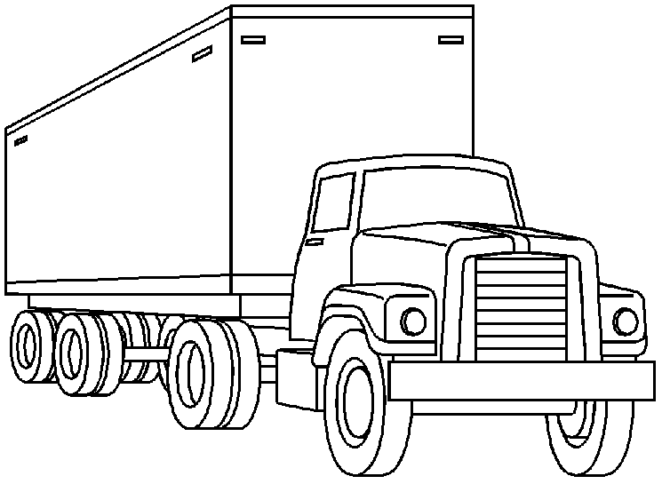

Acquisition Performance
FY22-FY26 (projected)
FY22 – FY25 Growth & Reduction in Obligations
15%
Growth in overall
obligations from
FY22 to FY25
-37%
Reduction in Energy
obligations from
FY22 to FY25
53%
Growth in Weapons
Support obligations
from FY22 to FY25
32%
Growth in Troop Support obligations from FY22 to FY25
Increased FY25 obligations can be attributed to both economic factors and volume. For example, Weapons Support saw increased demand in Depot Level Repairables (DLR) for the Navy and assisted acquisition support for Program Executive Offices (PEO).
DLA FY25 On-Time Delivery (OTD)
OTD
76-98%
Range across
Supply Chains

Slide 5


DLA Acquisition
FY 25 In Review
Contract Obligations
How DLA Does Business
8.5K+
DLA Industrial Base suppliers
11K
Awards per day
$.1B
$55.4B
Total Obligations
Disposition
Services
$.5B
13 YEARS
Consecutively surpassing DLA’s small business goals
Distribution
$2.3B
DCSO
$9.6B
Energy
$22.6B
To Small Business
23%
Of DoW small business obligations
81%
DLA competition rate for contracts
$16.8B
Weapons
Support
$26.2B
Troop Support
3.9M Contract Actions
AbilityOne Program
AbilityOne Program awards represented 2.3% (non-Energy) of DLA obligations, exceeding the goal of 2% - highest ever
DLA procured $692M in AbilityOne Products and $110M in Services for a combined total of $802M – highest ever
94%
Actions automated
Manual
Auto Purchase Order
(< 15 days)
7.6 TIMES
DLA’s action count exceeds all Military Services combined
Auto LTC Delivery
Order (< 1 day)

Slide 6

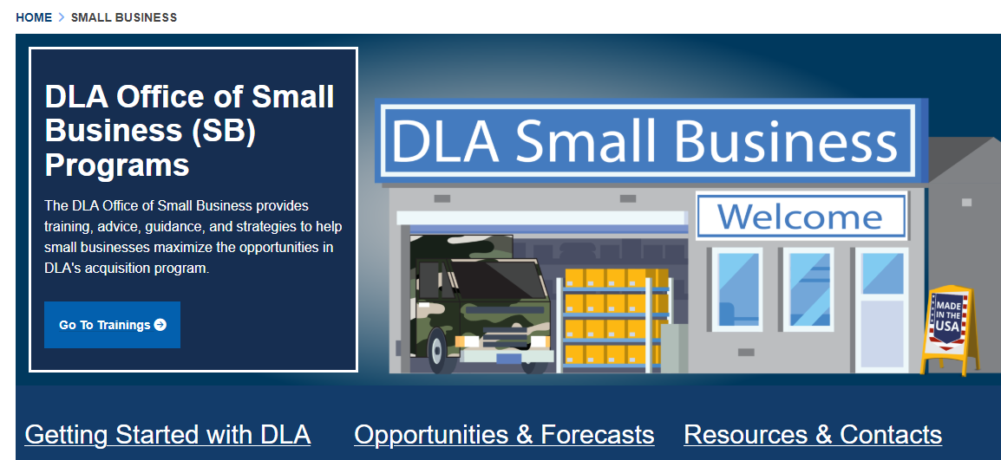
Small Business
Trends and Resources
Supplier Pathway Program
FY25
Search Products and Services DLA buys
Locate which buying organization to do business with
Find information on required and optional certifications
Navigate tailored pathways
8.5K
Suppliers
6.7k (80%)
SB Suppliers
20%
New Entrants
$22.6B (46%)
SB Spend
\
Small Business Videos and Guides
Learn from Web series with “mini” episodes
“How-to” with 100+new topical training guides
https://www.dla.mil/Small-Business/

Slide 7
Demand Projection
Supply Chain Management (SCM)
Sales fluctuating over the period of FY22 through FY25
    by ~ $341M in Weapons Support
    by ~ $1.9B in the Troop Support Supply Chains
Timeline of Contributing Factors
FedGov Shutdown
FY22 | FY23 | FY24 | FY25 | FY26
\
COVID Impacts
Working Capital Fund Challenges
Ukraine Support
Hurricane Ida
Hurricane Ian
Hurricanes Helene & Milton
SCM and Energy
What challenges does Industry foresee in supporting DLA demands in a Contested Logistics environment?
What can DLA do to improve Industry’s ability to support the warfighter?
FY26 demand projected:
    13% higher than FY25 for Weapons Support
    11% lower than FY25 for Troop Support
    4% higher than FY25 for Energy
Notes:
Updated 11/13/2025

Slide 8
Weapons Support Net Sales at Cost Trends
$M
$M
$M
Consumable “Repair” Parts
Sales anticipated to modestly increase as we continue to replenish stock levels through FY26 that were depleted from prior year spending constraints
How will this forecast shape/impact industry’s posture to support DLA

Slide 9
Troop Support Net Sales at Cost Trends
$M
$M
$M
$M
How will this forecast shape/impact industry’s posture to support DLA?
Notes:
Association removed

Slide 10
FY26 Projections
FY26 Projections (less Depot Level Repairables (DLR)
FY26 Obligation Projections
Low / High Range
Most Likely:
$35.3B
PBR27 Request
PB26
Budget
$B
*Totals not inclusive of DLRs
Notes:
Edited 11/13/2025

Slide 11
Projected Demand
Energy
US Gallons (M)
Sold
Projections
How will this forecast shape/impact industry’s posture to support DLA?
Notes:
DLA Energy’s net sales of petroleum products are largely driven by world events.
Beginning in 2022 we saw a roughly 5% decrease in demand which was attributed to decreased military operations in the Middle East, largely driven by the withdrawal from Afghanistan. All products in the Middle East trended downwards from 48M gal per month in Sep 2019 to 16M gal per month in Aug 2022, a decrease of 32M gal per month.
The Air Force continues to set an annual goal to reduce aviation fuel consumption by 1% annually. This began in FY22.
These patterns have largely plateaued through FY24 & FY25 with a marginal decrease in overall petroleum sales of 1%. Despite the Army demand declining by 1% and 3% decline in sales to Federal Civilian Agencies.
For FY26, in coordination with the Services, we are projecting an overall 5% increase in petroleum net sales. The Army projects the largest increase in demand – roughly 12% over what was projected for FY25. We are also seeing increased demand signals from the Other DoW and Marine Corps, all of which are attributed to expected increase in operational tempo.

Slide 12
Services Acquisition
Projected
$4.60
$5.10
$3.59
Over 95 DLA requirements—with an estimated total value of $1.9 billion—have successfully passed DOGE efficiency reviews with a 100% approval rate. This achievement highlights DLA’s commitment to excellence in resource stewardship and showcases its robust, high-performing processes in delivering effective and efficient logistics solutions.

Slide 13
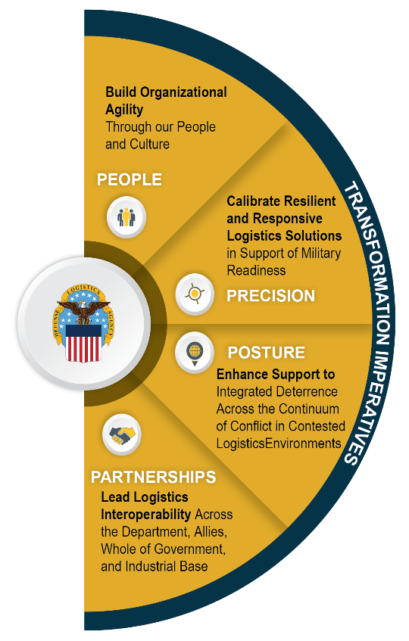






DLA Annual Guidance
Fiscal Year 2026
Mission: Drive and sustain Warfighter readiness by delivering unmatched global support as the Nation’s Logistics Combat Support Agency.
Vision: DLA delivers agile, adaptive, and resilient logistics support across the continuum of conflict.
Transform and sustain a resilient, mission-driven workforce aligned to DLA’s evolving structure, priorities, and global logistics posture.
FY 26 PRIORITIES
SET THE
GLOBE
Position DLA to deliver capability to ensure sustained readiness for the Services, Combatant Commands, and allies prioritizing the Homeland and Indo-Pacific theater.
Prioritize digital solutions and data-driven decision making across all agency operations to achieve agile, efficient, and effective Warfighter support.
Position DLA for a clean audit opinion in FY28.
Accelerate organizational and workforce transformation, balancing effectiveness and efficiency to achieve resilient capabilities.
SET THE
AGENCY
Enhance global logistics readiness to ensure mission success in contested environments.
SET
SUPPLY
CHAINS
Modernize the supply chains to operate faster and smarter, strengthen resilience to mitigate disruption, and respond at scale.
Illuminate and mitigate global supply chain risk to increase resiliency and agility.
Aggressively integrate with DoW, WoG, allies, and partners to improve logistics planning, training, and execution.
Leverage our Industrial Base partnerships to expand capabilities
and capacity to strengthen the Joint Logistics Enterprise.
FY 26 PRIORITIES

Slide 14
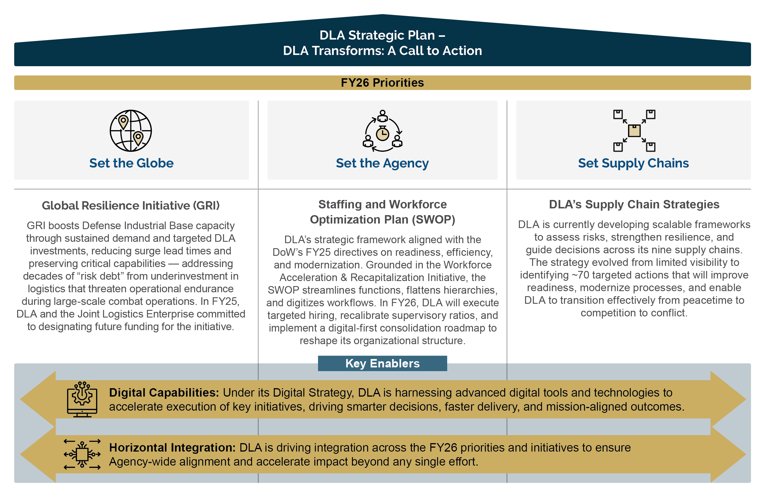
FY26 Transformation Priorities

Slide 15
Phased Implementation of Cybersecurity Maturity Model Certification Requirements
Cybersecurity Maturity Model Certification (CMMC) increases the cybersecurity posture of the Defense Industrial Base and better protects sensitive unclassified information. All defense contractors and subcontractors must demonstrate compliance with applicable security requirements—through self-assessment or independent assessment—prior to contract award, excluding Commercial-Off-The-Shelf procurements.
Phase 1 – Initial Implementation
Phase 2
Begins at 48 CFR
Rule Effective Date,
10 Nov 25
Where applicable, solicitations will require Level 1 (Federal Contract Information (FCI)) or 2 Self-Assessment (Controlled Unclassified Information (CUI))
Phase 3
Begins 12 months after Phase 1 start,
10 Nov 26
Where applicable, solicitations will require Level 2 Certification (CUI)
Phase 4 – Full Implementation
Begins 24 months after Phase 1 start,
10 Nov 27
Where applicable, solicitations will require Level 3 Certification (CUI)
Begins 36 months after Phase 1 start,
10 Nov 28
All solicitations and contracts will include applicable CMMC Level requirements as a condition of contract award
DLA may implement CMMC requirements in advance of the planned phase

