Slide 1
Casting and Forging
Brian Egbert
DLA/L&M Casting and Forging Program Manager​
November 06, 2024

Slide 2
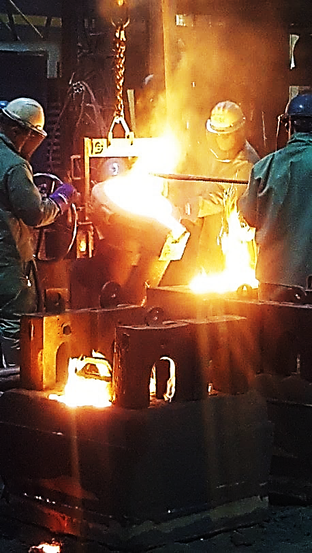
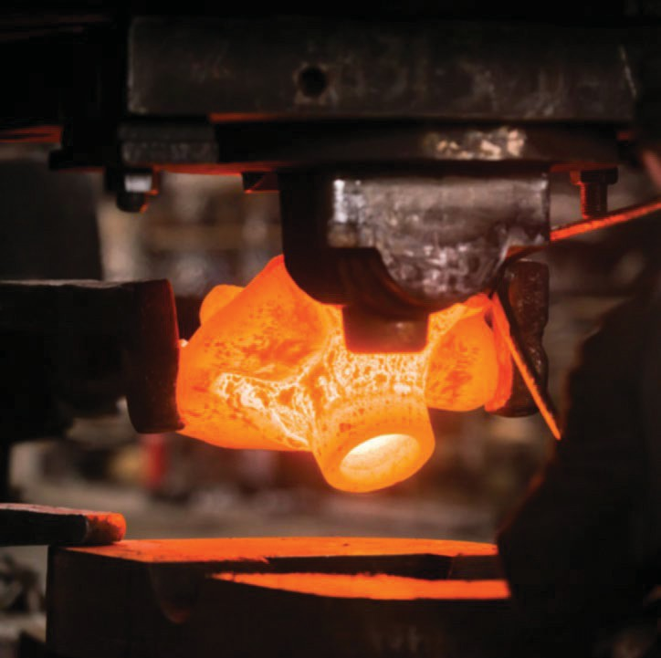
Program Background
Casting Program
  Manufacturing Technology R&D program
  Supports DLA and the foundry industry
Forging Program
  Manufacturing Technology R&D program
  Supports DLA and the forge industry
Notes:
DLA’s Casting ManTech program started in early 90s to , Forging, in the mid 90s.
American Metalcasting Consortium (AMC) competes for R&D funds to develop new metal-casting/forging technologies and processes to support DLA and commercial industry in the design , manufacture, and procurement of cast and forged parts.
Advanced Technologies International (ATI) is the current consortium manager.
I work directly with them.

Slide 3
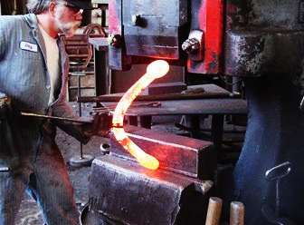
Castings & Forgings
Process & Method
Why Castings?
Complex geometries
Manufactured at a foundry.
Metal is melted and poured into a mold for near net shape.
Usually requires some post processing for finished parts.
Why Forgings?
For structural parts.
Manufactured at a forge.
Metal is heated to soften and then pounded or pressed into near net shape.
Usually requires some post processing for finished parts.
Castings and forgings are only 3% of all NSNs, but are a disproportionate share of backorders.
Castings and forgings are 20% of the 100 oldest DLA backorders.
Notes:
Types of castings: sand
Casting and Forging can have more challenging issues what typical manufacturing techniques.

Slide 4
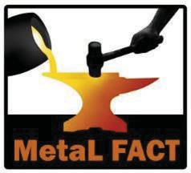
Program Engagement
MetaL FACT (Maritime & Land Forging And Casting Team) is comprised of government & industry personnel
We assist with DLA-managed NSNs with cast or forged components
MetaL FACT is a resource available to:
  DLA personnel
  Engineering Support Activities (ESA)
  Contractors & Suppliers
    With active DLA Land & Maritime contracts
      With Contracting Officer’s approval
    Bidding on open DSCC solicitations
    Support Source Approval Requests
    Email Assistance Requests to: DSCC.cast.forge@dla.mil
Notes:
SARs are submitted for specific NSNs – needs KO involvement if under contract

Slide 5
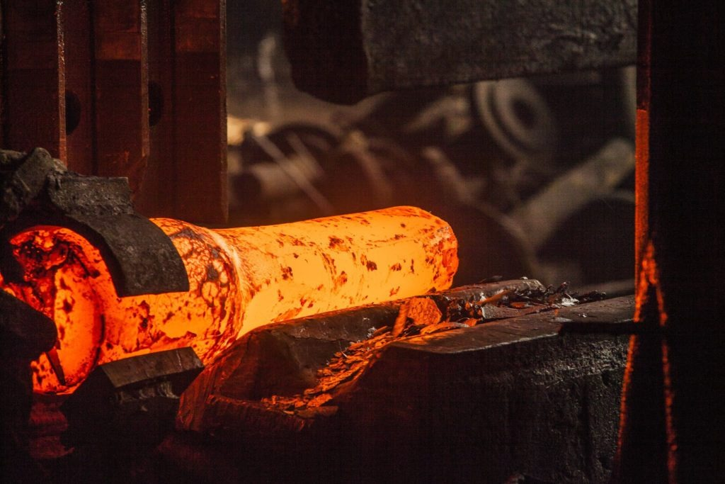
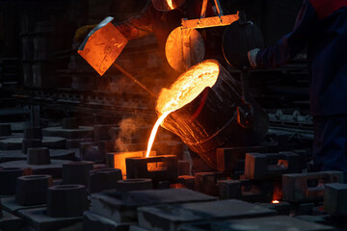
Types of Assistance Provided
Find existing tooling
Identify foundry and forge resources
  Material and process support
Provide technical analysis and support
  Tech data issues or questions
  Casting & forging process analysis
  Material issues
  Inspection issues
    Coordinate with contractor and ESA and/or test lab
Notes:
Finding tooling and foundries/forges are the most common assistance we provide

Slide 6
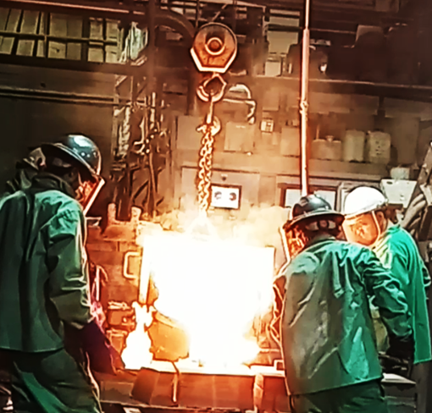
Support Tools
Integrated Casting Order Network (ICON)
  Cast tooling database
  Supplier database
  Toolkit database
  https://icon.nffs.org
Haystack Gold
  National Forging Tooling Database (NFTD)
Forging Industry Association Request for Quote (FIA RFQ)
  https://www.forging.org/fia/content/rfq-form/RFQ_Submission_Form.aspx
Notes:
Capability surveys – manufacturing technique, size, material, etc.
Search manufacturing history by NSN or finished part #.
If you load your capabilities into ICON, it can notify you of Solicitations that match.
Haystack is expensive – may be available through local library system
FOA RFQ - machine shops can fill out to price/procure forged parts for processing

Slide 7
Program Implementation
Example Solicitation
Section B
Casting
A metal casting process was identified as a means to manufacture this item. Tooling is required to produce a casting. For sourcing, tooling, materials or other information, please contact the appropriate assistance team: (Aviation, C&E Supply Chains) DSCR.AFCAT@dla.mil; (Land & Maritime Supply Chains) DSCC.cast.forge@dla.mil
Forging
A forging process was identified as a means to manufacture this item. Tooling is required to produce a forging. For sourcing,
tooling, materials or other information, please contact the
appropriate assistance team: (Aviation, C&E Supply Chains) DSCR.AFCAT@dla.mil;(Land & Maritime Supply Chains) DSCC.cast.forge@dla.mil
Suspected
Casting/forging may be required to manufacture this NSN. If a casting/forging is required, tooling is typically involved. The government may not have this special tooling. For sourcing, tooling, materials or other information, please contact the appropriate assistance team: (Aviation, C&E Supply Chains) DSCR.AFCAT@dla.mil; (Land & Maritime Supply Chains) DSCC.cast.forge@dla.mil
SECTION B
QPL/QML COMPONENTS ONLY FROM SOURCES QUALIFIED ON THE APPLICABLE
QPL(S)/QML(S).
SAMPLING:
THE SAMPLING METHOD SHALL BE IN ACCORDANCE WITH MIL-STD-1916 OR ASQ H1331, TABLE 1 OR A COMPARABLE ZERO BASED SAMPLING PLAN UNLESS OTHERWISE SPECIFIED BY THE CONTRACT. IF THE APPLICABLE DRAWING, SPECIFICATION, STANDARD, OR QUALITY ASSURANCE PROVISION (QAP) SPECIFIES CRITICAL, MAJOR AND/OR MINOR ATTRIBUTES, THEY SHALL BE ASSIGNED VERIFICAITON LEVELS OF VII, IV AND II OR AQLS OF 0.1, 1.0 AND 4.0 RESPECTIVELY. UNSPECIFIED ATTRIBUTES SHALL BE CONSIDERED AS MAJOR UNLESS SAMPLING PLANS ARE SPECIFIED IN APPLICABLE DOCUMENTS. FOR MIL-STD-1916, THE MANUFACTURER MAY USE THE ATTRIBUTE OR VARIABLE INSPECTION METHOD AT THEIR OPTION OR PER THE CONTRACT. MIL-STD- 105/ASQ Z1.4 MAY BE USED TO SET SAMPLE LOT SIZE, BUT ACCEPTANCE WOULD BE ZERO NON-CONFORMANCES IN THE SAMPLE LOT UNLESS OTHERWISE SPECIFIED IN THE CONTRACT.
CLASS I OZONE DEPLETING CHEMICALS ARE NOT TO BE USED NOR INCORPORATED IN ANY ITEMS TO BE DELIVERED UNDER THIS CONTRACT.THIS PROHIBITION SUPERSEDES ALL SPECIFICATION REQUIREMENTS BUT DOES NOT ALLEVIATE ANY PRODUCT REQUIREMENTS. SUBSTITUTE CHEMICALS MUST BE SUBMITTED FOR APPROVAL UNLESS THEY ARE AUTHORIZED BY THE SPECIFICATION REQUIREMENTS. "CONTRACTOR/MANUFACTURER IS REQUIRED TO ESTABLISH AND MAINTAIN A CALIBRATION SYSTEM THAT MEETS THE REQUIREMENTS OF ANSI/NCSL Z540-1-1994, AMERICAN NATIONAL STANDARD FOR CALIBRATION - CALIBRATION LABORATORIES AND MEASURING AND TEST EQUIPMENT-GENERAL REQUIREMENTS, OR ISO 10012-1, QUALITY ASSURANCE REQUIREMENTS FOR MEASURING EQUIPMENT- PART 1, METROLOGICAL CONFIRMATION SYSTEM FOR MEASURING EQUIPMENT."
"FINAL INSPECTION AND ACCEPTANCE OF THE ITEM SHALL BE AT THE ACTUAL MANUFACTURING FACILITY. TECHNICAL INSPECTION IS REQUIRED. THE CONTRACTOR SHALL MAKE DRAWINGS AND TECHNICAL INFORMATION AVAILABLE TO VERIFY THAT THE ITEM MEETS ALL TECHNICAL REQUIREMENTS.
COUNT, KIND, AND CONDITION INSPECTIONS ARE
NOT ACCEPTABLE. THIS NOTE TAKES PRECEDENCE OVER MASTER SOLICITATION PART ONE PROVISIONS, NOTE 6, QUOTATIONS BY NON-MANUFACTURERS (APR 1984,
DCSC 52.217-9C01). FINAL INSPECTION OF PACKAGING, IF REQUIRED, MAY BE CONDUCTED ELSEWHERE."
FULL AND OPEN COMPETITION APPLIES.
THE CONTRACTOR SHALL RETAIN ALL FIRST ARTICLE UNITS AS PRODUCTION STANDARDS. DISPOSITION OF APPROVED FIRST ARTICLE TEST SAMPLES: THE CONTRACTOR MAY DELIVER APPROVED UNDAMAGED FIRST ARTICLE SAMPLES AS PART OF THE PRODUCTION QUANTITY.
A metal casting process was identified as a means to manufacture this item. Tooling is required to produce a casting. For sourcing, tooling, materials or other information, please contact the appropriate assistance team: (Aviation, C&E Supply Chains) DSCR.AFCAT@dla.mil; (Land & Maritime Supply Chains) DSCC.cast.forge@dla.mil
IAW BASIC DRAWING NR 19200 11741103 REVISION NR D DTD 07/11/2009 PART PIECE NUMBER:
IAW REFERENCE DRAWING NR 19200 11741140 REVISION NR D DTD 11/07/2009 PART PIECE NUMBER:
IAW REFERENCE DRAWING NR 19200 11741141 REVISION NR C DTD 11/07/2009 PART PIECE NUMBER:

Slide 8
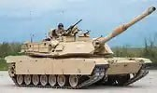
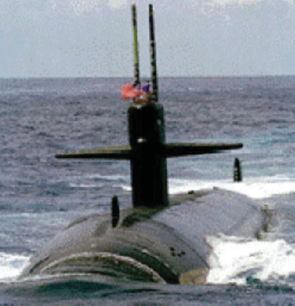
DECAF NSN Reviews
DLA Enterprise Cast And Forge (DECAF) Database
LAND
Casting 8,783
Forging 3,273
Both 2,044
Suspected 7,885
Total NSNs 21,985
MARITIME
Casting 8,757
Forging 5,599
Both 1,300
Suspected 10,027
Total NSNs 25,683
As of Oct 2024

Slide 9
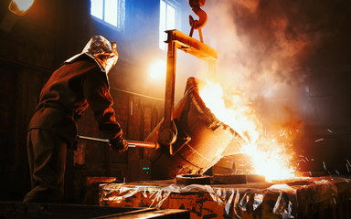
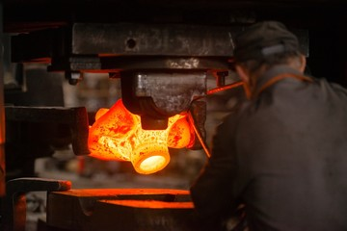
Key Takeaway
The MetaL FACT is here to provide assistance . . .
  Who: to both Government and Contractor entities.
  What: for parts manufactured via casting or forging.
  How: Email to access our resources.
Mailbox: DSCC.cast.forge@dla.mil

Slide 10



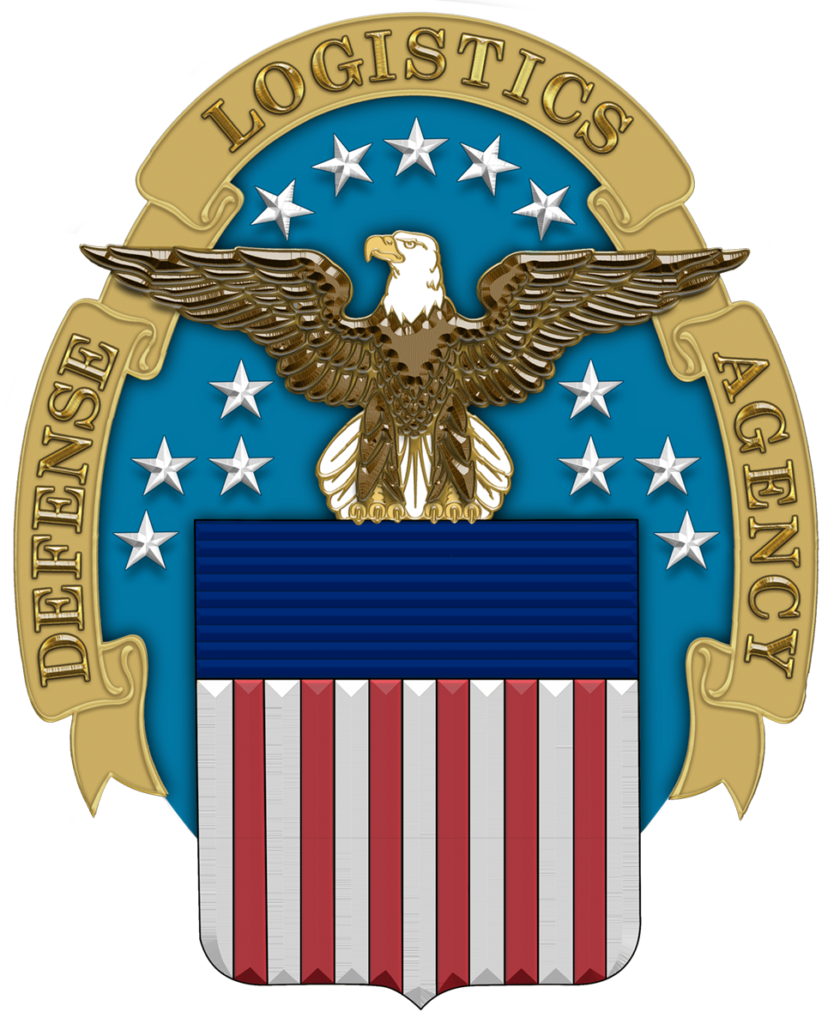
Questions?
10 of 10

