Slide 1
Replenishment Parts Purchase or Borrow (RPPOB) Program
Jared Lillo, Value Analyst
Nov 04, 2024

Slide 2
Title and Date: Name of The Engagement
To give a brief overview of the RPPOB program and its function in the RE (reverse engineering process).
RPPOB
Mission Overview
Key Facts/Assumptions
Guidance

Slide 3
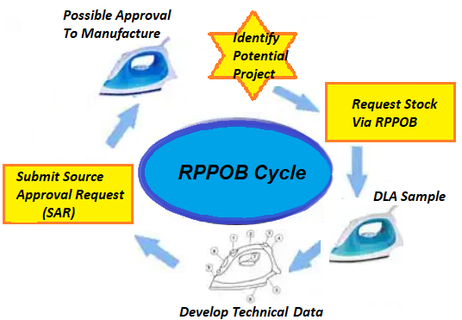
Purpose
The RPPOB program supports vendor initiated reverse engineering efforts
Designed to allow vendors to visually inspect, borrow or purchase Government owned material with the intent of becoming an approved source

Slide 4
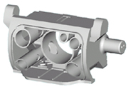
Why RPPOB
Statutory Requirement
  Defense Procurement Reform Act of 1984
  Public Law 98-525, Section 1216(a)
  Codified at Title 10 U.S.C. 2320(B)
Benefits
  Break Sole Source
  Provide additional sources on limited source items
  Reduce cost through enhanced competition
  Potential for Unlimited Rights Technical Data Packages (TDP)
GOAL: Enhance Competition

Slide 5




RPPOB Methods
Direct Purchase
  Contractor purchases at Standard Unit Price (SUP)
  Item is not returned
  Specific terms spelled out in contract
Bailment
  Item loaned at SUP
  SUP held in Trust by DFAS
  SUP monies returned if item returned in
    original condition
View Parts or Send Pictures
  Contractors may inspect part in a designated area
  Test equipment not permitted

Slide 6
RPPOB - What it is not
Not eligible on Acquisition Method Suffix Codes (AMSC):
  AMSC B - (non-government source-controlled drawing)
  AMSC G - (full and open)
  AMSC T - (specification controlled)
Not available on NSNs with less than $10,000 annual buy value or with multiple years of stock on-hand
Not to compare with other approved sources’ stock
Not to find out information on the NSN after being awarded a contract
Purpose: Develop New Sources in the best interest of the Government Reference - DoD Manual 4140.01, Volume 9

Slide 7
1ST Screening
Ensure vendor is eligible and item meets program requirements:
    Verify Vendors are not suspended or debarred at time of request
    Vendor is not already an approved source
    Verify Joint Certification Program (JCP) certification
    Item is not coded full and open, Annual Demand Value (ADV) > $10,000, stock available, etc.
    Verify Directorate of Defense Trade Controls (DDTC) registration - NSNs with Demilitarization Code other than “A or Q”
If you wish to proceed, you need to inform DLA

Slide 8
2ND Screening
    Review data sources for releasable technical data
      If no additional data is found (such as catalog data, picture, etc.) vendor is requested to let us know if you want to proceed
    If data is found, we will request whether you want to receive the data (cFolders) or continue to contact the Engineering Support Activity (ESA)
      You will need to tell us if you want to proceed
  “ESA Concurrence” or “Own Risk” option is determined.
      ESA Concurrence – reverse engineering (RE) pre-approval requested prior to bailment
      Own Risk – no pre-approval requested, and bailment can proceed

Slide 9

Process Overview
screening process
  Maximum of 10 days
2nd screening process
  Maximum of 10 days
Request for ESA Concurrence
  Minimum of 30 days for response from ESA
Answer back to Vendor after ESA RE approval/denial
Vendor provides monies and signs the agreement based on availability of stock
Item (when in Stock) sent to Vendor

Slide 10
Identifying Potential Projects
List of NSNs available on Value Management Webpage
Forecast information can be found on DIBBS webpage: Supplier Requirements Visibility Application (SRVA) link. It should provide 24 months of projected purchase order quantities
Search the website to find opportunities that match your company's capabilities
  Some available tools are:
    PTACs (Procurement Technical Assistance Centers).
    Haystack (available through your PTAC)
Identify NSNs that are sole or limited-source

Slide 11
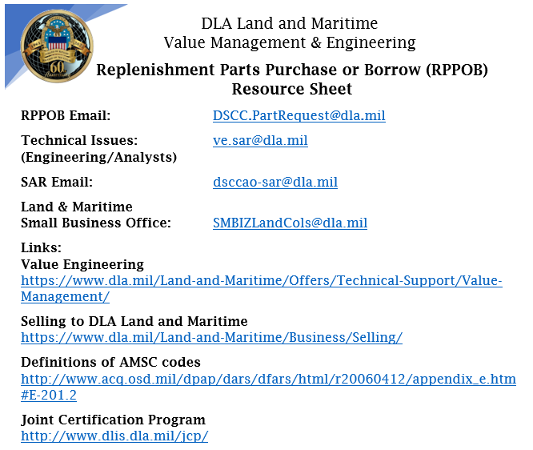
Websites

Slide 12
What is needed to Fill a Request
Your Name
Your Company Name
CAGE CODE
Phone Number
Shipping Address
NSN included on subject line of email

Slide 13
Resources
RPPOB Request for DSCC.PartRequest@dla.mil
DLA Land & Maritime
AO/SAR submission dsccao-sar@dla.mil
or questions
Technical Issues ve.sar@dla.mil
(Engineering/Analysts)
Land and Maritime SMBIZLandCOLS@dla.mil
Small Business Office

Slide 14

Questions and Answers

