Slide 1
Defense Priorities and Allocation System (DPAS)​
Rachel Earles, Procurement Analyst​
October 2024

Slide 2
DPAS Authority
Title I of the Defense Production Act of 1950:
  allows the President to require persons to prioritize and accept contracts for material and services as necessary to promote the national defense
  is the President’s primary authority to mobilize resources and expediate critical industrial items
  does not require an emergency declaration
Executive Order 12919
  Defense Production Act:
    designates the Secretary of Commerce to administer the DPAS
The Department of Commerce has delegated authority to DoD to place priority ratings on its contracts in accordance with DPAS

Slide 3
Purpose of DPAS
To prioritize the delivery of goods and services needed for national defense and emergency preparedness purposes
Establishes procedures for the placement, acceptance, and performance of priority rated contract orders
It is invoked when there are critical shortages of essential materials equipment and services required for defense production

Slide 4
Priority Ratings
DPAS rules are a standard part of U.S. defense contracting process
  Two levels of priority ratings:
    DX: highest national defense urgency
      All DX rated orders have equal priority and take preference over DO and unrated orders
      Orders may only be assigned a DX rating if they are in support of a program that has been approved by OSD
    DO: critical to national defense
      All DO rated orders have equal priority and take preference over unrated orders

Slide 5
Priority Ratings
Priority Rating = Rating Level + Program ID Symbol
  Program ID Symbols are listed in Schedule I to 15 CFR Part 700 – Approved Programs and Delegate Agencies
  ex. DOA1 = DO + A1 (aircraft)
  ex. DXA4 = DX + A4 (MRAP vehicles)
Programs that are approved for DX ratings can be found at DPAS (dcma.mil) (at the bottom of this site under “DX Rated Program Listing”)

Slide 6
Limitations
A DPAS rating does not automatically put an order in front of the line in the manufacturing process​
Contractors must schedule operations to satisfy delivery requirements of each rated order
  Changing production or delivery schedules is only required when established delivery dates cannot be met​
A rated order does not get prioritized ahead of ay other orders unless the delivery date cannot be met. Only then should production schedules be modified and unrated or lower priority orders be delayed.

Slide 7
Limitations – Examples
A contractor receives a DO rated order with a delivery date of June 3; if meeting that date would mean delaying production or delivery of an item for an unrated order, the unrated order must be delayed
A DX rated order is received calling for delivery on July 15 and there is already a DO rated order requiring delivery on June 2; operations can be scheduled to meet both deliveries. There is no need to alter production schedules to give any additional preference to the DX rated order
  However, if both the June 3 and July 15 delivery dates cannot be met, then the DX rated order must be given priority over the DO rated order

Slide 8
Rated Order
Four elements of a properly rated order must appear on every contract, purchase order, or delivery order:
  Priority Rating
  A required delivery date (on or about or asap will not do)
  Manual or electronic signature
  A statement that reads in substance “This is a rated order certified for national defense use, and you are required to follow all provisions of the Defense Priorities and Allocations System regulation (15 CFR 700).” (FAR 52.211-15)
  Person receiving a rated order must ensure all four elements are present

Slide 9
Contractor’s Obligations / Options
Acceptance of rated orders
  Accept and prioritize ratings in order
Rejection of rated orders
  Notify contracting officer if you cannot meet the delivery and provide earliest date for delivery
    Notification must be provided within 15 days for DO orders and 10 days for DX orders
Contract adjustments
  You may have to adjust production schedules, resource allocation, and delivery commitments
Documentation and compliance
  Maintain records and documents of compliance with DPAS regulations

Slide 10
Subcontractors
A person must use rated orders with suppliers to obtain items needed to fill a rated order. The person must use the priority rating indicated on the customer’s rated order, except as otherwise provided in 15 CFR 700.
  This continues from contractor to subcontractor to supplier throughout the entire procurement chain
  Example: if a person is in receipt of a DO-A3 rated order for a navigation system and needs to purchase semiconductors for its manufacture, that person must use a DO-A3 rated order to obtain the needed semiconductors

Slide 11
Form BIS-999
Contractors experiencing difficulty with rated orders should promptly seek special priorities assistance
  A request for special priorities assistance or priority rating authority must be submitted on a Form BIS-999 to the local contract administration representative
This form can be found at Defense Priorities & Allocations System Program (DPAS) (doc.gov) under “DPAS Program Resources”
Your local DCMA DPAS POC will assure the form is complete

Slide 12
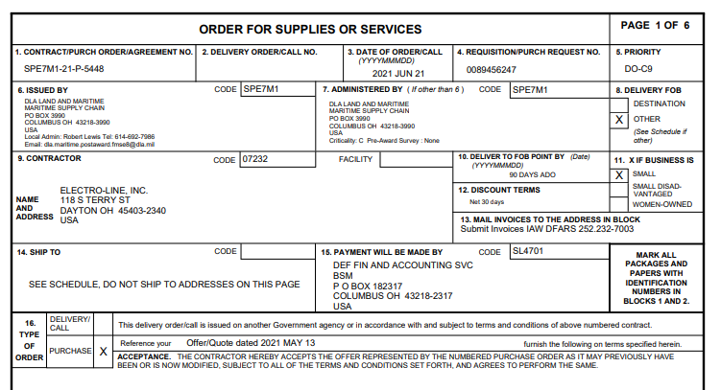
DPAS Rating Location

