Slide 1
Resolving Issues with Orders:
Delays in Being Paid
John Hamilton, Land and Maritime Quality Notification (QN) Team
Contracting Specialist
​
Notes:
Good Afternoon,
And Welcome to Resolving Issues with Orders,
At least 2nd most important briefing you will receive
As it addresses “WHY DIDN’T I GET PAID?”
I am John Hamilton, Contracting Officer, for Maritime Supplier Ops Directorate

Slide 2
Overview
Normal Payment Timeline
Acceptance
Discrepancies
Top 10 Reasons for Payment Delay
Best Practices
Helpful Websites
Points of Contact
Notes:
In this presentation, we will cover
Normal Payment Timeline
Acceptance
Discrepancies
Top 10 Reasons for Payment Delay
Best Practices
Helpful Websites
Points of Contact

Slide 3
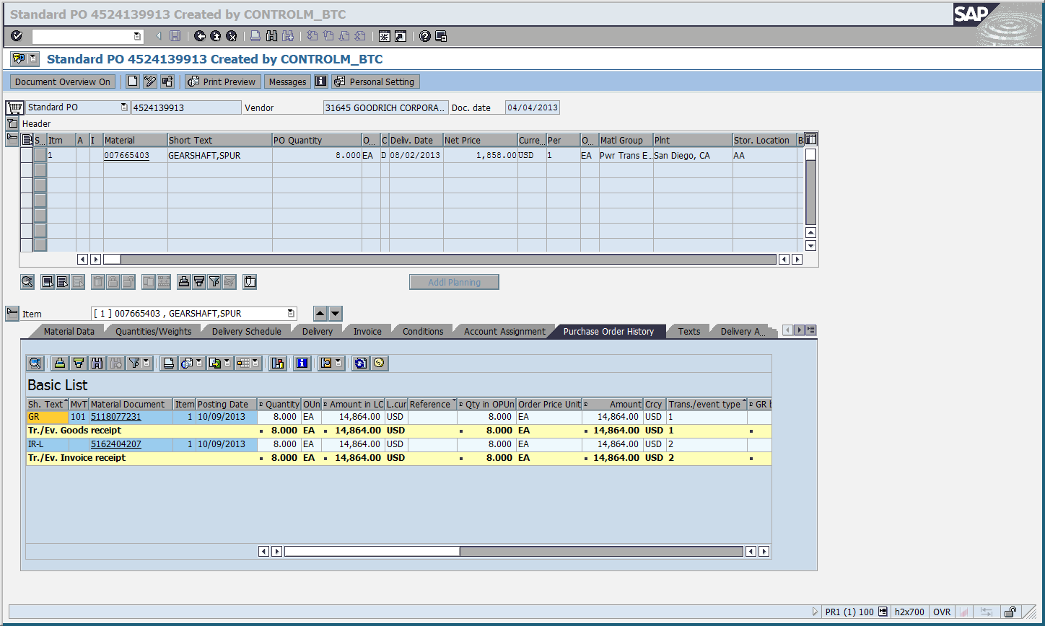
Normal Payment Timeline
Payment is made based on the latter date of the receipt of a valid invoice or Government acceptance.
Notes:
Payment processing starts after both the invoice and Government acceptance match. The date is based on whichever comes last, Invoice or Government Acceptance.
- If matching, then payment is made within 30 days or according to the terms of the contract.
For example, on this slide, the second row shows the Goods Receipt or Gov Acceptance, is on Oct 9th 2013, for 8 EA, and $14,864.00. The forth row, shows the Invoice, which also matches. So, payment processing can begin on Oct 9th 2013 and conclude on or before Nov 10th.
- Note: Everything must also match the contract

Slide 4
Discrepancies
Acceptance is based on:
  Material
  Quantity
  Price
  Receipt Location
  Shipping, Packaging, Marking Requirements
  Receiving Documents
Everything must match the contract
Notes:
Government Acceptance entitles the Contractor to payment of the contract price. But again, the invoice must also be submitted and match the goods receipt in order for payment processing to start.
Inspection and Acceptance Authority, time and place, and method of acceptance, are identified in the Contract, and address the following:
Material
Quantity
Price
Receipt location
Shipping, packaging, and marking requirements
And receiving documents
This list is not comprehensive, and the Contract should always be referenced for all requirements.
Everything must match the contract, for Government acceptance, but also to prevent later retraction of acceptance, due to latent defects, fraud or gross mistakes amounting to fraud.

Slide 5
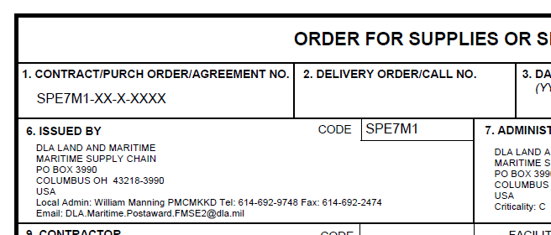
Discrepancies
A Post Award Request [PAR] must be submitted via DIBBS (https://www.dibbs.bsm.dla.mil) in order for your assigned Post Award Contract Administrator to take action. Do not contact the administrator listed on in Block 6 of the award directly:
Notes:
Post Award Requests, or PARs, are tickets assigned directly to your assigned Contract Administrator. Because DLA, Land and Maritime, Post Award Administration Employees, are assigned workload based on Post Award Requests, the individual listed in BLOCK 6 of the Contract, may not be directly involved in resolving your issues. So, to get faster, and more specific assistance, use the PAR submission option in DIBBS at dibbs.bsm.dla.mil.

Slide 6
Discrepancies
Discrepancies/Issues generate a Quality Notification(QN) or a Supply Deficiency Report (SDR).
When an issue is reported, the QN will go to the Post Award Quality Notifications Team to define and determine the extent of the problem and seek a solution depending on the type of issue.
The QN Team and the Resolution Specialist (RS) work together to investigate and the RS processes the final disposition on how the issue will be remedied.
Notes:
All discrepancies or issues with the material, regardless of who's at fault for the discrepancy, will result in generation of a Quality Notification (QN) or also known as a Supply Deficiency Report (SDR).
An investigation ensues, and the QN is assigned to the Post Awards Quality Notification Team, to define, verify and determine the extent of the problem, then seek a solution depending on the type of issue. The QN Team will work with the Resolution Specialist (RS) to remedy the situation, and if needed will contact the Contractor to notify them of the discrepancy and options for solution.

Slide 7
Top 10 Reasons for Payment Delay
Non-conformance to heat treatment requirement for wood packing materials. Since 2007, all wood packing materials require a stamp certifying heat treatment
(DLAD clause 52.247-2012)
Notes:
TOP 10 Reasons for Payment Delay
#10 Non-conformance to heat treatment requirement for wood packing materials. Since 2007, all wood packing materials require a stamp certifying heat treatment
This includes pallets

Slide 8
Top 10 Reasons for Payment Delay
Non-conformance to heat treatment requirement for wood packing materials. Since 2007, all wood packing materials require a stamp certifying heat treatment
(DLAD clause 52.247-2012)
9. Incorrect item received
Notes:
#9 Incorrect item received
If Contract calls for part X Model 1, but Model 1 is obsolete, do not deliver Model 2 as it will be rejected as non-conforming to the Contract. If you are ever uncertain about the Contract requirement, contact your Contract Administrator before delivery, by creating a PAR in DIBBS.

Slide 9
Top 10 Reasons for Payment Delay
10. Non-conformance to heat treatment requirement for wood packing materials. Since 2007, all wood packing materials require a stamp certifying heat treatment (DLAD clause 52.247-2012)
9. Incorrect item received
8. Wrong CLIN on shipping documents or invoice
Notes:
#8 Wrong CLIN on shipping documents or invoice
For contracts with multiple CLINs, pay attention to the CLIN you are supplying on, as it may differ in quantity, delivery date, delivery location address, etc.

Slide 10
Top 10 Reasons for Payment Delay
7. Material not received in acceptable condition (i.e. damaged, other quality issues)
Notes:
# 7 Material not received in acceptable condition (i.e. damaged, other quality issues)
Ensure materiel is shipped in accordance with the terms and conditions of the contract.

Slide 11
Top 10 Reasons for Payment Delay
7. Material not received in acceptable condition (i.e. damaged, other quality issues)
6. Quantities on shipping documents or the invoice do not match quantities in shipment
Notes:
#6 Quantities on shipping documents or the invoice do not match quantities in shipment
Double check the quantities shipped match the reported quantities on the labels, documents and invoices.

Slide 12
Top 10 Reasons for Payment Delay
7. Material not received in acceptable condition (i.e. damaged, other quality issues)
6. Quantities on shipping documents or the invoice do not match quantities in shipment
5. Material shipped to the wrong depot
Notes:
#5 Material shipped to the wrong depot
DLA has many different Depots, so do not assume that because a previous contract shipped to Susquhena PA, that it is ok to send ever contract to that same Depot. Additionally, Contracts with multiple CLINs may have multiple Depots for delivery.

Slide 13
Top 10 Reasons for Payment Delay
No documentation received with shipment (MIL-Std129R requires a copy of the receiving report be sent with the shipment unless otherwise noted in contract) or without Government inspection and acceptance for I&A Source contracts
Notes:
#4 No documentation received with shipment (MIL-Std-129R requires a copy of the receiving report be sent with the shipment unless otherwise noted in contract) or without Government inspection and acceptance for I&A Source contracts
MIL-Std-129R requires a copy of the receiving report be sent with the shipment unless otherwise noted in contract
DSCC.packaging@dla.mil

Slide 14
Top 10 Reasons for Payment Delay
No documentation received with shipment (MIL-Std129R requires a copy of the receiving report be sent with the shipment unless otherwise noted in contract) or without Government inspection and acceptance for I&A Source contracts
3. Electrostatic Device received in non-compliant ESD packaging (not meeting QPL 81705)
Notes:
# 3 Electrostatic Device received in non-compliant ESD packaging (not meeting QPL 81705)
Regardless of if material was actually exposed to ESD, the Government cannot accept the material if it is not packaged correctly, because the integrity of the material is in question. So, the material will be returned for replacement or returned to cancel the contract.

Slide 15
Top 10 Reasons for Payment Delay
No documentation received with shipment (MIL-Std129R requires a copy of the receiving report be sent with the shipment unless otherwise noted in contract) or without Government inspection and acceptance for I&A Source contracts
3. Electrostatic Device received in non-compliant ESD packaging (not meeting QPL 81705)
2. Incorrect Quantity Unit Pack or Unit of Issue
Notes:
#2 Incorrect Quantity Unit Pack or Unit of Issue
On contracts which call for unit of issue of anything other than Each, for example “package”….Pay attention to the quantity per package. If the Contract calls for 5 per package, ensure both the actual material is delivered in packs of 5, but also all documentation and the invoice match.

Slide 16
Top 10 Reasons for Payment Delay
# 1 Reason Why Payments Are Delayed:
Material received with incorrect or missing MIL-STD129R labels (Missing Shelf Life, Unit of Issue, Contract Number or other required information)
Notes:
# 1 Material received with incorrect or missing MIL-STD129R labels
Ensure the labels include:
The Barcode,
NSN,
Cage Code,
Part number,
Item Description,
quantity and Unit of issue,
Contract number,
Lot number,
Method, date, and unit of Preservation,
and Serial Number

Slide 17
Best Practices
Contact your Contract Administrator via a PAR in DIBBS before shipping if you have any questions
  https://www.dibbs.bsm.dla.mil
Maintain up-to-date point of contact information in the System for Awards Management (SAM.gov)
Retain and make available Proof of Delivery (Carrier Tracking) information
Recommend placing shipment commercial tracking numbers in Wide Area Work Flow (WAWF) Receiving Report
Notes:
Make sure you fully understand the terms, conditions and requirements of the Contract. DO NOT make any assumptions before shipping, as anything that does not conform to the Contract requirements, is subject to rejection of acceptance. You should contact your Contract Administrator via Post Awards Request (PAR) in DIBBS.
Additionally, keep your contact information up-to-date in SAM.gov.
Always maintain valid proof of delivery. Valid proof of delivery must include:
• Name, date, and signature of the person signing for the item at the Depot.
• The address that the item was shipped to.
• The quantity that was shipped and contract reference number.
• Tracking Number (UPS and FedEx) or PRO Number (Trucking Companies)
• Weight of the package or skid.
It is also helpful to place shipment commercial tracking numbers in WAWF Receiving Report.

Slide 18
Helpful Websites
http://assist.daps.dla.mil/ - copies of Military Standards including MIL-STD-129R and MIL-STD-2073-1D, MIL-PRF 81705E and QPL-81705 for approved ESD requirements and materials
https://pieetraining.eb.mil/wbt/ – online training for WAWF
Notes:
Use assist.daps.dla.mil for copies of Military Standards and approved ESD requirements and materials.
For tutorials on how to use WAWF, use : https://pieetraining.eb.mil/wbt/

Slide 19
Helpful Websites
http://www.dla.mil/Portals/104/Documents/InformationOperations/EBS%20Supplier%20Information/Post%20Award%20Requests%20(PARs)%20in%20DIBBS_Nov15.pdf – for assistance with creating PARs in DIBBS
http://www.dla.mil/HQ/InformationOperations/Business/EBSSupplierResources.aspx – the Supplier Information Resource Center
Notes:
For guidance on creating PARs in DIBBS, you can follow this link, or go to the DLA home page at dla.mil, and use the search option at the top right hand corner to search for Post Awards Requests.
Also, from the DLA.mil website, you can find the Supplier Information Resource Center. Which contains links to many other useful documents and resources.

Slide 20
Point of Contact
DLA Land and Maritime Quality Notification Inquiry
  DLALand.MaritimeQNInquiry@dla.mil
DLA Land and Maritime Packaging
DSCC.Packaging@dla.mil
John Hamilton
  John.k.hamilton@dla.mil
Notes:
My email is john.k.hamilton@dla.mil, but for pressing and immediate concerns you should use the other e-mail on this slide.

Slide 21

Questions

