Slide 1
DCMA Small Business Overview Brief and Tools
Unclassified
Richard Matz
Corporate Operations Directorate
General Procurement and Acquisition
Customer Engagement Division (CED) DCMA Corporate Operations Directorate
None
Richard Matz, Richard.j.matz.civ@mail.mil
November 06, 2024
Unclassified

Slide 2


Agenda
Unclassified
DCMA Overview
  Mission, Vision, Values
  Authority & Functions
  DCMA Leadership
  DCMA Presence
  Contract Management Office/Acquisition Community
  DCMA Contribution
  DCMA Role In Post Award
Tool/Video Orientation:
  DCMA Award Management Team (AMT)
  From Paper to Product: We Are DCMA
  What DCMA Does
  How To find Us
Questions
Unclassified

Slide 3

Mission, Vision, Values
Unclassified
Mission
  We are the independent eyes and ears of DoD and its partners, enhancing warfighter lethality by ensuring timely delivery of quality products, and providing relevant acquisition insight supporting affordability and readiness.
Vision
  A team of trusted professionals delivering value to our Warfighters throughout the acquisition lifecycle.
Values
  Integrity, Service and Excellence
Unclassified
Notes:
At its most basic, DCMA’s mission – our purpose – remains the same as it did when our nation began to manage defense contracts centuries ago.
DCMA’s primary mission is to perform contract administration services or CAS for DoD and its partners after contract award. DCMA is your representative at the contractors’ facilities to act as your eyes and ears. DCMA has workforce co-located with the contractors, and has offices in the US and oversea, which put DCMA in a unique position to deliver independent assessments and acquisition insights.
DCMA’s vision is to be a valued member of the national defense team; trusted by all the stakeholders; and to deliver actionable insight, data, and recommendations our customers need to making informed decisions at every stage of the acquisition and contracting process.

Slide 4
DCMA Mission, Authority & Functions (DoDD 5105.64)
Unclassified
DCMA performs Contract Administration Services for DoD and authorized federal agencies, foreign governments, international organizations, and others.
Specific guidance on roles & responsibilities for Contract Administration functions
  Federal Acquisition Regulation 42.302(a)
  Defense Federal Acquisition Regulation Supplement 242.302(a)
  78 functions (normally assigned to DCMA) if DCMA administers the contract
    Incorporates broad range of disciplines: Contract Administration, Engineering, Quality Assurance, Financial Management and Payments, Higher level Financial Analysis, Project Management, Industrial and Property Management, Safety, Aviation, and Accounting
  When DCMA is the Cognizant Federal Agency Official, the DCMA ACO/DACO/CACO will perform the following functions:
  Negotiation of forward pricing rate agreements
  Establishment of final indirect cost rates and billing rates
  Determination of contractor’s compliance with Cost Accounting Standards; including disclosure statement adequacy & compliance
  Determination of Adequacy of contractor's accounting system
Unclassified
Notes:
DCMA gets its authority to perform CAS from FAR 42.302(a) and DFARS 242.302(a), there are a total of 78 business and technical functions, but that does not mean DCMA automatically performs all 78 functions on every contract, DCMA performs functions that are applicable to the requirements of the contract.
The PCO may retain some of the CAS functions within the FAR 42.302 and DFARS 242.302 but the PCO may not retain the following four functions when DCMA is the Cognizant Federal Agency Official (CFAO): Read back the four sub-bullets.
It would be inefficient and duplicative to have numerous individual contracting officers from numerous agencies performing the functions, the FAR designates a single contracting officer, the CFAO, to perform the Cognizant Federal Agency functions on behalf of all contracting offices at all Federal agencies.

Slide 5
Defense Acquisition Community
Unclassified
Secretary of Defense
Under Secretary of Defense
(Acquisition & Sustainment)
Chairman
Joint Chiefs of Staff
Buying Commands
Defense Contract Management Agency
Army
Combat Support Agency
Navy
Air Force
Marines
Space Force
Contract Administration
Defense Logistics
Agency
Other 4th Estate and
Non-DoD Agencies
Unclassified

Slide 6




















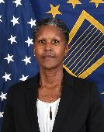




Organizational Leadership Chart
Unclassified
General Counsel
Mr. Tremaglio
Director
LtGen Masiello
Deputy Director
Ms. Ebright
Sr En Advisor
CMSgt Akande
Chief of Staff
Mr. Rosenberger
Mobilization Assistant
Brig. Gen. Heick
Internal Audit & IG
Mr. Conforto
Equal Employment Opportunity
Ms. Galimore
International
CAPT Jones
Special Programs
Mr. Norris
West Region
Col Kennebrae
Central Region
COL Darnall
East Region
CAPT Gathright
Cost & Pricing
Mr. Bennett
AIMO
CAPT Hohner
Aircraft Operations
CAPT McElwain
Contracts
Ms. Banks
Corporate Operations
Mr. Wiley
Digital & Artificial Intelligence
Mr. Morgan
Financial & Business Ops
Dr. Wilcoxon
Information Technology
Ms. Schultheis
Enterprise Analytics & Modernization Mr. Eady
Technical Directorate
Dr. Christensen
Total Force
Mr. Uehling
Unclassified

Slide 7
Presence in the U.S.
Unclassified
DCMA Headquarters
Fort Gregg-Adams, VA
36 CONUS Contract Management Offices
  43 total including International & Special Programs
10,000+ serviced contractor locations
DCMA Western Regional Command
HQ: Carson, CA
DCMA Central Regional Command
HQ: Chicago, IL
DCMA Eastern Regional Command
HQ: Boston, MA
DCMA Aircraft Integrated Maint. Ops
HQ: St. Augustine, FL
DCMA Southern California
DCMA Mountain Pacific
DCMA Space Enterprise
DCMA Missiles
DCMA Boeing Seattle
DCMA Palmdale
DCMA NASA Product Ops
DCMA South
DCMA Land Systems
DCMA Ohio River Valley
DCMA Chicago
DCMA Twin Cities
DCMA Bell Textron Fort Worth
DCMA Boeing St. Louis
DCMA Lockheed Martin Fort Worth
DCMA Northeast
DCMA Mid-Atlantic
DCMA Southeast
DCMA Radar & Sensors
DCMA Springfield
DCMA Boeing Philadelphia
DCMA Lockheed Martin Marietta
DCMA Sikorsky Aircraft Stratford
DCMA Aircraft Propulsion Ops
DCMA Naval Special Emphasis Ops
AIMO Eglin
AIMO Greenville
AIMO San Antonio
AIMO North Texas
AIMO Oklahoma City
AIMO St. Augustine
Unclassified
Notes:
31 CONUS Contract Management Offices
39 total including International & Special Programs
10,000+ serviced contractor locations

Slide 8
Unclassified International Presence
Canada
London, ON
Toronto, ON
Montreal, QC (2)
Vancouver, BC
Abbotsford, BC
Europe
Wiesbaden, Germany
Americas
Ottawa, ON
United Kingdom
Bristol
Huntingdon/Wyton
Samlesbury
Korea
Busan
Daegu
Japan
Atsugi
Komaki
Iwakuni
Kisarazu
Mizuho
Nagoya
Okinawa
Greece
Athens
Italy
Cameri
Milan
Israel
Herzliya
Taiwan
Taichung
DCMA International HQ
Ft Gregg-Adams, VA
Kuwait
Kuwait City
Saudi Arabia
Riyadh
Pacific
Singapore
Americas
Europe
Pacific
Australia
Melbourne
Nowra
Williamtown
Amberly
New Zealand
Christchurch
Effective 4 JUN 23
Unclassified

Slide 9
Contract Management Office (CMO)
Unclassified
Commander/
Director
Mandatory Structure
Quality
Assurance Group
Engineering/
Manufacturing
Group
Contracts Group
Flexible ─ Based
on workload
QA Team
Engineering Team
Manufacturing Team
Contracts
Team
Full service on-site support
  Can be either co-located with major contractor or geographically oriented
On-site eyes and ears of the customers
Accept products for military services
Provide business systems insight and ensure compliance
Analyze contractor performance capability
Assess contractor progress and authorize payments
Unclassified

Slide 10
DCMA Acquisition Workforce
Unclassified
Unclassified

Slide 11
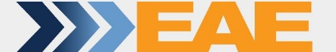
Where DCMA Contributes
UNCLASSIFIED
Preaward
Acquisition Planning
Lessons learned/acquisition insights
History of discrepancies/quality issues
Solicitation/contract clause review
Commerciality determination
Business system insight
Financial stability
Cost & pricing considerations
Production capacity
Market research/technology shifts
Proposal analyses
Forward Pricing Rate Agreements
Preaward surveys
Cost & price/technical analysis
Contract incentive structures
Reality of production promises
Proposal Evaluation
Post Award
Program Assessment Reports (PAR)
Contractor PAR input
Payment authorizations/withholds
70+ contract admin services
Production/delivery status
Fraud investigations
Small business compliance
Subcontract insight
Contract Performance
Contract
Closeout
Negotiate final rates
Reconcile deliverables
Property disposition
Contract closeout
Funds release
Canceling funds
Engage early ……………………………………………………………………………………………….
Avoid problems later
UNCLASSIFIED
Notes:
These are the products and services that DCMA provides throughout the acquisition lifecycle. First two blocks are on the pre-award side and the last two on post award. The more coordination on the pre award side usually results in a smoother contract execution and closeout.

Slide 12
DCMA’s Role in Post Award
UNCLASSIFIED
Typical functions for DCMA personnel
DCMA Capabilities
  Acquisition Directorate (AQ)
    Contract Administration Support
    Contractor Business Systems
    Property and Plant Clearance
    Small Business Support
    Contract Terminations
    International Contract Administration
  Technical Directorate (TD)
    Quality Assurance
    Contract Safety Services
    Engineering & Manufacturing
    Transportation
    Packaging
  Enterprise Analytics and Modernization Directorate
    Chief Data Officer
    Major Program Support Division
    Industrial Analysis Division
  Aircraft Operations
PEOPLE
PROCESS
TOOLS
TECHNIQUES
UNCLASSIFIED
12
Notes:
This chart provides an outline the products and services DCMA delivers during post award administration.
Highlight a couple Key Capabilities
We have multiple functions across multiple directorates that work together to support the customer.

Slide 13

(AQ) Contract Administration Support and Services
UNCLASSIFIED
Mission
Provide contract administration support and advice on all contract related matters and improve the overall contracting mission
Functions
Provide pre-award support
Identify potential performance risks throughout the entire lifecycle of the contract/Other Transaction/Grant/Agreement
Support contract negotiations
Negotiate and execute ACO mods
Monitor contract performance
Review and process contract financing payments, vouchers, and invoices
Contract closeout
Cost Accounting Standards compliance
Resolve contract issues
    Basic Contract Administration Assignment Rule – Contractor (CAGE) Can Only Be Administered By One CMO
UNCLASSIFIED
13
Notes:
The ACO leads a contract administration team and relies on every member within the team. The business and technical experts provide collective/individual advice to the ACO. Using the advice of these experts, the ACO would analyze the issue and recommend resolution, focusing on the facts (i.e., advisor’s report, contractor’s response, other data relative to the issue) and take prompt action and document the basis for the decision. The ACO will also work closely with the Defense Contract Audit Agency (DCAA) to identify priorities, negotiate rates, and disposition system audits among other items.
The ACOs and contract administrators perform all these important functions during the course of administering a contract.
The followings are further explanation for a few of these functions:
Provide Pre-award Support – Buying commands can request pre-award support from DCMA to include: performing proposal analysis (both pricing and technical), conducting contractor capability surveys (from a technical standpoint i.e. quality, manufacturing, engineering, etc.), business system reviews, and financial capability reviews.
Negotiate and execute ACO Modifications – When administering contracts, ACOs may have to issue modifications to the contract. These modifications can vary in complexity from an administrative modification (clarifying omissions, adding clauses, etc.) to bi-lateral agreements definitizing contract negotiations.
Reviewing and processing of contractor’s payment requests - cash flow is very important to the contractors, especially for the mid-size contractors and small businesses, they rely on DCMA’s timely processing of their payment requests in order to continue operating.
There is a FAR mandate for closing physically completed contracts within a certain timeframe base on the contract type. Therefore, DCMA places lot of emphasis on closing contracts.

Slide 14
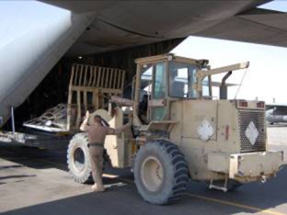

(AQ) Property Management and Plant Clearance
UNCLASSIFIED
Mission
To Ensure Government assets in the possession of contractors are appropriately managed, accounted for, utilized, and maintained from initial receipt through final disposition.
Functions
Conduct Property Management System Analysis (PMSA)
Adjudicate property loss cases (includes theft, damage, and destruction) and determine liability
Direct timely, cost-effective disposal of excess government property in the possession of contractors (Plant Clearance)
Ensure defense against unauthorized release of sensitive defense articles
Accept delegations from other federal agencies, e.g., NASA
Support CCAS property administration
Support CMO contract closeout efforts
Plant Clearance and Property loss administration is managed within PIEE
UNCLASSIFIED
14
Notes:
The property management system requirement in a contract ensures the contractors are providing effective and efficient stewardship of the Government property in their custody. DCMA’s property administrators perform property management system analysis (PMSA) to ensure the contractors are adhering to their system to acquire, control, use, care for, report, and dispose of Government property.
DCMA’s property administrators do not track property, maintain contractor’s property records, or perform physical inventories. These are the contractors’ responsibilities.
When Government property is no longer needed for contract performance, the Plant Clearance Officer coordinates the timely and cost-effective reutilization, sale and disposal of excess government property in the possession of contractors.

Slide 15
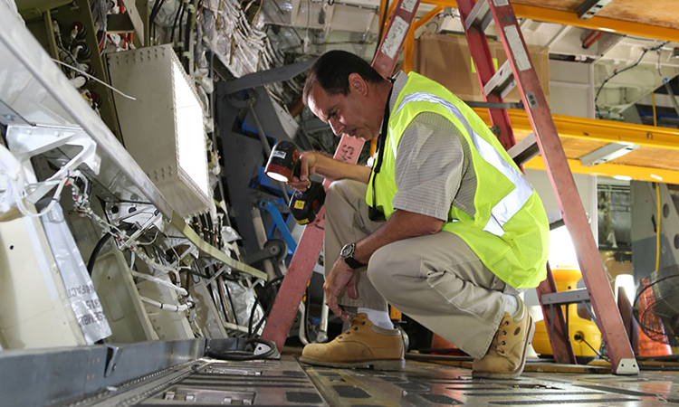
(TD) Quality Assurance Services
UNCLASSIFIED
Mission
We are the independent eyes and ears of DoD and its partners,
enhancing warfighter lethality by
ensuring timely delivery of quality
products, and providing relevant
acquisition insight supporting
affordability and readiness.
Objectives
Verify the contractors’ quality management system is meeting contractual standards
Conduct risk assessments of contractor's processes with greater rigor placed on processes most likely to contribute to nonconformance or noncompliance
Evaluate contractors' Technical Assessment business system based on past and present performance
Evaluate contractor’s inspection system, to ensure results are credible and provide adequate objective evidence to perform government acceptance
Functions
Conduct audits and assess capability of contractor quality systems
Provide insight to contractors’ Quality Management System based on past and present performance
Ensure product meets contract quality and technical requirements and perform government acceptance
UNCLASSIFIED
Notes:
All of DCMA’s Quality Assurance Specialists (QAS) are located either in the contractor facilities, or in geographically assigned teams covering all contractors in a given area.
They perform the important mission of Government Contract Quality Assurance (GCQA), assessing contractor’s quality-related controls of adequacy, compliance, and effectiveness. If necessary DCMA will independently inspect the materiel manufactured, however this is not the preferred method of surveillance. In lieu of hands on physical inspection, the DCMA QAS will often witness the contractors' inspections and tests to ensure that the contractor’s QA controls are effective and identify nonconforming material before it is presented for Government acceptance.
They review the contractor’s Quality Management System to ensure it is meeting contractual standard. If a contractor has an effective Quality Management System, there is a higher probability of quality end item being produced. The Quality Assurance Specialists have a direct impact on the quality of the end items that are being used by the warfighters .
* DCMA policies refer to QA oversight actions as “surveillance.”

Slide 16
Tool/Video Orientation:
DCMA Award Management Team (AMT)
From Paper to Product: We Are DCMA/What DCMA Does
How to Find Us
Unclassified
Unclassified

Slide 17
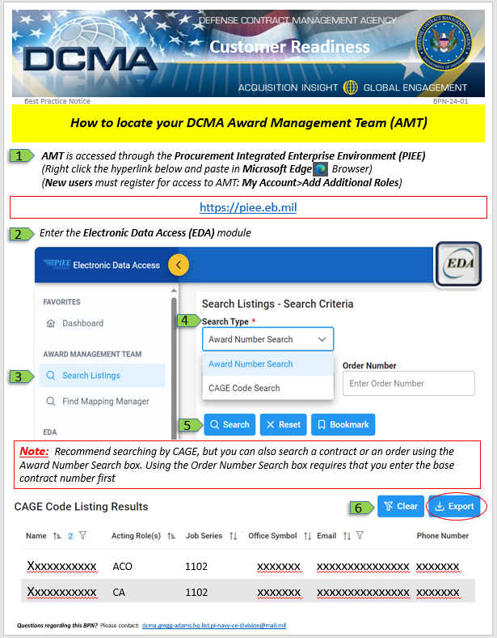
DCMA Award Management Team (AMT)
Unclassified
To reach proper DCMA Functional Specialists, Administrative Contracting Officer (ACO), Industrial Specialists (IS), Quality Assurance (QA), Transportation Officer (TO), etc... from a Personal Computer, is available within Procurement Integrated Enterprise Environment (PIEE). https://piee.be.mil
Unclassified
Notes:
The new tool will reside in the Procurement Integrated Enterprise Environment (PIEE) within the Electronic Data Access (EDA) functionality and will be known as Award Management Team (AMT).
Still active ---Until then go to: https://www.dcma.mil/

Slide 18
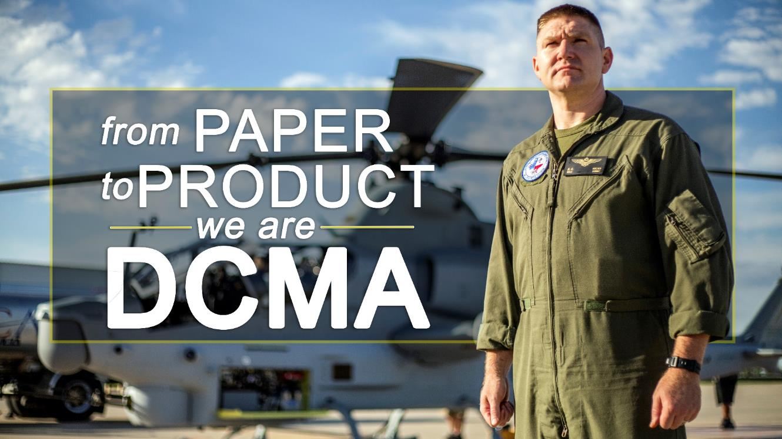
From Paper to Product: We Are DCMA
Unclassified
https://www.dvidshub.net/video/691167/paper-product-we-dcma
Unclassified

Slide 19

What DCMA Does
Unclassified
https://www.dvidshub.net/video/480264/dcma-does
Unclassified

Slide 20
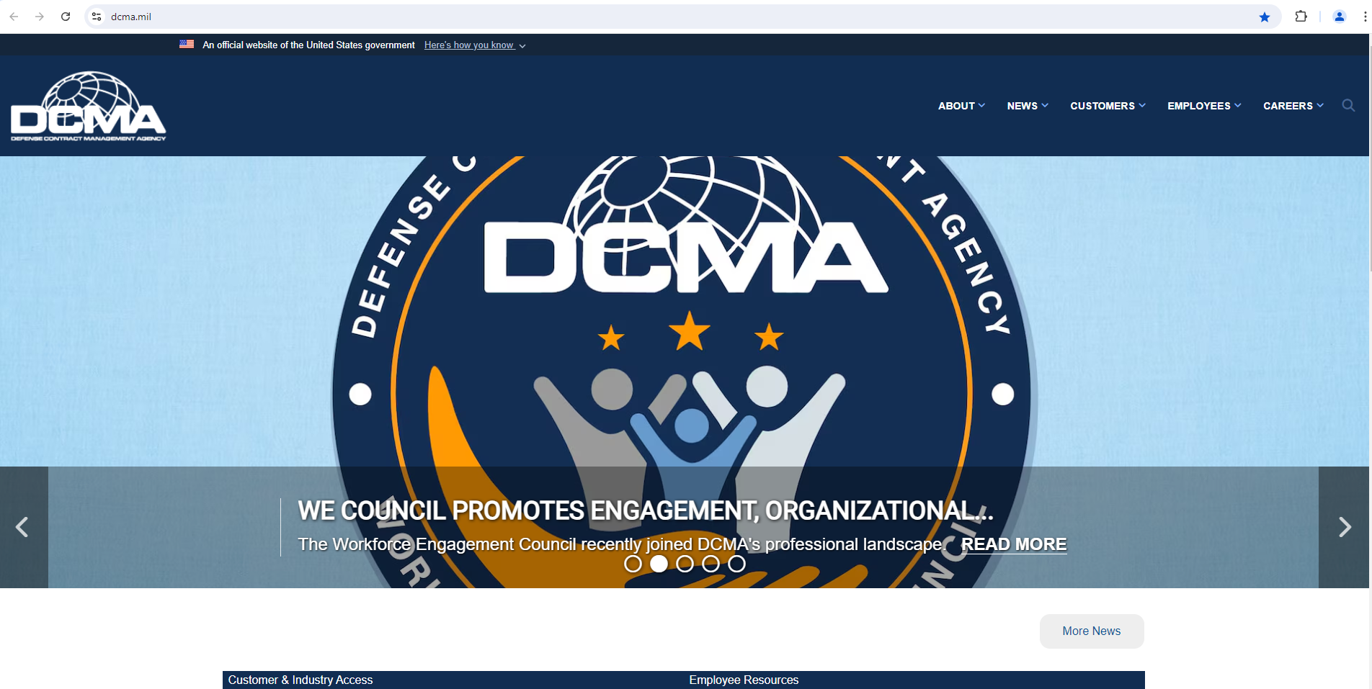
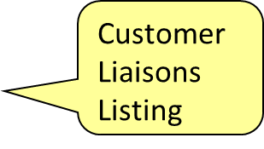
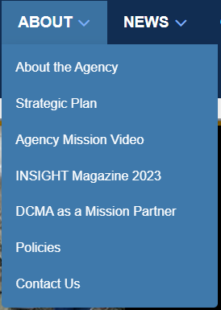
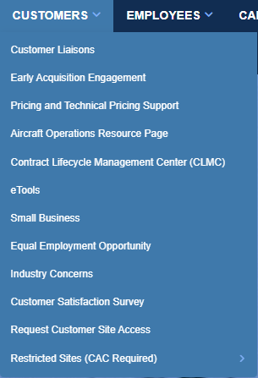
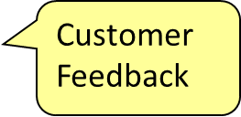
How to Find Us (www.dcma.mil)
Unclassified
Hover Over Customers
Link to
Policies
Pricing Support
Request External Access
Unclassified
Notes:
External Website has access to a lot of DCMA information:
Link to DCMA's publicly available policies.
Under Customers
Customer Liaison Listing
Customer Feedback
CMT
External Access
Personnel external to DCMA can access a suite of etools by clicking on Request Customer Site Access in order to perform registration process thru the External Web Access Management (EWAM). May be OBE soon
The Contract Management Team Locator is a tool to find DCMA team members assigned to a CAGE or a contract.
Many tools moving to PIEE

Slide 21

Questions
Unclassified
How to reach your DCMA HQ team:
Customer Engagement Division:
dcma.gregg-adams.hq.list.dcn@mail.mil
Unclassified

