Slide 1
cFolders and Technical Data
Jason Head, TQ BPA
Timothy Thurston, TQ BPA
XXXX XX, 2024

Slide 2
Training, Knowledge, and Opportunities (TKO) Seminar - cFolders/Tech Data Presentation
Provide an in-depth focus on acquisition software platform utilization for researching and finding technical data: DLA Internet Bid Board System (DIBBS), DLA Collaboration Folders (cFolders), and Joint Certification Program (JCP).
What is cFolders?
Access to Solicitation Technical Data
cFolders Password Process
Navigating cFolders
DIBBS Online Help
Points of Contact

Slide 3
What is cFolders?
Collaboration Folders (cFolders) is: An online system that stages DLA’s technical data.
It is a multifunctional tool used for posting technical data related to:
  Open solicitation(s)
  Other projects
NOTE: These solicitation(s) are found on the DLA Internet Bid Board System (DIBBS).

Slide 4
What is cFolders?
DLA Internet Bid Board System (DIBBS)
Solicitation
YES
cFolders
Tech Data
YES
End

Slide 5
Access to Solicitation Technical Data on cFolders
There are multiple ways for manufacturers and suppliers to access cFolders:
  Access via a link within the solicitation
  Access from link identified from DLA Internet Bid Board System (DIBBS) home page
    https://www.dibbs.bsm.dla.mil/
  Access through Request for Quote (RFQ) or Request for Proposal (RFP) in DIBBS
  Direct Login to cFolders
    https://pcf1x.bsm.dla.mil/cfolders/

Slide 6
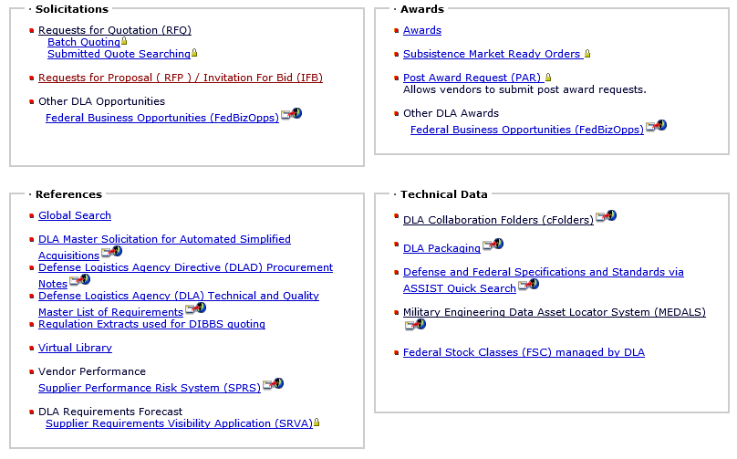
DIBBS Home Page Link to cFolders
Notes:
There is a cFolders link on the DIBBS homepage

Slide 7
DIBBS Home Page Link to Search for Active Procurements
Notes:
There are various ways to search for solicitations
One of the ways to search is by clicking on the “RFQ search”. Let’s walk through this process…

Slide 8
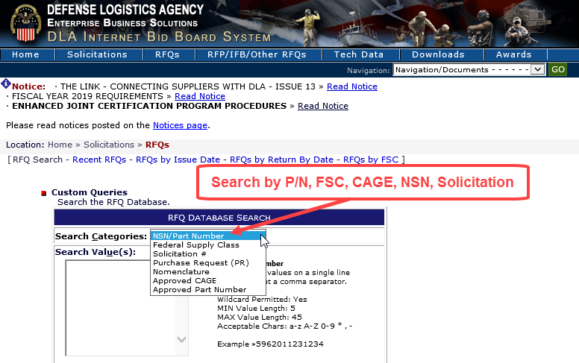
DIBBS Solicitation RFQ Search Screen
Notes:
Within the RFQ area you can search by different categories.
The most direct search results will come from searching by the solicitation number.
If your organization supplies a specific stock class or NSN that would be another great way to find open solicitations. Let’s look at an NSN search…NSN 1005012522820

Slide 9
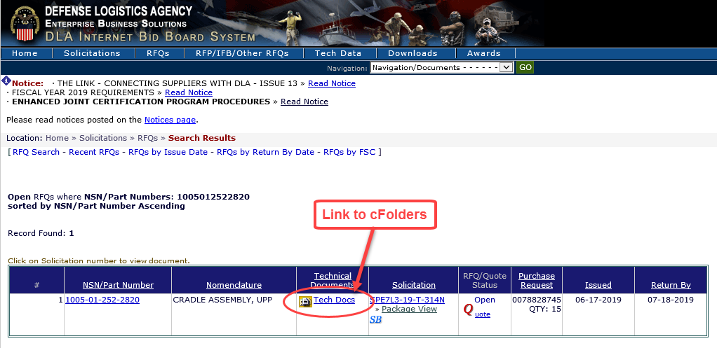
DIBBS Solicitation RFQ Search Results
Notes:
Here are the results for an NSN search, if a solicitation has technical data there will be a link to cFolders within the search results. (as you see above). Let’s click on the cFolders link and take a look at the tech docs…

Slide 10
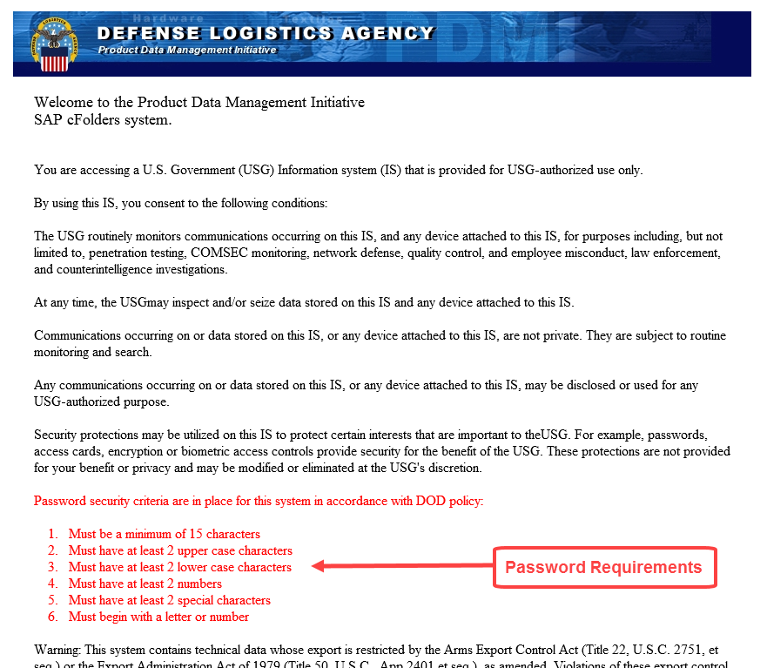
cFolders Password Requirements
Notes:
cFolders is a separate system from DIBBS
cFolders accounts is created automatically when a DIBBS account is created
First time you log in you will have to setup your password.

Slide 11
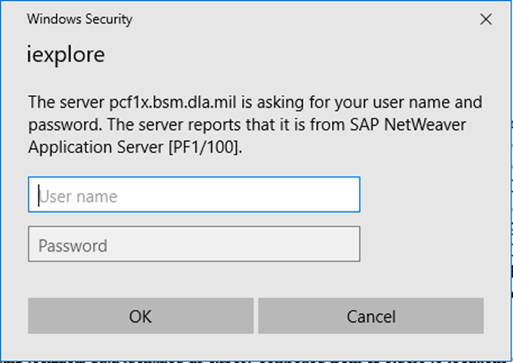
Password Entry Screen
Notes:
Pop-up to enter your user ID and password
Need to log in at least once every 30 days to keep your account active. Slide 24 has POC information with who to contact if your account becomes locked

Slide 12
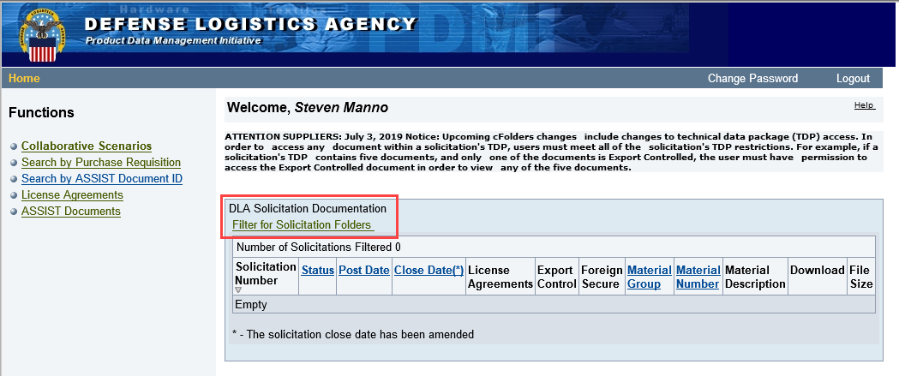
cFolders Home Page
Notes:
Main cFolders page
Click to search by solicitation number #
Download link will take you to Download page.

Slide 13
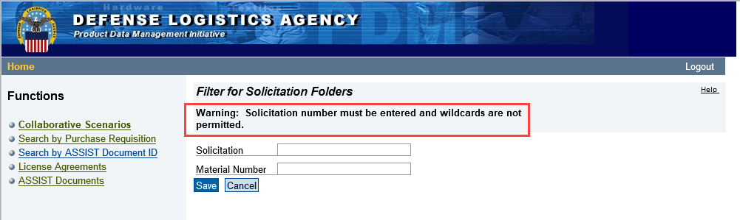
Search by Solicitation Number
Notes:
Recent security enhancement.
You will need to know the full solicitation number.
You can’t search with wild cards or solely by NIIN.
For LTCs you may need to enter the “Project Number”.

Slide 14
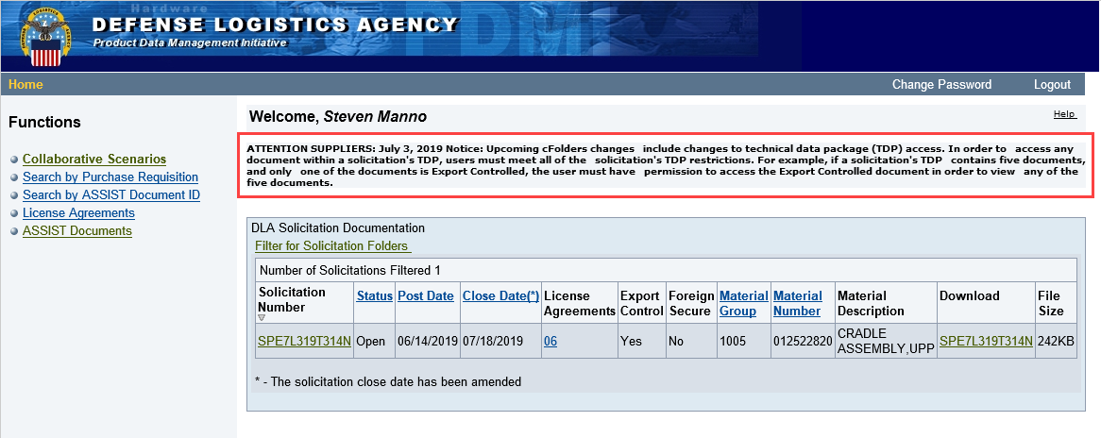
cFolders View of TDP
Notes:
Always check the message at the top for important information or changes.
Current message, can’t view any of the drawings in a TDP unless you have permission to view all of them.
Can just click under the download button but I’ll walk through all the screens.

Slide 15
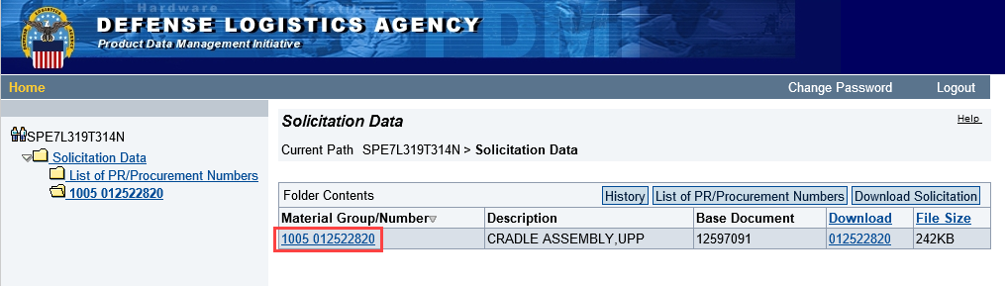
Drilling into TDP
Notes:
Click on material number

Slide 16
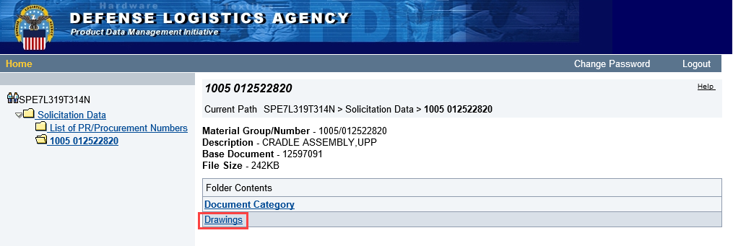
Drilling into TDP
Notes:
Click on drawings.
From this screen you can also see non-government solicitations
A government spec will give you a link to Assist

Slide 17
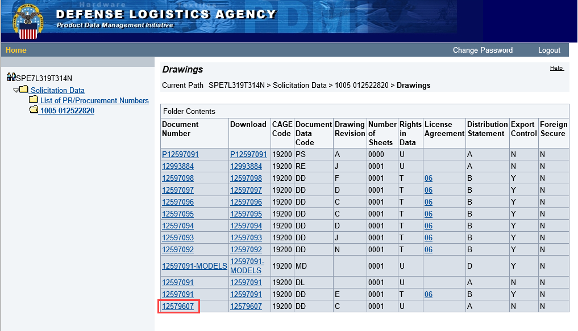
Drilling into TDP
Notes:
Lists all the drawings with metadata
Click on Document Number

Slide 18
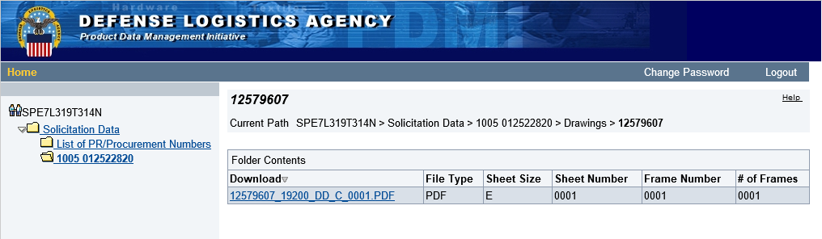
Drilling in to TDP
Notes:
Pulls up the individual file, click to download

Slide 19
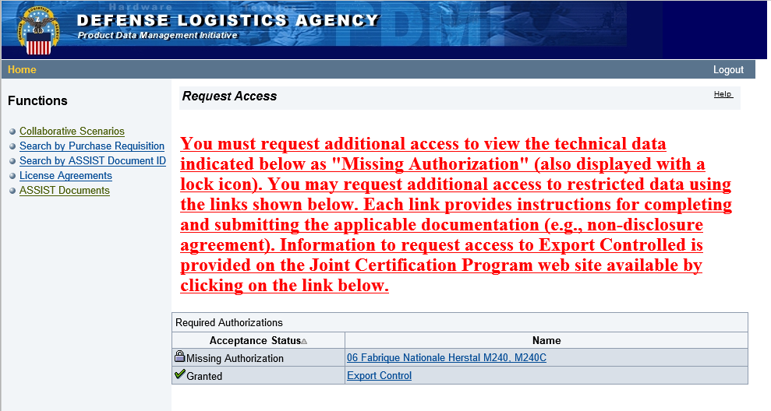
TDP Restrictions
Notes:
Here’s what happens if you don’t have access
Lock next to what permission you are missing, hyperlinked so you can click for more information

Slide 20
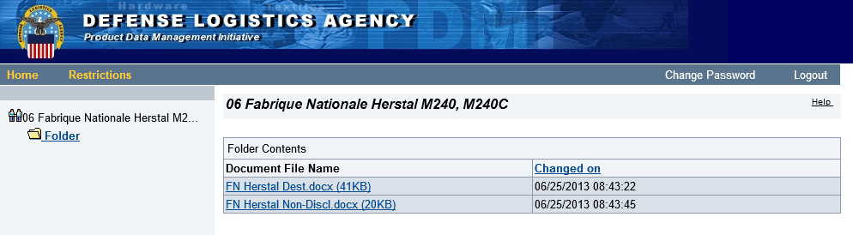
License Agreements
Notes:
This License Agreement requires a certificate of destruction and an NDA

Slide 21
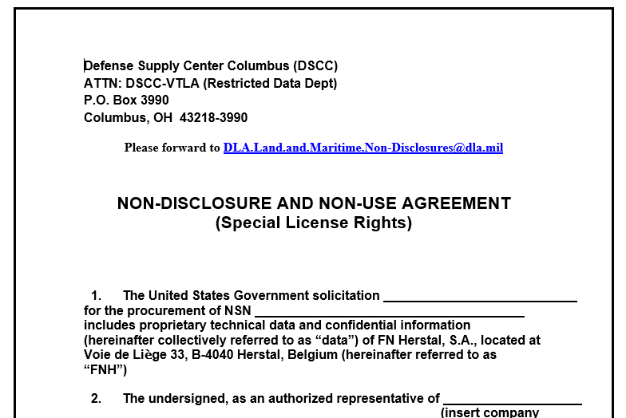
Example License Agreement Form
Notes:
Turn around should be around 3 days to get you into Solicitation

Slide 22
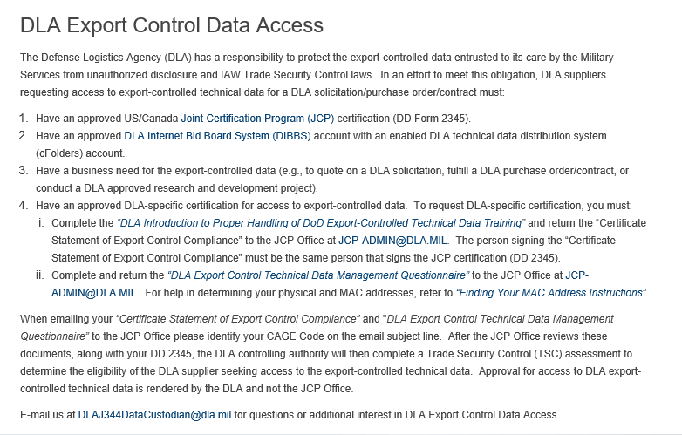
Export Control
https://www.dla.mil/Logistics-Operations/Enhanced-Validation/
Notes:
DOD requirement is Joint Certification Program (JCP) to access export control TDPs
DLA has added an additional requirement to view export control TDPs called Enhanced JCP (EJCP)
Hyperlink on cFolders takes you here but here is the direct link.
If you have JCP certification but still see this screen or an empty drawing your need enhanced JCP (EJCP).
J344 data custodian email with question.

Slide 23
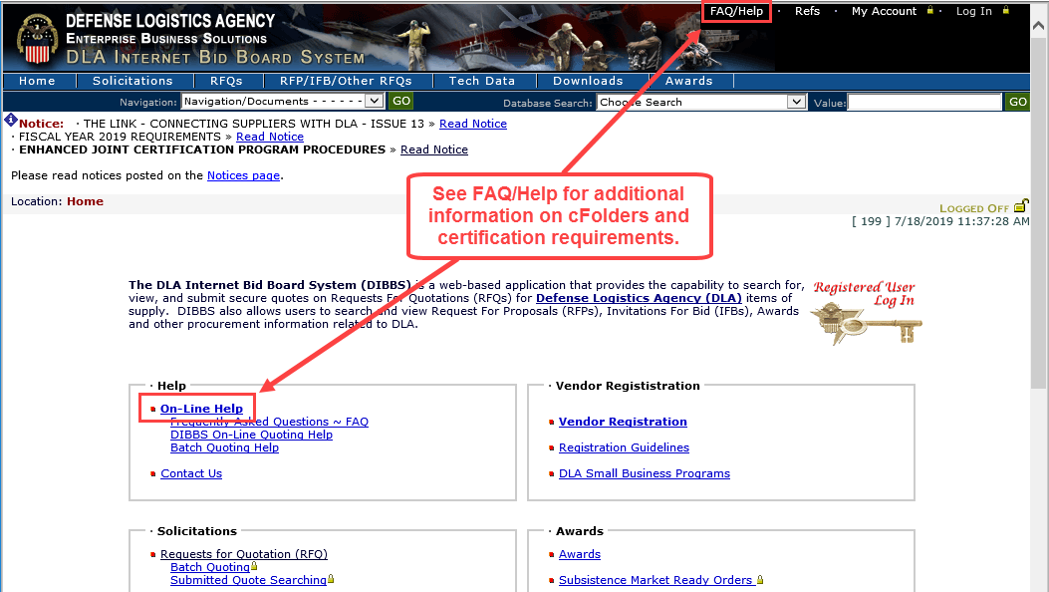
DIBBS Online Help
Notes:
Back to DIBBS
There's a FAQ/Online Help area with useful information

Slide 24
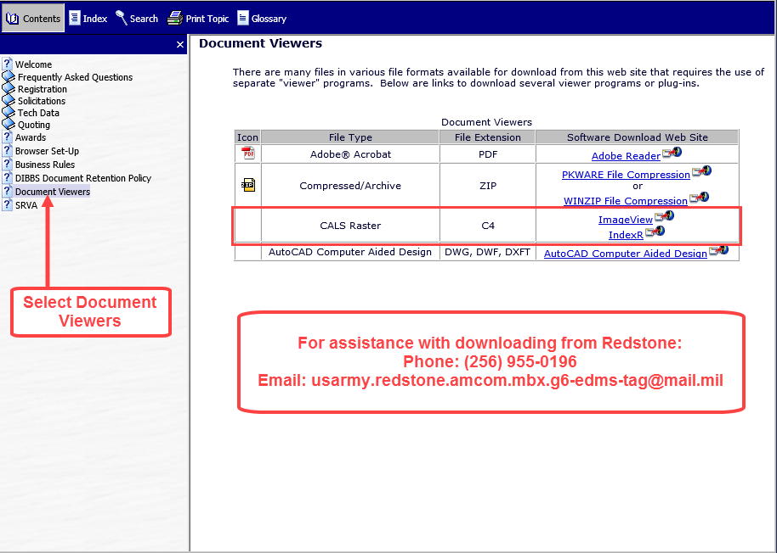
Document Viewers
Notes:
Most useful part, links to document viewers you might need
C4 is the most common type you may not be able to open, common file type for old Army drawings

Slide 25
Points of Contact
cFolders System Issues, Passwords and Resets
DISA Global Service Desk
1-844-347-2457
Press 5, then speak or enter D-L-A
cFolders Admin Teams:
dscc.cddwgs@dla.mil – Land and Maritime
dscr.pdmddistribution@dla.mil - Aviation
trpsptdrawings@dla.mil –Troop Support

Slide 26
Questions

