Slide 1
VENDOR SHIPMENT MODULE (VSM)
Janet Hern
Strategic Opportunities Analyst
November 5-6, 2024

Slide 2
Vendor Shipment Module
Definition and Purpose
VSM is a DLA enterprise wide, web-based system that supports cargo movement from DLA Suppliers to DLA customers and DLA warehouses
Suppliers access VSM to notify DLA that an FOB Origin order is ready for pickup
DLA Suppliers access VSM to print Military Shipping labels, package or box labels, and correct destination addressing for both FOB Origin and FOB Destination orders

Slide 3
Vendor Shipment Module
Use When Contracts Are
FOB ORIGIN
FOB DESTINATION
Found in Block 8 of the Contract
Use of VSM is a requirement
DLA manages and pays for transportation
Supplier enters shipment details—
Weight, Pieces, Dimensions
VSM provides tracking label for small parcel or Bill of Lading (BOL) for LTL and TL shipments
VSM prints all labels and transportation documents
Found in Block 8 in the Contract
Use of VSM is a requirement per PROC LTR 2023-01 effective 10/20/22
Supplier manages and pays for transportation
Supplier enters minimal shipment information
Supplier can enter their carrier’s name and tracking number to aid in receipting material
VSM provides the Military Shipping label and package or box labels

Slide 4
Vendor Shipment Module
How it Works
VSM Registration
https://vsm.distribution.dla.mil
Contracts from EBS
VSM
Contract information flows from EBS into VSM by CAGE Code and by FOB Origin or FOB Destination terms
If a supplier is not registered prior to
award, the contract will not be available in VSM
Awards missing from VSM can be manually populated by the supplier after registration is complete
Suppliers register each of their ship from addresses in VSM

Slide 5

Vendor Shipment Module
Transportation Routing
VSM determines whether shipment will be routed Small Parcel or Freight
VSM personnel combine smaller freight shipments when destined to the same address and have the same priority to save $
VSM utilizes current DLA routing and addressing logic
VSM provides limited in transit visibility

Slide 6
Vendor Shipment Module
Ground Transportation Modes
Small Parcel
UPS and FedEx
150 lbs. or less with dimensions of 165” or less length and girth combined or no longer than 108”
Less than Truckload (LTL) & Truckload (TL)
Crowley Logistics (3PL)
LTL - generally more than 150 lbs., but less than 10,000 lbs.
TL - generally 10,000 lbs. to 40,000 lbs.

Slide 7
Vendor Shipment Module
Process Schedule
WHERE
IS
MY
TRUCK
???????????????

Slide 8
Vendor Shipment Module
Process Schedule/LTL Freight Shipments
If VSM entry by 1000
Monday | Tuesday Documents available in VSM by 1500 | Wednesday Shipment pickup by carrier prior to COB | Thursday | Friday | Monday | Tuesday
Tuesday |  | Documents available in VSM by 1500 | Shipment pickup by carrier prior to COB
Wednesday |  |  | Documents available in VSM by 1500 | Shipment pickup by carrier prior to COB
Thursday |  |  |  | Documents available in VSM by 1500 | Shipment pickup by carrier prior to COB
Friday |  |  |  |  | Documents available in VSM by 1500 | Shipment pickup by carrier prior to COB

Slide 9
Vendor Shipment Module
Processing Screen
Processing Screen
Choose FOB Origin or
FOB Destination Screen

Slide 10
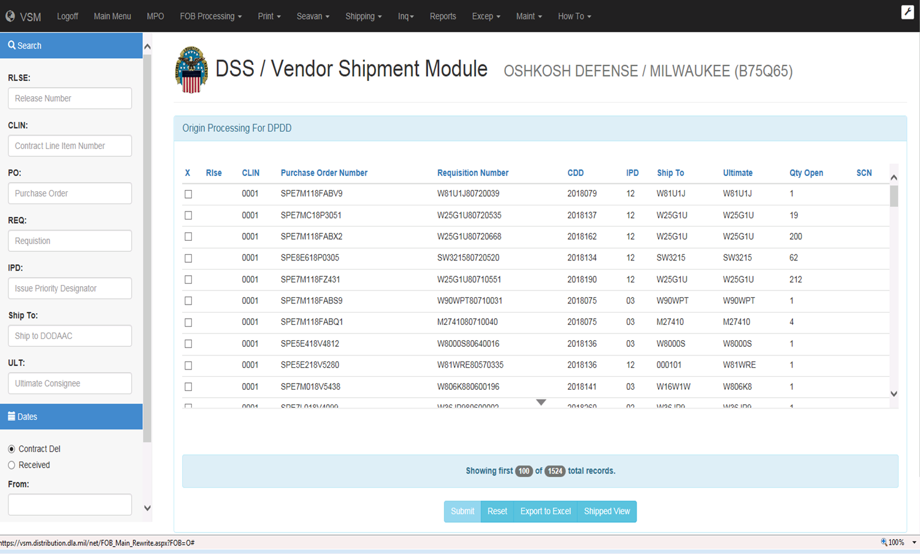
Vendor Shipment Module
Processing Screen

Slide 11
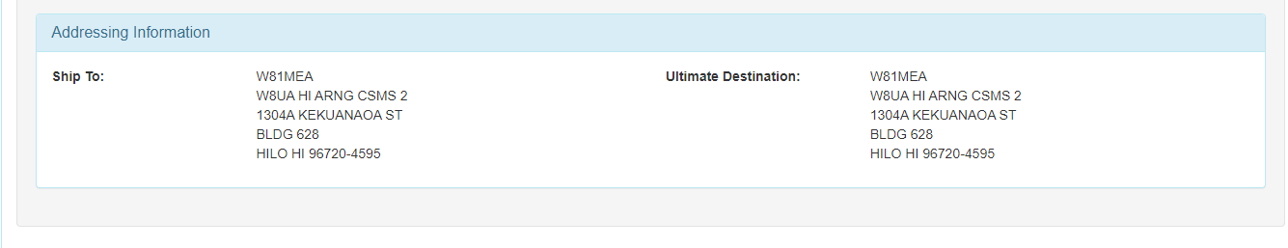
Vendor Shipment Module
Addressing
Most up-to-date addressing
  Follows the Cargo Routing Instruction File (CRIF)

Slide 12
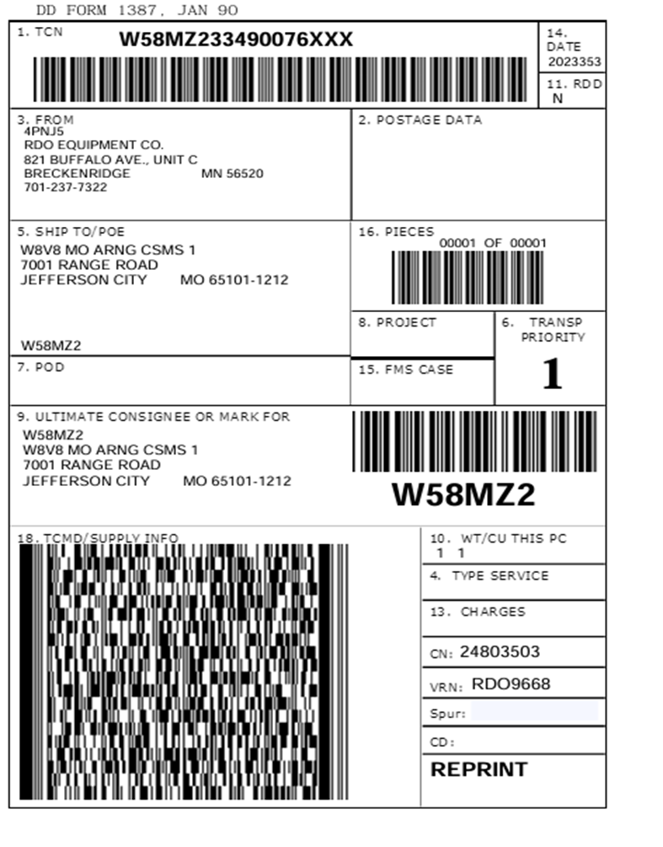
Vendor Shipment Module
Military Shipping Label

Slide 13

Vendor Shipment Module
Date Marking
MARKING REQUIREMENTS

Slide 14
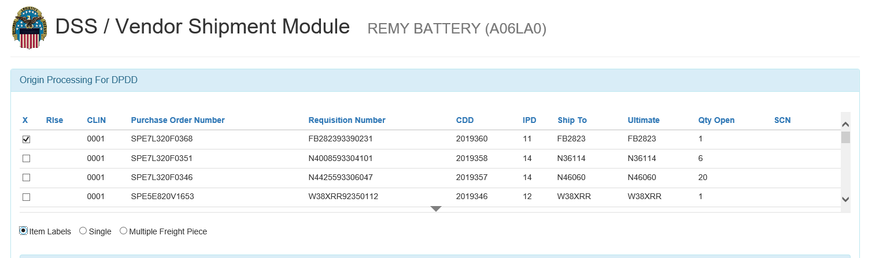
Vendor Shipment Module
Shelf-Life Entry

Slide 15
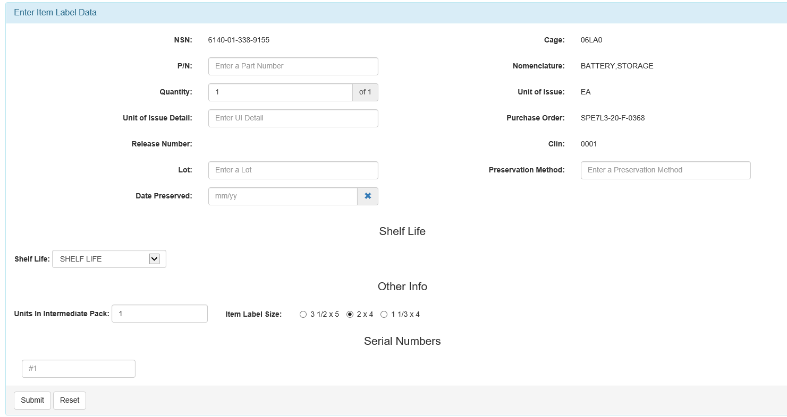
Vendor Shipment Module
Shelf-Life Entry

Slide 16
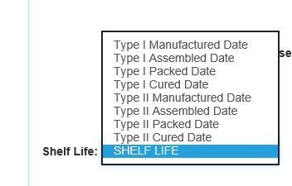
Vendor Shipment Module
Required Date Marking

Slide 17
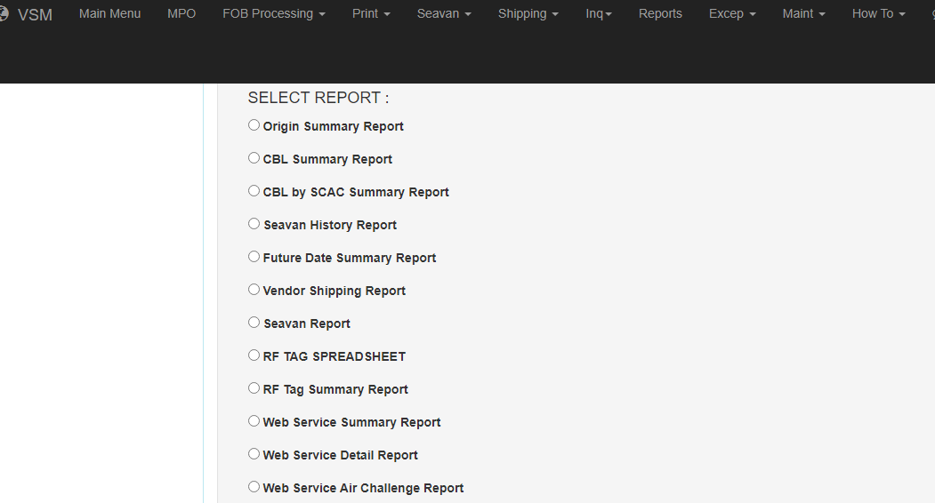
Vendor Shipment Module
Reports Capability

Slide 18
Vendor shipment Module
Origin Summary Report
 |  |  | Origin Summary Report for |  | RDO EQUIPMENT CO. |  |  | C4PNJ5 |  |  |  | Period |  |  | 10-06-2024 |  | to | 10-12-2024 |  |  | Items Reported | 175
IPG | Dt Shpd | Tcn |  | Shpmnt Cntrl Nbr |  | Ship To Dodaac | Ultmt Cnsge |  | Ovrseas Ind |  | POE |  | POD |  |  | Gross Wt | Gross Cube |  | ITN |  |  | Air Srfc Cd | Scac |  | Trkg Nbr
3 | 10/07/2024 | W25G1U42810503XXX |  | 25996205 |  | W25G1U | W25G1U |  | N |  |  |  |  |  |  | 35 | 3 |  |  |  |  | S | FDXG |  | 280326628250
2 | 10/07/2024 | W58GTV42790013XXX |  | 25996573 |  | 000101 | W58GTV |  | Y |  | 101 |  | O1R |  |  | 28 | 11 |  |  |  |  | A | FDXE |  | 280330282032
1 | 10/07/2024 | M6710042780162XXX |  | 25996743 |  | M22320 | M22320 |  | N |  |  |  |  |  |  | 10 | 4 |  |  |  |  | A | FDXE |  | 280332066283
1 | 10/07/2024 | M6710042780168XXX |  | 25996775 |  | M22320 | M22320 |  | N |  |  |  |  |  |  | 1 | 1 |  |  |  |  | A | FDXE |  | 280332372390
1 | 10/07/2024 | M6710042780158XXX |  | 25996773 |  | M22320 | M22320 |  | N |  |  |  |  |  |  | 3 | 1 |  |  |  |  | A | FDXE |  | 280332359349
1 | 10/07/2024 | M6710042780161XXX |  | 25996746 |  | M22320 | M22320 |  | N |  |  |  |  |  |  | 17 | 6 |  |  |  |  | A | FDXE |  | 280332059226
1 | 10/07/2024 | M6710042780159XXX |  | 25996742 |  | M22320 | M22320 |  | N |  |  |  |  |  |  | 10 | 1 |  |  |  |  | A | FDXE |  | 280332071672
2 | 10/07/2024 | W813LY42780222XXX |  | 25996777 |  |  |  |  | N |  |  |  |  |  |  | 1 | 1 |  |  |  |  | A | FDXE |  | 280332368354
2 | 10/07/2024 | W813LY42780223XXX |  | 25996779 |  | W813LY | W813LY |  | N |  |  |  |  |  |  | 1 | 1 |  |  |  |  | A | FDXE |  | 280332362183
1 | 10/07/2024 | W813LY42780117XXX |  | 25996814 |  | W813LY | W813LY |  | N |  |  |  |  |  |  | 1 | 1 |  |  |  |  | A | FDXE |  | 280332650188
3 | 10/07/2024 | MMR10042740388XXX |  | 25998547 |  | MMR100 | MMR100 |  | Y |  |  |  |  |  |  | 1 | 1 |  |  |  |  | A | FDXE |  | 280344517694
1 | 10/07/2024 | W58GTV42770049XXX |  | 25998236 |  | 000101 | W58GTV |  | Y |  | 101 |  | O1R |  |  | 1 | 1 |  |  |  |  | A | FDXE |  | 280342948382
1 | 10/07/2024 | M6710142545657XXX |  | 25998342 |  | M67101 | M67101 |  | N |  |  |  |  |  |  | 25 | 1 |  |  |  |  | A | FDXE |  | 280343250747
1 | 10/07/2024 | W58GTV42770060XXX |  | 25998238 |  | 000101 | W58GTV |  | Y |  | 101 |  | O1R |  |  | 1 | 1 |  |  |  |  | A | FDXE |  | 280342952260
1 | 10/07/2024 | W42UUE42750268XXX |  | 25998346 |  | W42UUE | W42UUE |  | N |  |  |  |  |  |  | 2 | 1 |  |  |  |  | A | FDXE |  | 280343258921
1 | 10/07/2024 | W42UUE42750267XXX |  | 25998348 |  | W42UUE | W42UUE |  | N |  |  |  |  |  |  | 2 | 1 |  |  |  |  | A | FDXE |  | 280343265658
1 | 10/07/2024 | W45G184281001IXXX |  | 25998239 |  | W45G18 | W45G18 |  | N |  |  |  |  |  |  | 1 | 1 |  |  |  |  | A | FDXE |  | 280342945501
1 | 10/07/2024 | W33TLB42770045XXX |  | 25998419 |  | W33TLB | W33TLB |  | N |  |  |  |  |  |  | 1 | 1 |  |  |  |  | A | FDXE |  | 280343546444
3 | 10/07/2024 | MMR10042710352XXX |  | 25998344 |  | MMR100 | MMR100 |  | Y |  |  |  |  |  |  | 2 | 1 |  |  |  |  | A | FDXE |  | 280343267536
3 | 10/07/2024 | W58GQR42750046XXX |  | 25998844 |  | 000101 | W58GQR |  | Y |  | 101 |  | PN1 |  |  | 12 | 4 |  |  |  |  | S | FDXG |  | 280346377436
3 | 10/07/2024 | S05FRC42650744XXX |  | 25999853 |  | S05FRC | S05FRC |  | N |  |  |  |  |  |  | 1 | 1 |  |  |  |  | A | FDXG |  | 280355381731
3 | 10/07/2024 | MMC10042621174XXX |  | 26000155 |  | MMC100 | MMC100 |  | N |  |  |  |  |  |  | 2 | 1 |  |  |  |  | S | FDXG |  | 280359170296
3 | 10/07/2024 | S05FRC42650630XXX |  | 25999944 |  | S05FRC | S05FRC |  | N |  |  |  |  |  |  | 1 | 1 |  |  |  |  | A | FDXG |  | 280356411973
3 | 10/07/2024 | S05FRC42650663XXX |  | 25999958 |  | S05FRC | S05FRC |  | N |  |  |  |  |  |  | 1 | 1 |  |  |  |  | A | FDXG |  | 280356567291
3 | 10/07/2024 | S05FRC42650613XXX |  | 26000117 |  | S05FRC | S05FRC |  | N |  |  |  |  |  |  | 1 | 1 |  |  |  |  | A | FDXG |  | 280358693055
3 | 10/07/2024 | S05FRC42650709XXX |  | 25999990 |  | S05FRC | S05FRC |  | N |  |  |  |  |  |  | 2 | 1 |  |  |  |  | S | FDXG |  | 280357180776
3 | 10/07/2024 | S05FRC42650614XXX |  | 26000096 |  | S05FRC | S05FRC |  | N |  |  |  |  |  |  | 1 | 1 |  |  |  |  | A | FDXG |  | 280358559539
3 | 10/07/2024 | S05FRC42650745XXX |  | 25999876 |  | S05FRC | S05FRC |  | N |  |  |  |  |  |  | 1 | 1 |  |  |  |  | A | FDXG |  | 280355703587
3 | 10/07/2024 | S05FRC42650606XXX |  | 26000003 |  | S05FRC | S05FRC |  | N |  |  |  |  |  |  | 2 | 1 |  |  |  |  | S | FDXG |  | 280357348920
3 | 10/07/2024 | S05FRC42650600XXX |  | 26000023 |  | S05FRC | S05FRC |  | N |  |  |  |  |  |  | 1 | 1 |  |  |  |  | S | FDXG |  | 280357534193
3 | 10/07/2024 | S05FRC42650731XXX |  | 25999888 |  | S05FRC | S05FRC |  | N |  |  |  |  |  |  | 1 | 1 |  |  |  |  | A | FDXG |  | 280355898042
3 | 10/07/2024 | S05FRC42650714XXX |  | 25999980 |  | S05FRC | S05FRC |  | N |  |  |  |  |  |  | 7 | 2 |  |  |  |  | A | FDXG |  | 280356977536

Slide 19
Vendor Shipment Module
Origin Summary Report
NIIN Part Nbr | MRO Qty | Qty Open | Qty Shpd | Rlse Nbr | Prch Ord Nbr | CLIN | Small Parcel Ind | Freight Ind | USML Ind | VENDOR REFERENCE NUMBER | BOL NBR | Mode Shipped
015006848 | 74 | 0 | 74 |  | SPE7L124FATDS | 0001 | Y | N |  | 103820 |  | 5
015914663 | 2 | 0 | 2 |  | SPE7L125FA384 | 0001 | Y | N |  | RDO8870 |  | J
015522745 | 3 | 0 | 3 |  | SPE7L125FA367 | 0001 | Y | N |  | RDO8872 |  | J
015678281 | 3 | 0 | 3 |  | SPE7L125FA370 | 0001 | Y | N |  | RDO8877 |  | J
015522309 | 3 | 0 | 3 |  | SPE7L125FA368 | 0001 | Y | N |  | RDO8874 |  | J
015522754 | 3 | 0 | 3 |  | SPE7L125FA369 | 0001 | Y | N |  | RDO8871 |  | J
015674018 | 3 | 0 | 3 |  | SPE7L125FA366 | 0001 | Y | N |  | RDO8873 |  | J
016510011 | 1 | 0 | 1 |  | SPE7L125FA380 | 0001 | Y | N |  | RDO8876
016510011 | 1 | 0 | 1 |  | SPE7L125FA381 | 0001 | Y | N |  | RDO8875 |  | J
016735161 | 1 | 0 | 1 |  | SPE7L125FA375 | 0001 | Y | N |  | RDO8878 |  | J
015676661 | 1 | 0 | 1 |  | SPE7L125FA130 | 0001 | Y | N |  | RDO8887 |  | J
015724296 | 10 | 0 | 10 |  | SPE7L125FA287 | 0001 | Y | N |  | RDO8880 |  | J
015676658 | 2 | 0 | 2 |  | SPE7L124FAQHW | 0001 | Y | N |  | RDO8882 |  | J
015360726 | 10 | 0 | 10 |  | SPE7L125FA289 | 0001 | Y | N |  | RDO8881 |  | J
016508919 | 1 | 0 | 1 |  | SPE7L125FA194 | 0001 | Y | N |  | RDO8883 |  | J
016508919 | 1 | 0 | 1 |  | SPE7L125FA195 | 0001 | Y | N |  | RDO8884 |  | J
013288545 | 1 | 0 | 1 |  | SPE7L125FA391 | 0001 | Y | N |  | RDO8879 |  | J
015111668 | 1 | 0 | 1 |  | SPE7L125FA293 | 0001 | Y | N |  | RDO8886 |  | J
015677081 | 4 | 0 | 4 |  | SPE7L124FATHR | 0001 | Y | N |  | RDO8885 |  | J
015335655 | 15 | 0 | 15 |  | SPE7L125FA215 | 0001 | Y | N |  | RDO8888 |  | 5
015677753 | 1 | 0 | 1 |  | SPE7LX24FBL95 | 0001 | Y | N |  | 103432 |  | 5
015671489 | 1 | 0 | 1 |  | SPE7L124FASFR | 0001 | Y | N |  | RDO8889 |  | 5
015676644 | 1 | 0 | 1 |  | SPE7LX24FBL06 | 0001 | Y | N |  | 103372
015676615 | 1 | 0 | 1 |  | SPE7LX24FBL05 | 0001 | Y | N |  | 103341 |  | 5
015704736 | 2 | 0 | 2 |  | SPE7LX24FBL11 | 0001 | Y | N |  | 103467
014706328 | 1 | 0 | 1 |  | SPE7LX24FBL80 | 0001 | Y | N |  | 103317 |  | 5
015704738 | 2 | 0 | 2 |  | SPE7LX24FBL13 | 0001 | Y | N |  | 103450 |  | 5
015680138 | 1 | 0 | 1 |  | SPE7LX24FBL97 | 0001 | Y | N |  | 103352
015687538 | 2 | 0 | 2 |  | SPE7LX24FBK99 | 0001 | Y | N |  | 103490 |  | 5
015671507 | 1 | 0 | 1 |  | SPE7LX24FBK94 | 0001 | Y | N |  | 103511 |  | 5
015676303 | 1 | 0 | 1 |  | SPE7LX24FBL89 | 0001 | Y | N |  | 103353 |  | 5
015677284 | 1 | 0 | 1 |  | SPE7LX24FBL94 | 0001 | Y | N |  | 103470

Slide 20
Vendor Shipment Module
Supplier Benefits
Benefits to Suppliers with FOB Origin Contracts
No charge to utilize VSM
VSM provides and pays for transportation via DLA contracted carriers
Multiple supplier addresses/locations are supported
Accurate ship to addressing
Email notification when shipping documents are ready to print/carrier pickup date
Accurate on time delivery scoring
Printed labels and transportation documents sourced from DLA contract information
Benefits to Suppliers with FOB Destination Contracts
No charge to utilize VSM
Accurate ship to addressing
Printed labels and transportation documents sourced from DLA contract
information

Slide 21
Vendor Shipment Module
Resources
FAQs for VSM help
https://www.dibbs.bsm.dla.mil/notices/msgdspl.aspx?msgid=1000
VSM USER GUIDE
  https://vsm.distribution.dla.mil/net/docs/Vendor_USER_Guide.pdf
VSM Registration
  https://vsm.distribution.dla.mil
VSM Help Desk DLA administered contracts
  delivery@dla.mil 800 456-5507 Mon-Fri 0900-1700 Eastern
VSM Help Desk DCMA administered contracts
dcma.stlouis-mo.hq.mbx.transportation-inbox@mail.mil
FDTPI Mailbox fdtpi@dla.mil or daniel.riggle@dla.mil or 614 692-8246

Slide 22
Vendor Shipment Module
Future of VSM
SAP FIORI will replace/enhance VSM
Compatible with DLA Warehouse Management System (WMS)
Expected implementation in 2025
Interfaces with order process through to goods receipt
Interfaces with accounts payable through to payment
Provides real-time status information
Offers increased supply chain visibility
DLA VSM manages both DLA and DCMA administered contracts beginning September 17, 2024, except for:
Hazardous Materials
OCONUS vendors
Foreign Military Sales (FMS)
Arms, Ammunition, and Explosives (AA&E)
Vendors must use DCMA SIR E tools

