Slide 1
DLAD
Procurement Notes
&
Technical and Quality Requirements​
Scott Beauchamp
Procurement Analyst​
October 21, 2024

Slide 2
Procurement Notes and Technical/Quality Requirements
The Defense Logistics Acquisition Directive (DLAD) was revised for the purpose of removing solicitation provisions and contract clauses that duplicated those within the Federal Acquisition Regulation (FAR) and Defense FAR Supplement (DFARS)
Information that was previously contained in DLAD provisions and clauses now appear as Procurement Notes or Technical and Quality Requirements
  Procurement Notes: directives that contain instructions or list evaluation criteria
  Technical and Quality Requirements: directives that contain technical, quality, or packaging requirements
DLAD Procurement Notes and Technical and Quality Requirements supplement FAR and DFARS requirements when the procurement has special requirements unique to DLA
Formatting for the DLAD Procurement Notes and Technical and Quality Requirements is consistent with the FAR and DFARS

Slide 3
Procurement Notes and Technical/Quality Requirements
Procurement Notes:
  Appear in the applicable Uniform Contract Format (UCF) sections of the solicitation or contract along with standard FAR and DFARS provisions and clauses
  May also appear in Section B of the solicitation or contract, separate from FAR and DFARS provisions or clauses, if manually added by the contracting officer
  Consists of a three-character code with the first position identifying the applicable UCF section
    Example - C01: Superseded Part Numbered Items
Technical and Quality Requirements:
  Appear in the Procurement Item Description (PID) of Section B
  Identified by a five-character code with the first position having either an “R” or “I”
    Example - RP001: DLA Packaging Requirements for Procurement

Slide 4
Procurement Notes and Technical/Quality Requirements
Procurement Notes and Technical and Quality Requirements will be incorporated by reference in solicitations and contracts, unless they require fill-in(s), in which case they will be incorporated as full-text
  Incorporated by Reference:
  E01 Supplemental First Article Exhibit Disposition –Contractor Maintained
  Incorporated in Full-Text:
  E09 Contractor First Article Test (FAT) Information
  (1) For FAT requirements, the Government will conduct inspection at source and acceptance at destination. The FOB point is destination. Due to known system limitations, solicitations may contain erroneous inspection, acceptance, and FOB points. This procurement note takes precedence over any conflicting terms.
  (2) CONTRACTOR FAT DELIVERY SCHEDULE
  (a) ___ Days: To Deliver FAT Report to the Government
  (b) ___ Days: Government FAT Report Evaluation and Notification to Contractor
  (c) ___ Days: To Deliver Final Production Quantity After Approval of FAT Report
  (d) ___ Total Delivery Days for FAT (Sum of Paragraphs (2)(a) through (2)(c))

Slide 5
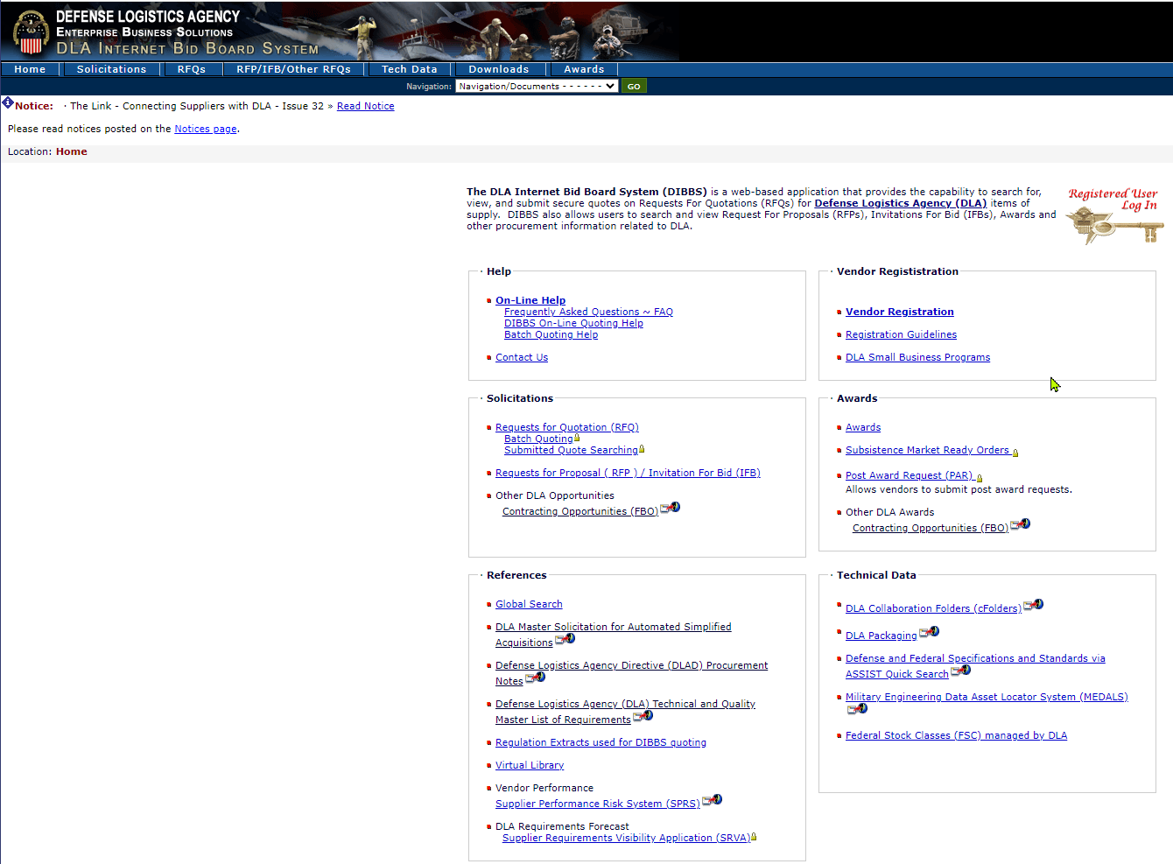
Procurement Notes and Technical/Quality Requirements
Full text of Procurement Notes and Technical and Quality Requirements are linked at the DLA Internet Bid Board System (DIBBS)
https://www.dibbs.bsm.dla.mil/

Slide 6
Commercial
Acquisitions​
Scott Beauchamp
Procurement Analyst
October 21, 2024

Slide 7
Benefits of
Commercial Acquisitions
FAR 12 commercial procedures streamline the acquisition process and allow greater flexibility
  Fewer contract terms and shorter publicizing times
  Aligned more closely with commercial industry practices
  Leverages technical innovation and market supply capabilities
  Improves price competition based on commercial market pricing
  Expands the Government’s supplier base and product availability
  Exception from having to submit certified cost or pricing data because a competitive commercial market drives the price of the product or service
FAR 13.5 allows the use of simplified acquisition procedures (SAP) for commercial products and services over the simplified acquisition threshold (SAT)
  May be used for commercial products and services up to $7.5M
  May be used up to $15M for emergency/contingency acquisitions

Slide 8
Commercial Definitions
Commercial definitions are provided in detail at FAR 2.101
  Six commercial product definitions
  Three commercial service definitions
Three general commercial categories:
  Commercial of a type customarily used by the general public
  Modifications to of a type customarily available in the commercial market
  Minor modification to of a type which is not customarily available in the commercial market that is made to meet Government requirements but does not significantly alter the function or physical characteristics
Commercially Available Off-the-Shelf (COTS)
  Subset for of a type customarily used by the general public
  Sold in substantial quantities in the commercial market
  Sold in the same form as in the commercial market (not modified)
  Does not include bulk cargo items (i.e., agricultural products)

Slide 9
Commercial Modifications
Modifications must not be so extensive that they change the essential function or physical characteristics (item may no longer be commercial)
  How similar is the modification to other modified items in the marketplace?
    If there is little similarity, then the modification is likely not commercial
  Are similar modifications performed for non-Government customers?
    If not, the modification is likely not commercial
  Is manufacturing similar for Government and non-Government customers?
    If not, the modification is likely not commercial
  What is the cost of the modification?
    Large costs may mean large modifications and so less likely to be commercial
FAR 15.403-1(c)(3)(iii)(C) Modifications to a commercial product are not exempt from submission of certified cost or pricing data if:
  The total price of all modifications exceeds the greater of the certified cost or pricing data threshold ($2M), or 5% of the total price of the contract

Slide 10
Evidence to Support
Commerciality
Supporting evidence should describe the salient characteristics of the product or service that meet the Government’s requirements
  Form: Physical characteristics (e.g., dimensions, weight, etc.)
    Modifications may impact pricing or commercial determination
  Fit: Ability to connect, install, or interface with other materials
    Refers to tolerances or connection specifications
    Government requirements may alter the commercial of a type fit
  Function: The “essential” purpose of the product (most important)
    Compare the similarities and differences between the proposed of a type product or service and those commercially available
    Is the function commercial in nature or is it Government unique
    The less similar, the less consideration for a commercial determination
  Scope: For services, describe the proposed scope of work
    Provide sufficient detail to assess whether it can reasonably be considered similar to services provided to the general public
    What are the terms and conditions of the service

Slide 11
Technical Data for
Commercial Acquisitions
DFARS 227.71 Technical Data and Associated Rights
  DoD shall require only the technical data customarily provided to the public with a commercial product or commercial service except:
    Will require data regarding form, fit, or function
    Will require data for the repair, maintenance, proper installation, operating, or handling of a commercial product or service
    Will require data that describe modifications made at Government expense to a commercial product or service to meet Government requirements
  DoD shall not require submission of technical data related to commercial products or services that is not customarily provided to the public
    The Government will not request a right to use, modify, reproduce, release, perform, display, or disclose technical data pertaining to any commercial products or services except for a transfer of rights mutually agreed upon
DFARS 252.227-7015 Technical Data-Commercial Products/Services
  Clause incorporated into the solicitation and contract when a contractor will be required to provide technical data
  DoD will only acquire data, or rights to data, as necessary to meet needs

Slide 12
Commercial Pricing
DFARS 212.209 Determination of Price Reasonableness
  The contracting officer will first conduct market research to determine the price reasonableness based on the market price
  Market Price: Current prices established in the course of ordinary trade between buyers and sellers in the marketplace that are substantiated through competition or from sources independent of the contractor
    Invoices to substantiate sales history (most definitive for market price)
    Evidence of commercial sales or offers that were made to the general public (data on same or similar item sold or offered at same or similar quantities)
    Published catalog prices or price lists (i.e., websites)
    Previous price paid in which the price had been determined to be reasonable
  Price Analysis: Most effective method to establish price reasonableness of a commercial product or service based on established market prices
    The commercial marketplace is presumed to be a competitive environment that drives a fair and reasonable price through adequate competition
    Price Analysis is the preferred method to establish price reasonableness of commercial products or services in a competitive market (not cost analysis)

Slide 13
Commercial Pricing
DFARS 215.404-1 Proposal Analysis Techniques
  If the contracting officer determines that market research information is insufficient for determining price reasonableness the contracting officer may request the contactor to submit uncertified price information:
    Prices paid by the Government and commercial customers for the same or similar commercial products/services under the same terms and conditions
  If the contracting officer determines that price information submitted by the contractor is not sufficient to determine price reasonableness, then the contracting officer may request that the contactor submit:
    Price paid for same or similar items sold under different terms and conditions
    Price paid for similar levels of work or effort on related products or services
  If the submitted price information is still not sufficient to determine price reasonableness the contracting officer may request uncertified cost data (e.g., labor costs, material costs, and other direct/indirect costs)
DFARS 215-402 Pricing Policy
  Uncertified cost data may serve as a basis for determining price as fair and reasonable if no other relevant price information can be provided

Slide 14
Commercial Pricing
DFARS 252.215-7010 Requirements for Data Other Than Certified Cost or Pricing Data
  (b)(1)(ii) The contactor shall submit information that is adequate for the evaluation of price reasonableness for the acquisition as follows:
    For market pricing, a description of the nature of the commercial market, the methodology used to establish a market price, and all relevant sales data
    For catalog pricing, a copy of the current catalog showing the price and an explanation if the catalog pricing is not consistent with all relevant sales data
    For items provided by subcontractors, the information supporting the prime contractor’s price reasonableness determination on the subcontractors’ data
FAR 15.404-3 Subcontract Pricing Considerations
  Prime contractor is responsible for determining the subcontract price as fair and reasonable and to include this price in their own proposal
  Contracting officer is responsible for determining the prime contract price as fair and reasonable (which must include any subcontract costs)

Slide 15
Contracting Officer’s
Responsibilities
Performs market research:
  Query DoD Commercial Item Database for prior commercial acquisitions
  Evidence of sales in the commercial marketplace and market pricing
  Request technical information (sources sought, market surveys, etc.)
  Technical analysis of characteristics and functionality (form, fit, function)
  Customary commercial practices (warranties, packaging, testing etc.)
  Coordinate with technical experts to determine if:
    Offered product/service meets Government requirements
    Offered product/service can be modified to meet Government requirements
    Government requirements can be tailored to the existing commercial offer
Requests contractor information if needed (sales, technical data, etc.)
Conducts price analysis to determine fair and reasonable pricing
Has ultimate authority to make commercial item determination (CID)
Documents the determination in the DoD Commercial Item Database

Slide 16
Contractor’s
Responsibilities
FAR 15 solicitation exceptions must be supported with evidence that justifies the assertion of commerciality for a product or service being offered to include:
  Submit data on prior DoD procurements using FAR Part 12 procedures
  Identify the specific FAR 2.101 commercial definition being asserted
  Technical analysis of proposed product to similar commercial product to demonstrate similarities/differences (i.e., side-by-side comparison)
  Explanation of any modifications to the base product and costs involved
  Information to support price analysis/price reasonableness determination such as invoices and sales data demonstrating commercial sales
  Demonstrate the commercial application and use by the general public
  Compare the scope of work between the proposed service and similar commercial service in sufficient detail to make a reasonable assessment
DFARS 244.402 Prime determines commerciality for subcontractors
  Verify that subcontractor’s assertion identifies a FAR 2.101 definition
  Perform price analysis to determine price reasonableness of subcontract
  Per FAR 15.403-1(c)(3), the contracting officer makes final determination

Slide 17
Record of
Commercial Acquisitions
DFARS 212.1 Acquisition of Commercial Products and Services
  Contracting officers will search the DoD Commercial Item Database for the solicited item as part of their market research
  Contracting officers may presume that a previous acquisition of an item by a DoD component using commercial procedures under FAR Part 12 shall serve as a commercial determination for subsequent procurements
  Generally, once the DoD determines an item is commercial, it remains commercial unless overturned by the Head of the Contracting Activity
  Exceptions apply to commercial acquisitions of emergency supplies for defense from cyber, nuclear, biological, chemical, or radiological attack. These will not serve as a prior commercial determination
DFARS 252.215-7010 Requirements for Certified Cost or Pricing Data and Data Other Than Certified Cost or Pricing Data
  If the contractor asserts that a prior commercial determination was made by the DoD they must provide the contract number, DoD component that made the determination, and a Government point of contact if known

Slide 18
Misconceptions on
Commerciality
Common misconceptions:
  Products of a “commercial company” are always commercial
  Items on company websites are automatically commercial
  If commercial, the asking price must be fair and reasonable
  Catalog prices are automatically fair and reasonable
  An item with no commercial sales data cannot be commercial
  A product “family” is recognized as a commercial category
  Invoices can be “too old” for consideration in commerciality
  An item developed at private expense must be commercial
  General Services Administration (GSA) items are always commercial

Slide 19
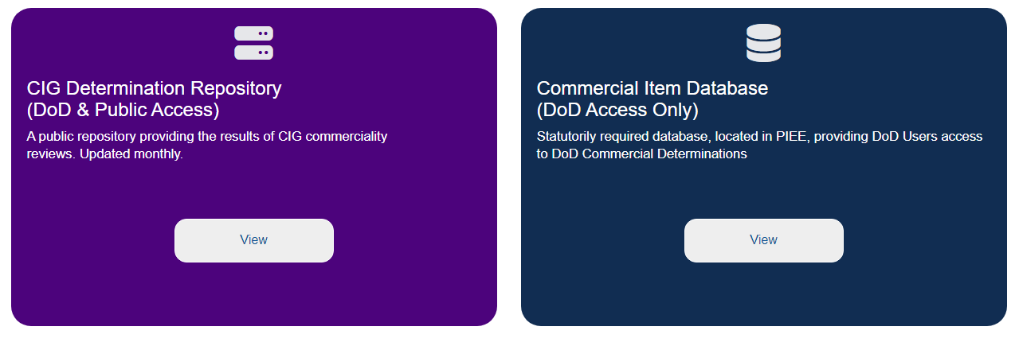
Resources for
Commercial Determination
FAR 2.101(Commercial Definitions)
  https://www.acquisition.gov/browse/index/far
DoD Guidebook for Acquiring Commercial Items (Parts A)
  https://www.acq.osd.mil/asda/dpc/pcf/docs/resources-training/Guidebook-PartA.pdf
DCMA Commercial Item Group (CIG)
  https://www.dcma.mil/commercial-item-group/

