Slide 1
Navigating the DLA Internet Bid Board System (DIBBS) Alonzo W. Burris II Small Business Professional Land and Maritime Office of Small Business Programs

Slide 2
Navigating DIBBS
Learn How to Navigate DIBBS
DIBBS Helpdesk
DIBBS Solicitations
DIBBS Quoting
Questions

Slide 3
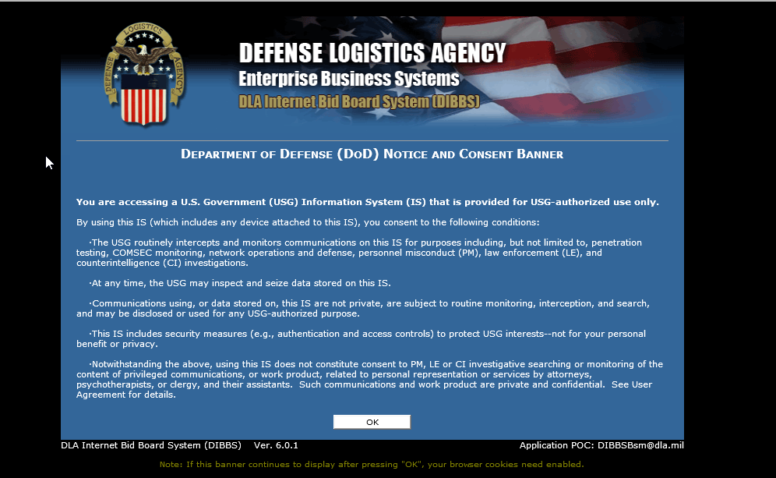
DIBBS Homepage
Notes:
**CLICK**
To submit a quote through DIBBS, users will need to log into DIBBS. If contractors have trouble accessing DIBBS, the contractor call the Customer Interaction Center (CIC) for support at 877-352-2255.
FLOOR WALKERS: VENDORS For this exercise, please go ahead and log into DIBBS.
**CLICK**

Slide 4
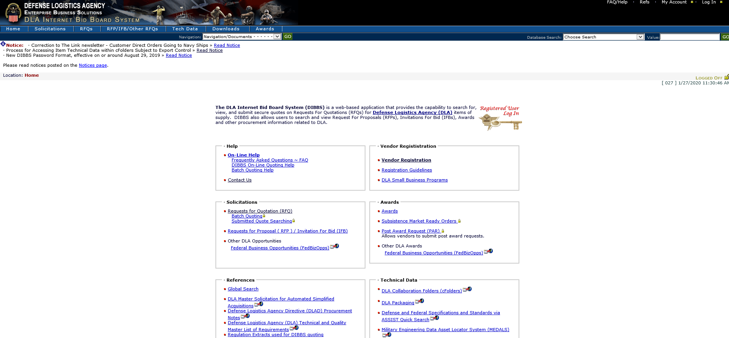
DIBBS Homepage – www.dibbs.bsm.dla.mil
Notes:
Please note the DIBBS web address at the top of this slide and the banner that lists important notices.
I want to talk about the boxes that you see on the DIBBS homepage, and the kind of functionality that you can achieve by clicking on the links that show up in blue. So, in the upper left-hand corner is the Help box. * In our office, we receive a lot of requests for help, but I want to show some resources that have been placed in the DIBBS System to help you either get started, or navigate through an issue you might be having.
There is an online Frequently Asked Questions page that you can get to by clicking on the link under “Online Help.” There’s also batch quoting help for those of you who have had experience with DIBBS, and may be having issues with batch quoting.

Slide 5
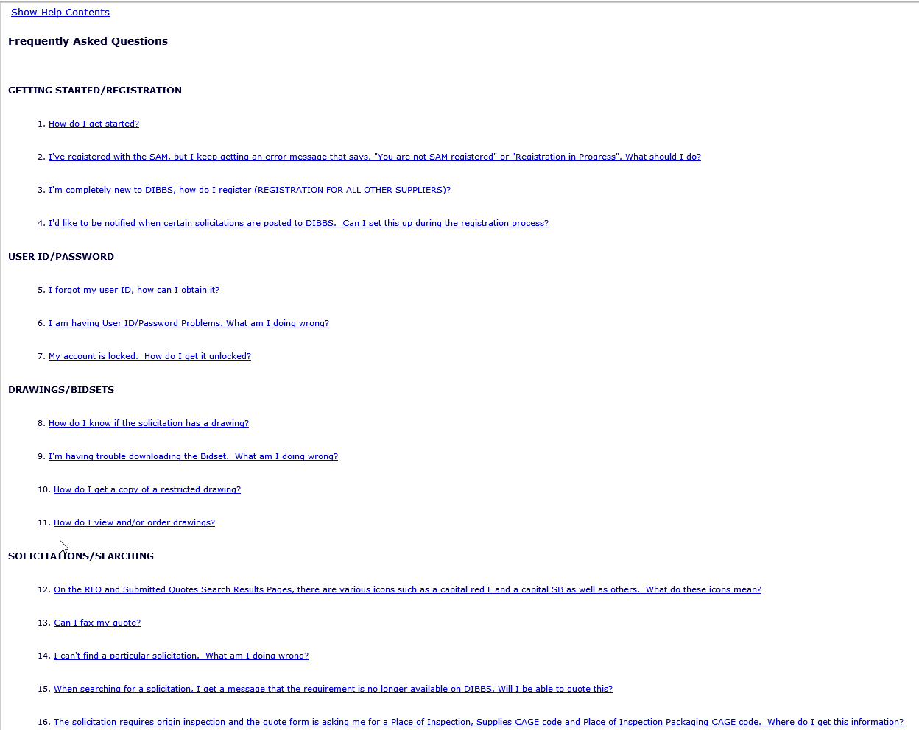
DIBBS Help – FAQ Topics
Notes:
This is a view of the Frequently Asked Questions site.
There are 16 different topics and 43 common questions, in multiple parts.

Slide 6
DIBBS On-Line Quoting Help
Notes:
This is a view of the On-Line Quoting Help site.
Submitted quotes may be viewed until such time that the requirement is awarded/cancelled. Revisions to quotes submitted on behalf of a CAGE will overlay any previously submitted quote for the same requirement.
The system will provide a message that the quote submittal was "successful" or "unsuccessful".

Slide 7
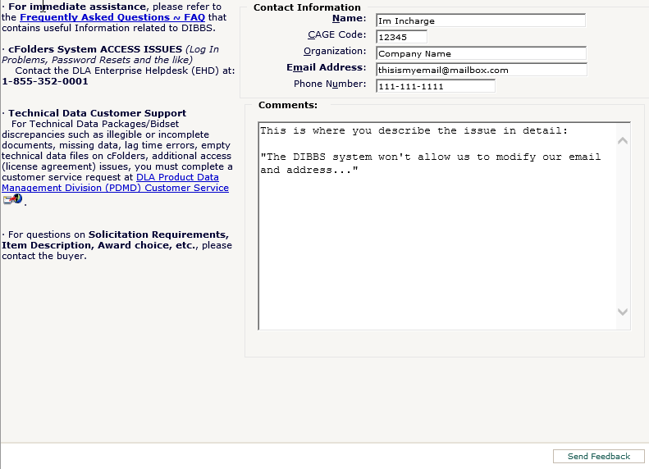
DIBBS Help – Contact Us
Fill out as much of the contact information as possible
Notes:
In Help – you would click on Contact Us
This is a view of the Help Contact Us site.

Slide 8
How DLA Buys
Approved CAGE Code & Part Number stated in solicitation under item description
Manufacturer(s) already approved
Approved source(s) for dealers and distributors
Qualified Products/Manufacturers Lists (QPLs/QMLs)
Pre-qualified Large and/or Small Businesses
Source controlled via approved sources
Restricted to pre-approved sources listed on drawing
Fully Competitive
Government has available for use to any manufacturer to make items of supply
IAW Drawings Available (BidSets/Technical Data Packages)
Notes:
* Now, when considering DLA’s buying practices, if you think about DLA as a large quality control agency, they have ways in which they assure the quality of the items meet the needs of the military customer they’re buying for.
The first way is by the approved CAGE Code and Part Number. This means engineers or technical personnel identified a part that is made by a certain company who has a CAGE code, and they have approved that part number. So when they want to buy that item, they are asking you to provide that specific item. Now, quite often we will solicit for a CAGE Code and Part Number, but vendors will want to offer a substitute, that they are certain is just like the item shown on the solicitation. Be careful! We consider this an “Alternate Item.” Only the CAGE and part number shown on the solicitation can be called the “Exact Item.”
In other cases, there are qualified products and manufacturers on a list, called a Qualified Products List, QPL or Qualified Manufacturers List, QML. Technical staff has reviewed the characteristics of items, and the capabilities of manufacturers who provides them. It may be the original manufacturer, or someone else. The QPL or QML list determines what qualified products we will buy and what qualified manufacturers can supply them.
The third kind of item, would be source controlled via approved sources. In these cases, source control items are those that have been tested and approved by the OEMs (Original Equipment Manufacturers)
The greatest range of competition, especially for new or small businesses is in the case of fully competitive items. Here we reserve the right to test, but we don’t necessarily test before we buy. What happens then, as part of the DIBBS bidding process, we administer a set of drawings, or what’s called a technical data package, and the business determines whether or not they can make the item in conformance with those drawings. The businesses submit their offer based on what they feel it would take, in terms of time, cost, and profit, to provide that item.
So these are the primary ways in which a business would determine whether or not they can bid on an item. Either they are on a list, the item has been previously approved, or they can look at a set of drawings, a technical data package, and determine if they can make and quote for that item.
This is giving you a lot of Information, (ASK : DO YOU HAVE ANY QUESTIONS?)

Slide 9
Common Solicitation Types
Request for Quotations (RFQs)
- Under SAT
- Most common type at DLA
- Average award is under $4,000
- Most quoted through DIBBS
Request For Proposals (RFPs)
- Over SAT
- Proposals may be negotiated
- Solicitations must be filled out by hand and
returned to DSCC by a specific time and date
stated on solicitation
-Upload Proposal Capability
Notes:
* CLICK There are two common solicitation types. One is a Request for Quotation. This is for solicitations with an estimated value under $250,000, the most common type of solicitation at DLA. Believe it or not, the average award value at DLA is under $4,000. And when you consider the billions of dollars we spend, you recognize that we issue a lot of solicitations, and awards, every day and every year. But most interesting is the fact that 30 to 40 percent of those are awarded without human intervention.
So the requirements can be solicited and awarded by an automated system. Your quotes are evaluated by that system, and if all goes well, the announcement of the award is sent to you electronically. So if you are really focused on working on a system where you have a lot of human interaction, this may be a hard system for you to get used to initially, but we’ll talk about ways in which you can identify some support resources, both at DLA and in your local community, to help you to effectively participate in that system a bit later.
The other type of solicitation is a Request for Proposal. These are solicitations for awards over $250,000. Sometimes they are one-year contracts, sometimes multiyear contracts. The terms of these solicitations can be negotiated once the solicitation period has closed. For example, terms that can be negotiated may include price, delivery time, or delivery quantity. The initial announcement of the solicitation will be found on DIBBS, but the proposal and negotiation will be processed outside of DIBBS.

Slide 10
Contract/Solicitation Numbering
SPE7L1-24-T-1234
Sequential Reference Number
4th Digit
1 Clothing & Textiles
2 Medical
3 Subsistence
4 Aviation
5 Construction & Equipment
6 Energy
7 Land and Maritime
Solicitation/Contract Type:
T – Automated One Time Buy solicitation
U – AIDC solicitation
Q or M – Manual solicitation
R – Request for Proposal
X – Indefinite Delivery Purchase Order
M – Purchase Order
C – Contract Number
D – Long-Term Contract Number
F – Schedule
DFARS 204.70
Fiscal Year (Starts Oct 1)
DOD Activity Address (DODAAC) – Location of the Buying Activity. https://www.transactionservices.dla.mil/daasinq/daasinq_dodaac.asp
Notes:
Contract Numbering is described in the FAR and applies to all Federal Contract and solicitation numbers.
The DODAAC tells you the Contracting Agency. DLA starts with “S” Army - W Navy - N Air Force - F Marines – N or M
ROOKIE MISTAKE: Do not use the letters I or O as alpha characters in CAGES or Call Numbers. Use numbers 1 and 0 only.

Slide 11
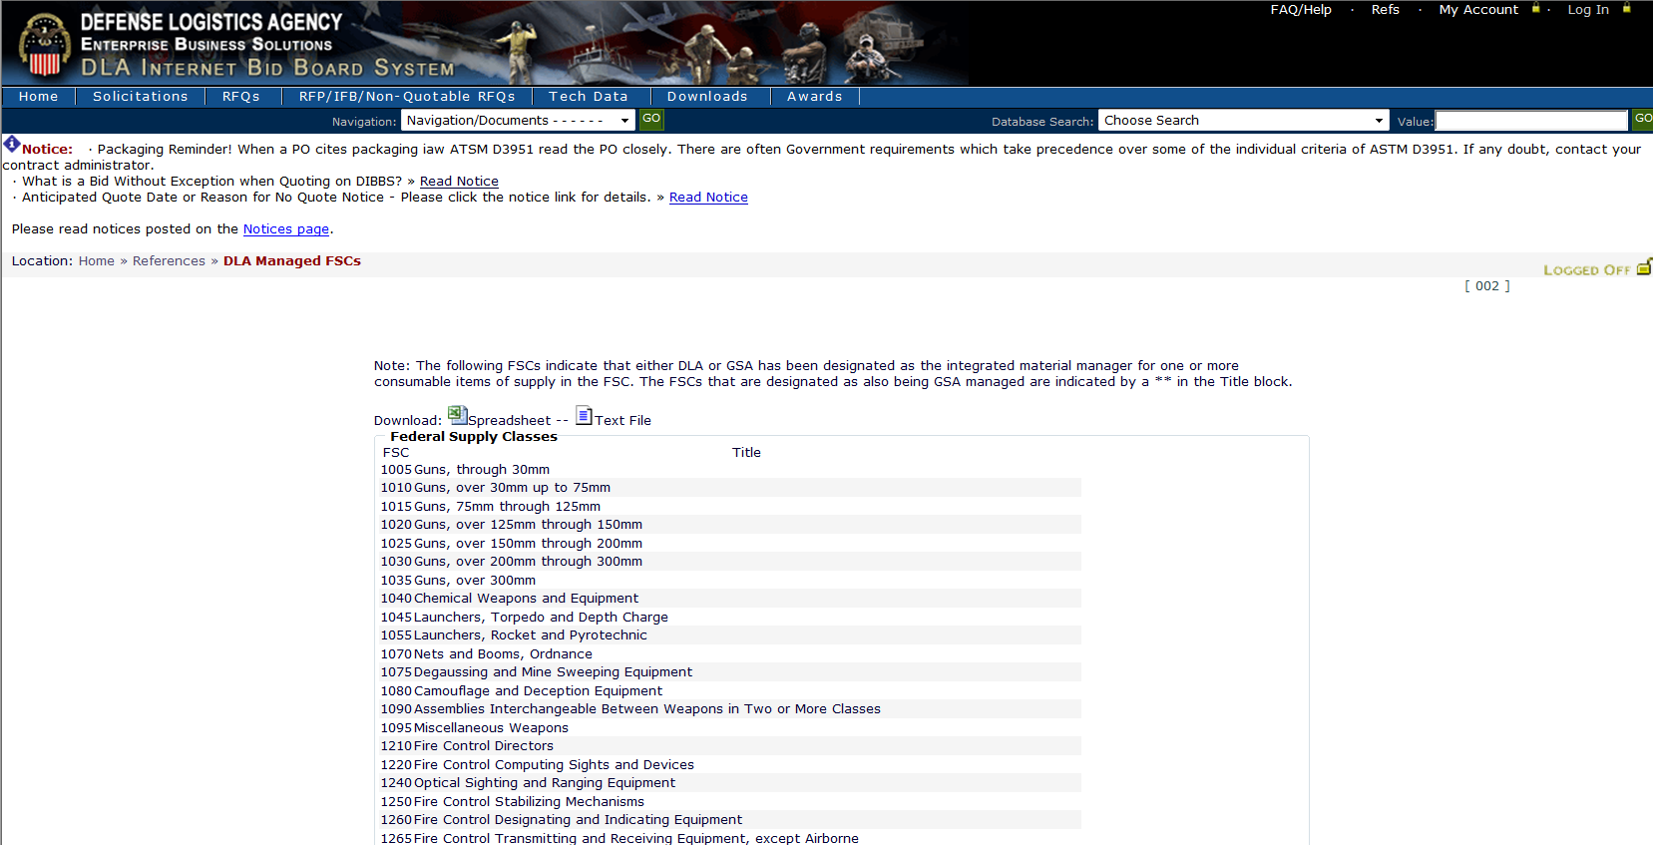
Identifying Federal Supply Classes
DLA’s FSC list with corresponding item description
Think of an FSC as an “area code” of a phone number & each FSC having thousands of NSNs in it’s “area code”
Notes:
In the Technical Data Section – Federal Supply Classes shows those FSCs Managed by DLA
This is a view of the FSCs managed by DLA. You can see, that this list will provide the FSC and the corresponding description of the item
(think of FSC (first four numbers of National Stock Number [NSN]) as area code of your phone number)
NIIN – National Item Identification Number

Slide 12
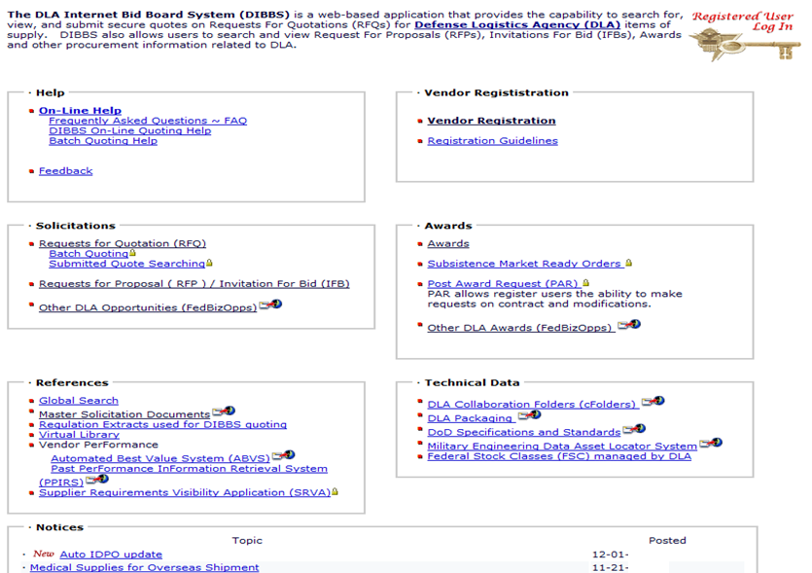
RFQ Quote Search
Estimated value at or below SAT
RFPs - estimated value above SAT & Offers/Sealed Bids shall be submitted in accordance with the instructions in Block 9 of the solicitation
Notes:
Now, let us move over to the solicitation area of DIBBS and review the use of the “Request for Quote” search. *CLICK
Remember that a Request for Quotation has an estimated value at or below $250,000.
Be sure to check Request for Proposal for opportunities estimated above $250,000.

Slide 13
Solicitation Types
RFQ
RFP
Cover Page:
Set aside Type
Issuing Activity / Contracting Officer
Master Solicitation Revision used
*(Q’s) Return by date & time
Section A:
General Contract Requirements
Quality Provisions / Testing
Any available Contract History
Section B:
Item description
Drawing / Specification List OR Code & Part Number List
Contract Delivery lines
Packaging / Shipping Data
Section D: (Q Solicitation)
Contains all required solicitation clauses
Contractor: Reviews & Fills-in applicable clauses
Section A: Cover Sheet
Return by date & time
Set-a-side Type
Issuing Activity / Contracting Officer
Cover Page:
Same as above
Table of Contents w/ # of pages
Part I: The Schedule
Section: A thru H
Part II: Contract Clauses
Section: I
Part III: - List of Documents, Exhibits & Other Attachments
Section: J
Part IV: - Representations & Instructions
Section: K thru M
Notes:
Shanda - PTAC Explanation
After she is finished say: Future Webinar offerings will include more detailed information on this topic

Slide 14
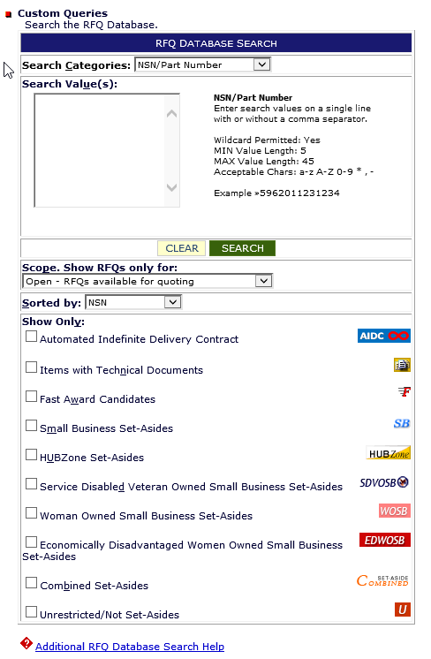
DIBBS Icons
Fast Award Candidates are Less than the Micro Purchase (under $10,000) – Evaluated by the automated system and may be awarded before the return date/time.
Notes:
Before we talk about how to search for solicitations. Here are some icons that appear inside the solicitation area of DIBBS. We will see these in action, but I just want to cover them briefly.
The Government buys a wide range of material from aardvarks to zithers (A to Z). While we may know the part numbers, occasionally will we have technical documents. If we do have the drawings, and can share them with you, you will see the Tech Docs Icon in your solicitation search results.
“Fast Award” indicates that we may award a purchase order as soon as we receive acceptable quotes, even before the official closing date. One day after the solicitation issue date the auto system will start to evaluate quotes. If the offer is determined fair and reasonable an award will be made, if not the automated system will re-evaluate every 24 hours after.
We Set-Aside many acquisitions for Small business and socio-economic set-asides. Participation on these solicitations is restricted. For questions on socio-economic certifications you can contact your local PTAC and/or SBA Office.
Auto-IDPO is an Indefinite Delivery Purchase Order, covering DLA requirements lasting for one year, with an estimated value under $250,000 being this is a part of the old system

Slide 15
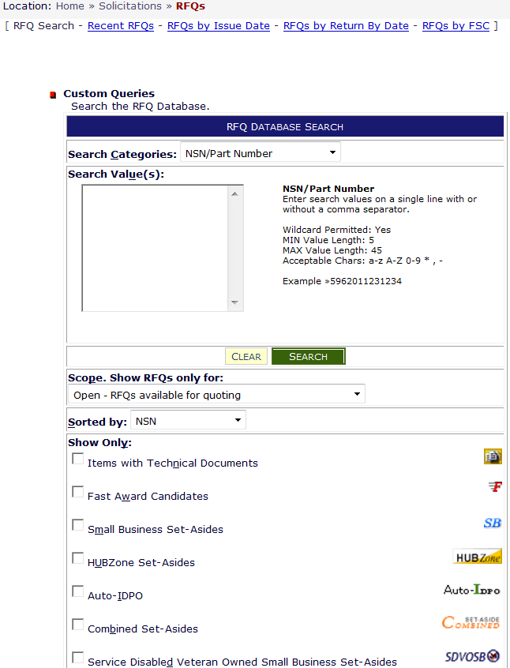
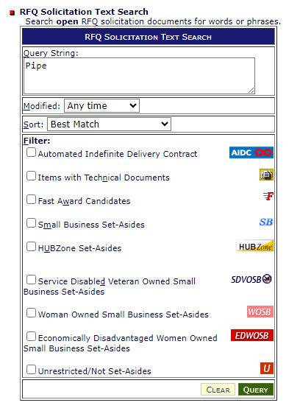
RFQ Database Search
Search by words or phrases
NATIONAL STOCK NUMBER (NSN)
• FEDERAL SUPPLY CLASS (FSC)
• SOLICITATION NUMBER (SPM)
• PURCHASE REQUEST (PR)
• NOMENCLATURE
• APPROVED PART NUMBER
• APPROVED OEM CAGE CODE
)
Wildcard (*) & Min search value rules change for each category
Notes:
NOTE: Queue floor walkers to assist attendees.
VENDORS: Go to Solicitation section, click on RFQ search.
We see a database search window that looks like the one on the screen. Now, you can search for “Requests for Quotations” by searching all the various search categories that are illustrated in the red box- *CLICK -National Stock Number, FSC, Solicitation Number etc.
A Purchase Request Number, is often referred to as a PR, and that is created from a request by a military customer. There may be multiple purchase requests on a single solicitation. If the requirement is not based upon a National Stock Number, look for an Approved Part Number and manufacturer’s CAGE code.
The wildcard character ( * ) may be used following a search value. The wildcard character ( * ) preceding search values is only permitted on the Nomenclature Search Category.

Slide 16
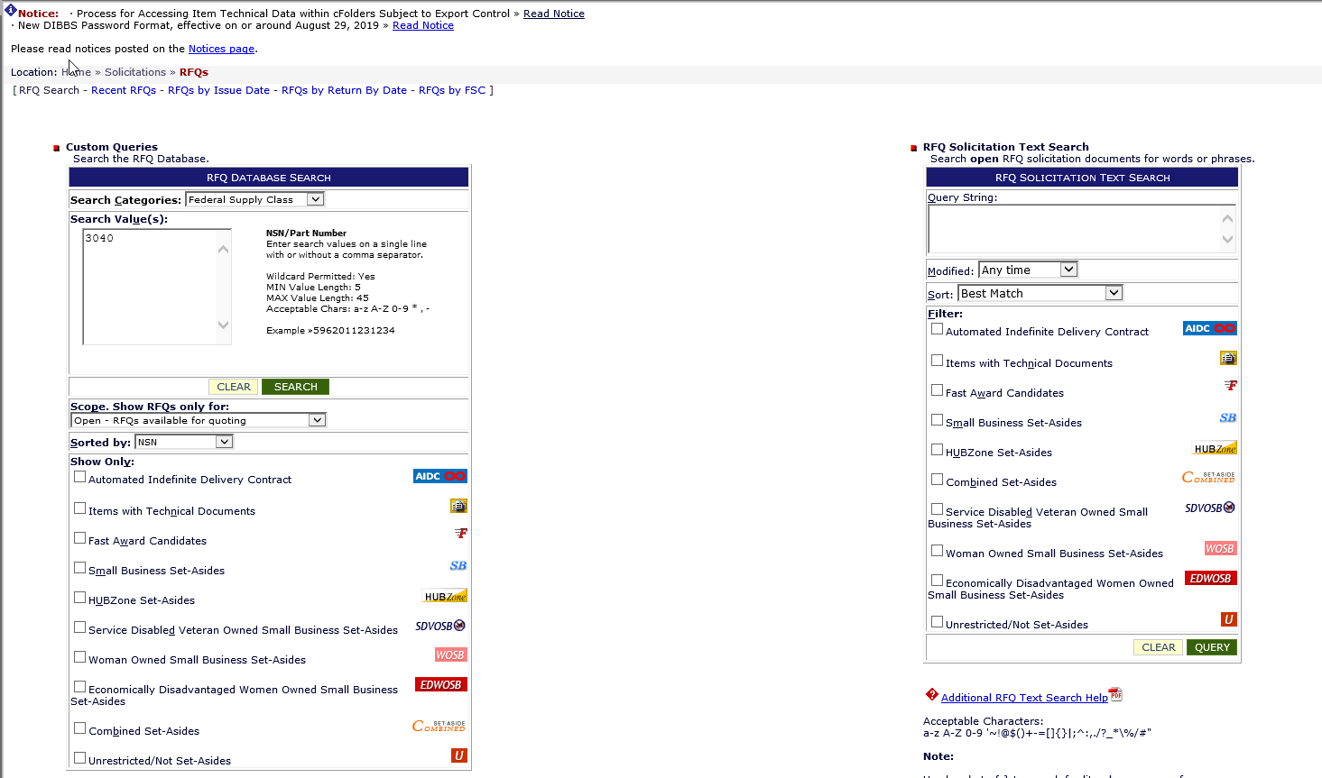
Solicitations – FSC 3040
Mechanical Power Transmission Equipment - Miscellaneous
Notes:
Vendors follow along.
We will select “Federal Supply Class” from the search categories dropdown box, *CLICK and type in FSC “3040” then click “SEARCH”.
3040 is the FSC for “Miscellaneous Power Transmission Equipment”, a Federal Stock class managed by DLA.

Slide 17
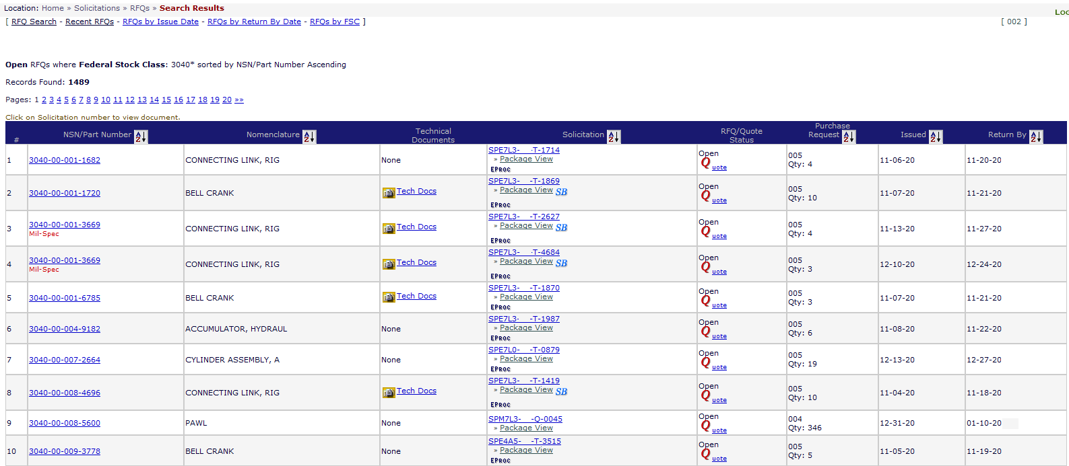
Solicitation Results – FSC 3040
Number of open solicitations
Note: T or U Solicitations –Automated by the System
CLICK: a “NSN” link for Code & Part Number example
Note: Q Solicitations –Generated by an Actual Buyer
Notes:
*CLICK DIBBS returns over 1,450 open solicitations for that FSC. That should give you a feeling for the scope and breadth of what DLA buys, and the potential sales opportunities open to you.
ASK VENDORS: how many results they found.
We could take a long time going through that number of solicitations. So you’ll want to narrow your search to a more manageable list. You might want to limit your search to Small business set-asides, opportunities with Technical documents, or sort the results by nomenclature.
VENDORS: Go ahead and click on the first NSN in column 2 that has the word“None” in the Technical Document field Column 4

Slide 18
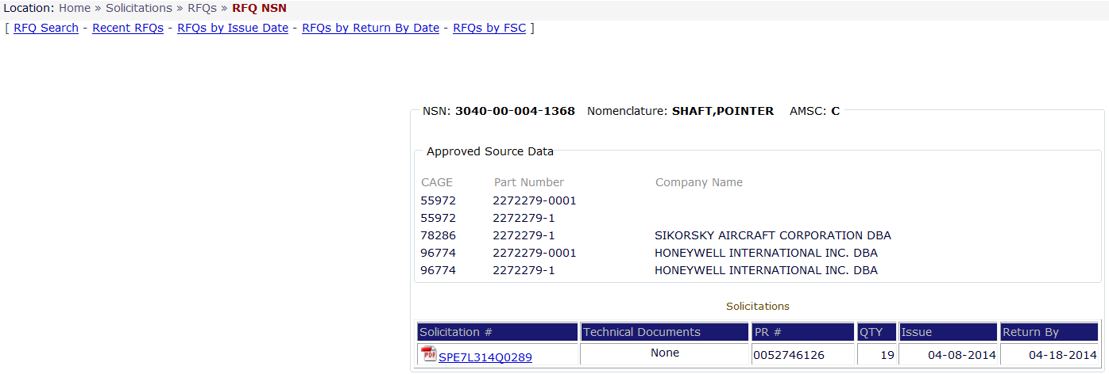
Solicitation – Code and Part Number
Common Code & Part Number AMSC:
(Acquisition Method Suffix Code- limited sources):
B: Source Control
C: Contracting from Approved Source
H: Inadequate Data
T: Qualified Products List (QPL)
Approved Cage Code
Company Name
Approved Part Number
Solicitation #
Notes:
Once you click on the NSN it will give you a synopsis of the NSN details. In this example under Approved Source Data there is a list of approved CAGE codes, manufacturers and their approved part numbers. It also provides a link to the open Solicitation.
The AMSC (Acquisition Method Suffix Code) that is assigned to the NSN is located in the upper right hand corner. Listed are four of most common AMSCS.
VENDORS: Click RFQ Search in upper left hand corner.

Slide 19
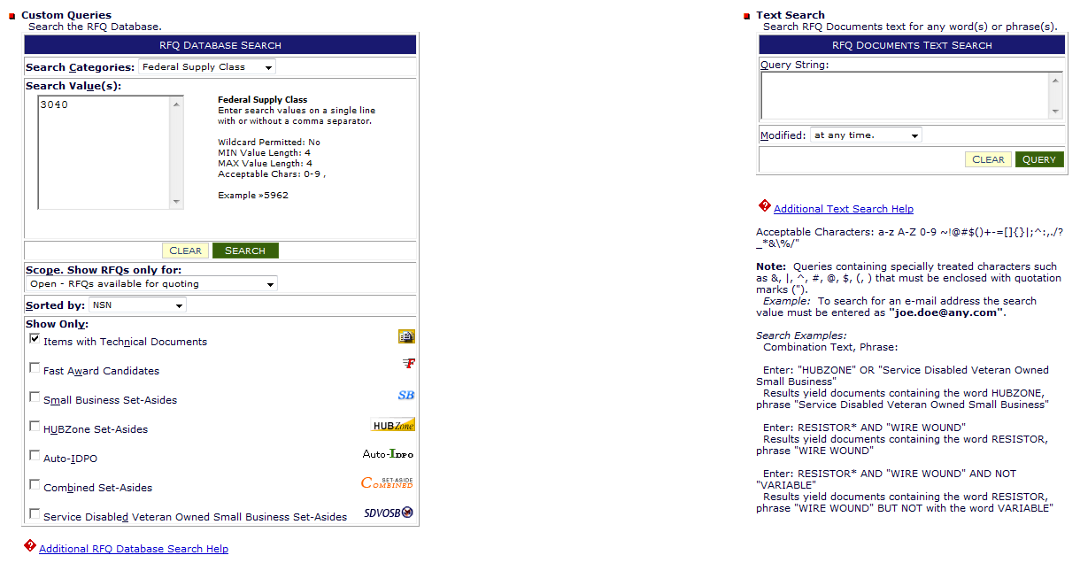
3040 Solicitations – Tech Docs Only
Note: Checking “Items with Tech Docs” reduced the search list by 64% the day this list was pulled
Check this box before submit
Notes:
Now, coming back to the database search window, we will have to re-select “Federal Supply Class” from the search categories dropdown box, and type in FSC “3040” -- but we can go below the search value box into the “Show Only” section and filter that category by clicking on “Items with Technical Documents”. If you could please click on it now.
And the reason this is important is if you are a manufacturer, chances are you will only want to bid on items that have technical documents.
If you are not a manufacturer, you will probably be more interested in items that are purchased by CAGE code and part number. But in either case, by checking one or several of the boxes in the bottom portion of your screen, you’ll be able to refine the search results.
VENDORS: Click Search.

Slide 20
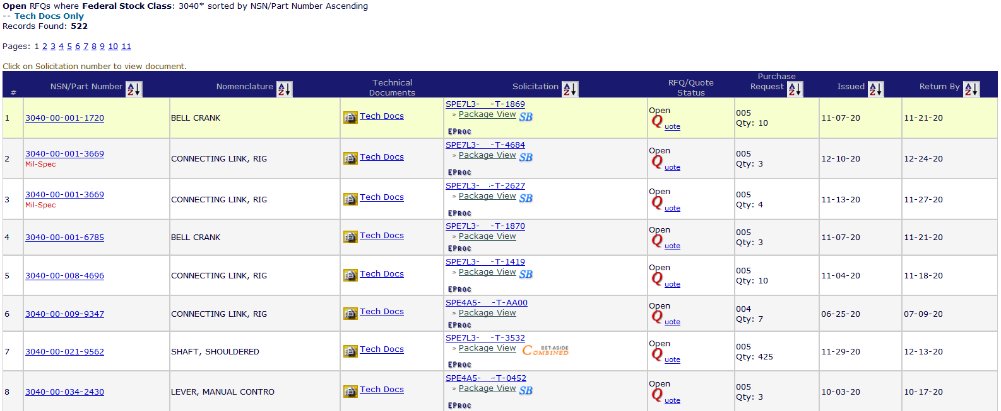
3040 Solicitations – Tech Docs Only
Note: Checking “Items with Bidsets” reduced the search list by 64% the day this list was pulled
CLICK: a “NSN” link for the next screen
Notes:
In this case, we went from over 1,450 responses down to 522 * CLICK — a somewhat more manageable set of solicitations to review. As you can see this is a search for FSC 3040 solicitations that have technical documents available.
ASK VENDORS: HOW MANY RESULTS DO YOU HAVE NOW?
If you click on the solicitation number in the middle of the page, you can read the solicitation document, NOTE the other specialized Icons..
If you click on a NSN in column two, you can see the specifications and drawing numbers for that item. Let’s take a closer look….

Slide 21
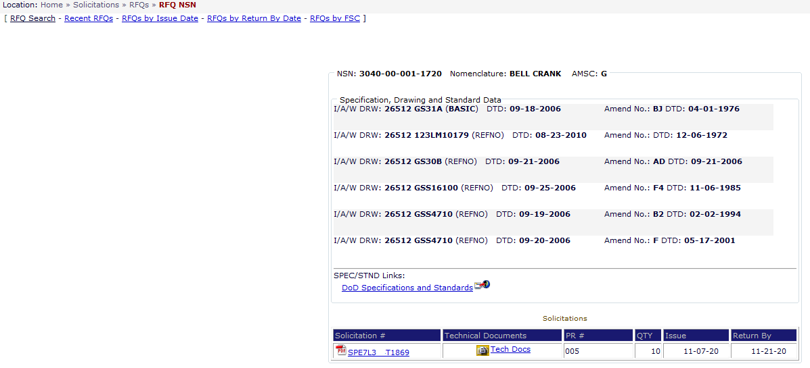
3040 Solicitations – AMC Code “G”
AMSC (Acquisition Method Suffix Code) “G” – indicates the adequacy of the available technical data
List of drawings w/ rev & date required to make item of supply
List of Gov’t & Industry Spec’s & Standards required to make item of supply
Icon to cFolders to down load Tech Docs
Notes:
In my example the AMSC Codeis “G” which indicates that DLA has the complete Technical Data Package for this item.
If you look down at the bottom of that screen, you’ll see a little icon for technical documents, and that verifies that we have the documents that you can download and determine whether or not you can make that particular item.
If you are a manufacturer and the AMSC is other than “G” Remember you want to access solicitations that have the complete technical documents. We recommend you to to the previous page and look for AMSCs of “G:go to the previous page and choose the next NSN.
As a reminder if you have questions in regards to accessing the Technical Data in cFolders you can go to the FAQ section on DIBBS home page.
SAY: Go back to top left or VENDORS CLICK ON RFQ SEARCH
VENDORS CLICK ON RFQ SEARCH.

Slide 22
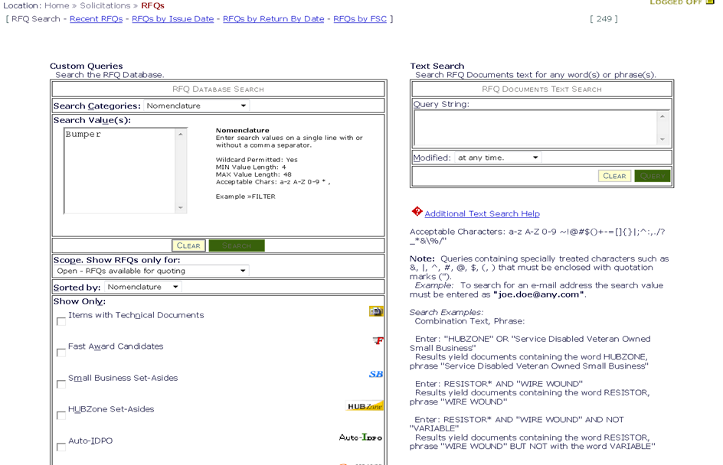
RFQ Nomenclature Search
Search by words or phrases
NATIONAL STOCK NUMBER (NSN)
• FEDERAL SUPPLY CLASS (FSC)
• SOLICITATION NUMBER (SPM)
• PURCHASE REQUEST (PR)
• NOMENCLATURE
• APPROVED PART NUMBER
• APPROVED OEM CAGE CODE
Only solicitations with the word “Bumper” in the Nomenclature are listed
Notes:
Now to show you how to do a nomenclature search.
VENDORS: (1) change the drop down to Nomenclature.
Enter the word “Bumper” into the Search Value field
You have the option to Click the item with technical documents
Only solicitations with the word “Bumper” in the nomenclature are listed in your results.
VENDORS CLICK RFQ SEARCH

Slide 23
RFQ Database Search (cont’d)
The word “Bumper” appears in the item description, but may not be the actual nomenclature
Notes:
When you search by a word or phrase, the word or phrase may appear in the item description but may not be part of the item name or “nomenclature” for that NSN.
So searching for a “bumper” may yield a list of automotive bumpers, loading dock bumpers, or rubber baby buggy bumpers. The FSC, or first four digits of the National Stock number, may help us to zero in on a particular product category.
SAY: This is a quick view of the Solicitation Search. I will be available tomorrow afternoon if you need more support after the C-Folders Brief.

Slide 24
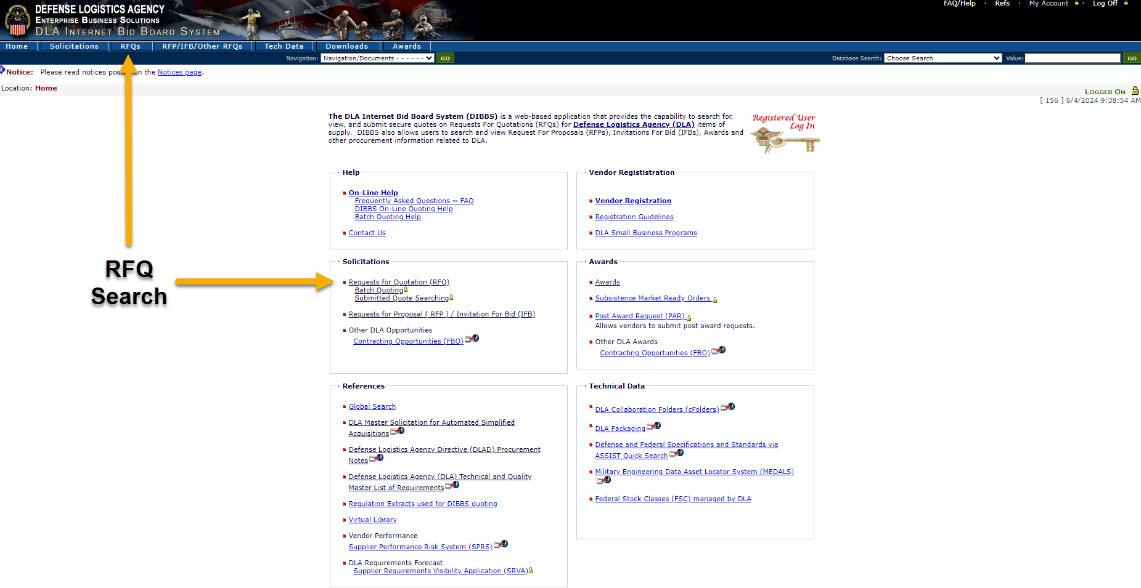
DIBBS Quoting
RFQ
Notes:
Back to the RFQ search result page, when you are ready to quote, just click on the letter “Q” (quote image) next to the solicitation number you wish to quote on within the search results.
This will take you to the DIBBS Quote Input Form.
**CLICK**

Slide 25
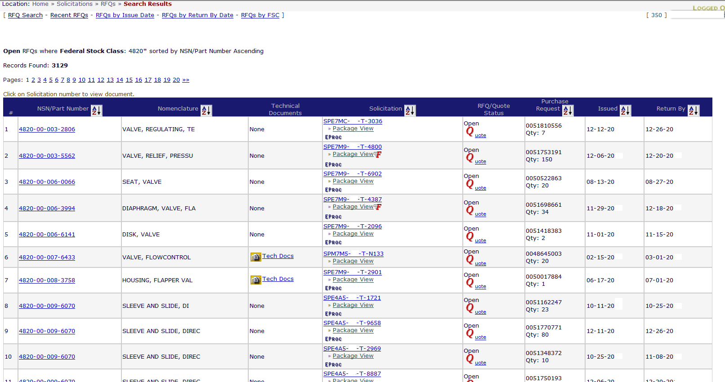
DIBBS Quoting
Notes:
Back to the RFQ search result page, when you are ready to quote, just click on the letter “Q” (quote image) next to the solicitation number you wish to quote on within the search results.
This will take you to the DIBBS Quote Input Form.
**CLICK**

Slide 26
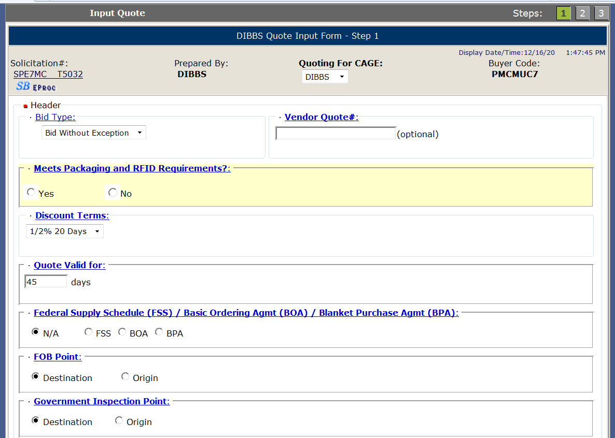
DIBBS Quote Input Form – Step 1
Choose 1 from multiple CAGEs you are preauthorized to quote on behalf of.
xxxxxxxxxxxx
Some data will pre-fill from your registration data
Notes:
This is the DIBBS Quote Input Form.
Some of the questions are already pre-filled for you based on your DIBBS registration. However, you can change any field based on the solicitation requirement and your quote.
**CLICK**
VENDORS: Those who have a DIBBS registration can now follow along.
Your first vendor input will be Quoting for Cage. From the dropdown menu chose the cage code you are preauthorized to quote on behalf of.
FLOOR WALKERS Make sure vendors are filling in quote form as presentation goes on.
**CLICK**

Slide 27
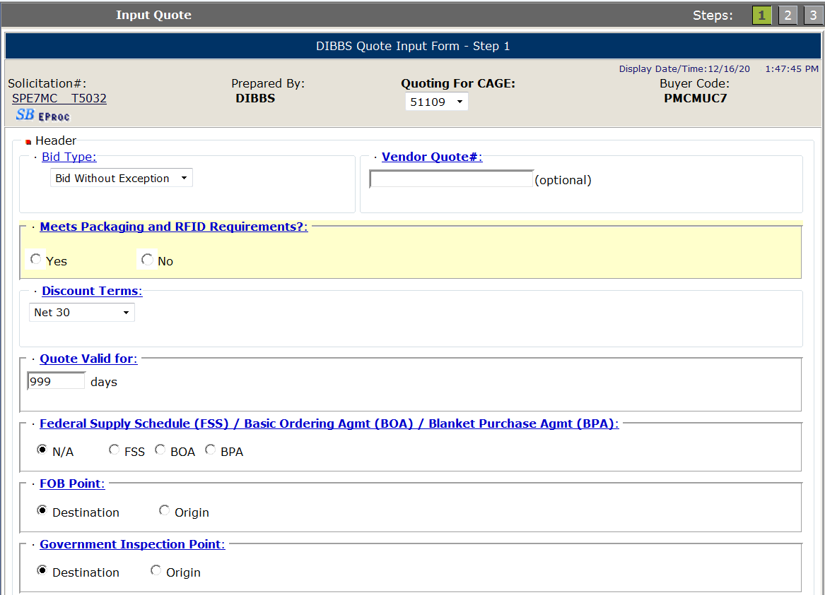
Bid Types – Bid Without Exception
Bid Without Exception: (Found in Master Solicitation)
Used to indicate quote is in exact compliance with the solicitation requirements.
The following conditions ARE NOT considered exceptions:
Quoting a different delivery than the required delivery.
Quoting origin inspection on solicitations requiring destination inspection.
Quoting a superseding or previously approved part or correction to a CAGE/part number cited in the AID on an item described by manufacturers CAGE and part number.
Quoting a used, reconditioned, remanufactured, new/unused Govt. surplus, foreign, or hazardous end item.
5. Quoting different “quote valid for” days than registration
Bid Type dropdown
xxxxxxxxxx
Notes:
Bid Type --- From the dropdown box vendors need to select 1 of 4 choices based on their quote. The information provided in this field is used by the auto evaluation system to evaluate automated solicitations which contain a “T” or “U” in the ninth position of the solicitation number.
**CLICK**
Bid Without Exception: (Found in Master Solicitation)
Used to indicate quote is in exact compliance with the solicitation requirements.
The following conditions ARE NOT considered exceptions:

Slide 28
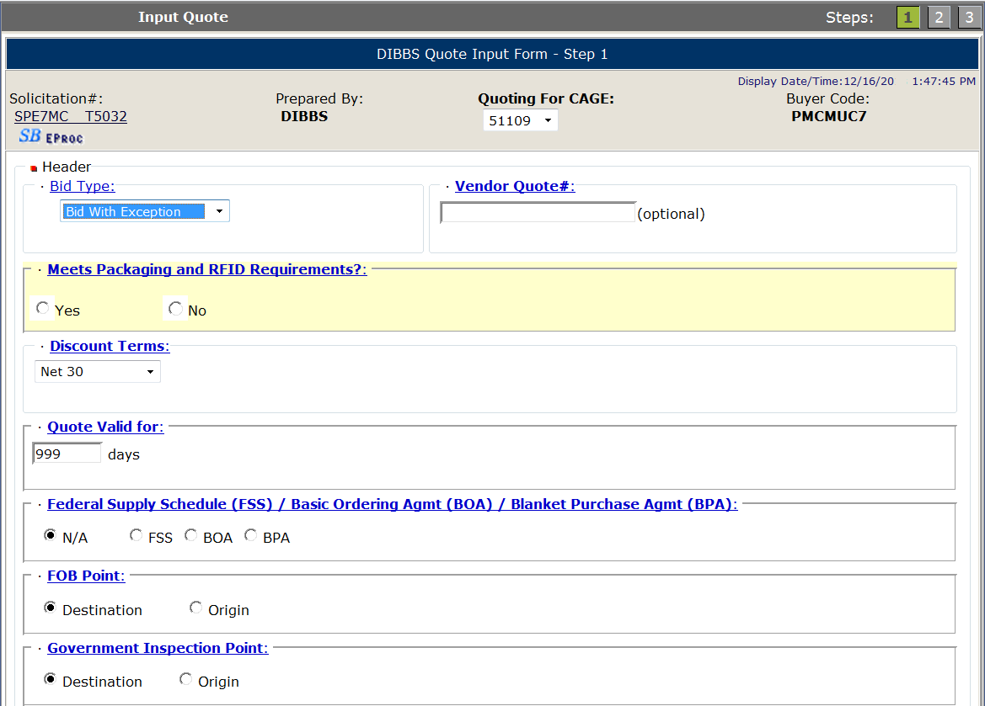
Bid Types – Bid With Exception
Bid With Exception: (Found in Master Solicitation)
The following ARE considered exceptions to the solicitation:
Taking exception to the item description
Exceptions to packaging requirements
Exceptions to FOB point
Quoting destination inspection on a solicitation requiring origin inspection
Exceptions to required quantity
6. Quoting a quantity variance outside the range specified on automated solicitations.
NOTE: Quoting Bid With Exception WILL preclude you from receiving an automated award.
Bid Type dropdown
xxxxxxxxxx
Notes:
Second bid type is Bid With Exception: This indicates that the quote is NOT in exact compliance with the solicitation. The following conditions are considered an exception to the solicitation.
Taking an exception to the solicitation item description, packaging requirements, FOB point or required solicitation quantity.
Quoting destination inspection when the solicitation requires origin inspection.
Quoting a quantity variance which is outside the range specified on automated solicitations. An automated solicitation will contain a “T” or “U” in the 9th position of a solicitation number. Manual solicitations have a “Q” in the 9th position.
Quoting an exception will preclude you from receiving an automated award.
**CLICK**

Slide 29
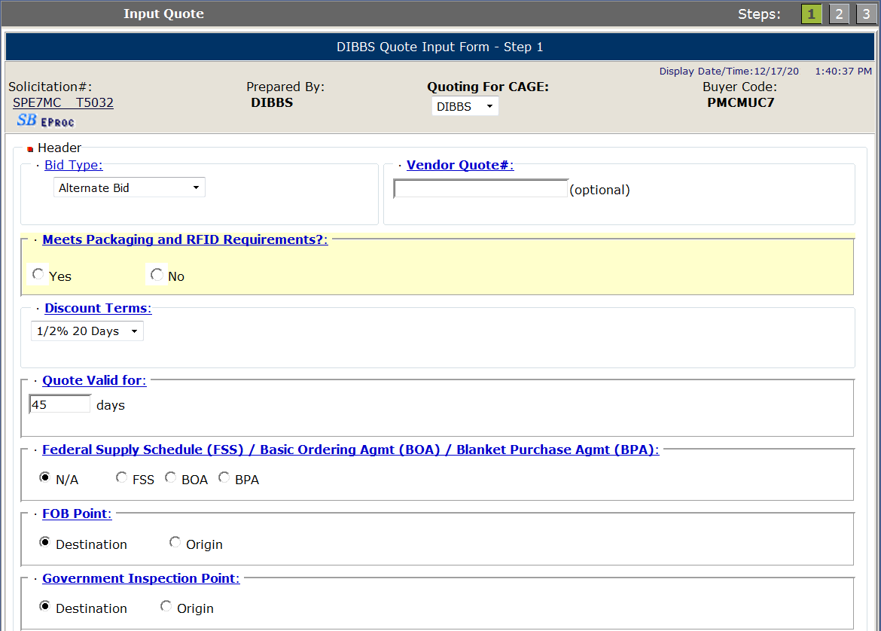
Bid Types – Alternate Bid
Bid Type dropdown
Alternate Bid:
If you wish to supply other than the approved part, you will have to submit your bid as an Alternate Bid.
For automated solicitations ("T" or "U“ in 9th position of solicitation number), the following applies to your alternate offer:
Offers of alternate products will not be evaluated for the current procurement, ONLY for FUTURE procurements.
You may submit a request to the Supply Center for evaluation for future procurements of the same item.
xxxxxxxxxxx
Notes:
Third bid type is Alternate Bid: This indicates the vendor wishes to supply other than the approved part which is listed in the solicitation. Alternate offers are not evaluated on automated solicitations.
If vendors wish to have their alternate item evaluated for future requirements, they would need to submit a technical data package to the supply center which will be discussed later.
**CLICK**

Slide 30
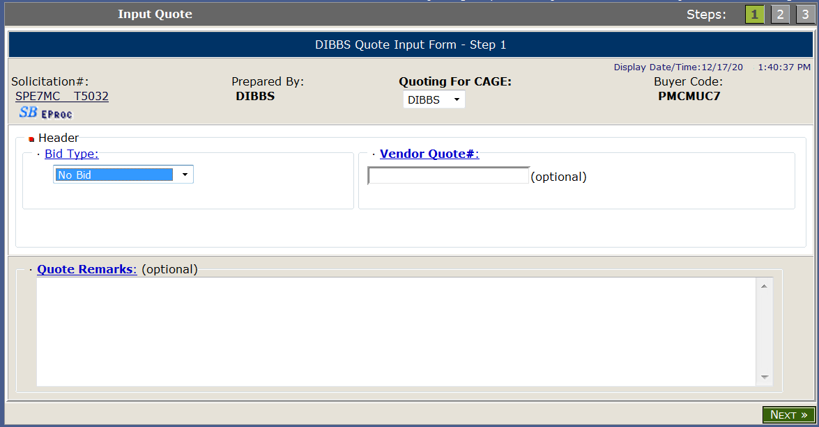
Bid Types – No Bid
No Bid:
Declining to submit a quote on this solicitation.
Quoting zero quantity for all line items will force a bid type of "No Bid.”
A “No Bid” will also delete a previously submitted bid.
Note: “No Bidding” is the ONLY way to delete a previously submitted bid.
Bid Type dropdown
Notes:
Last bid type is No Bid. Most vendors do not submit No Bids; however, it is beneficial to do so if the part number listed in the solicitation is obsolete. Vendors can add a quote remark to inform the supply center of a possible obsolete item.
Also submitting a “No Bid” is the only way to delete a previously submitted bid prior to a solicitation award.
**CLICK**

Slide 31
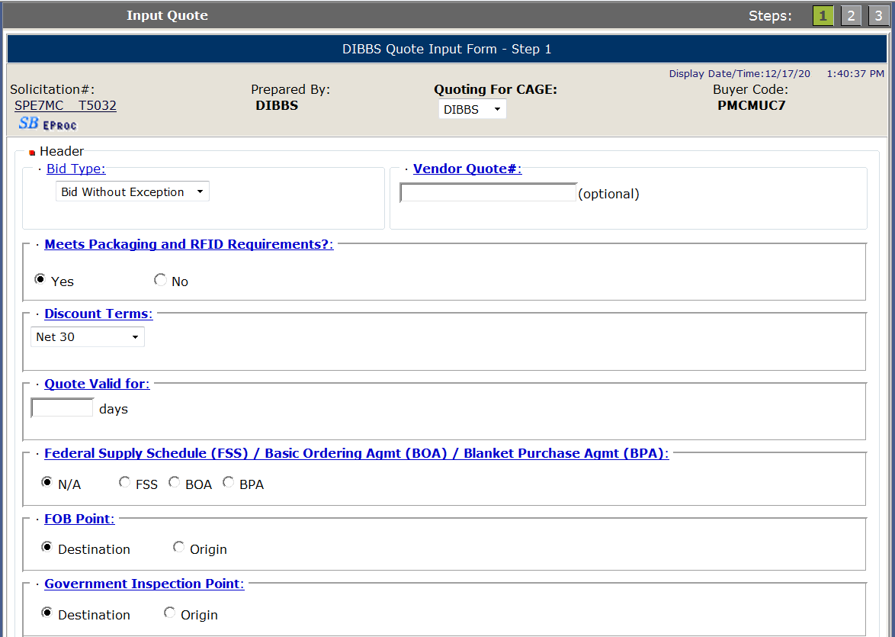
Quote Valid For
Enter number of days your quote is valid. Validation forces a numeric response from 1-999.
This field will default from vendor DIBBS registration.
Notes:
Quote Valid For is where the vendor will input the number of days the quote is valid for. Typically the Government requests 90 days.
If you quote less than 90 days, most likely the buyer will be coming back to you to ask you to extend the quote or submit a new quote.
**CLICK**

Slide 32
FOB (Free on Board) Point
Defaults to Solicitation requirement.
Select Destination or Origin for FOB point. FOB Origin will require City, State and Country.
If quoting other than what is required, bid type must be Bid with Exception.
Notes:
Free on Board or FOB point. This field will default to the solicitation requirement.
If vendor quotes FOB Destination, then all shipping costs must be included into the unit price of the item.
If vendor quotes FOB Origin, shipping costs are NOT included in the unit price. Vendors will invoice for the cost of supplies.
First Destination Transportation (FDT) RFQs must be quoted FOB origin as solicited. If you quote FOB Destination on an FDT eligible solicitation, the quote will be considered a “bid with exception” and the quote will not be considered for an automated award.
FLOOR WALKERS: make sure vendors are following along.
**CLICK**

Slide 33
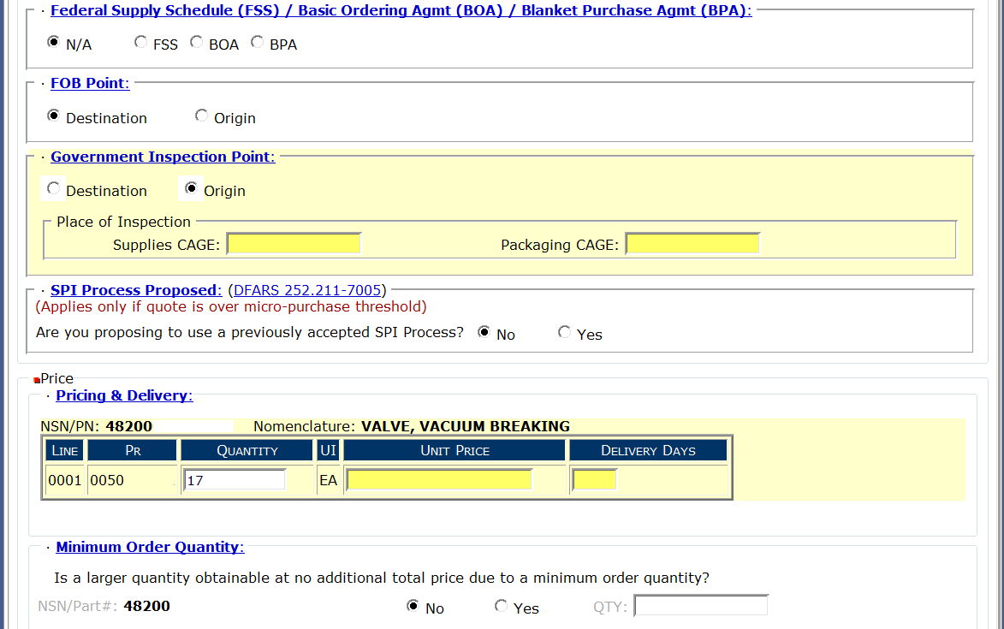
Government Inspection Point
Defaults to Solicitation requirement.
Select Destination or Origin for Inspection point.
Inspection at Origin will require the CAGE code where the supplies and packaging may be inspected.
If solicitation requirement is Origin Inspection and vendor quotes Destination Inspection, bid type must be Bid with Exception.
Notes:
Next section is Government Inspection Point.
This field will default to the solicitation requirement.
Inspection at destination means that the supplies/packaging will be inspected at the shipping destination on the order.
Inspection at origin means that the supplies/packaging will be inspected at the CAGE code provided for supplies and packaging per the quote, prior to shipping.
**CLICK**

Slide 34
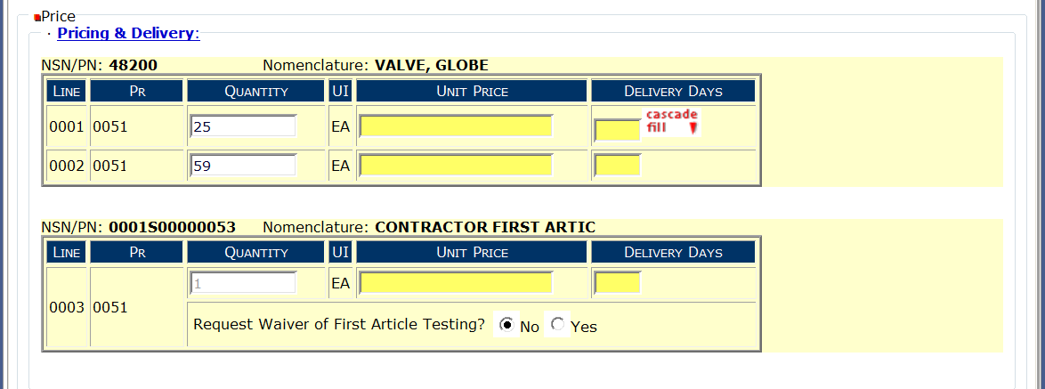
Pricing & Delivery
First Article price/delivery and Waiver Request
Enter price and delivery by line item.
If price or delivery do not vary per line, enter info into first line and click on “cascade fill” for all other line items.
If quantity quoted is not in accordance with RFQ, bid type must be Bid with Exception.
Notes:
When you go into submitting a unit price, there maybe different quantities per Line. If the quantities do not require different unit prices or delivery, you can input the unit price and delivery in Line 1 and click on “Cascade Fill”.
**CLICK**
This will repeat the unit price and delivery for the remaining quantity lines on the solicitation.
However, if you can provide a lower unit price/delivery for 59 compared to 25, please provide the different unit prices and/or delivery days. Also, since the total quantity will be on one purchase order, give us the unit price for a total quantity of 84 compared to the unit price for 25 and a unit price for 59. During evaluation, you may lose out on an award because you were unable to give us a better price for a higher quantity.
**CLICK**
Now, if the solicitation requires a first article test, you are able to quote a unit price and delivery only for the first article test. Make sure this is the unit price and delivery for the first article test. Its okay if the first article unit price & delivery is different from the Line quantities requested on the solicitation.
If there was a first article test before and it passed, vendors can ask for a waiver of the first article testing.
**CLICK**

Slide 35
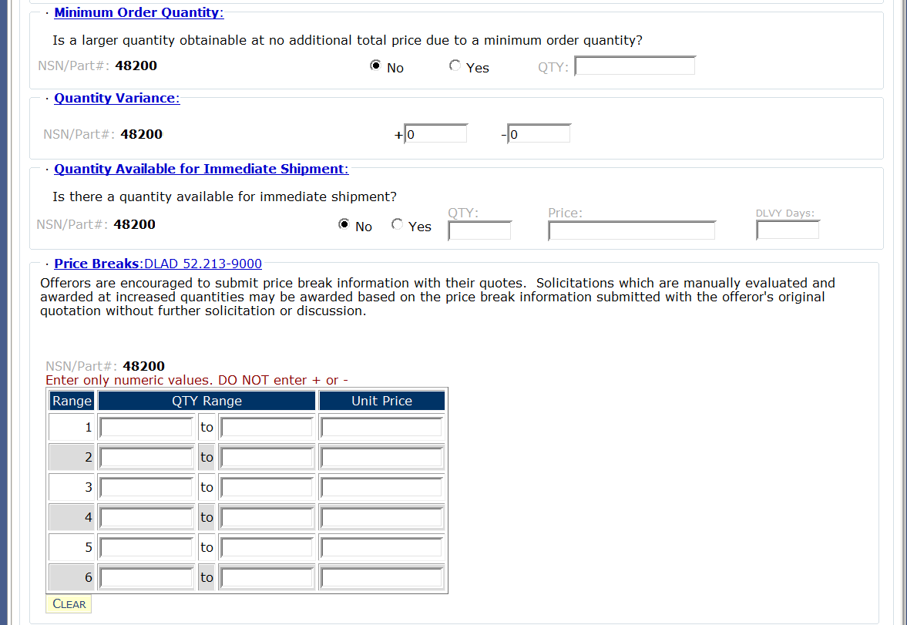
Min Order, Qty Variance, Immediate Shipment
Select appropriate response to question.
Qty % Government will accept under or over required quantity.
Select appropriate response to question.
Notes:
Minimum Order Quantity: Vendor will select the appropriate response to the question…Can the Government obtain a larger quantity at no additional price due to a minimum order quantity? Selecting “Yes” requires an entry for the quantity that is available at no additional cost.
**CLICK**
Quantity Variance: This value represents the quantity the Government will accept under or over the required solicitation quantity. The default is +0, -0 which is the norm in most cases. But for example, if the unit of issue is feet, you may see a quantity variance of +10, -10. This means that the Government will accept 10% more or 10% less than the required solicitation quantity.
NOTE: On automated solicitations, if a quantity variance is quoted when not allowed or a quantity variance is quoted outside what is allowed in the solicitation, bid type must be Bid with Exception.
**CLICK**
Quantity Available for Immediate Shipment: Select the appropriate response to the question, Is there a quantity that can be shipped immediately? If yes, then what is the quantity, unit price and number of delivery days.
**CLICK**

Slide 36
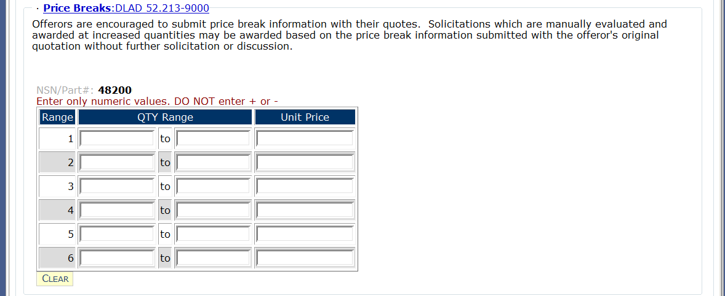
Price Breaks
Enter price break ranges and unit prices in the blocks provided.
If price breaks are solicited, default values will show. Ranges may be altered using the “CLEAR” button.
If price break ranges were not solicited, values will be blank. However, vendors can provide ranges and unit prices with quote.
1
5
10.00
6
10
7.00
Notes:
Price Breaks: If a larger quantity is obtainable at a lower unit price, then enter the lowest to highest quantity that can be provided for a given unit price.
**CLICK**
For example: 1 – 5 at $10.00 each
6 – 10 at $7.00 each
11 – 15 at $5.00 each
The Government may elect to accept these alternate quantities and unit prices for quotes not exceeding 250,000 without further solicitation or discussion.
**CLICK**

Slide 37
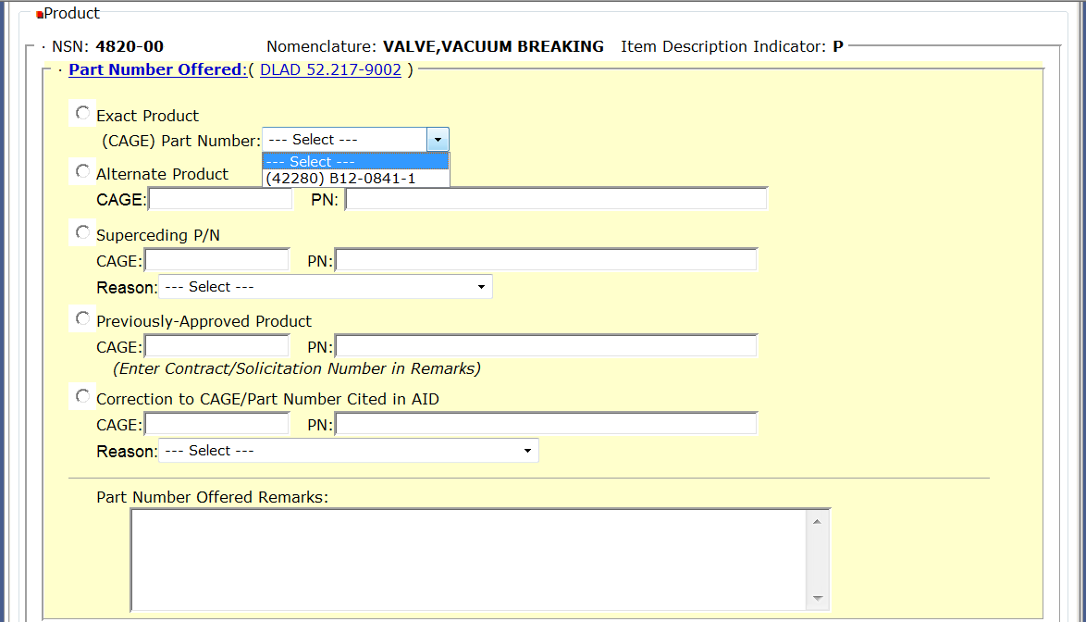
Part Number Offered
Exact Product & Alternate Product
Exact Product = providing EXACT manufacturer CAGE code & part number as it appears in the solicitation. Bid type is “Bid without exception”.
Alternate Product = providing manufacturer CAGE code & part number that is NOT listed in solicitation. Bid type is “Alternate Bid”.
Notes:
In this next section, you are telling the Government what product are you providing. For product type definitions that are listed, click on the DLAD 52.217-9002 reference for exact definitions.
First, we’ll go over the difference between an exact product and alternate product.
**CLICK**
If you are providing the Government the exact manufacturer CAGE code and part number as it appears in the solicitation --- then click the radial button next to “Exact Product”. Select the dropdown arrow and from the list of manufacturer CAGE code(s) and part number(s) provided, select the exact manufacturer CAGE code and part number you are quoting to provide.
If you are providing a manufacturer CAGE code and part number that is NOT exactly listed in the solicitation – then click on the radial button next to “Alternate Product”. You will then type in the CAGE code of the manufacturer and the part number you are quoting to provide.
If you quote an alternate product, the bid type must be “Alternate Bid”.
FLOOR WALKERS: make sure vendors select drop down arrow to select correct part number.
**CLICK**

Slide 38
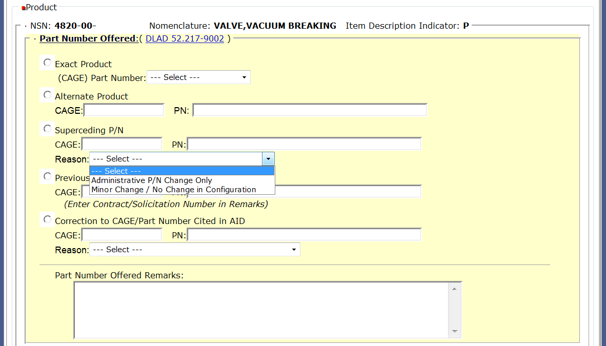
Part Number Offered
Superseding P/N
Superseding P/N = providing exact product; however, there is a part number change. Bid type is “Bid without Exception”.
Notes:
A vendor would quote superseding part number if the offered item qualifies as an exact product; however, there is a part number change. With a superseding part number the change in question would not affect the form, fit or function of the exact product…again just a part number change.
If a vendor quotes a superseding part number, select the radial button next to Superseding P/N, type in the CAGE code and part number that you are quoting to provide and then from the dropdown arrow select either option provided.
A superseding quote is considered a Bid WITHOUT Exception.
**CLICK**

Slide 39
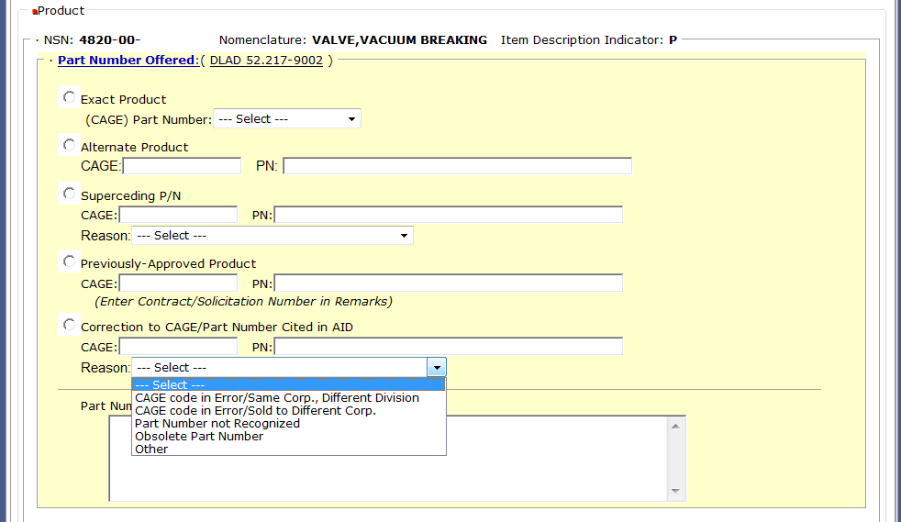
Part Number Offered
Correction to CAGE/PN cited in AID
Correction to CAGE/PN Cited in Acquisition Item Description = used to notify the Gov’t if there is a CAGE code error, obsolete p/n etc. Bid type is “Bid without Exception”.
Notes:
Last option for a part number offer is Correction to CAGE/Part Number which is cited in the acquisition item description (AID). From the “reasons” dropdown list, select the correct reason why there needs to be a correction made to the CAGE code and Part number in the item description. Vendors will select correct reason and provide the corrected information in the fields for CAGE and PN.
If the selection is “Other”, vendor needs to provide additional information in the part numbered offered remarks section.
A correction to CAGE/PN cited in the AID is considered a Bid WITHOUT Exception.
**CLICK**

Slide 40
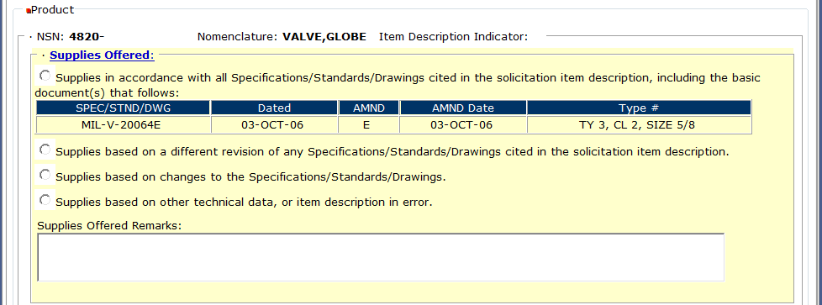
Drawing Item Offered
Specifications/Standards/Drawings
For a DRAWING ITEM: Select the type of supplies being offered based on the 4 options provided. Bid type is not affected.
Notes:
VENDORS: THIS SAMPLE MUST VIEW POWERPOINT PRESENTATION. This is an example when the solicited item is described by a basic specification/standard/drawing, this is how you tell the Government what product are you providing. If you’re going to make an exception to the specs/standards or drawings listed, you must let us know so we can evaluate the change. For example, say the drawing calls for aluminum but you want to provide steel, you need to provide us that information for evaluation.
Vendors will select the type of supplies they are offering based on the 4 options provided:
**CLICK**
If supplies are in accordance with all specs/ standards/ drawings cited in the solicitation item description the first radial button should be selected. Supplies offered remarks are not allowed.
**CLICK**
2. If supplies are based on a different revision of any of the specs/standards/drawings cited in the solicitation, select the second radial button. Supplies offered remarks are available, but not required. Bid type is not affected.
**CLICK**
3. If supplies are based on changes to the specs/standards/drawings, select the third radial button. Supplies offered remarks are available, but not required. Bid type is not affected.
**CLICK**
4. Last selection is if the supplies are based on other technical data or there’s an error in the item description. Supplies offered remarks are available, but not required. And again, bid type is not affected.
**CLICK**

Slide 41
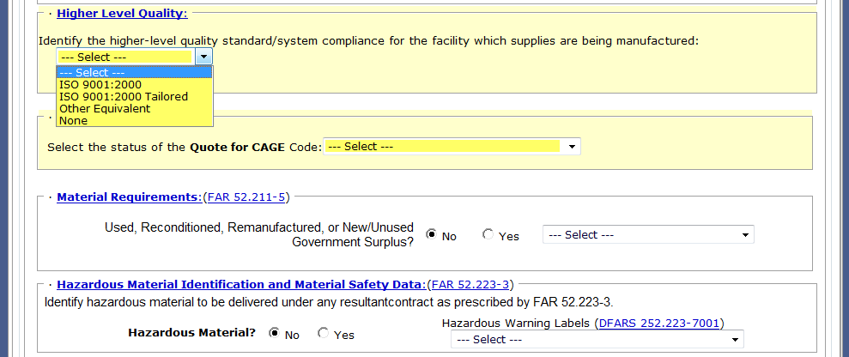
Higher Level Quality Requirements
Select appropriate higher level quality system that is currently in place at the manufacturing facility for the supplies.
Notes:
VENDORS: THIS SAMPLE MUST VIEW POWERPOINT PRESENTATION.
In this next section…based on the quality requirements of an item, vendors may need to identify the higher-level quality standard or system compliance that is in place at the manufacturing facility for the supplies.
The quality requirement of the item is stated in the item description as well as in the clauses portion of the solicitation. Vendors will need to select the quality standard or system that is in place at the manufacturing location for the supplies being offered.
If requirement is ISO 9001:2000 then the vendor must be certified.
If the requirement is ISO 9001:2000 TAILORED, the vendor just has to be in compliance with the requirement and NOT certified.
A selection of “NONE” will force a “Bid with Exception”.
**CLICK**

Slide 42
Product Offered
Are you a Manufacturer or Dealer?
Select one
If quoting as dealer or QSL dealer – provide CAGE of MFG or if unknown, provide Name and address
Notes:
In this next section you are telling the Government whether you are a manufacturer providing this quote OR are you a dealer providing this quote?
**CLICK**
From the dropdown arrow – first select Dealer, Manufacturer, Qualified Supplier List (QSL) Dealer or Qualified Supplier List (QSL) Manufacturer.
**CLICK**
If you select dealer or QSL dealer – you will need to provide the CAGE code of the actual manufacturer under the CAGE field. If you don’t know the CAGE code, then in the CAGE unknown field, provide the manufacturers name and address.
If you are the manufacturer or QSL Manufacturer no additional information is required.
MAKE SURE VENDORS KNOW THE DIFFERENCE BETWEEN MFG AND DEALER.
**CLICK**

Slide 43
Material Requirements
Select one of the following, if your reply is “YES”
Notes:
Under Material Requirements, the system default is “NO”. With the reply of “NO” you are proposing to offer a NEW/UNUSED product from this quotation.
However, if you are going to provide a used, reconditioned, remanufacturer or new/unused Government Surplus then your selection must be “YES” and from the dropdown arrow identify what kind of product you are providing.
**CLICK**

Slide 44
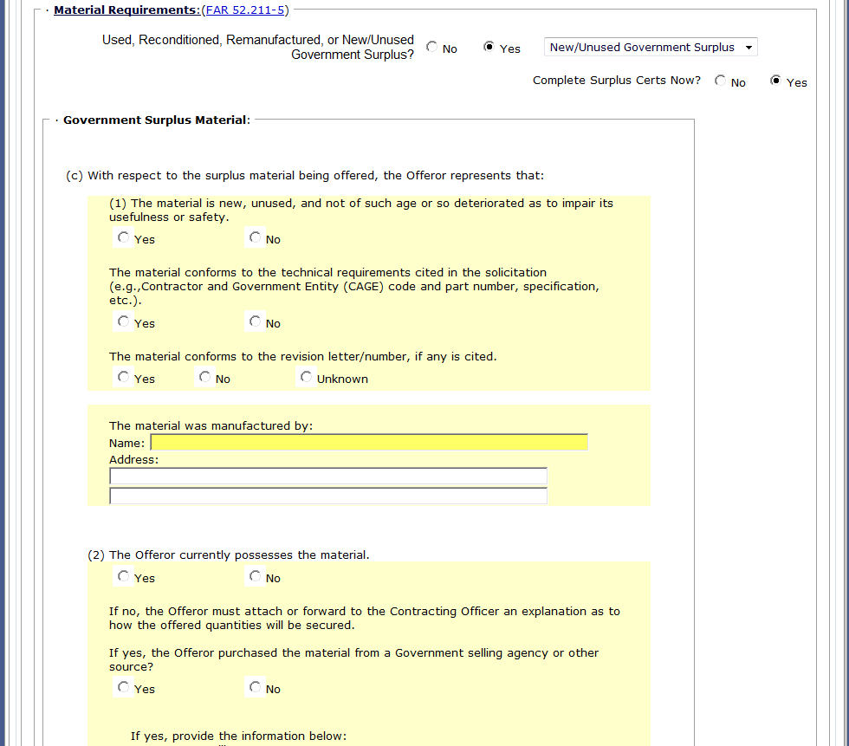
Material Requirements
Surplus / On-line Certification
Fill-in completely
Government Surplus Material certification
Notes:
If supplying new/unused previously owned Government surplus, an on-line certification can be filled out at this point and submitted with your offer.
**CLICK**
To assist with the evaluation, it is recommended that you complete the surplus certification with your offer.
A reminder: Vendor surplus is NOT accepted. Only previously owned Government surplus will be evaluated.
FLOOR WALKERS: VENDORS select surplus “yes” so you can view surplus certification.
**CLICK**

Slide 45
Hazardous Material Identification and
Material Safety Data
Select one of the following, if your reply is “YES” to Hazardous Material
Notes:
For the Hazardous Material section, the system default is “NO”. With the reply of “NO” you are stating that “NO” hazardous material will be delivered on any resultant contract.
**CLICK** If yes, then review DFARS 252.223-7001 to determine which statute the hazardous warning label will conform to.
**CLICK** Remember you can view the DFARS reference by clicking on the underlined blue text.
**CLICK**

Slide 46
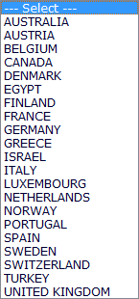
Buy American Act
Fill-in for information purposes only on Foreign Military Sales (FMS), overseas shipments, and all micro-purchases as the restrictions of the Buy American Act DO NOT apply.
Select one of the following:
Domestic
Qualifying Country
Non-Qualifying Country
Notes:
In the Buy American Act section you are informing the Government whether you are quoting a domestic end product, Qualifying Country End Product or a Non-Qualifying Country End Product.
**CLICK** If providing a Domestic End product click radial next to domestic.
**CLICK** If providing a Qualifying Country, then click radial next to qualifying country and select the applicable Country from the dropdown list.
**CLICK** If providing a Non-Qualifying Country, click radial next to Non-Qualifying Country and then also provide the Country of Origin, if known in the text field.
**CLICK** The Buy American Act does not apply to Foreign Military Sales (FMS), overseas shipments or micro-purchases, but is used for informational purposes, only.
**CLICK** Remember you can refer to DFARS 252.225-7035 by clicking on the underlined blue text.
**CLICK**

Slide 47
Buy American Act (cont’d)
Default = NO
If requesting duty free, select yes and answer questions 1 – 3.
Notes:
Under Duty Free Entry, the system default is “NO”.
However, if the product is coming from overseas, you need to request duty free. So select “YES’ and then answer the 3 questions provided.
**CLICK**

Slide 48
Small Business and
Other Business Type Representations

Slide 49
Affirmative Action Compliance
Affirmative Action Compliance applies to solicitations estimated to exceed $10,000.
Select one as applicable
Notes:
The next field – Affirmative Action Compliance applies to solicitations estimated to exceed $10,000.
**CLICK** Select as applicable from dropdown list.
**CLICK**

Slide 50
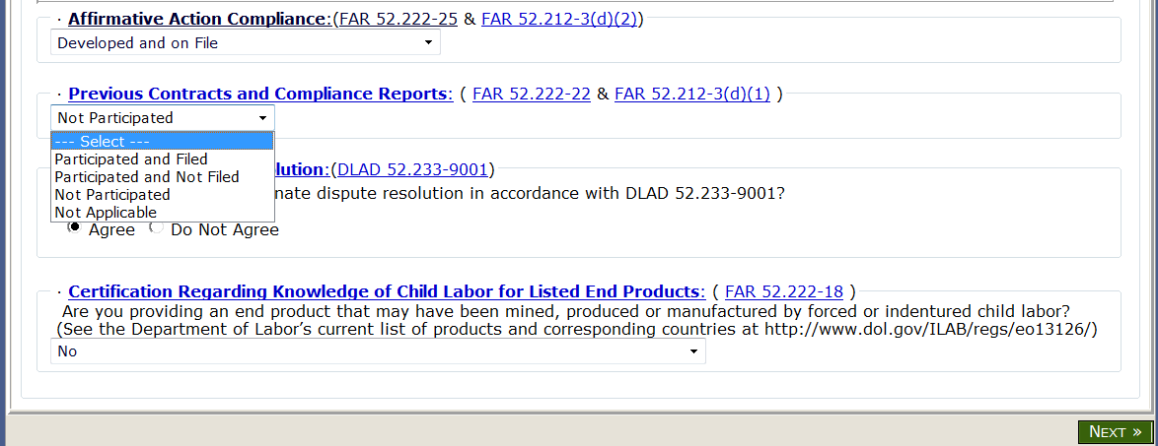
Previous Contracts and
Compliance Reports
Previous Contracts and Compliance Reports applies to solicitations estimated to exceed $10,000.
Select one as applicable
Notes:
Next field – Previous Contracts and Compliance Reports applies to solicitations estimated to exceed $10,000.
**CLICK** Select as applicable from dropdown list.
**CLICK**

Slide 51
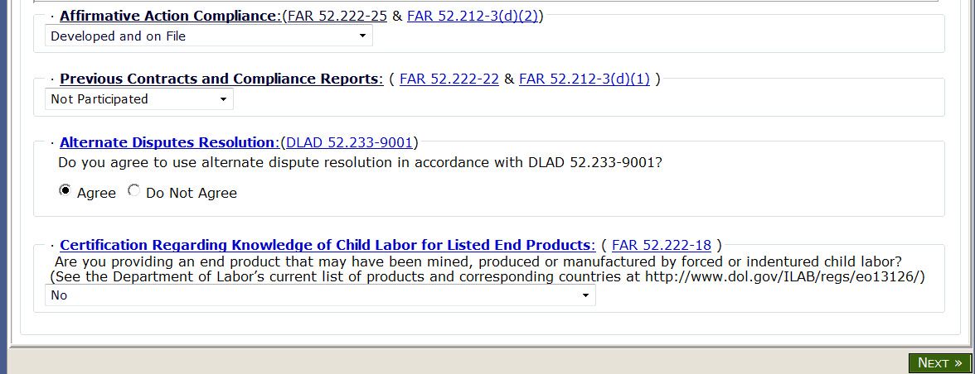
Alternate Disputes Resolution
Select as applicable
Notes:
Next field – Alternate Disputes Resolution, answer the question, Do you agree to use ADR in accordance with DLAD 52.233-9001?
You can select the blue underlined DLAD reference for the full text.
**CLICK** Select Agree or Do not Agree as applicable.
**CLICK**

Slide 52
Certification Regarding Child Labor
Select as applicable
Make sure all information on your quote is complete and correct.
Click on NEXT.
Notes:
Last field is Certification Regarding Knowledge of Child Labor for Listed End Products.
Vendors to select response from dropdown box based on the question given: Are you providing an end product that may have been mined, produced or manufactured by forced or indentured child labor?
If “YES” then bid type must equal Bid with Exception or Alternate Bid.
**CLICK** Finally, scan through quote to make sure all information is completed and correct….and then click on NEXT.
**CLICK**

Slide 53
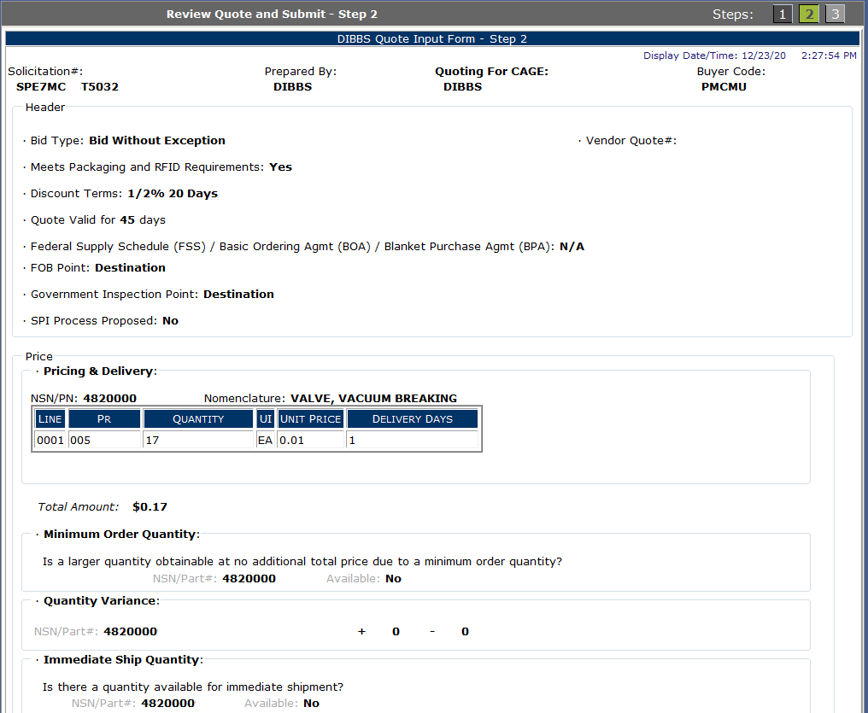
Review Quote
Validate Quote for Accuracy
Scroll down to bottom of webpage
Notes:
Step 2 is now review quote. This is your final chance to review your quote to make sure every field is completed and correct.
Remember you will have to scroll down the page to see the rest of your quote.
**CLICK**

Slide 54
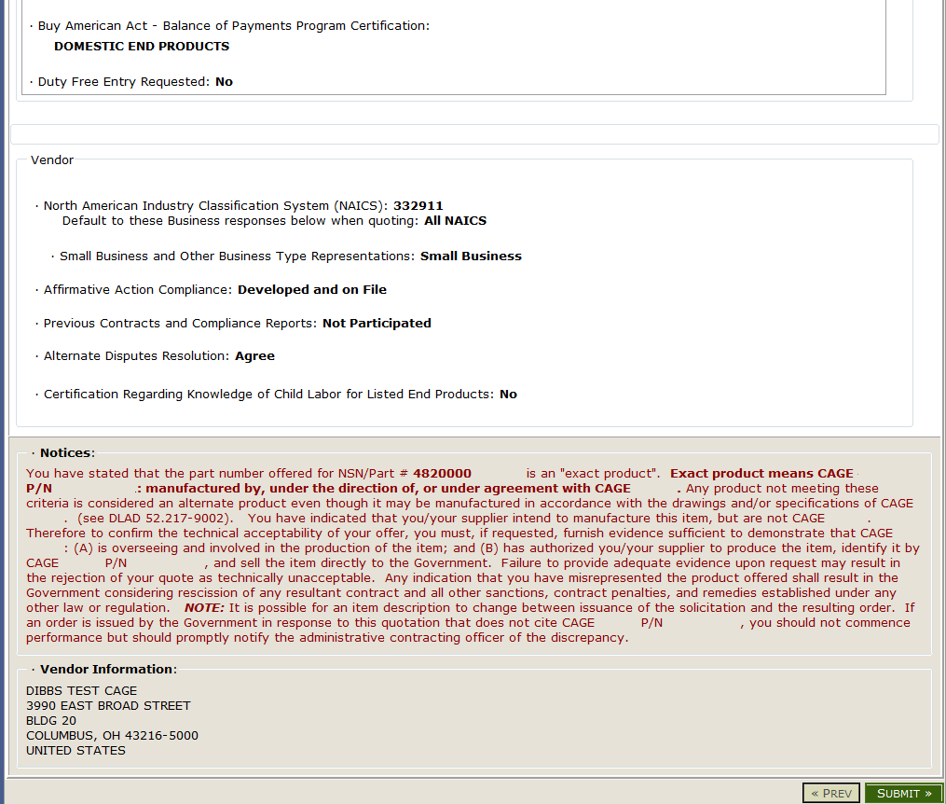
Legal Notice for Part Numbers
and Submit
Notes:
IMPORTANT NOTICE: Make sure you read and understand the Notices portion of this quote prior to submitting a quote. This will explain to you based on your quote information, what we expect from you. Many vendors have went to court and lost because they did not abide by this NOTICE.
This is an example of a notice when offering an exact part number from an approved manufacturer. The next slide will demonstrate there is no notice presented when the quoting item is in accordance with a specification/standard/drawing.
**CLICK**
FLOOR WALKERS/PRESENTOR: VENDORS CAN CLICK ON SUBMIT DURING THIS EXERCISE.
Now on bottom right side of page, click on SUBMIT.
**CLICK**

Slide 55
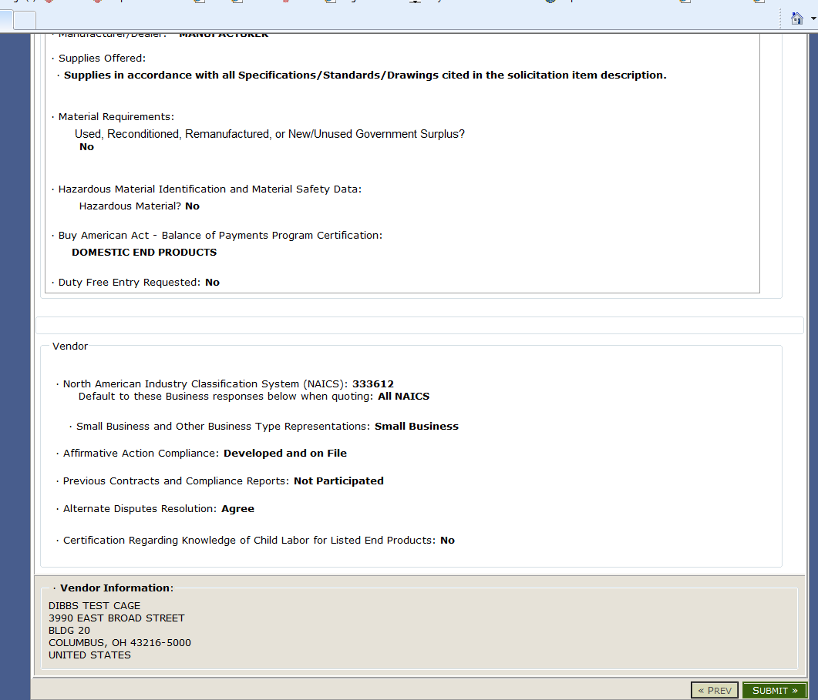
Vendor Statement Concerning the Supply of Material IAS Spec/Std/Drawings and Submit
Notes:
Example where the legal notice is not shown when the quote is in accordance with a specification/standard/drawing.
**CLICK**
FLOOR WALKERS/PRESENTOR: VENDORS CAN CLICK ON SUBMIT DURING THIS EXERCISE.
Again, click on bottom right side of page to SUBMIT
**CLICK**

Slide 56
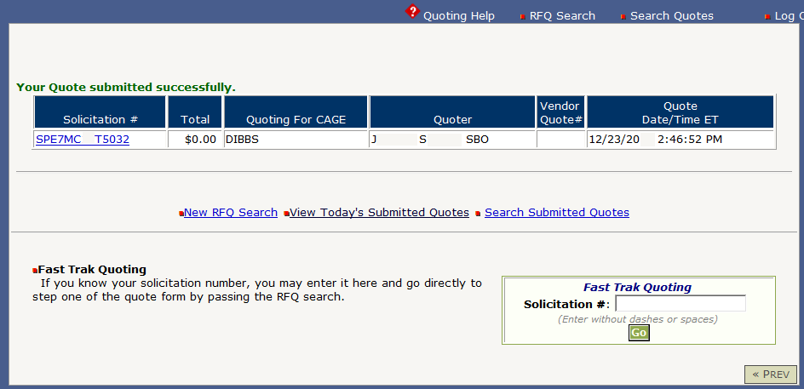
Quote Accepted
Notes:
FLOOR WALKERS: Make sure vendors are now following along online.
Once you click on SUBMIT, make sure you receive this next screen which states that your quote was submitted successfully.
If you do not receive this screen, then your quote did not submit and you’ll have to redo it.
**CLICK**

Slide 57
View Submitted Quotes
Notes:
To view submitted quotes, go back to the welcome screen of DIBBS and under HOT LINKS – click on QUOTES.
FLOOR WALKERS: Make sure vendors are now following along online.
**CLICK**

Slide 58
Quote Search
Notes:
On this quote search page you can search by:
Today’s Quotes
Recent Quotes
View quotes by date
View quotes by date range
Or
Custom search for solicitation number, quote for CAGE or Vendor Quote Number
VENDORS For this exercise: Click on Today’s Quotes.
**CLICK**
Just click on “GO” next to search criteria for results.
**CLICK**

Slide 59
Quote Search Results
Notes:
Here is a sample of the quote search.
If you need to revise a quote that’s been previously submitted, you may do so here before the PR is awarded.
**CLICK**

Slide 60
DLA Land Depot Level Reparables (DLRs) and
Shipyard Detachments
Find Contracting Opportunities at:
https://www.neco.navy.mil
DLR Site
DLA Mechanicsburg: DoDAAC = SPRMM1
DLA Warren: DoDAAC = SPRDL1
Shipyards
DLA Norfolk: DoDAAC = SPMYM1
DLA Puget Sound: DoDAAC = SPMYM2
DLA Portsmouth: DoDAAC = SPMYM3
DLA Pearl Harbor: DoDAAC = SPMY4
Contact DLA Land and Maritime Small Business Specialist @
800-262-3272 or DSCC.bcc@dla.mil
Notes:
DLA Maritime Depot Level Reparable Procurements are located at DLA Mechanicsburg.
DLA Land and Maritime also provides contracting oversight for the DLA shipyards listed.
**CLICK**

