Slide 1


Performance
Transformation
Culture
Accessing Technical Data
through
DIBBS - cFolders

Slide 2
System Requirements
Performance
Transformation
Culture
In order to access cFolders to view and download drawings, the following system requirements are necessary:
  Microsoft Internet Explorer, version 6.0 or later
  Windows 2000 or later
  Java Applet. This can be downloaded from the following website:
    http://www.java.com/en/download/windows_xpi.jsp

Slide 3
System Requirements
Performance
Transformation
Culture
In order to access cFolders to view and download drawings, the following system requirements are necessary:
  Microsoft Internet Explorer, version 6.0 or later
  Windows 2000 or later
  Java Applet. This can be downloaded from the following website:
    http://www.java.com/en/download/windows_xpi.jsp

Slide 4
Supplier Access – Account Establishment
Performance
Transformation
Culture
All cFolders users must have a DIBBS account
Upon account creation, Suppliers have access to non-restricted data (Distribution Statement A)
Suppliers with US/Canadian Joint Certification Program (JCP) certification have appropriate access to restricted data (Distribution Statements C & D)
Suppliers have the ability to download license agreement application forms from cFolders
A DLA POC manually tracks and approves additional access to data covered by license agreements

Slide 5
Downloading a Drawing Viewer to View cFolders Documents
Performance
Transformation
Culture
In order to view and download drawings from cFolders, you must have a viewer program:
  Access DIBBS Help - Frequently Asked Questions
  Show Help Contents
  Document Viewers
  Download CALS Raster – C4 software available at:
    http://jtshelp.redstone.army.mil

Slide 6
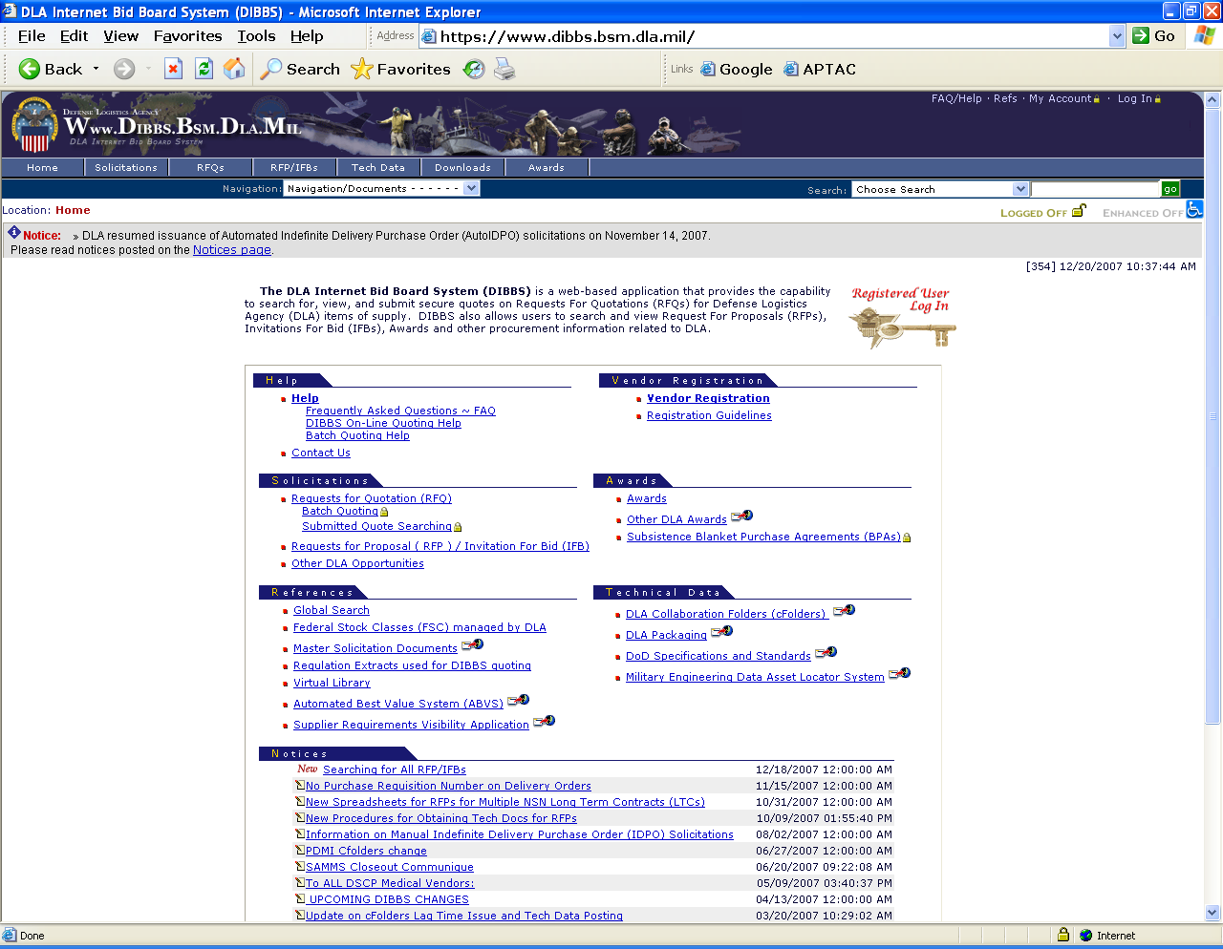
Go to FAQ

Slide 7
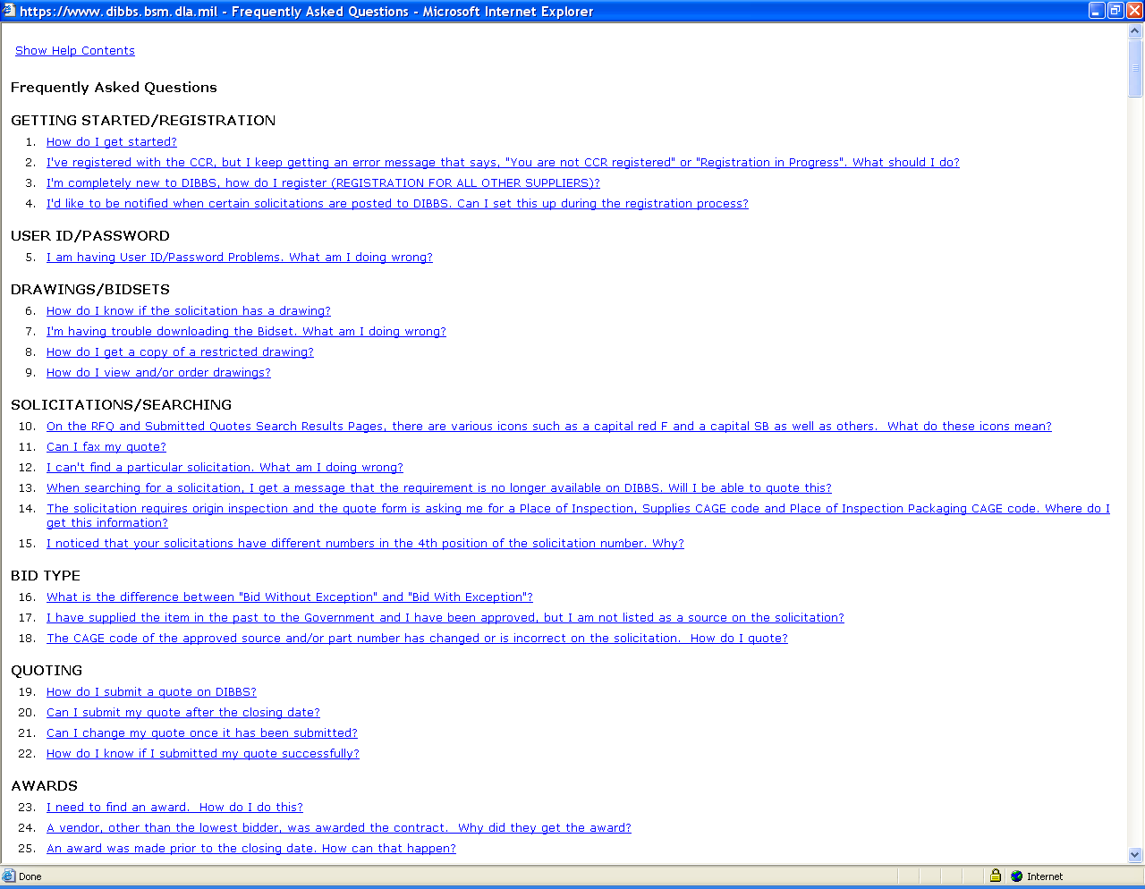

Slide 8
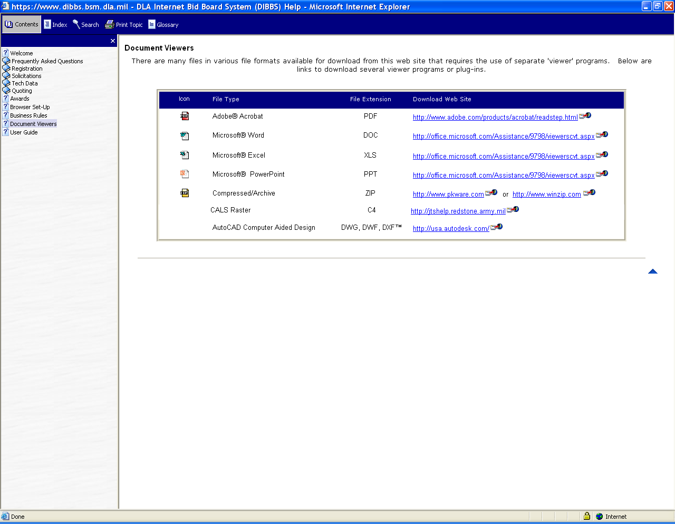

Slide 9
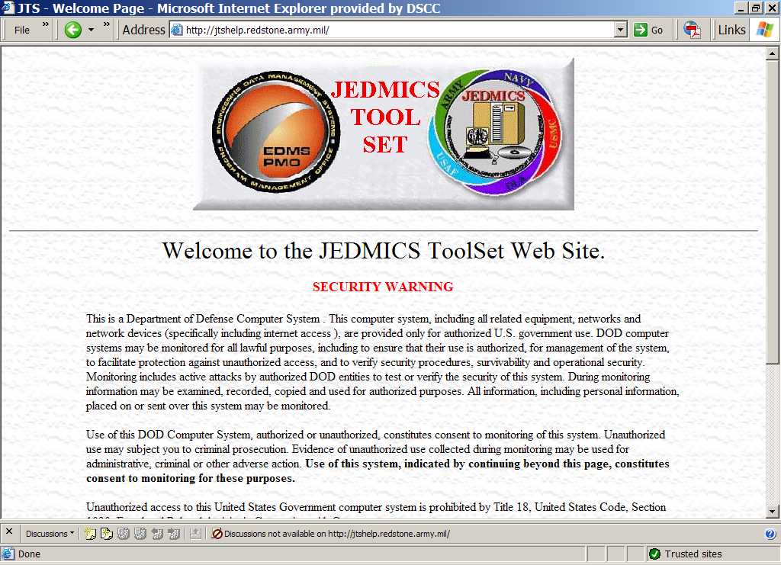

Slide 10
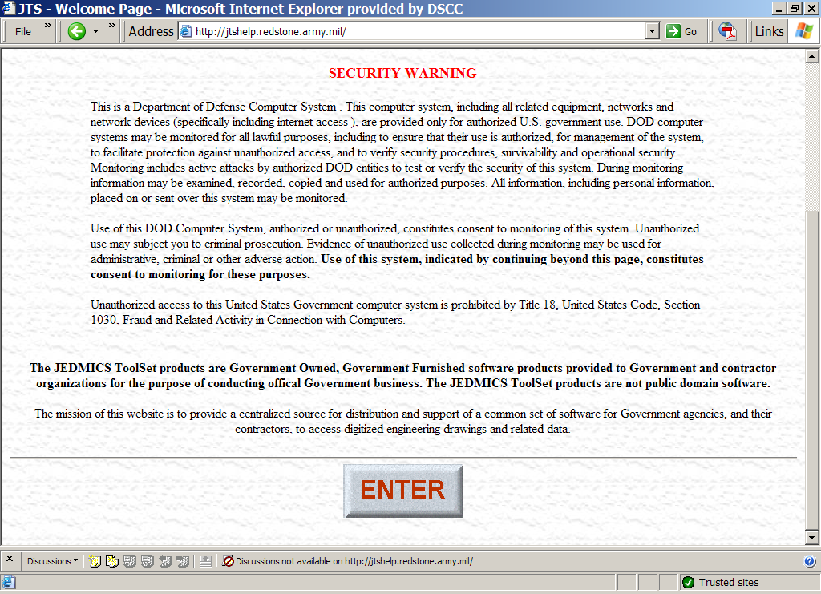

Slide 11
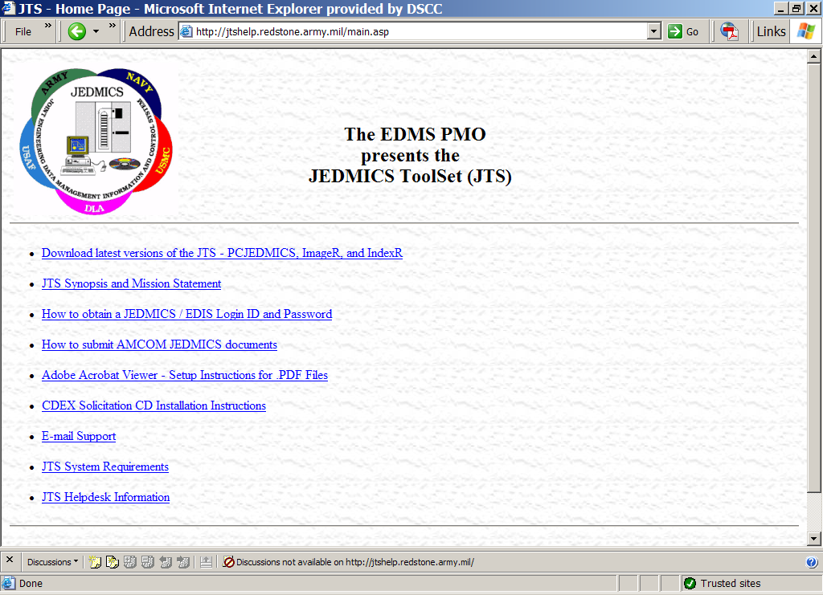

Slide 12
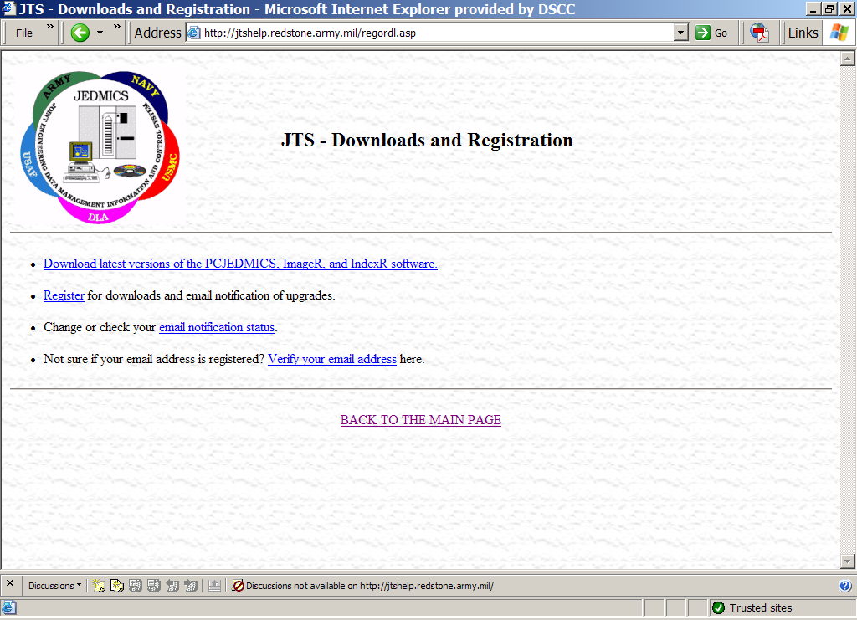

Slide 13
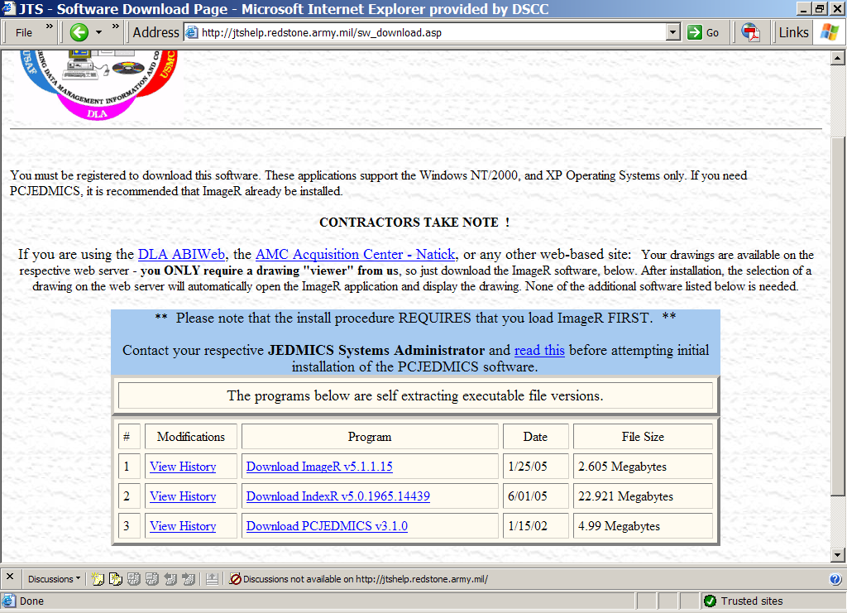

Slide 14
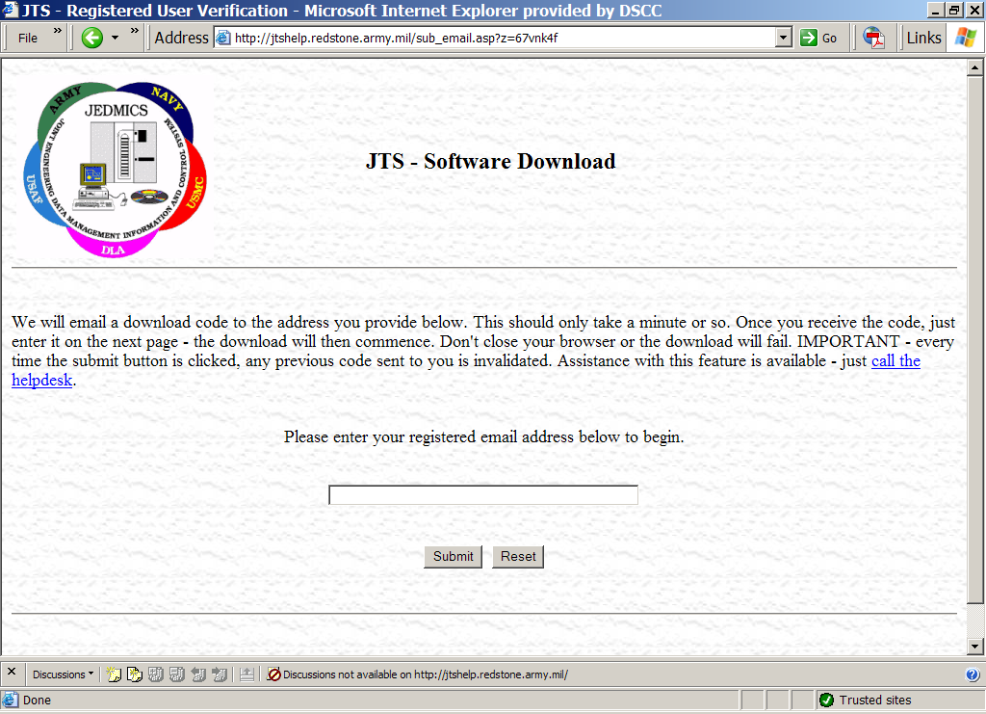

Slide 15
cFolders Passwords
Performance
Transformation
Culture
In order to access cFolders to view and download drawings, you must also have a cFolders password:
  Contact cFolders Support at 1-866-335-4357 (HELP)
  Provide your CAGE, receive a 4-digit temporary password
  Receive email with second half of temporary password
  Access DIBBS registration screen using your CAGE + 01 and your complete temporary password
  Create a new password

Slide 16
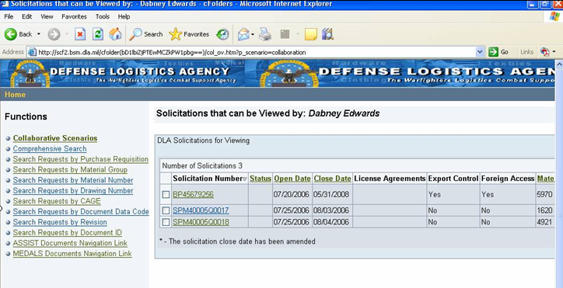
Collaboration Folders
(cFolders)
Performance
Transformation
Culture
cFolders include details about the data and provide users with the ability to download the documents once the user has appropriate access
Query cFolders by:
  National Stock Number
  Solicitation Number
  Purchase Request Number
  Document Number
  Dates
  Status
  Downloaded previously
  Changes

Slide 17
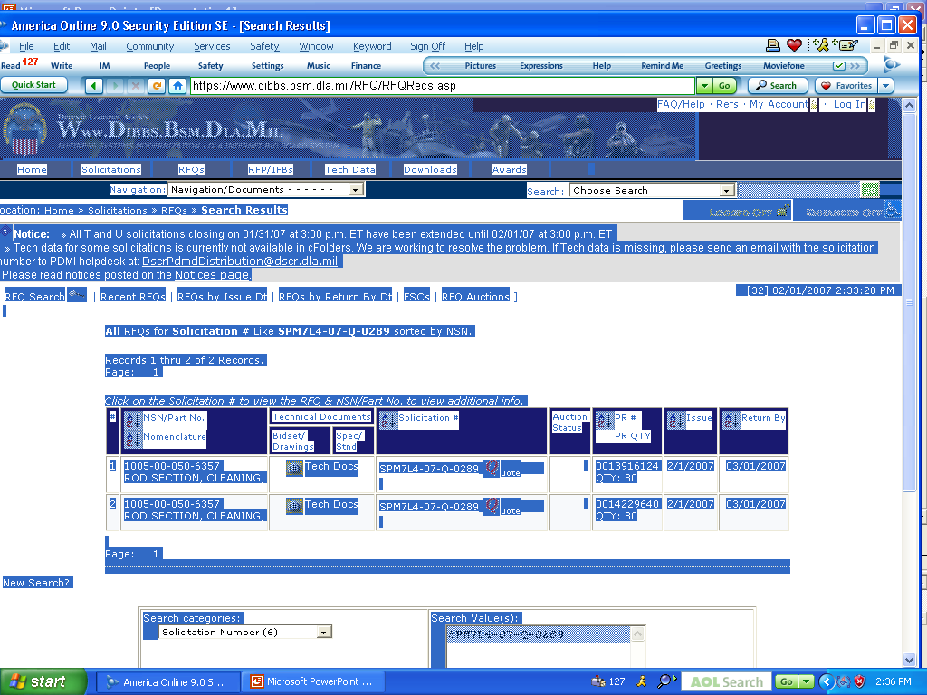
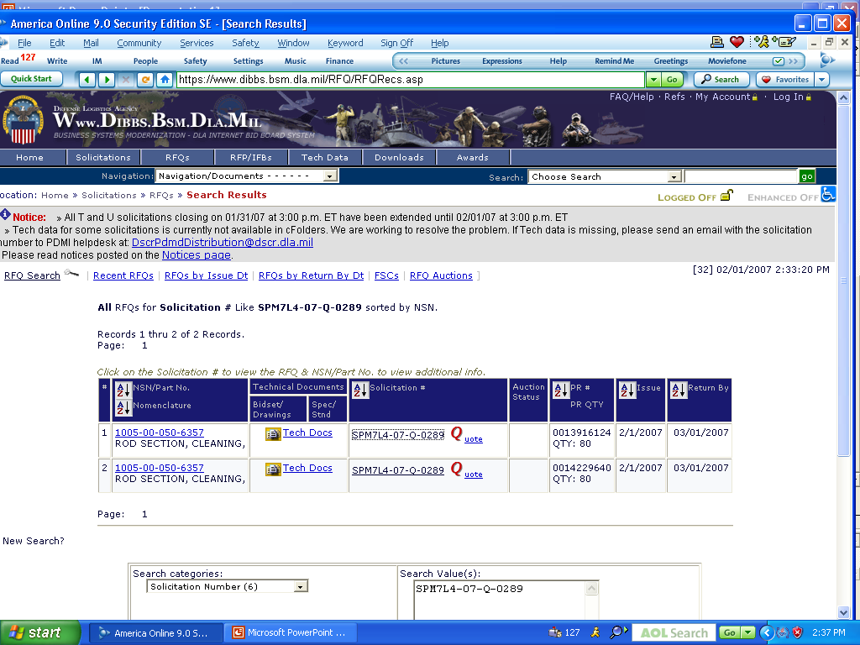

Slide 18
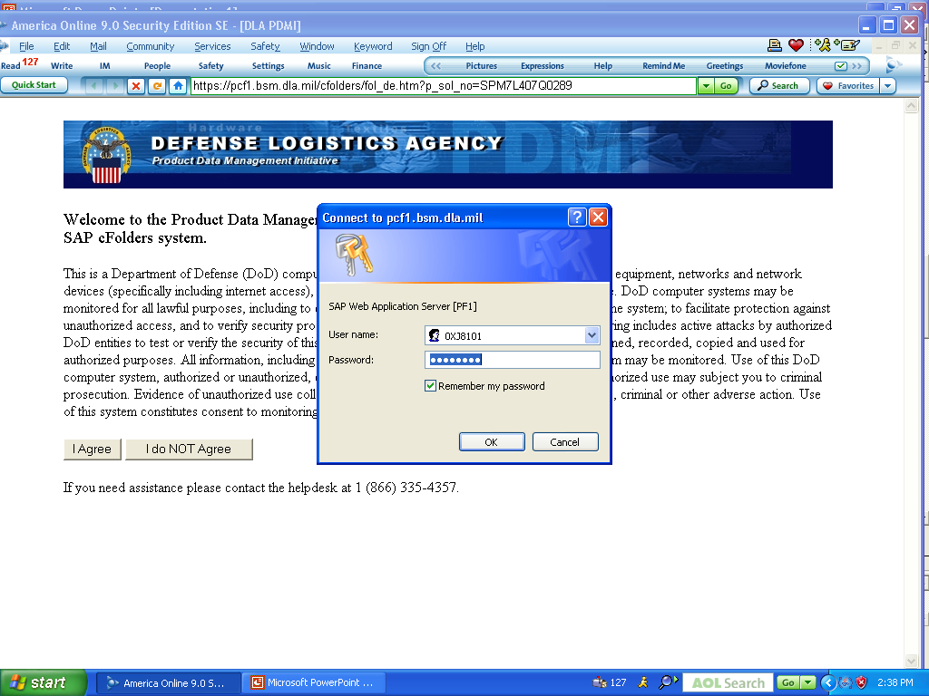

Slide 19
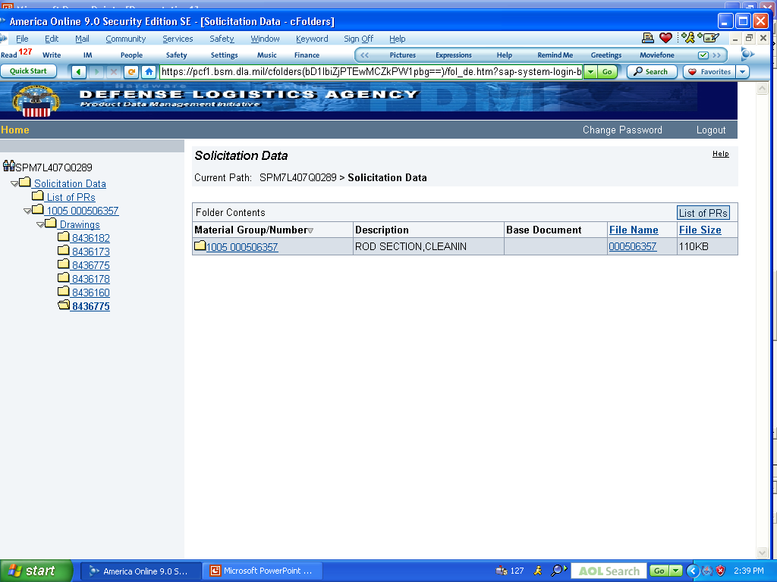

Slide 20
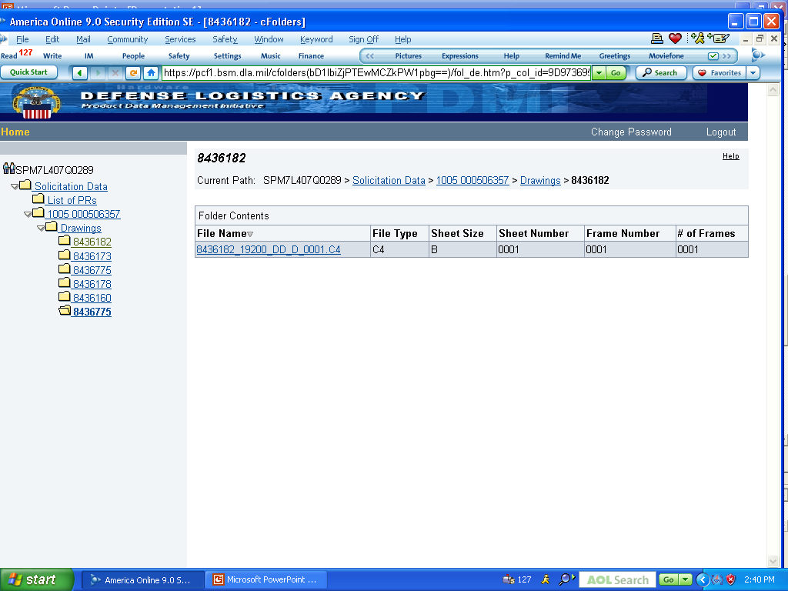

Slide 21
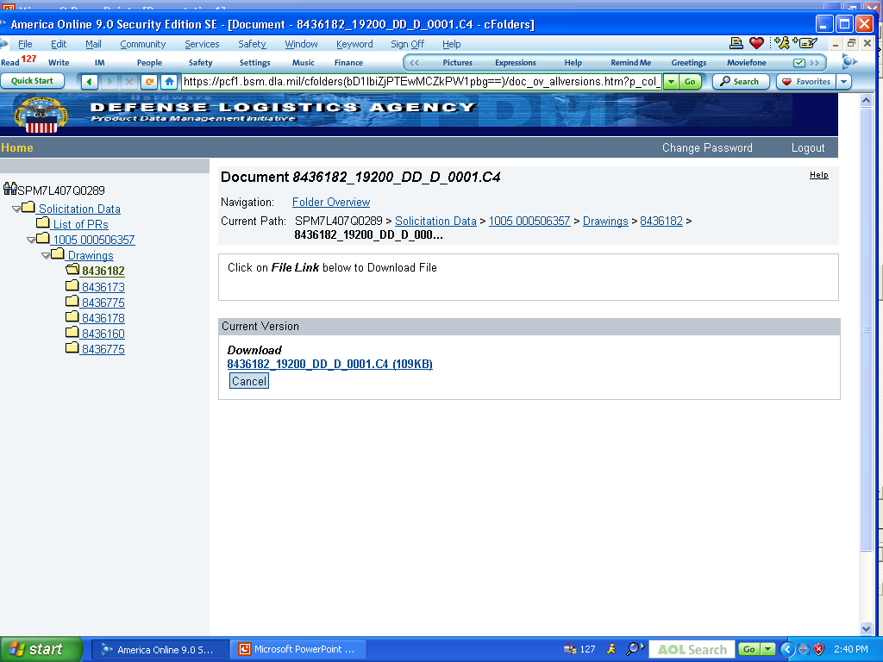

Slide 22
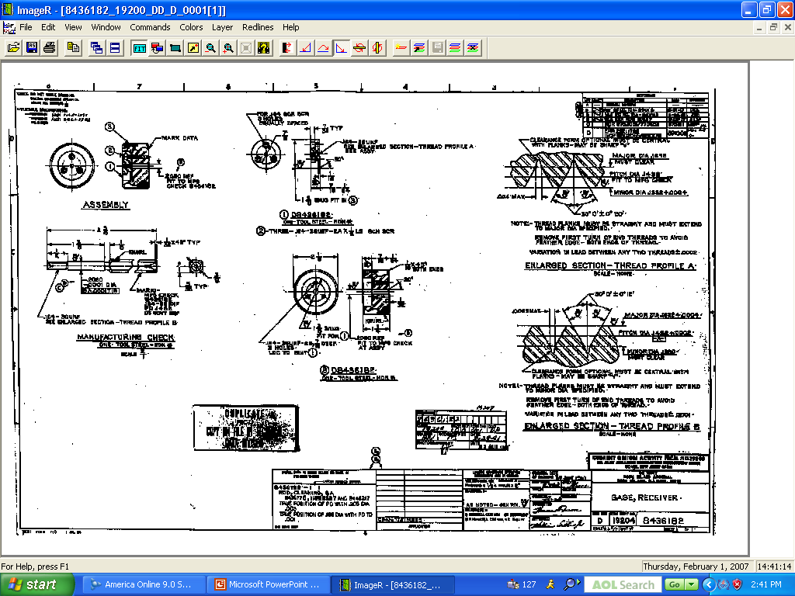

Slide 23
Performance
Restricted Drawing Access
Transformation
Culture
Requires certification through the Joint US/Canadian Certification Program (JCP)
Establishes eligibility of U.S. and Canadian contractors to receive technical data under control of DoD or the Canadian Department of National Defense
Limits access to military critical sensitive data

Slide 24
How to get a JCP
Certification Number
Performance
Transformation
Culture
Go to: http://www.dlis.dla.mil/jcp/
Complete DD Form 2345
Submit the completed form and copies of the following:
  State or Provincial License,
  Incorporation Certificate,
  Sales Tax Identification Form, or
  Other documentation which verifies the legitimacy of your company

Slide 25
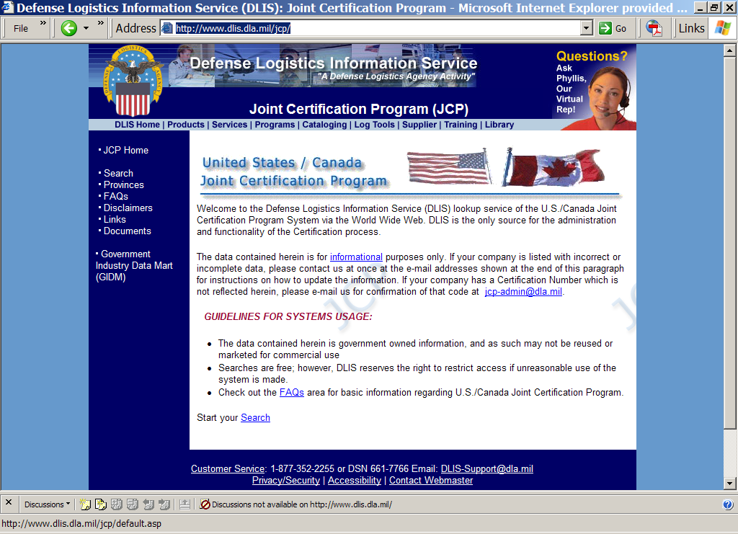
http://www.dlis.dla.mil/jcp/

Slide 26
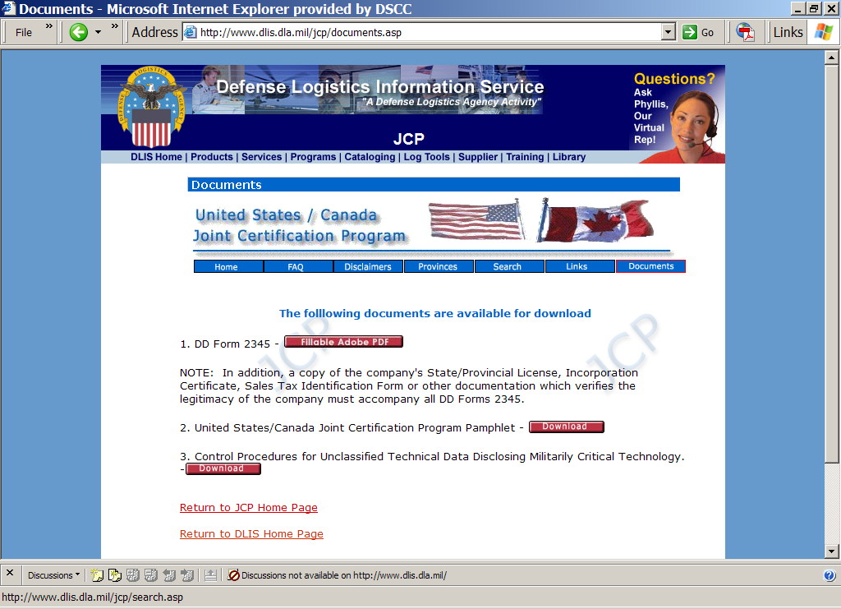

Slide 27
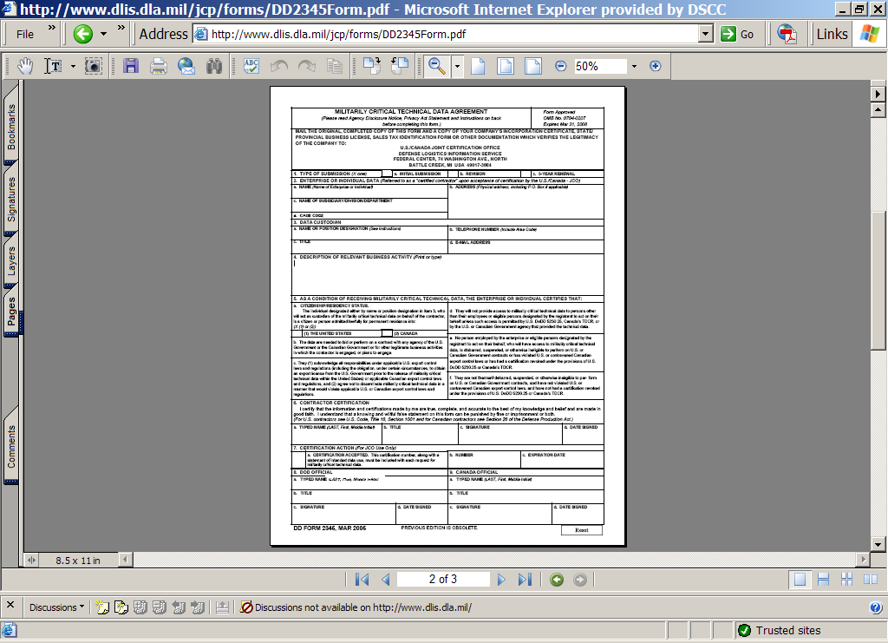
Mail to
Battlecreek, MI

